Slide 1
3 Yankee Companies Update on National & State SNF Policy
NEHLRWT Taskforce Meeting, NTSF, Austin Texas
June 24, 2026
Kathleen Capstick
Director of Government & Public Affairs
Maine Yankee Atomic Power Company, Connecticut Yankee Atomic Power Company, & Yankee Atomic Electric Company

Slide 2
US Inventory of SNF/HLW and Reprocessing Waste
As of the end of 2022, the U.S. Inventory of SNF/HLW and primary reprocessing waste was located at over 100 sites in 39 states.
These locations include commercial Nuclear Power Reactors (NPR) and Independent Spent Fuel Storage Installations (ISFSI) sites; DOE sites; and other research and development (R&D) sites.
73 Sites of Commercial NPRs and/or ISFSIs (often co-located) with SNF/HLW stored onsite including: 72 sites of 74 Light Water Reactor (LWR) nuclear power plants with a total of 92 operating NPRs and 27 shutdown NPRs – not including ISFSIs at DOE site.
1 away-from-reactor NPR SNF pool storage ISFSI.
6 DOE Sites with SNF storage and/or DOE research reactors.
28 Other Research and Development (R&D) Sites including: 20 university research reactor sites; 4 other government agency research reactors; and 4 commercial R&D centers.
4 Reprocessing Waste Storage Sites: 3 DOE sites with primary reprocessing waste and 1 commercial HLW storage location.
278 HLW stainless steel canisters in long term interim storage at the West Valley New York former reprocessing site awaiting DOE removal to a federal disposal site.
(Reference – “Spent Nuclear Fuel and Reprocessing Waste Inventory, December 2024, PNNL-33938, Rev.1.1, page 2 inventory summary)
NOTE: U.S. commercial reactors have generated about 95,000 metric tons of spent fuel since the 1950s and generates about 2,000 metric tons of spent fuel each year (Yucca Mountain limit is 70,000 MTUs)
Notes:
This slide reflects the large inventory of radioactive material stored in the US awaiting removal from sites to permanent disposal. SNF and HLW are located at 100 sites in 39 states - with 73 of those sites at NPPs and/or independent spent fuel storage installations (or what we call ISFSIs).
U.S. commercial reactors have generated over 95,000 metric tons of spent fuel since the 1950s - and generates about 2,000 metric tons of spent fuel each year– so there is a need for a geologic disposal site for all the nation’s commercial SNF/GTCC as well as all the nations non-commercial SNF & HLW.

Slide 3
US Non-Commercial Nuclear Waste
The inventory of non-commercial nuclear waste includes roughly 360,000 cubic meters of reprocessing waste managed by DOE that is liquid/sludge waste in tanks in Hanford WA and the Savannah River Site in South Carolina.
Non-commercial SNF generated by activities – including the Navy’s nuclear fleet SNF stored in Idaho with 201 naval SNF canisters already temporarily stored at the Idaho National Laboratory site.
DOE Research & Development activities - DOE’s current SNF inventory for R&D activities totals approximately 2,400 MTUs.
Notes:
There is a lot of non-commercial waste, for example the SNF generated by the US Navy nuclear fleet that is in dry cask storage in the state of Idaho. This waste will also need to be disposed of in a permanent disposal site.

Slide 4
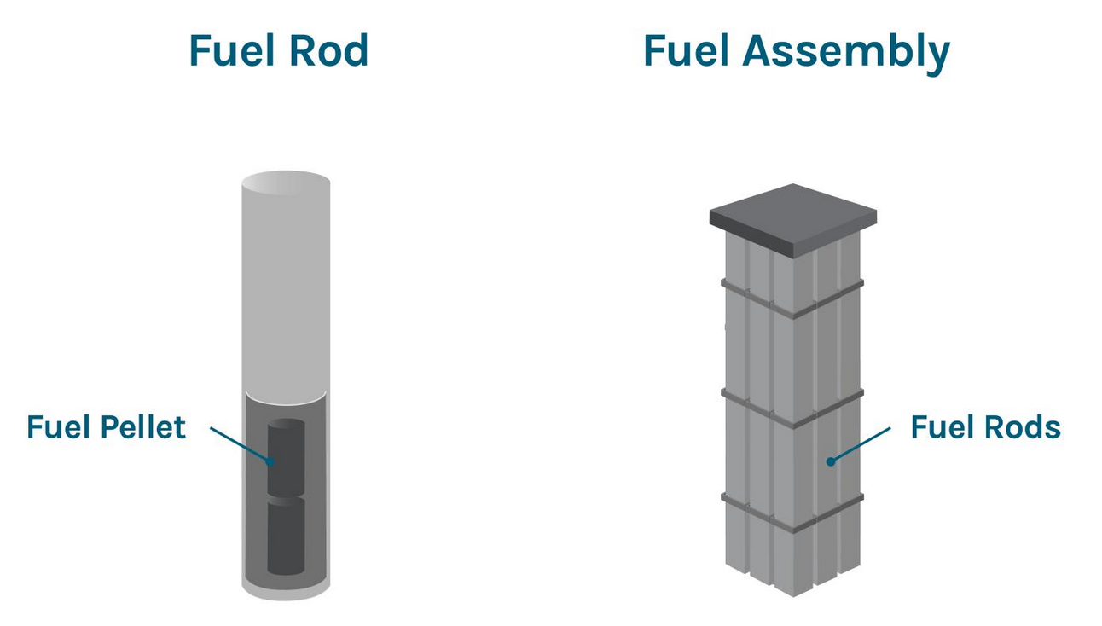
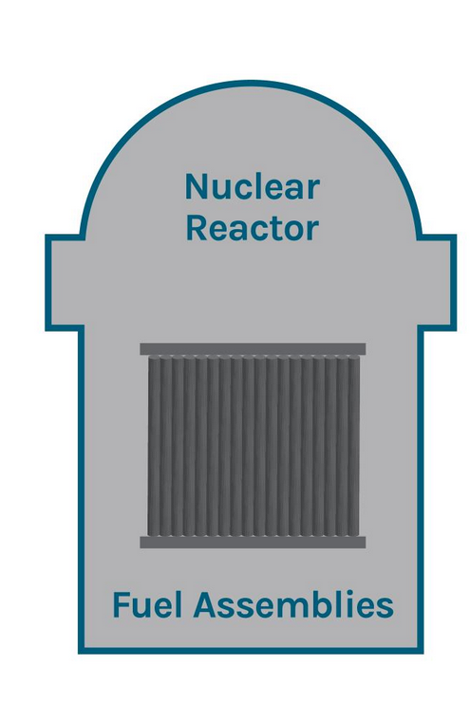
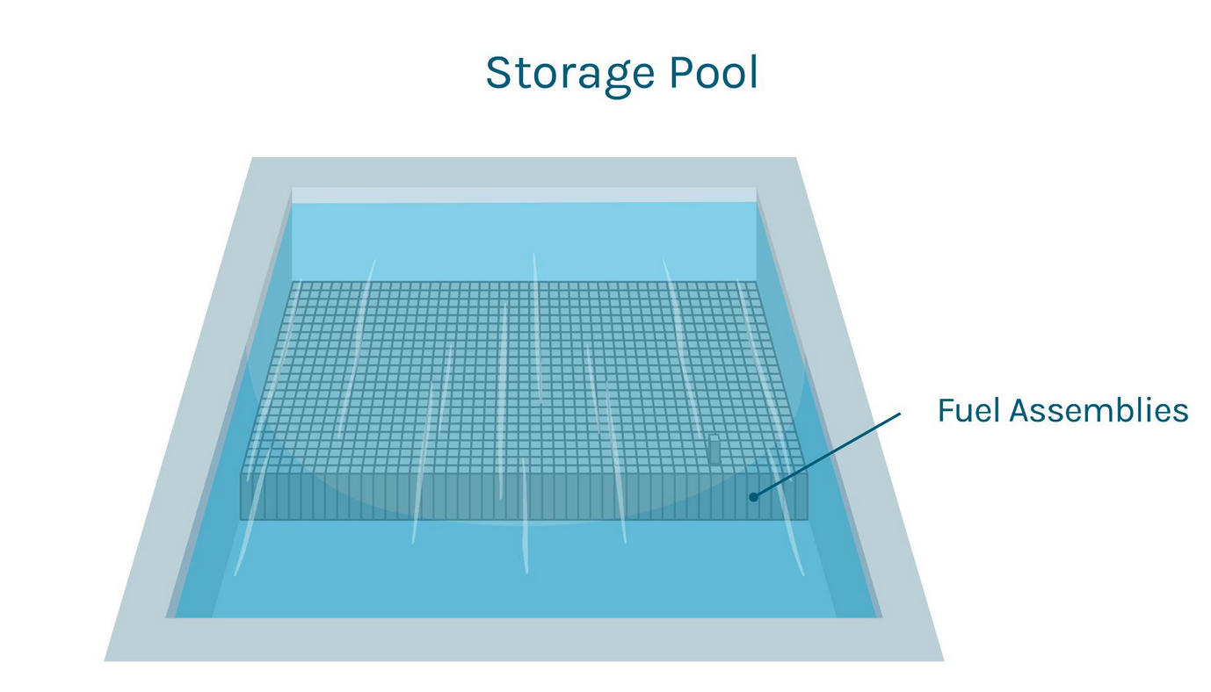
Commercial Nuclear Fuel Basics
Spent
(or Used) Nuclear Fuel
Credit: DOE IWM StoryMap: Consent-Based Siting for Consolidated Interim Storage, May 2024

Slide 5
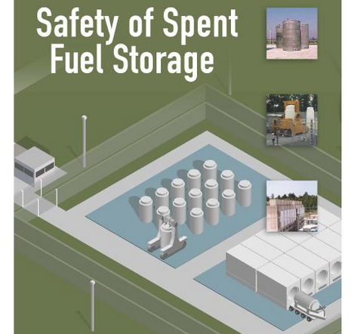
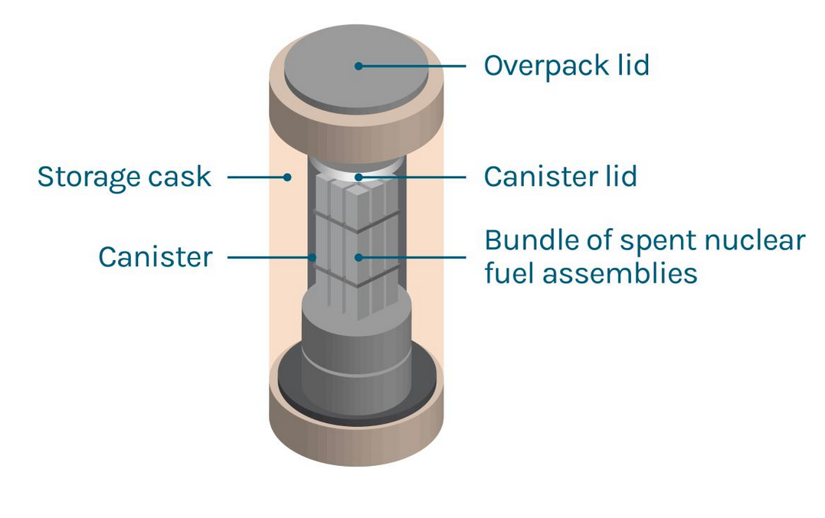
Commercial Nuclear Fuel Basics
Independent Spent Fuel Storage Installations (ISFSIs) not originally anticipated.
1st ISFSI licensed in 1986.
Credit: NRC Safety of Spent Fuel Storage Report (excerpt from cover), April 2017
Credit: DOE IWM StoryMap: Consent-Based Siting for Consolidated Interim Storage, May 2024

Slide 6
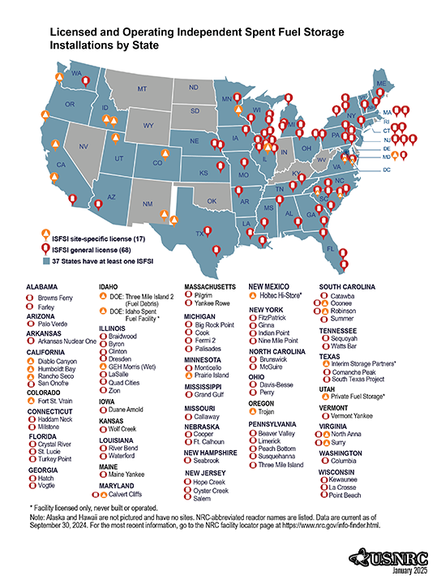

Slide 7
Pre-Nuclear Waste Policy Act 1950’s - 1960’s
1954 – President Eisenhower Atoms for Peace Program
1957 – National Academy of Sciences recommendation for deep geologic disposal (reaffirmed similar 1966, 1970, 2001);
1957 - 1st US commercial nuclear power plant (Shippingport, PA) began operation.
1960 - Yankee Rowe (Massachusetts) operational.
1966 – Only US commercial reprocessing plant (West Valley in NY) to operate. Operated from 1966 - 1972.
Note: Reprocessing plants at Morris Illinois and Barnwell South Carolina never permitted to operate – Morris pool currently storing commercial SNF.
Notes:
This slide shows that commercial nuclear power began in 1954 – the same year that Yankee Atomic Electric Company was created as a result of the Atoms for Peace Program - to build and operate the Yankee Rowe NPP in Western MA.
I’d note that back in those days - Yankee Rowe routinely shipped spent fuel assemblies (well over 300 in total) to the only US commercial reprocessing facility located in West Valley NY during the late 1960’s – early 70’s. Connecticut Yankee also shipped 82 assemblies to the GE Hitachi Morris Illinois site for reprocessing that was never allowed to be built – they are still there along with other utility assemblies that the companies annually pay for. The cost to CY this year will be over $2 million dollars.

Slide 8
Pre-Nuclear Waste Policy Act 1970’s
1974 – Energy Reorganization Act abolished the Atomic Energy Commission:
  created NRC to focus on protecting health & safety;
  moved nuclear R&D to DOE’s predecessor Energy Research & Development Administration.
1977 – Department of Energy Organization Act created DOE.
1977 - President Carter banned commercial reprocessing indefinitely.
1981 – President Reagan lifted ban on commercial reprocessing – but was not considered economic.

Slide 9
1982 Nuclear Waste Policy Act (NWPA)
Called for repository site search to result in 2 sites (1 in East & 1 in West assumed).
Limited 1st repository to 70,000 metric tons until 2nd repository opens.
Created office in DOE to focus on waste (OCRWM).
Established the Nuclear Waste Fund and mandated DOE contract with utilities as a prerequisite for their continued operation and for DOE to remove the SNF starting in January 1998 in return for fees collected from electric customers that benefitted form the nuclear energy.
Directed DOE to propose site & design for monitored retrievable storage (MRS).
Assigned licensing to NRC using EPA standards.

Slide 10
1987 NWPA Amendments
Named Yucca Mountain (YM) as sole repository site.
Rescinded MRS site selection and tied future operation to repository progress (“linkage”).
Offered limited incentives to host states & tribes.
Established Nuclear Waste Negotiator to find voluntary repository or MRS sites (expired).
If YM found unsuitable, studies to be stopped, site restored, and DOE to report to Congress in 6 mos.
Maintained “quid pro quo” of electric customer payments for federal “performance”.

Slide 11
History: 1990’s
In early 1990’s it was clear DOE will not meet the 1998 obligation to remove the SNF/HLW.
NARUC and utilities filed lawsuit in US Court seeking a Writ of Mandamus for DOE to meet its statutory and contractual obligation to remove the material beginning January 1998.
Court decision ruled DOE had no place to take it so there was a partial breach of the contracts.
Storage costs incurred by utilities could be recovered in damages claim lawsuits in the US Court of Federal Claims or utility-DOE settlements.
Settlements/lawsuits continue today with damages awarded out of taxpayer funded Treasury Department Judgement Fund – not the NWF – awards today are on the order of $1-2 million/day.
Operating nuclear power plant spent nuclear fuel pools reaching storage capacity - even with re-racking.
Permanently shutdown nuclear power plant decommissioning projects need to move the SNF out of the spent fuel pools to demolish the plant.
SNF moved to on-site dry cask storage/ISFSIs.

Slide 12
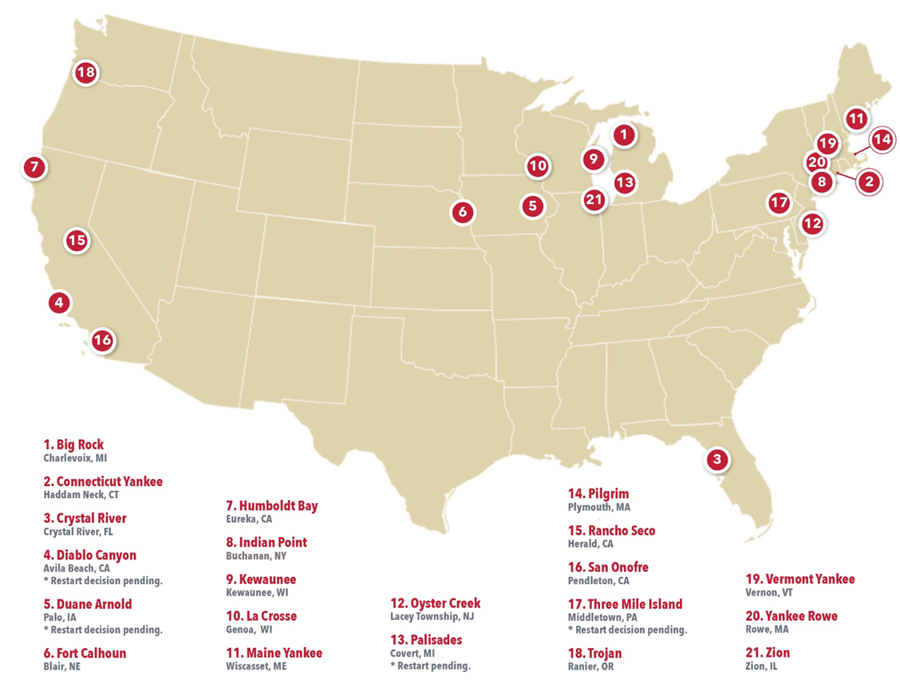
Permanently & Announced Shutdown Nuclear Plant Sites
10/31/2025
Notes:
This map notes that there are about 20 permanently shut down reactor sites in the US – and also identifies using an asterisk the several sites that are now being considered for restarting.

Slide 13
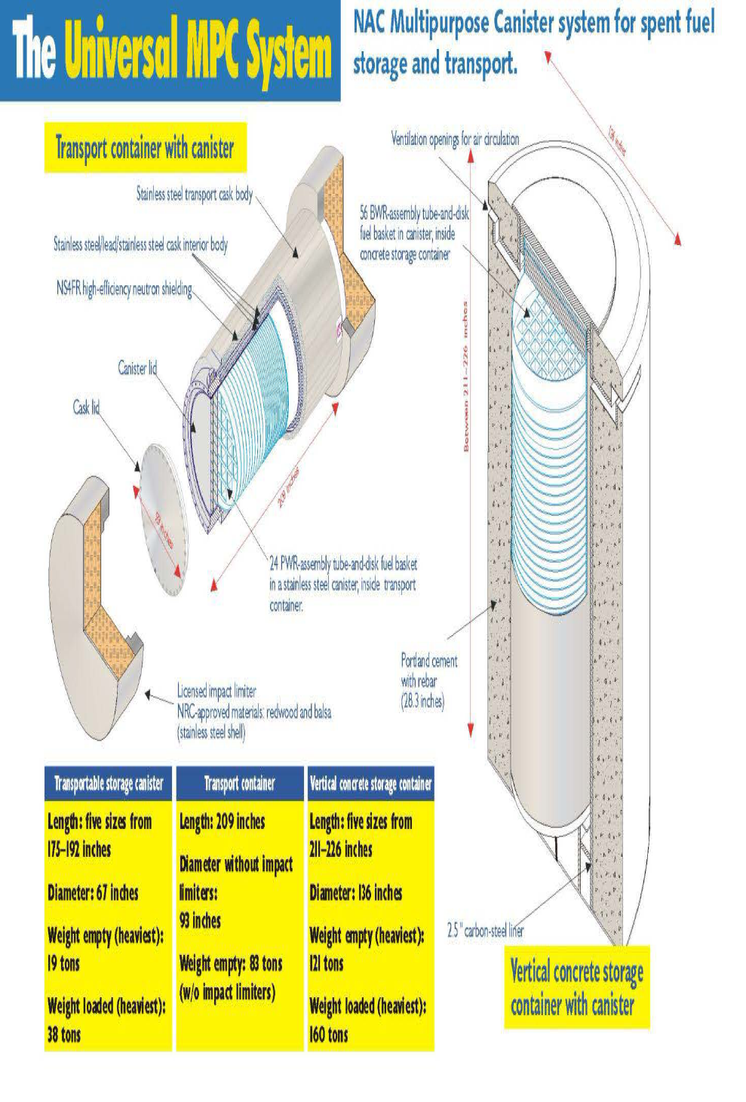
NAC Dual-Purpose Canister System Schematic

Slide 14
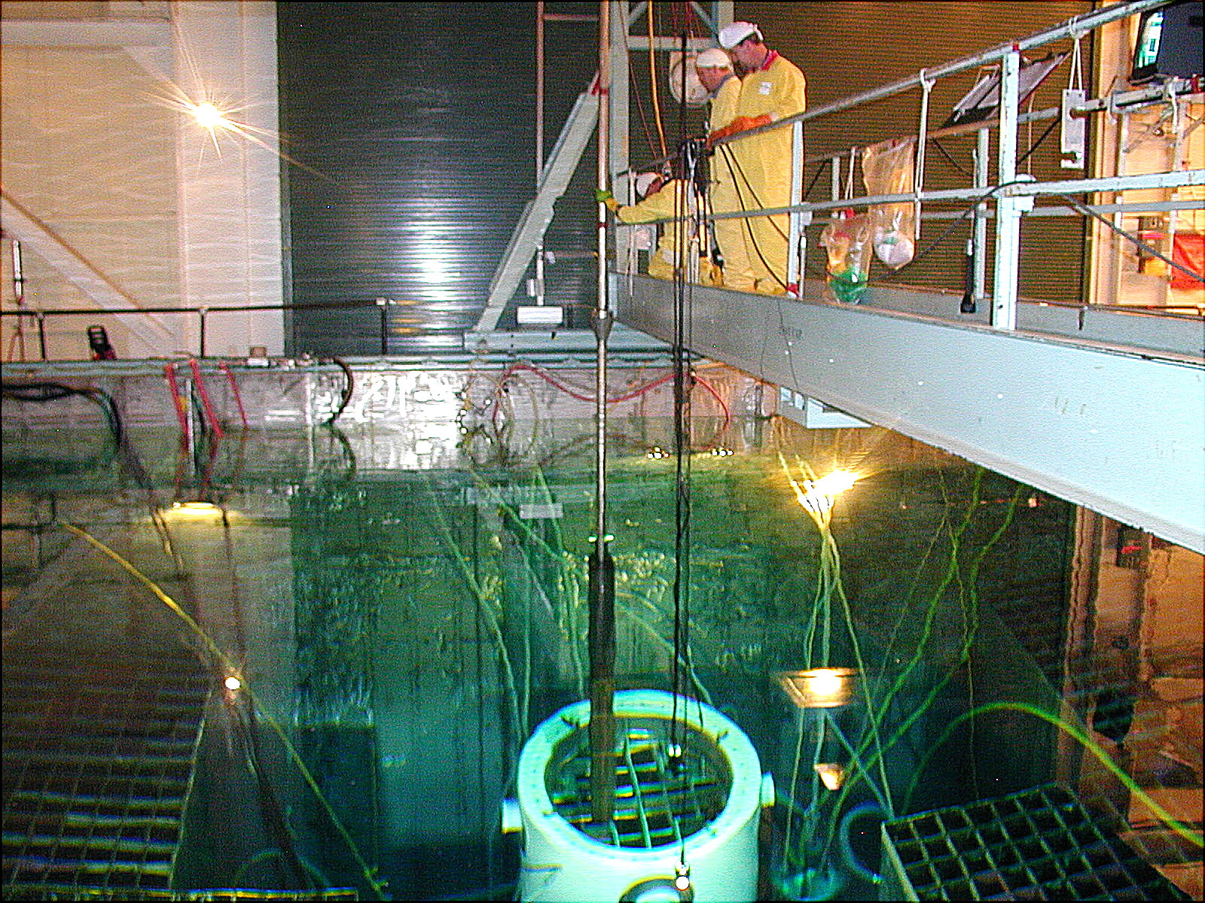
Loading a fuel assembly into a TSC inside transfer cask

Slide 15
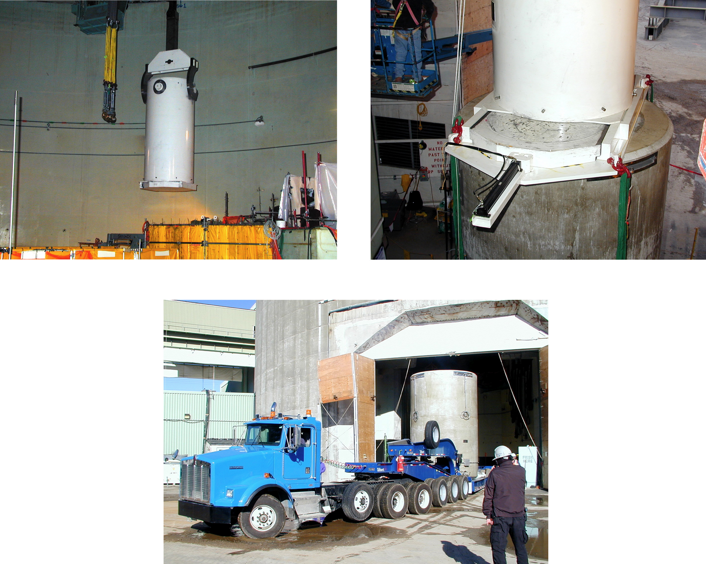
Transfer Cask lift, Transfer to VCC, and Transfer to the ISFSI Pad
Notes:
Transfer from pool to pad at MY – the transfer cask is lifted out of the pool – placed in the VCC (Vertical Concrete Cask) and then trucked out to the storage pad.

Slide 16
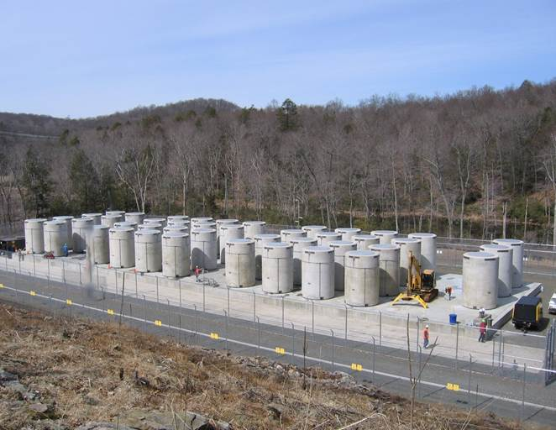
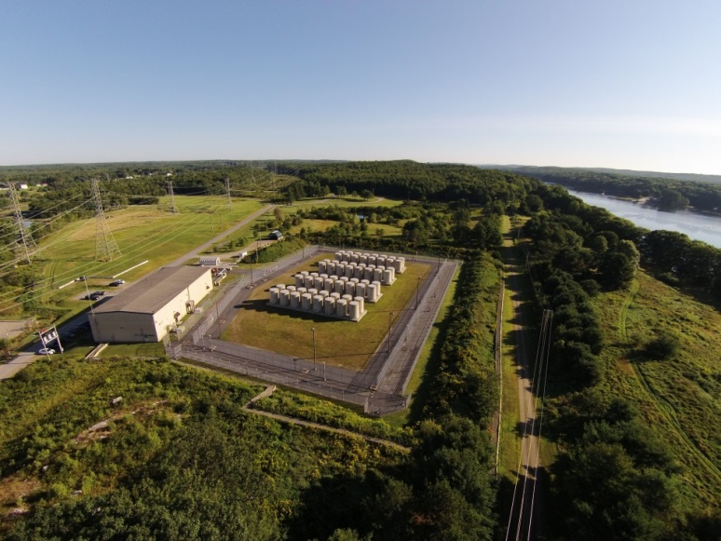
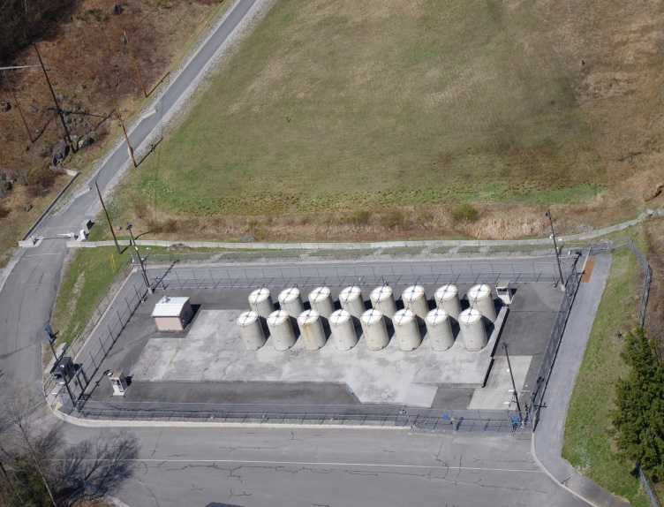
The 3 Yankee Company ISFSIs
Connecticut Yankee
15 Spent Fuel Dry Casks
1 GTCC Dry Cask
NAC canister system
172 MTUs
40 Spent Fuel Dry Casks
3 GTCC Dry Casks
NAC canister system
448 MTUs
60 Spent Fuel Dry Casks
4 GTCC Dry Casks
NAC canister system
542 MTUs
Notes:
This slide shows the 3 Yankees ISFSI pads where the casks with the SNF and GTCC waste are located. Their size is roughly that of a hockey rink.

Slide 17
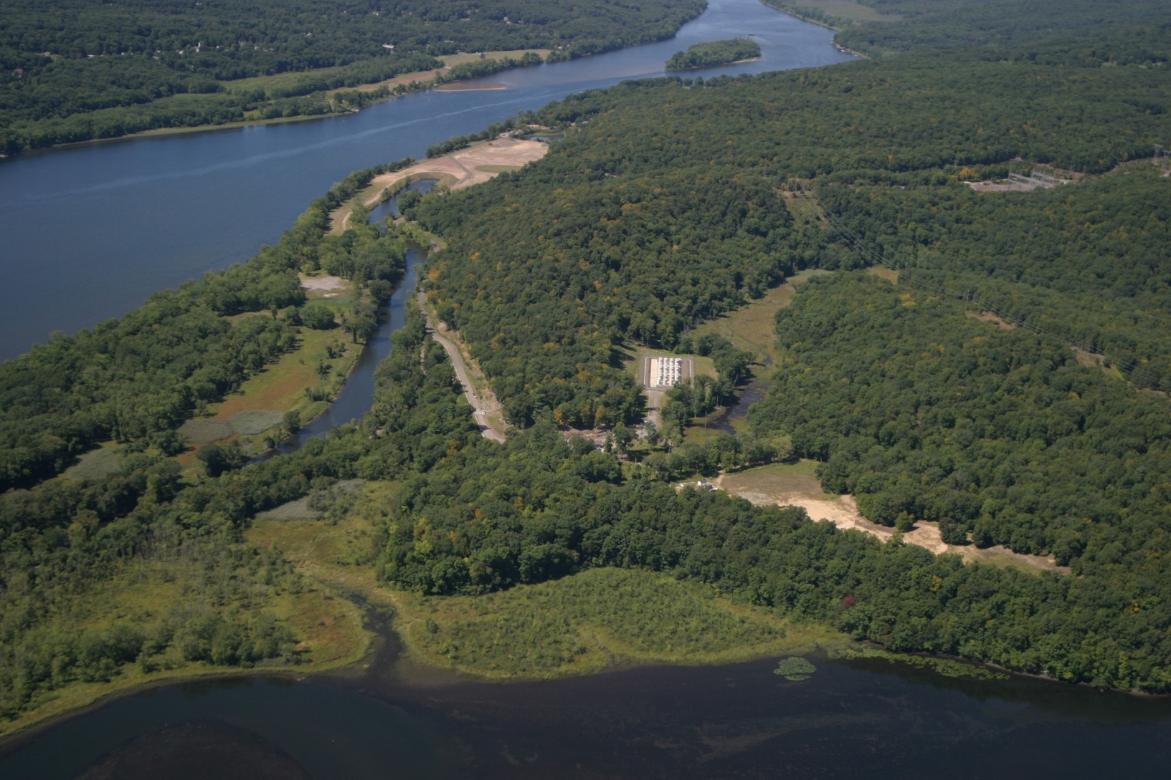
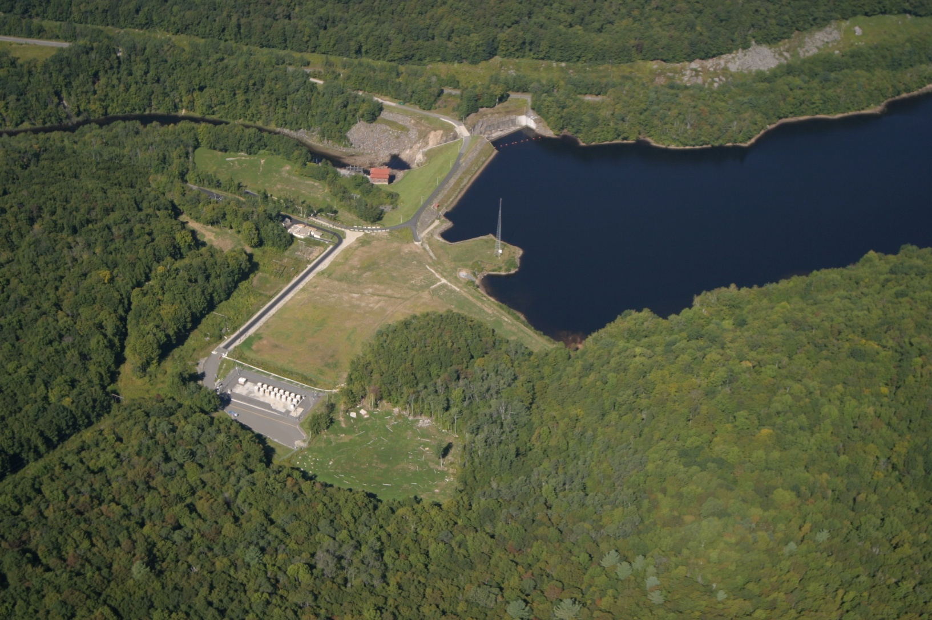
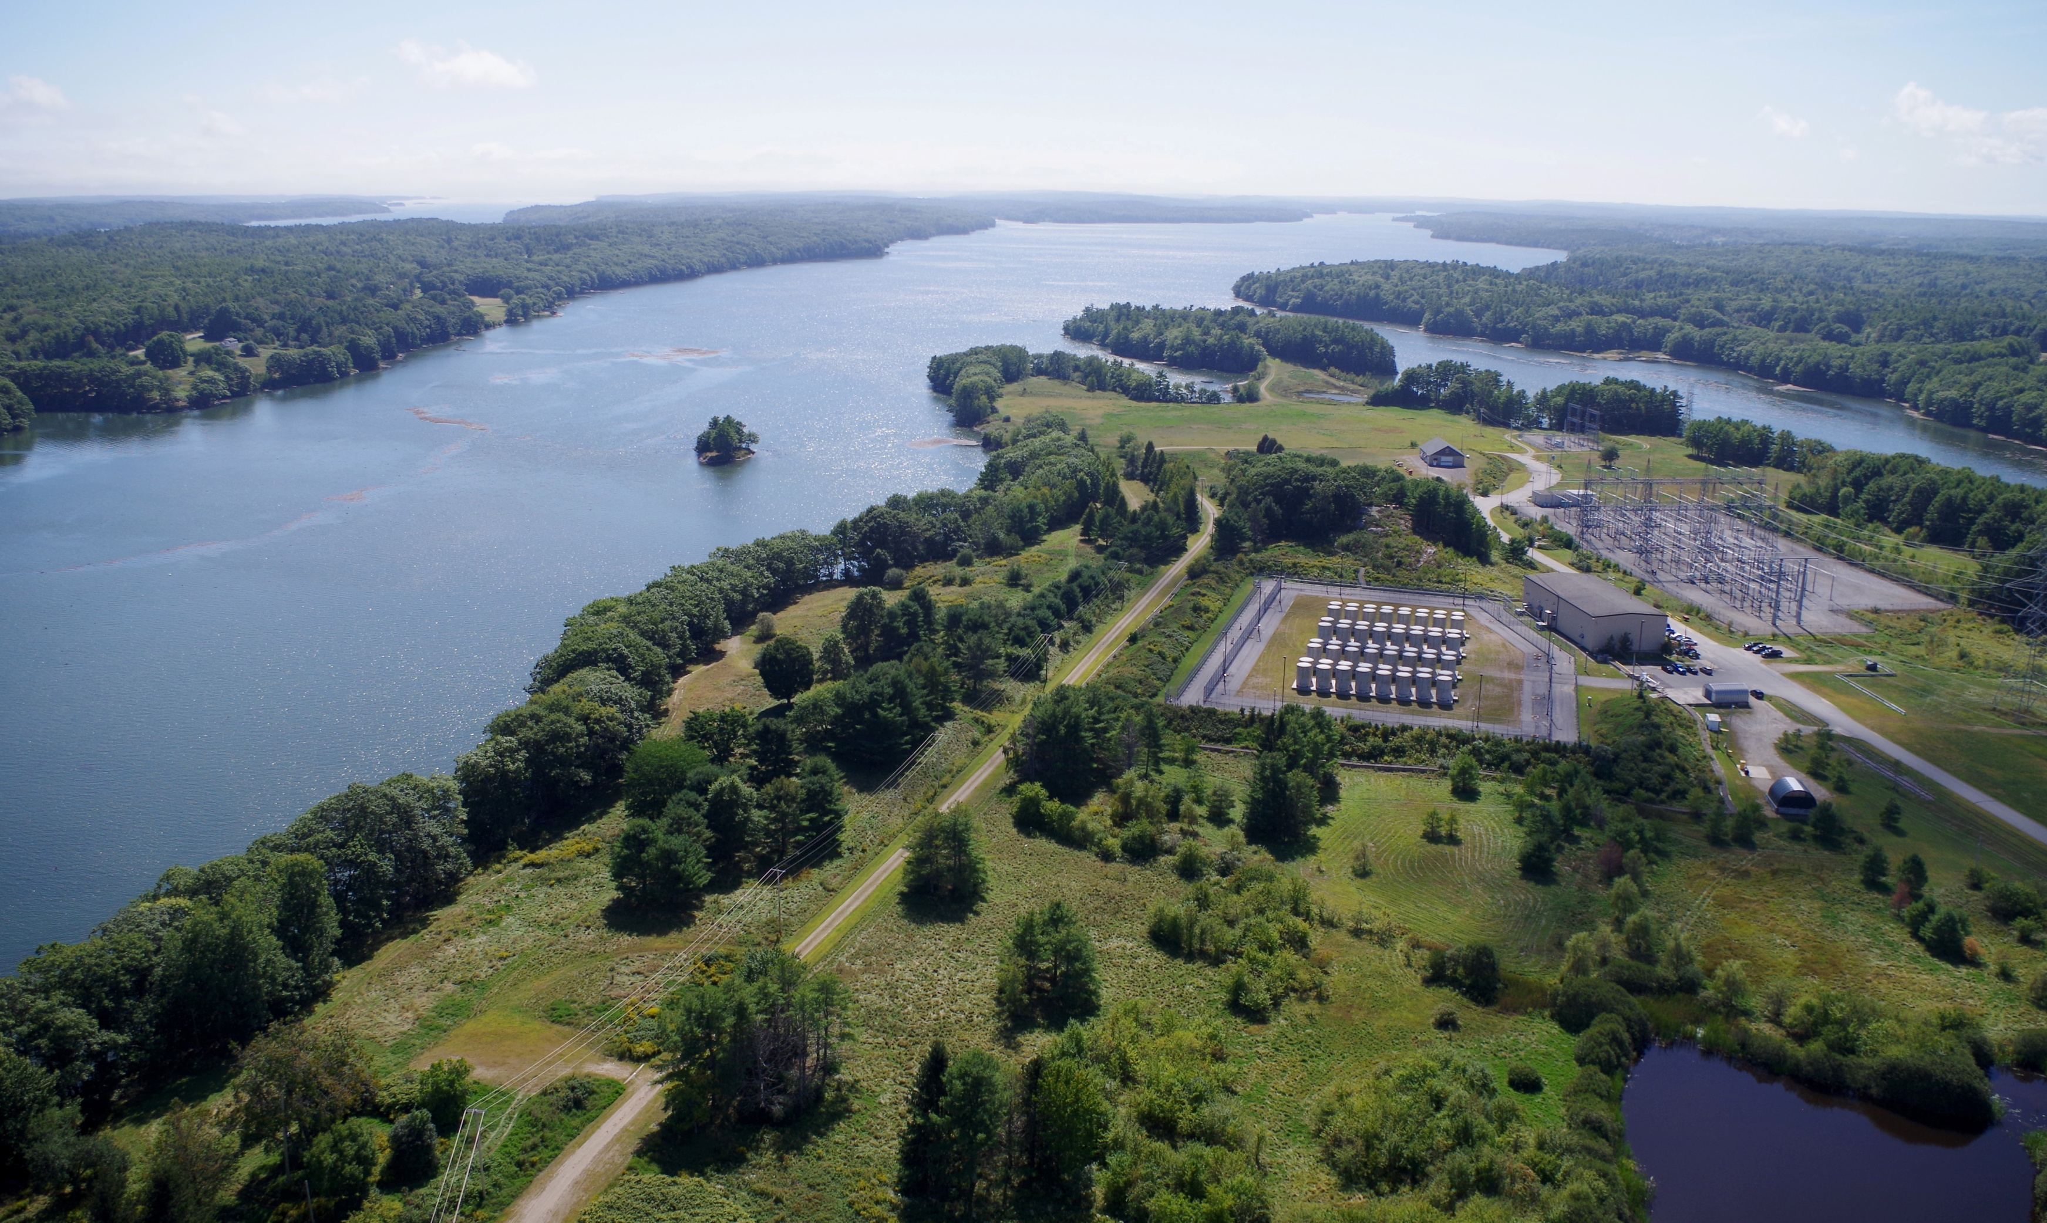
Connecticut Yankee
Yankee Rowe
Maine Yankee
Notes:
Aerial view of the 3 sites – plants decommissioned and removed and the sites environmentally restored. All that remains is the ISFS facility.

Slide 18
History: 2000 - 2011
Milestones Achieved 2002
    Energy Secretary recommended Yucca Mountain (YM) for only repository; Pres. Bush approved
    Nevada exercised state veto in April
    Veto overridden by Congress by mid-July
2008 – DOE submitted license application for YM repository to NRC
Political Intervention Sidetracks Program 2009-2010
    Administration zeroed out YM funding and DOE Secretary Chu moved to withdraw YM license application
    President created Blue Ribbon Commission (BRC) to “recommend a new strategy”
    DOE’s OCRWM closed
2011 – NRC discontinued technical review of YM license application thus the national nuclear waste policy became – and remains - the Yucca Mountain Final EIS No-Action Alternative – which is to leave the material where it is currently stored in perpetuity.

Slide 19
Final Environmental Impact Statement for a Geologic Repository for the Disposal of Spent Nuclear Fuel and High-Level Radioactive Waste at Yucca Mountain, Nye County, Nevada
February 2002
S.3.2 NO-ACTION ALTERNATIVE
Under the No-Action Alternative, DOE would end site characterization activities at Yucca Mountain. The commercial nuclear power utilities and DOE would continue to store spent nuclear fuel and high-level radioactive waste. Because it would be highly speculative to attempt to predict future events, DOE decided to illustrate one set of possibilities by focusing its analysis of the No-Action Alternative on the potential impacts of two scenarios:
Scenario 1 assumes that spent nuclear fuel and high-level radioactive waste would remain at the 72 commercial and 5 DOE sites under institutional control for at least 10,000 years.... For purposes of analysis, DOE assumed that the storage facilities would undergo one major repair during the first approximately 100 years, and complete replacement after the first 100 years and every 100 years thereafter.
Scenario 2 assumes that spent nuclear fuel and high-level radioactive waste would remain in dry storage at the commercial and DOE sites and would be under institutional control for approximately 100 years (as in Scenario 1). This scenario, however, assumes no effective institutional control after 100 years, and that the storage facilities at 72 commercial and 5 DOE sites would begin to deteriorate after 100 years.

Slide 20
History: 2012-2016
2012: President’s Blue Ribbon Commission on America’s Nuclear Future Report to DOE
2013:
  DOE issues “Strategy” for Integrated Waste Management, Jan. 2013
  NRC restarts review of YM license app as directed by USCA-DC writ of mandamus
  USCA-DC decision in NARUC fee suspension case, Nov. 2013
2014: DOE suspended collection of fees from electric customers, May 2014
2015:
  NRC completion of Safety Evaluation Report (SER), confirming YM repository can dispose of SNF & HLW for > 1 M years while protecting public health, safety & environment (Jan. 2015) – that the Commission has not acted on.
2016:
  DOE pursuit of Deep Boreholes for specific waste forms (canceled 2017)
  NRC completion of YM Supplemental EIS (concerning groundwater impacts)
  DOE Consent-Based Siting (CBS) Public Meeting Series (2016)

Slide 21
History: 2017- 2020
2017: DOE issues Draft Consent-Based Siting Process Report, Jan 2017
2017-2019:
Admin Budget Requests for FY 2018, 2019 & 2020: Sought $116 M - $120 M for DOE for YM and “robust” interim storage and $30 M - $47.7 M for NRC for YM licensing.
Congress did not award the YM requested funding - and the administration eventually changed its position in support of YM.
2020:
  Admin Budget Request for FY 2021: Sought $0 for YM and $25 M for interim storage
  Congress FY 2021 Appropriations: New $20 M for interim storage and $7.5 M from NWF for NWF oversight

Slide 22
Nuclear Waste Fund (NWF) Summary
Established by NWPA and composed of payments by generators and owners of commercial SNF and HLW to ensure that costs relating to disposal were borne by those benefiting from the power (i.e., electric customers).
Quarterly fee (1 mill/kWh = 1/10 of a cent/kWh) established for nuclear power generated and sold from April 7, 1983 forward.
“One-time fee” established for nuclear power generated and sold prior to April 7, 1983 (does not have to be paid until DOE begins SNF removal from reactor site).
In response to lawsuit initiated by NARUC, U.S. Court of Appeals for D.C. Circuit ordered DOE Secretary to suspend collecting fees until DOE conducts a legally adequate fee assessment. NARUC v. DOE (D.C. Cir. Nov. 19, 2013). Fee collection ceased in May 2014.

Slide 23
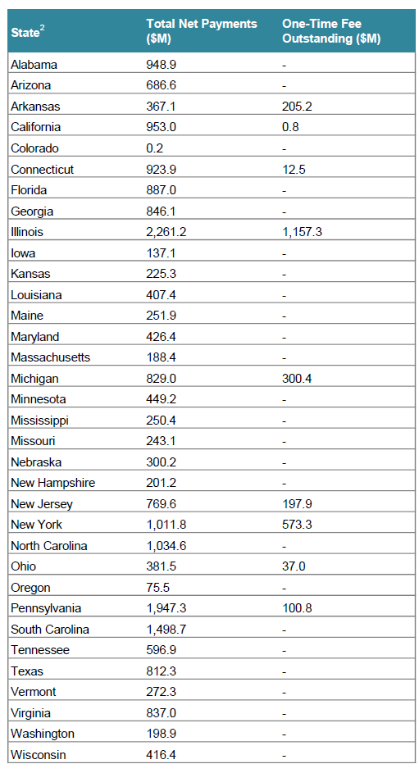
Nuclear Waste Fund Summary as of December 31, 2023
Net Payments and Balances by State Under Standard Contracts with Commercial Facilities¹
Notes:
1. The Nuclear Waste Policy Act established the Federal Government’s responsibility to dispose of commercial spent nuclear fuel (SNF) and high-level radioactive waste (HLW), and the Nuclear Waste Fund, composed of payments made by the generators and owners of SNF and HLW, to ensure that the costs relating to disposal are borne by the generators and owners of SNF and HLW. The “one-time fee” was established for fuel used to generate electricity prior to April 7, 1983 (permanently discharged SNF and fuel that had been irradiated but was still in-core), and an ongoing quarterly fee was established based on electricity generated and sold from April 7, 1983 forward. This summary does not include the $5.293M one-time fee and $2.263M ongoing fee payments made by DOE. Payment information comes from the Department of Energy Consolidated Accounting & Investment System (CAIS). Payments are net of credits/refunds of fees and interest, and do not include penalties. The one-time fees include principal and interest. This summary also includes on-time fee payments by GE Vallecitos (CA), GE Morris (IL), NFS (NY), and B&W (VA).
2. The fees by state largely reflect generation of electricity from nuclear power plants located within each state. However, the ultimate consumers of some of the electricity may not be within the state, so out-of-state consumers may have contributed to a portion of these fees.

Slide 24
Notes:
This DOE NWF Annual Financial Report Summary shows there is now nearly $50 Billion dollars in the fund – all of which remains available for Congress to appropriate for an integrated nuclear waste program – and the fund is gaining interest approaching $2 Billion/year -
This is more than enough to begin to fund a national integrated nuclear waste program that includes a geologic disposal site - without having to reinitiate the nuclear waste fund fee collections.
The slide also documents that the Fund exists - and confirms that Congress continues to appropriate small amounts funds out of it – so they obviously can when they want to…
but they need to be urged to do so - and do it on a sustained annual basis to reestablish an integrated nuclear waste program - and get going on a national geologic disposal site for all the nation’s waste – including that from the proposed new nuclear sites.

Slide 25
Department of Energy (DOE) Request for Information (RFI)
On January 28, 2026, the DOE issued a RFI seeking input from states interested in hosting potential “Nuclear Lifecycle Innovation Campuses.”
Integrated nuclear ecosystems that could co-locate and support the entire nuclear fuel cycle from fuel fabrication to storage and permanent final disposition capabilities.
26 states have responded, though not all have embraced the back end of the fuel cycle in their responses. A handful of states appear to have indicated some acknowledgment of helping with SNF/HLW storage or final disposition.
Now that the RFI submittal response period has closed, DOE is reviewing the submissions and entering the negotiation phase to narrow down the potential states to 2-3.

Slide 26
Recent Developments - DOE’s RFI
There is no indication to date that the Administration is looking for immediate action that would lead to the creation of a federal facility for SNF disposal with priority for SNF from permanently shutdown commercial nuclear power reactors.
Moving forward DOE is focused on creating a closed fuel cycle at these Nuclear Lifecycle Innovation Campuses – which might lead to first fuel movement being determined by recycling or reprocessing companies preferred feedstock for their particular technology and market strategy.
It’s also rumored that DOE is drafting legislation to be introduced as early as July – with hopes to have it pass during the lame duck session.

Slide 27
Congress: FY27 Budget & Appropriations
The President’s FY27 Budget request was submitted to Congress on April 3. DOE Office of Nuclear Energy is allocated $1.53 billion, a decline from the FY26 request. The request for DOE Used Nuclear Fuel and High-Level Waste Disposition is essentially a flat $102 million.
The President’s budget request did not include any federal contributions with respect to the DOE’s RFI.
The House Energy & Water Development (E&WD) Appropriations Subcommittee released the Committee report for the FY27 bill and passed the bill out of Committee.
  Congressman Levin (D-CA) successfully included Committee report language in the Used Nuclear Fuel and High-Level Waste Disposition section (pg. 134) that prioritizes acceptance of used nuclear fuel from shutdown reactors in accordance with current contracts.
The Senate E&WD Appropriations Subcommittee bill has not been released yet.

Slide 28
Path Forward Report
On January 15, 2026, a bi-partisan group of used fuel experts published the “Path Forward for Nuclear Waste in the U.S.” Report, sponsored by the MacArthur Foundation.
This report is a result of a bipartisan 10-month dialogue between participants covering the political spectrum from former NRC Chair Allison Macfarlane to Jack Spencer of the Heritage Foundation.
This report is consistent with long established Decommissioning Plant Coalition and Nuclear Waste Strategy Coalition policy perspectives:
  Need for an independent organization to implement a national disposal program with options for consolidated storage to address shutdown plant inventories as a priority;
  A fix to the financing mechanism that provides sustained access to necessary funds; and
  The development of a partnership between the various levels of government.

Slide 29
Private Consolidated Interim Storage Facility Status
Texas and New Mexico Private CIS Facility Litigation Status
the U.S. Supreme Court on June 30th in a 6-3 decision reversed the Fifth US Circuit Court of Appeals decision that vacated the license NRC granted to the Texas CIS facility. The Court held that Texas and a mineral company were not a party to the NRC’s licensing proceedings and hence were not entitled to the judicial review of the NRC licensing decision. On August 14, 2025, the Fifth Circuit Clerk requested the parties’ legal counsels provide briefs by August 29th advising on what the Court should do next on remand. All parties told the court that in light of the Supreme Court decision, the case should be dismissed and the NRC license recognized as valid. ISP has indicated they won’t begin construction of a facility without agreement from the Governor and state legislature. On September 27th, 2025 the 5th Circuit dismissed Texas’ challenge to the NRC license on remand as a result of the Supreme Court decision.
The Supreme Court decision in the ISP case didn’t directly rule on the parallel challenges to the NRC license for the Holtec facility, but the Supreme Court decision has set in motion filings that will validate the NRC's licensing action(Supreme Court docket).
Holtec said in a statement on October 8th that the company and the project's local backers agreed to cancel the deal, citing "the untenable path forward for used fuel storage in New Mexico."
Notes:
Both private CIS initiatives continue to remain dormant.

Slide 30
Thank you!
kcapstick@3yankees.com
https://maineyankee.com/
https://connyankee.com/
https://yankeerowe.com/

