Slide 1
Microreactor
Risk-Informed Transportation Package Approval Methodology
Steven J. Maheras
Harold E. Adkins, Jr.
Garill Coles
Steven Short
Pacific Northwest National Laboratory
Northeast High-Level Radioactive Waste Transportation Task Force Spring Meeting
June 24, 2026
Austin, Texas

Slide 2
Topics
Introduction to microreactors
Rulemaking changes
Risk-informed transportation package approval methodology
Current status of methodology

Slide 3
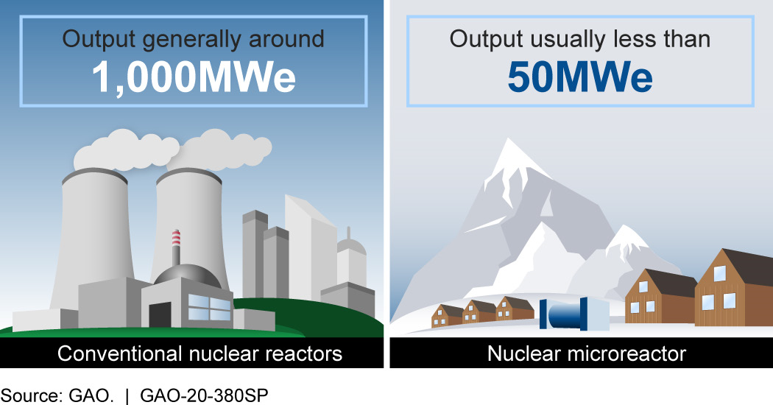

What Are Microreactors?
Electrical output up to 50 MWe
  Transportable microreactors up to 20 MWe
  Also known as Transportable Nuclear Power Plants (TNPPs)
Much smaller and simpler than traditional nuclear power reactors
There are a variety of microreactor/advanced reactor designs, including gas, liquid-metal, molten-salt, and heat-pipe-cooled concepts
Refueling: 2-10 years
Operational Lifetime: 5-20 years
Potential microreactor applications are:
  Data Centers
  Remote communities
  Mining sites
  Remote defense bases
  Back-up generation for power plants
  Humanitarian aid and disaster relief (HADR) missions

Slide 4
U.S.-Based Microreactor Developer Landscape
Technology Diversity Snapshot (25+ Active Designs)
HTGR= High Temperature Gas-Cooled Reactor
MSR= Molten Salt Reactor
LWR= Light Water Reactor
TRISO= tri-structural isotropic

Slide 5
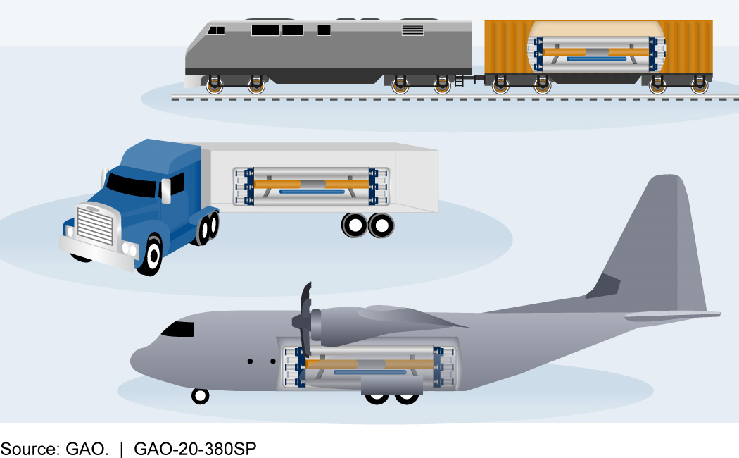
Microreactor Transportation
Current microreactor concepts include transporting a microreactor containing its unirradiated or irradiated fuel
A microreactor containing its unirradiated fuel or irradiated fuel is unlikely to meet the entire suite of regulatory requirements in U.S. Nuclear Regulatory Commission (NRC) transportation regulations (10 CFR Part 71)
A risk-informed process may be used for NRC transportation package approval
  Demonstrate equivalent safety and that the risk to the public is low
  This may require the use of compensatory measures

Slide 6
Potential Compensatory Measures Include
Transportation routing
Heavy haul truck or superload permit requirements
Establishment of an exclusion zone around reactor
Realtime health/fitness onboard monitoring
Escorting of the microreactor shipment
Rolling road closures
Avoiding bodies of water
Bridge controls
Time-of-day and day-of-week restrictions
Avoiding severe weather
Training for emergency responders

Slide 7
Current Domestic Transportation Approach
The microreactor shipment would be a commercial shipment and would require transportation package approval from the NRC, likely through the application of a risk-informed approach
  Highway risk-informed methodology received NRC endorsement in October 2024
  Maritime risk-informed methodology under review by NRC (submitted August 2025)
Strategy is Crawl-Walk-Run
  Concentrate on highway transport first
  Then other surface modes (rail and barge/ship) – evaluation of transport by vessel has just started
  Finally, air transport
The microreactor containing its irradiated fuel would contain a highway route-controlled quantity (HRCQ) of radioactive material (i.e., > 3000 A₂)
  For truck shipments this means that a Commercial Vehicle Safety Alliance (CVSA) Level VI inspection and safety permit would be required (see 49 CFR Part 385 and 49 CFR Part 397)
  For rail shipments this means that the transportation planning requirements in 49 CFR 172.820 would apply
The microreactor would be fueled by LEU or HALEU (not HEU)
For rail shipments, transport would be via Association of American Railroads (AAR) Standard S-2043 railcars
Marine shipments would be via a Class INF-2 or INF-3 ship
LEU= Low Enriched Uranium (< 5 % U-235)
HALEU= High Assay Low Enriched Uranium (5-20 % U-235)
HEU= High Enriched Uranium (> 20% U-235)

Slide 8
Unique Elements Associated with Microreactor Designs and Domestic Transport
Unusual nature of microreactor designs
  Increased time may be required for transportation planning
  Increased coordination with States and Tribes along transportation routes may be required
  Due to the unusual nature of the microreactor designs, there may be the desire to perform an increased number of en route inspections
  Due to the unusual nature of the microreactor designs, there may be an increased need for public information and communications regarding microreactor transport
  There may be calls for increased microreactor-specific training for emergency responders, and there may be additional microreactor-specific training modules that are required. These training modules may be design-specific
  Microreactor designs that contain other hazardous materials such as beryllium or sodium could affect the content of emergency response plans and procedures

Slide 9
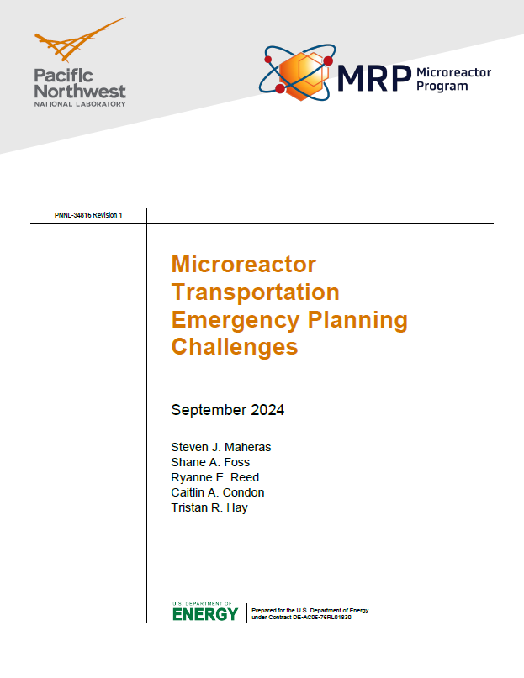
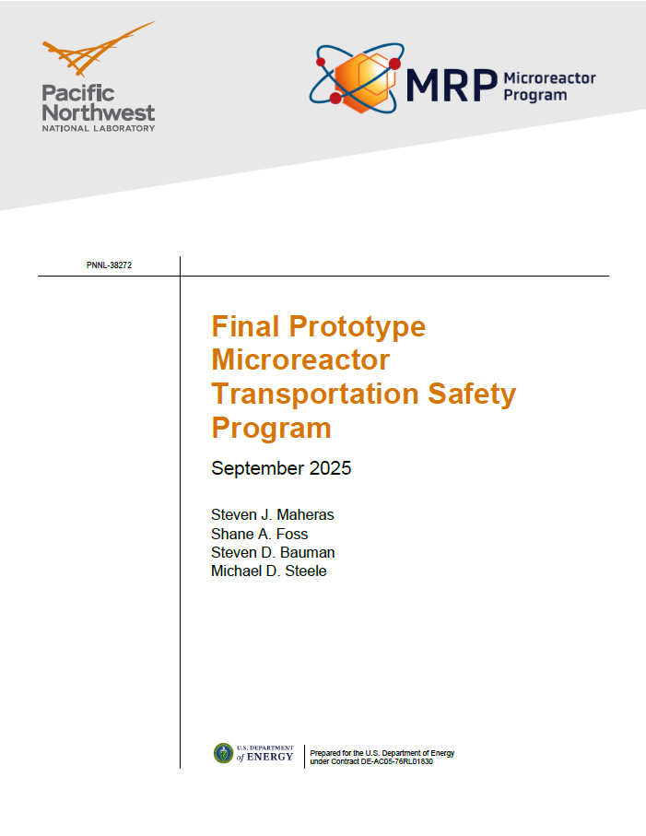
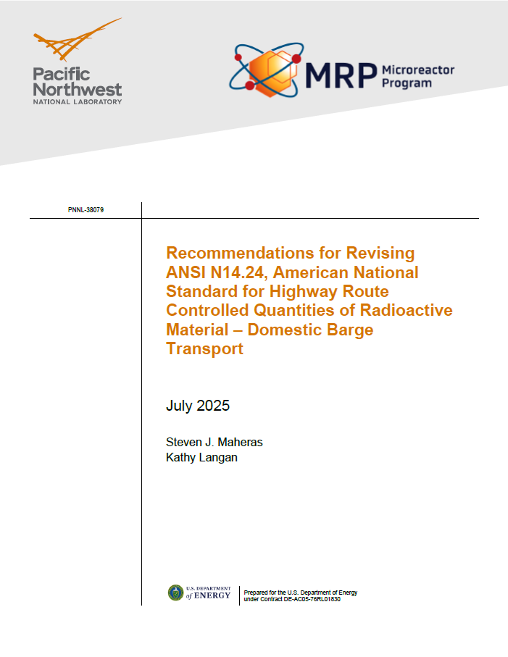
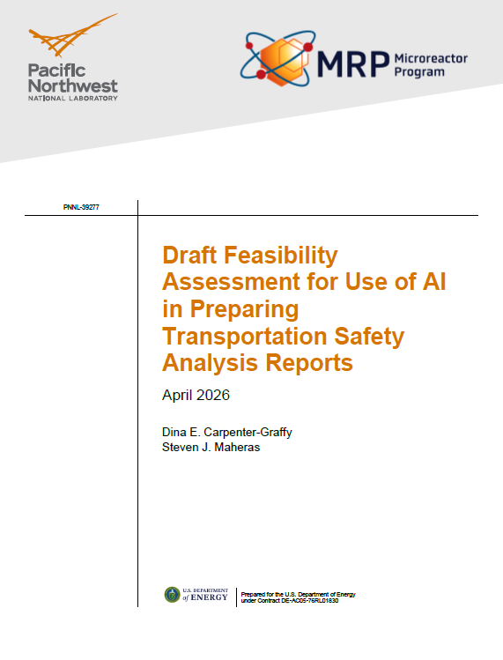
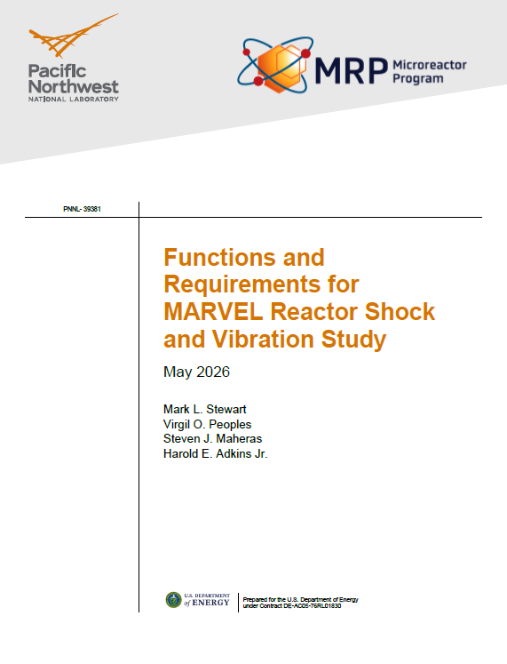
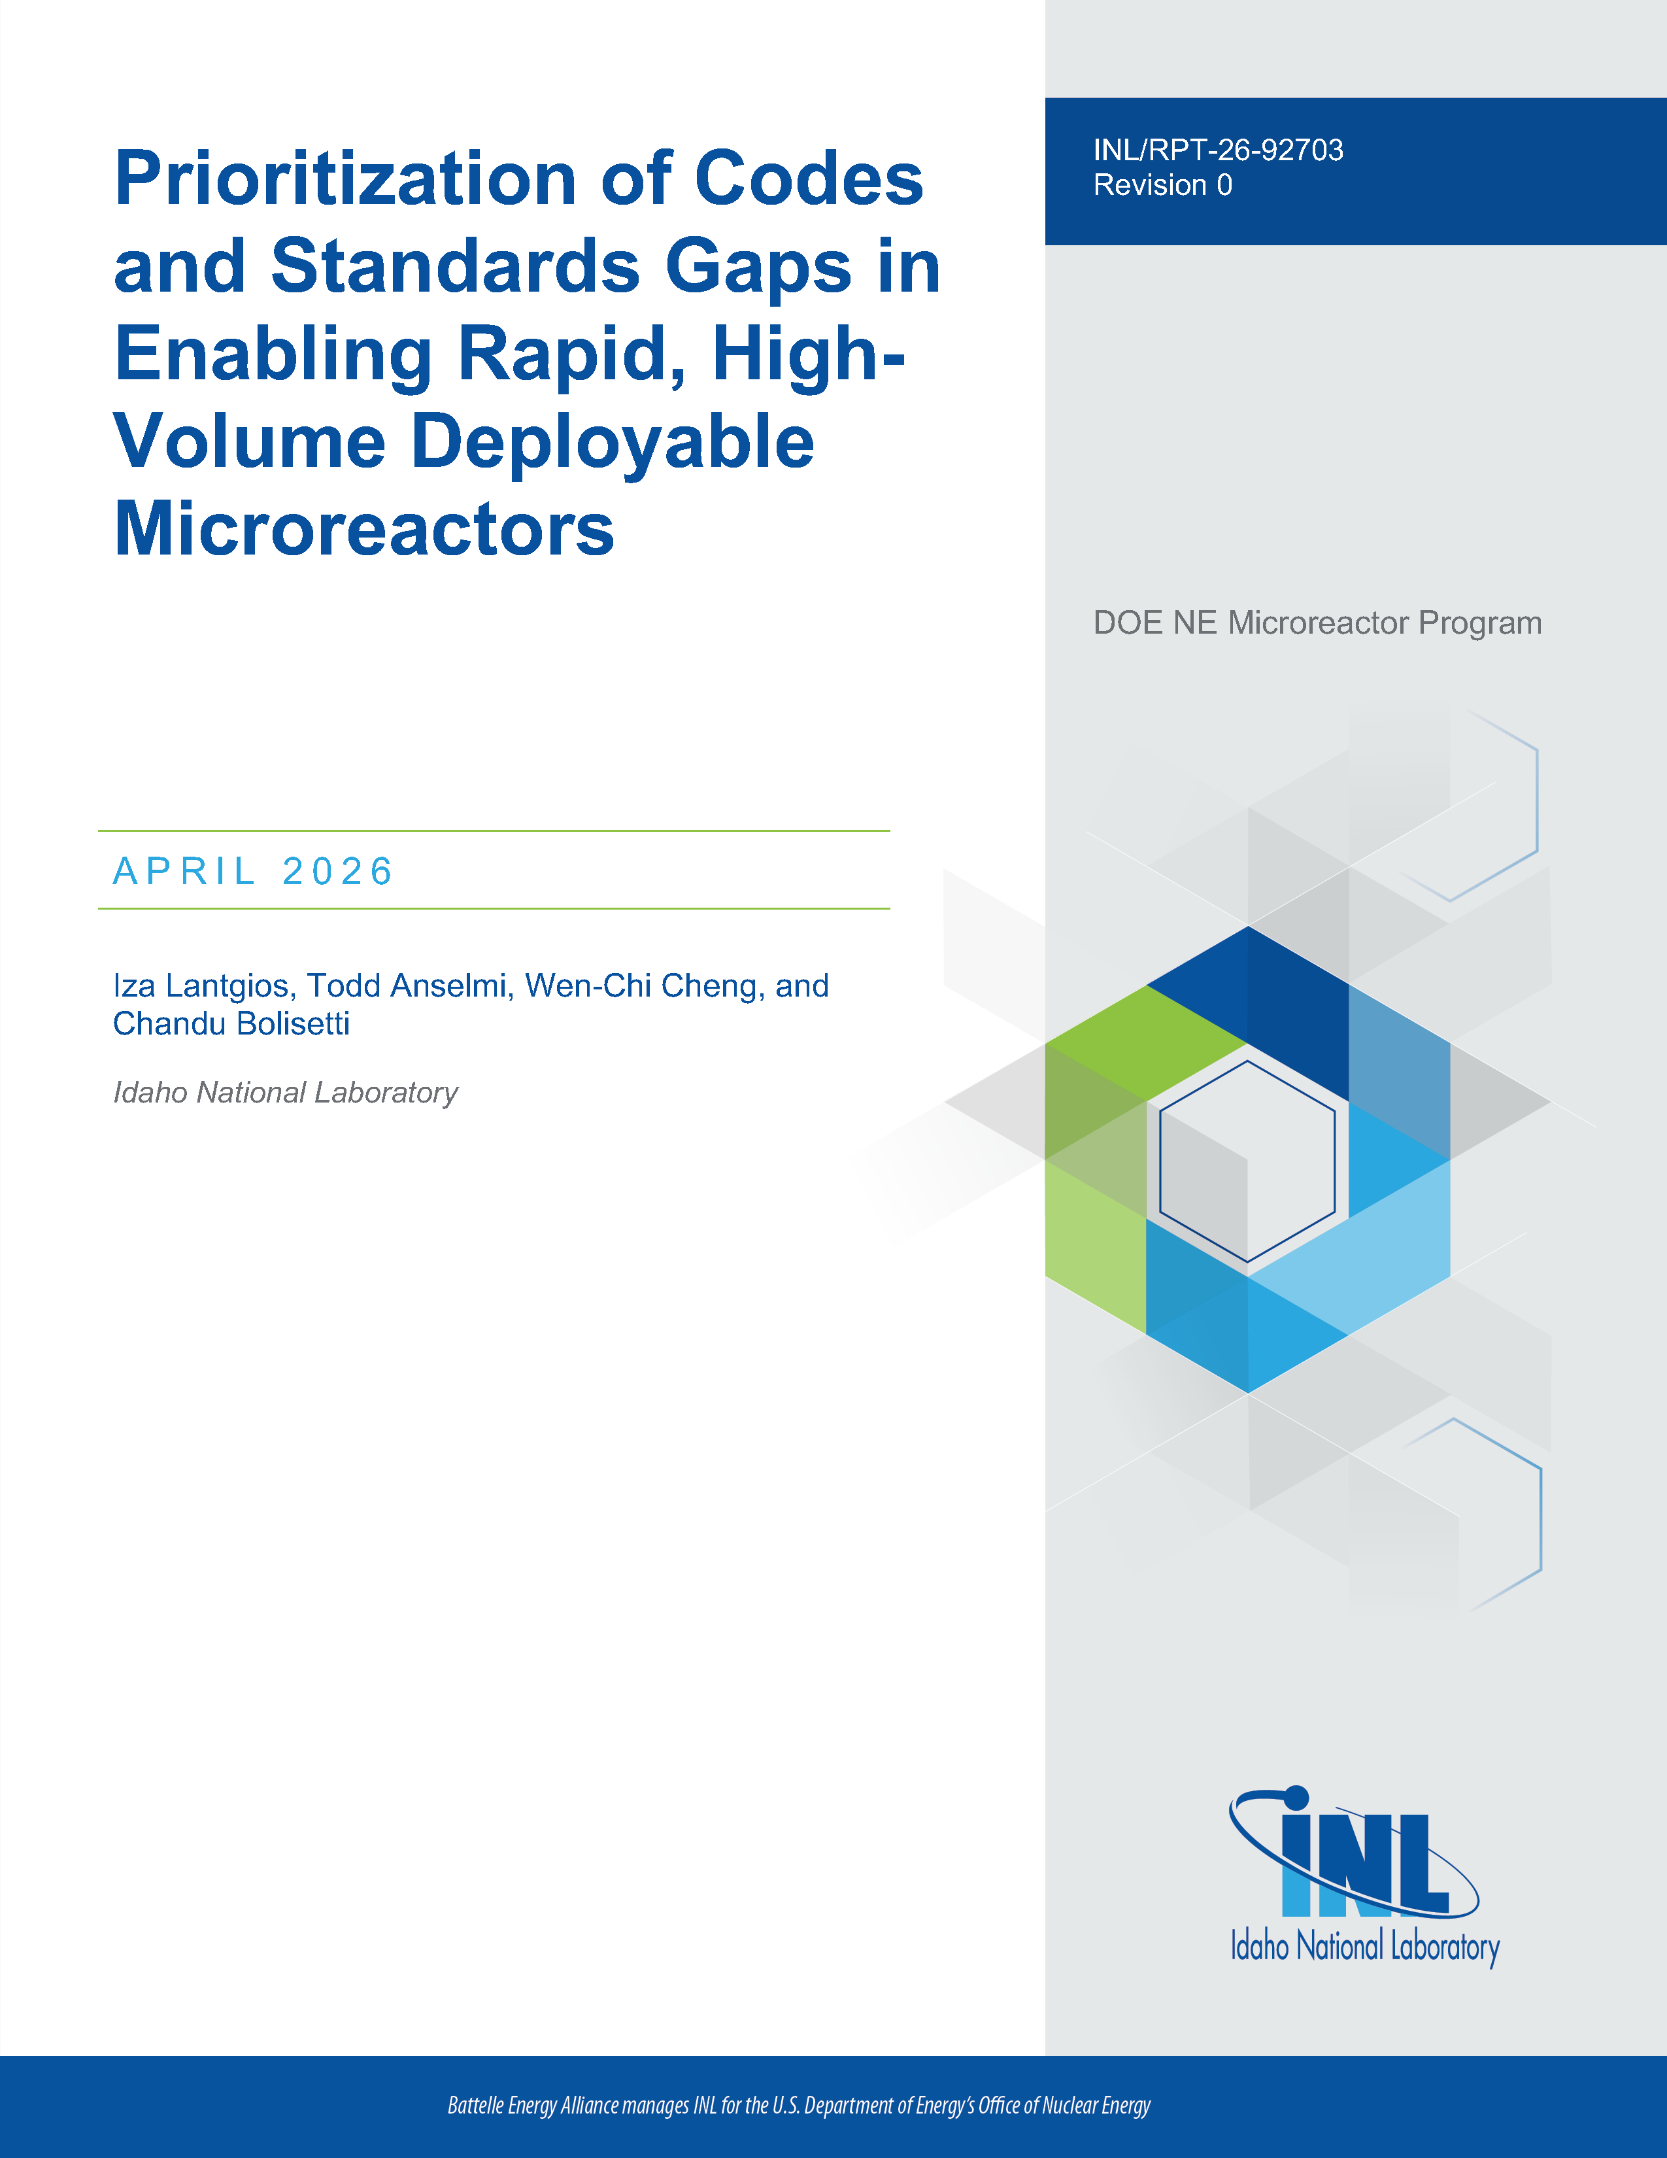
DOE Microreactor Program Transportation Activities
Microreactor Transportation Emergency Planning Challenges
Prototype Microreactor Transportation Safety Program
Recommendations for Revising ANSI N14.24, American National Standard for Highway Route Controlled Quantities of Radioactive Material – Domestic Barge Transport
Use of AI to streamline the preparation of Transportation Safety Analysis Reports
Transportation Shock and Vibration testing associated with shipping the MARVEL microreactor
Cost analyses for shipping microreactors
Gaps in codes and standards
Much of this work is applicable to the transport of a microreactor containing its unirradiated fuel (front-end) or irradiated fuel (back-end)
Available at https://gain.inl.gov/doe-microreactor-program/technical-reports-doe-microreactor-program-2/

Slide 10
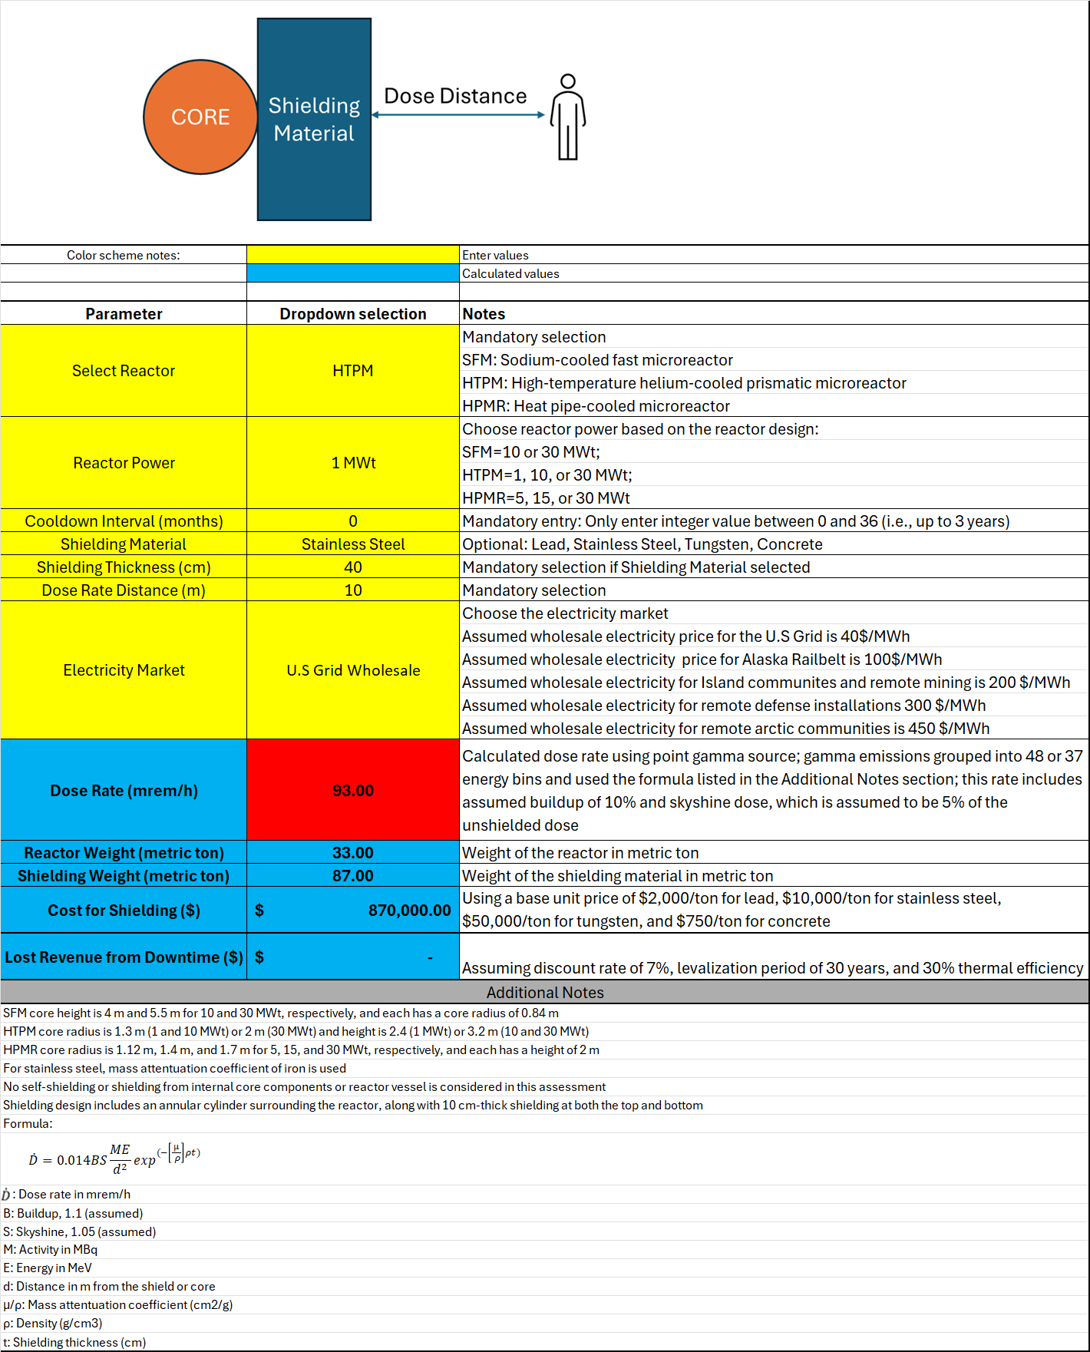
Exclusion Zone/Dose Rate Study
An exclusion zone/shielding study was completed for the DOE Microreactor Program
  ORNL, INL, and PNNL Team
  Calculation tool has three reactor types, multiple power levels, accounts for shielding and exclusion zone distance, decay time, costs, weights, etc.
  Study looked at impacts of expanding exclusion zone distance, increasing shielding, varying decay times, and different dose rates limits, etc.
  Study will be refined after additional engagement with the US Department of Transportation (DOT)

Slide 11
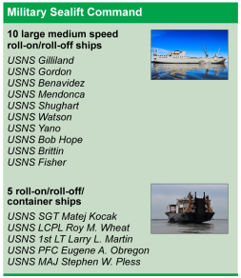
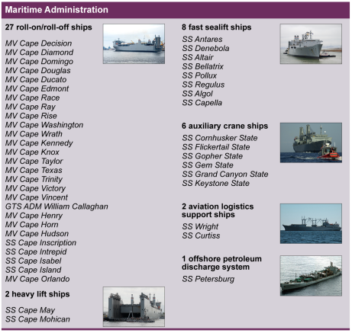
DoD/DoW Operational Energy Capability Improvement Fund (OECIF)
Maritime Nuclear Asset Transportation Capability Development (MNATC)
  In-Depth Study to Analyze Maritime Options Available to the DoD To Transport Nuclear Reactors
  Subset of Study will also Examine Options to Retrofit a DoD Cargo Vessel or Procure Vessels to Meet INF Code Requirements and DoD Objectives
Legal and Regulatory Taxonomy for Maritime Nuclear Defense Applications (TMNDA)
  In-Depth Study to Analyze Legal and Regulatory Frameworks, Gaps and Seams Relevant to DoD Maritime Nuclear Reactors
  Subset of Study will also Examine Options and DoD Objectives
  Goal is to meet requirements to achieve sustainable, reliable and scalable microgrid with reserve power capability for operations and expeditionary support
Target completion for both studies end of FY26

Slide 12
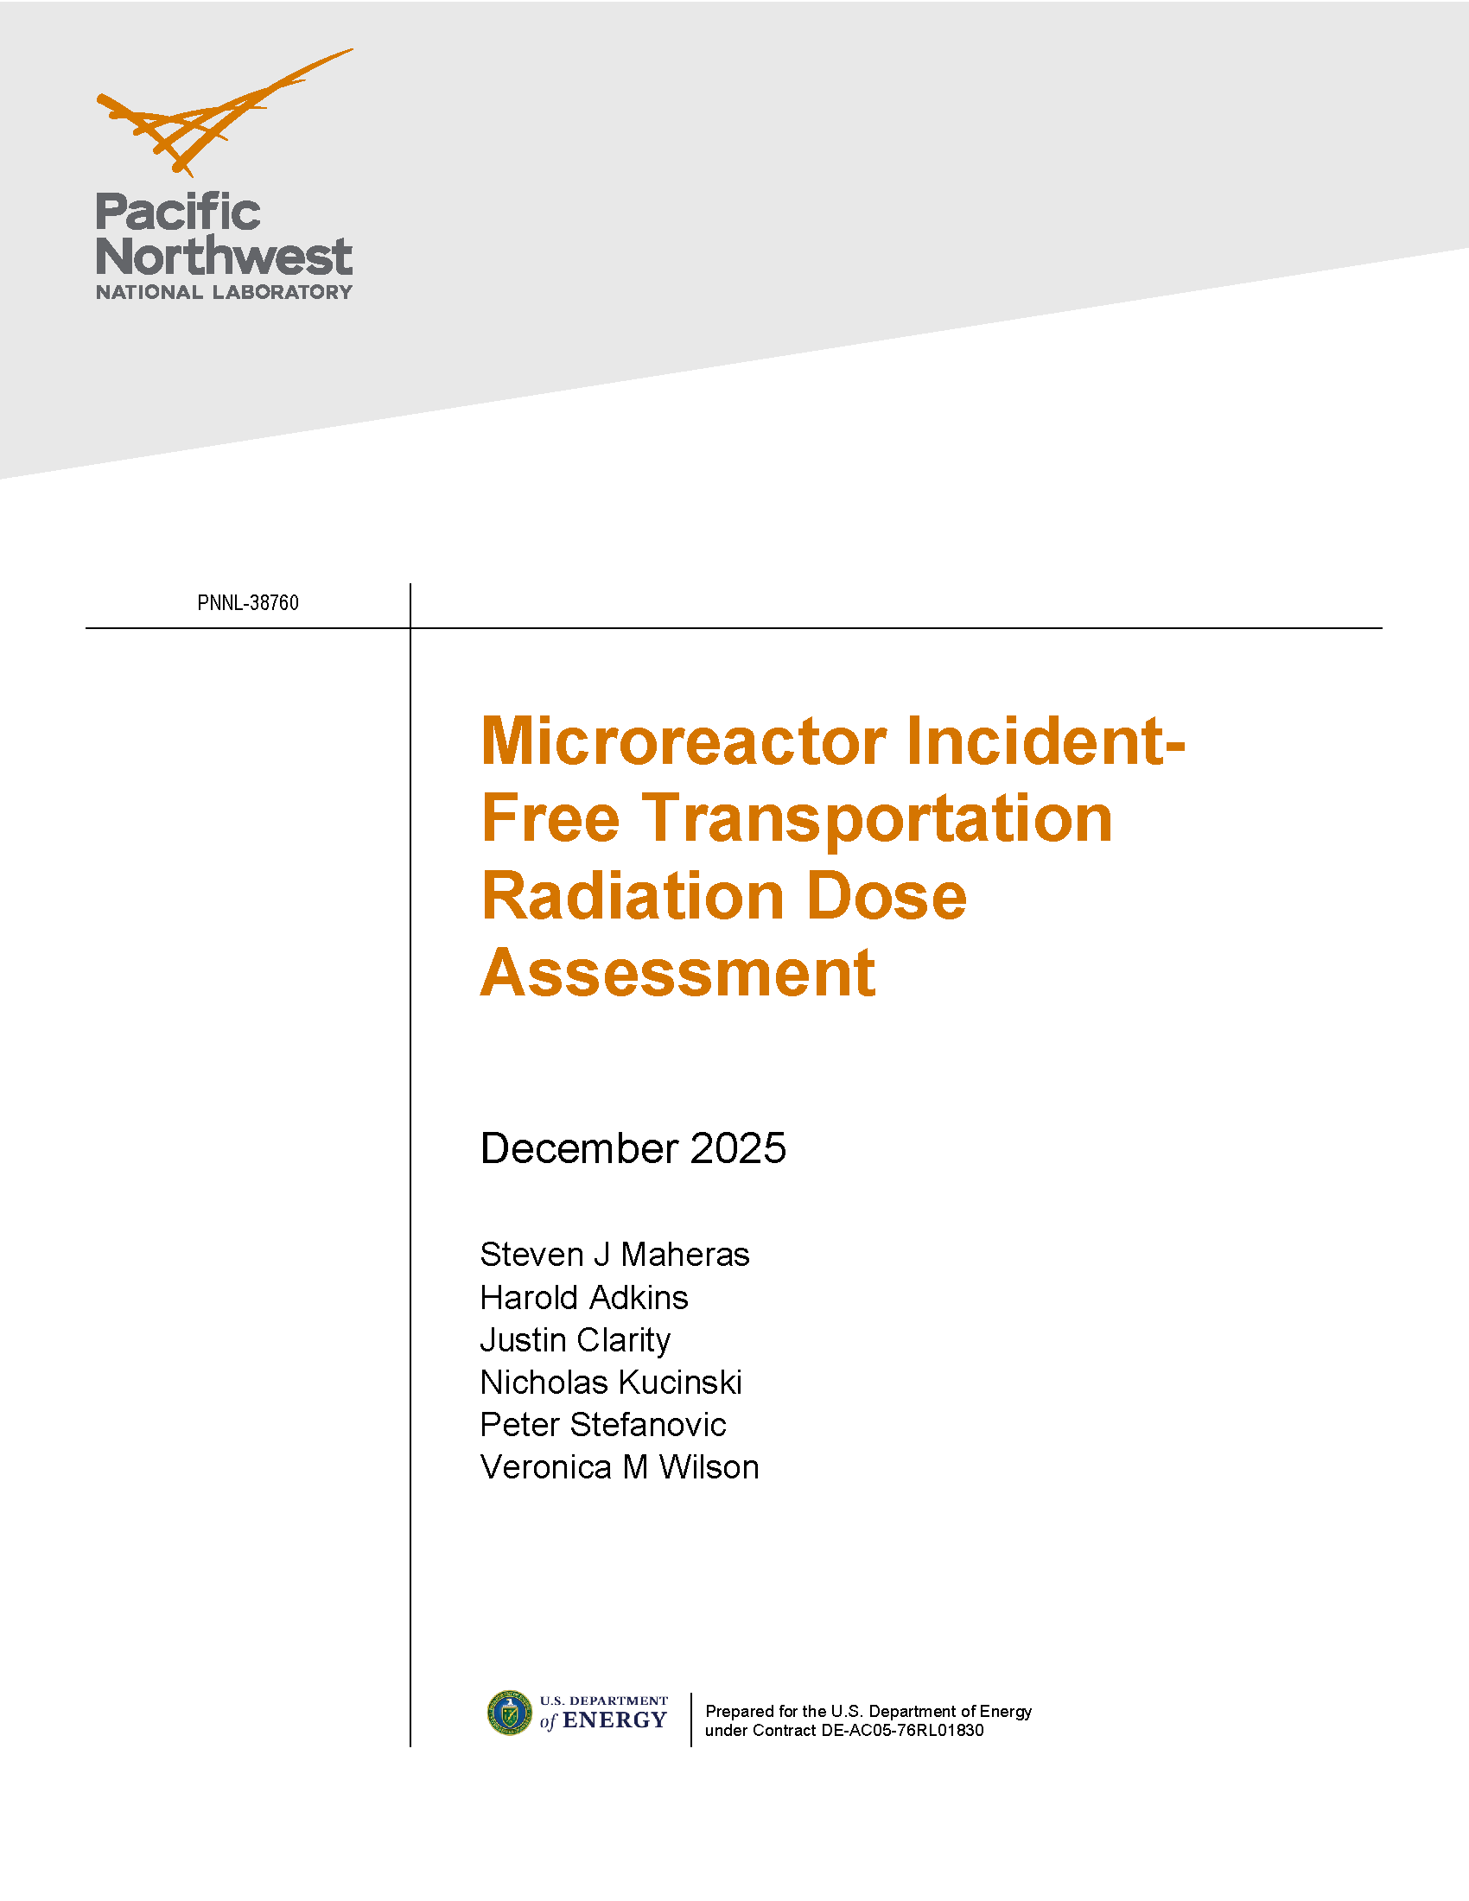
Microreactor Incident-Free Transportation Radiation Dose Assessment (NRC)
Study estimates the radiation dose to maximally exposed individuals (MEIs) under the current regulatory radiation dose rate limit of 10 mrem/hr at 2 meters from the vehicle as well as alternative limits of 50, 100, and 200 mrem/hr at 2 meters from the vehicle for highway and rail transport
Analysis expands on prior incident-free transportation radiation dose assessments conducted for used nuclear fuel and radioactive waste transportation
Key factors analyzed include the microreactor fuel type and burnup, shipment cooling periods, shielding designs integrated into transport packaging, and exposure scenarios for MEIs for highway and rail transport
This report considers additional distances that may be associated with compensatory measures to ensure safe transport conditions under varying radiation dose limits, including enhanced routing measures, escort protocols, vehicle inspections, and operational restrictions
Report available at https://www.nrc.gov/docs/ML2606/ML26061A014.pdf

Slide 13
Rulemaking Changes
US proposed regulation 10 CFR Part 57, “Licensing Requirements for Microreactors and Other Reactors With Comparable Risk Profiles,” released 1 May 2026, comments due 15 June 2026
Four transportation questions
  Q7-1:Provide feedback on the need for alternate dose rates for transportable microreactors, the technical basis for those alternate dose rates, and the safety implications for those alternative dose rates.
  Q7-2:Are there cost-benefit considerations beyond the costs and benefits associated with rulemaking (e.g., the costs of additional shielding due to lower dose rates) that the NRC should consider with respect to alternate dose rates for transportable microreactors? Please provide a basis for your response.
  Q7-3:Provide feedback on the impact to international and interstate shipments if there were alternate transportation package dose rate limits for transportable microreactors.
  Q7-4:What assumptions should the NRC use when estimating the number of shipments, exposure scenarios, and expected dose rates for fresh and irradiated transportable microreactors? Please provide a basis for your response.
10 CFR Part 71 rulemaking “Modernizing Package Certification Requirements”
  Currently due to be released on 07/07/2026
  The rulemaking is advertised to amend the regulations for radioactive materials transportation packages to modernize package certification requirements for large Type B Fissile Material packages to accommodate anticipated transport of irradiated transportable microreactors and similar packages

Slide 14
Risk-Informed Transportation Package Approval Methodology

Slide 15
Background
Methodology developed for Project Pele
  Project Pele led by the U.S. Department of Defense Strategic Capabilities Office to design, build, and demonstrate an advanced prototype mobile nuclear reactor
  Close collaboration with U.S. Department of Energy, U.S. Nuclear Regulatory Commission (NRC), and others
Objectives
  Develop a prototype of a transportable, modular, high-temperature gas-cooled reactor (HTGR) system with a 3-year operating life
  Initiated 2020
  Started assembly 2025
  Ship to Idaho National Laboratory site in 2027
  Operational in 2028
Army Semi-Tractor and Trailer Carrying a 20-foot ISO Container
Photo courtesy of DOD - http://www.military-today.com/trucks/m915a5.htm

Slide 16
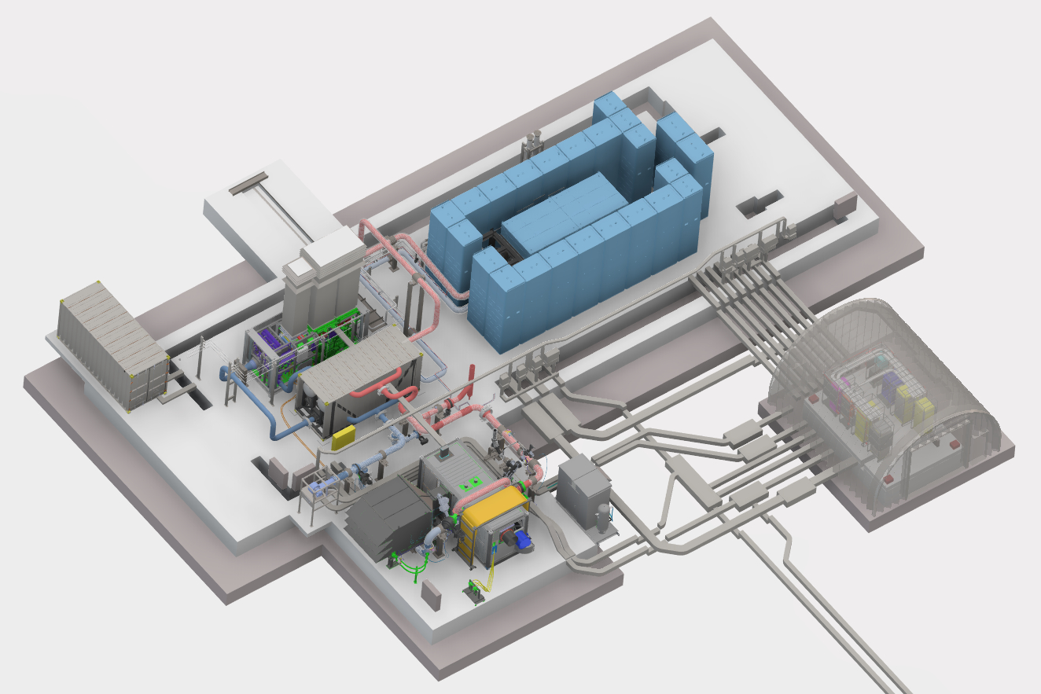
Major Pele Performers
Strategic Capabilities Office – project management and funding
BWXT-AT – prime contractor for design and build
Major Subcontractors: Rolls Royce and Northrup Grumman
Idaho National Laboratory (INL) – site build; plant assembly, test, and operations; technical authority
DOE–Idaho – regulatory authority
BWXT-NOG-L – TRISO fuel production
PNNL and INL – Transportation Advisory Group

Slide 17
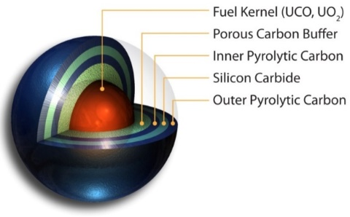
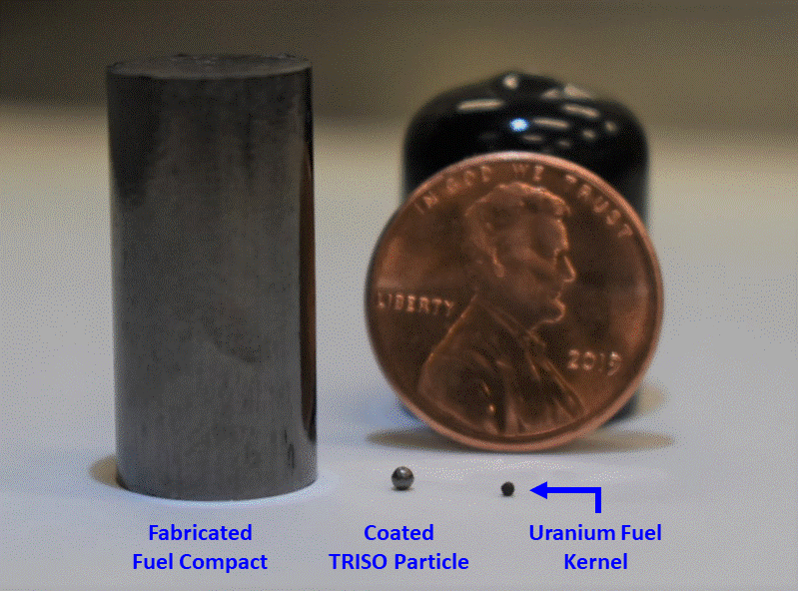
Transportable Nuclear Power Plant (TNPP) Package
1 to 5 MWe, minimum of 3 years of full power operation
HTGR using HALEU UCO TRISO fuel
4 or 5 modules
  Reactor Module
  IHX Module
  Control Module
  Power Conversion Module
Reactor Module contains well over 99% of radioactivity (remainder in IHX Module)
Each module contained in and integral with separate ISO-compliant CONEX containers
Acronyms: MWe – megawatt electric; HTGR – high temperature gas-cooled reactor, HALEU – high-assay low-enriched uranium; UCO – uranium oxycarbide; TRISO – tri-structural isotropic; IHX – intermediate heat exchanger; CONEX – container express

Slide 18
Risk-Informed Process
Develop proposed risk evaluation guidelines
Develop an integrated assessment process
  Compile reactor and shipment route
  Identify package safety functions
  Identify shipment hazards
  Select Bounding Accident Scenarios (BAs) for each accident phenomena group
  Develop bounding likelihood for each BA
  Develop bounding consequence for each BA
  Compare risk Results to proposed risk evaluation guidelines
  Assess Sensitivities to Model Uncertainties
  Assess Defense-in-Depth
  Assess Adequacy of Safety Margins
Demonstrate the risk-informed process using a hypothetical shipment of the Project Pele microreactor/TNPP

Slide 19
Proposed Risk Evaluation Guidelines
Phase 1: develop proposed risk evaluation guidelines
Developed based on NRC and DOE risk guidance for licensing nuclear facilities
Proposed guidelines are compatible with NRC nuclear safety goals, Qualitative Health Objectives, and NRC-proposed Quantitative Health Guidelines
Proposed Risk Evaluation Guidelines
Acronyms: NRC – U.S. Nuclear Regulatory Commission; DOE – U.S. Department of Energy

Slide 20
Integrated Risk Assessment Process
Integrated Safety/Risk
Assessment Process
Compile Transportation Package
and Shipment Route
Identify
Hazardous Conditions
Information
Phase 2: develop an integrated risk assessment process
  Based on probabilistic risk assessment (PRA) approaches and methods
Uses standard methods acceptable to both NRC and DOE for assessing the risk of nuclear facilities
Phase 3: demonstration implementation of the integrated risk assessment process on a hypothetical shipment of the Project Pele TNPP
Identify Package Safety
Postulate Accident Conditions
Functions
Identify Shipment Hazards
Assign Likelihood and
Consequence Bins to Each
Accident
Select
Bounding Representative
Accident Scenario (BA) for
Each Group
Screen Accident Conditions
Develop
Bounding Likelihood
Develop
Bounding Consequence
for Each BA
for Each BA
Identify Accident Scenarios
Compare Risk Result
for Each
BA to the Risk Evaluation
Group Accident Scenarios by
Guidelines
Accident Phenomena
Assess
Sensitivities to Model
Uncertainties
Assess Defense
Assess Adequacy
of Safety
-
in
-
Depth (DID)
Margins
Decision
on Adequate Safety
Probabilistic Risk Assessment Development Process

Slide 21
Step 1 – Compile TNPP and Shipment Route Information and Step 2 - Identify Package Safety Functions
Step 1, Information Collection
  TNPP transportation package (Reactor Module only)
    system design and configuration information, estimated radionuclide inventory at various time periods following reactor shutdown, information on the process for preparing the module for shipment
  Shipment route assumed to be from the INL site to the WMSR located near Carlsbad, New Mexico
Step 2, Package Safety Functions
  provide containment of radiological materials
  provide radiation shielding
  maintain a criticality-safe configuration
  maintain passive cooling?
Acronyms: WMSR – White Sands Missile Range

Slide 22
Step 3 – Identify Shipment Hazards
Utilize standard hazards analysis (HA) approach
Use of expert panels to identify and assess hazardous conditions that could occur during TNPP transport
Complete hazardous condition evaluation worksheets
Consider both highway accident and non-highway accident-initiated events
Formulate hazardous conditions to contain information needed to define accident scenarios
Total of 31 accident scenarios representing 8 accident phenomena classes were defined
Identify
Hazardous Conditions
Identify Package Safety
Postulate Accident Conditions
Functions
Identify Shipment Hazards
Assign Likelihood and
Consequence Bins to Each
Accident
Select Bounding
Accident Scenario (BA) for
Each Group
Screen Accident Conditions
Identify Accident Scenarios
Group Accident Scenarios by
Accident Phenomena

Slide 23
Step 4 – Select Bounding Accident Scenarios (BAs) for Each Accident Phenomena Group
BA ID | Description
1 | Fire-only event that originates inside the transport container.
2 | Diesel fuel fire-only event that originates outside the transport container and propagates into the transport container and ignites combustible material in the transport container which damages the package.
3 | Hard impact highway accident that leads to release of radioactive material and loss of shielding. Includes impact with heavy vehicles and unyielding objects (e.g., concrete abutments), drops to lower elevation, or rollovers.
4M 4L | Less than a hard impact highway accident that results in release of some radiological material and loss shielding. Medium impact that involves a severe collision with a light vehicle. Less than a hard impact highway accident that results in no release of radiological material or loss of shielding. Light impact such as a jackknife, impact with a yielding object (e.g., a road sign or soil embankment), or impact that is not severe with a light vehicle.
5H 5M | Hard impact highway accidents that result in fire with exception of collision with a tanker carrying flammable material. Medium impact highway accidents (i.e., severe collision with a light vehicle) that results in fire.
6 | Collision with a tanker carrying flammable material that leads to fire.
7 | Loss of non-pressurized reactor containment boundary not caused by a road accident but rather by human error and failures of containment features.
8 | Loss of pressurized reactor containment boundary not caused by a road accident but rather by human error and failures of containment features.
9 | Addition of moderator and a change in core geometry caused by a drop into body of water that results in criticality.
10 | Control rod withdrawal caused by impact from a road accident that results in criticality.
Identify Shipment Hazards
Select Bounding
Accident Scenario (BA) for
Each Group
Develop
Bounding Likelihood
Develop
Bounding Consequence
for Each BA
for Each BA
Representative of a group of accident scenarios that are phenomenologically similar
  but not overly conservative
Bounds the risk of all accident scenarios in the group

Slide 24
Step 5 – Develop Bounding Likelihood for Each BA
Specific routing hazard information
  Distances; key features such as bridges, bodies of water, steep drops to a lower elevation
Truck transportation accident rate data
  Frequency of impacts, non-impacts, rollovers, fires
Package-specific failures not in accident rate data
  Internal-initiated fires, random failures, human error
Select Bounding
Accident Scenario (BA) for
Each Group
Develop
Bounding Likelihood
Develop
Bounding Consequence
for Each BA
for Each BA
Compare Risk Result
for Each
BA to the Risk Evaluation
Guidelines

Slide 25
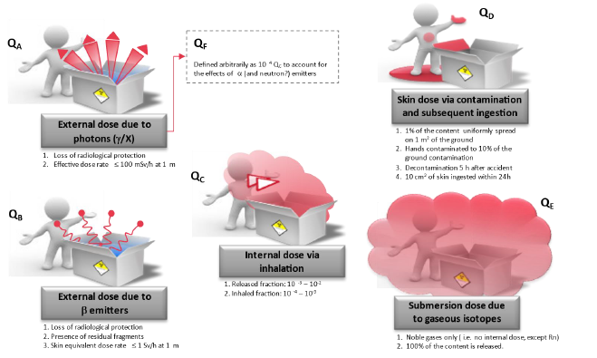
Step 6 – Develop Bounding Consequence for Each BA
Select Bounding
Radiological dose pathways from IAEA SSG-26 (Q System) for developing A₁ and A₂ values (which are the same as in NRC regulations)
Estimated effective doses for each pathway based on IAEA SSG-26 methods/data, with some refinements used to estimate the consequences for the public and from inhalation
Used DOE/NRC methods/data to determine source term (e.g., MAR × DR × ARF × RF × LPF)
Source term includes used fuel inventory and inventories diffused into reactor during operation
  Fuel (concerns about performance under mechanical impact)
  Core/compact (concerns about fuel qualification)
  Pressure Boundary (concerns about plating)
Accident Scenario (BA) for
Each Group
Develop
Bounding Likelihood
Develop
Bounding Consequence
for Each BA
for Each BA
Compare Risk Result
for Each
BA to the Risk Evaluation
Guidelines

Slide 26
Step 7 – Compare Risk Results to Proposed Risk Evaluation Guidelines
Develop
Bounding Likelihood
Develop
Bounding Consequence
for Each BA
for Each BA
Compare Risk Result
for Each
BA to the Risk Evaluation
Guidelines
Assess
Sensitivities to Model
Uncertainties
Sum the likelihood of all accident scenarios included in each BA
Consequence is the maximum of the accident scenarios included in each BA
PRA Results for the Public

Slide 27
Step 8 – Assess Sensitivities to Model Uncertainties
Compare Risk Result
for Each
BA to the Risk Evaluation
Parameter uncertainty analysis (e.g., Monte Carlo analysis) typical of PRAs is not included in the methodology
  Because each BA is evaluated with a bounding estimate of the likelihood and consequence
Sensitivity studies are to be performed to address the impact of key assumptions and sources of uncertainty
Guidelines
Assess
Sensitivities to Model
Uncertainties
Assess Defense
Assess Adequacy
of Safety
-
in
-
Depth (DID)
Margins
For the demonstration implementation, the results of sensitivity studies were not available in time for this paper, but are currently being performed
  Time after reactor shutdown when the reactor is shipped
  Distance between the public and the TNPP transportation package
  Variations in source term factors

Slide 28
Step 9 – Assess Defense-in-Depth
Step 10 – Assess Adequacy of Safety Margins
DID is a design and operational philosophy that calls for multiple layers of protection to prevent and mitigate accidents
  use of controls
  multiple physical barriers to prevent release of radiation
  redundant and diverse key safety functions
  emergency response measures
Safety margin is defined as a measure of the conservatism that is employed in a design or process to assure a high degree of confidence that it will perform a needed function
  One approach often used is to demonstrate adherence to acceptable codes and standards

Slide 29
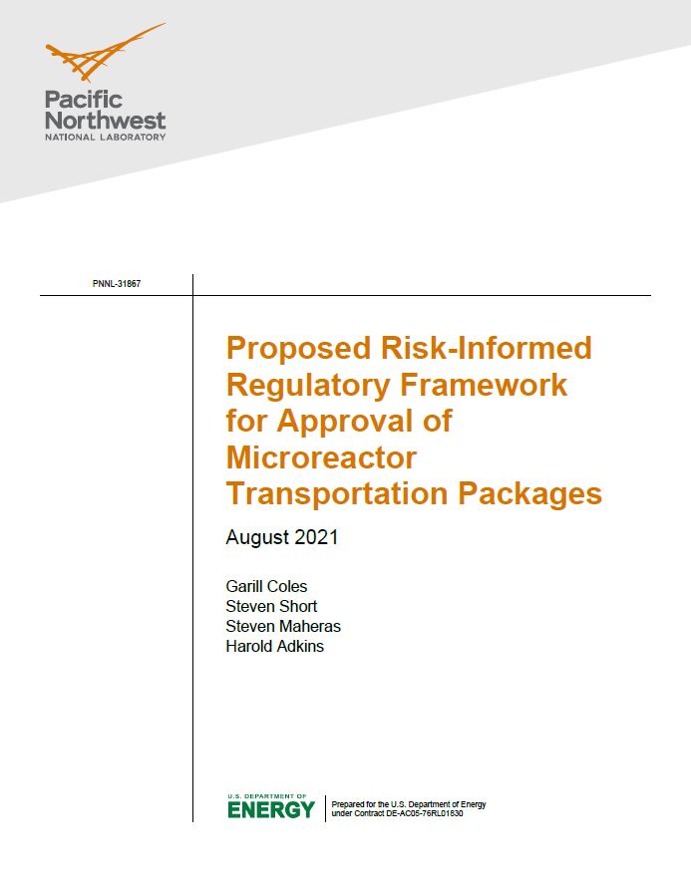
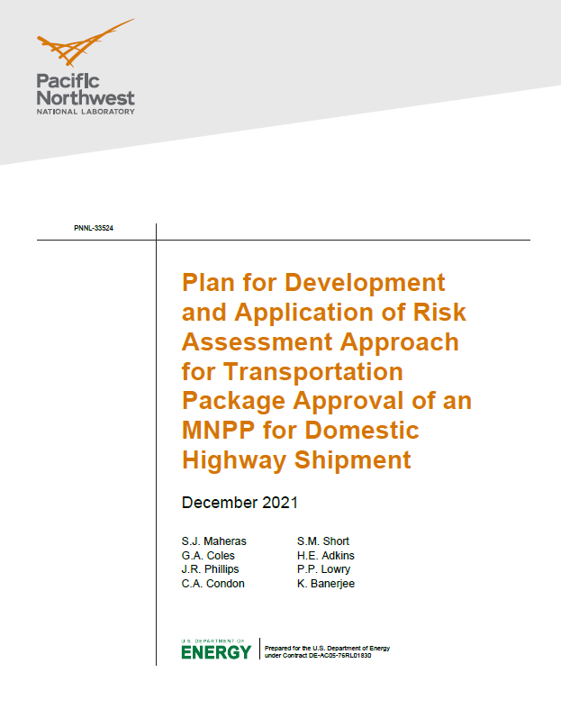
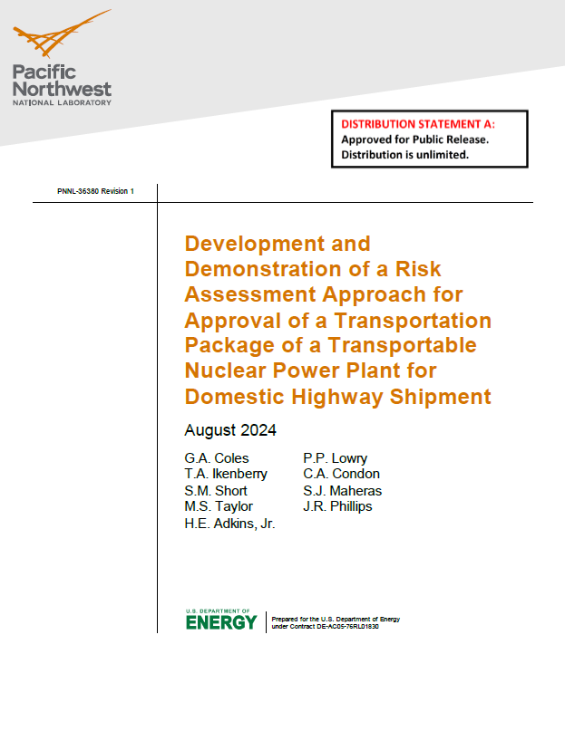
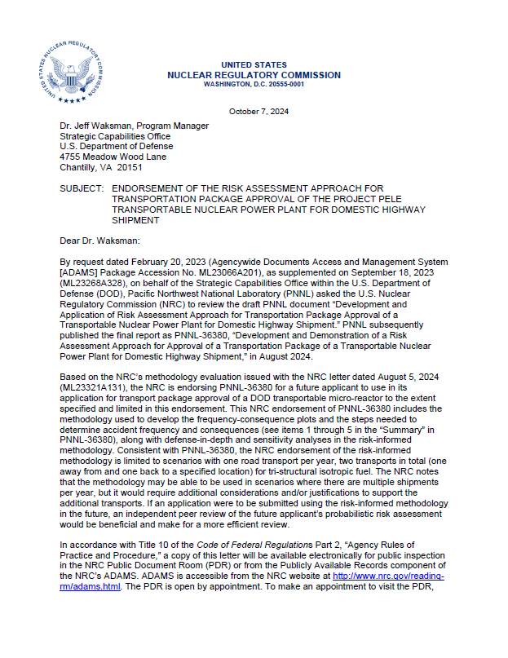
Highway Risk-Informed Transportation Package Approval Process
Risk-Informed Transportation Package Approval for Domestic Highway Shipment of a TNPP Methodology Document
  Final report published and docketed
    ML24268A101 - 1. PNNL-36380 Rev 1, "Development and Demonstration of a Risk Assessment Approach for Approval of a Transportation Package of a Transportable Nuclear Power Plant for Domestic Highway Shipment August 2024" (8/21/2024)
    ML24268A102 - 2. List of Updates to 2024 Version of Pele PRA Report (8/21/2024)
  Endorsement letter published and docketed
    Endorsement of the Risk Assessment Approach for Transportation Package Approval of the Project Pele Transportable Nuclear Power Plant for Domestic Highway Shipment. Docket No. 71-9396. U.S. Nuclear Regulatory Commission. Washington, D.C. October 7, 2024. https://www.nrc.gov/docs/ML2427/ML24271A054.pdf

Slide 30
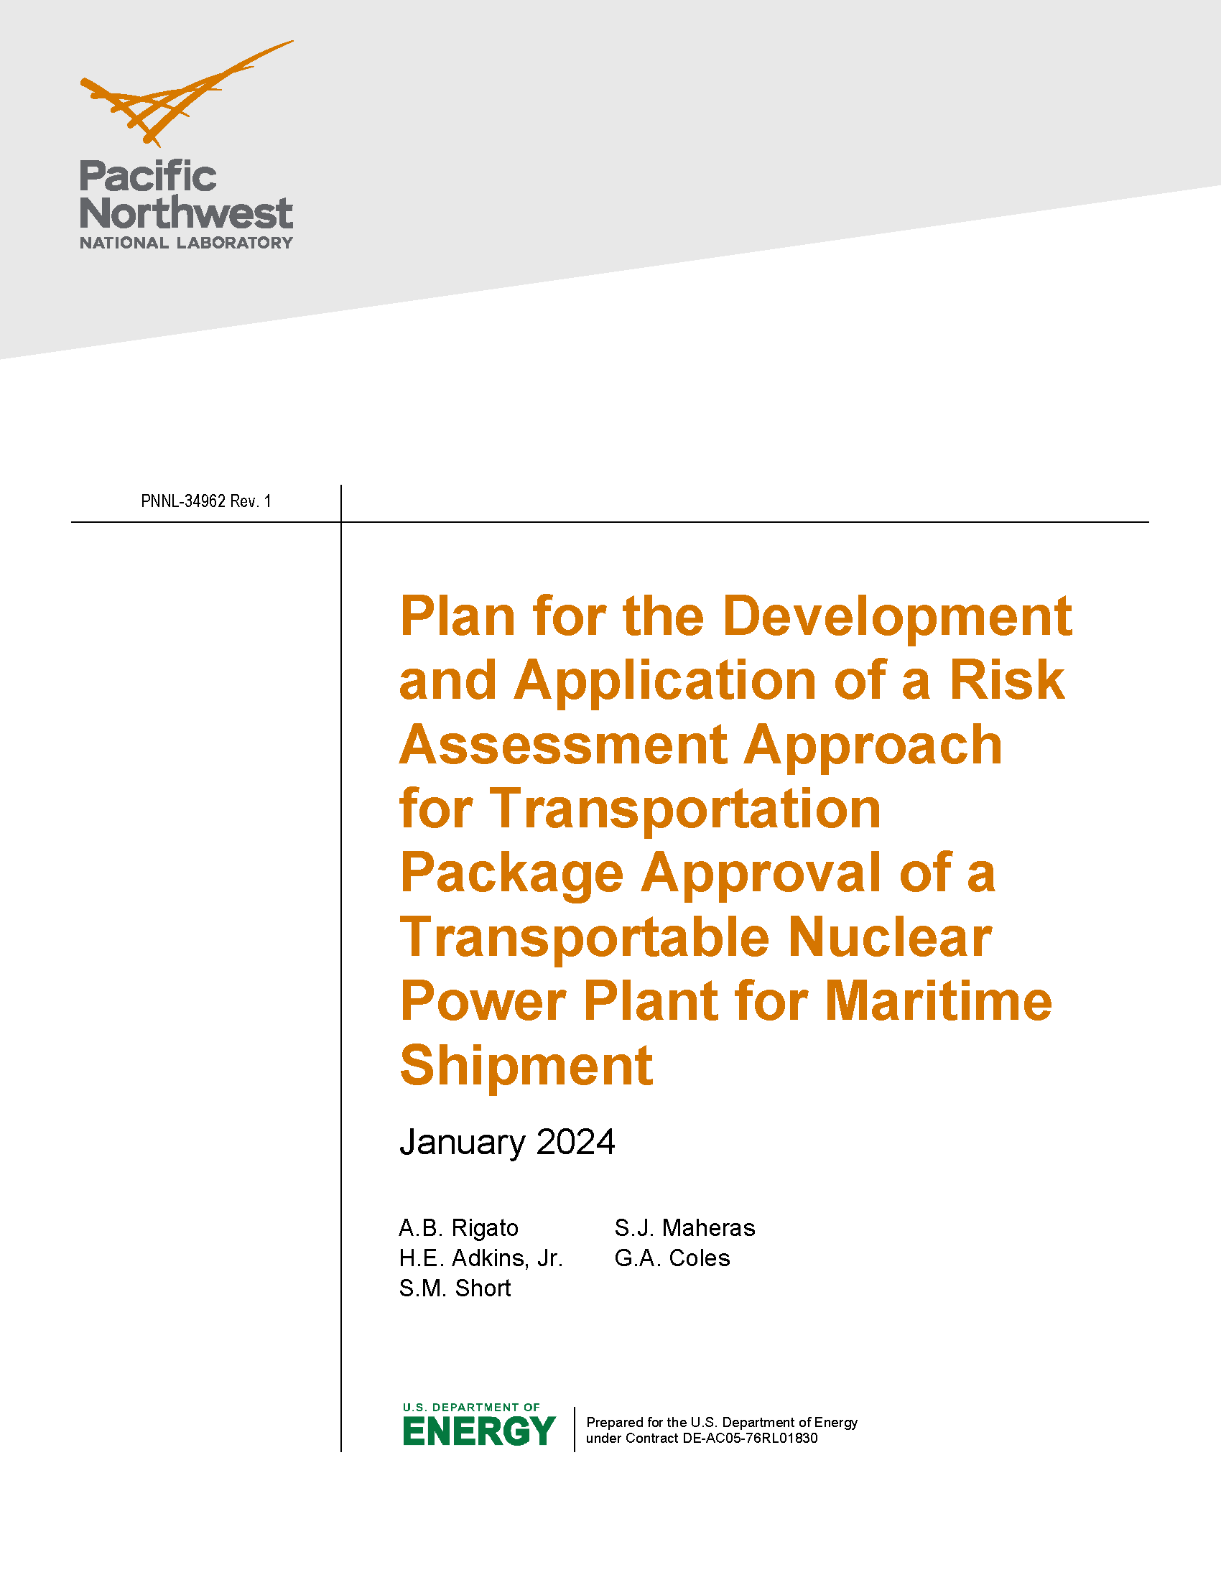
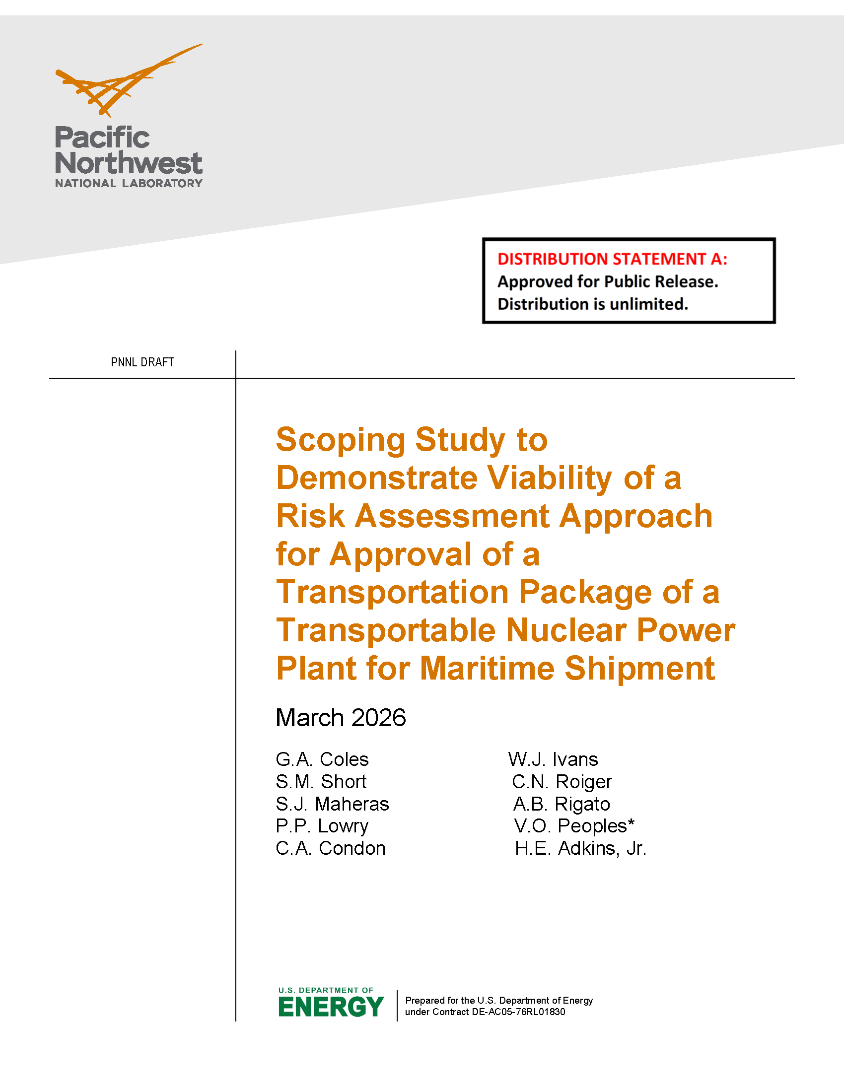
Maritime Risk-Informed Transportation Package Approval Scoping Study
Risk-Informed Transportation Package Approval for OCONUS Maritime Shipment of a TNPP Methodology Document
  Completed draft document and submitted to NRC on 8/18/2025 for review
  Engagement meetings with NRC commenced in March
  Applied concepts and lessons learned from the domestic highway study to maritime shipment with input from X-Energy on TNPP design and Nuclear Transport Solutions on transport ship design and on accident data to support viability of an endorsed approach for approval of maritime shipment of a TNPP package
    Revamped a Next Generation Nuclear Plant (NGNP) model to perform MAR predictive evaluations with X-Energy (featured in a topical submitted to NRC to support installation energy initiatives)
  Endorsement targeted for end of CY26
  Documents available at
    https://www.nrc.gov/docs/ML2607/ML26078A347.html
    http://www.pnnl.gov/main/publications/external/technical_reports/PNNL-34962Rev1.pdf

Slide 31
Questions
&
Discussion

