Slide 1
U.S. Nuclear Waste Technical Review Board
Council of State Governments–Northeast
Daniel Ogg, Executive Director
May 21, 2025

Slide 2
Independent Federal Agency
The U.S. Nuclear Waste Technical Review Board (Board) was established by Congress as an independent federal agency in the 1987 amendments to the Nuclear Waste Policy Act (NWPA)

Slide 3
Board Mission
The Board evaluates the “technical and scientific validity” of U.S. Department of Energy (DOE) activities related to implementing the NWPA
These DOE activities include:
Packaging of spent nuclear fuel (SNF) and high-level radioactive waste (HLW) and transportation of the wastes to a storage or disposal facility
Site characterization, design, and development of facilities for disposing of SNF or HLW

Slide 4
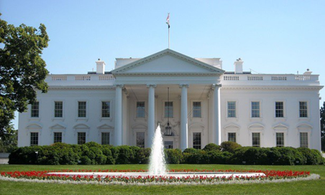
Board Members
At full strength, the Board has eleven members:
Candidates nominated by National Academy of Sciences solely on the basis of eminence and expertise
Appointed by the President
Serve part time for four-year, staggered terms
May serve until replaced
Supported by permanent, full-time staff

Slide 5
Current Board Members
Peter Swift, Ph.D., Chair – Consultant, Risk Assessment
Other members were asked to resign effective January 23, 2025, by the incoming Administration; official status of these Board members has not yet been confirmed
[two vacant positions]

Slide 6
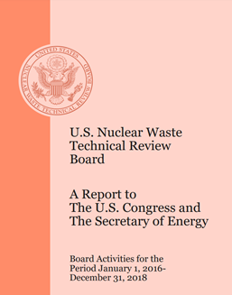
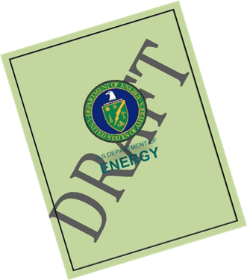
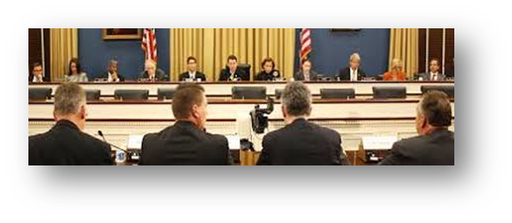
About the Board
Conducts independent and objective peer review of DOE activities
Required to report its findings, conclusions, and recommendations to the U.S. Congress and the Secretary of Energy
By law, has access to draft DOE documents – allows Board recommendations to be made during decision-making, not after the fact
Provides congressional testimony at the invitation of Congress

Slide 7
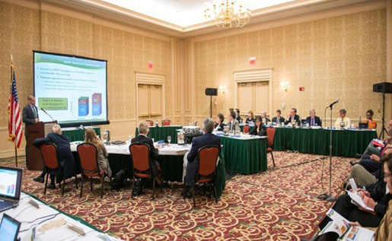
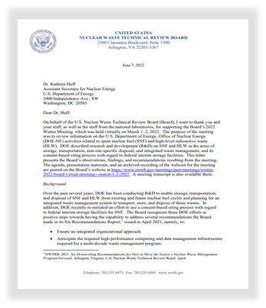
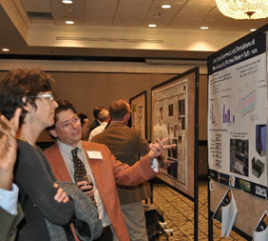
About the Board (cont.)
Holds public meetings several times per year in different geographic locations in the United States
The meetings are webcast
Provides technical and scientific comments in letters or reports to DOE following public meetings
Makes all official documents (meeting transcripts and materials, reports, correspondence, congressional testimony, etc.) available on its website: www.nwtrb.gov

Slide 8
Recent Board Meetings
Spring 2024 Meeting – May 21-22, 2024
Location: Knoxville, Tennessee / Hybrid
Topic: DOE non-site-specific R&D on waste disposal in crystalline rock types and R&D on fuel degradation after disposal
Summer 2024 Meeting – August 29, 2024
Location: North Augusta, South Carolina / Hybrid
Topic: DOE management and plans for disposal of DOE spent nuclear fuel (SNF)

Slide 9
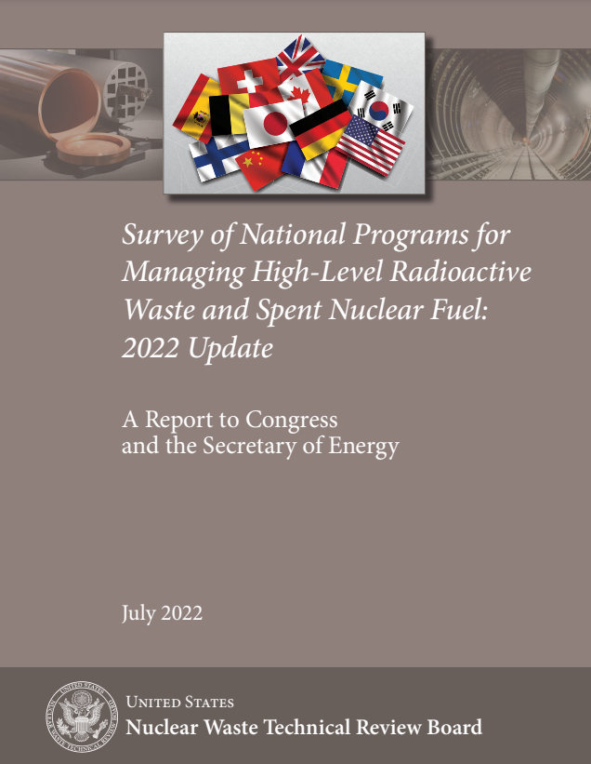
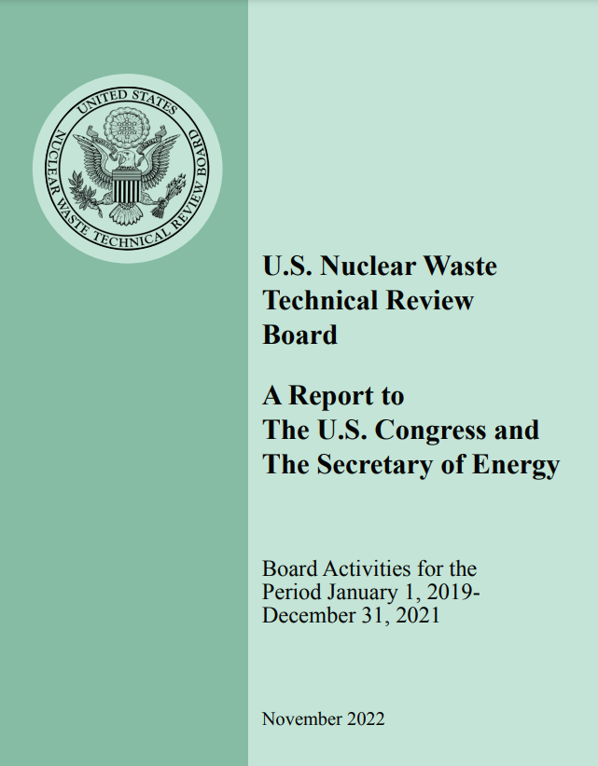
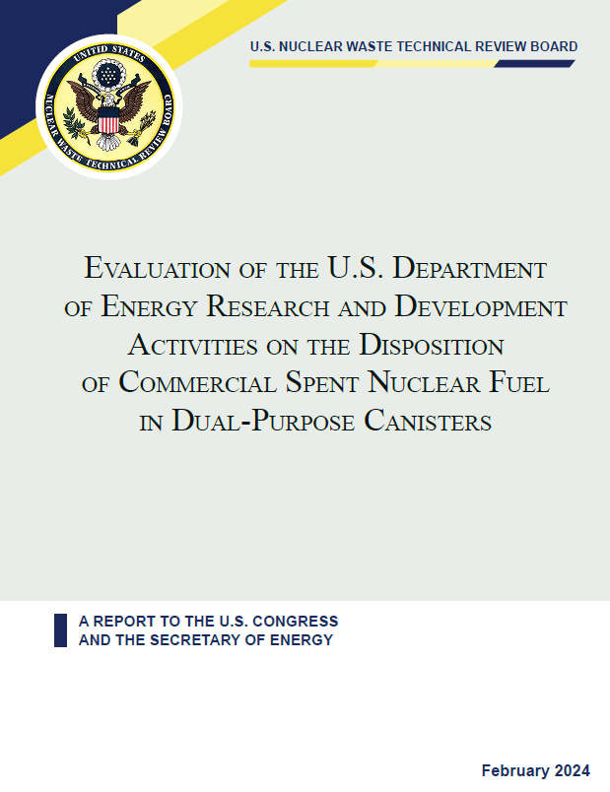
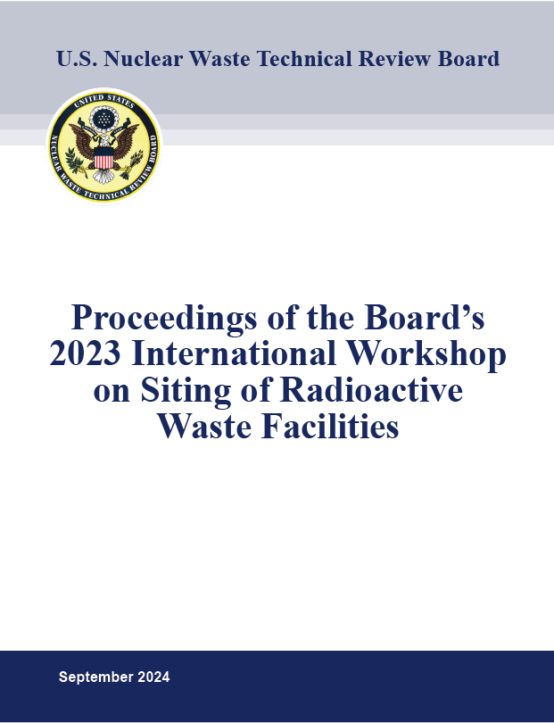
Recent Board Reports
Survey of National Programs for Managing High-Level Radioactive Waste and Spent Nuclear Fuel: 2022 Update – July 2022
Report to the U.S. Congress and the Secretary of Energy: Board Activities for the Period January 1, 2019 - December 31, 2021 – November 2022
Evaluation Of The U.S. Department Of Energy Research And Development Activities On The Disposition Of Commercial Spent Nuclear Fuel In Dual-Purpose Canisters – February 2024
Proceedings of the Board 2023 International Workshop of Siting of Radioactive Waste Facilities – September 2024

Slide 10
Board Letter of March 18, 2025
Addressed to the U.S. Congress and the Secretary of Energy
Includes a finding, two conclusions, and a recommendation regarding the nuclear waste management program in the U.S., and the need for a deep geologic repository for SNF and HLW
The timing of the letter was motivated by the change of Administration, a new Congress, and a new Secretary of Energy

Slide 11
Board Letter (cont.)
Finding: The nation needs one or more deep geologic repositories for permanent disposal of domestic spent nuclear fuel and high-level radioactive waste.
Conclusion 1: The Department of Energy does not have an effective program, as of December 2024, that could lead to a deep geologic repository.
Conclusion 2: The lack of an effective repository program brings a high risk that ongoing efforts to site one or more federal interim storage facilities will ultimately be unsuccessful.
Recommendation: The Board recommends that the Department of Energy take the steps necessary, working with Congress as needed, to create a workable pathway to site, license, construct, and operate a geologic repository for the permanent disposal of spent nuclear fuel and high-level radioactive waste.

