Slide 1


Rural Population Loss and Revitalization
Council of State Governments East Policy Summit
Kyle C. Kopko, Ph.D., J.D.
Executive Director, Center for Rural Pennsylvania
Chairman, Pennsylvania Rural Population Revitalization Commission
kkopko@rural.pa.gov
Office: (717) 787-9555

Slide 2
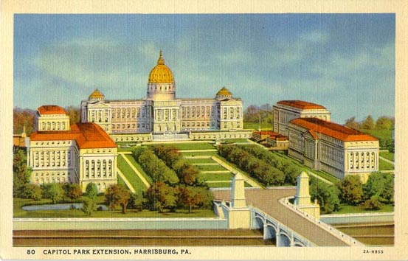
    Legislative research agency of the Pennsylvania General Assembly
    (Act 16, 1987 & Act 12, 2009)
    Mandates
    Administer grants to conduct research on rural conditions.
    Maintain a database on rural conditions and needs.
    Recent Legislative Hearings:
    Rural Hospital and Health Care Sustainability, Rural Population Change, Child Care Access in Rural Pennsylvania, Opioid and Substance Use Disorder Crisis in Pennsylvania, and more...

Slide 3

Rural/Urban Definition

Slide 4
Pennsylvania Rural and Urban Counties, 2020
Data Source: U.S. Census Bureau.

Slide 5

Three Demographic Trends Shaping Pennsylvania
Slow population growth
Aging and more diverse population
Inability to grow naturally

Slide 6

Slow Population Change

Slide 7
Stagnant Population Change in Pennsylvania,
1920 to 2050 (Projected)
(In Millions)
Data Sources: U.S. Census Bureau and the Pennsylvania State Data Center.

Slide 8
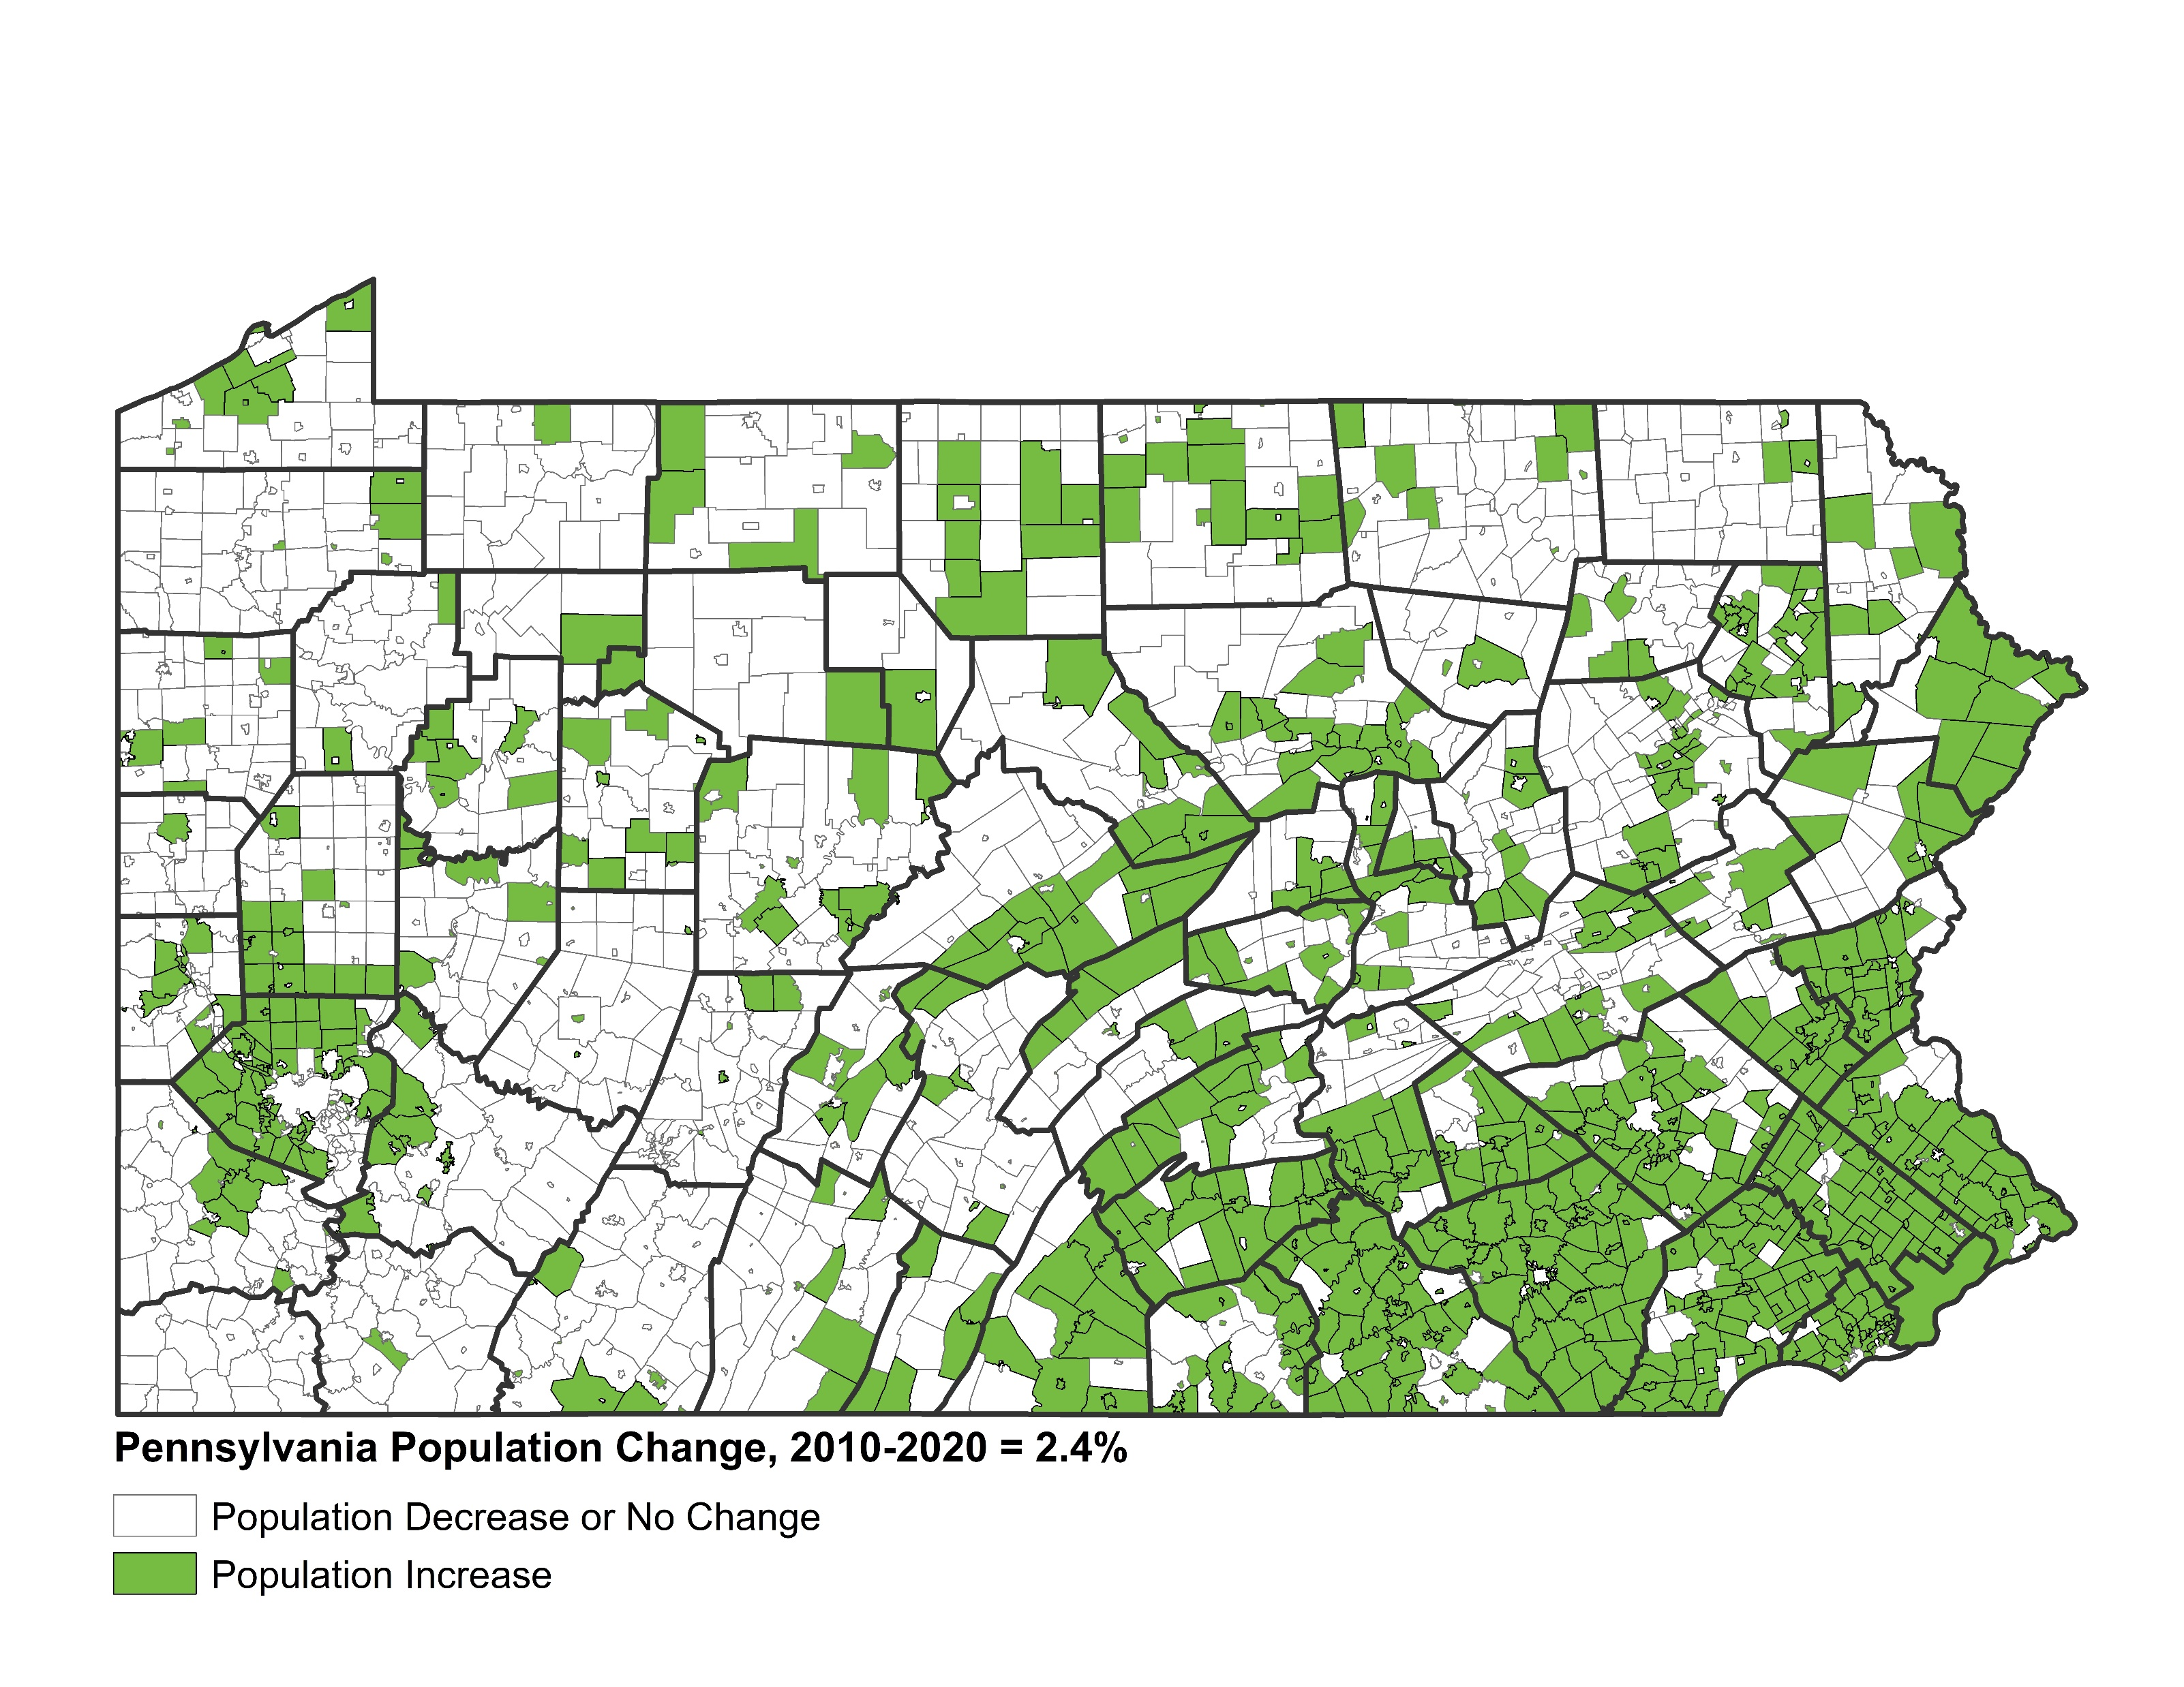
Population Change by Municipality,
2010 to 2020
Data Source: U.S. Census Bureau.

Slide 9
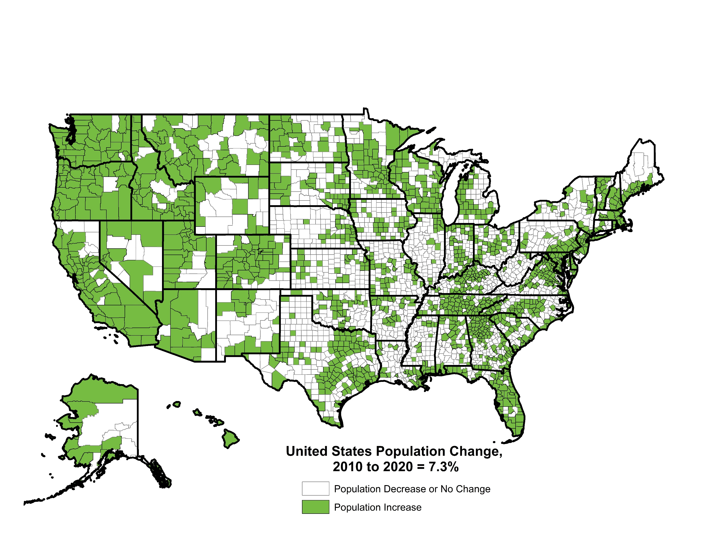
Population Change by County, 2010 to 2020
Data Source: U.S. Census Bureau.

Slide 10
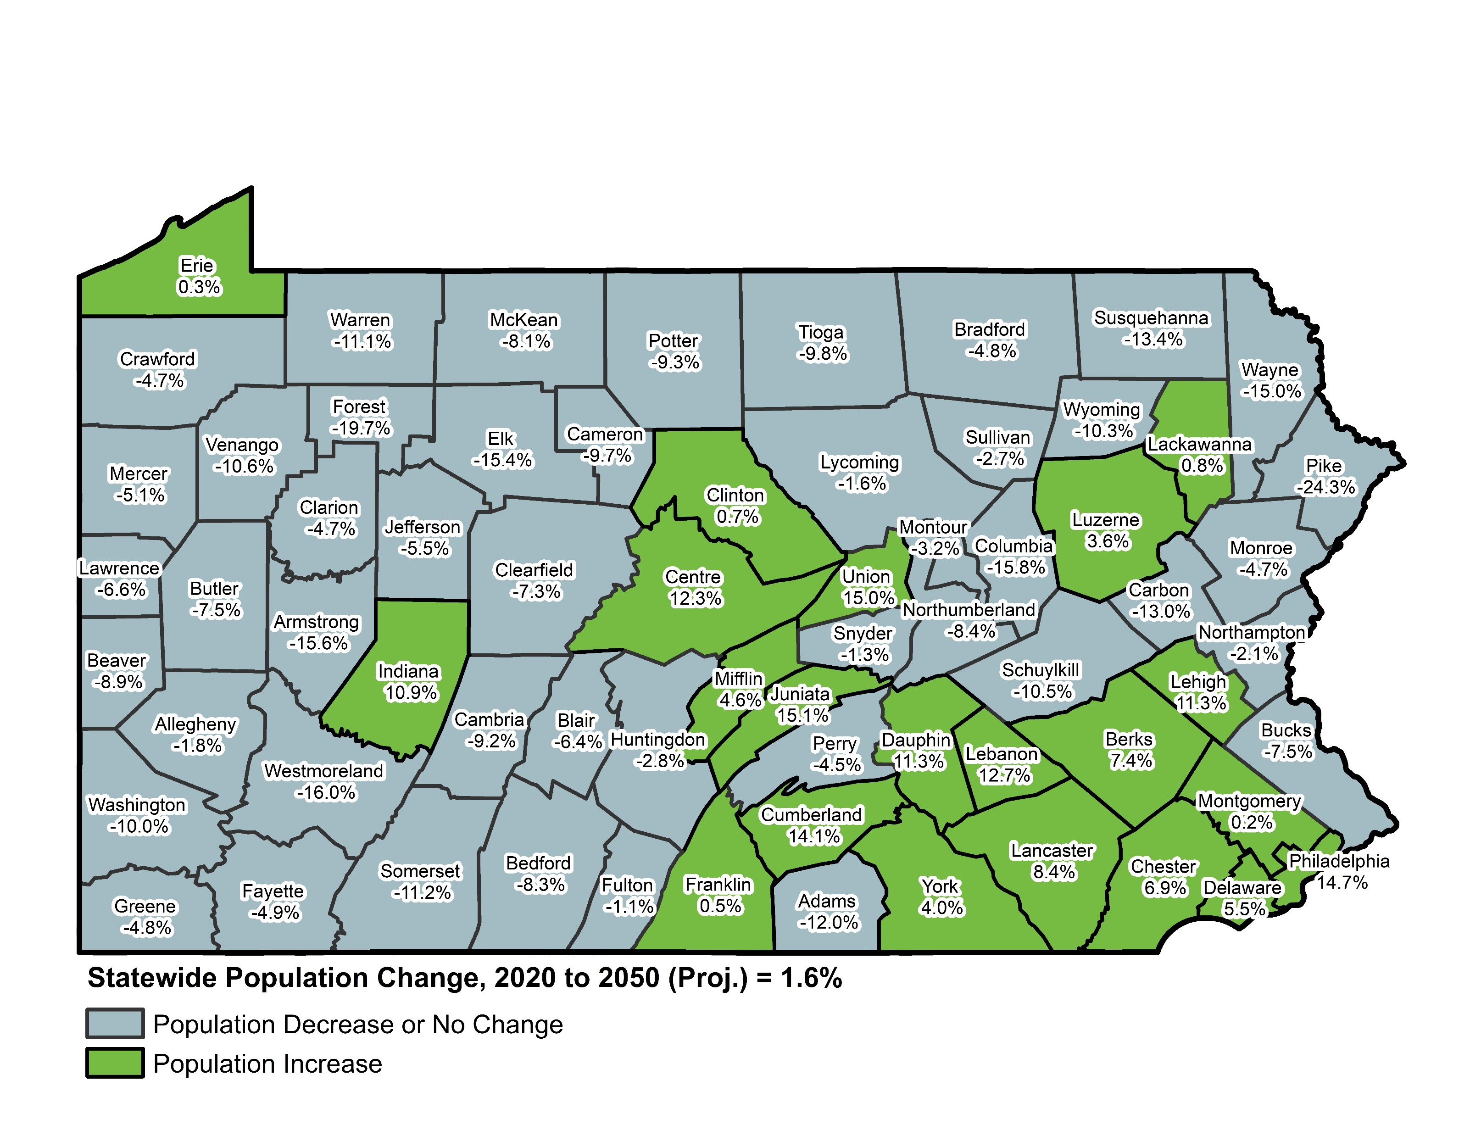
Projected Population Change, 2020 to 2050
Data Source: Pennsylvania State Data Center.

Slide 11
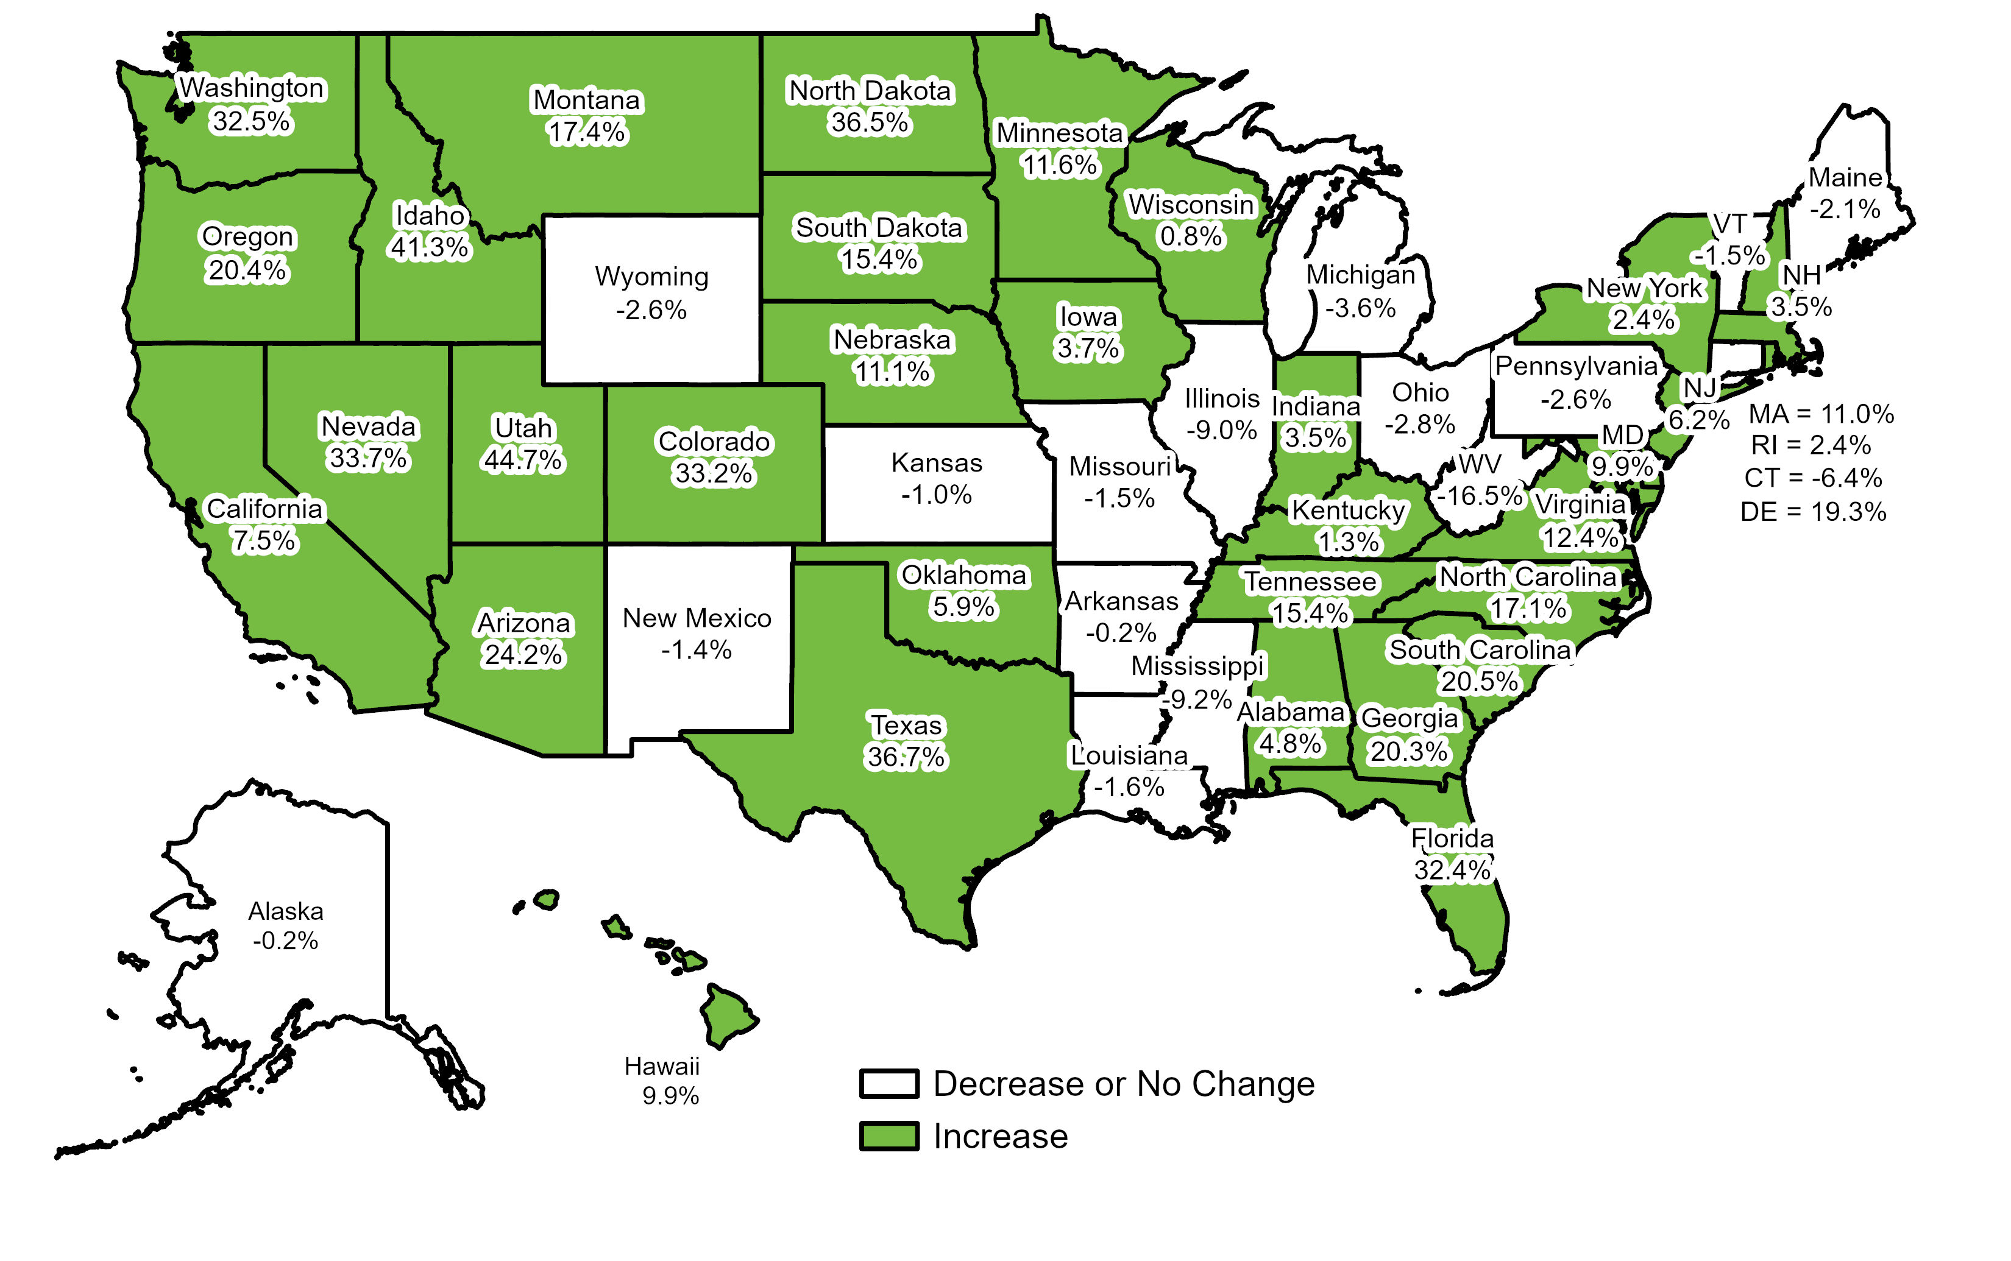
Projected Change in Population by State from 2020 to 2050
United States = 12.2%
Data Source: University of Virginia, Weldon Cooper Center for Public Service.

Slide 12
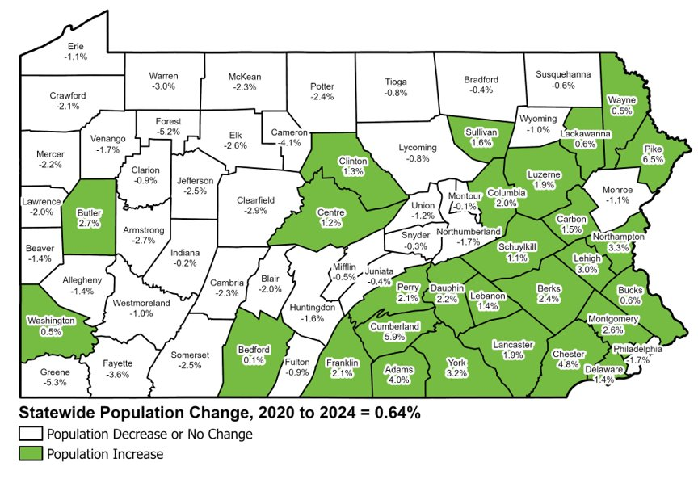
Population Change by County, 2020 to 2024
Data Source: U.S. Census Bureau.
Population Change, 2020 to 2024
PA Statewide: +82,600 (+0.64%)
Rural PA: -12,200 (-0.36%)
Urban PA: +94,800 (+1.00%)
Notes:
Urban: 1%
Rural: -.3%

Slide 13
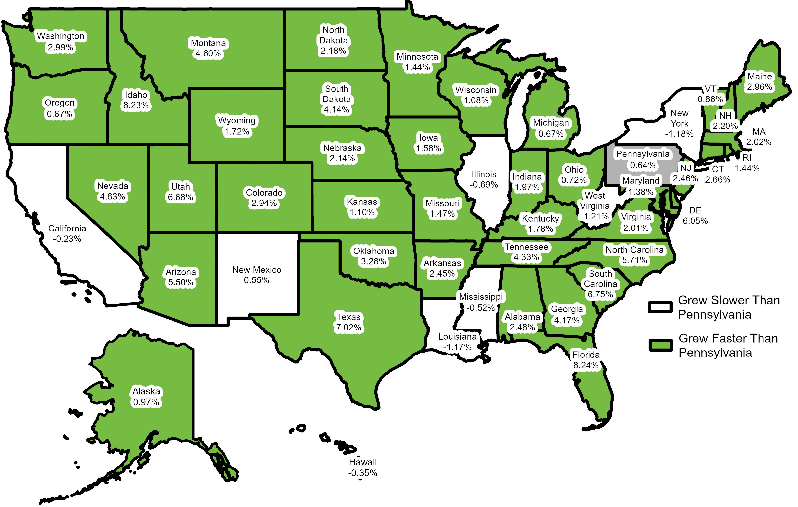
Percent Change in Population by U.S. State, 2020 to 2024
United States = 2.6%
Data Source: 2024 Population Estimates, U.S. Census Bureau.

Slide 14

Older and More Diverse Population

Slide 15
Generational Cohorts in Pennsylvania, 2020
Generation Defined by Pew Research Center. Data Source: 2020 Census, U.S. Census Bureau.
T.B.A. Generation
(Born After 2012) 1.25 Million
(10%)
Silent Generation
(Born Before 1946)
1.05 Million
(8%)
Baby Boomers
(1946-1964)
3.10 Million
(24%)
Generation X (Born 1964-1980)
2.52 Million
(19%)
Millennials
(Born 1981-1996) 2.63 Million
(20%)
Generation Z
(Born 1996-2012) 2.45 Million
(19%)

Slide 16
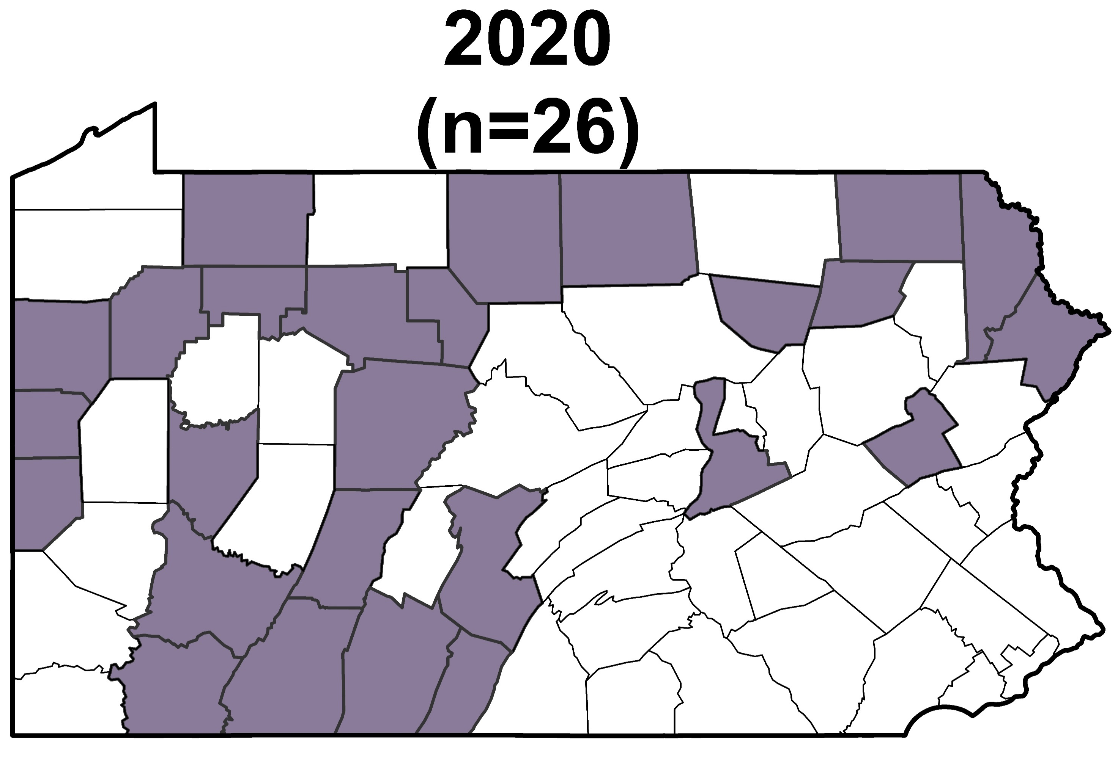
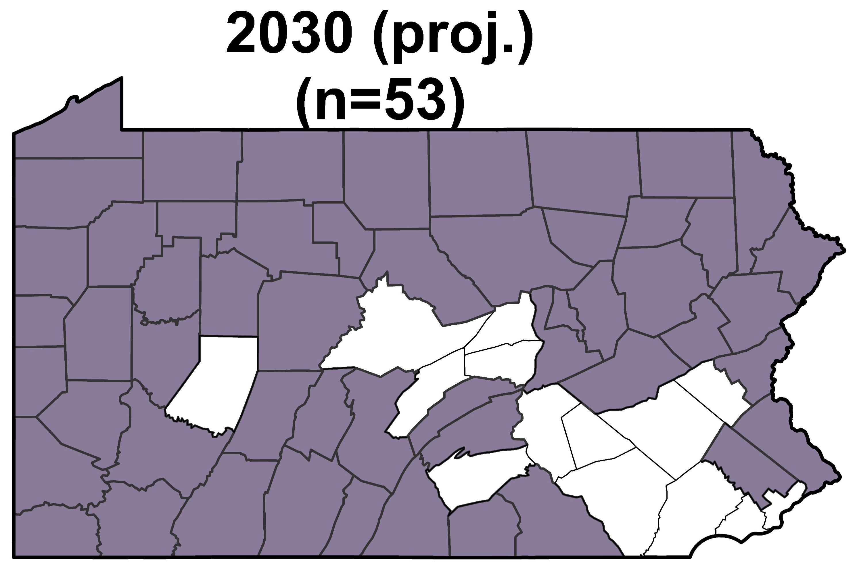
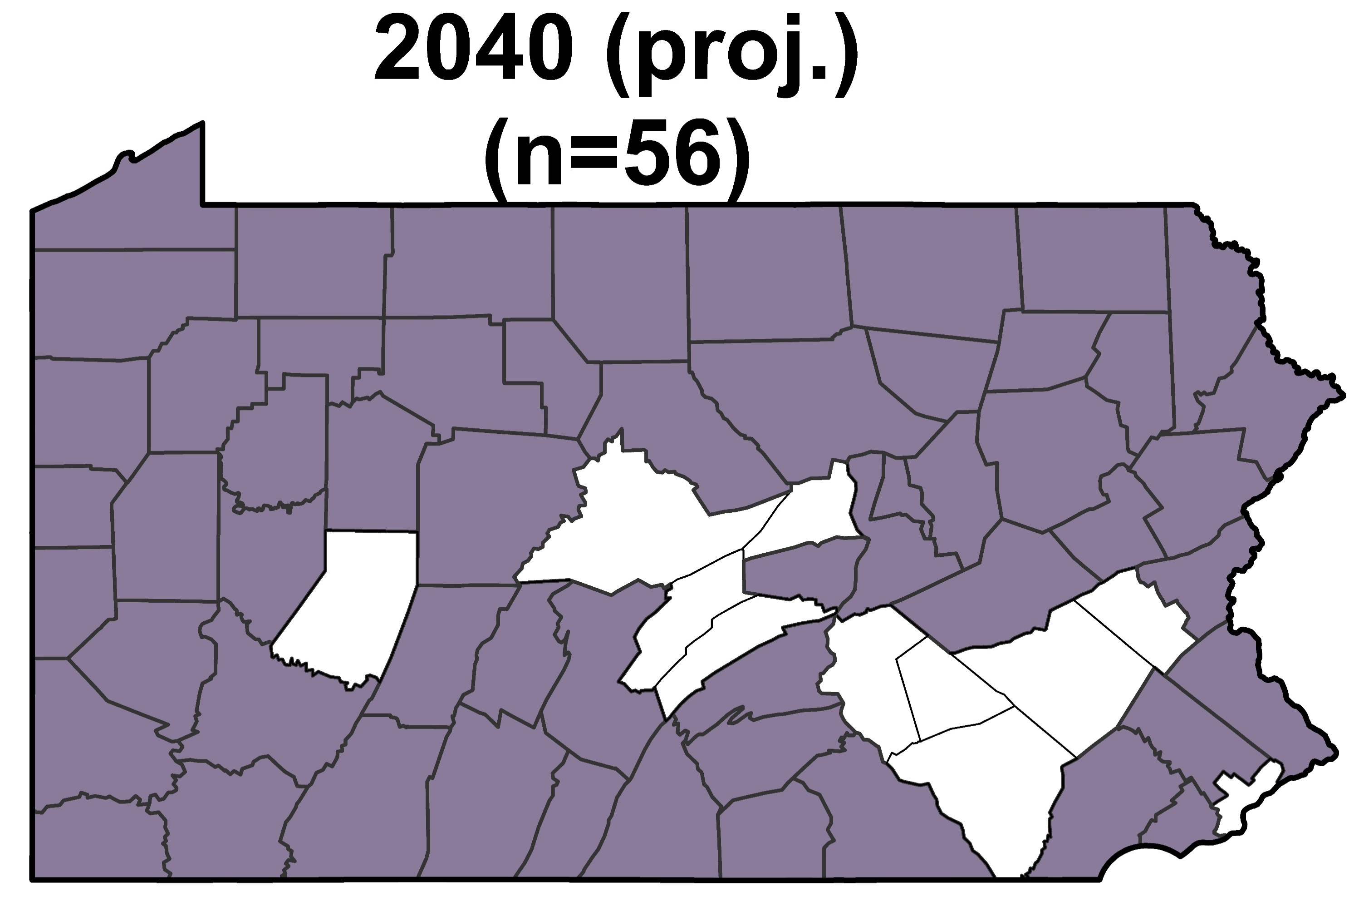
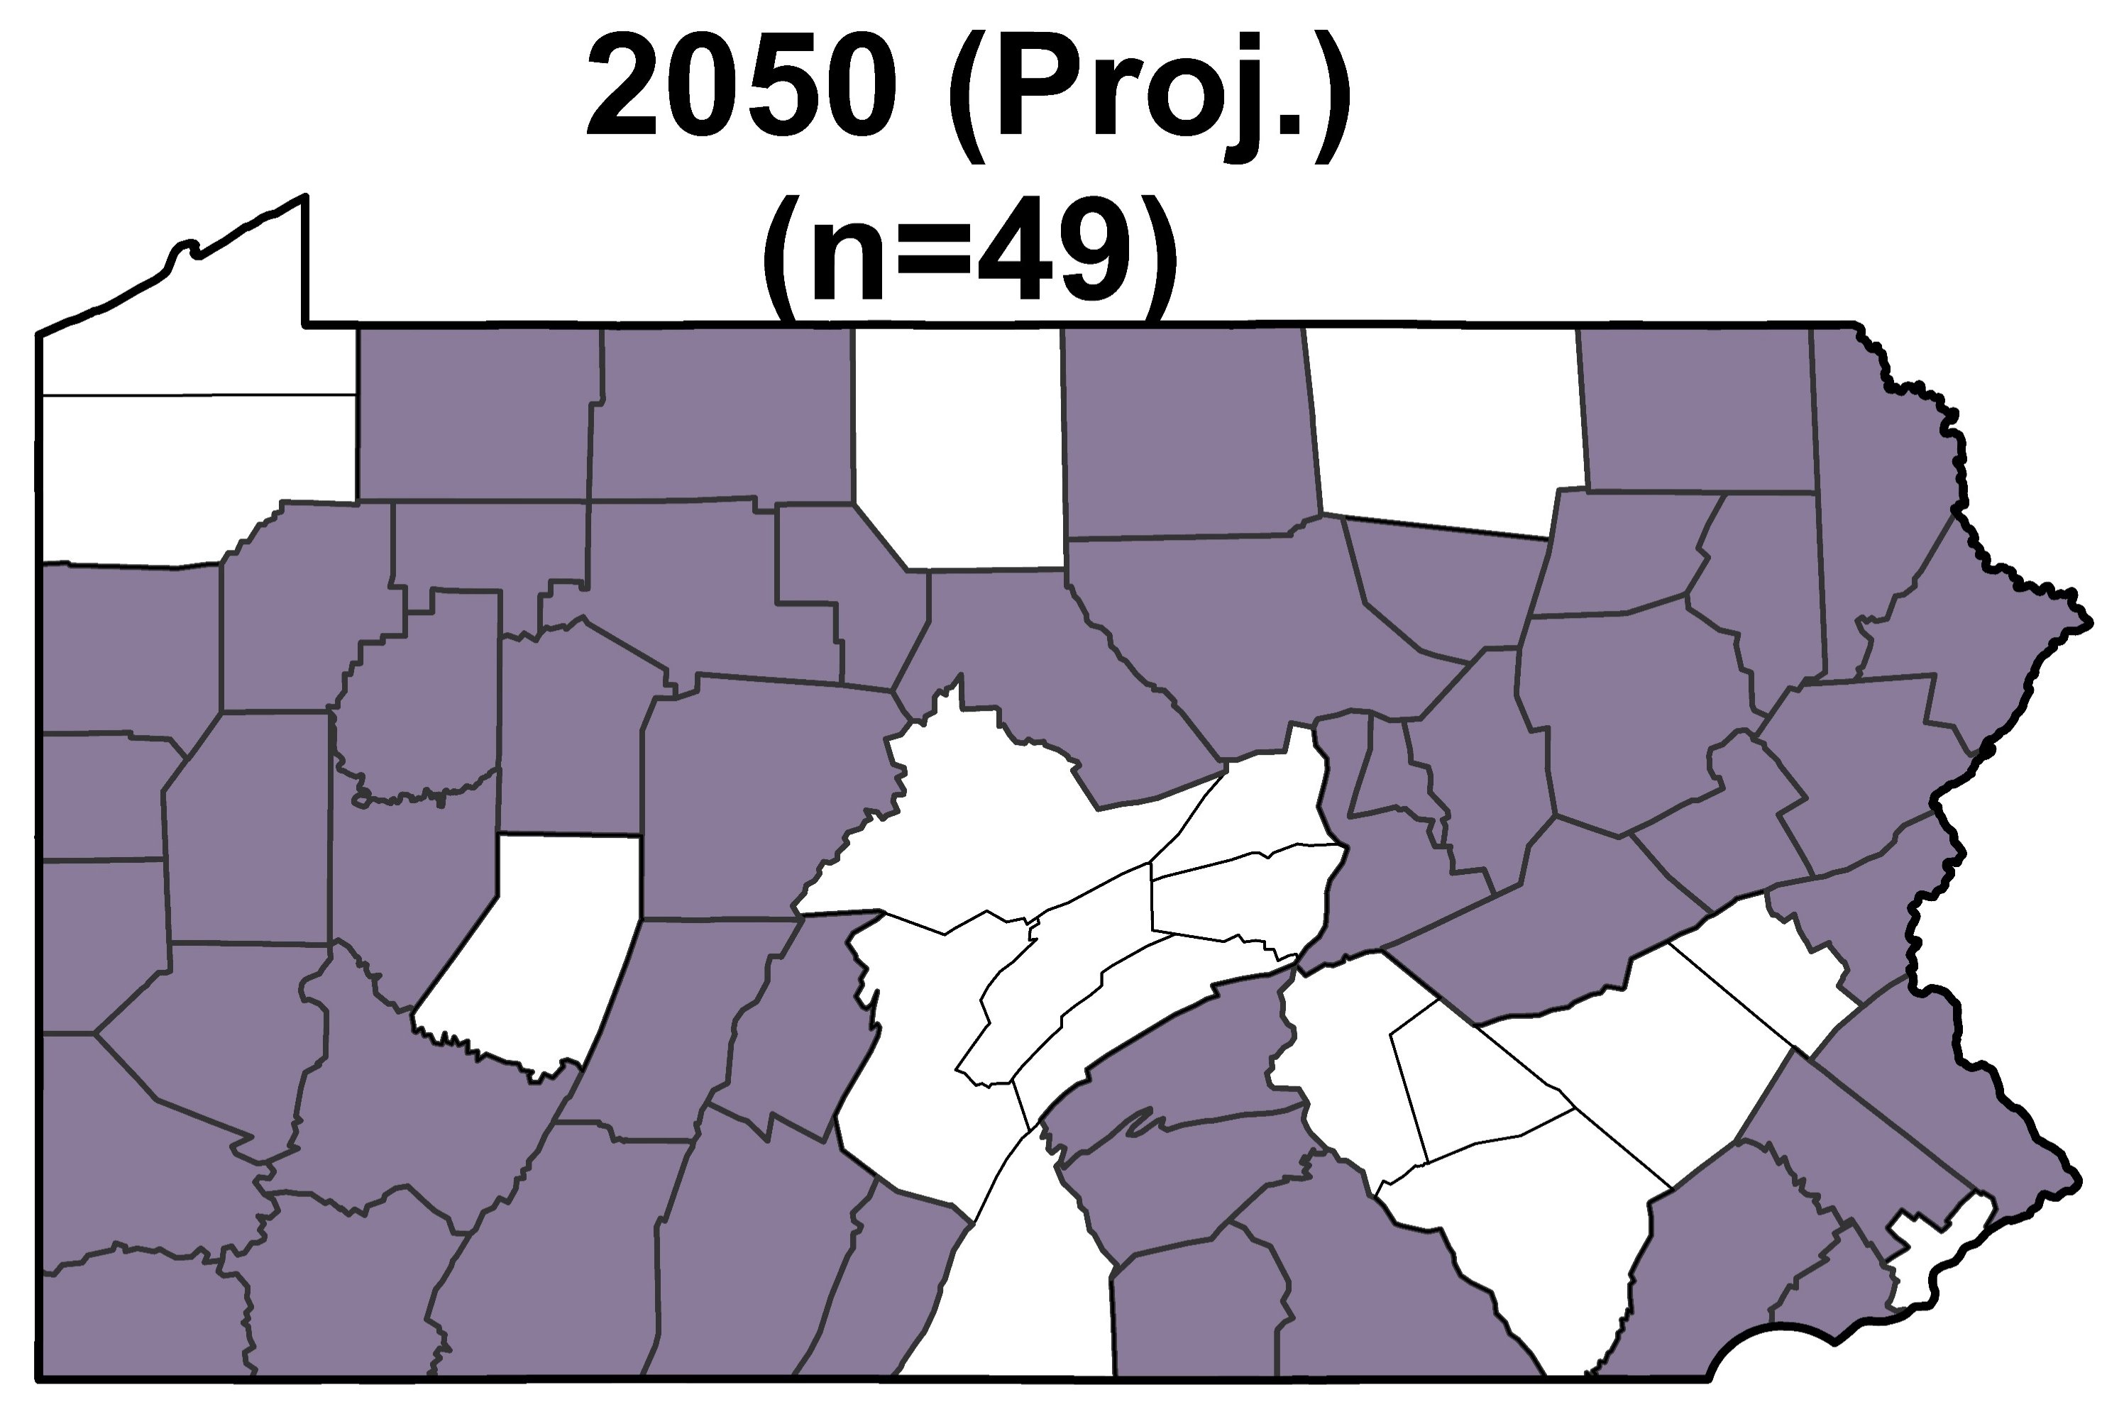
Number of Youth and Senior Citizens in
Pennsylvania, 1950 to 2050 (Projected)
Shaded counties have more people 65+ than people <20 years old
Data Sources: U.S. Census Bureau and the Pennsylvania State Data Center.

Slide 17
Number of People of Color by Municipality,
2000 and 2020
Number of People of Color, 2000
(n=1,966,809)
1 Dot = 10 People
Number of People of Color, 2020
(n=3,463,572)
People of color include all people who are not non-Hispanic whites. Data Sources: 2000 Census, and 2020 Census, U.S. Census Bureau.
Notes:
The middle part of the state will never be “filled-in”.
There is not a lot of people of any color living in the middle part (Clinton, Cameron, Elk, Clearfield, etc.)

Slide 18
Unlikely to Grow on Our Own

Slide 19
Number of Births and Deaths in Pennsylvania, 1990 to 2023
Data Source: Pennsylvania Department of Health.

Slide 20
Number of Births and Deaths
in Pennsylvania by Urban and Rural, 1990 to 2023
Data Source: Pennsylvania Department of Health.

Slide 21
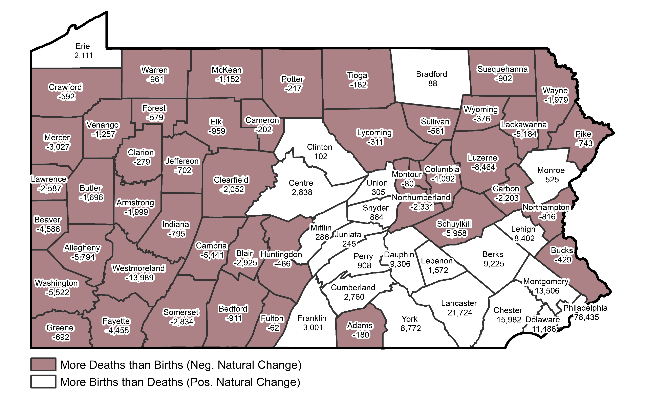
Natural Population Change
(Births Minus Deaths) by County, 2010 to 2019
Data Source: Pennsylvania Department of Health.

Slide 22
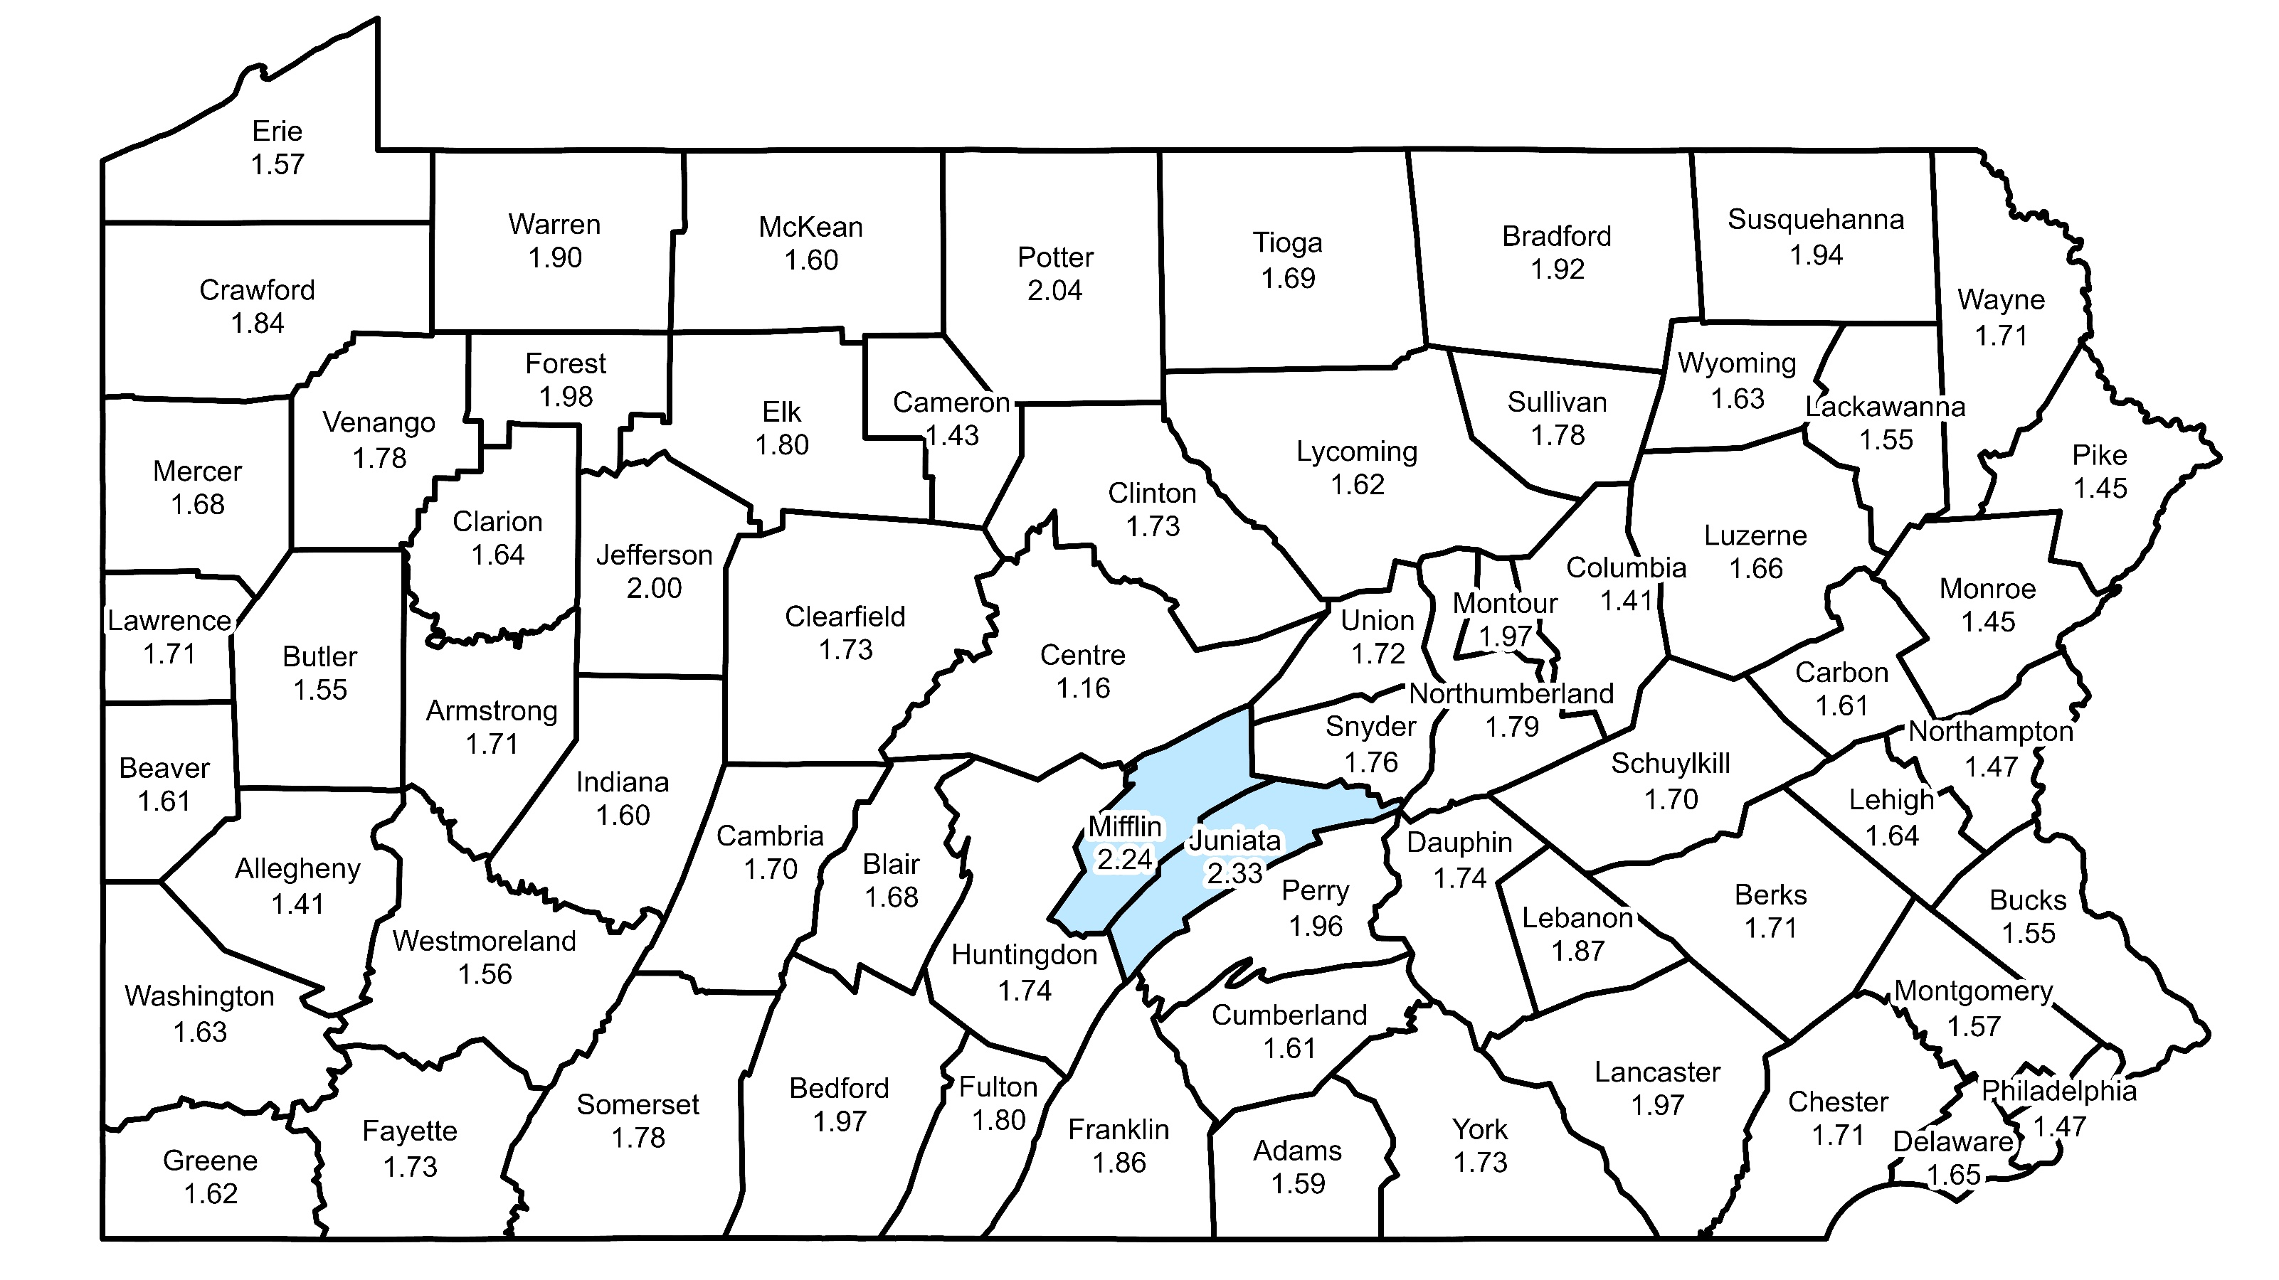
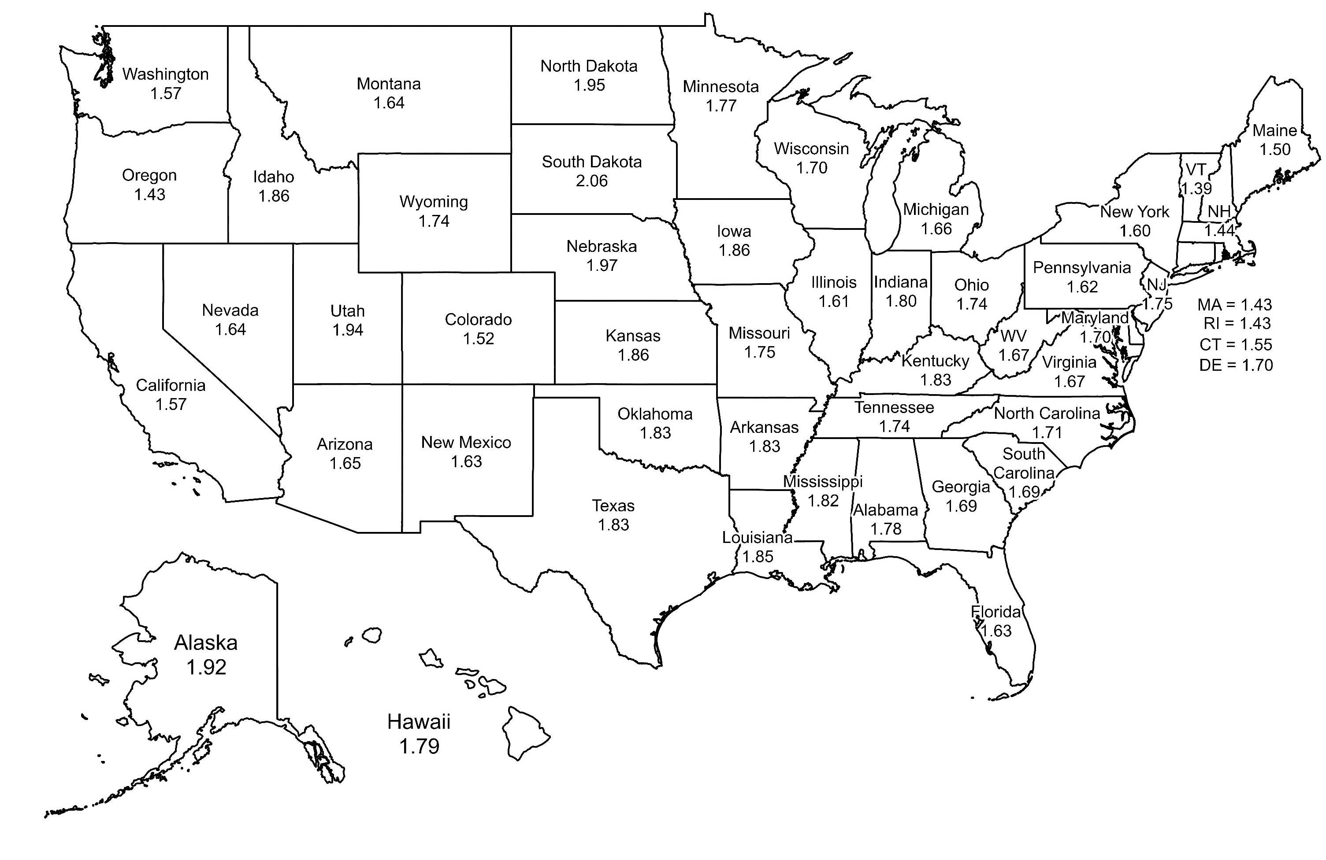
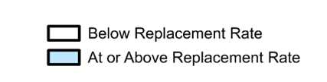
Total Fertility Rates in Pennsylvania and United States
Top Five States with the Highest Total Fertility Rates, 2018-2022
South Dakota = 2.06
Nebraska = 1.97
North Dakota = 1.95
Utah = 1.94
Alaska = 1.92
...
38. Pennsylvania = 1.62
Total Fertility Rates for United States, 2018 to 2022
Total Fertility Rates for Pennsylvania, 2019 to 2023
Total Fertility Rate Replacement Rate = 2.10+
According to the CDC, the total fertility rate (TFR) estimates the number of births that a hypothetical group of women would have over their lifetimes, based on age-specific birth rates in a given year. Replacement level for the TFR is the level at which a given generation can exactly replace itself (generally considered to be 2.1 births per woman). Data Sources: Pennsylvania Department of Health and the U.S. Centers for Disease Control and Prevention (CDC).

Slide 23
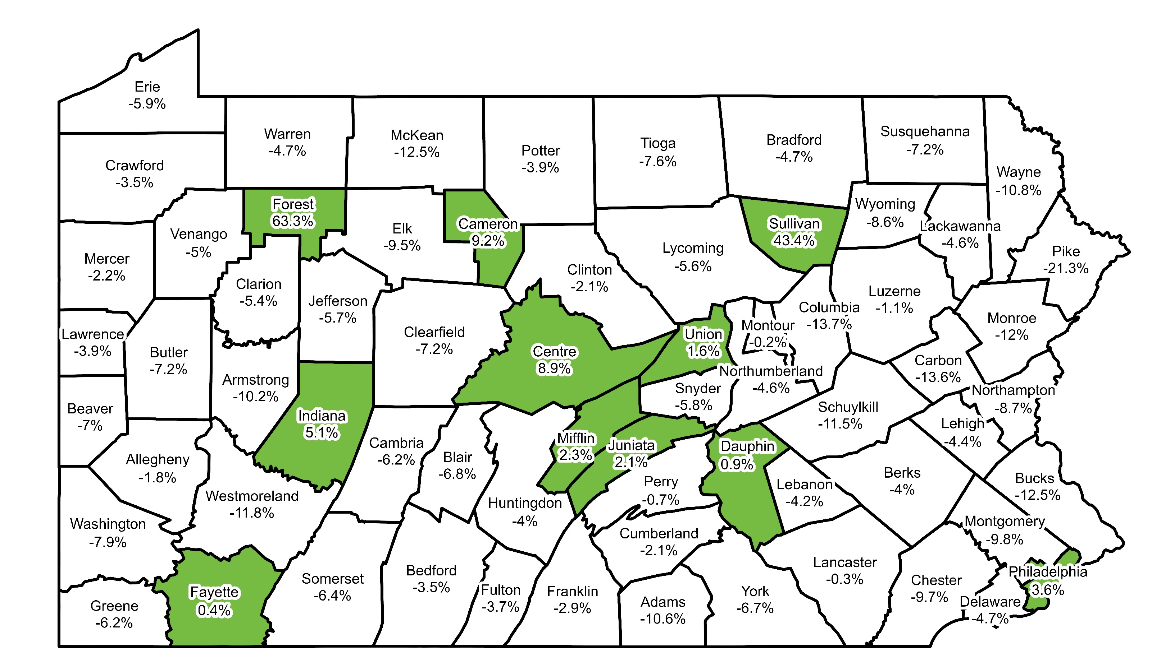
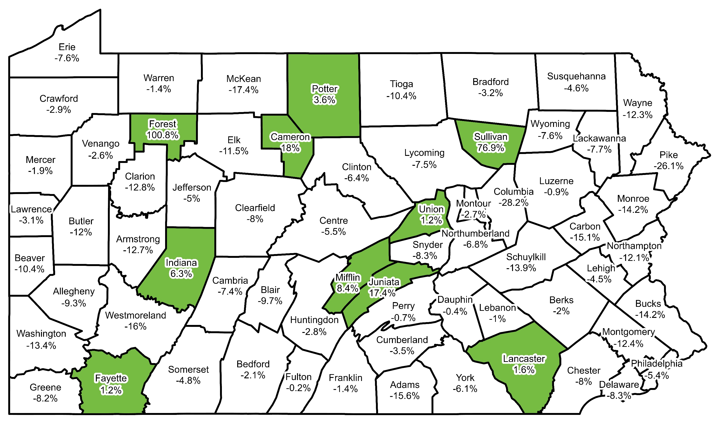
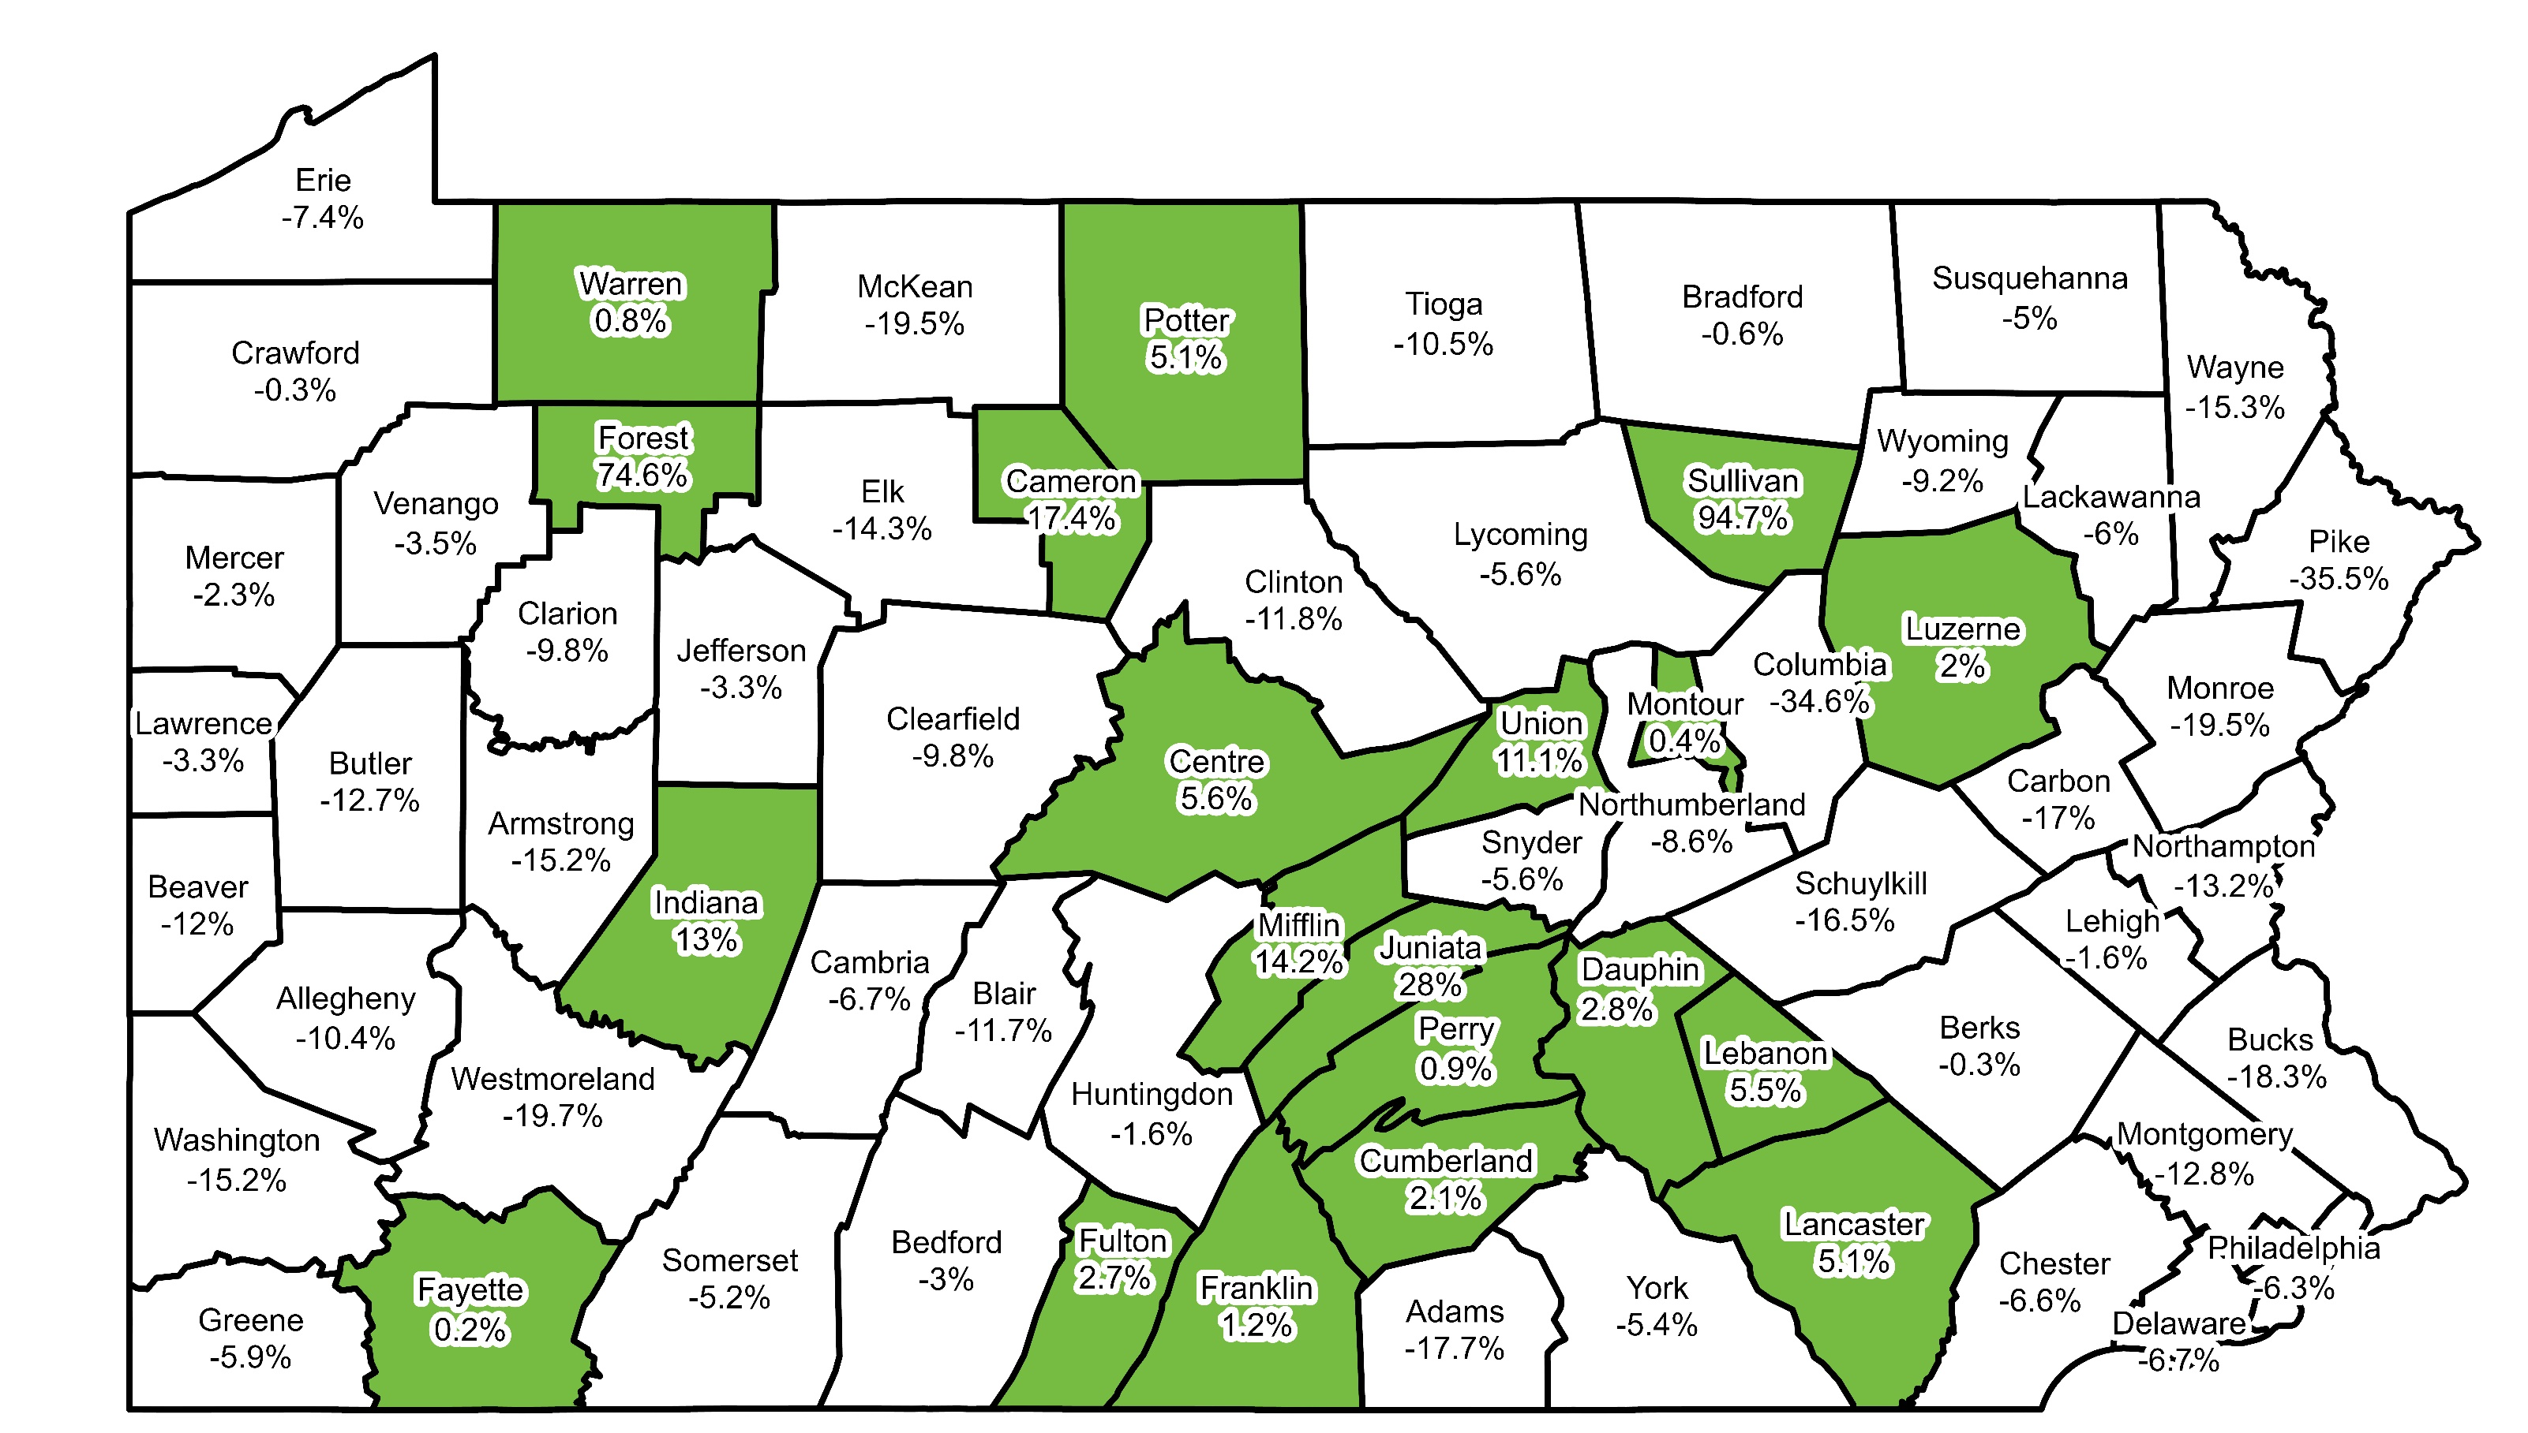

Population Projections (Ages 0 to 19)
2020 to 2030
Data Source: The Pennsylvania State Data Center.
2020 to 2040
Statewide 2020 to 2030 = -4.4%
2020 to 2050
Statewide 2020 to 2040 = -7.2%
Statewide 2020 to 2050 = -6.8%

Slide 24
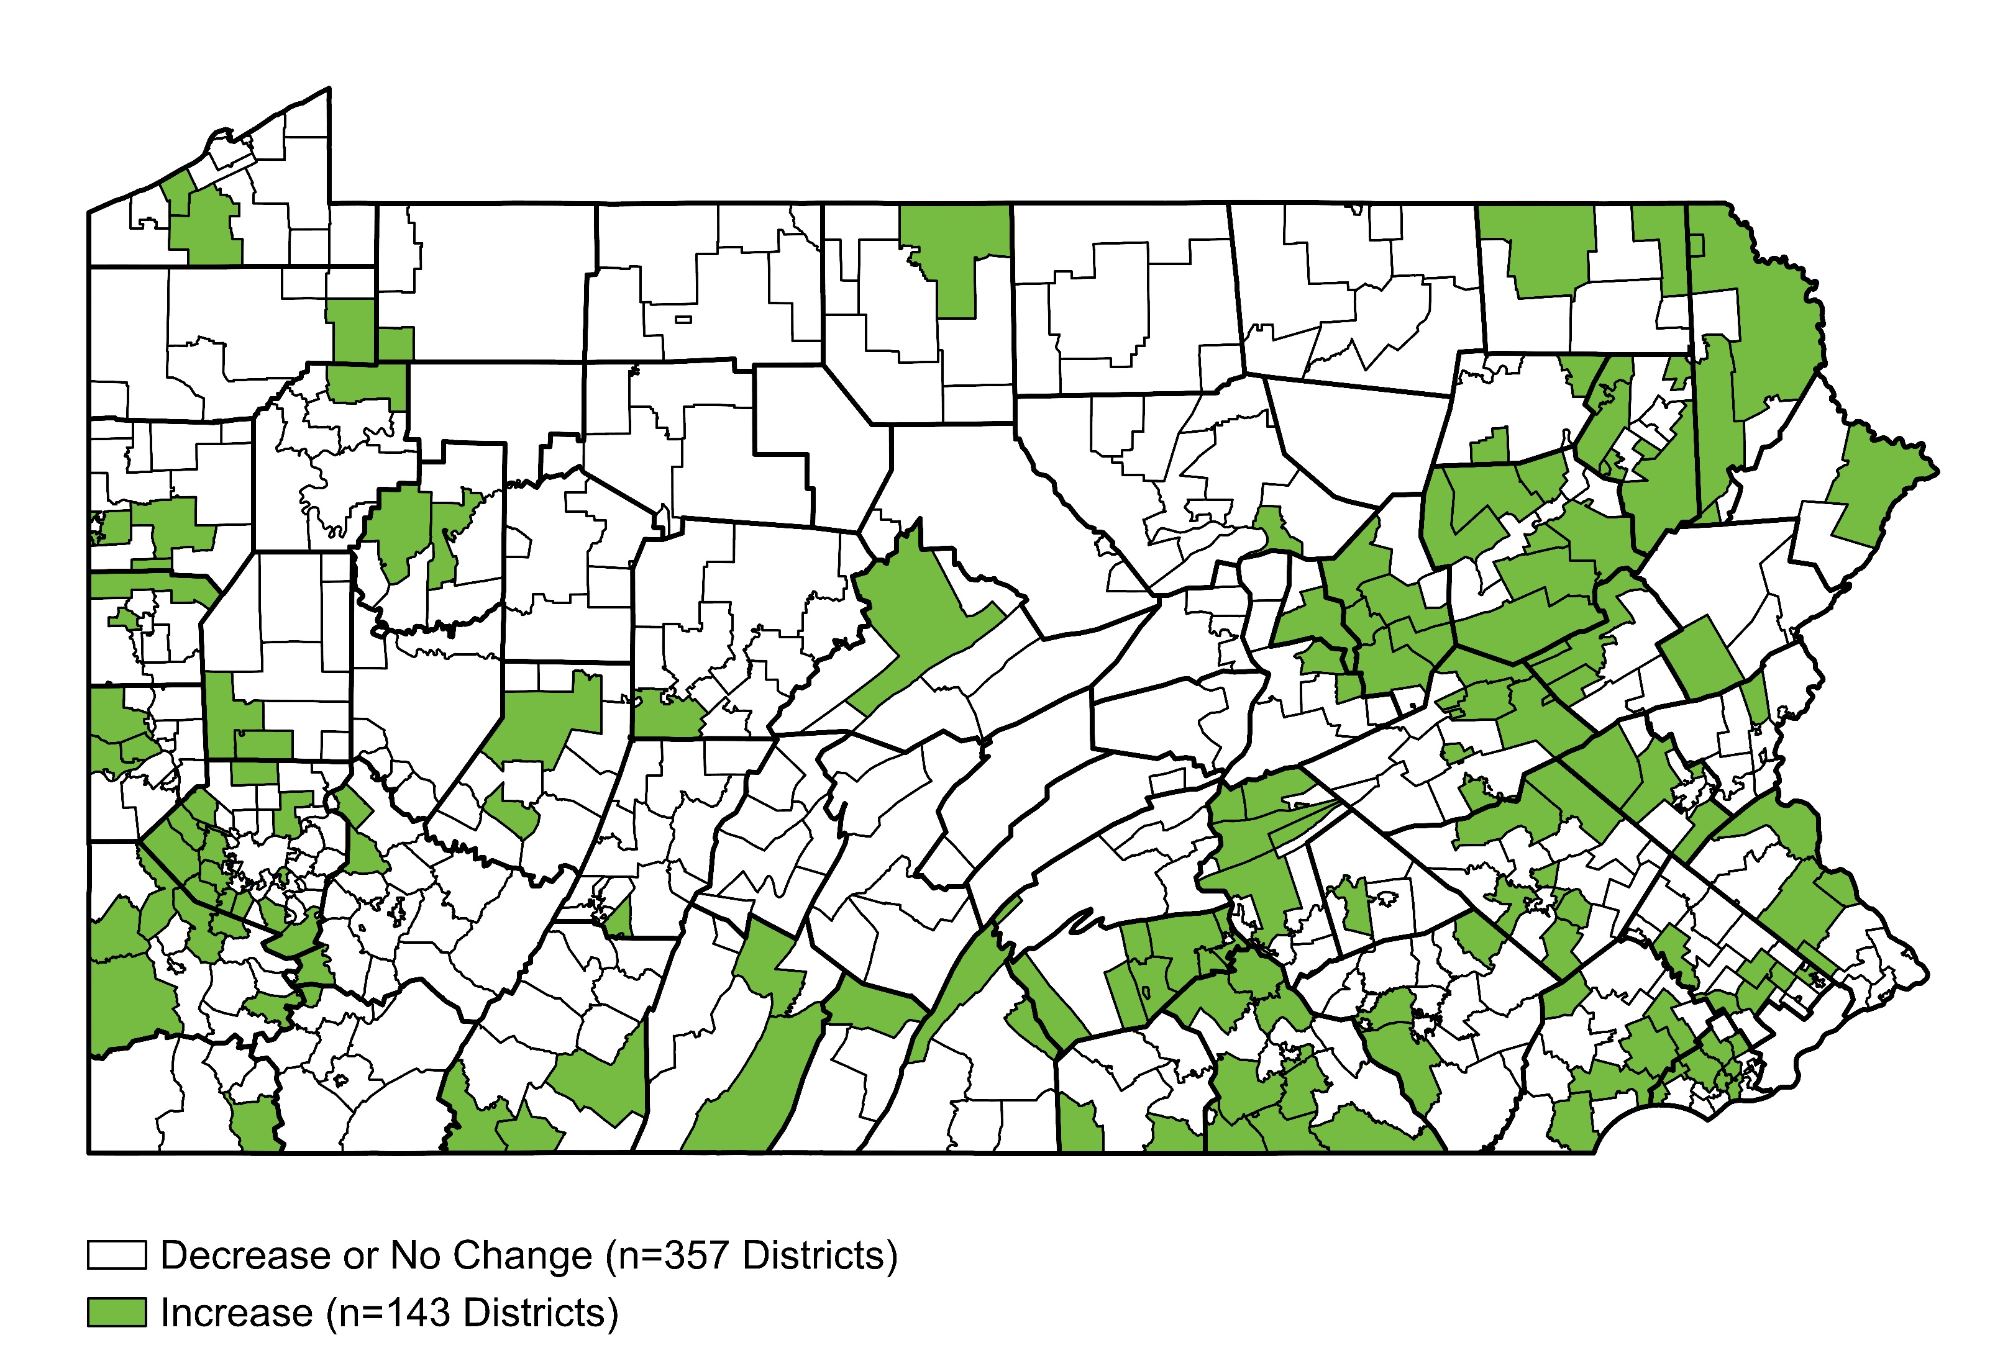
Percent Change in Public School K to 12 Enrollment,
2023-24 to 2033-34 (Projected)
Statewide Student Enrollment Change, 2023-24 to 2033-34 = -6.5%
Data Source: Pennsylvania Department of Education.

Slide 25
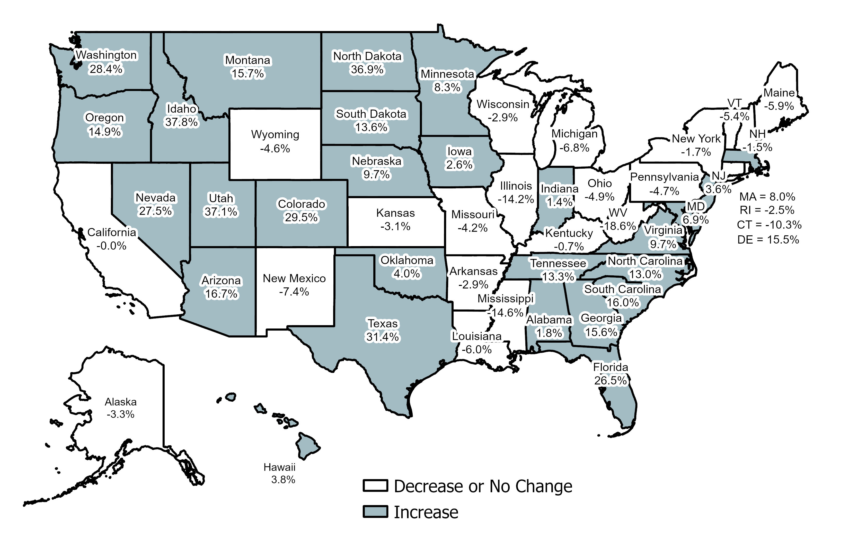
UVA: Projected Change in Youth Population
(<20 Years Old), 2020 to 2050
United States = 8.1%
Data Source: University of Virginia, Weldon Cooper Center for Public Service.

Slide 26
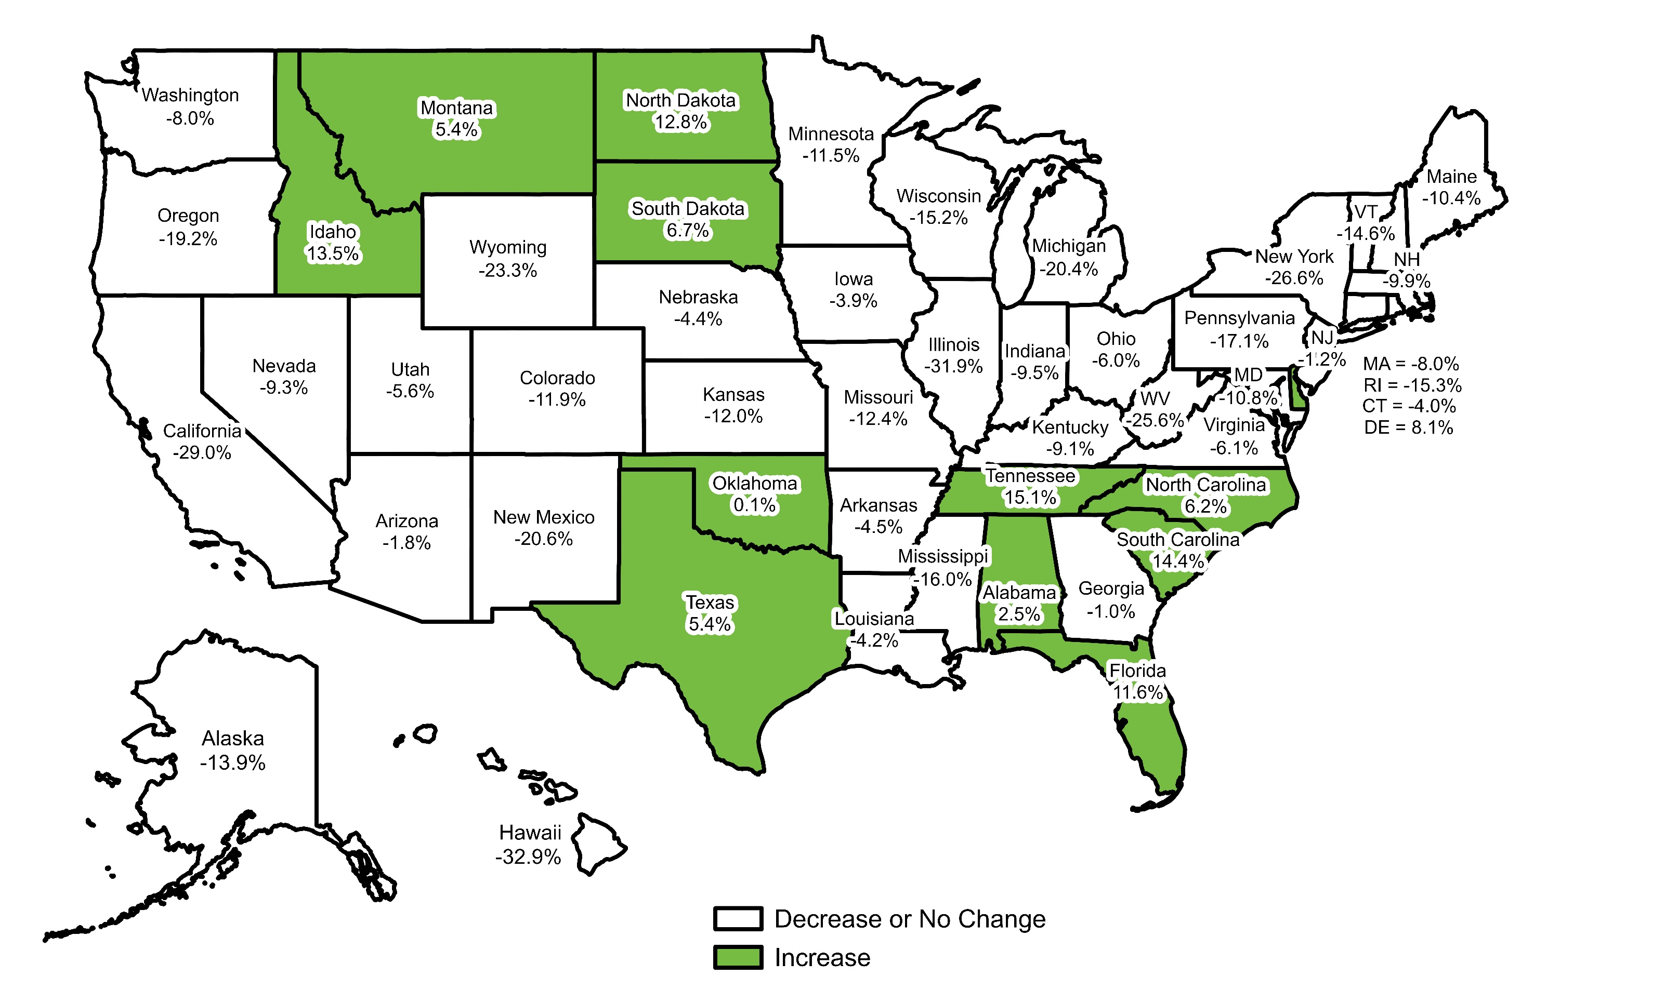
WICHE: Projected Percent Change in High School Graduates, 2023 to 2041
United States = -9.1%
Data Source: Western Interstate Commission for Higher Education (WICHE). (2024). Knocking at the College Door.

Slide 27
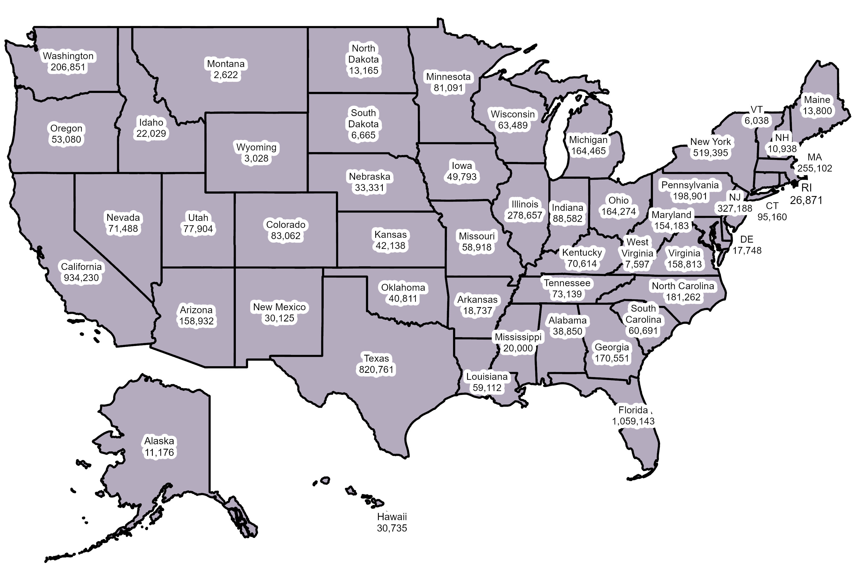
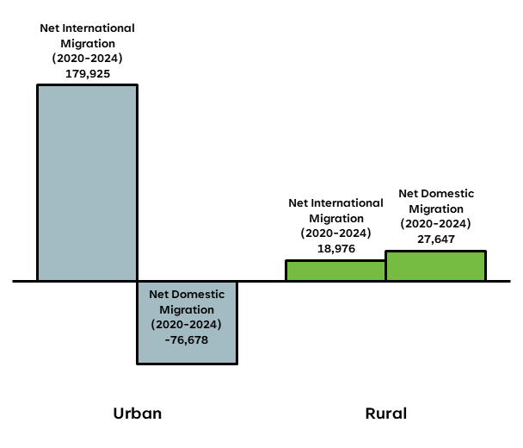
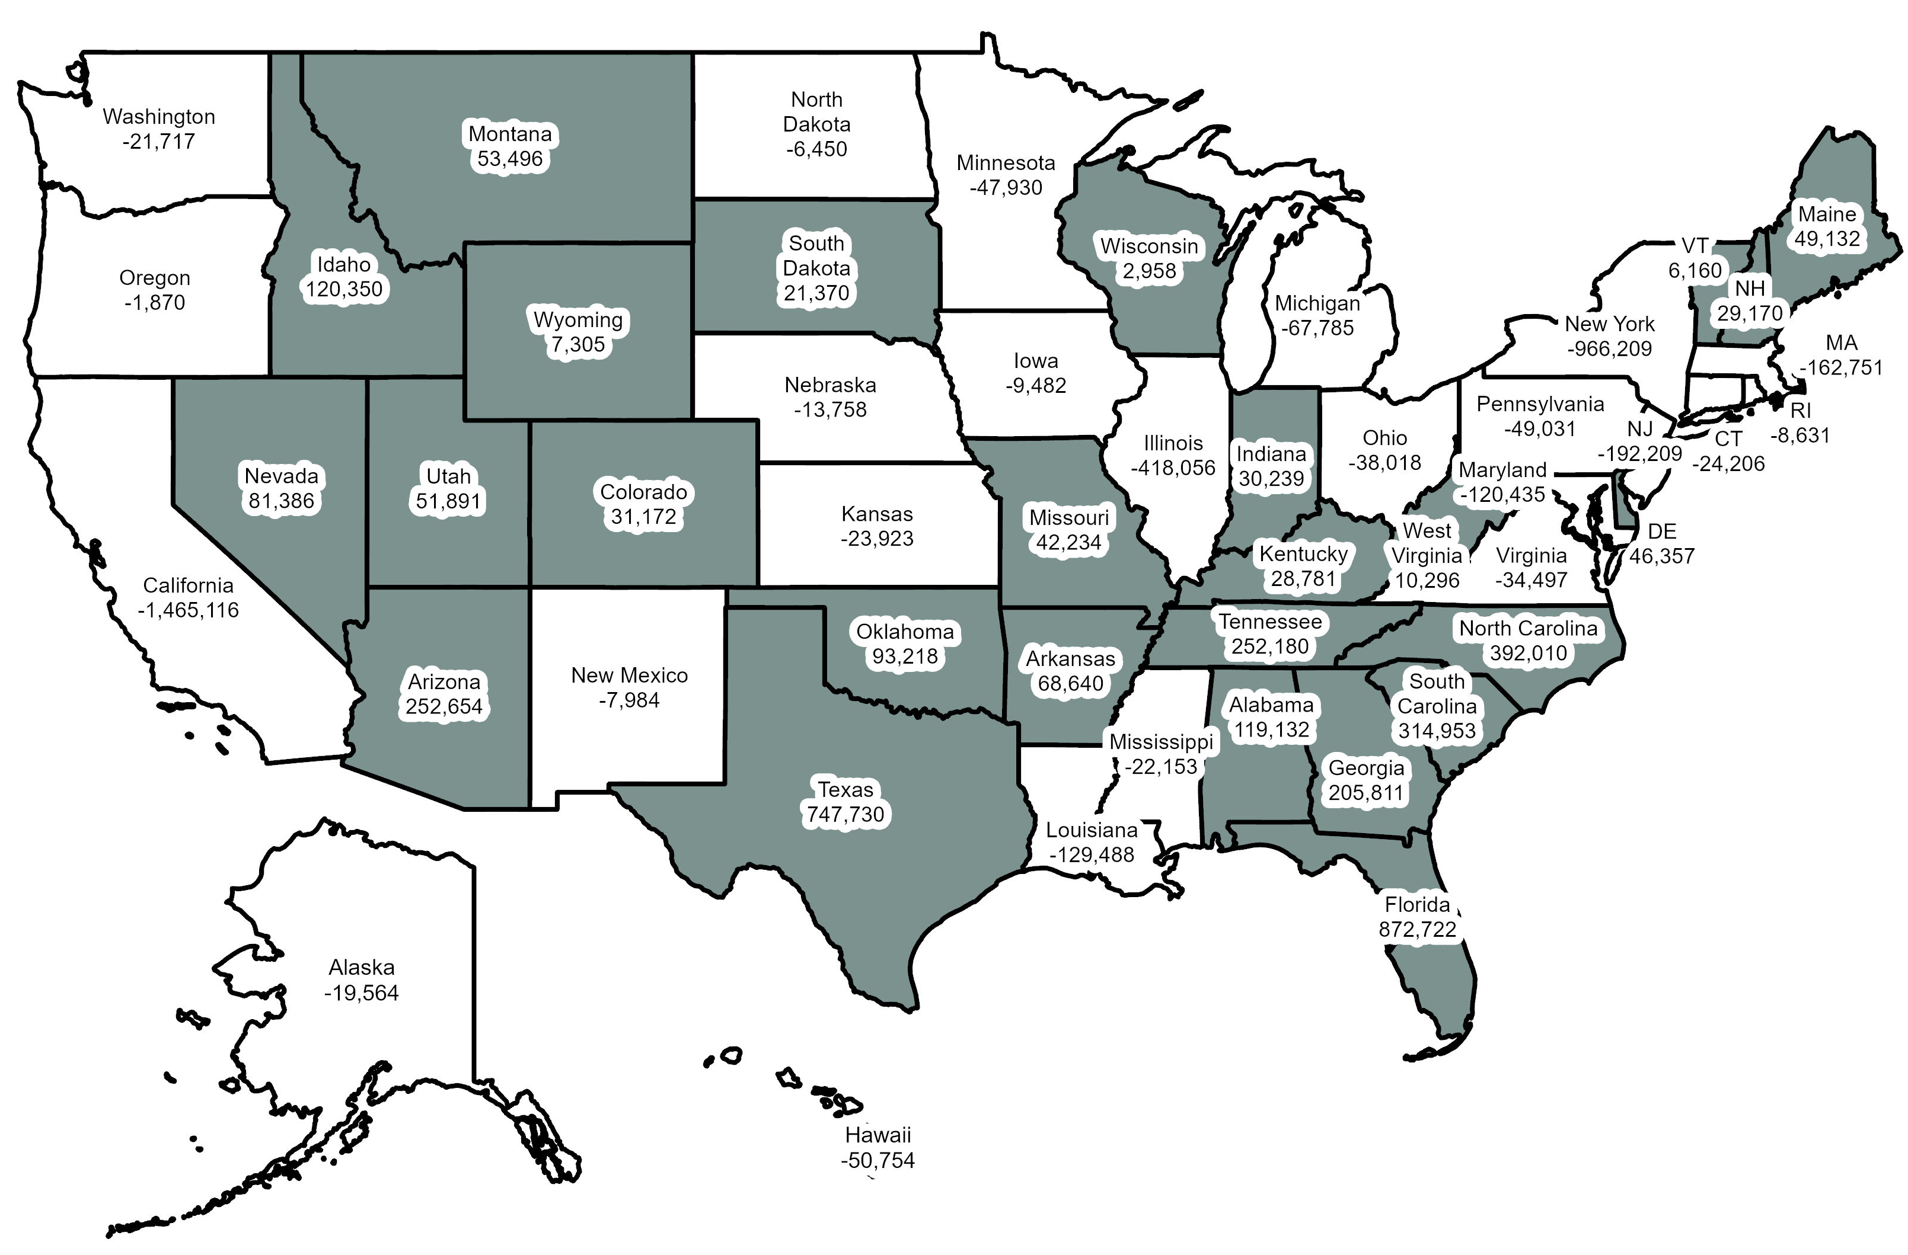
Pennsylvania Net International and Domestic Migration,
2020 to 2024
Data Source: 2024 Population and Housing Estimates, U.S. Census Bureau.
Net International Migration, 2020 to 2024
Shaded States Have Positive Net Migration
Note: Pennsylvania had 551,644 births compared to 629,193 deaths from 2020 to 2024.
Net Domestic Migration, 2020 to 2024

Slide 28
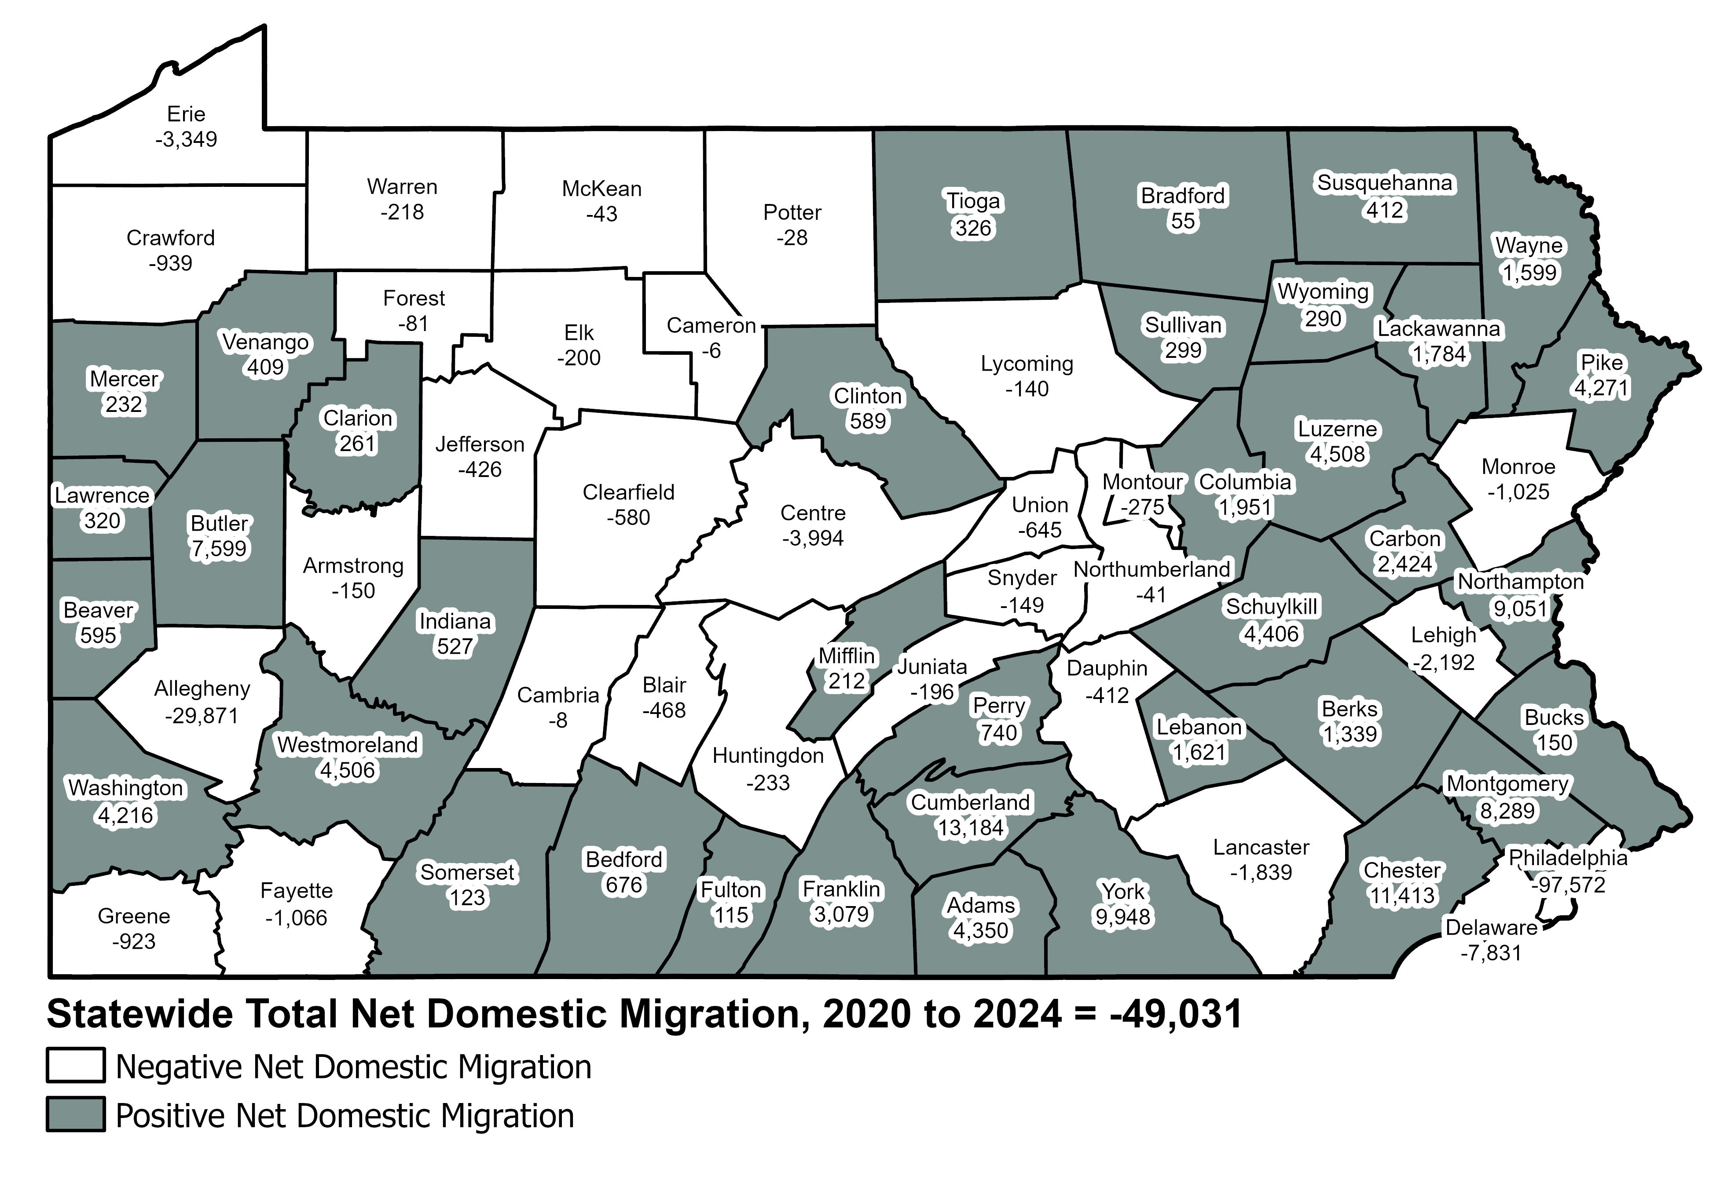
Statewide Total Net Domestic Migration,
2020 to 2024
Data Source: 2024 Population and Housing Estimates, U.S. Census Bureau.

Slide 29
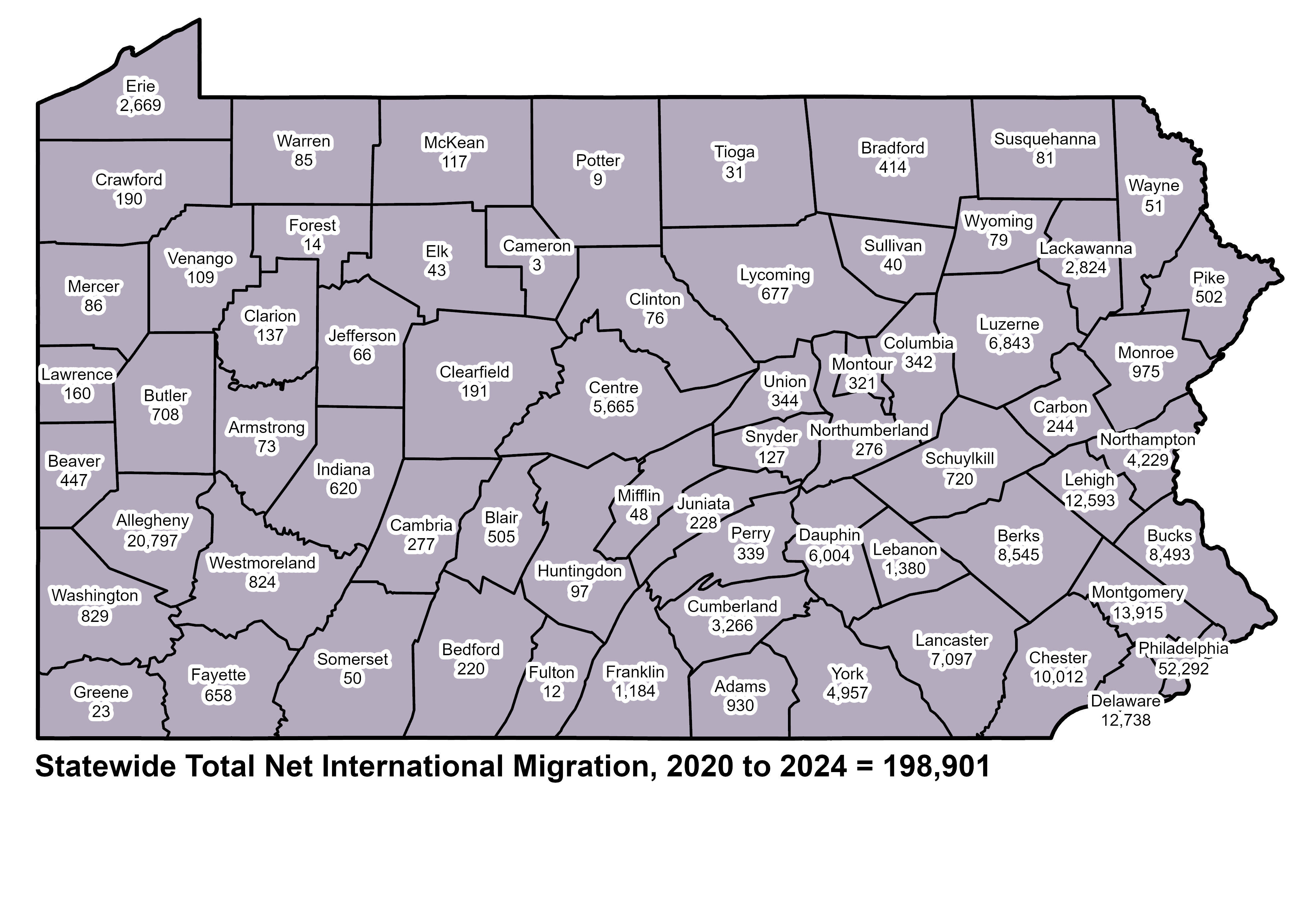
Statewide Total Net International Migration, 2020 to 2024
Data Source: 2024 Population and Housing Estimates, U.S. Census Bureau.

Slide 31
Pennsylvania Rural Population
Revitalization Commission
Established by Act 21 of 2024
Purpose: To create policy “reviews and recommendations aimed at attracting and retaining residents in rural Pennsylvania while addressing challenges facing rural communities due to population shifts and changing demographics.”
  This includes recommending legislation, regulatory change, and community best practices.
Commission is comprised of Officials from:
  State Government
  Local/County Government
  Private Sector

Slide 32
Duties & Responsibilities

Slide 33
Policy Reviews and Recommendations
Increasing participation in the Federal decennial census.
Attracting and retaining residents in rural Pennsylvania.
Education and career opportunities.
Access to health care.
Affordable housing.

Slide 34
Policy Reviews and Recommendations (Continued)
Access to social services.
Current issues facing rural Pennsylvania.
Grant awards and tax credit opportunities for rural Pennsylvania residents and businesses.
Statutory and regulatory costs and impacts on rural municipal governments, businesses, and communities.
Other issues facing rural Pennsylvania as identified by the Commission.

Slide 35
Additional Powers and Duties
Findings and recommendations to mitigate population shifts.
Consult with experts.
Receive input from interested parties.
Hold public hearings throughout the Commonwealth.
Review/consider rural development strategies.
Review state/regional programs.

Slide 36
Additional Powers and Duties (Continued)
Recommend proposed legislation and regulatory changes based upon the Commission’s findings.
Maintain a database on rural PA’s demographic trends.
Establish subcommittees to address specific population change issues.
Periodic estimates of fiscal impacts.
Distribute information on public grants.

Slide 37
Membership Composition

Slide 38
Pennsylvania Rural Population Revitalization Commission

Slide 39
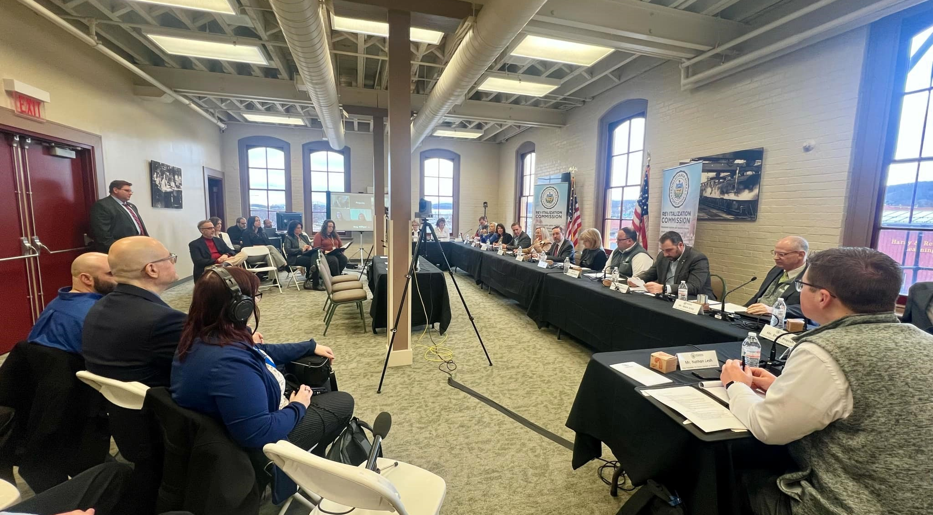
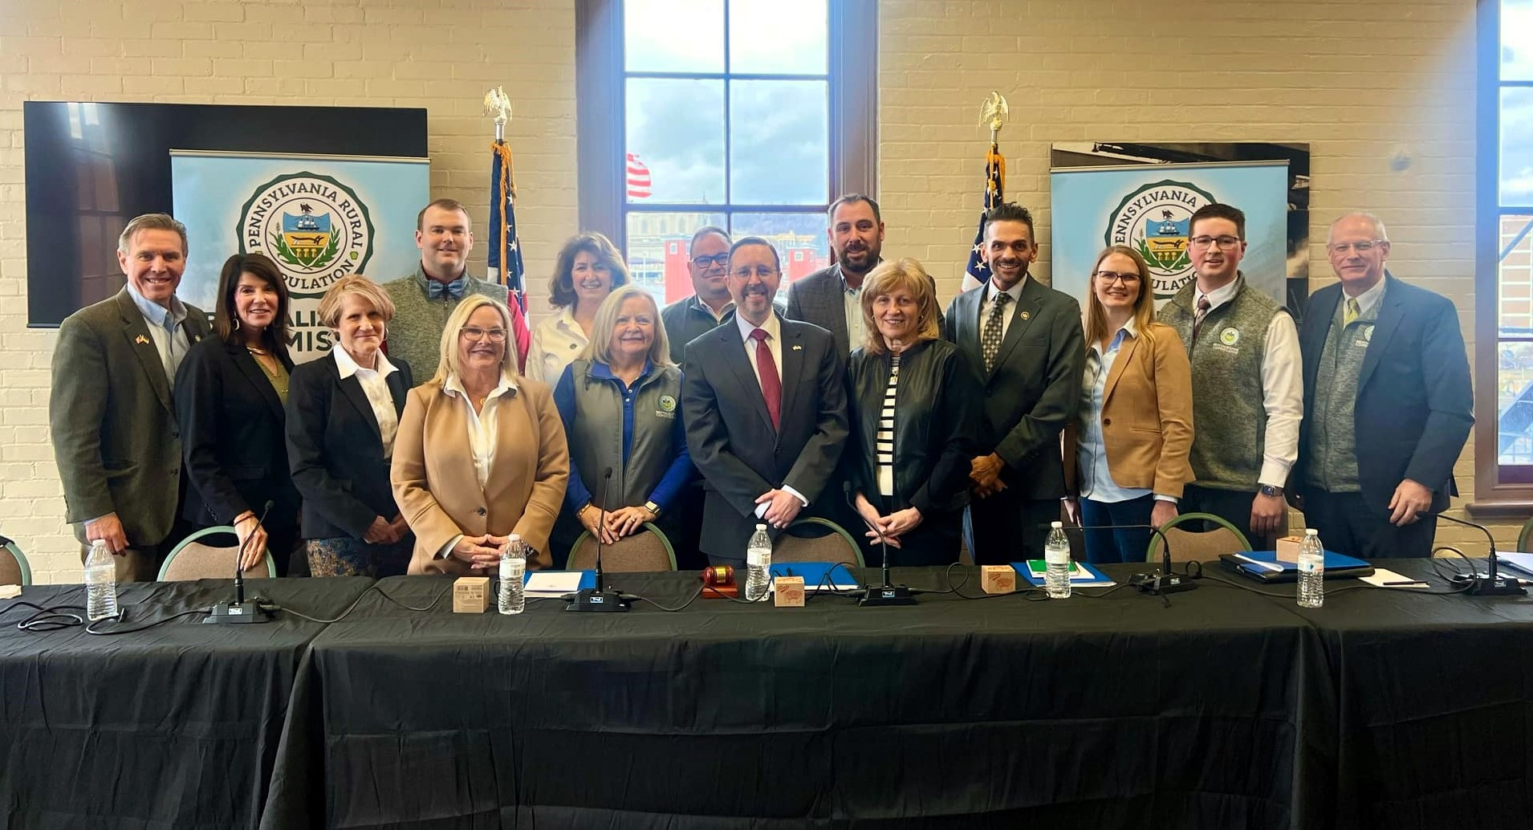
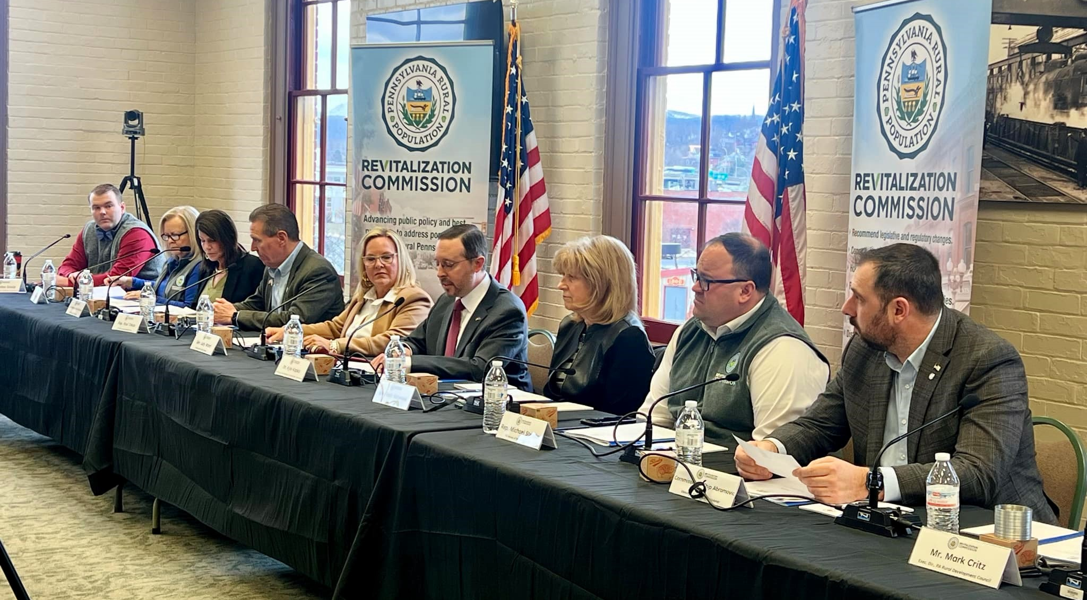
Commission Inaugural Public Hearing:
Growing Local Capacity in Rural Pennsylvania
On February 28, the Pennsylvania Rural Population Revitalization Commission hosted its inaugural public hearing at the Railroaders Memorial Museum in Blair County. The event focused on addressing local capacity issues and how these limitations affect the ability of rural communities to solve challenges and implement solutions.

Slide 40
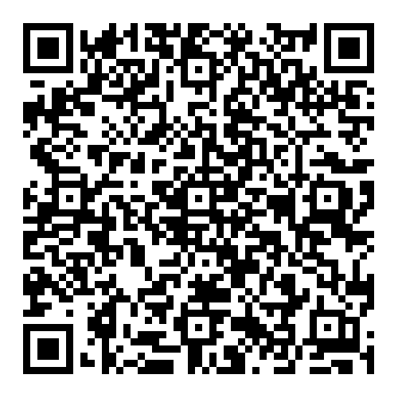

Commission Inaugural Public Hearing:
Growing Local Capacity in Rural Pennsylvania
Scan the QR code below to access the testimony highlights and video recording of the public hearing on the Commission’s webpage.

Slide 41
Thank You
Dr. Kyle C. Kopko
Executive Director, Center for Rural Pennsylvania
Chairman, Pennsylvania Rural Population Revitalization Commission
kkopko@rural.pa.gov
Office: (717) 787-9555

Slide 42
Supplemental Information

Slide 43
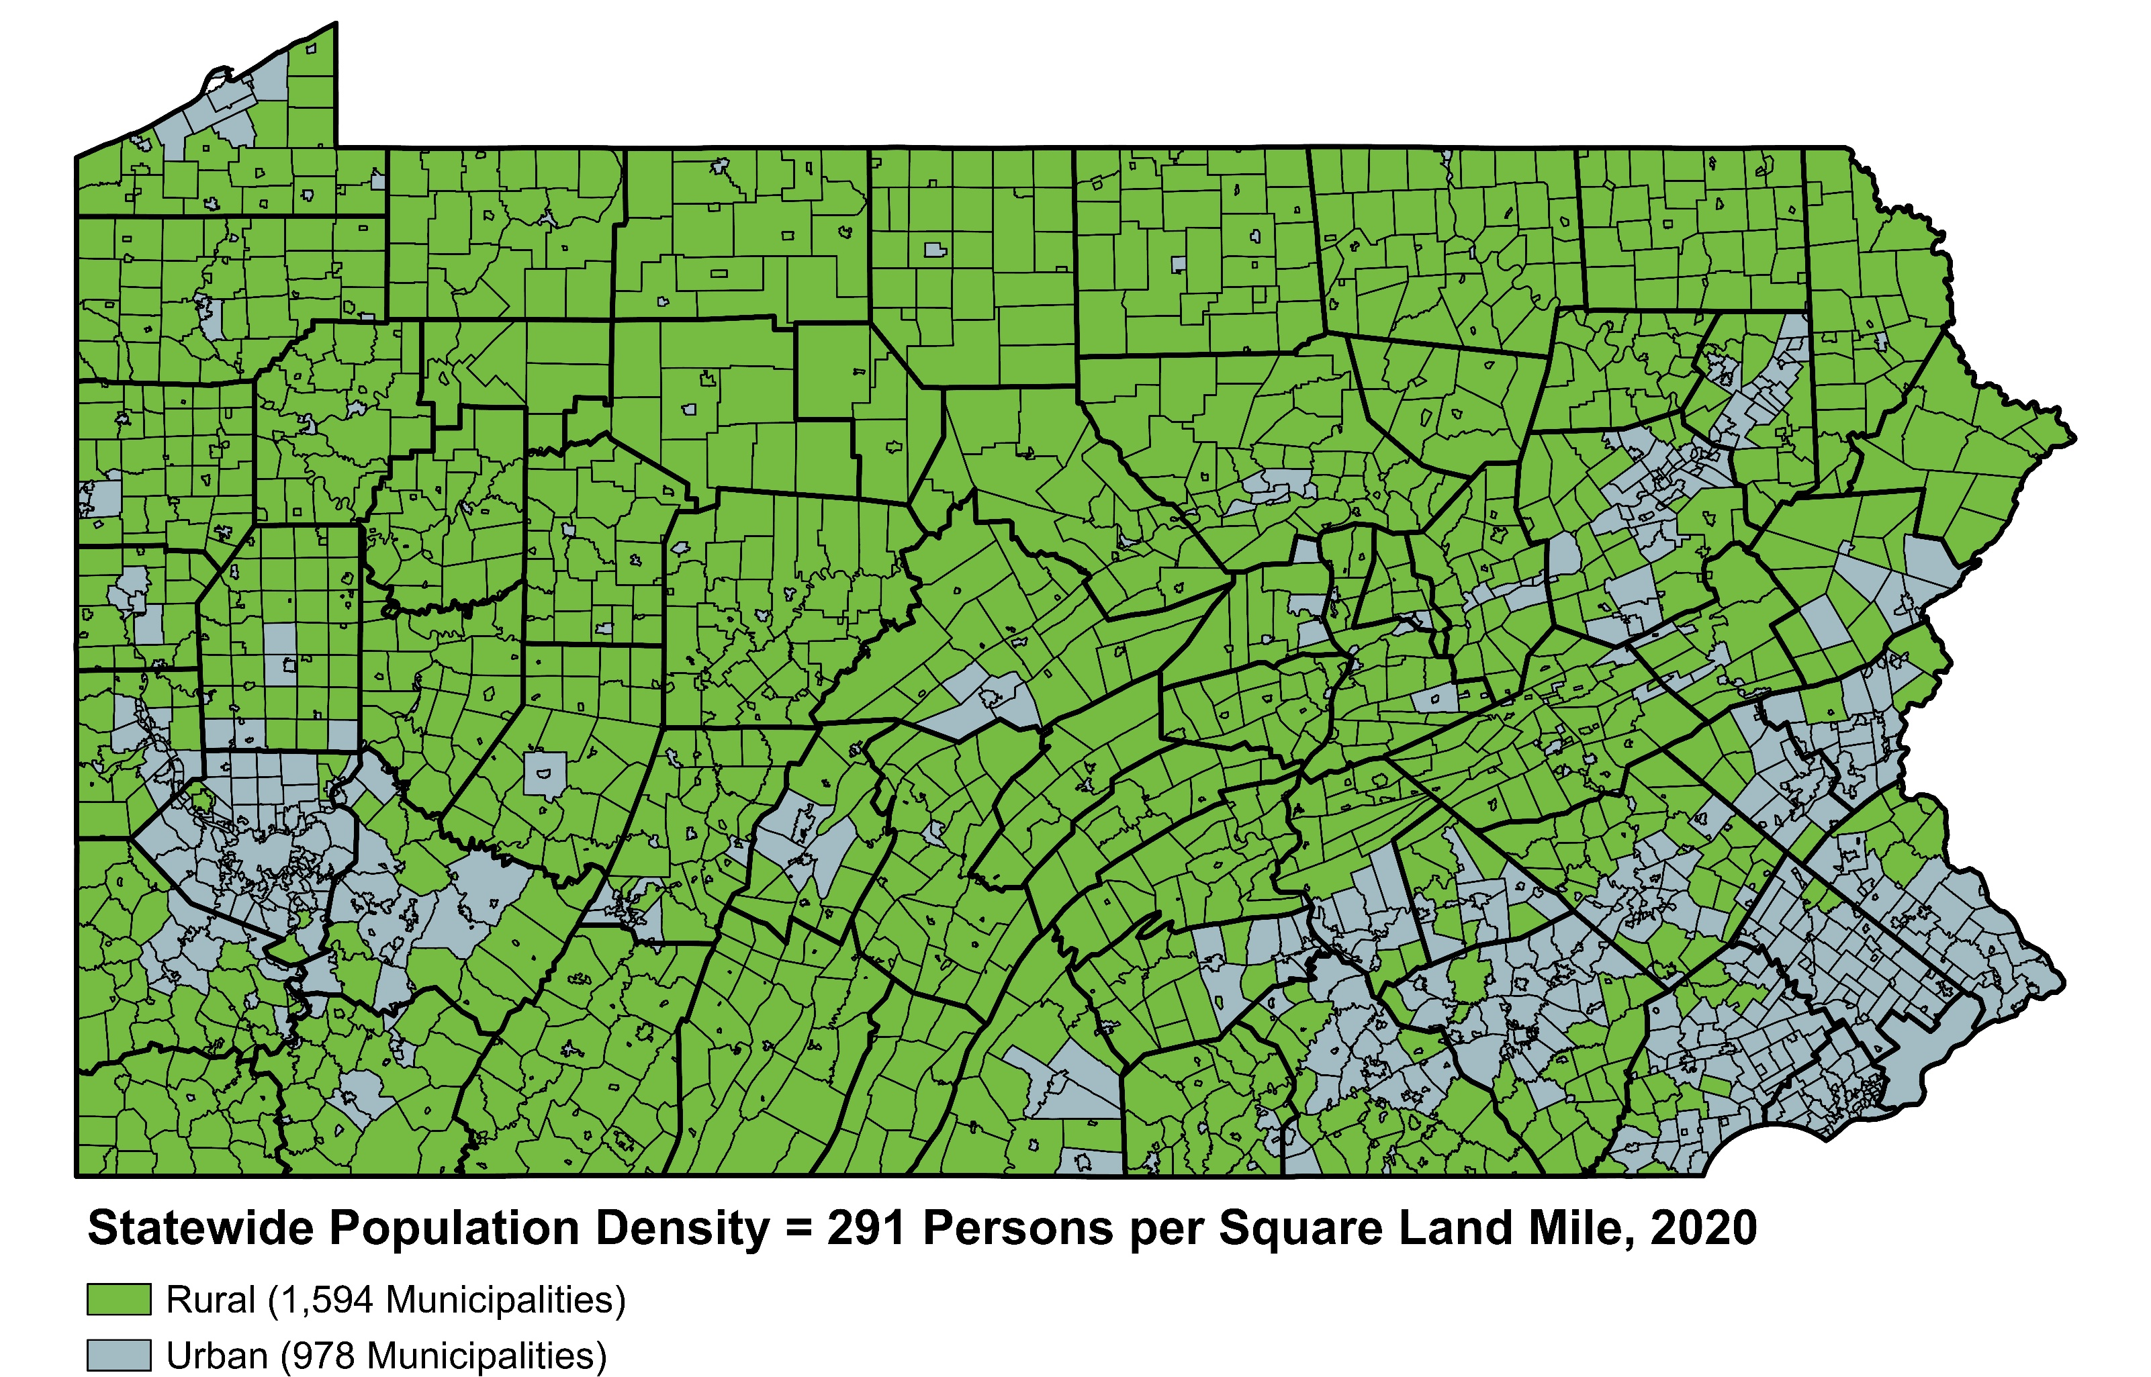
Pennsylvania Rural and Urban Municipalities, 2020
Data Source: U.S. Census Bureau.

Slide 44
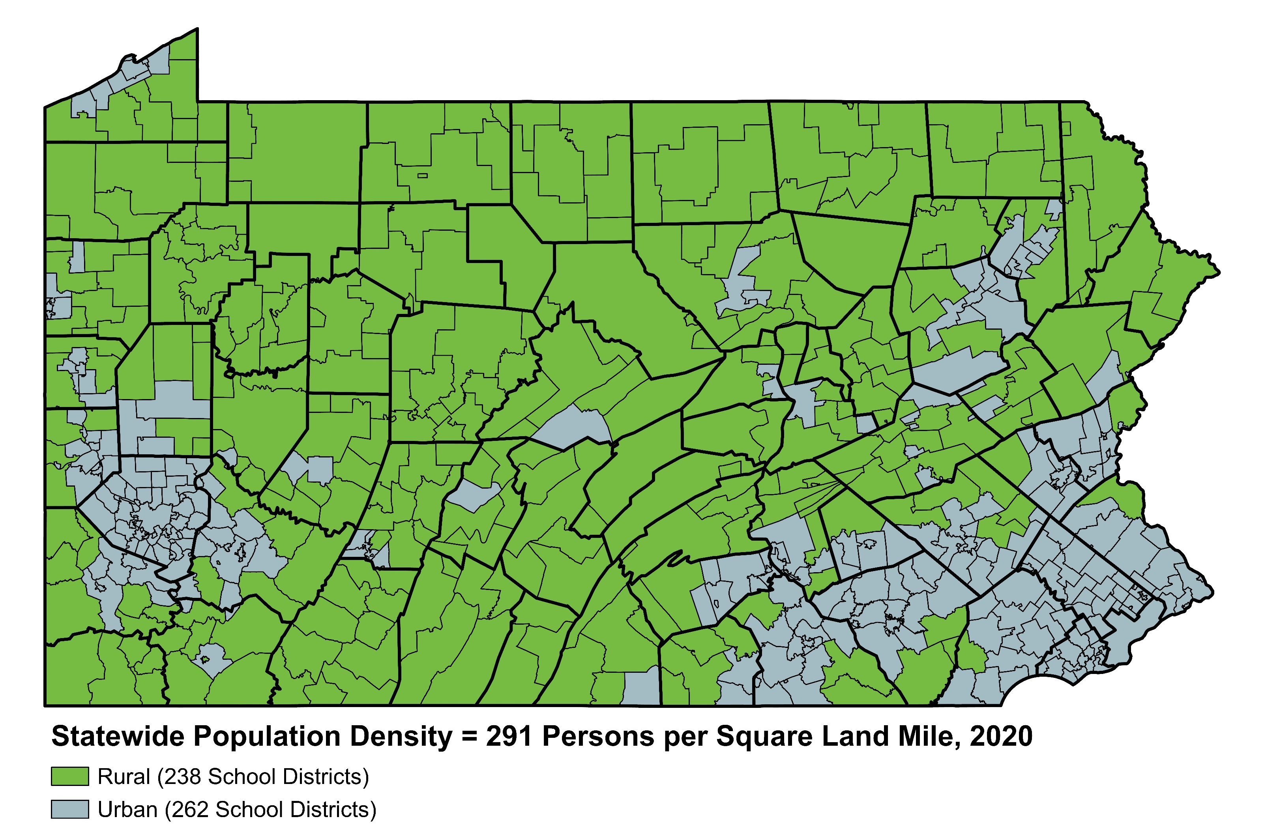
Pennsylvania Rural and Urban School Districts, 2020
Data Source: U.S. Census Bureau.

Slide 45
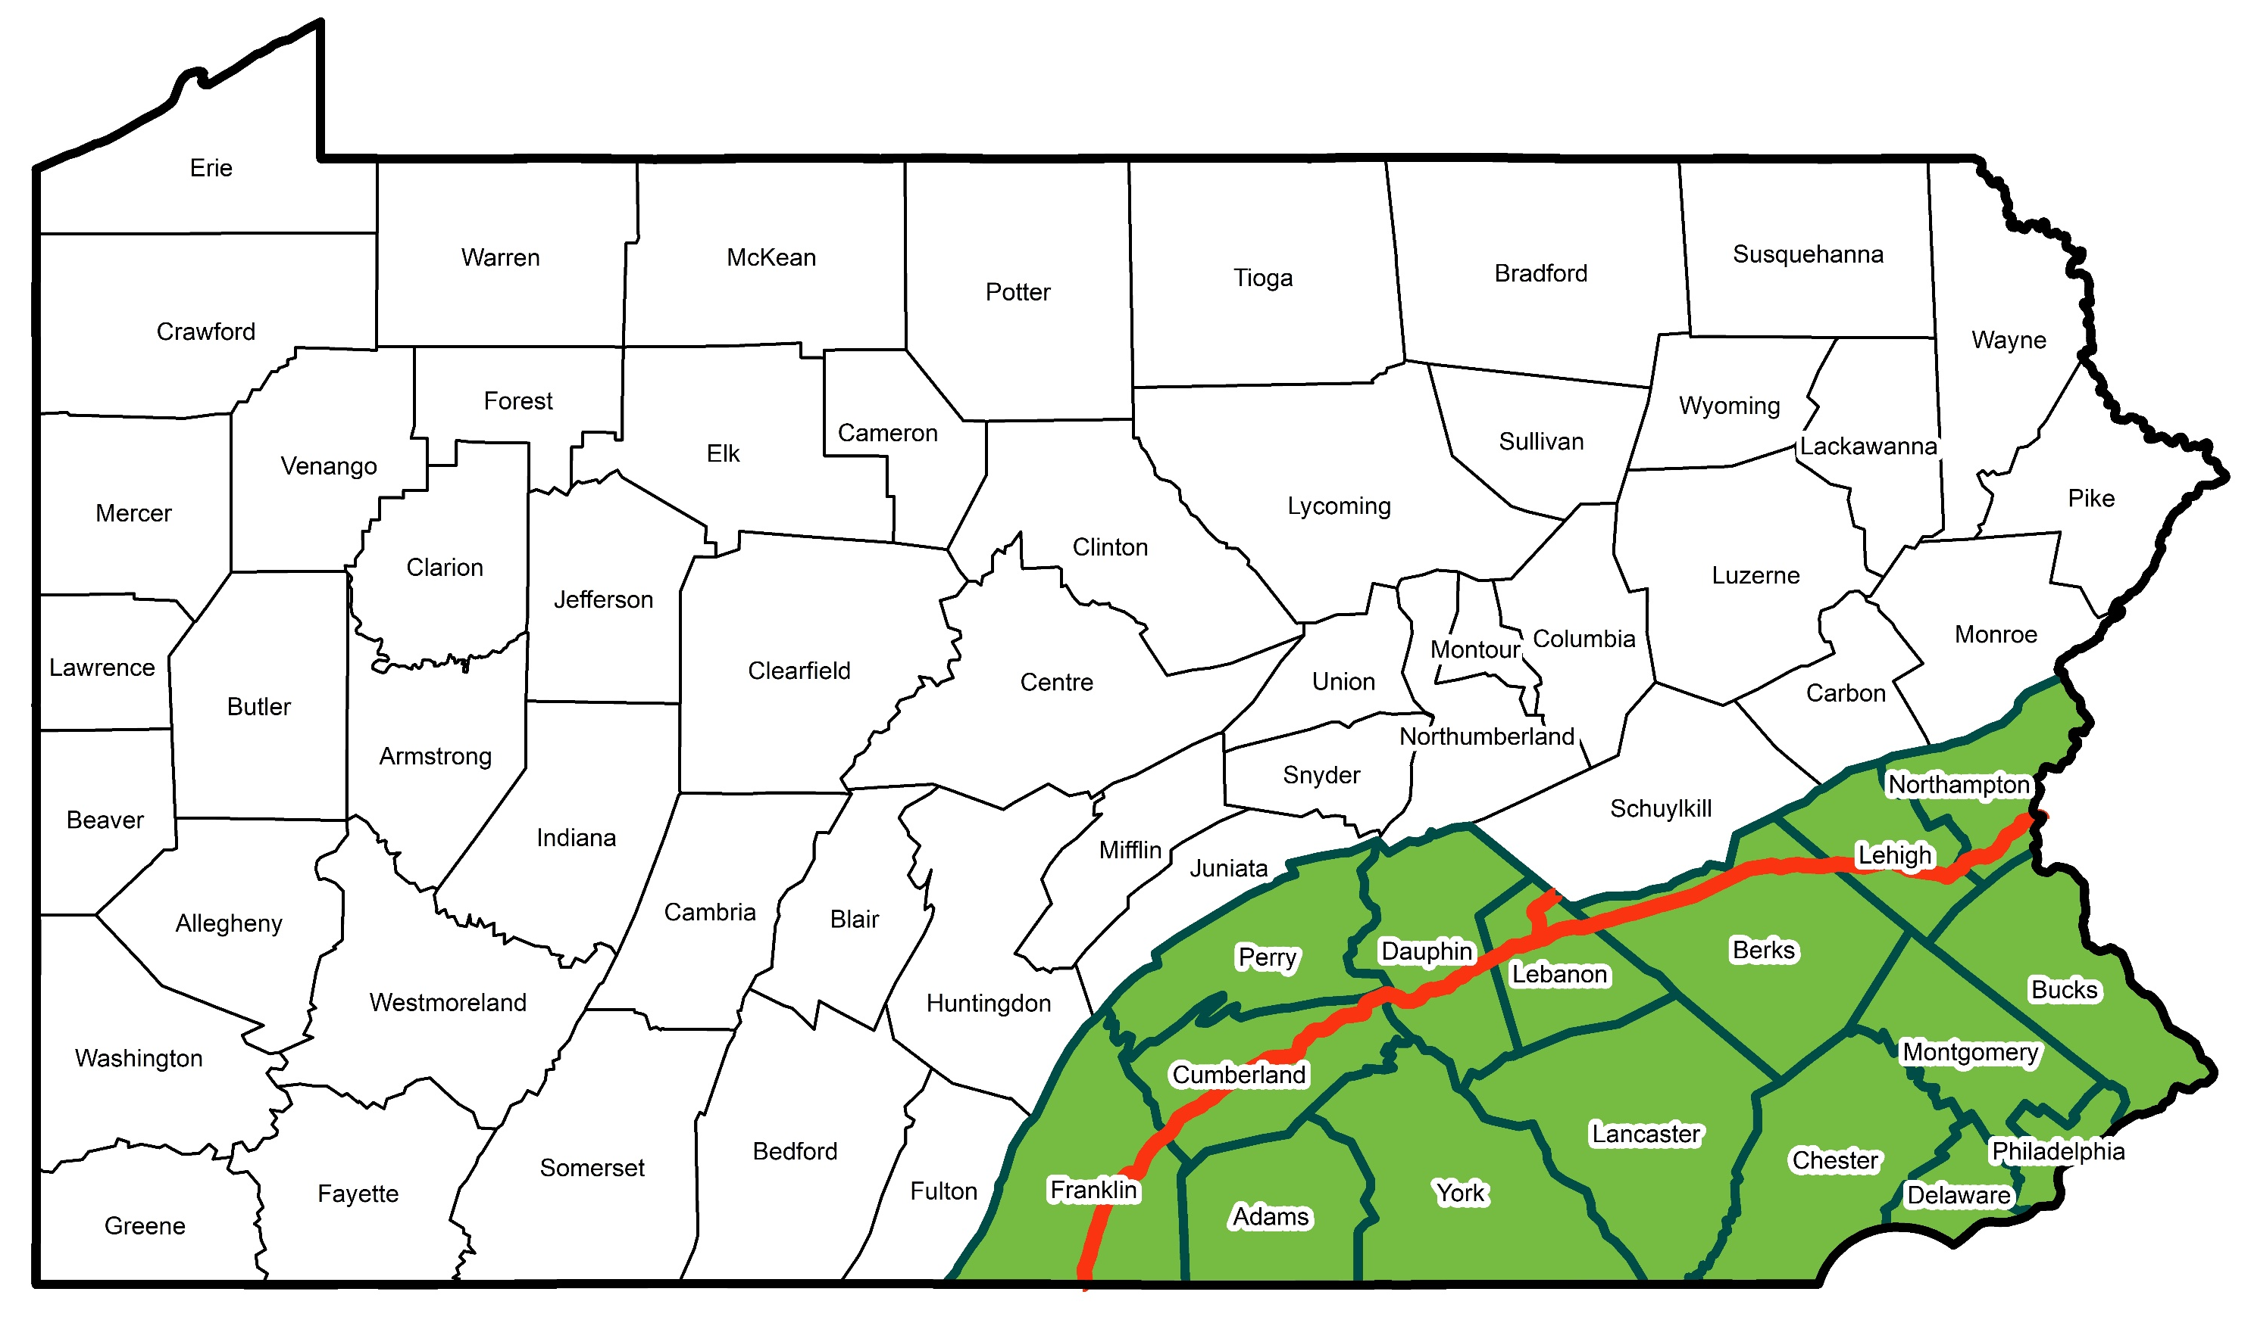
Pennsylvania’s Population Shifting Towards the Southeast
Data Sources: U.S. Census Bureau and the Pennsylvania State Data Center.
Southeast Region
Population in Southeastern Pennsylvania and Rest of Pennsylvania,
1920 to 2050 (Projected)
(In Millions)

Slide 46

Where are Pennsylvania’s International Migrants Coming from?
Total Estimated International Migration in 2023 = 73,871
Top 10 International Countries People are Migrating from to Pennsylvania, 2023
Note: Margin of Error for International Migration is ~9,500 people for the total.
Data Source: 2023 ACS 1-Year Estimates Public Microdata Sample.
*Includes Hong Kong, Macau, and Paracel Islands.

Slide 47
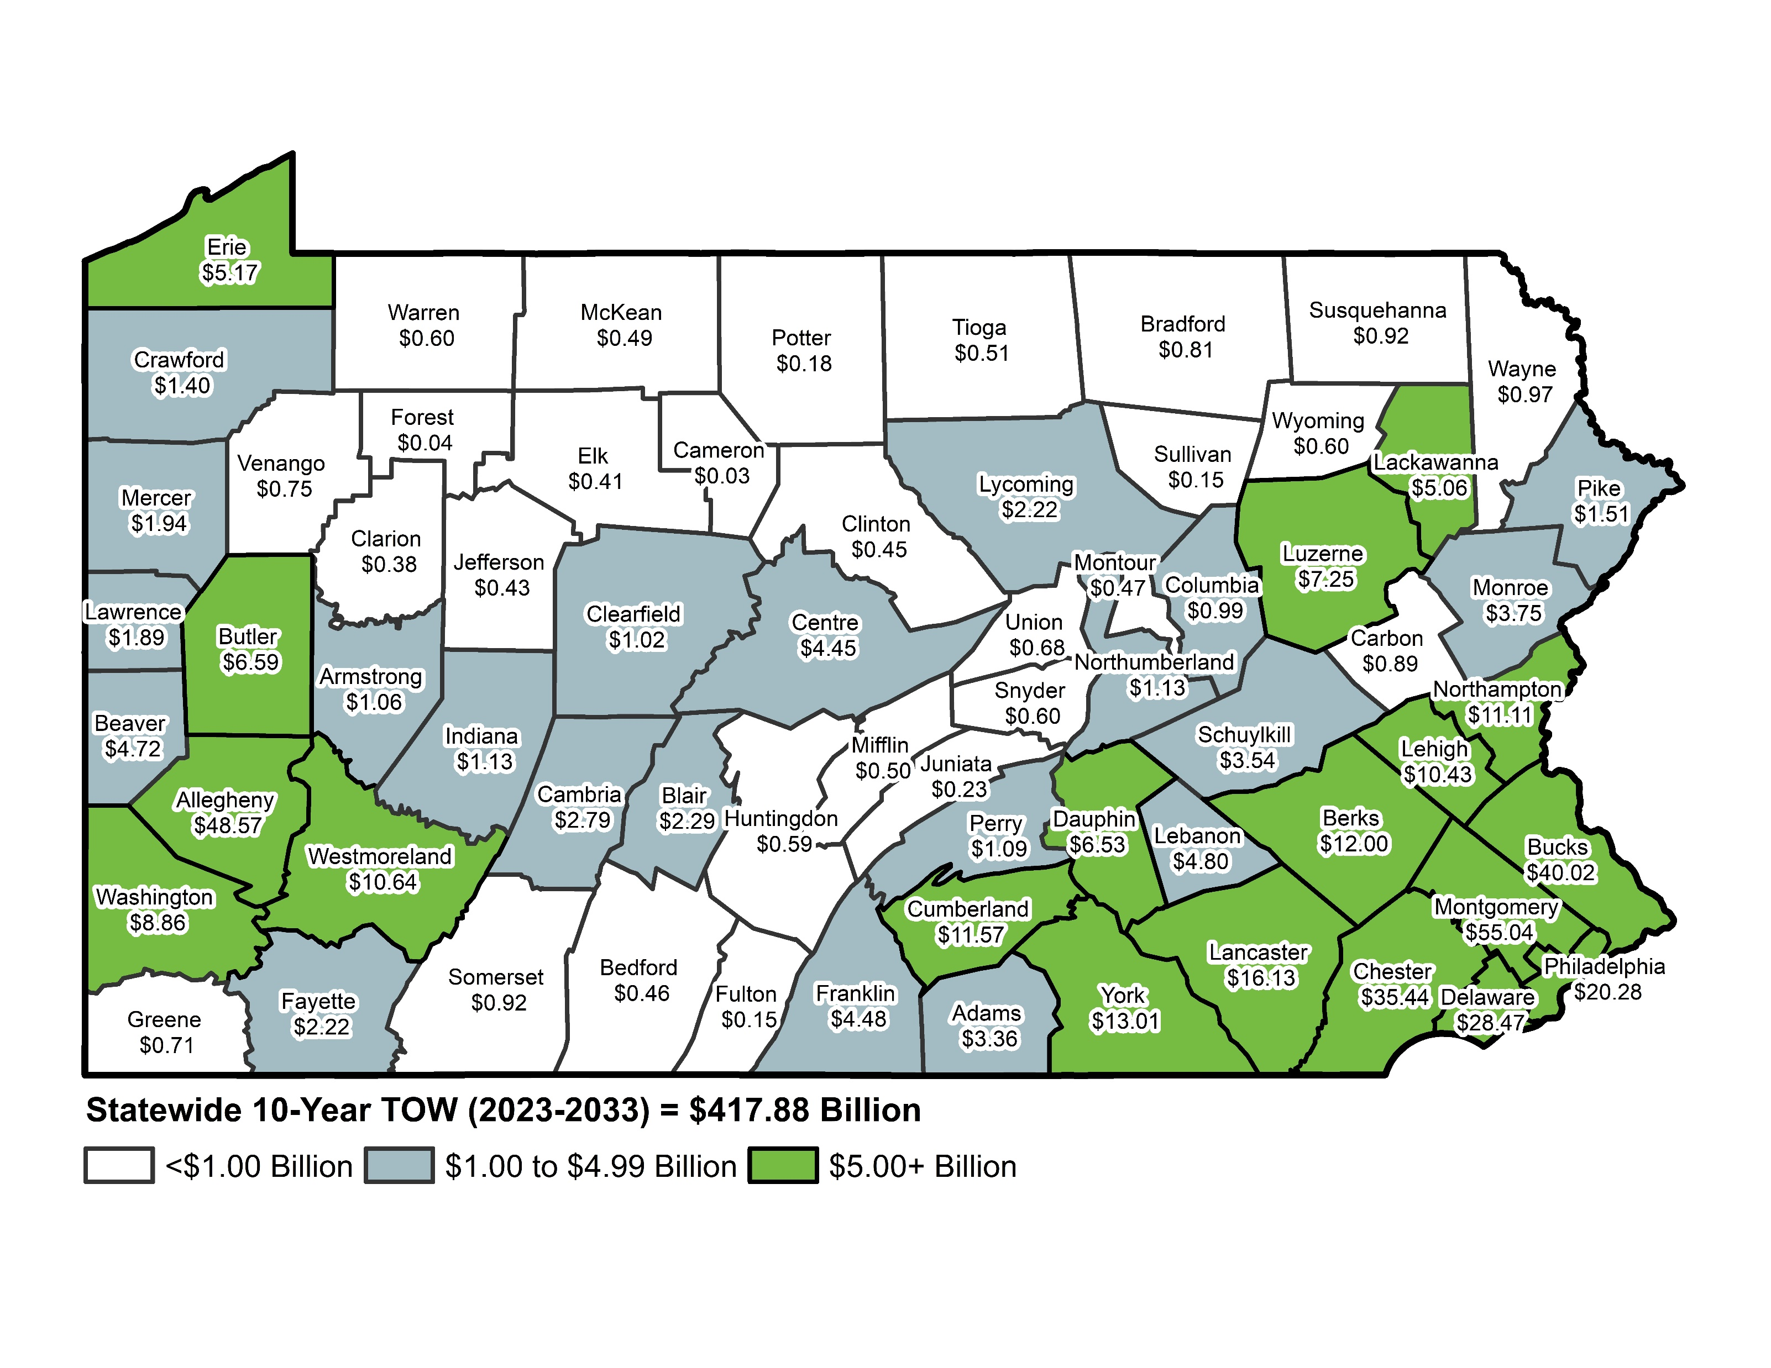
10-Year (2023-2033) Transfer of Wealth
($ Billions)
Data Source: Macke Carver and Associates, LLC Partnership. Information is based on Esri household wealth estimates, U.S. Census Bureau, U.S. Bureau of Economic Analysis, and the Pennsylvania State Data Center population projections.

Slide 48
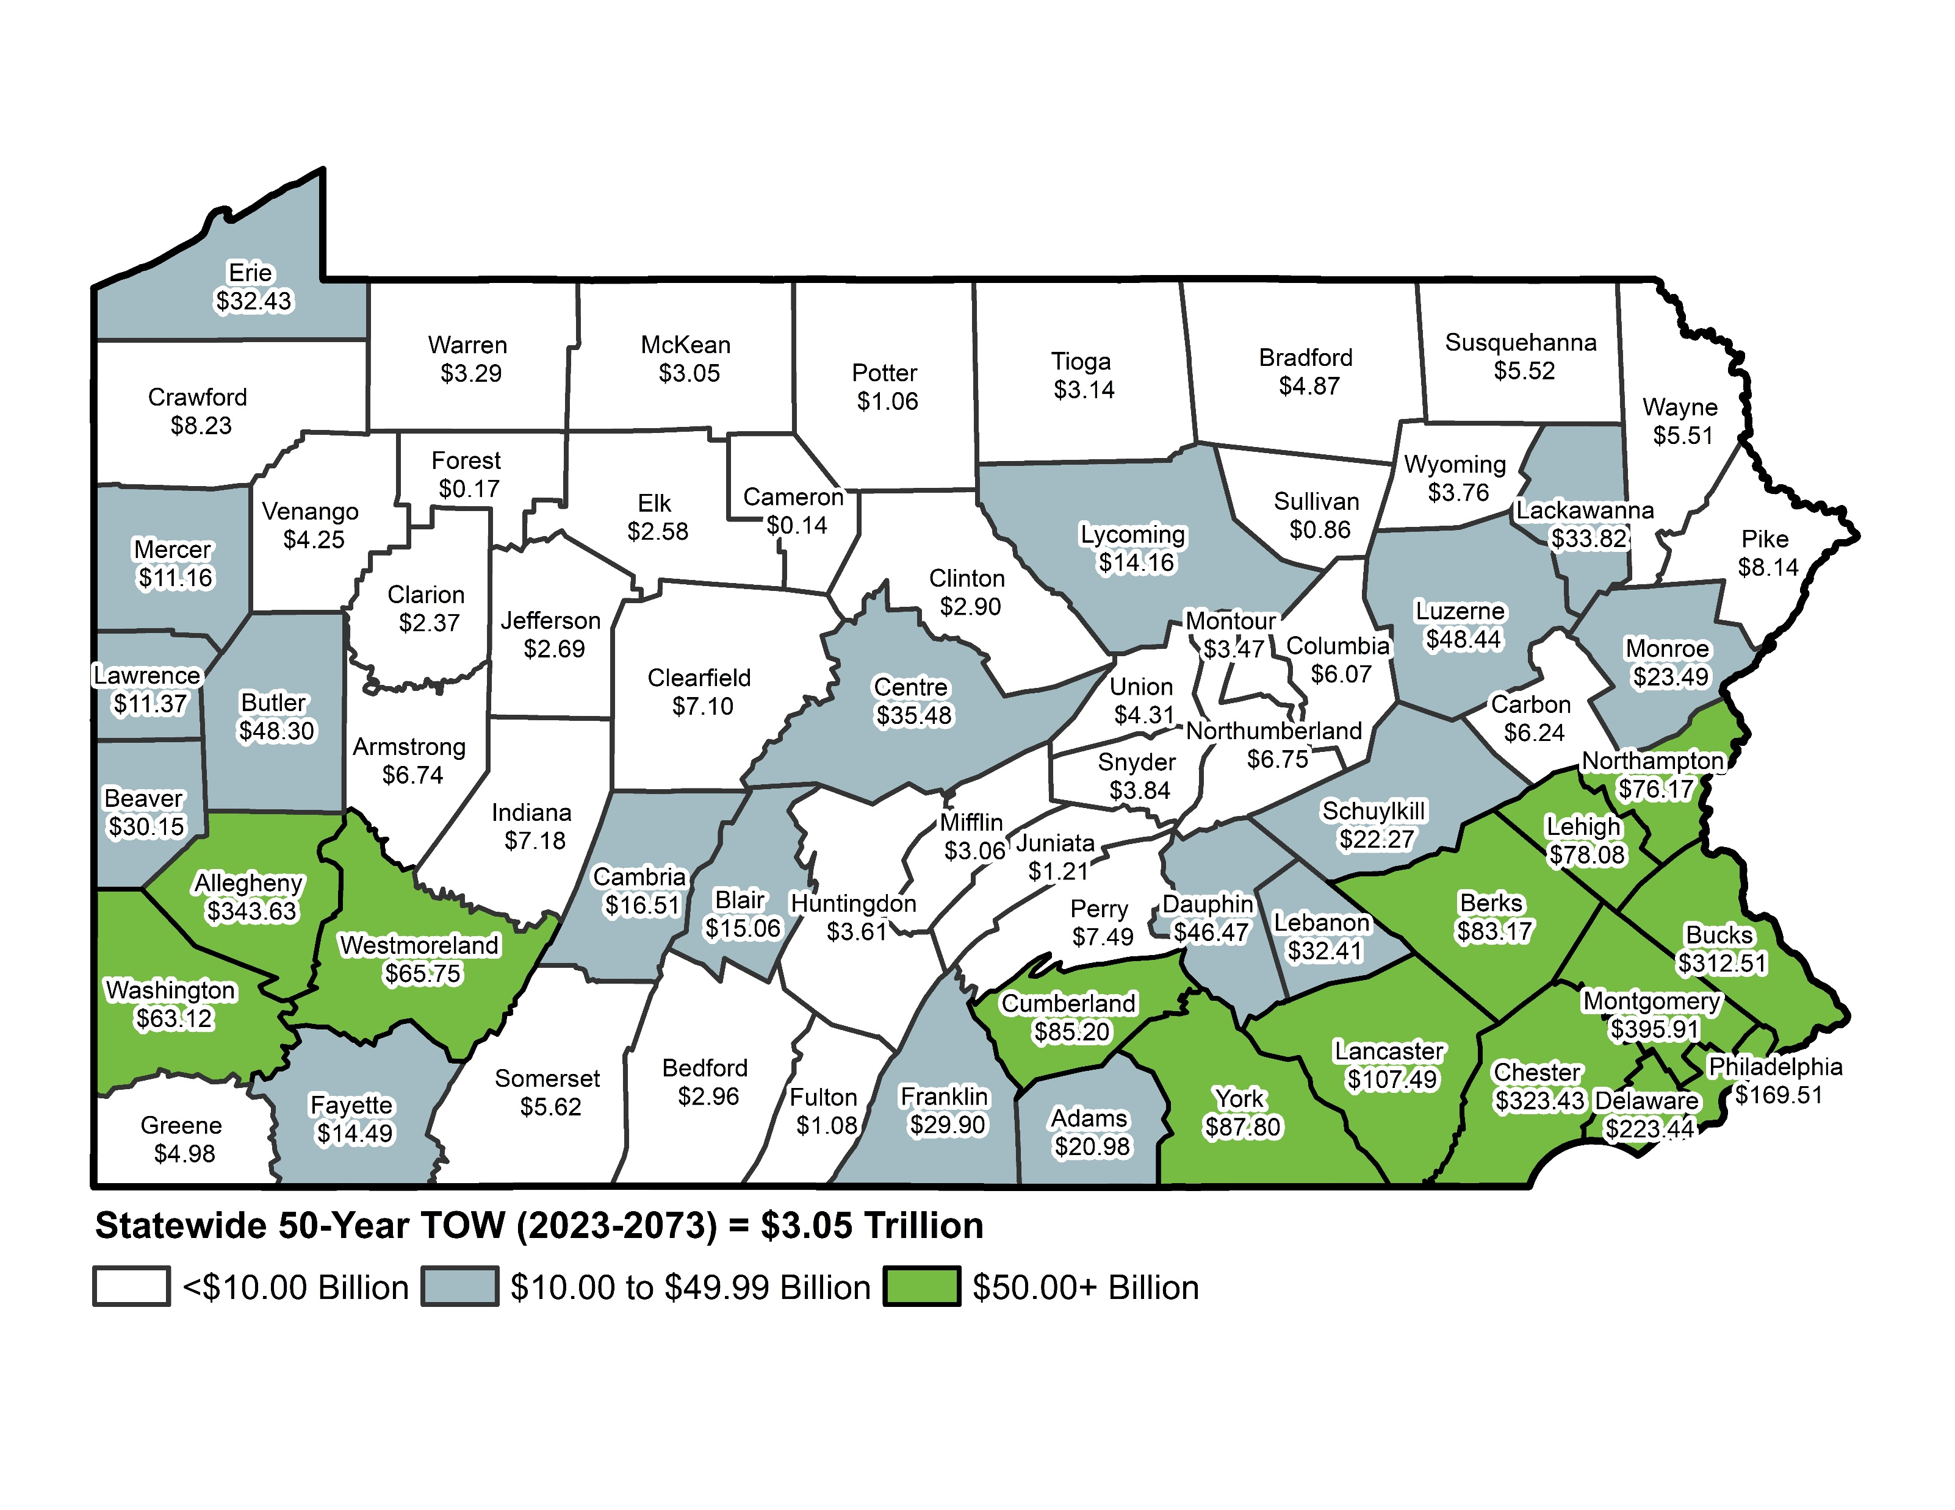
50-Year (2023-2073) Transfer of Wealth
($ Billions)
Data Source: Macke Carver and Associates, LLC Partnership. Information is based on Esri household wealth estimates, U.S. Census Bureau, U.S. Bureau of Economic Analysis, and the Pennsylvania State Data Center population projections.

