Slide 2
2024 NTSF/Northeast Region Meeting-Connecticut Update
June 6, 2024
Mike Firsick
Denver

Slide 3
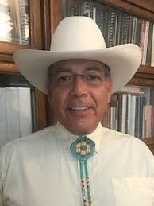
MP Unit One SFP

Slide 4
MP Unit Two SFP

Slide 5
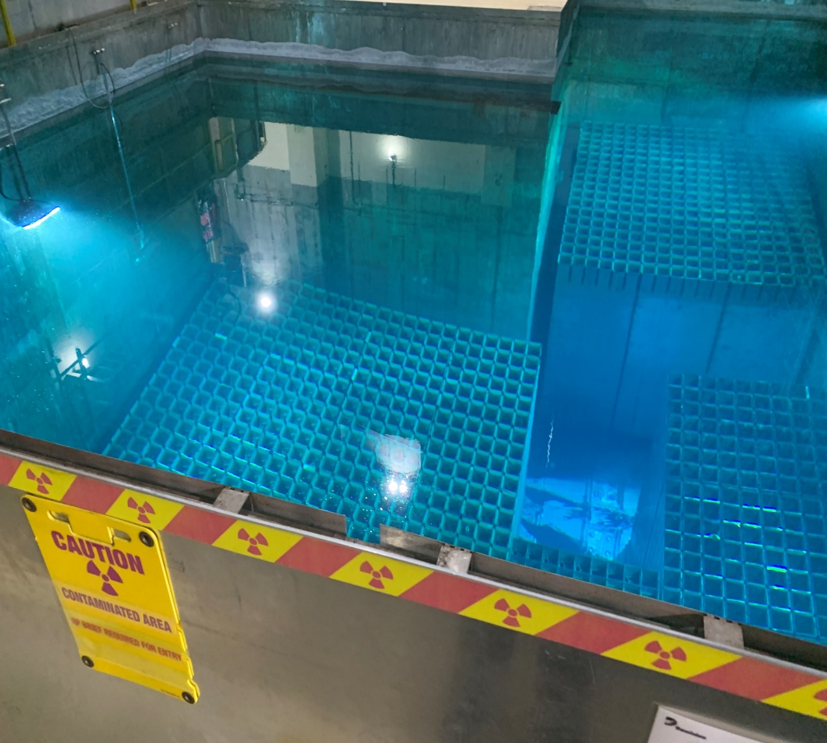
MP Unit Three SFP

Slide 6
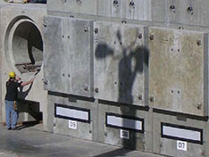
MP Unit Two
Dry Cask Storage Campaign In July
2-5 Casks To be Loaded

Slide 7
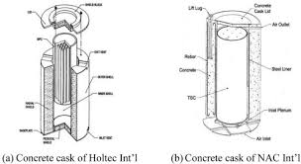
Connecticut Yankee

Slide 8
End

