Slide 1
3 Yankee Companies & National SNF Status Update
NEHLRWT Taskforce Fall Meeting, Portland, ME
October 25, 2023
Eric Howes, Director Public & Government Affairs
Maine Yankee Atomic Power Company

Slide 2
Overview of the 3 Yankee Companies
MY, CY, and YR are independent, single-asset, fully decommissioned NPP sites that have been stand-alone ISFSIs for nearly two decades.
When DOE meets its obligation to remove the SNF/GTCC waste, the ISFSIs will be decommissioned, the NRC licenses terminated, the sites made available for other purposes, and the companies will go out of business.
Until then it is the 3 Yankees’ responsibility as the NRC licensees to store and secure the SNF/GTCC waste in accordance with all applicable regulations.
The 3 Yankee Companies have been in litigation with the DOE since 1998 to recover costs for the 3 companies' utility owners and their ratepayers resulting from the federal government's ongoing failure to remove the SNF/GTCC waste. The 3 companies to date have recovered about $575 million through 4 rounds of litigation.
There are currently 21 permanently & announced shutdown sites in the U.S.

Slide 4
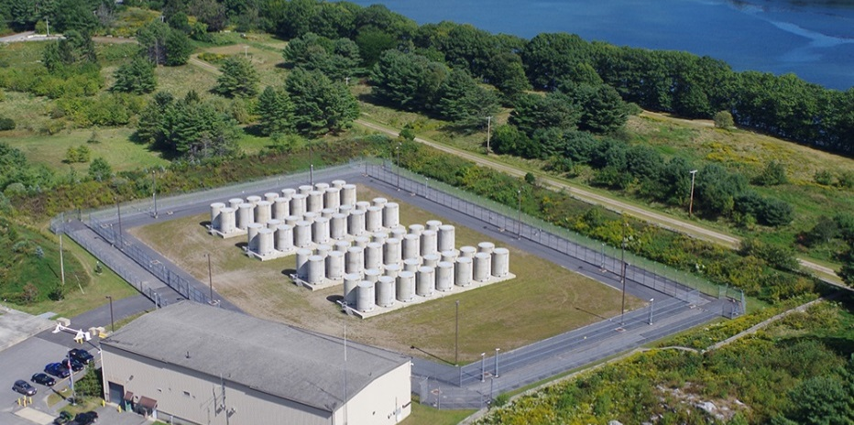
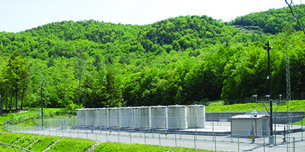
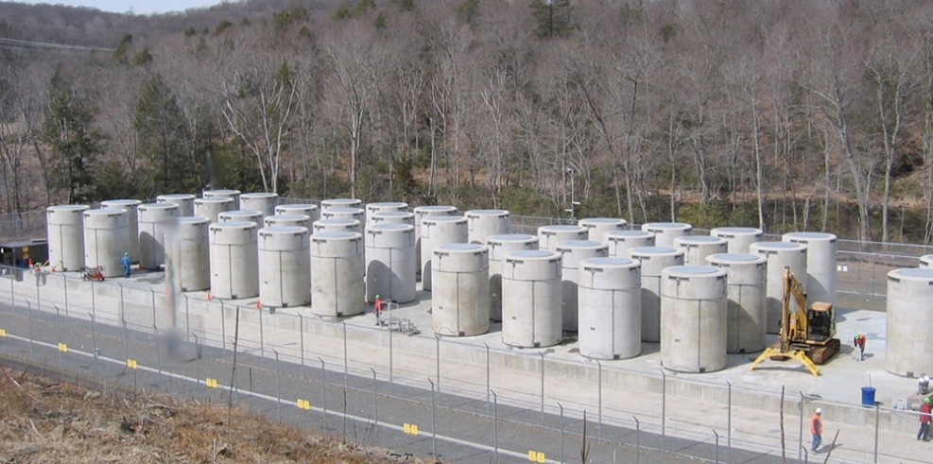
ISFSI dry cask systems licensed by NRC for storage & Transport: NAC UMS System at MY, NAC MPC system at CY & YR
115 canisters SNF, 8 canisters GTCC waste
Yankees are working with NAC on NRC applications to renew the MPC & UMS storage CofCs for 40 years.
NRC approval of the MPC storage C of C renewal occurred on 10/17/23 and the UMS C of C approval is expected in the second quarter of 2024.
Aging Management Programs for each of the 3 Yankee sites have been drafted and are in the review process.
Dry storage system inspections: YR summer 2022; CY, summer 24; MY, 26 (Previous MY inspections 2018, 2016)
Maine Yankee
Yankee Rowe
Connecticut Yankee

Slide 5
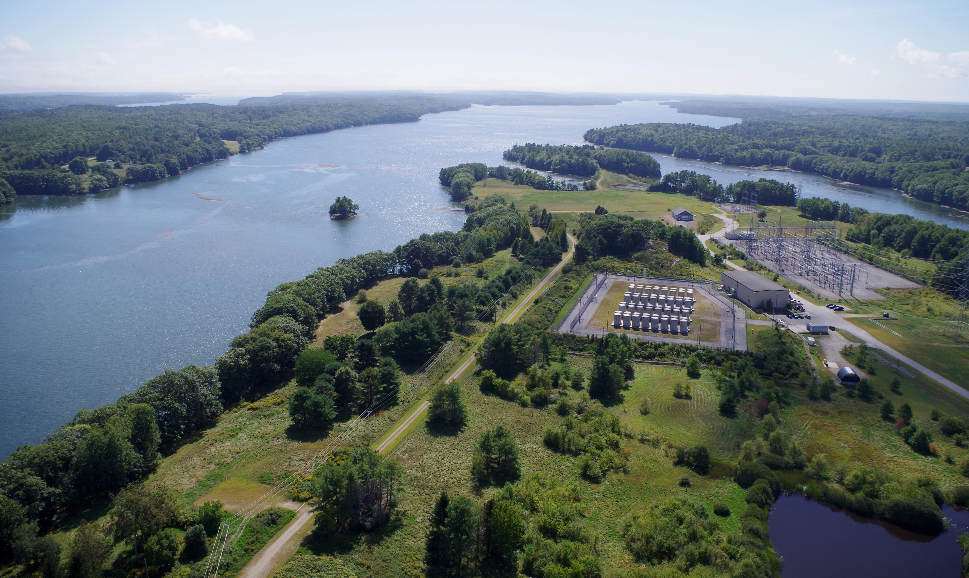
Maine Yankee ISFSI Site, Wiscasset, ME

Slide 6
Congress: Funding legislation
45 day Continuing Resolution to fund the federal government until mid-November.
The path forward on appropriations is up in the air, given the current situation in Congress and everything being on hold.
Both the Senate/House House full approps committees passed the FY24 E&WD approps bill in the summer with support for DOE’s consent-based siting federal CIS initiative.
The House bill includes a prohibition on the use of federal monies for private CIS entities until such time that host state and local governments and any affected Indian tribes have formalized their consent.
The Senate FY 2024 E&WD Appropriations bill includes authorization for one or more federal CIS facilities and priority for permanently shutdown sites as it has in past years.

Slide 7
Congress: Authorizing legislation
The Senate ADVANCE Act (SB 1111 “Accelerating Deployment of Versatile, Advanced Nuclear for Clean Energy”) mainly focuses on future nuclear technology - but also contains a grant program to assist shutdown site communities for the next 5 years.
The bill was reported out of the Senate Environment and Public Works Committee in July by a vote of 16-3. The bill was included as an amendment to the FY 24 National Defense Authorization Act that has passed both the Senate and House.
The two chambers have yet to pass a compromise version.

Slide 8
Private Consolidated Interim Storage facility status
The Holtec New Mexico and the Texas Interim Storage Partners NRC licensed CIS facilities have been licensed by the NRC; however, both remain subject to litigation and strong state political opposition.
The NM Governor signed into law on 3/17/23 a bill that bans the storage or disposal of SNF and/or high-level radioactive waste in NM unless the state has consented to the creation of the disposal facility. Holtec has said it plans to challenge the state law in court.
In September 2021, the TX governor signed a bill into law that prohibits the storage and disposal of SNF/HLRW in the state except for storage at existing nuclear power and research reactor sites.

Slide 9
Private Consolidated Interim Storage litigation status
Texas: On 8/25/23 in the case of Texas v. NRC challenging the NRC license of the ISP CIS facility, the U.S. Court of Appeals for the Fifth Circuit ruled that the NRC lacks the statutory authority to grant licenses to private entities for the storage of used fuel at reactor sites and vacated the NRC license for the ISP facility.
The NRC and DOJ yesterday filed an appeal for a full (en banc) review by the Fifth Circuit Court of Appeals. NEI plans to file an amicus brief. This decision is at variance with two other appellate courts (the DC and tenth Circuits) who have previously upheld the NRC’s licensing actions.
New Mexico: On 9/8/23 the petitioners in the Holtec facility NRC licensing case (Beyond Nuclear; Fasken Land and Minerals; Sierra Club and 6 other groups) filed three separate opening briefs before the U.S. Court of Appeals for the D.C. Circuit challenging NRC’s grant of a license for the Holtec CIS facility.

Slide 10
3 Yankees’ working with others to overcome the SNF policy impasse
The 3 Yankee Companies are participants in several organizations advocating for policy reform that results in a national integrated nuclear waste management program including the Nuclear Waste Strategy Coalition, the Decommissioning Plant Coalition and the Nuclear Energy Institute.
Substantial progress will occur only when Congress authorizes and provides sustainable annual funding from the NWF for an integrated nuclear waste management program that includes near-term CIS with priority for SNF stored at shutdown reactor sites, a parallel effort toward a permanent geologic repository, and funding for transportation planning focused on communities, states, and tribes.
Additionally, the 3 Yankee Company CABs, which began during plant decommissioning, continue to be active over 25 years later. CY’s annual meeting was in May, MY’s in September, and YR’s just last week.

Slide 11
MY CAP letter to ME congressional delegation
Each year the MY CAP sends a letter to the ME delegation thanking them and sharing thoughts from the panel’s discussion. This year’s letter emphasizes the following:
“CAP members expressed frustration that the SNF is seemingly stranded indefinitely, raising concerns regarding the impact of climate change and sea level rise, as well as the ability to transport the SNF in the future.”
While we are encouraged that the DOE is learning from its international counterparts and making incremental progress in a consent-based siting process for a federal CIS facility, we are dismayed the DOE expects this process to take 10-15 years, including necessary amendments to the NWPA before a federal facility can be operational.
We look forward to any suggestions you may have on how our CAP can be helpful in resolving the policy impasse.”

Slide 12
Thank you!
ehowes@3yankees.com
http://www.3yankees.com/index.html

