Slide 1
Office of Integrated Waste Management (IWM) Overview
Sara Hogan, PhD
Office of Integrated Waste Management
US Department of Energy
Northeast High-Level Radioactive Waste Transportation Task Force Fall Meeting
October 25-26, 2023
Portland, ME

Slide 2

Office of Integrated Waste Management
Mission (updated June 2023)
Construct one or more federal interim storage facilities, using a consent-based siting process, ready to receive commercial spent nuclear fuel as soon as practicable.​

Slide 3
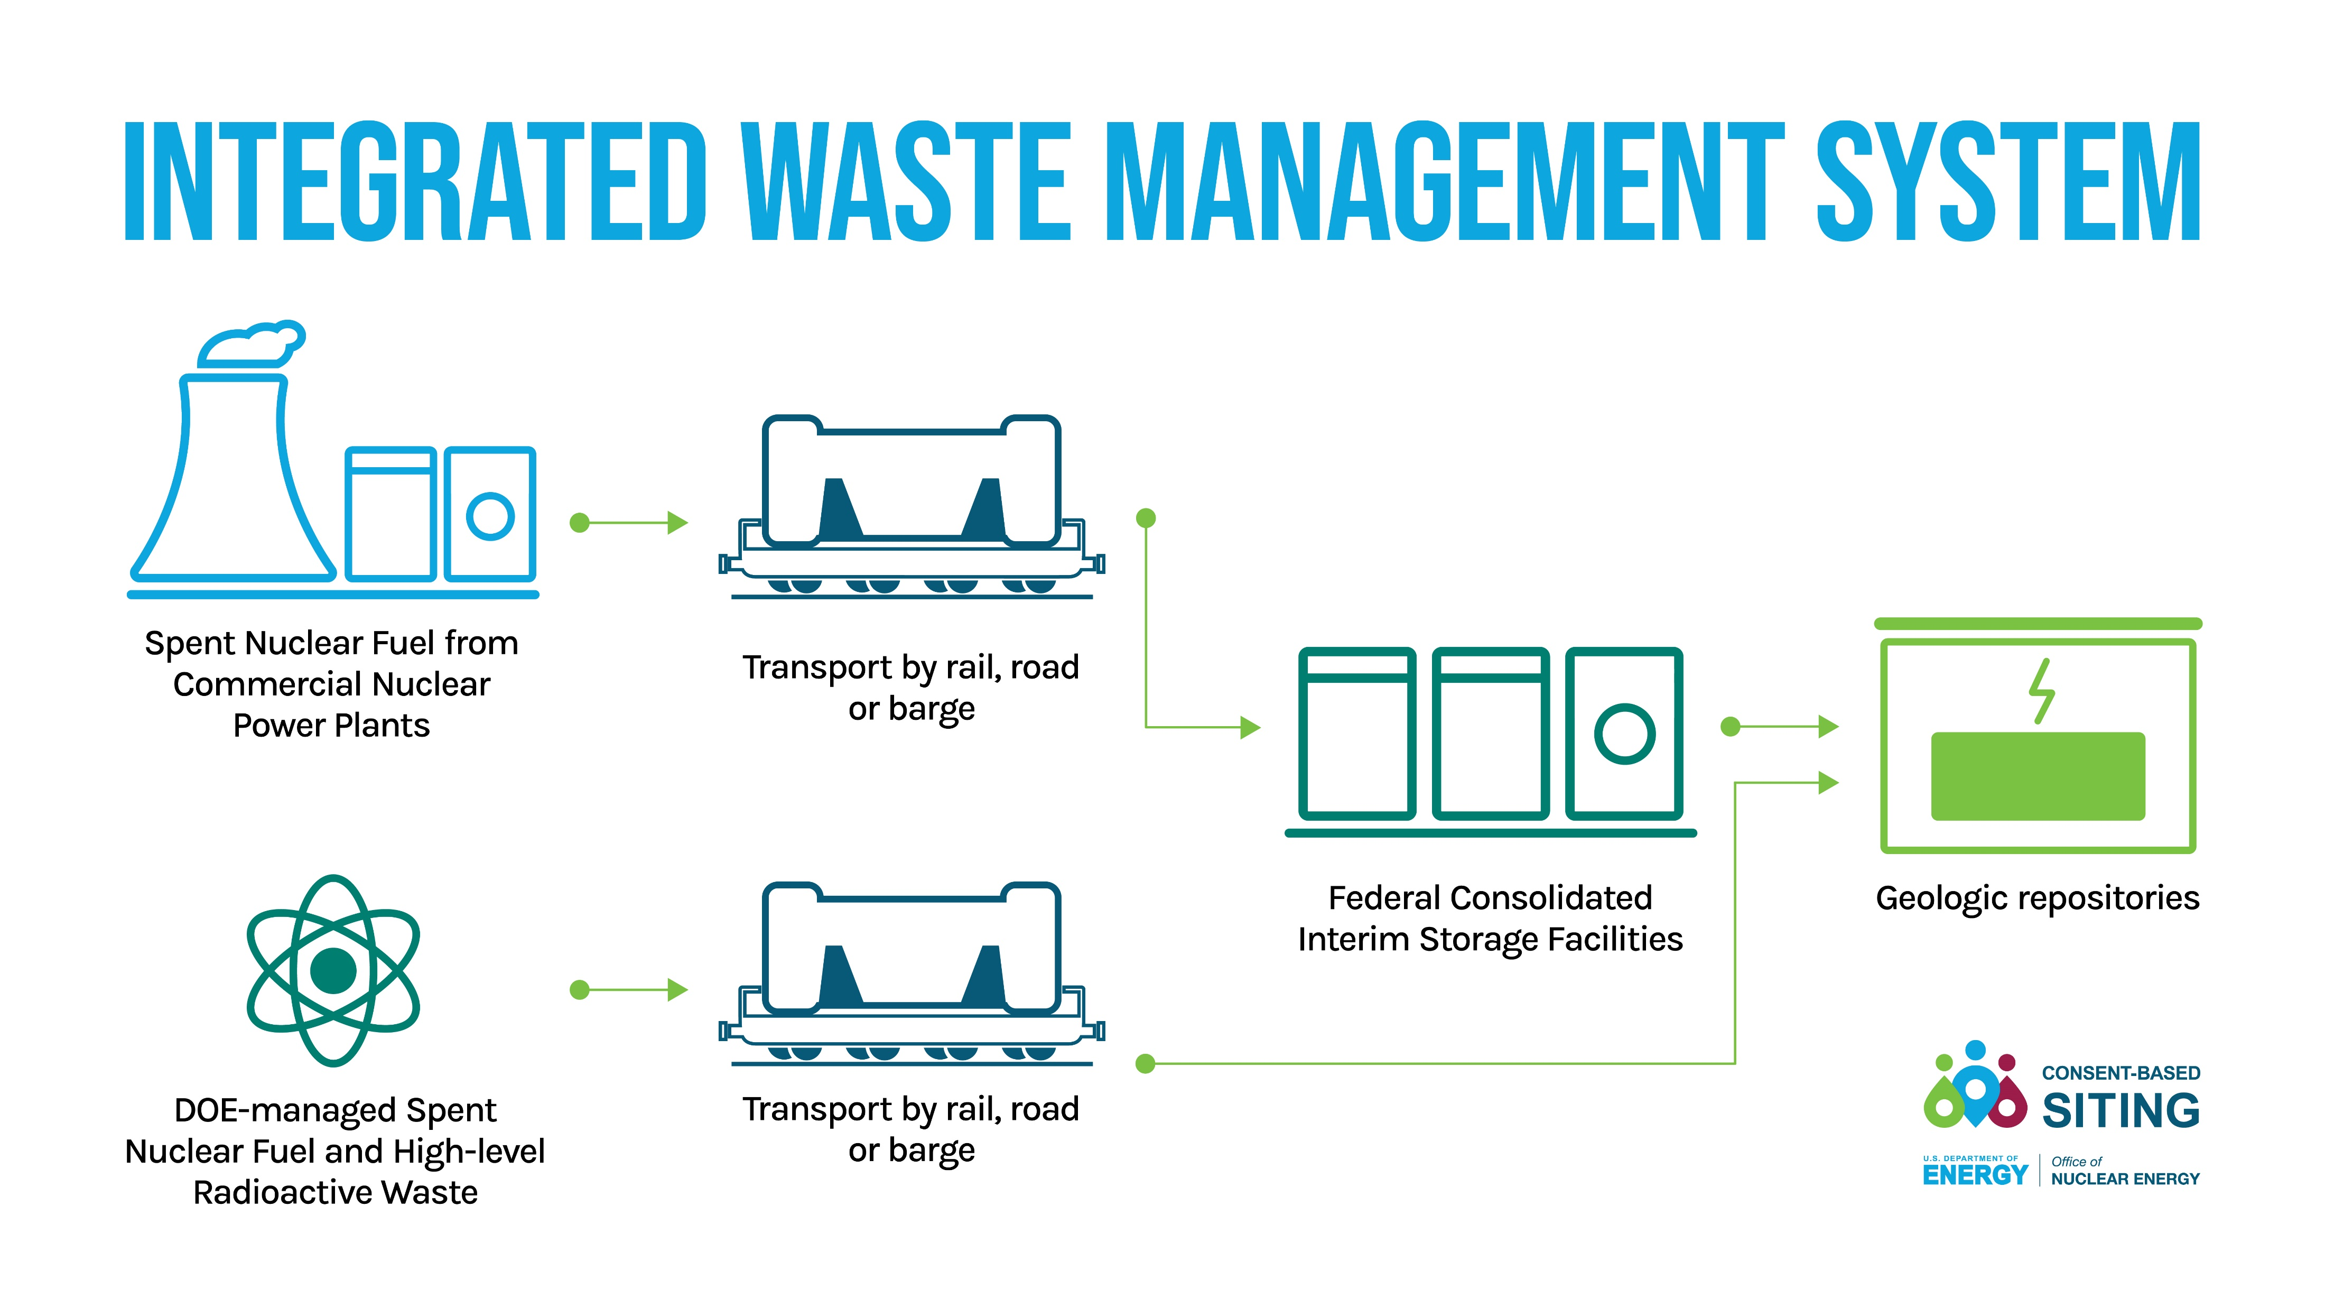
Integrated Waste Management System
Storage facility(ies)
Transportation capability
Disposal facility(ies)
Interfaces

Slide 4
FY24 IWM Appropriations Status
Draft House Mark
$18 million
Draft Senate Mark
$53 million
Integrated Waste Management System.—The Department is directed to move forward under existing authority to identify a site for a Federal interim storage facility. The Department is further directed to use a consent-based approach when undertaking these activities. The Department is reminded that the Nuclear Waste Policy Act provides for a wide variety of activities that may take place prior to the limitation in that act.

Slide 5
IWM FY24 Planned Activity Highlights
Effective implementation of a federal consolidated interim storage facility(ies) for the nation’s nuclear waste using a consent-based approach
A full-scale package performance test of a rail-sized spent nuclear fuel (SNF) cask
Engaging with State and Tribal partners to cooperatively plan for large-scale SNF transportation, including approaches to emergency response training and vehicle safety inspections
Developing purpose-built railcars and security and safety monitoring equipment to support large-scale SNF transport
Beginning acquisition path for transportation casks for SNF, which may require moderate lead times to update cask certificates of compliance and initiate commercial fabrication capacity
Evaluating transportation infrastructure at nuclear power plant sites to identify options for removing SNF from the sites.

Slide 6
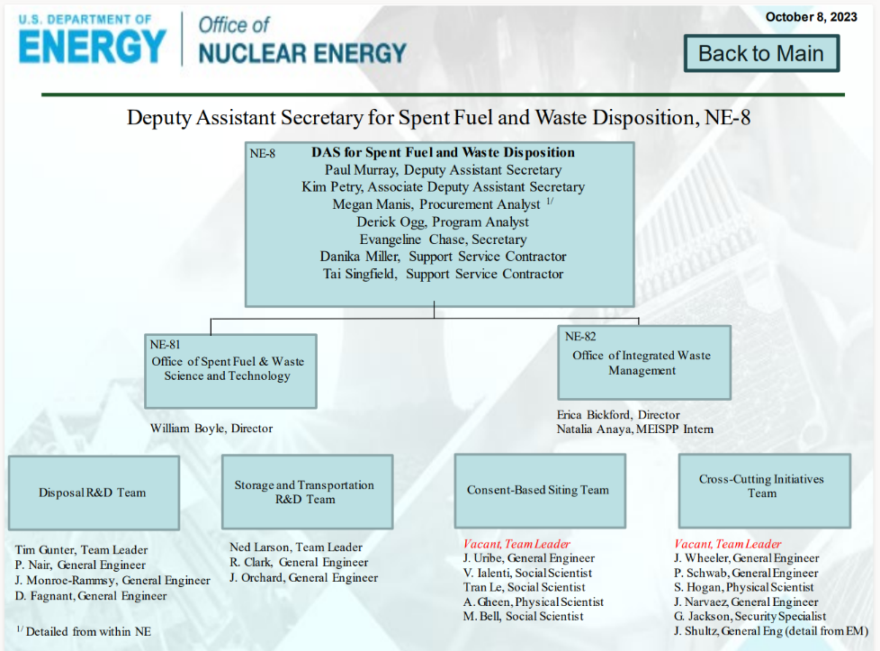
Office of Integrated Waste Management
Organization Chart
Paul Murray is the new Deputy Assistant Secretary for Spent Fuel and Waste Disposition, NE-8!
DAS Murray comes to the Office of Nuclear Energy from Orano Federal Services where he most recently served as its Chief Technology Officer.
He has had a long career in Nuclear Energy including working with spent fuel management, advanced reactors and accident tolerant fuel.
Paul will begin his federal career on October 10, 2023, and will be duty stationed in the Forrestal Building in Washington DC.

Slide 7
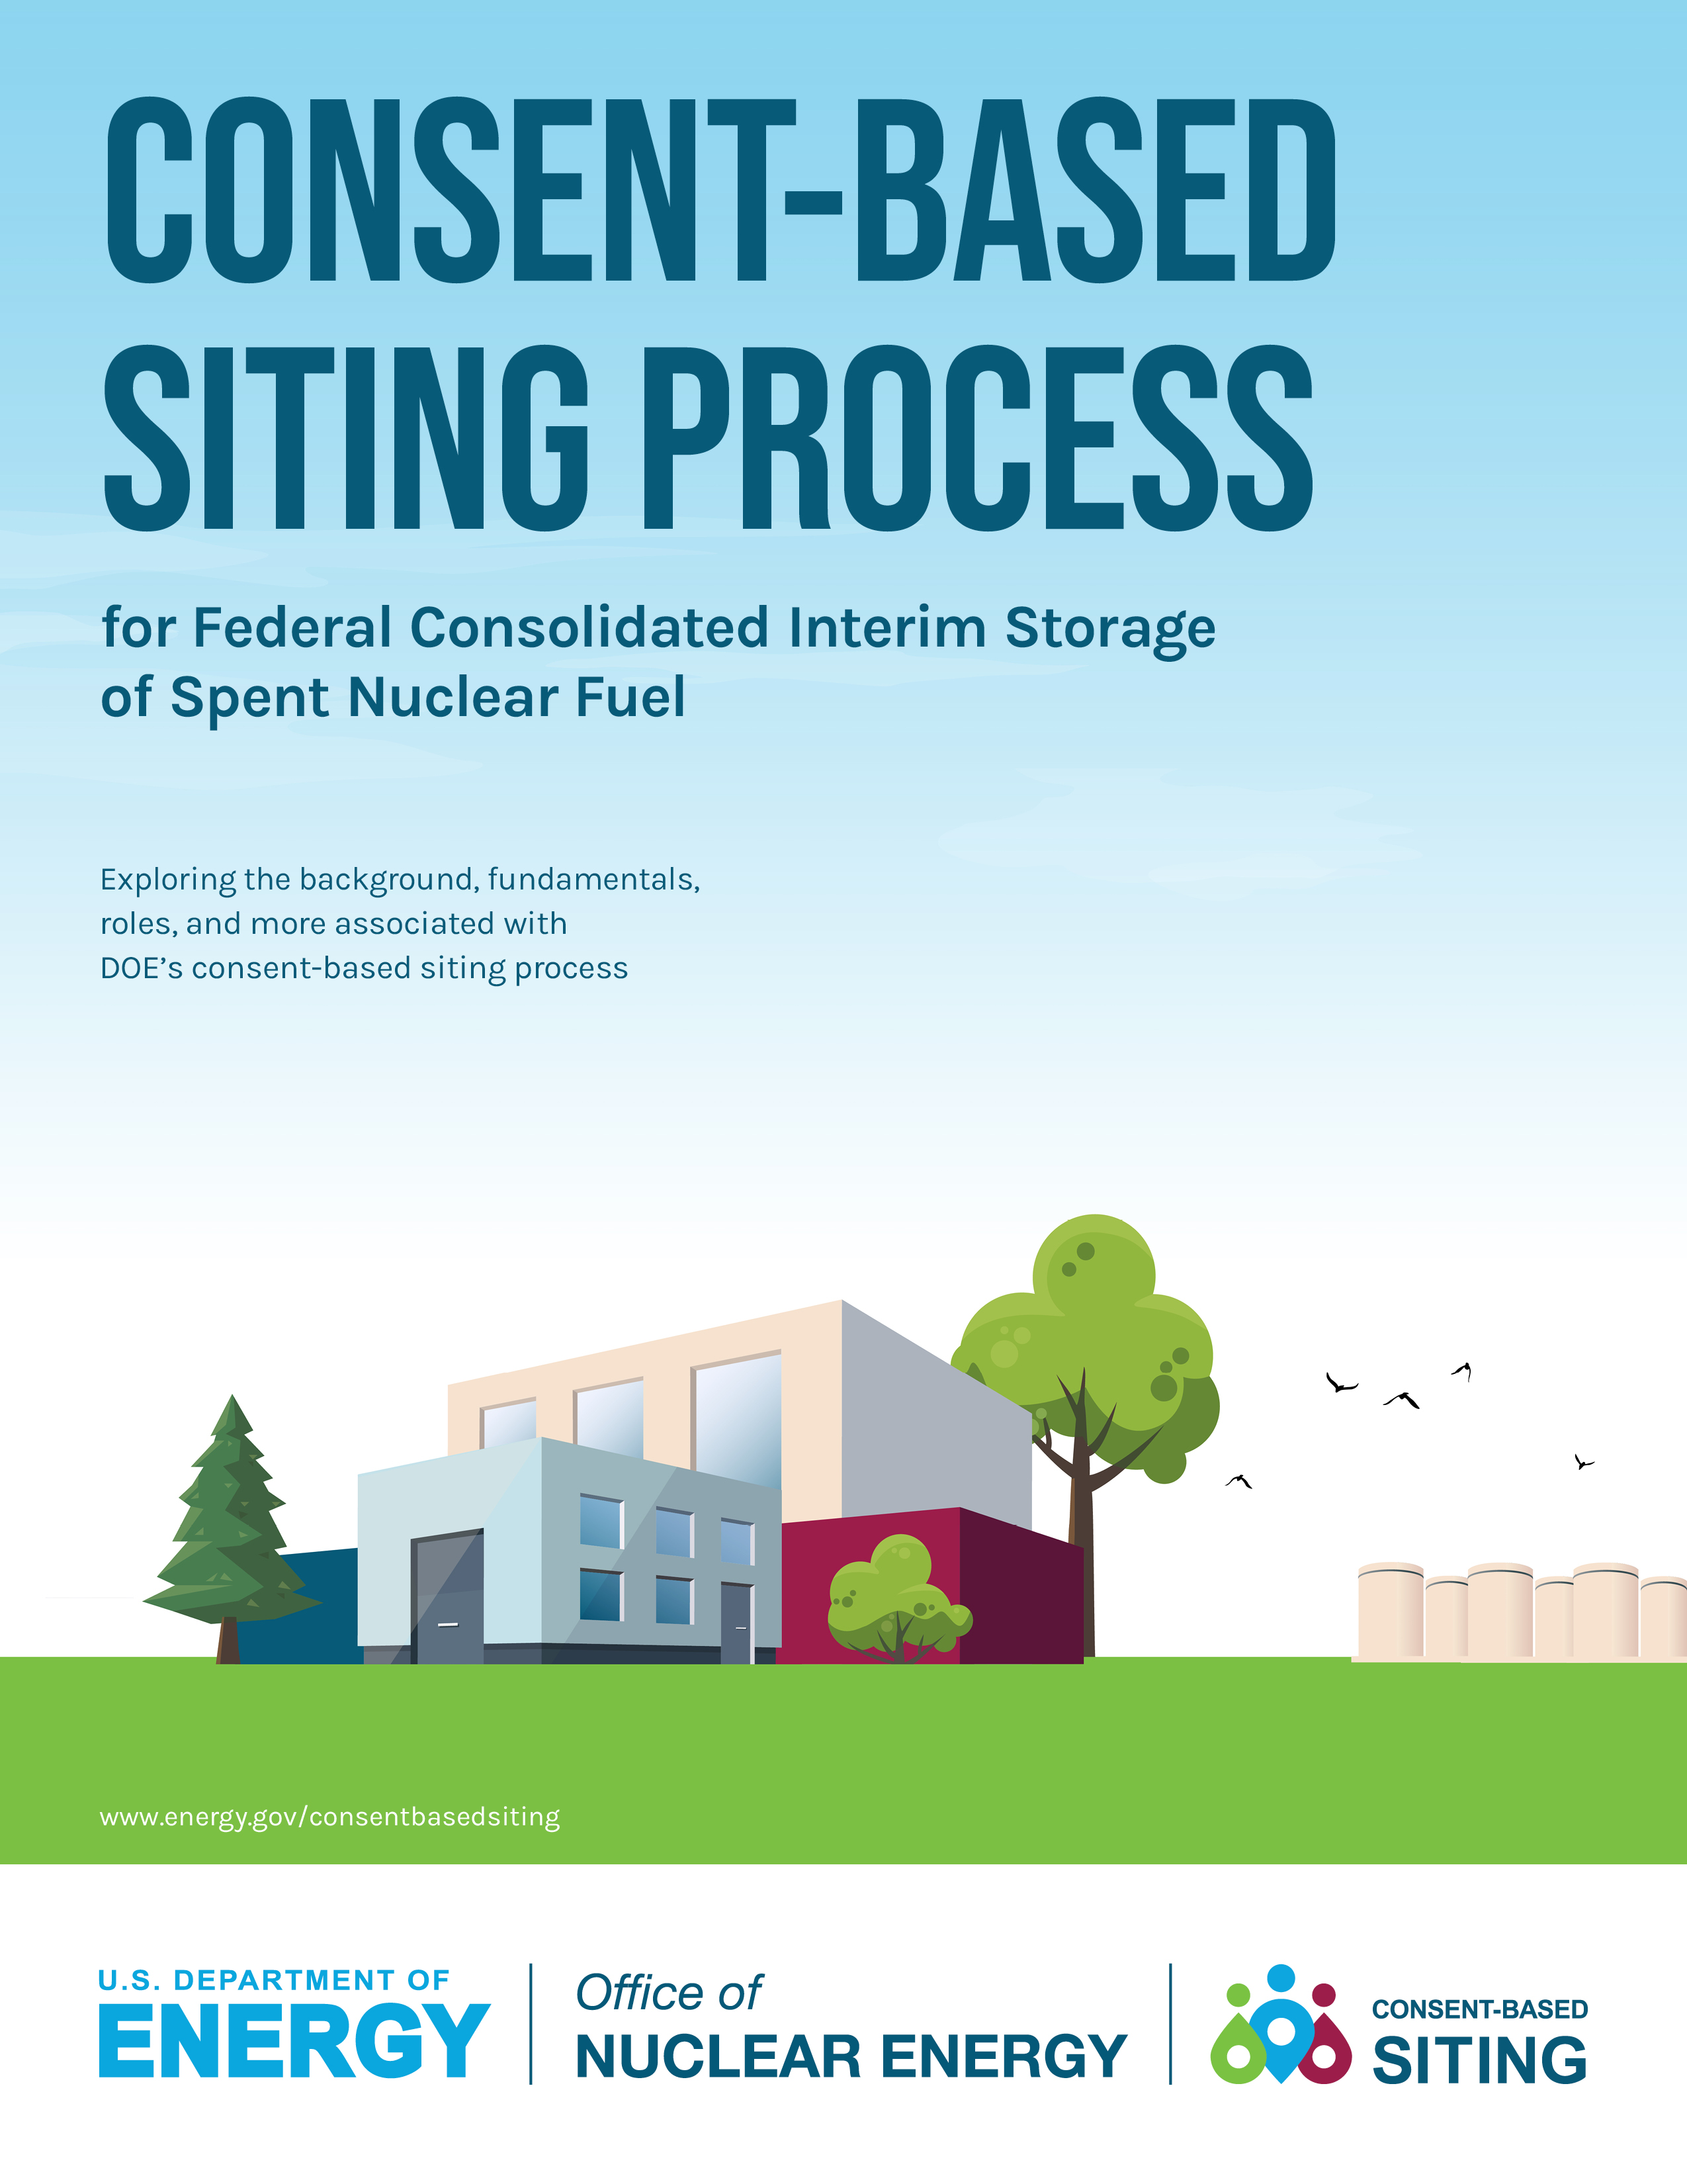
THE CONSENT-BASED SITING PROCESS
April 2023
Prioritizes people and communities
Centers equity and environmental justice
Collaborative, phased, and adaptive
www.energy.gov/consentbasedsiting

Slide 8
4 Key Updates
Current focus is on one or more federal consolidated interim storage facilities for commercial SNF
A Greater emphasis on equity and environmental justice
Increase host communities' role in developing site-specific assessment criteria
Expand consideration of funding opportunities to support community participation

Slide 9

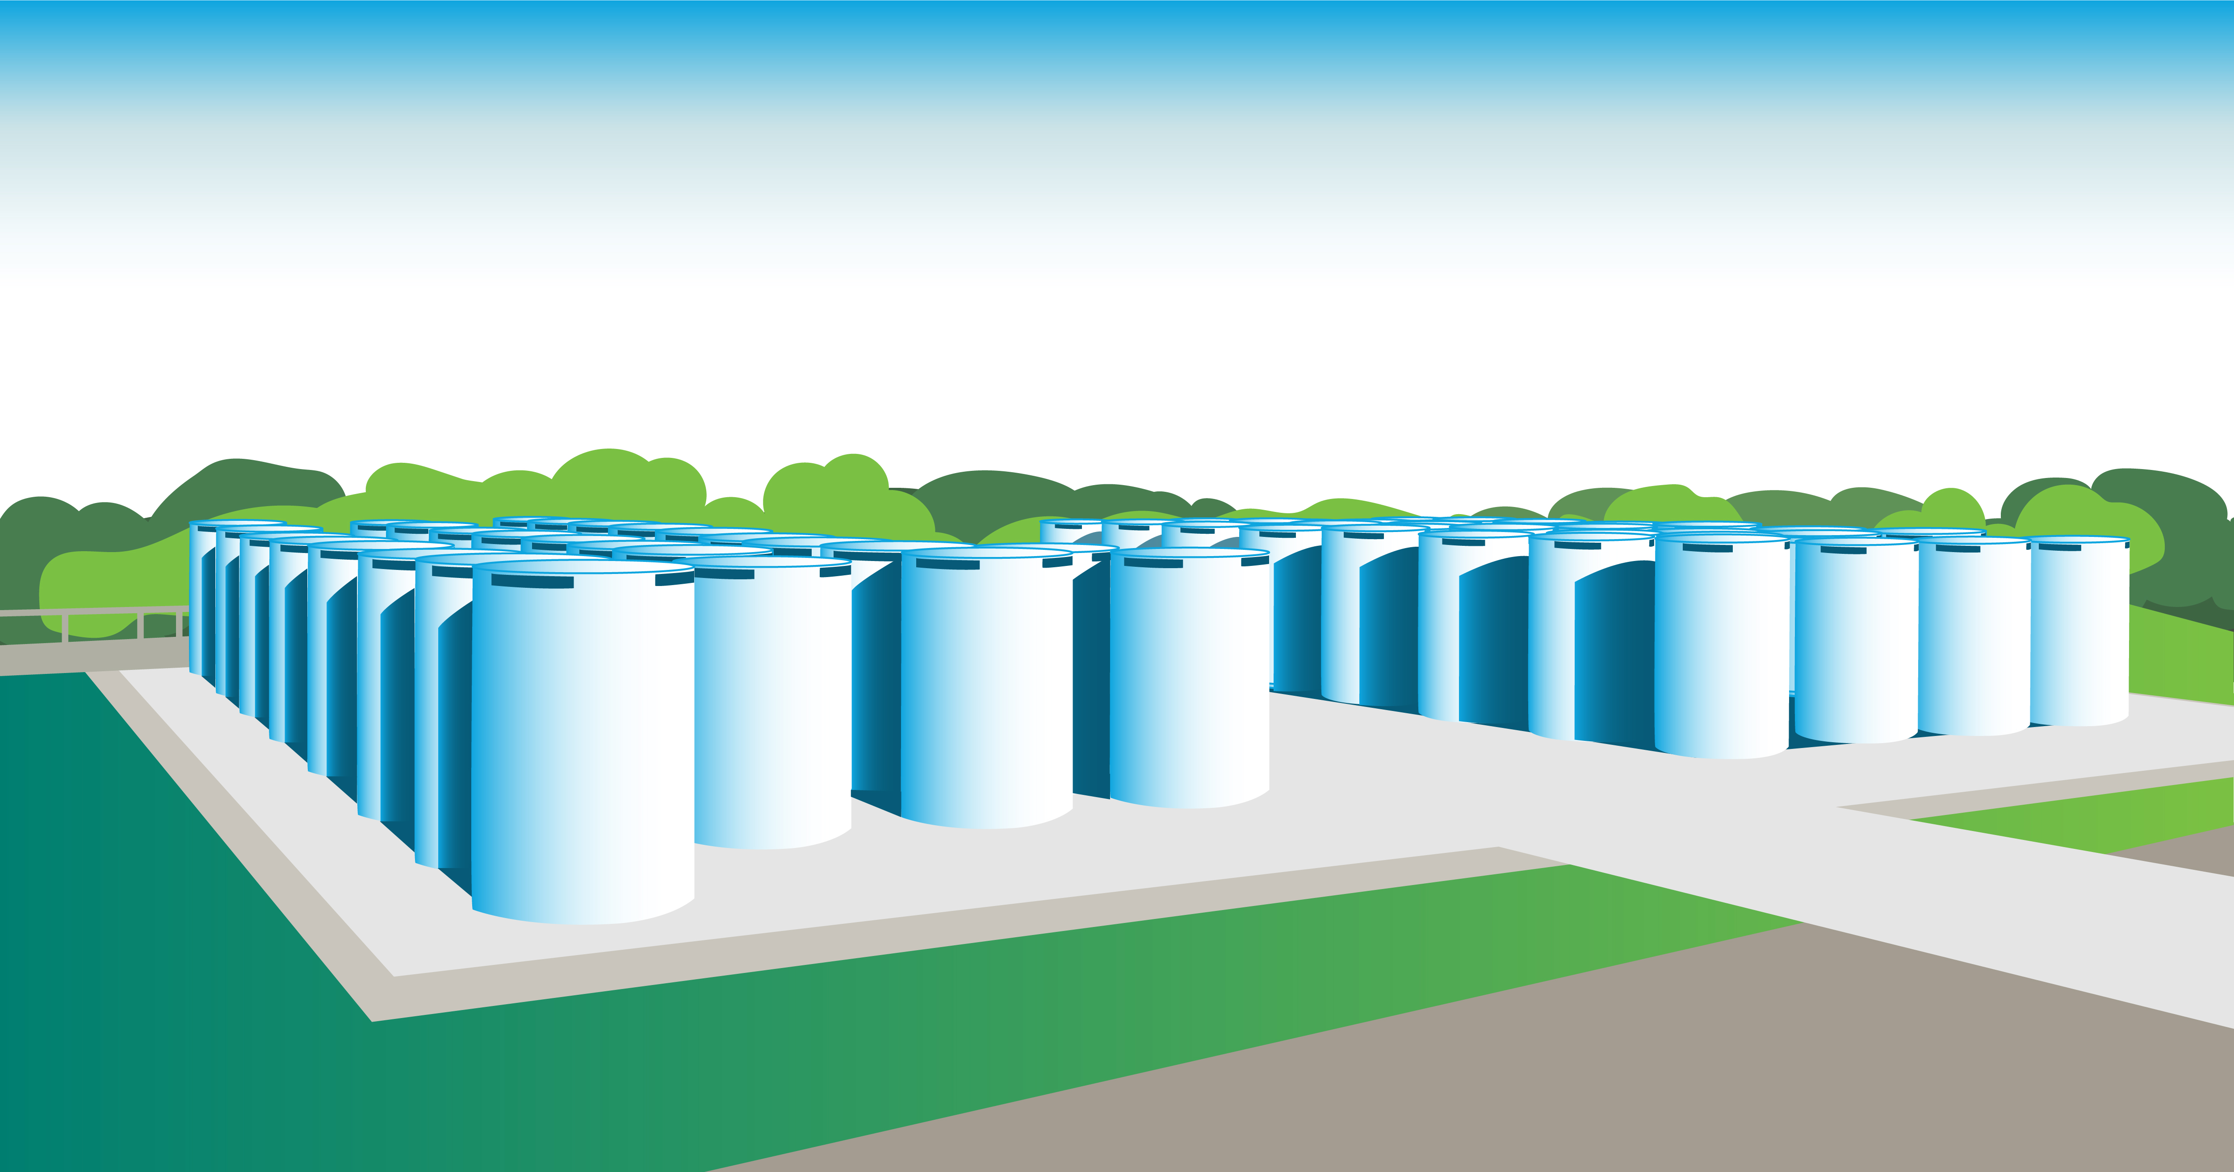
CONSENT-BASED SITING PROCESS
Stage 1: Planning and Capacity Building
Build relationships, encourage mutual learning, develop a common understanding of nuclear waste management-related topics.
Stage 2: Site Screening and Assessment
Share screening and assessment criteria; issue a national call for volunteers; preliminary and detailed site assessments in collaboration with volunteer communities.
Stage 3: Negotiation and Implementation
Negotiate agreements with willing and informed host communities with licensing, construction, and operation activities to follow.
Phases 1A & 1B
ANTICIPATED REMAINING
DURATION 2-3 YEARS
Phases 2, 3, & 4
ANTICIPATED DURATION 4-7 YEARS
Phases 5, 6A, & 6B
ANTICIPATED DURATION TO INITIAL
OPERATION READINESS 4-5 YEARS

Slide 10
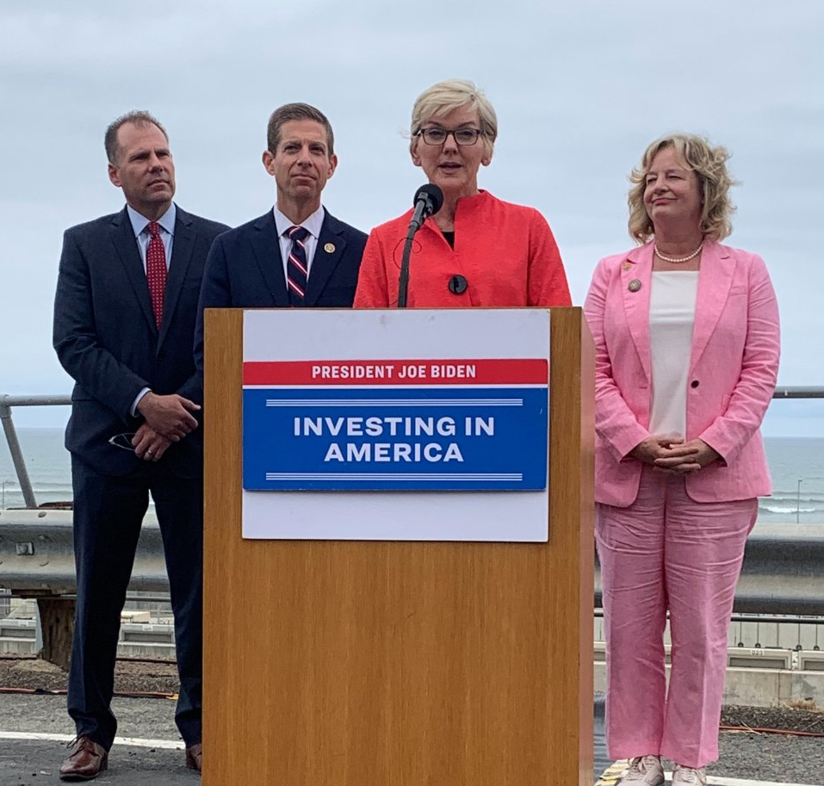
CONSENT-BASED SITING CONSORTIA
June 9, 2023, Secretary Granholm announced the FOA awardees at San Onofre Nuclear Generation Station, San Clemente, CA.

Slide 11
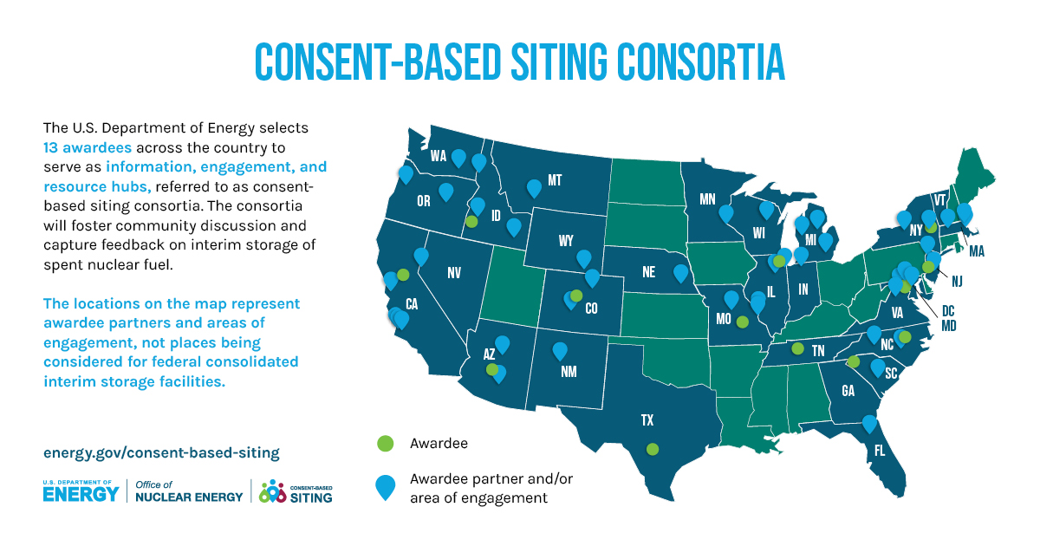
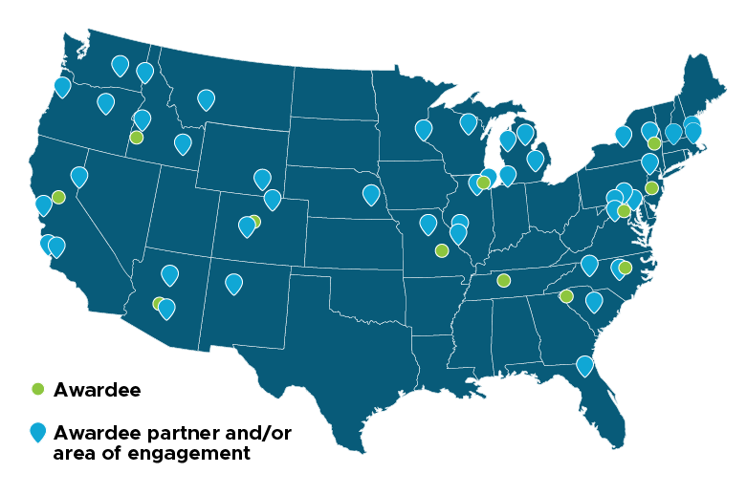
12
*List of geographical markers is
preliminary and expected to evolve over time.

Slide 12
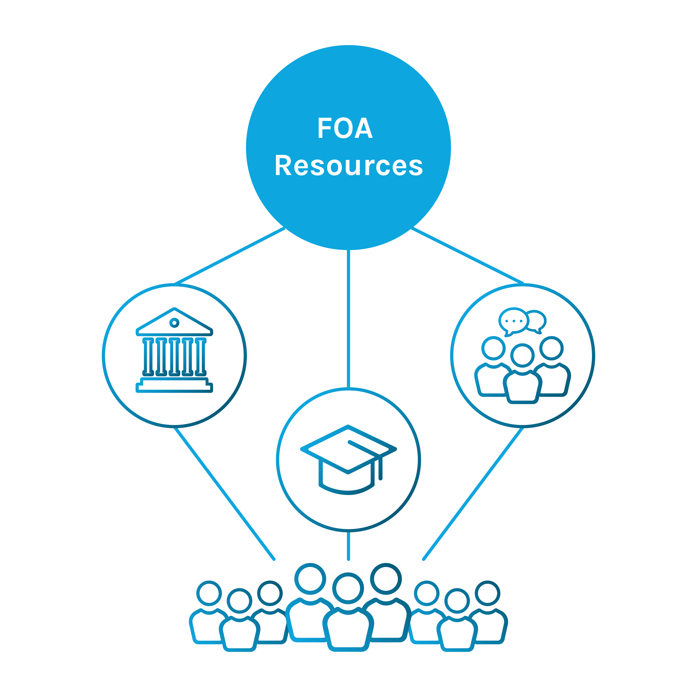
CONSENT-BASED SITING CONSORTIA CONT.
Award recipient is a hub for community engagement and resources
Reduce barriers for participation
Increase outreach (multiplication factor)
Allow for greater community engagement
Allow for cohort development/capacity

Slide 13
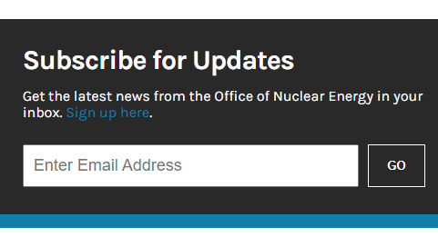

More information at: energy.gov/consentbasedsiting

Slide 14
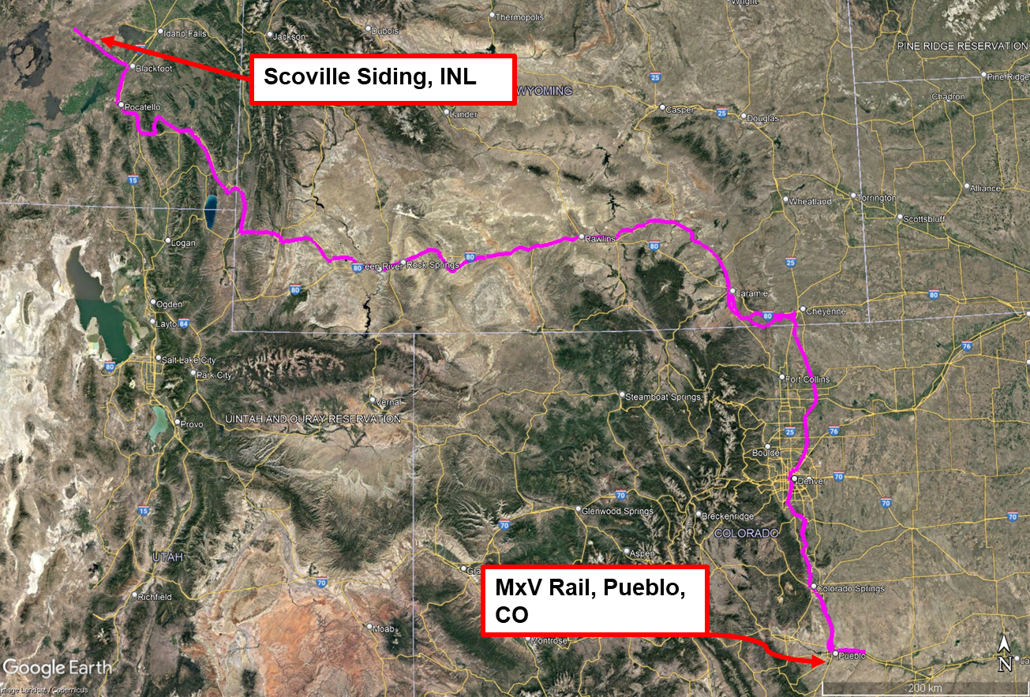
Transportation Project Updates
Railcar Development
Atlas (12 axle), buffer railcar, and rail escort vehicle (REV): Completed its final test in September – “Demonstration Run”
Demonstration Run: 1680 Miles from Pueblo CO- MxV Rail testing site to Scoville Siding Idaho, and back
Fortis (8 axle): Fabrication experiencing delays due to component supply chain issues, necessitated some design adjustments
https://www.trains.com/trn/news-reviews/news-wire/atlas-railcar-designed-for-spent-nuclear-fuel-completes-1680-mile-test-run/

Slide 15
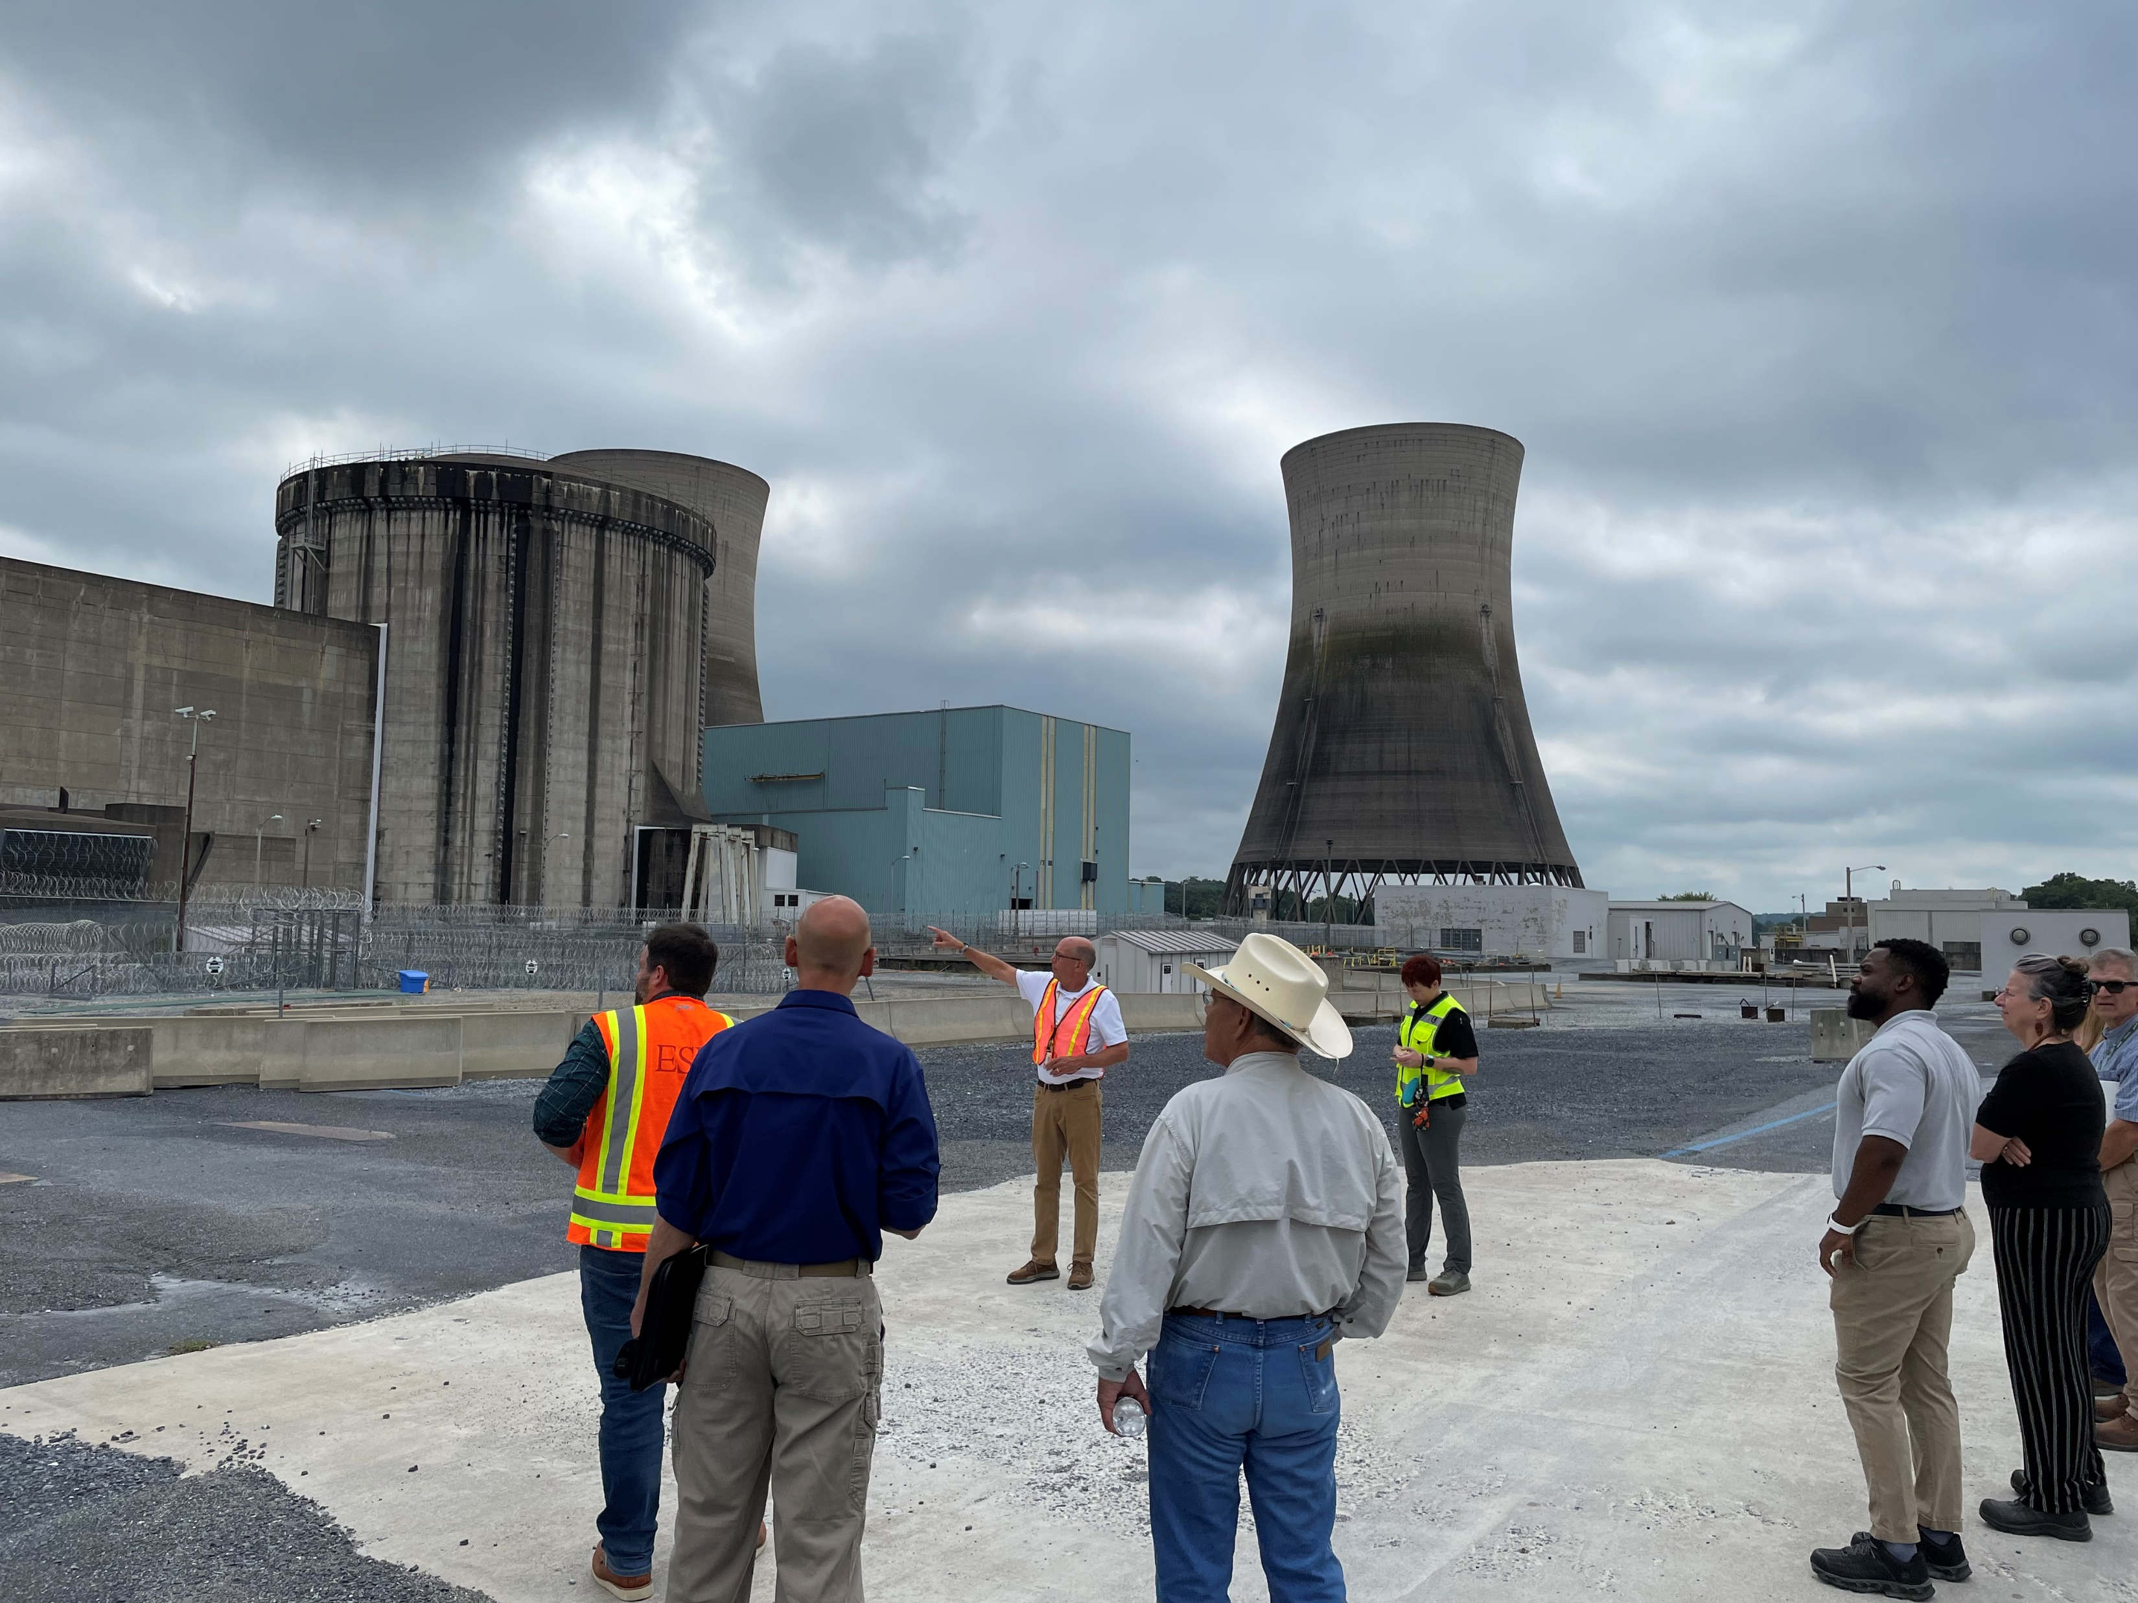
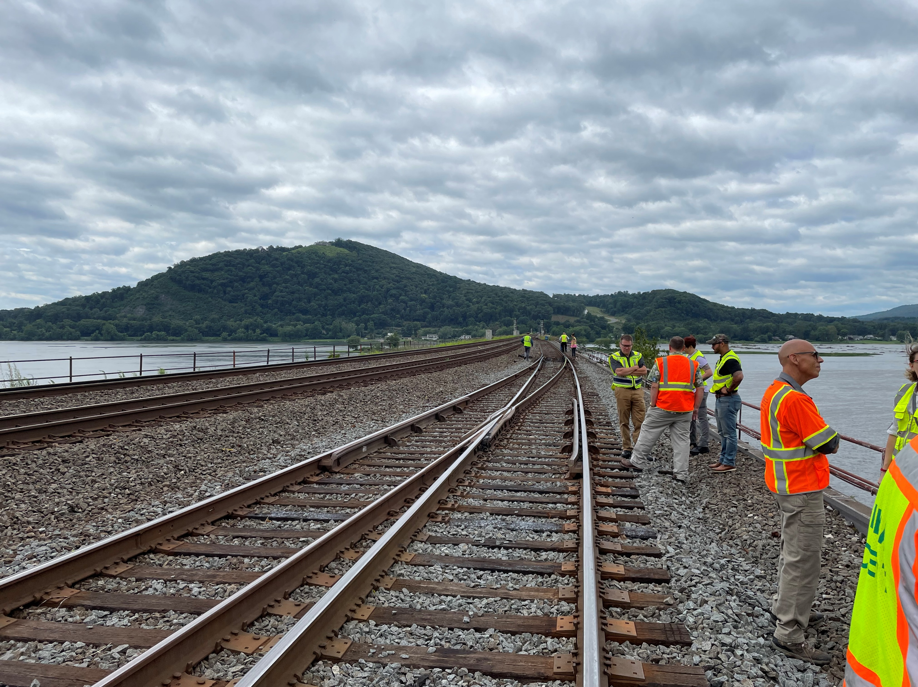
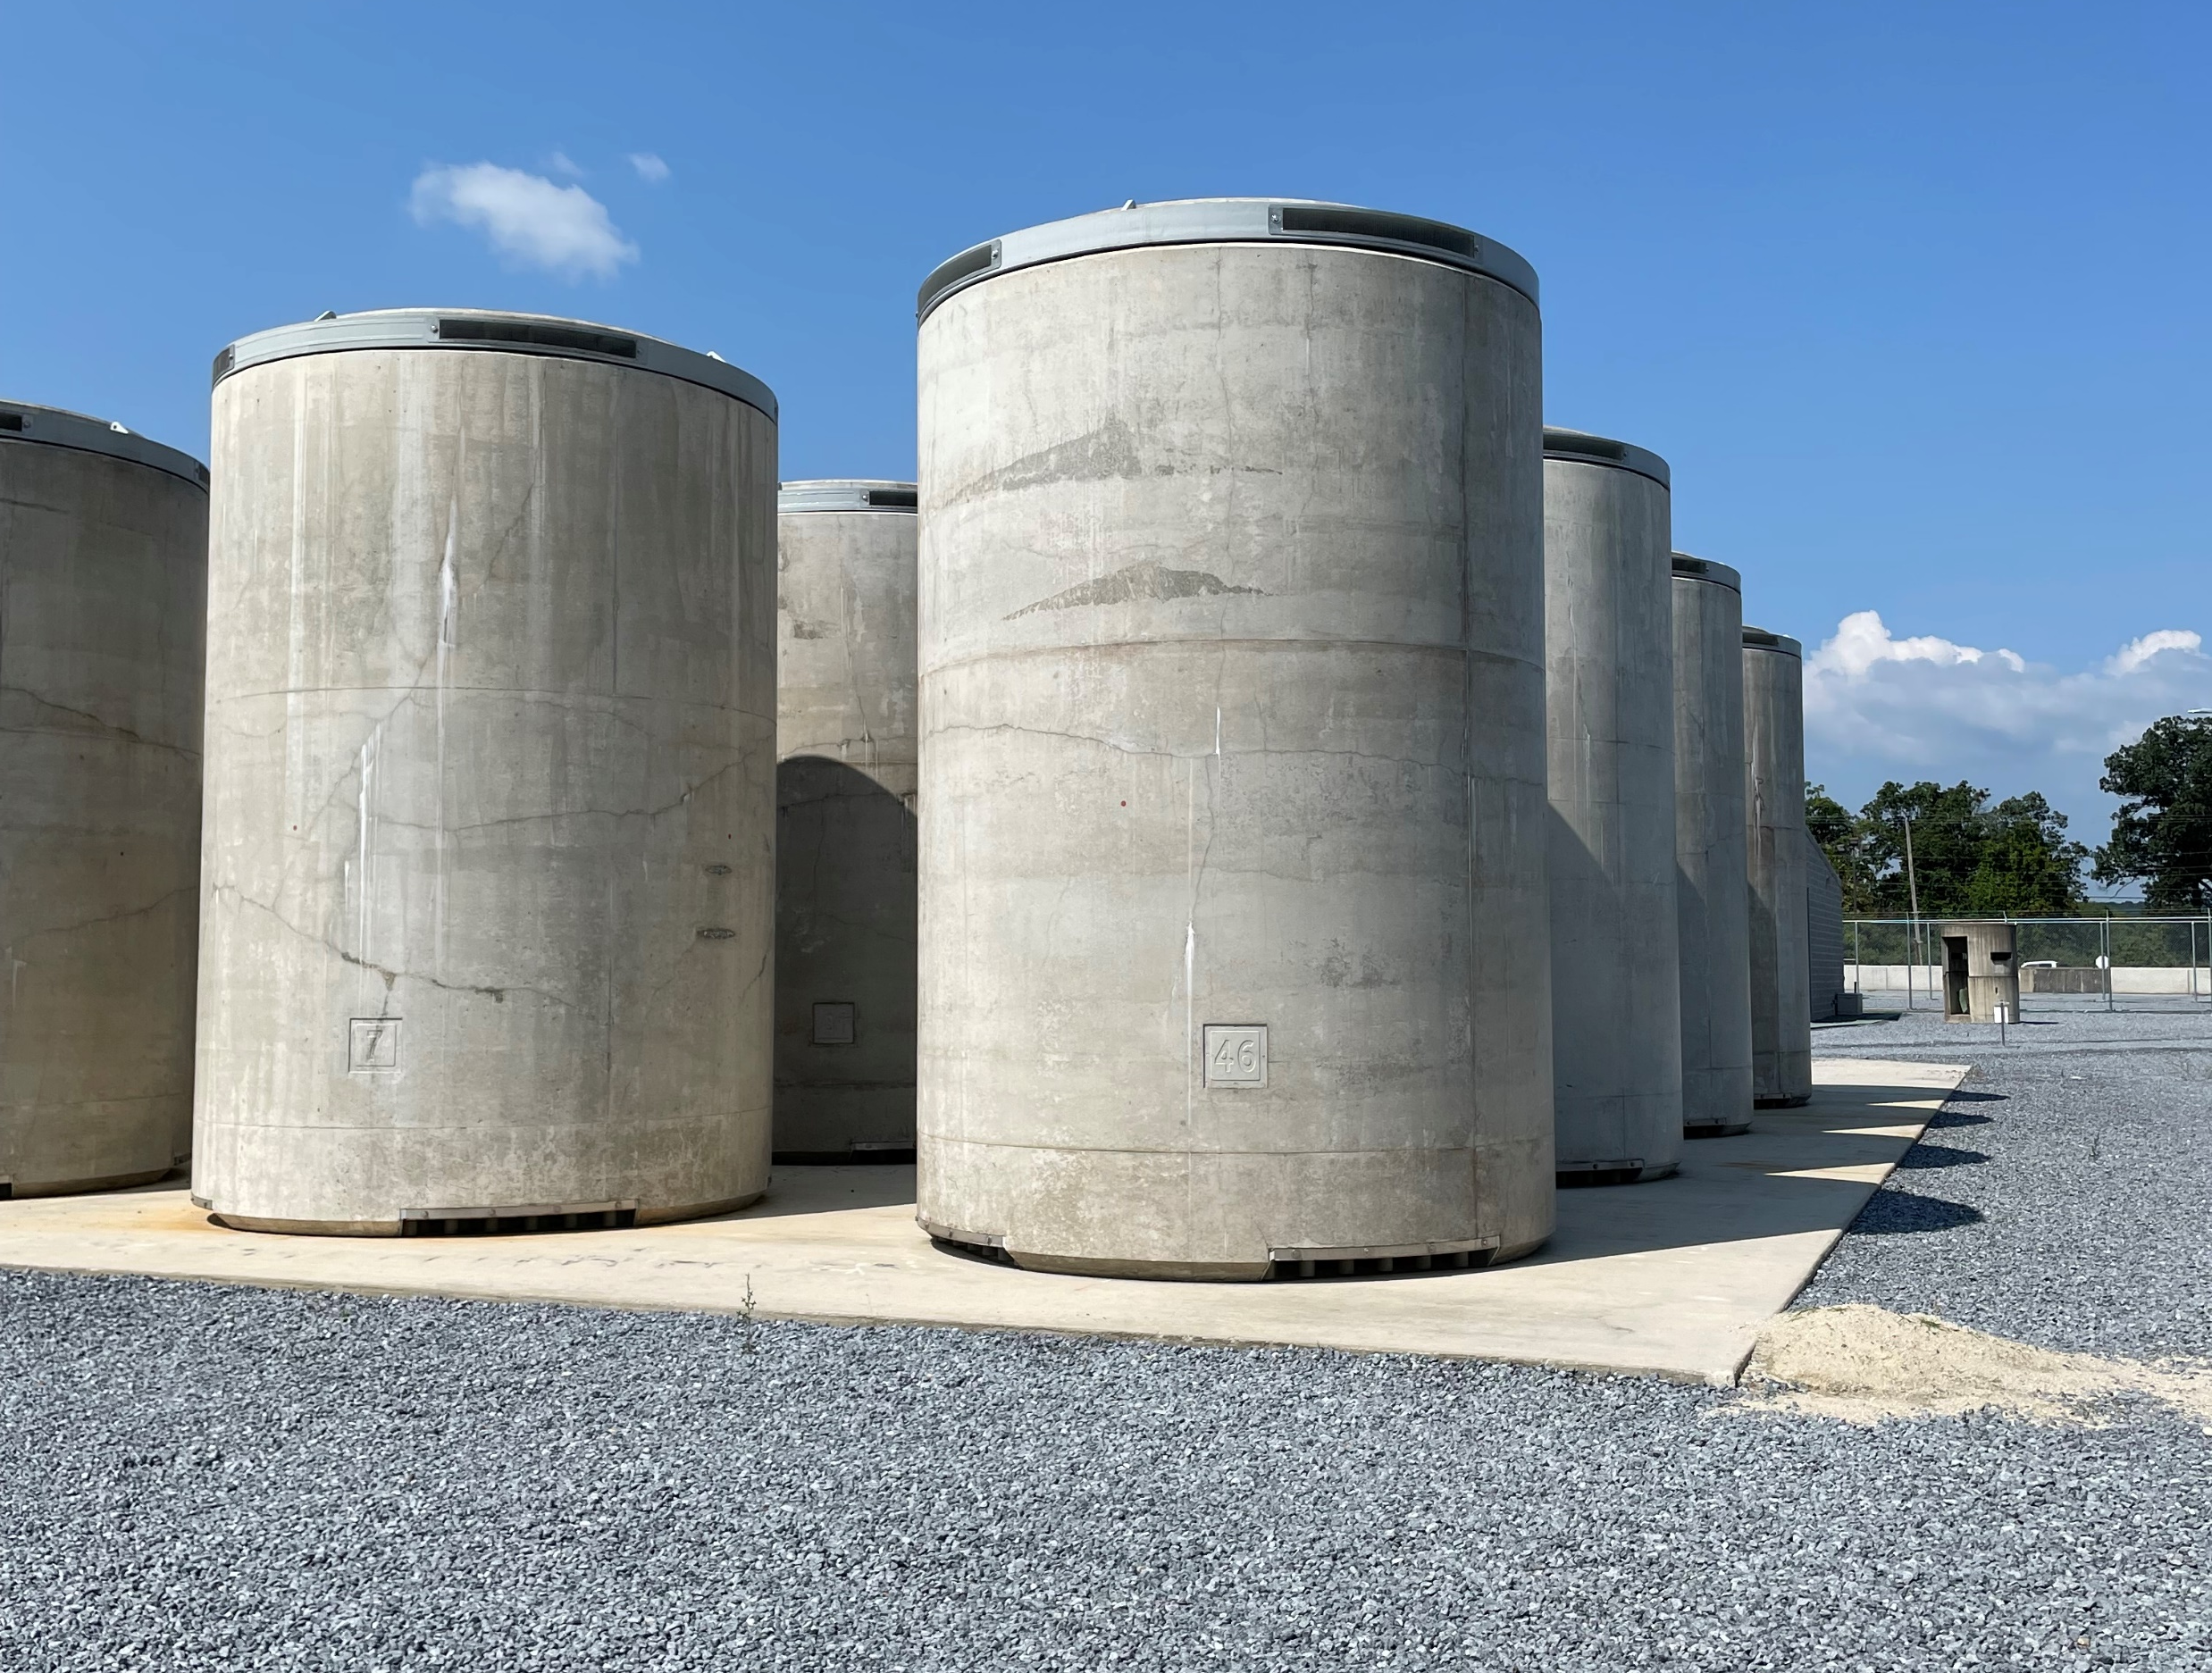
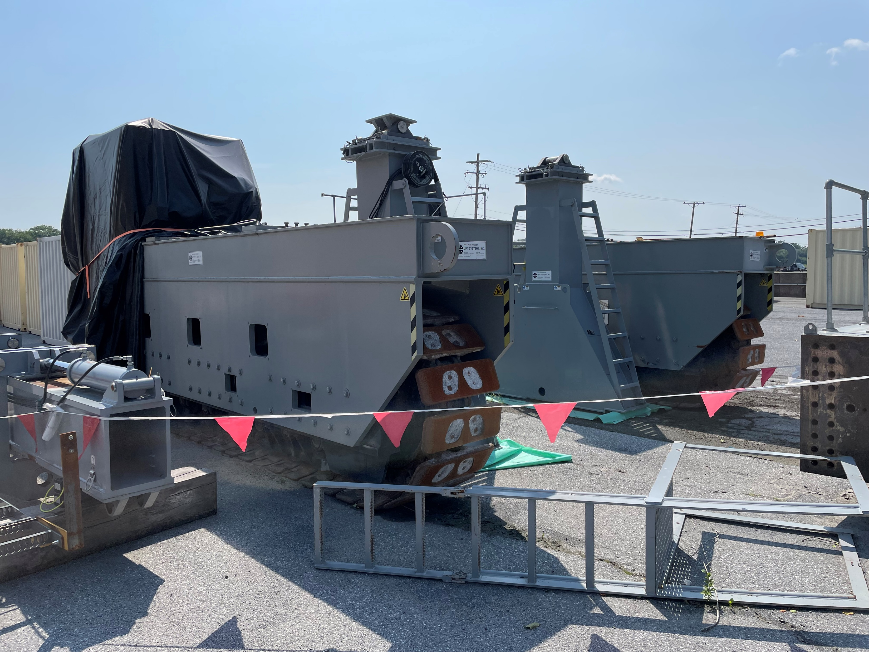
Transportation Project Updates
Site Evaluations
Nuclear Power Plant Infrastructure Evaluations for Removal of Spent Nuclear Fuel
  Three Mile Island – Completed August 2023
  Duane Arnold – Completed September 2023
DOE presented at the Vermont Yankee Nuclear Decommissioning Citizens Advisory Panel’s Nuclear Waste Policy Committee at their September Meeting
DOE presented to the Three Mile Island Unit 2 Community Advisory Panel at their September meeting
DOE requested to present to the San Onofre Community Engagement Panel at their October meeting
Also have 11 Initial Site-Specific de-inventory reports on CURIE.pnnl.gov and/or OSTI.gov building on this data collected

Slide 16

Transportation Project Updates
Cooperative Agreement Engagements: NTSF & More
NTSF Ad Hoc Working Groups:
  SNF Rail/Routing
  Section 180(c)
  SNF Management – Communications and Outreach AHWG
NTSF Webinars
  SCCOP Webinar Sept 28th
  Recording available at ntsf.info
Transportation Core Group
  Met Sept 6-7, hosted by Prairie Island Indian Community
  Next meeting likely March 2024 in DC
This Photo by Unknown Author is licensed under CC BY-NC-ND

Slide 17
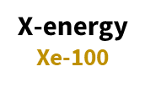

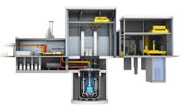
Advanced Reactor SNF Considerations
Integrated Project Team – Back-End Management for Advanced Reactors (BEMAR)
Multi-program team evaluating spent nuclear fuel from proposed advanced reactor designs
  Considerations for storage, transportation, and disposal
Providing data to inform Standard Contract negotiations
TerraPower
Natrium

Slide 18
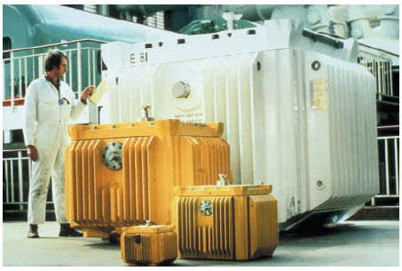
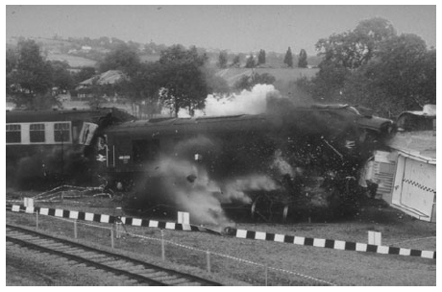
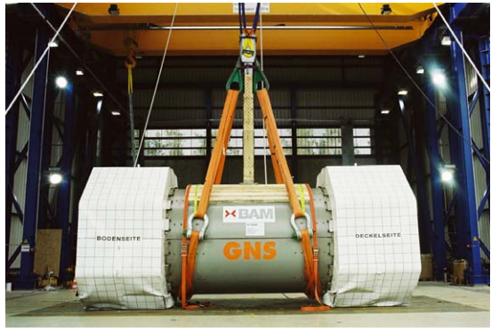
Transportation Project Updates
Package Performance Study
Developing preliminary plans for a full-sized rail cask package test (actual testing will depend on funding).
  DOE will lead, and invite NRC to participate
  Other possible precipitants to be considered
US has not tested a current full-sized SNF transportation cask
Endorsed by National Academy of Sciences and the Blue Ribbon Commission
Test will include regulatory tests (unyielding surface, puncture, fire, immersion) and DOE is also considering non-regulatory (e.g., train collision, waterbody retrieval demonstration)
Goals include building public trust and confidence in the safety of SNF transportation casks and SNF transportation by rail and gathering technical data

Slide 19
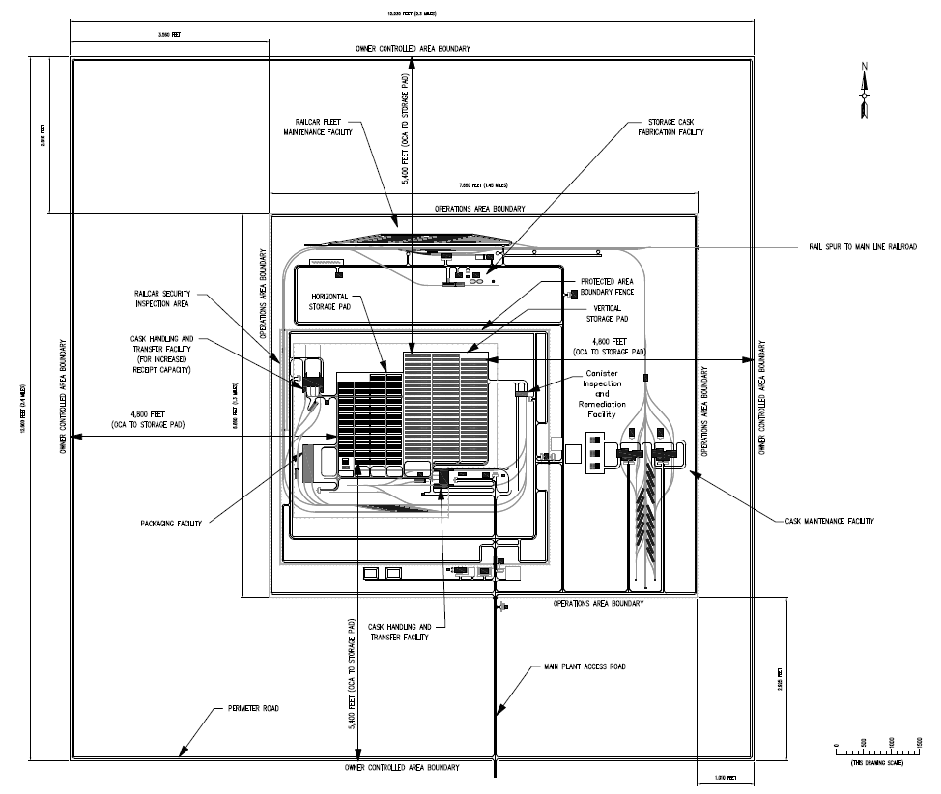
Storage Facilities & Equipment
Project management for a federal consolidated interim storage facility
  DOE critical decision process for capital projects
Storage Facility Design
  Functions and requirements
  Reference design concepts
  Regulatory analysis
Canister inspection and remediation concepts
  Canister handling
  Helium leak testing

Slide 20
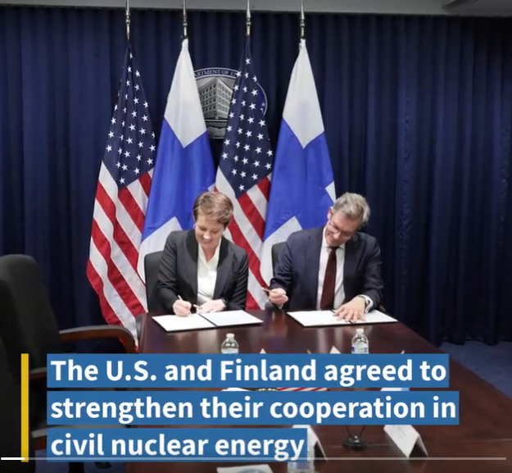
International Cooperation
Memorandum of Understanding signed with Finland
  April 2023
  Includes multiple Office of Nuclear Energy Program topic areas
Statement of Intent signed with Canada’s Nuclear Waste Management Organization
  May 2023
  Focused on nuclear waste management
Information exchange with Australian Delegation under AUKUS agreement
  August 2023

