Slide 1
Council of State Governments – East Fall Meeting
Ellen Edge
TEPP Program Manager/NTSF Program Lead
Office of Packaging and Transportation
October 25, 2023

Slide 2
Discussion Topics
Office of Environmental Management
Office of Packaging and Transportation Update
Transportation Compliance Assurance Program (TCAP)

Slide 3
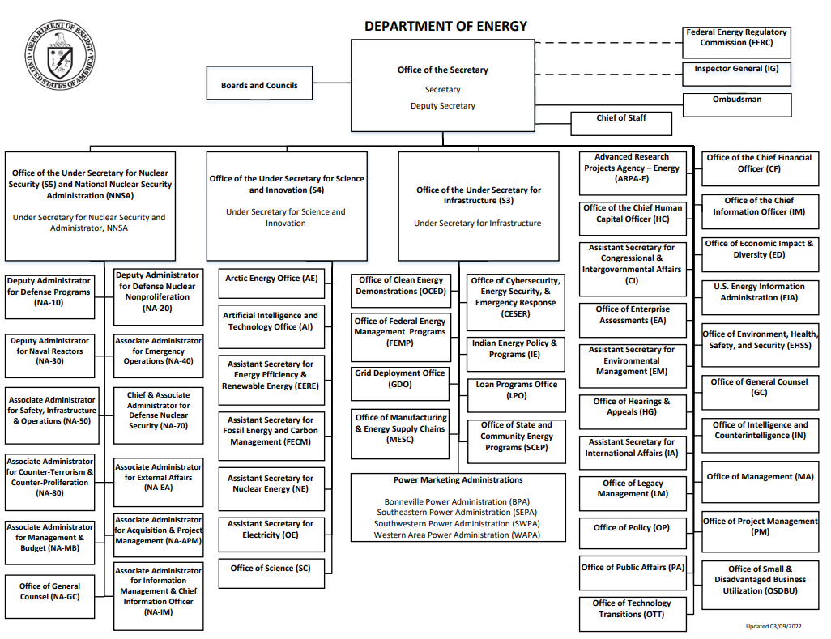

Slide 4
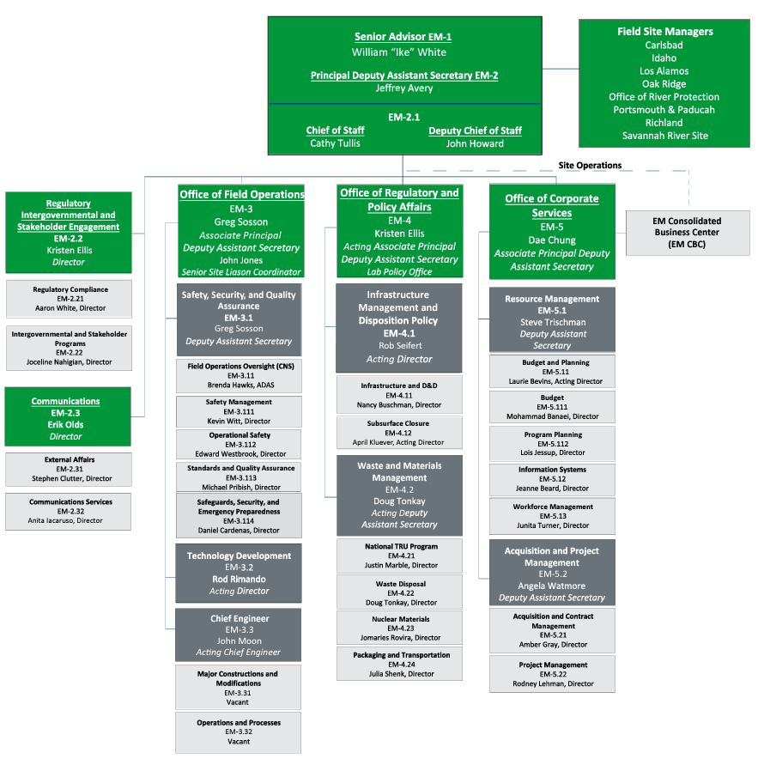
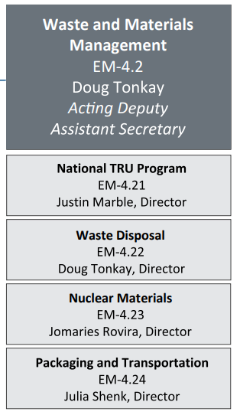
Office of Environmental Management Org Chart October 23, 2023

Slide 5
DOE Environmental Management Office’s Mission: CLEANUP
EM’s mission is to safely and efficiently address the environmental liability resulting from decades of nuclear weapons production and government-sponsored nuclear energy research
The production and research work resulted in environmental contamination at 107 sites throughout the United States, housing more than 5,000 contaminated facilities
Remediation included liquid radioactive waste, plutonium, depleted uranium, contaminated soil, and contaminated groundwater

Slide 6
Significant Mission Progress
Over the past three decades, EM achieved significant and lasting progress in tackling this environmental legacy
EM eliminated, or mitigated, at most sites the environmental, safety, and health risks from the most dangerous legacy wastes and contaminated facilities
Contaminant pathway have been effectively controlled in groundwater and soils
The program’s combined active remediation footprint has been reduced by 90%, from approximately 3,300 square miles to less than 300
Significant legacy cleanup work remains at 15 sites
Notes:
EM has completed cleanup at 92 sites across the country and is responsible for completing cleanup of 15 sites in 11 states
EM is responsible for safely and successfully performing work in challenging environments
EM operates in a highly complex regulatory environment, with active participation from stakeholders
EM enables other continuing DOE missions, such as national defense

Slide 7
Success Through Collaboration
30+ years of EM cleanup underpinned by 30 years of stakeholder engagement
DOE / EM Guiding Principles
Openness
Transparency
Stakeholder consideration
Multi-tiered public engagement shapes understanding and policy, while helping to advance EM success.

Slide 8
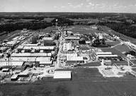
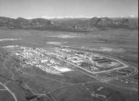
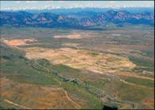
Example of Success
Public and intergovernmental involvement is an essential component of DOE-EM’s success. Through frequent and ongoing collaboration, DOE-EM has made significant progress in completing environmental cleanup and restoration.
Fernald (former EM cleanup site in Ohio)
Rocky Flats (former EM cleanup site in Colorado)

Slide 9
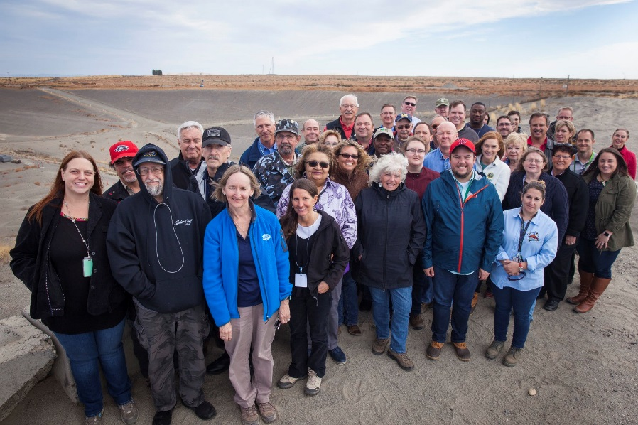
Citizen Advisory Boards
EM Site-Specific Advisory Boards (SSAB)
Hanford, Idaho, Los Alamos, Nevada, Oak Ridge, Paducah, Portsmouth, Savannah River
EM Advisory Board (EMAB)
Provides independent and expert advice/recommendations for the EM Assistant Secretary

Slide 10
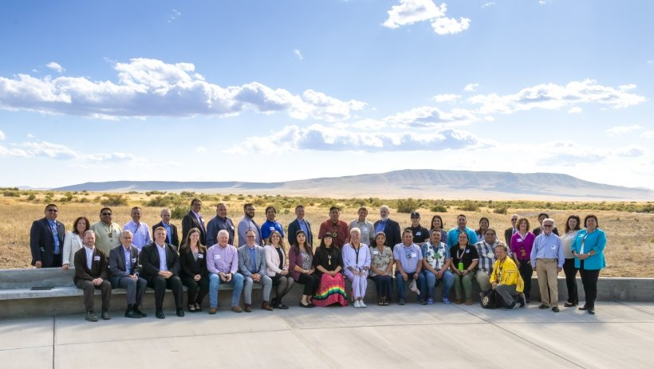
Tribal Interaction and Consultation
DOE consults with several Tribes around the EM Complex, pursuant to DOE Order 144.1 – American Indian and Alaska Native Tribal Government Policy.
Field Offices located near tribal lands may have actions or projects that affect tribal rights or resources, to include cooperative agreements to support tribal involvement in DOE decisions.

Slide 11
Tribes and Pueblos
EM Site | Tribal Nation(s)
Hanford | Confederated Tribes and Bands of the Yakama Nation (WA) Confederated Tribes of the Umatilla Indian Reservation (OR) Nez Perce Tribe (ID) Wanapum Band of Indians (WA)
ETEC | Santa Ynez Band of Chumash Indians
Idaho | Shoshone-Bannock Tribes
Los Alamos | San Ildefonso Pueblo Cochiti Pueblo Santa Clara Pueblo Jemez Pueblo
Nevada | Consolidated Group of Tribes and Organizations (CGTO)
West Valley | Seneca Nation of Indians
Carlsbad Field Office | Nambe Pueblo Pojoaque Pueblo San Ildefonso Pueblo Tesuque Pueblo Shoshone-Bannock Tribes Confederated Tribes of the Umatilla Indian Reservation

Slide 12
Update on the Office of Packaging and Transportation

Slide 13
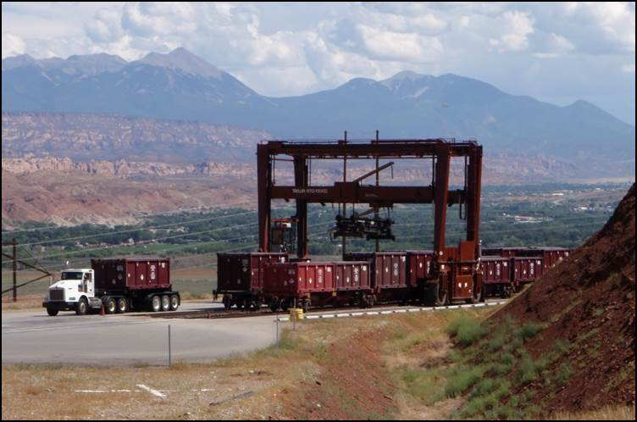
Our OPT Mission
The Office of Packaging and Transportation protects people and the environment by ensuring safe, compliant, and efficient packaging and transportation of materials critical to successful Department operations. We achieve this mission by conducting packaging and transportation assessments and oversight; assisting field sites; and developing, managing, and advocating policies, orders, guidance and tools in accordance with DOE requirements and government regulations.

Slide 14
FY23 DOE Offsite HAZMAT Shipments by Program*
*Data Pulled before FY23 completion, in September, 2023
EM 1,246
NE 27
SC 804
NNSA 1,283 PMA 0**
Total 3,360
**PMA = Power Marketing Administration

Slide 15
FY23 EM Offsite HAZMAT Shipments*
Waste 540
Non-Waste 708
Total 1,248**
**One shipment may contain both waste and non-waste
*Data Pulled before FY23 completion, in September, 2023

Slide 16
FY23 EM Offsite HAZMAT Waste Materials Shipped*
LLW 164
MLLW 18
TRU 168
Other 223
Total Waste 573** Materials
*Data Pulled before FY23 completion, in September, 2023
**One shipment may contain multiple materials
Notes:
Other Breakdown:
HRCQ: 35
RCRA: 182
SNF: 0
SNM: 1
HLW: 0
TSCA: 8
NonReg 0
* One ‘Other’ may contain multiple materials

Slide 17
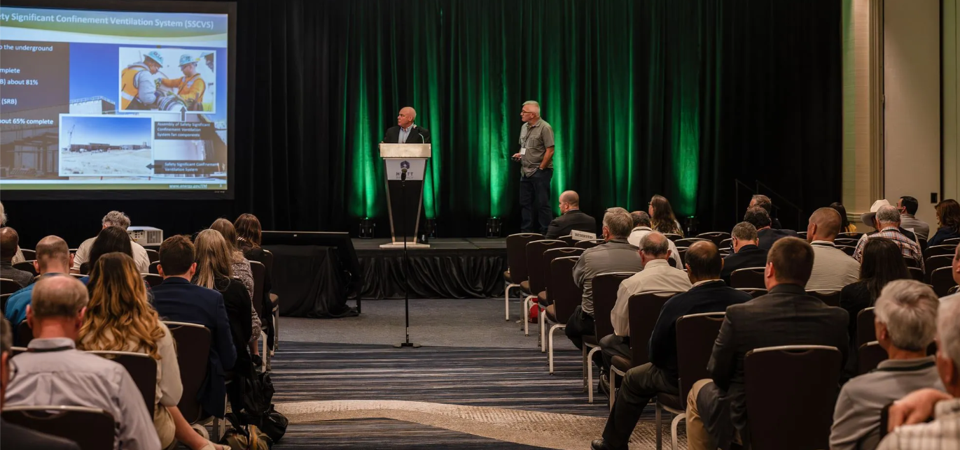
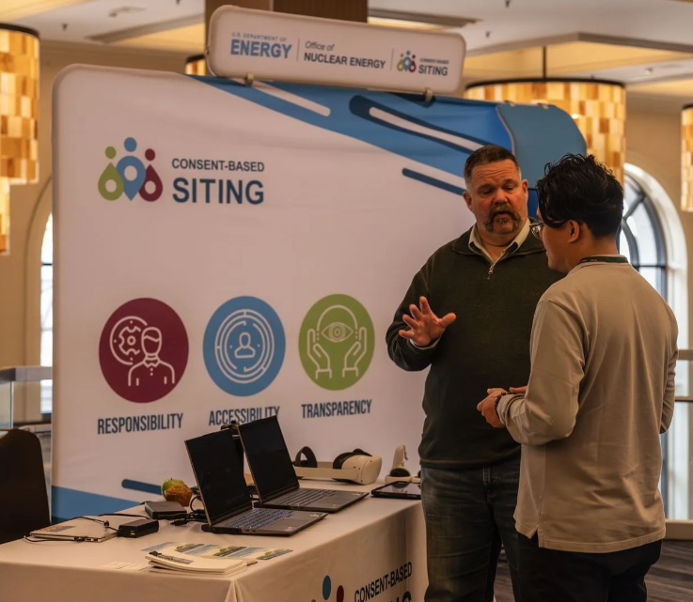
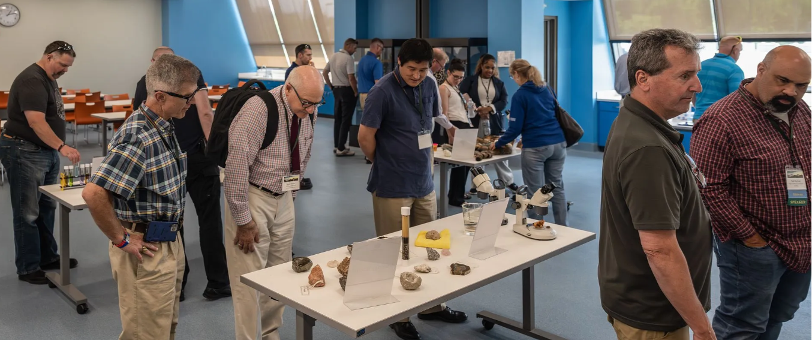
National Transportation Stakeholders Forum
Annual Meetings
The 2023 Annual Meeting was held in St. Louis, MO
The 2024 Annual Meeting will be held in Denver, CO
The 2025 Annual Meeting will be hosted by the Western Interstate Energy Board

Slide 18
National Transportation Stakeholders Forum
Webinars
2023 Newcomers Orientation was held on May 9, 2023
Federal Railroad Administration (FRA) Safety Coordination and Compliance Oversight Plan (SCCOP) was held on September 28, 2023
Planning underway for one more before the end of 2023

Slide 19
National Transportation Stakeholders Forum
Ad Hoc Working Groups (AHWG)
Management Plan updates are beginning in November 2023
Three Office of Nuclear Energy AHWGs are currently active

Slide 20
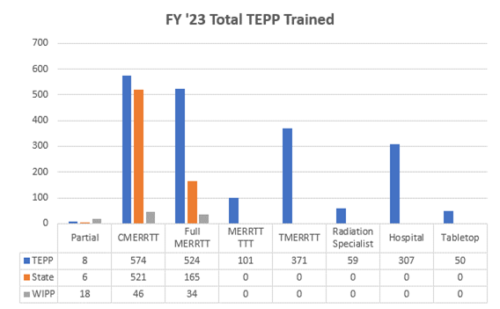
Transportation Emergency Preparedness Program (TEPP)

Slide 21
Transportation Emergency Preparedness Program (TEPP)
CSG-Midwest
Illinois | 0
Indiana | 0
Iowa | 12
Kansas | 0
Michigan | 0
Minnesota | 0
Nebraska | 2
North Dakota | 0
Ohio | 30
South Dakota | 40
Wisconsin | 0

Slide 22
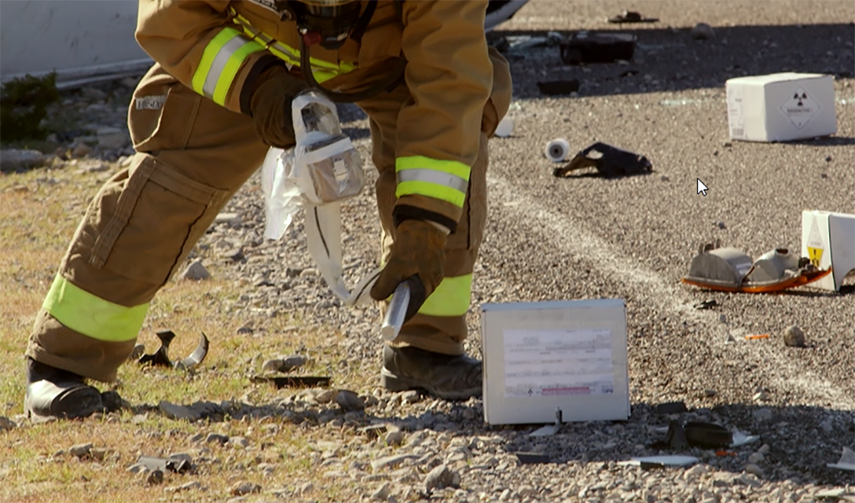
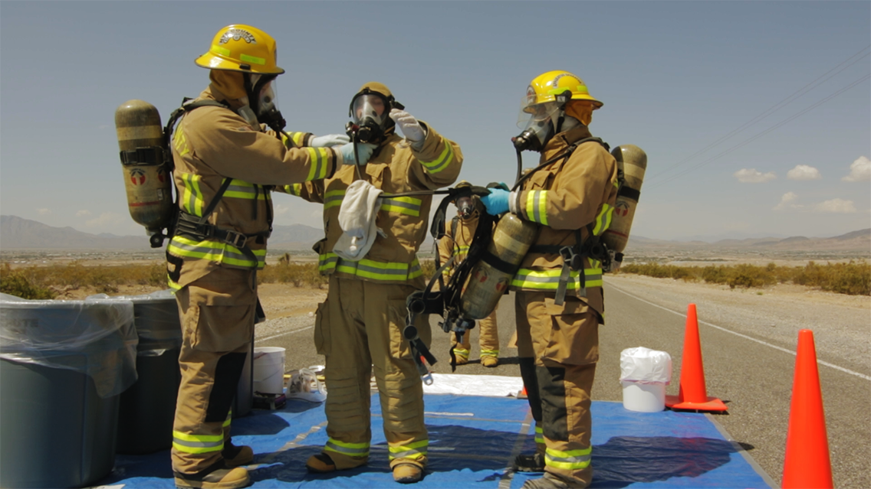
Transportation Emergency Preparedness Program (TEPP)
Course development update
MERRTT –
Stakeholder comment resolution on October 9.
Proposed 2024 Module 5 changes.
Hospital class – being revised based on stakeholder feedback
Public information officer class – being developed in conjunction with WIPP and EM’s Communication office
Notes:
The new Module 5 includes: a title change, the addition of selected wording from the PIO Module (that is proposed to be deleted), one added PIO objective and check your understanding question and deleting one existing Module 5 check your understanding question on medical priorities (covered in Module 6).

Slide 23
Transportation Compliance Assurance Program (TCAP)
Prakash Kunjeer, Program Manager

Slide 24
TCAP Purpose
Systematic approach to evaluate and ensure compliance with applicable regulations, policies and Orders
Identify opportunities for process improvements for P&T operations
Share lessons learned and best practices from other sites

Slide 25
TCAP History
Department of Energy (DOE) Order 460.2, Departmental Materials Transportation and Packaging Management, requires DOE organizations and their contractors to ensure that all packaging and transportation operations across the DOE complex are fully compliant with all applicable international, federal, state, tribal, and local laws, rules, and regulations.
At the contractor level, DOE Order 460.2 contractor requirements document (CRD also requires that self-assessments of packaging and transportation operations are performed, at a minimum, every three years.
EM Chief Operating Officer has identified OPT as the Office responsible for the development and execution of this program (memorandum dated August 23, 2011).

Slide 26
TCAP Roles and Responsibilities
EM Senior Advisor: Administers DOE Order 460.2B
OPT:
Evaluates and ensures compliance of packaging and transportation (P&T) activities
Provides assistance to Field Offices in meeting Order requirements
Field Office Management : Oversight of P&T safety and operations
TCAP Program Manager:
Develops & maintains TCAP policies & procedures
Coordinates & supports field TCAP activities with federal Team Lead
Field Office Point of Contact (POC): Coordinates with OPT for the TCAP assessments
TCAP Team Lead
Plans, coordinates and communicates TCAP assessment
Documents results to Field Office Manager via OPT

Slide 27
TCAP Process
The TCAP process consists of:
Identifying the DOE site to be evaluated
Self-Assessment performed by Contractor
Onsite evaluation performed by TCAP Team
Draft Report issued for a factual accuracy reviewed by all parties
Final Report issued to site management
Corrective Actions Plan (CAP)
Closeout memorandum by TCAP Program Manager to Field Office POC at completion of corrective actions.

Slide 28
TCAP Checklists
All checklists reviewed and revised according to subject matter experts across the DOE complex. They have been updated to reflect applicable regulatory requirement updates (e.g., 49CFR 100-185), as well as any updates or changes to applicable DOE directives (e.g., DOE 460.2B).
The checklists are stand alone documents supporting the TCAP Management Plan Performance Objectives and provide evaluation criteria.
The checklists will be revised as necessary to remain current with applicable DOE Orders and regulatory requirements.

Slide 29
TCAP Performance Objectives
P&T Quality Assurance
Hazmat Packaging
Hazmat Shipper
Transportation Management
Contractor Motor Carrier Operations
Onsite Railroad Operations
Transportation Emergency Response
Hazmat Employee Training
Transportation Security Plan
Waste Characterization Process
Transportation Safety Documents

Slide 30
TCAP Results
Best Business Practices: Activities and practices that demonstrate gains in effectiveness and/or efficiency in the areas of safety, compliance, cost and/or mission milestones. These practices may be shared with other sites as lessons learned and opportunities for improvement.
Findings: Practices and/or procedures that are considered to be in violation of federal regulations, DOE Orders, or other applicable regulatory and policy requirements.
Note: Findings will require corrective actions.

Slide 31
TCAP Performance Levels
Observations: Practices and/or procedures that are not considered to be in violation of federal regulations, DOE Orders, or other applicable regulatory and policy requirements; however, if no remedial actions are taken could potentially result in a violation.
Opportunities for Improvement: Operational improvements suggested by subject matter experts or the TCAP team based on recognized practices at other DOE sites or in the private sector to enhance P&T operations.
Note: Adopting suggestions is at the sole discretion of the site or contractor.

Slide 32
Contacts
Julia Shenk
Director/NTSF Chair
301-903-1388
julia.shenk@em.doe.gov
Ellen Edge
TEPP manager/NTSF lead
301-903-8327
ellen.edge@em.doe.gov
AskPAT@hq.doe.gov

Slide 33
QUESTIONS?

