Slide 1
Stakeholders Coming Together for
Transportation Security
Council of State Governments
Northeast HLRW Transportation Task Force
October 25, 2023
Mark Yeager– Oak Ridge National Laboratory

Slide 2

ARE SECURITY MEASURES ADVANCING with perceived threats to protect
RADIOACTIVE MATERIAL as it’s being moved around
NORTH AMERICA?
Notes:
In 2018, the Office of Radioactive Security asked Oak Ridge National Laboratory a simple question: is radioactive material safe as it’s being moved around North America? Each year, thousands of shipments of radioisotopes (the study focused upon Co-60, Cs-137, Ir-192 and Am-241),with a combined total activity averaging nearly 60 million curies—are shipped into, through and from the United States by land, air and sea, , engaging nearly every state. This material is crucial for a broad array of industrial, construction, medical, security and consumer uses and the number of shipments and total activity being shipped is increasing year over year.
While regulations, experience, processes and procedures are in place to help assure a safe and secure movement of these products, there is always room for improvement, as there is with everything else. One of the recommendations from the report was to create a cross functional organization that could investigate, assess and suggest actions and means by which transportation security could be improved. The organization would be cross functional and would encourage networking and sharing of experiences and activities. This evolved into the Transportation Security Unified Stakeholders Group, or what we call the TSUSG, with a primary focus on the radioisotopes noted just a minute ago. We are currently in the early stages of considering increasing the breadth of radioactive material to also include spent nuclear fuel. The initial meeting of the interested parties occurred in September 2019, and the TSUSG has developed strongly over the past three years, despite some significant hurdles, not the least of which was COVID-19.

Slide 3

Transport Security Unified
Stakeholders Group
SECURE TRANSPORT OF RADIOACTIVE SOURCES
Strengthening the transport security community in the United States to reduce risk to radioactive sources
Notes:
Today, The TSUSG has over 100 voluntary members from across the functional groups which comprise it (federal and state regulators; federal and state law enforcement; industry, including source producers and suppliers, carriers and freight forwarders; and professional associations). In addition, we have the Canadian Nuclear Safety Commission (CNSC), Transport Canada, industry and carriers and freight forwarders from Canada in our membership and we can integrate with the International Atomic Energy Agency (IAEA) as and when necessary. Members identify and prioritize issues of greatest importance to them, and then cross functional teams from the full membership, comprised of personnel who have specific experience, education, and understanding of the issue assess, investigate, and determine actions needed to either mitigate or resolve it.
We are also looking at the potential of inviting organizations from Mexico into the TSUSG at some point in the future.

Slide 4

TRANSPORT SECURITY
REGULATIONS
REQUIRE
COLLABORATION
Law Enforcement
Industry
Government
Notes:
What the TSUSG focuses on is the mutual collaboration between government, law enforcement and industry.
Government makes regulations
Law enforcement enforces regulations
Industry implements regulations
Those in industry may see challenges or need greater detail in existing, revised or new regulations. Government needs feedback to know what to update. And law enforcement needs to stay current in order to enforce the correct measures.
Integrating different groups towards agreed-upon understandings and actions is challenging but creates win-win outcomes for all parties. The responsibilities, interests, and activities of the participants varies, and are depicted as follows:

Slide 5

HOW
TSUSG
WORKS
IMPROVE
security practices
UNDERSTAND challenges
across organizations
Notes:
There are two ways to think about how TSUSG works.
Members share challenges and best practices for their organizations. This creates a shared awareness of the state of transportation security. In some cases, there needs to be a better relationship between government, law enforcement, and industry, and gaining understanding can bridge many issues.
If an organization has a challenge that is hindered, the TSUSG can try to solve it. This may mean asking governments to review policy, helping an organization create a new program to bring more structure to solving a problem, or providing training to create standards of practice across the country. Obviously, the method of evaluation and development of improved structure, processes or activities vary depending upon the issue at hand and that is why we ensure all issues are dealt with by the most capable and experienced cross functional members from our broad and broadening membership.

Slide 6
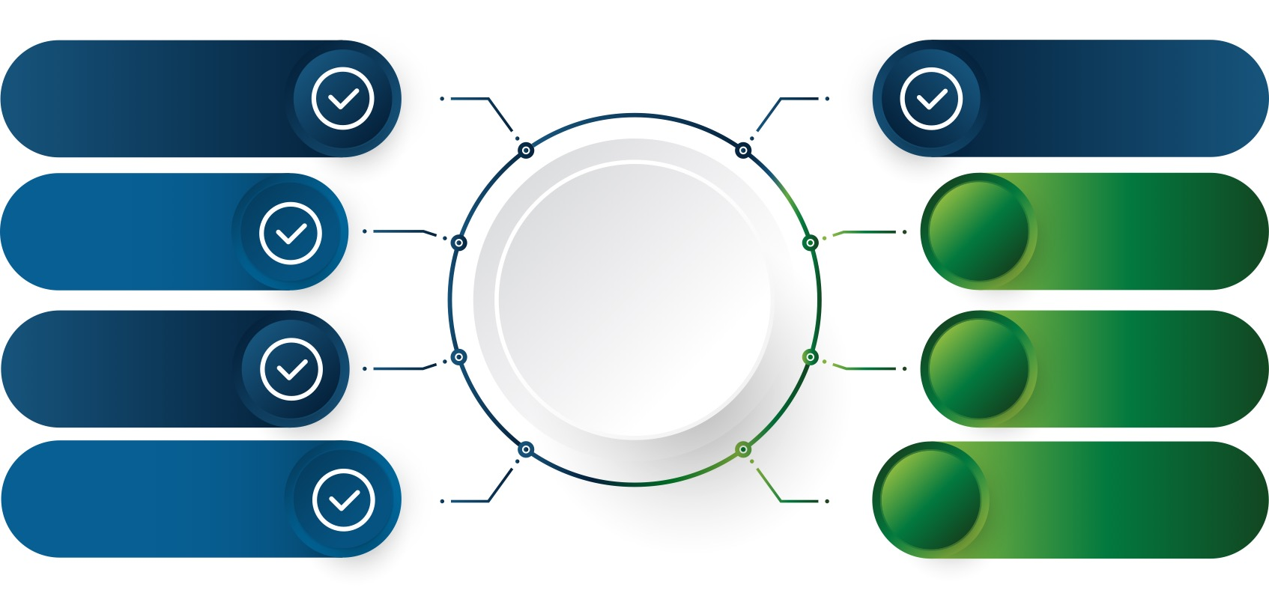

PRIORITY COMMITTEES focus on results
Create a standardized unified transport security plan
Continue to recruit TSUSG members
Create group charter for the Federal Advisory Committee Act
Cybersecurity and Mitigation Options
Insider threat training
Transport Security Training Opportunities
Review procedures for escorts and incident response across the U.S. and Canada
Managing Security Regulations with NRC, DOT, CNSC, and Transport Canada
Notes:
TSUSG Key Activities Report Card
The Priority Committees (cross functional groups investigating, evaluating, and identifying processes, procedures or measure that mitigate or resolve identified security issues) are the resources that assess issues and work to find resolution or mitigation opportunities
6 PCs were initially developed at the initial TSUSG meeting in 2019. One is a standing committee which will focus on consolidating and integrating the outcomes from all other Priority Committees
5 of the initial PCs completed their work in 2022 for the areas noted with the check marks on the blue sections of this slide
3 new PCs were identified and formed at the 2022 TSUSG Annual Conference and those are in green on this slide

Slide 7

TSUSG MEMBERSHIP is worth the investment
MEETINGS
WEBSITE
BULLETIN
Quarterly and Annual
With templates, resources, and contacts for members
Quarterly
NEW in 2023!
Notes:
An array of activities have been established to further develop the TSUSG and to bring as uch “value-added” to the membership as possible.
This includes:
Quarterly Tactical Meetings (virtual) where items or activities of interest are presented to the membership with lots of time available for discussion
Annual Conference (September) with keynote speakers, cross functional presentations and working groups, determination of future key issues needing Priority Committee involvement
Website tsusg.ornl.gov
Quarterly Newsletter

Slide 8

Questions?

Slide 9

JOIN TSUSG and be a part of history
tsusg.ornl.gov
Notes:
Consider joining the TSUSG and have your voice heard in updating regulations and improving practices. The CRCPD’s / NTSF’s mission is directly in line with what the TSUSG strives to do, and your insights could help shape best practices for decades to come.

