Slide 1
Office of Nuclear Energy Ad Hoc Working Group Updates
Sara Hogan, PhD
Office of Integrated Waste Management
US Department of Energy
Northeast High-Level Radioactive Waste Transportation Task Force Fall Meeting
October 25-26, 2023
Portland, ME

Slide 2
Ad Hoc Working Groups
Working groups associated with the National Transportation Stakeholder Forum (NTSF)
Participation is open only to State, Tribal, and Federal NTSF members
About 2-3 State or Tribal members from each SRG/TRMTC
Meet approximately quarterly, 1 meeting in conjunction with NTSF Annual Meeting
AHWGs ideally are led by State/Tribal Co-Chairs with a DOE federal lead and DOE lab staff to support meeting operations

Slide 3
NE Led NTSF Ad Hoc Working Groups (AHWGs)
Section 180(c), Sara Hogan
SNF Rail/Routing, Gerry Jackson
SNF Management – Communications and Outreach, Greg Harland and Juan Uribe

Slide 4
Section 180(c)
The Nuclear Waste Policy Act (NWPA) confers on the Department of Energy (DOE) the responsibility for transporting SNF and HLW to a NWPA-authorized facility
Through the Nuclear Waste Policy Amendments Act of 1987, Congress added the following language to the NWPA, which became Section 180(c) of the NWPA:
The Secretary [of Energy] shall provide technical assistance and funds to States for training for public safety officials of appropriate units of local government and Indian [T]ribes through whose jurisdiction the Secretary plans to transport spent nuclear fuel or high-level radioactive waste [to a NWPA-authorized facility]. Training shall cover procedures required for safe routine transportation of these materials, as well as procedures for dealing with emergency response situations. (42 U.S.C. 10175).

Slide 5
Section 180(c) Continued
Resuming activity in 2022 after bring paused since 2017
Established to continue to evaluate the Department’s proposed Section 180(c) policy and identify outstanding issues/activities necessary for successful implementation of the policy including, but not limited to, allocation of funds, allowable activities, and development of grant guidance documents and a technical assistance plan.
Co-chairs: Tony Leshinskie (VT) and Ryan Seabaugh (MO)
Lab Support: Ennea Fairchild-Grant (PNNL)
Activities:
Fact sheets
Consider reviewing the Section 180(c) Funding allocation formula
Consider proposing a Section 180(c) pilot program
Collaborate with other AHWGs
And more!

Slide 6
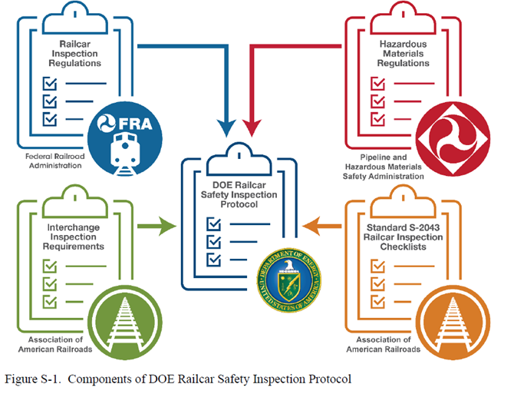
SNF Rail/Routing
Update to the Work Plan
Last update Version 8, November 2021
Co-Chairs Update
Heather Westra (PIIC)
Laurie Hernandez (NEW- Shoshone-Bannock Tribes)
Thanks, and Congratulations to Ray Hubbell for his new position at FRA
Upcoming projects
Formalize Draft Railcar Safety Inspection Protocol for KM (GC Review)
Support FRA with SCCOP review

Slide 7
SNF Management - Communications and Outreach
Purpose:
Helps the DOE effectively and accurately communicate about:
Planned Spent Nuclear Fuel (SNF) transportation
Associated SNF management activities
such as federal interim storage
Provides input to the DOE’s Office of Nuclear Energy on:
Developing messages, strategies, and products
Communicate effectively with Tribes, States, the general public, and other stakeholders.

Slide 8
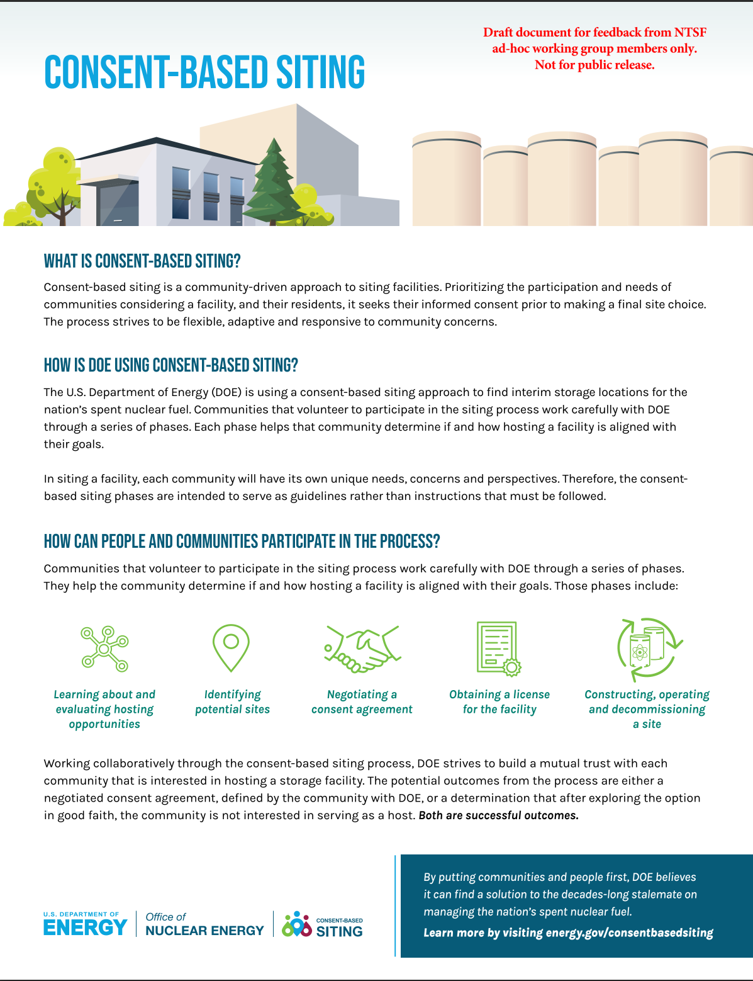
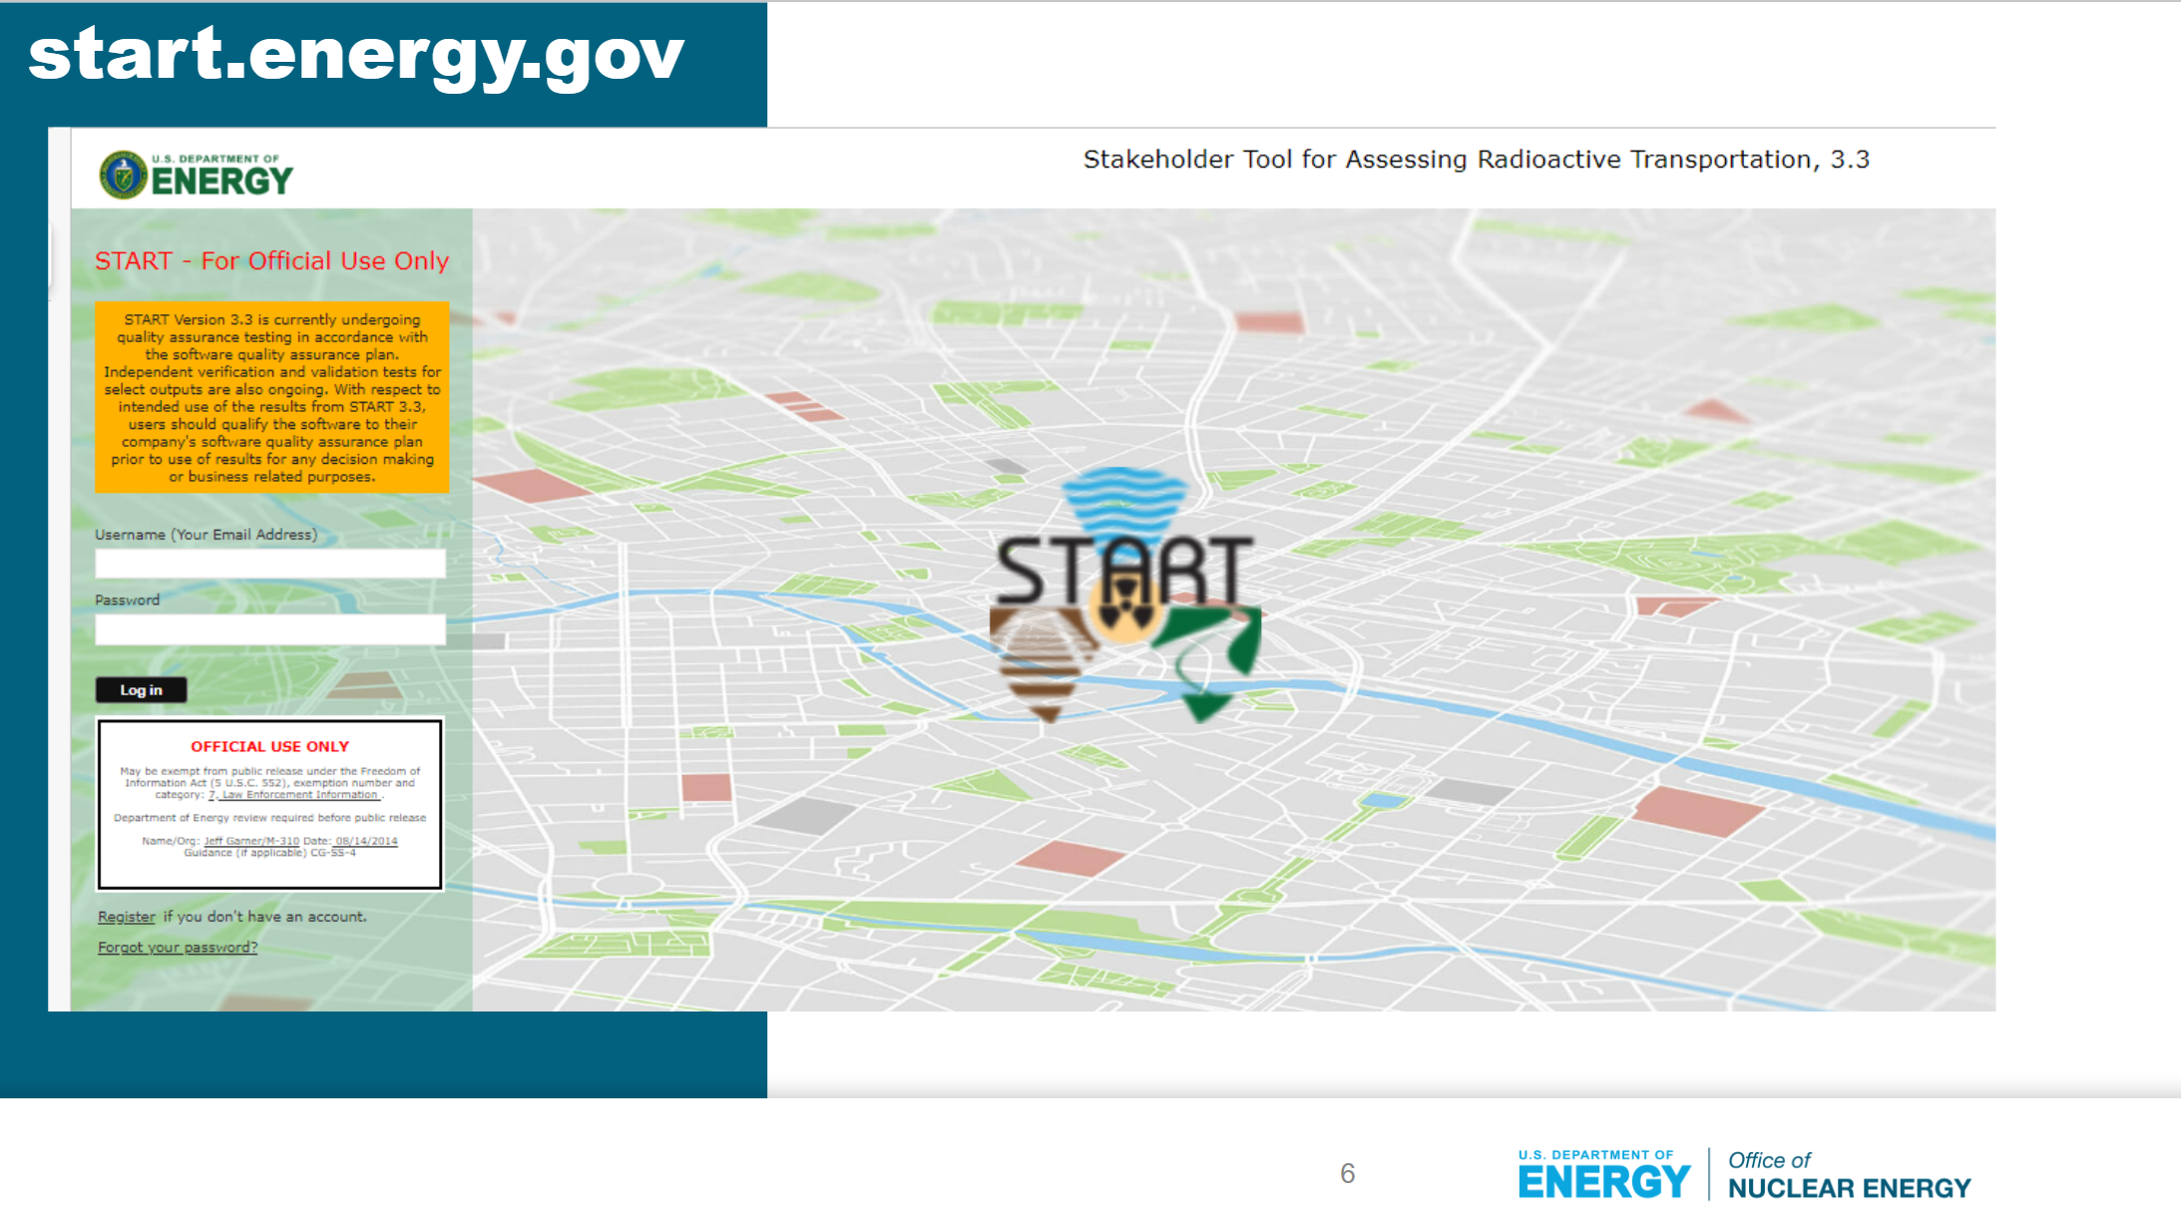
SNF Management - Communications and Outreach
Examples:
Flyer related to Consent-based Siting
CURIE Website
Collaborative tool START
Transportation Railcar Animation

