Slide 1
The Need to Update Radiation Protection Standards in the USA David J. Allard, MS, CHP, FHPS

Slide 2
Disclaimer

Slide 5
Low & High Dose Radiation

Slide 6
RP Recommendations and Guidance

Slide 7
Average Radiation Dose - USA

Slide 9
RP Regulatory Framework in USA

Slide 12
Example - PA Legislative Authority

Slide 14
U.S. Radiation Dose Limits

Slide 15
Cosmic Rays

Slide 16
Cosmic Rays

Slide 17
Cosmic Rays

Slide 18
Cosmic Rays – Ground Level

Slide 19
Cosmic Rays – Space

Slide 20
Cosmic Rays – Space

Slide 21
Cosmic Rays – Air Crew

Slide 22
Cosmic Rays – Air Crew

Slide 23
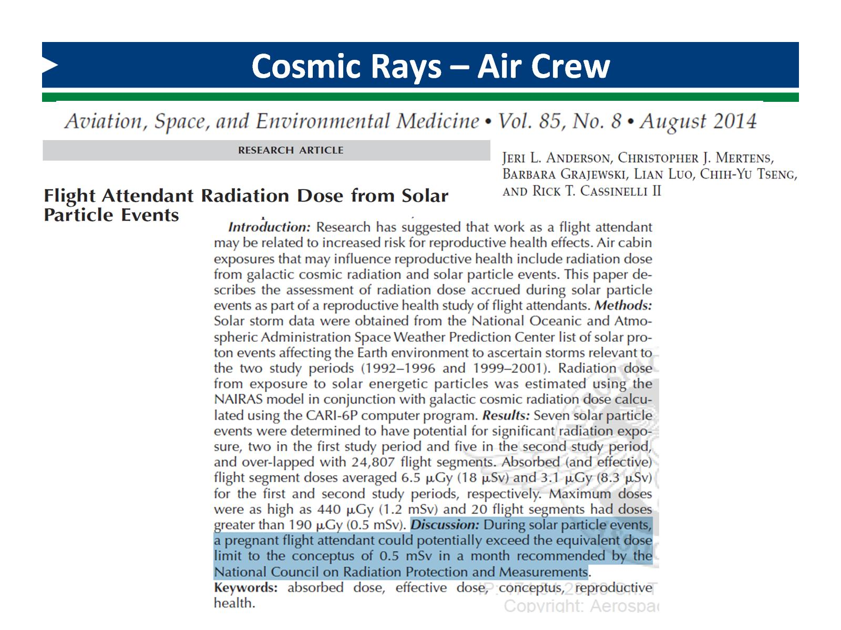
Cosmic Rays – Air Crew

Slide 24
Cosmic Rays – Air Crew & FFs

Slide 25
NORM and TENORM

Slide 26
Natural Uranium, Radium & Radon

Slide 27
Generation of TENORM

Slide 28
Uranium Fuel Cycle

Slide 29
NORM in U.S.A. and PA

Slide 30
Oil & Gas Well Types

Slide 31
TENORM & NORM Defined

Slide 32
O&G Shale Plays

Slide 33
Marcellus Shale Drilling & Fracturing

Slide 34
U-238 Series - Geochemistry

Slide 35
PA TENORM Study

Slide 36
Natural Gas Production & Use

Slide 37
Sample Types

Slide 38
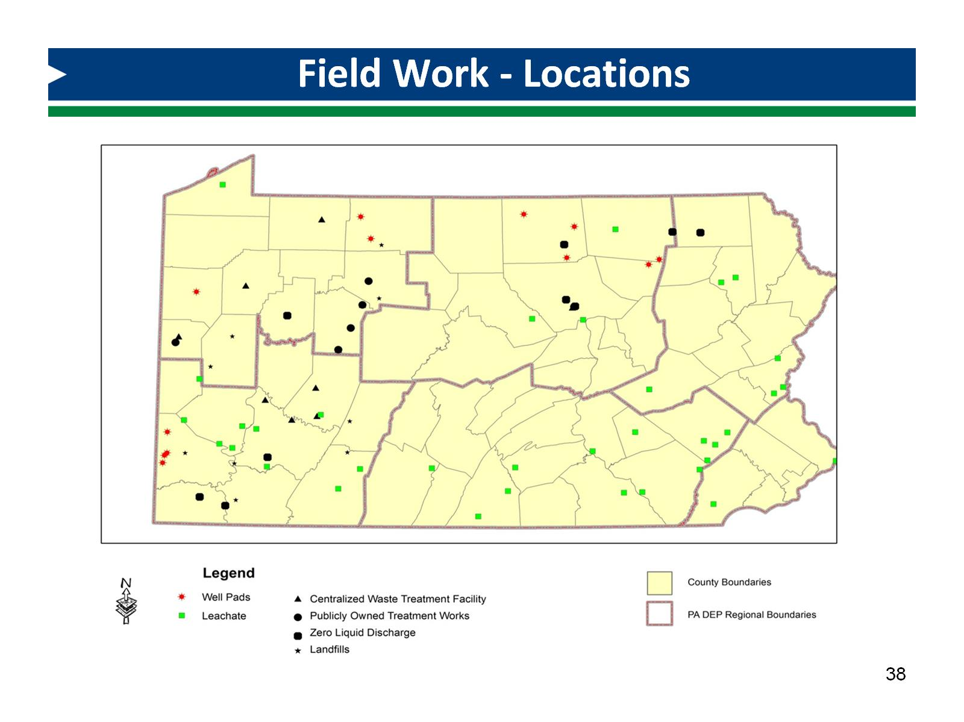
Field Work - Locations

Slide 39
Field Work

Slide 40
Field Work

Slide 41
TENORM Waste Disposal

Slide 42
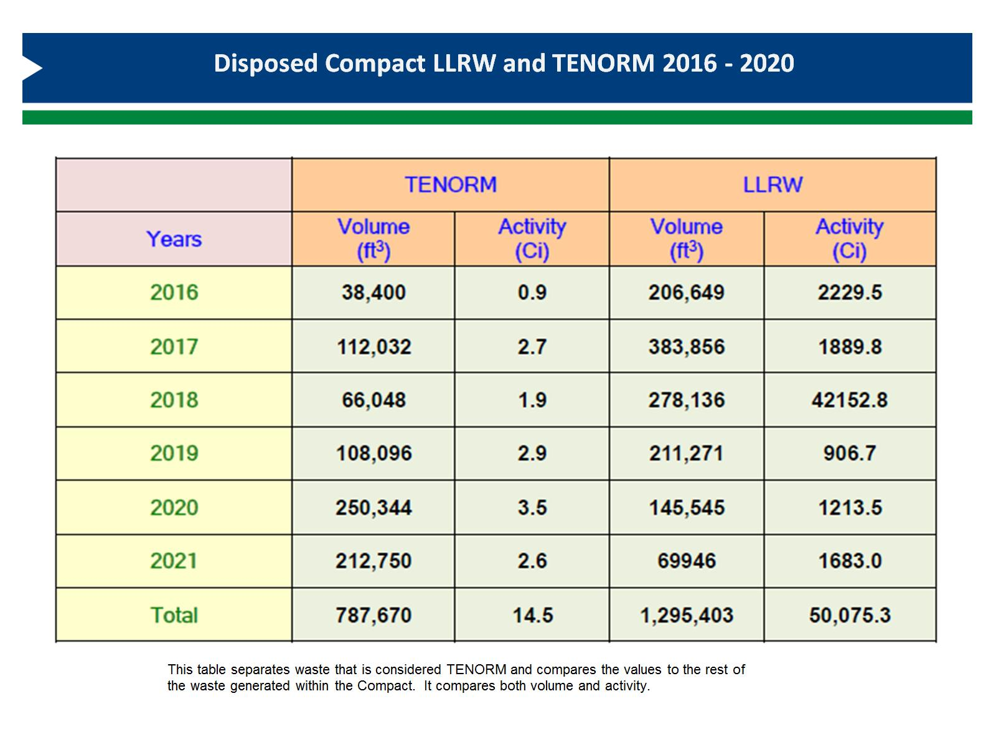

Slide 43
TENORM RP Regulatory Framework

Slide 44
TENORM RP Regulatory Framework

Slide 45
TENORM RP Regulatory Framework

Slide 46
TENORM RP Regulatory Framework

Slide 47
TENORM RP Regulatory Framework

Slide 48
TENORM RP Regulatory Framework

Slide 49
TENORM RP Regulatory Framework

Slide 50
EPA’s DW RP Regulatory Framework

Slide 51
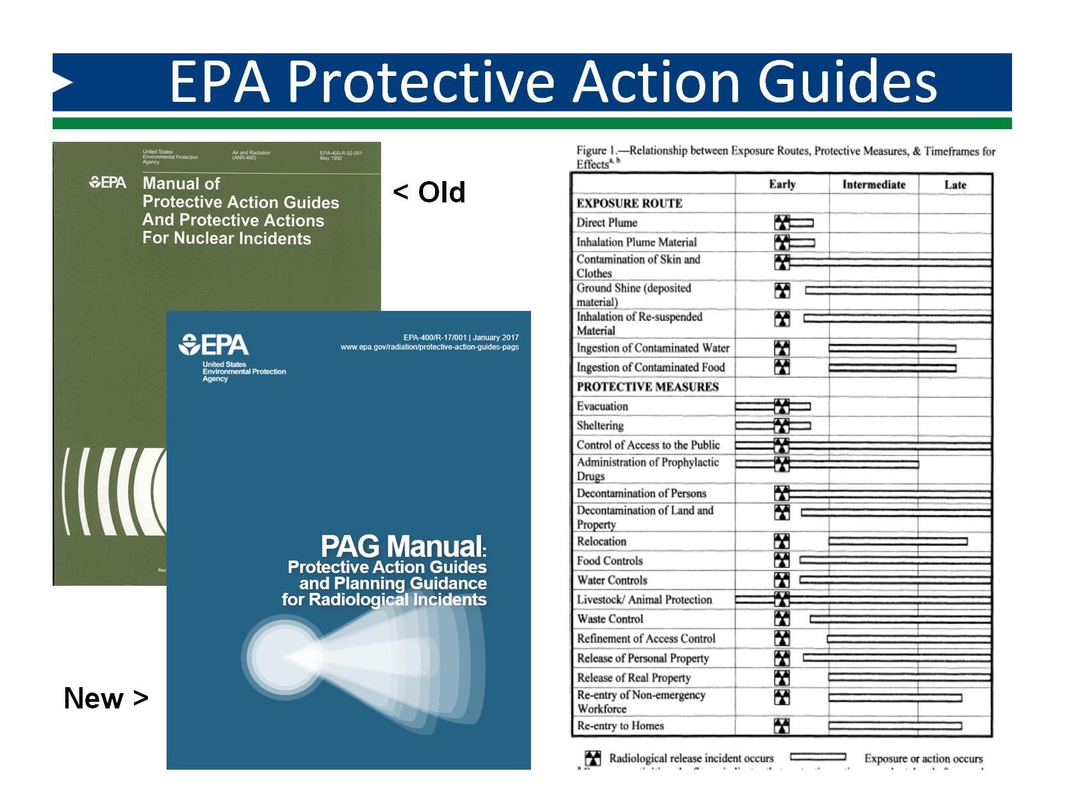
EPA Protective Action Guides

Slide 52
Rad. Material Regulatory Framework

Slide 54
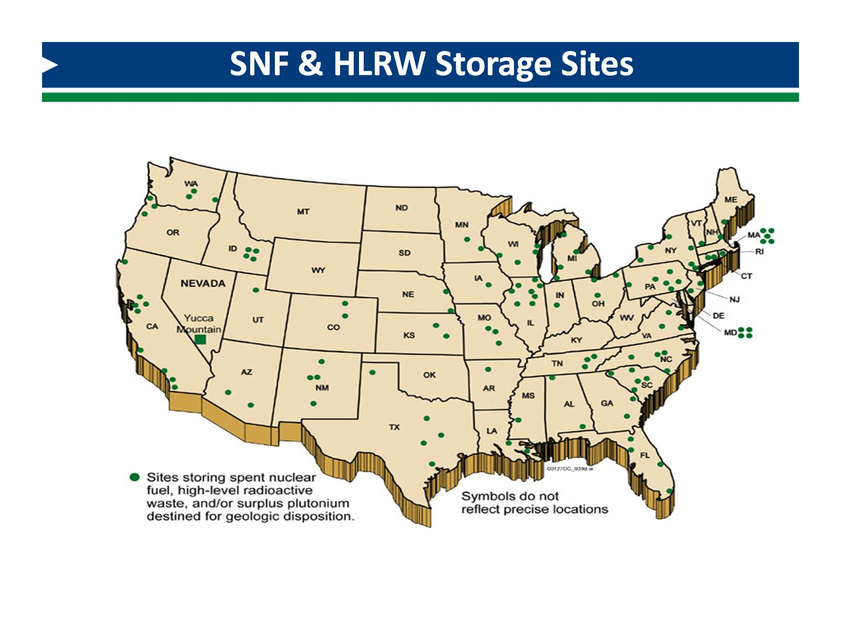

Slide 56
Radon

Slide 57
Dec. 1984 - the “Index House”

Slide 58
Radon Potential in the USA

Slide 59
The ‘Index House’ in 1984

Slide 60
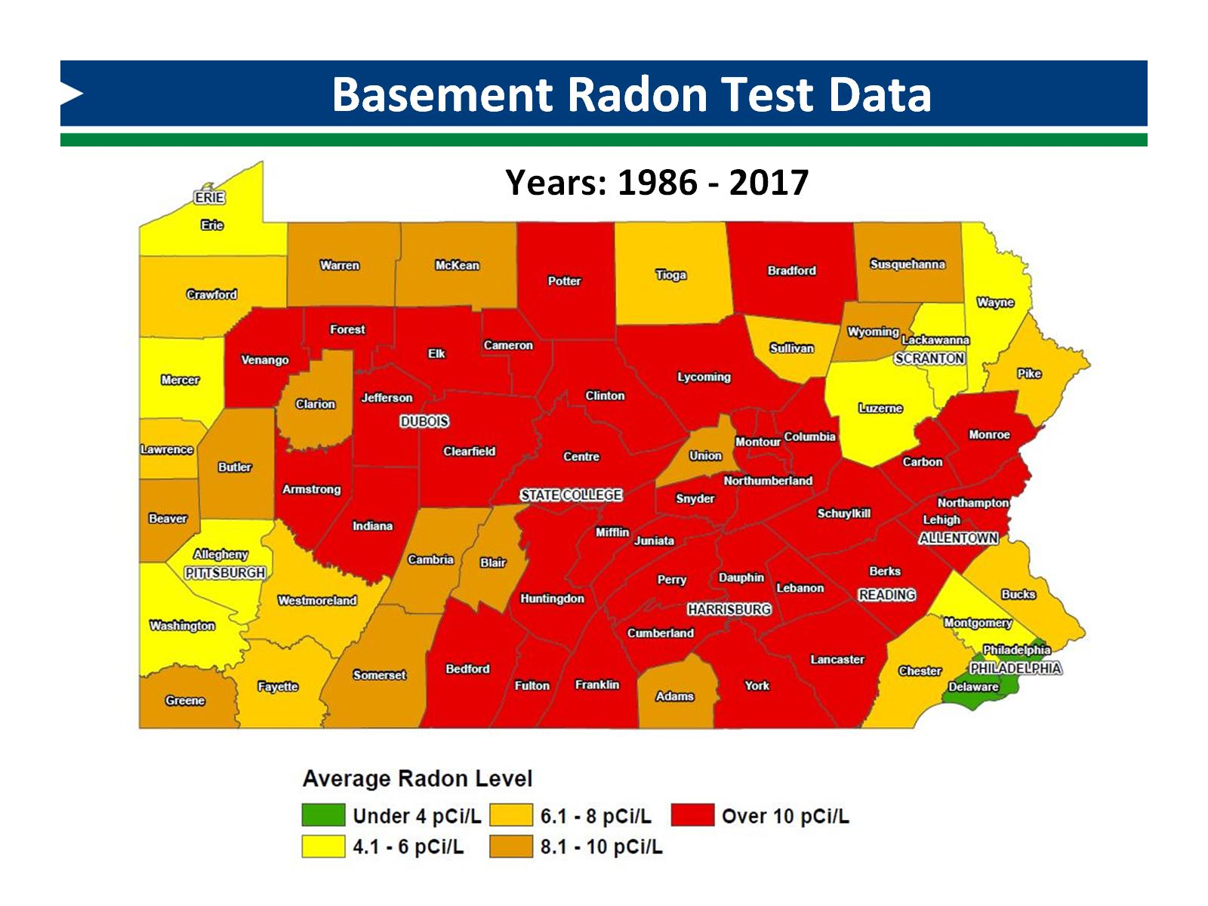
Basement Radon Test Data

Slide 61
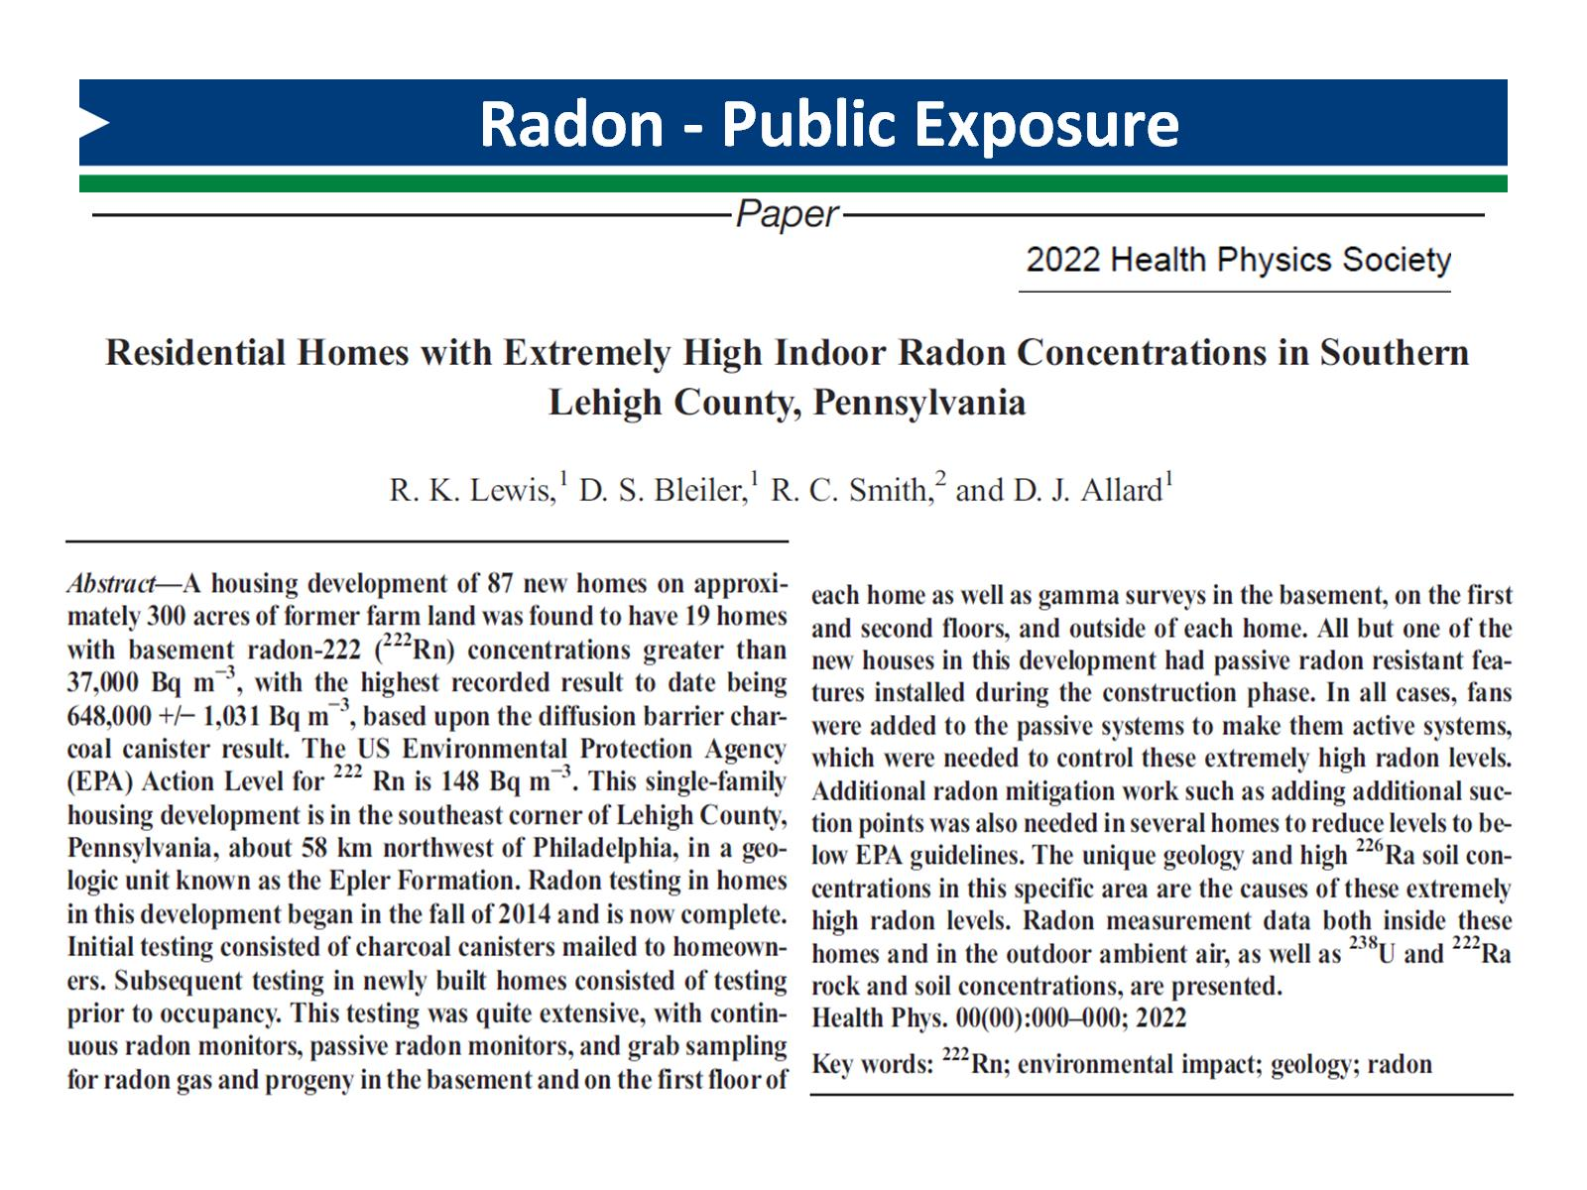
Radon - Public Exposure

Slide 62
Ongoing Communication Challenge

Slide 63
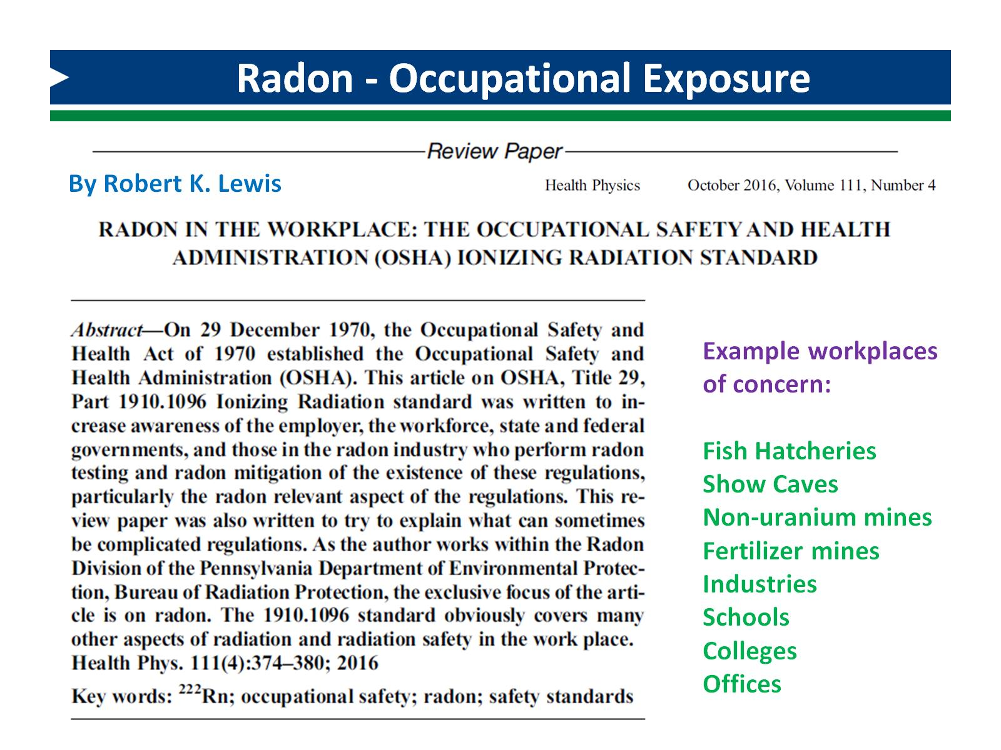
Radon - Occupational Exposure

Slide 65
Radiation Regulatory Jigsaw Puzzle

Slide 66
Disconnect Between Federal Agencies

Slide 67
Action Needed by the Federal Government

Slide 68
Disconnect Between Federal Agencies

Slide 69
Needed: a Presidential Executive Order

Slide 70
RP Standards in the USA Need an Update

Slide 71
David J. Allard, CHP allradcon@comcast.net

