Slide 1
3 Yankee Companies & National SNF Status Update
NEHLRWT Taskforce Meeting, St. Louis, MO
May 25, 2023
Eric Howes, Director Public & Government Affairs
Maine Yankee Atomic Power Company

Slide 2
Overview of the 3 Yankee Companies
MY, CY, and YR are independent, single-asset, fully decommissioned NPP sites that have been stand-alone ISFSIs for nearly two decades.
When DOE meets its obligation to remove the SNF/GTCC waste, the ISFSIs will be decommissioned, the NRC licenses terminated, the sites made available for other purposes, and the companies will go out of business.
Until then it is the 3 Yankees’ responsibility as the NRC licensees to store and secure the SNF/GTCC waste in accordance with all applicable regulations.
The 3 Yankee Companies have been in litigation with the DOE since 1998 to recover costs for the 3 companies' utility owners and their ratepayers resulting from the federal government's ongoing failure to remove the SNF/GTCC waste. The 3 companies to date have recovered about $575 million through 4 rounds of litigation.
There are currently 21 permanently & announced shutdown sites in the U.S.

Slide 3
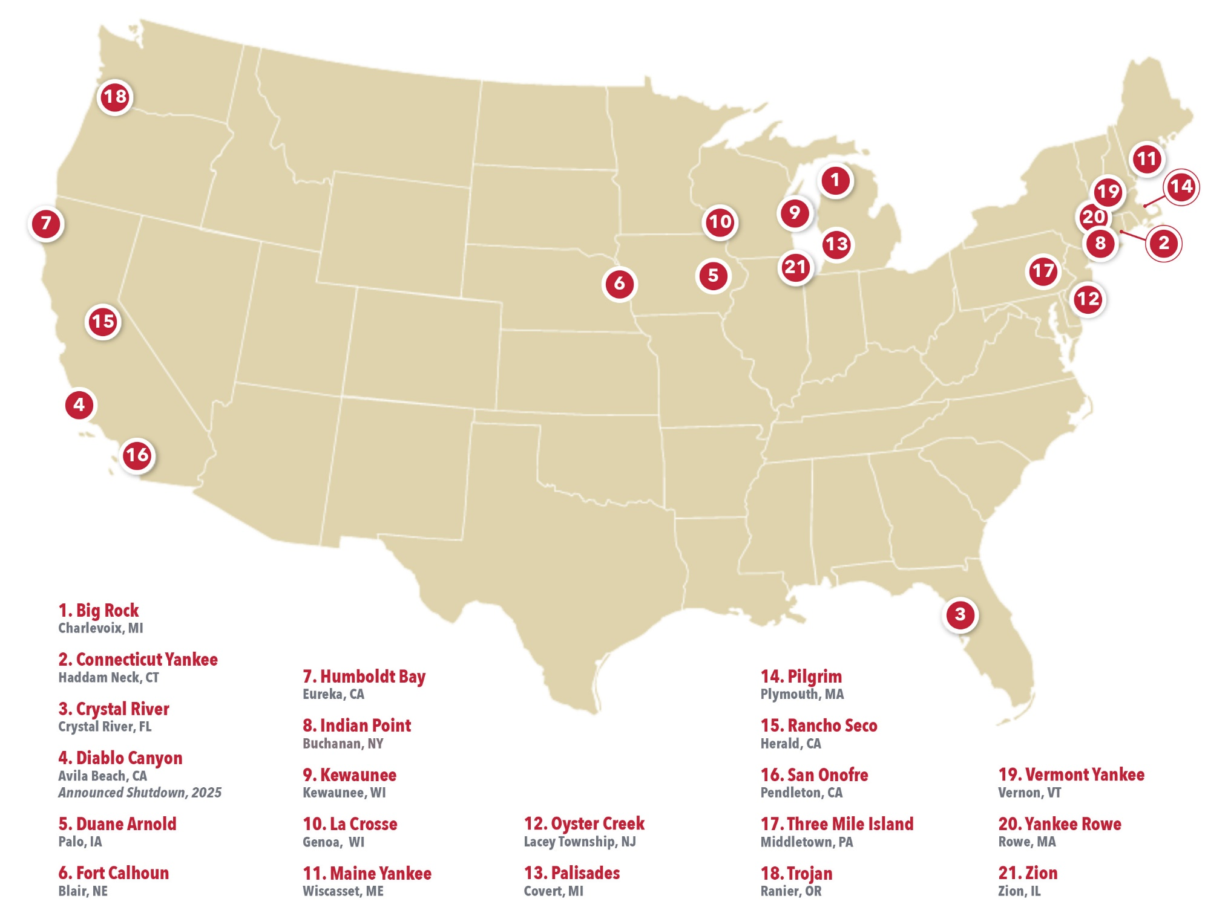
Permanently & Announced Shutdown Nuclear Plant Sites

Slide 4
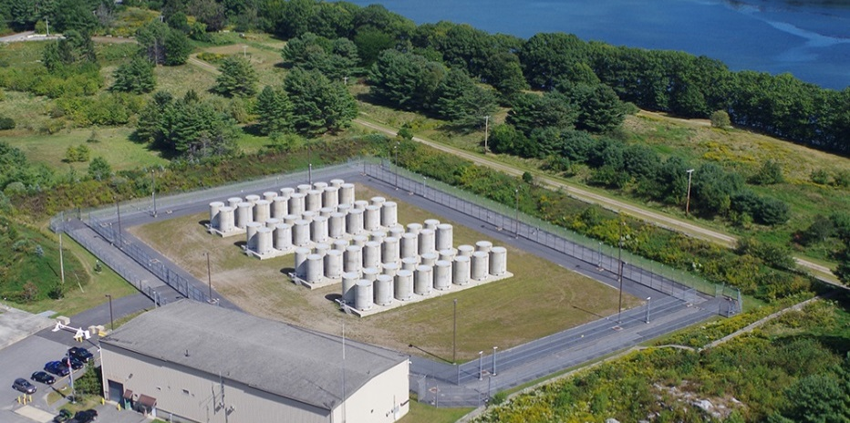
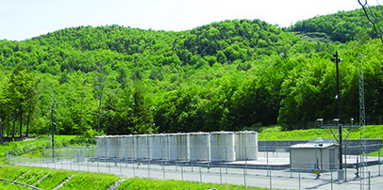
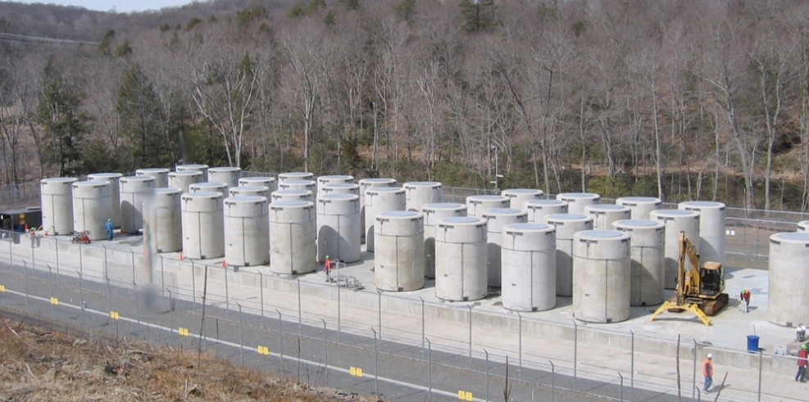
ISFSI dry cask systems licensed by NRC for storage & Transport: NAC UMS System at MY, NAC MPC system at CY & YR
115 canisters SNF, 8 canisters GTCC waste
Yankees are working with NAC on NRC applications to renew the MPC & UMS storage CofCs for 40 years.
NRC approval of the MPC storage CofC renewal is expected in October and the UMS in the first quarter of 2024.
Aging Management Programs for each of the 3 Yankee sites have been drafted and are in the review process.
A dry storage system inspection was conducted at YR summer 2022; CY, 24; MY, 26
Maine Yankee
Yankee Rowe
Connecticut Yankee

Slide 5
Congress: Funding legislation and related activity
On March 31^{st,} Rep Matsui (D-CA) and Rep Levin (D-CA) again led the effort to send a letter to the Chair and Ranking Member of the House E&WD Appropriations Subcommittee urging approval of the Administration’s FY ‘24 $53 million budget request for IWM and priority removal of SNF stored at shutdown reactor sites. 17 members of Congress signed the letter including 4 from NE – Reps Pingree (ME), Courtney (CT), Keating (MA), and Balint (VT).
On April 17th, the NWSC submitted its annual Testimony to the House Appropriations Subcommittee on E&WD Appropriations regarding FY ‘24 appropriations noting the need for Congress to provide “sustainable annual funding necessary for DOE and NRC to undertake critical activities related to developing, managing, and regulating an integrated program for the storage, transportation, and disposal of the nation’s SNF, Greater than Class C waste, and other high-level radioactive waste.” The NWSC submitted similar testimony to the Senate committee of jurisdiction.
There is the potential for an amendment to be offered as it was during the House markup of the FY ‘22 EWD bill consistent with the 3/22 “Heinrich/Cruz” bill which would prohibit the use of federal funds to carry out any activities that would lead to the development of a CIS facility owned or operated by a private company and that requires the prohibition to remain in place until a permanent repository is available to accept SNF.

Slide 6
Congress: Authorizing legislation and related activity
On December 1, 2022, the Senate E&NR Committee held a hearing on Chairman Manchin’s draft bill, The Nuclear Waste Administration Act. Among other provisions, the draft bill would establish a new organization to manage nuclear waste, provide a consensual process for siting nuclear waste facilities, and ensure adequate funding for managing nuclear waste. Sen Manchin is expected to introduce his bill this session.
On February 14th, Nevada Sen. Catherine Cortez Masto and Rep. Dina Titus introduced The Nuclear Waste Informed Consent Act in the Senate and House which would ensure that state, tribal, and local officials will play a key role in decisions regarding siting a deep geological repository for nuclear waste.

Slide 7
Congress: Authorizing legislation and related activity continued
On April 4th, Sens. Capito (R., W.Va.), Carper (D., Del.), Whitehouse (D., R.I.) and others introduced a bipartisan bill in the Senate The Accelerating Deployment of Versatile, Advanced Nuclear for Clean Energy (ADVANCE) Act that mainly focuses on future nuclear technology but that also contains a grant program to assist shutdown site communities with $35 million per year for the next 5 years and $5 million per year for community advisory boards for the next 5 years.
During the March 9, 2023, Senate ENR Committee hearing regarding the nuclear fuel cycle, Senator Angus King pressed DOE Assistant Secretary Kathryn Huff on the timing of the consent-based siting process for a federal CIS storage facility. Following the hearing Senator King issued a press release headlined “King declares nuclear waste storage scattered across the country ‘probably the worst solution’”.

Slide 8
3 Yankees’ Perspective on DOE’s Consent-Based Siting Initiative
DOE’s consent-based siting process and funding opportunity to establish federal interim storage facilities are important steps towards achieving an interim spent fuel storage solution.
DOE’s effort also serves to raise the profile of the spent nuclear fuel storage issue and the need to re-establish an integrated national nuclear waste management program that includes interim storage with priority removal for SNF/GTCC waste stored at shutdown sites, transportation planning and funding for states and tribes, and a permanent disposal repository.
Congressional action is needed to form a new independent waste management organization with sustained annual access to the Nuclear Waste Fund.
The indefinite storage of the SNF/GTCC waste was never consented to by our local communities, states, or companies.

Slide 9
Consent-Based Siting Engagement
On 12/20/22 CY hosted a site tour for Congressman Joe Courtney, DOE’s Dr. Kathryn Huff, Dr. Kim Petry, and state and local officials. Following the tour, Congressman Courtney, Dr. Huff and Dr. Petry held a roundtable discussion on “Consent Based Siting of Spent Nuclear Fuel: Policies, Programs, and Progress” in Waterford. There were several media outlets that covered the roundtable meeting.
On 4/27/23 Congressman Courtney sent CT elected officials a letter updating them on DOE’s consent-based siting process and attaching DOE’s 4/25 report on the CBS process.
On March 1, I participated on a panel at the Waste Management Symposia in Phoenix that explored “the re-start of DOE’s consent-based siting initiative and how to ensure past experiences inform new efforts.” My presentation focused on lessons learned from the MY CAP experience. DOE’s Dr. Kim Petry was a member of the panel.
Regarding DOE’s CBS FOA, the Decommissioning Plant Coalition is a non-compensatory participant in an application with other parties.

Slide 10
Private Consolidated Interim Storage Facility Status
New Mexico CIS NRC License Review
The NRC issued a license to Holtec International to construct and operate a consolidated interim storage facility in New Mexico on May 9, 2023.
The New Mexico Legislature passed, and the Governor signed into law on March 17th a bill that bans the storage or disposal of spent nuclear fuel and/or high-level radioactive waste in New Mexico unless the state has consented to the creation of the disposal facility. Holtec has said it plans to challenge the state law in court.

Slide 11
Private Consolidated Interim Storage Facility Status continued
Texas and New Mexico CIS Facility Litigation
In the Texas Interim Storage Partners CIS facility site case before the DC Court of Appeals brought by the litigants that were unsuccessful intervenors in the NRC licensing process - the Court issued a judgement on January 25th dismissing the petitions and upholding the license granted by the NRC.
In litigation against the NRC’s granting of a license to Interim Storage Partners in Texas in the 10th Circuit Court of Appeals - the Court denied New Mexico’s legal challenge on February 11th citing a lack of jurisdiction.
A decision is pending in the case brought by the Texas AG before the 5th Circuit Court of Appeals.
Intervenors in the Holtec CIS application also brought challenges in the DC Circuit Court of Appeals and those cases were being held in abeyance pending final action by the NRC on the Holtec CIS application.

Slide 12
Thank you!
ehowes@3yankees.com
http://www.3yankees.com/index.html

