Slide 1

Office of Packaging and Transportation
Overview and Key Activities
Ellen Edge
TEPP Program Manager
Northeast High-Level Radioactive Waste
Transportation Task Force
October 26, 2022

Slide 2
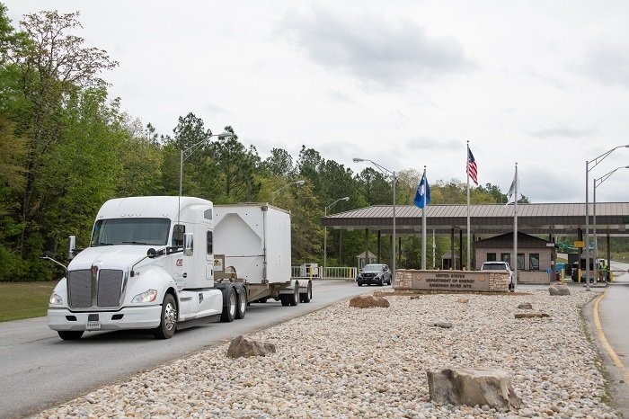
Agenda
  Office of Transportation (OPT) overview and programs
  DOE shipping statistics
  Recent accomplishments
  Program-specific highlights
    Stakeholder outreach
    Policy
    Planning
    Training
Outreach & Emergency Preparedness
Notes:
Photo: The final legacy Transuranic Package Transporter Model 3 shipment from Savannah River Site departs the site near Aiken, South Carolina in mid-April, en route to EM's Waste Isolation Pilot Plant in southeastern New Mexico for permanent disposal. https://www.energy.gov/em/articles/em-milestone-last-trupact-iii-shipment-legacy-transuranic-waste-srs-arrives-wipp

Slide 3
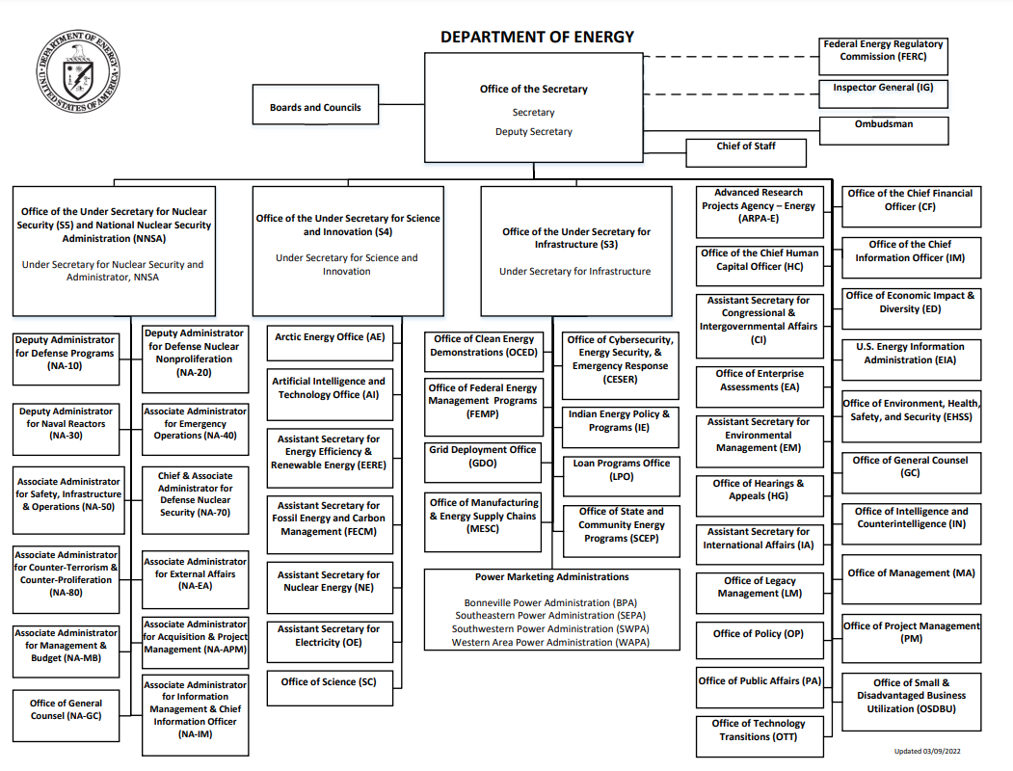
Department of Energy Organizational Chart

Slide 4
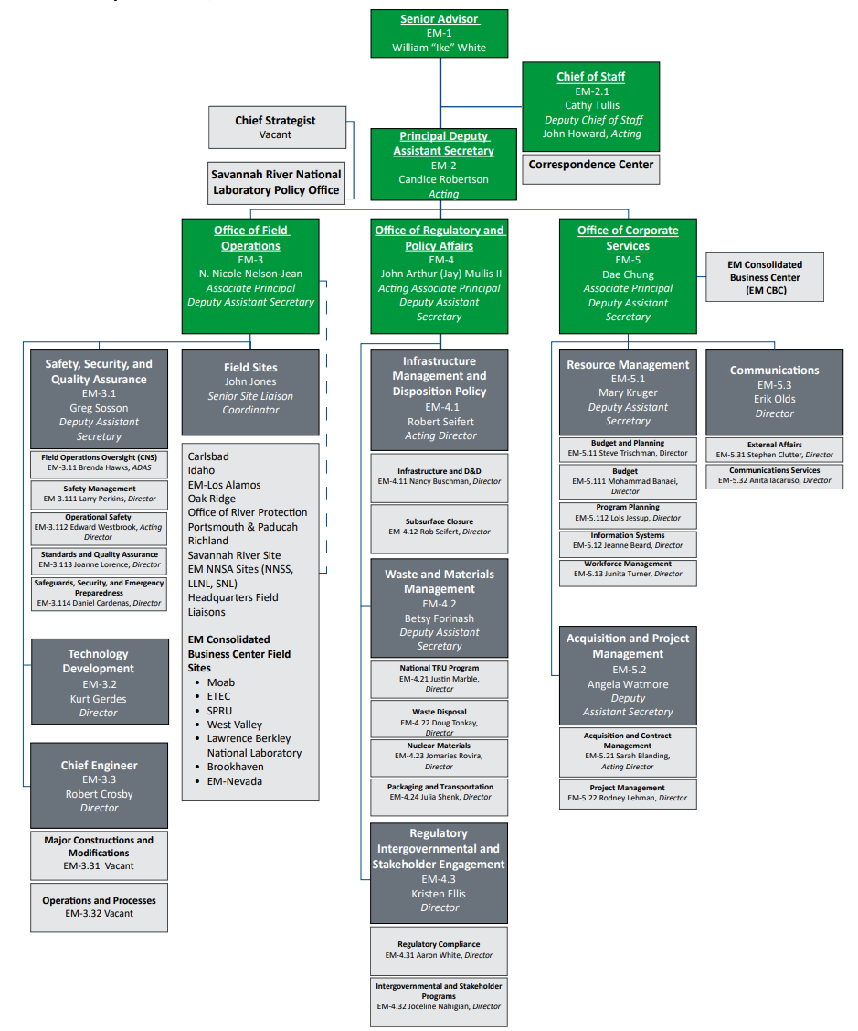
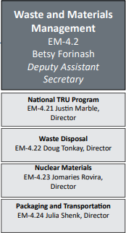
Office of Environmental Management (EM)
HQ Organization

Slide 5
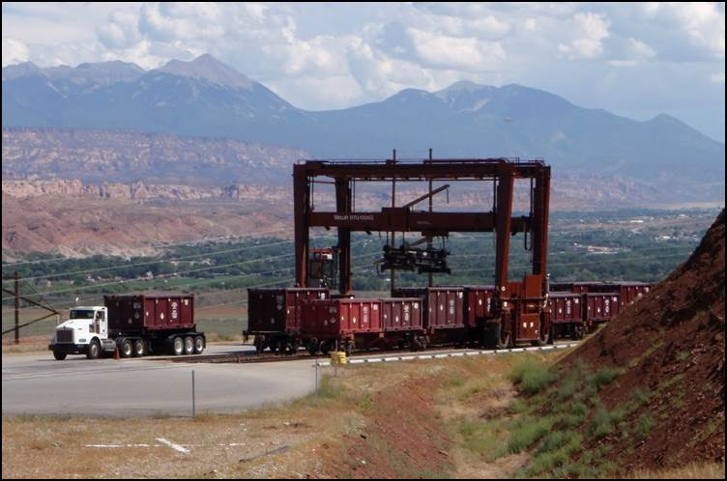
OPT Mission
The Office of Packaging and Transportation (OPT) protects people and the environment by ensuring safe, compliant and efficient packaging and transportation of materials. We achieve this mission by conducting packaging and transportation assessments and oversight; assisting field sites; and developing and managing policies, guidance and tools in accordance with DOE requirements and government regulations.

Slide 6
OPT Key Programs & Responsibilities
  Compliance and safety
  Motor Carrier Evaluation Program (MCEP)
  Transportation Compliance Assurance Program (TCAP) for DOE sites
Packaging Certification Program (PCP)
Stakeholder engagement and training
  Transportation Emergency Preparedness Program (TEPP)
  National Transportation Stakeholders Forum (NTSF)
Outreach & Emergency Preparedness

Slide 7
OPT Key Programs & Responsibilities
Transportation planning and management tools
  Multiple software programs facilitating safe and efficient transportation activities by DOE sites
  Field support
  Program support for site transportation managers
  Transportation Management Council; Packaging Management Council
  Policy and regulatory support
  DOE Orders
  Engagement with federal regulatory agencies
Outreach & Emergency Preparedness

Slide 8
FY21 DOE Shipments
FY21 DOE Shipments
FY21 DOE Offsite Hazardous Materials Shipments by Program
Environmental Management 1,404
Nuclear Energy 129
Science 748
Nat’l Nuclear Security Admin. 1,753
Total 4,024

Slide 9
FY21 EM Shipments
FY21 EM Waste Shipments
FY21 EM Waste Materials Shipped
Low Level Waste 448*
Mixed Low Level Waste 98
Transuranic Waste 96
Other 338
Total 980**
**One shipment may contain multiple materials

Slide 10
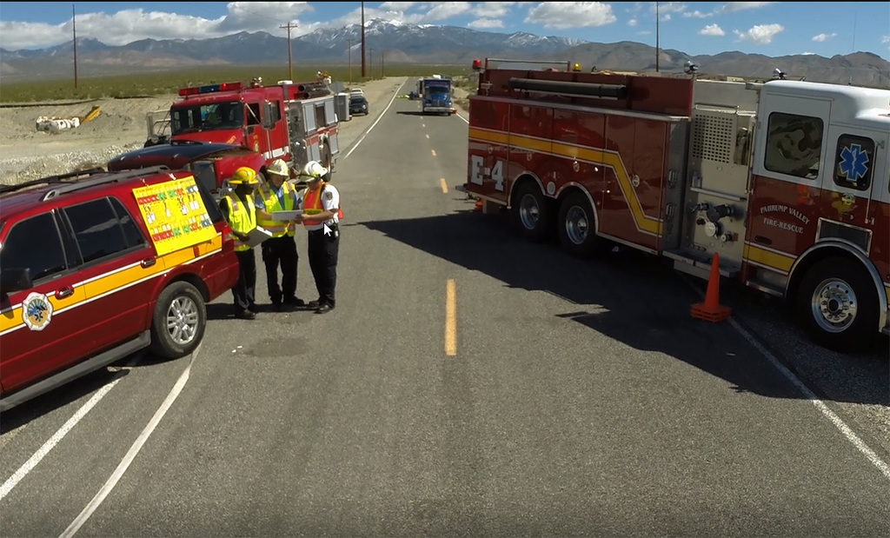
Packaging & Transportation
FY22 Accomplishments
  Transportation Emergency Preparedness Program (TEPP)
    Training conducted in 17 states – 97 classes and 1508 students
  Motor Carrier Evaluation Program (MCEP)
    13 carrier evaluations completed/in progress
Outreach & Emergency Preparedness

Slide 11
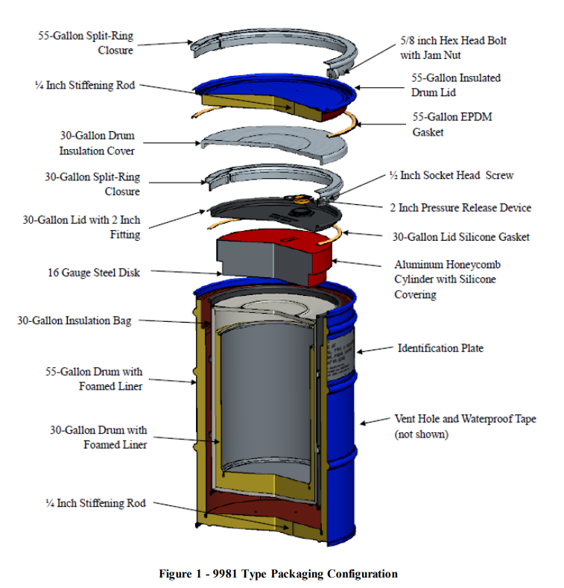
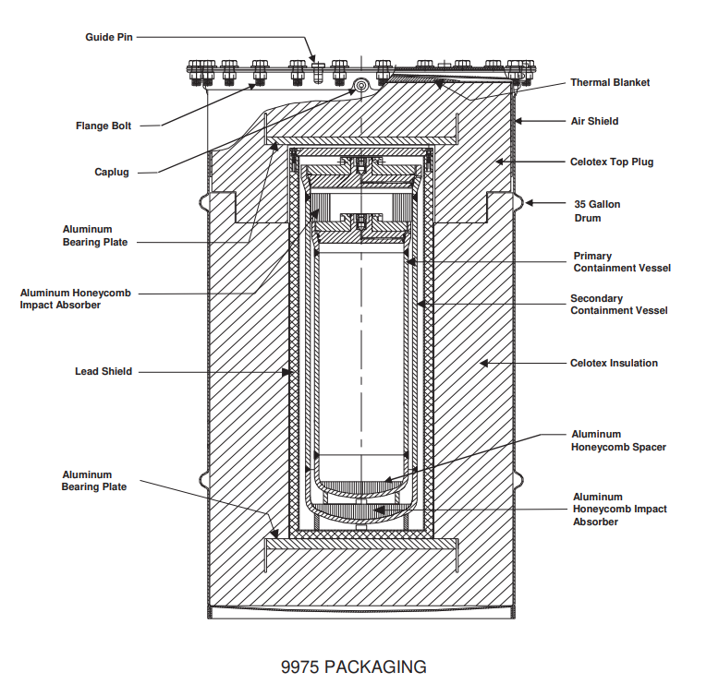
Packaging & Transportation
FY22 Accomplishments
  Packaging Certification Program (PCP)
    40+ dockets completed
    Packaging University courses: 15+ courses completed or scheduled
    See https://rampac.energy.gov for details
  Transportation Compliance Assurance Program (TCAP)
    Three site transportation assessments completed
Outreach & Emergency Preparedness

Slide 12
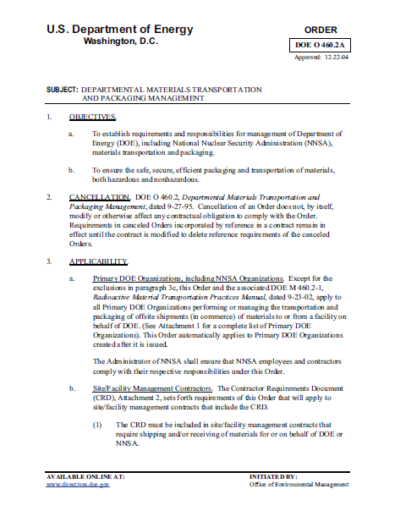
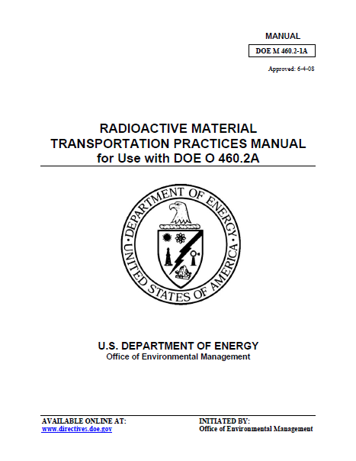
Packaging & Transportation
FY22 Accomplishments
  Revision of DOE Order 460.2, Departmental Materials Transportation Management
    Published June 2022
Outreach & Emergency Preparedness

Slide 13
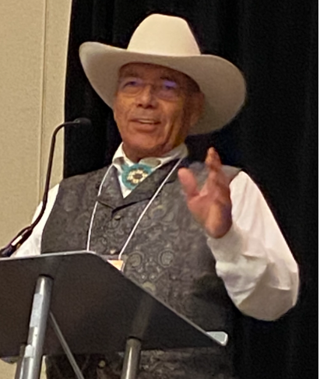
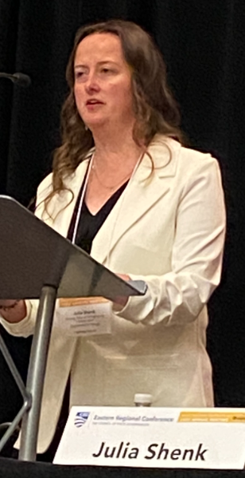
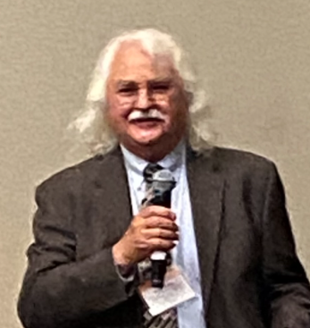
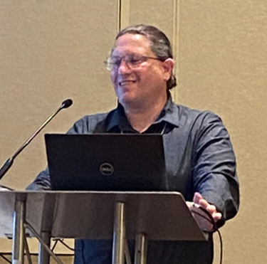
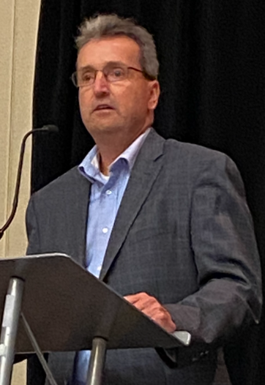
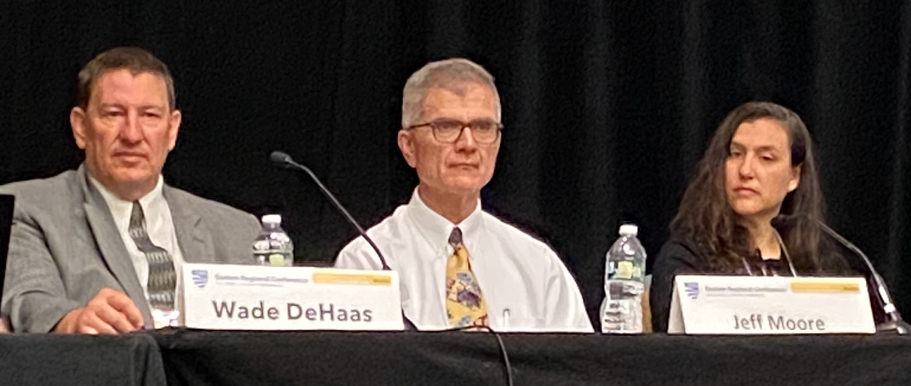
National Transportation Stakeholders Forum (NTSF)
  DOE’s primary mechanism to communicate with States and Tribes about shipments of radioactive material
  EM solicits State and Tribal input for shipment planning and execution
  Chaired by EM-OPT

Slide 14
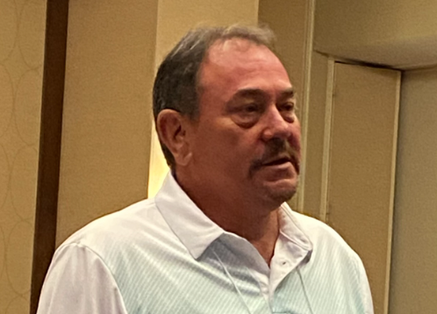
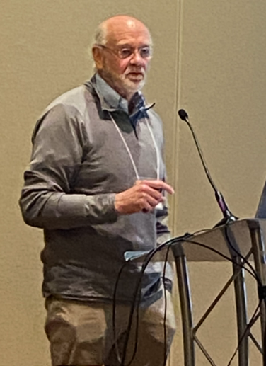

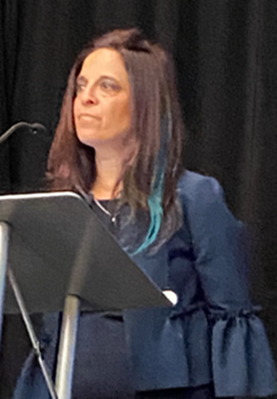

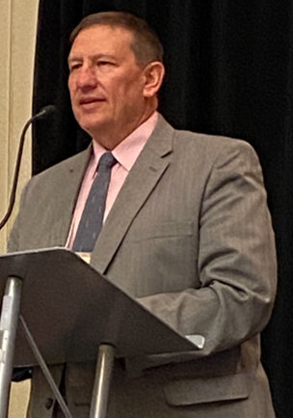

National Transportation Stakeholders Forum (NTSF)
  OPT provides funding for NTSF with additional funding and participation from the Office of Nuclear Energy (NE)
  Cooperative agreements with four State Regional Groups and the Tribal Radioactive Materials Transportation Committee (TRMTC)
  Revised website recently developed: https://www.ntsf.info/

Slide 15
NTSF Engagement
  NTSF Annual Meeting, June 2022
    First in-person meeting since 2019
    Approximately 180 attendees from local, State, and Tribal governments as well as other federal agencies
  Webinars on various technical topics throughout the year
    The most recent webinar was held on October 19 on the revised DOE Order 460.2.
  State Regional Groups and TRMTC hold semi-annual meetings
  Multiple ad-hoc working groups including TEPP and spent nuclear fuel rail/routing
Notes:
The U.S. Department of Energy (DOE)’s Office of Packaging and Transportation will lead a presentation and discussion on DOE Order 460.2B, Departmental Materials Transportation Management. The revised Order was published in June 2022 and includes important clarifications on topics including advance shipment notifications, public engagement, emergency response, and shipment security.

Slide 16
Motor Carrier Evaluation Program (MCEP)
  Promotes responsible and safe transport of DOE radioactive materials and hazardous wastes
  MCEP provides a transparent, technically defensible basis for DOE and its contractors to exercise due diligence in selecting and hiring services of for-hire carriers
  13 evaluations performed in FY22

Slide 17
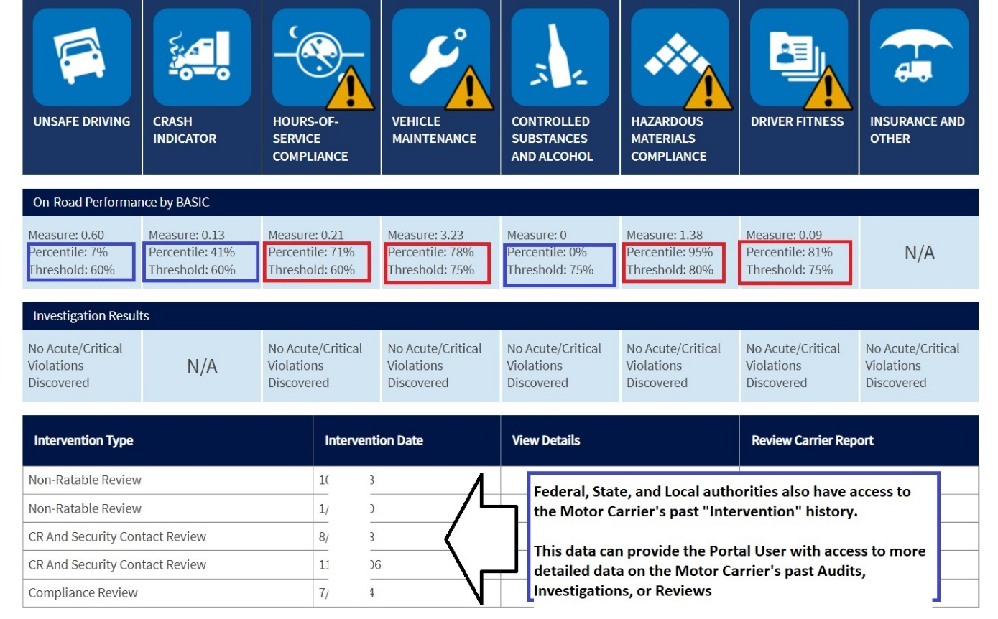
Motor Carrier Evaluation Program (MCEP)
  Areas of evaluation include:
    Driver training
    Drug and alcohol testing programs
    Security plans
    Financial security and insurance requirements
    Review of DOT safety measurements and inspections
    Equipment maintenance and records

Slide 18
Motor Carrier Evaluation Program (MCEP)
34 Total Active MCEP Carriers (September 2022)
35
30
28
25
20
15
10
6
5
2
0
Active National
Active Local
Temp Non-Use
Carriers
Carriers

Slide 19
Recent Transportation Engagement:
Policy
  Revision of DOE Order 460.2, Departmental Materials Transportation Management
    Through NTSF, State Regional Groups and TRMTC participated in a review period concurrent to DOE’s internal process
    Valuable input provided regarding advance shipment notifications, shipment planning, emergency response, and other requirements
    DOE EM provided an overview of key changes and topics of interest to stakeholders via webinar and will hold another webinar on October 19, 2022.
    Revised Order published in June 2022
    Available at: Departmental Materials Transportation Management — DOE Directives, Guidance, and Delegations
Outreach & Emergency Preparedness

Slide 20
Recent Transportation Engagement:
Planning
  Prospective Shipment Report (PSR)
    Bi-annual report produced by DOE EM based on data call to all DOE shipping programs and sites
    Provides preliminary information on planned high-volume shipments of radioactive waste, transuranic waste, and other high-visibility shipments of possible interest to stakeholders
    Reports provided to designated State and Tribal officials
    Intended for use as a planning tool to determine resources needed for inspections, emergency response, accident prevention and public information/outreach
    Most recent PSR disseminated in June 2022
Outreach & Emergency Preparedness

Slide 21
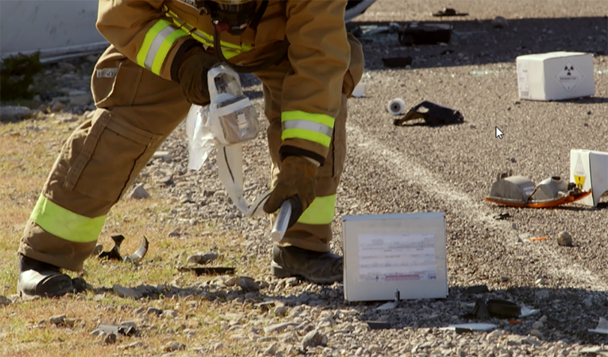
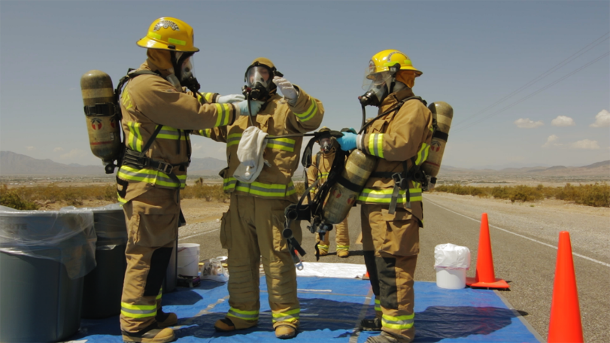
Recent Transportation Engagement:
Emergency Response Training
  Transportation Emergency Preparedness Program (TEPP)
    Provides tools for planning, training and exercises, and technical assistance to State and Tribal authorities to prepare for transportation incidents involving DOE radioactive material shipments
    Key component is first responder training provided at no cost to jurisdictions along DOE shipping routes
    In FY 2022, training conducted in 17 states – 97 classes and 1508 students
    Extensive engagement with State of Wyoming, including needs assessments, training, and tabletop exercises

Slide 22

Contact Information
Ellen Edge
301-903-8327
ellen.edge@em.doe.gov
AskPAT@hq.doe.gov

