Slide 1
3 Yankee Companies & National SNF Status Update
NEHLRWT Taskforce Meeting, Philadelphia, PA
June 7, 2022
Eric Howes, Director Public & Government Affairs
Maine Yankee Atomic Power Company

Slide 2
Overview of the 3 Yankee Companies
MY, CY, and YR are independent, single-asset, fully decommissioned NPP sites that have been stand-alone ISFSIs for nearly two decades.
When DOE meets its obligation to remove the SNF/GTCC waste, ISFSIs will be decommissioned, NRC licenses terminated, sites made available for other purposes, and companies will go out of business.
Until then it is the 3 Yankees’ responsibility as the NRC licensees to store and secure the SNF/GTCC waste in accordance with all applicable regulations.
The annual cost to operate each of the 3 ISFSIs and companies is on the order of $10 million per year per site.
The 3 Yankee Companies have recovered approximately $575.5 million in court awarded damages through four rounds of litigation.
There are currently 21 permanently & announced shutdown sites in the U.S.

Slide 3
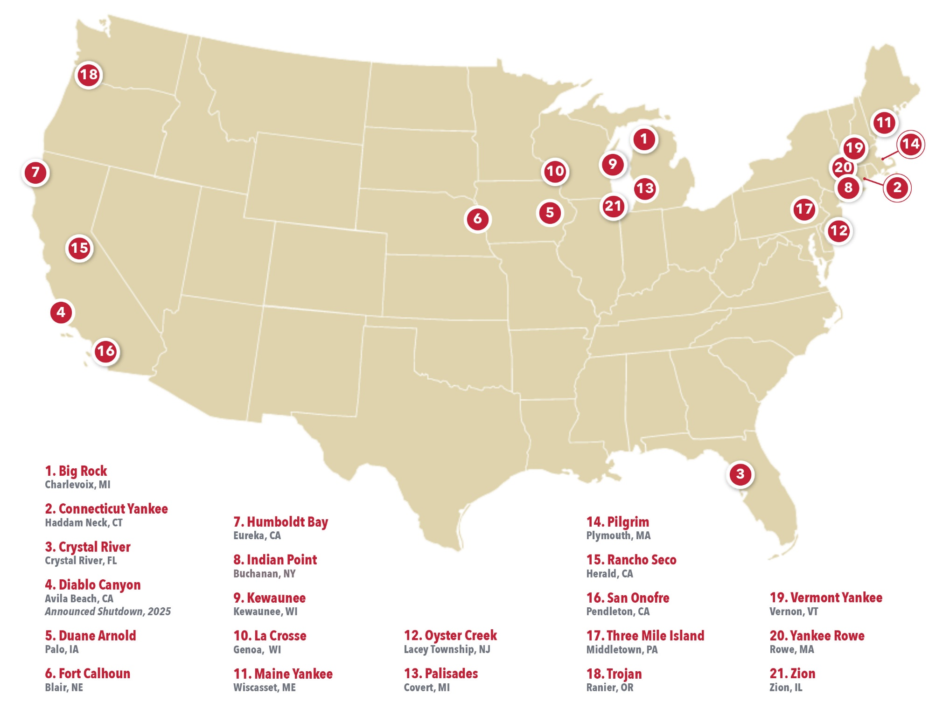
Permanently & Announced Shutdown Nuclear Plant Sites

Slide 4
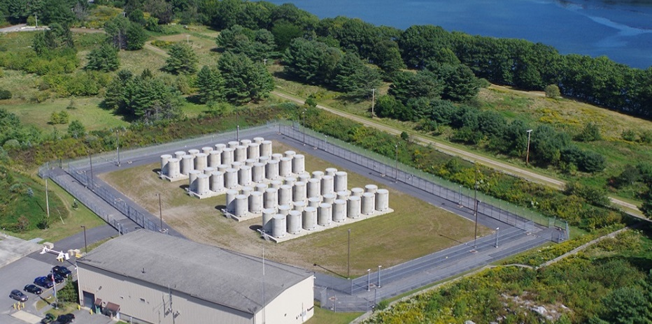
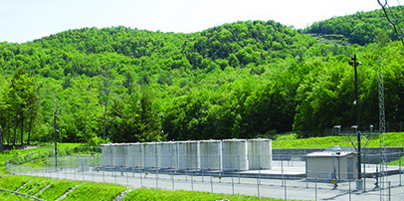
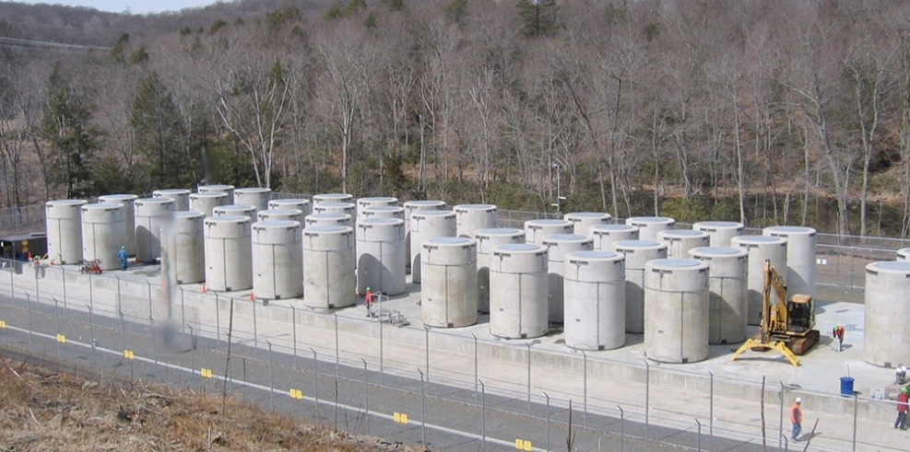
ISFSI dry cask systems licensed by NRC for storage & Transport: NAC UMS System at MY, NAC MPC system at CY & YR
115 canisters SNF, 8 canisters GTCC waste
Yankees are working with NAC on NRC applications to renew the MPC & UMS storage CofCs for up to 40 years. Both applications have been accepted for review. The review & approval process is expected to take approximately 2 years.
Aging Management Programs for each of the 3 Yankee sites have been drafted and are in the review process. A dry storage system inspection is scheduled for: YR, 22; CY, 24; MY, 26
Atmospheric monitoring is also ongoing at the 3 sites
Maine Yankee
Yankee Rowe
Connecticut Yankee

Slide 5
NRC ISFSI Security Requirements Rulemaking
In 2015 NRC Staff recommended delaying ISFSI Security Rulemaking to 2020 noting "the existing security requirements for ISFSIs, together with the additional requirements in the post 9/11 security orders, provide continued high assurance of adequate protection of public health and safety regardless of the license type or location…” The Commission concurred.
In October 2019 NRC Staff recommended discontinuing the security rulemaking because it “would not further improve public health and safety or the common defense and security and would not be cost justified.”
In January 2022, the Commission disapproved the Staff’s 10/19 recommendation and directed Staff to prepare an options paper for the Commission: “Before deciding whether and how to proceed with this rulemaking, the Commission would benefit from a staff analysis of more options for the scope of the rule and the potential regulatory, resource, and timing impacts of those options…”
NRC staff held a public meeting on 5/24 to gain stake holder input for the options paper.

Slide 6
NRC Decommissioning Rulemaking
In December 2014, the Commission directed Staff to develop a rule making on power reactor decommissioning in response to the growing number of plants entering decommissioning. The proposed decommissioning rule has been before the Commission since May 2018.
The staff proposed Decommissioning Rulemaking was approved by the Commissioners last November and was published for public comment in the Federal Register March 3rd. The staff released four rulemaking related draft guidance documents in late February. Public Comments are due August 30th. NRC held several public meetings to present the proposed rule and receive public comments including one in Plymouth, Ma on 5/9. Senator Edward Markey (D-MA) also held a Senate EPW Subcommittee field hearing in Plymouth on 5/6 on this and other issues related to decommissioning.
The Nuclear Energy Institute Decommissioning Working Group has formed 11 issue area subcommittees to review and develop comments on the rule and guidance documents. The 3 Yankee companies have participants on all the NEI subcommittees and are also involved with the Decommissioning Plant Coalition review and comment efforts as well.

Slide 7
NRC & NEI SNF Transportation Documents
In late December 2021, the NRC released its “Regulatory Readiness for Oversight of Large-Scale Commercial Transportation of Spent Nuclear Fuel” document. The report largely found the NRC prepared to support SNF transportation with some enhancements including increased public involvement. The NRC subsequently held a public meeting regarding its transportation readiness report.
In a similar vein in early January 2022 NEI released a document, “Spent Fuel Transportation Planning and Implementation Guidance” for stakeholder reference that provides the industry perspective regarding SNF transportation campaigns focused on private shipments of SNF as opposed to DOE shipments.

Slide 8
3 Yankee Response to DOE’s RFI on a Federal Consent-Based Siting Process for CIS
The 3 Yankees were involved with comments provided by the Nuclear Energy Institute, Nuclear Waste Strategy Coalition, and the Decommissioning Plant Coalition that were all supportive of the initiative, but also provided comments and suggestions on the process. Following are excerpts from the 3/4/22 DPC comments:
…We believe that State, Tribal and local governments need to be provided appropriate resources for engagement with the federal government on all aspects of the program that could lead to federal CIS capacity.
We do not believe the development of a "one size fits all" template is necessary or useful. Congress should refrain from attempting to define consent prior to the development of an agreement responsive to these governmental entities needs.
Current barriers to SNF interim storage facilities include the lack of any program leading to the development of a permanent geologic disposal facility, current restrictions that unduly link the siting, licensing and operation of such facilities to progress on the proposed Yucca Mountain repository license and perhaps, most importantly, the lack of direction/policy committing the federal government to enter into an enforceable and durable "consent agreement" with State, Tribal or local governments.

Slide 9
Congress: Funding Legislation
In March, an omnibus bill was passed that funds the federal government for the remainder of FY 22. As with the past two federal budgets, $20 million was appropriated for interim storage activities.
In the FY 23 Budget Request released by the Administration on 3/28, DOE requested $53 million to support the implementation of a consent-based siting process for a federal interim storage facility.
On 4/29 Rep Matsui (D-CA) and other Members with shutdown sites in their districts (including Rep Pingree D-ME, and Rep Courtney (D-CT) sent a letter to House E&WD Appropriations Subcommittee Chair & Ranking Member urging the subcommittee to include in its FY 22 bill $53 million for SNF storage and disposal, with an initial focus on accepting SNF from shutdown reactor sites. The $53 million request mirrors the DOE’s FY 2023 budget request.

Slide 10
Congress: Funding Legislation
As noted in that 4/29 Joint member letter, “While DOE is again engaged with regional transportation groups, it has not yet begun conversations with local communities where shutdown plants are located to solicit their views on transportation routes to interstate rail nor developed firm cost and schedule estimates for site specific infrastructure upgrades. For this reason, we are requesting $53 million for FY 2023, consistent with the President’s budget request. This increased funding level would support the implementation of a consent-based siting process for an interim storage facility by providing appropriate funds to work collaboratively with the public, communities, stakeholders, and governments at the Tribal, state, and local level. This increased funding would also provide necessary resources to build on the success of the RFI and advance the development of a durable interim storage program within DOE so that the federal government can begin to meet its statutory and contractual obligations.”

Slide 11
Congress: Authorizing Legislation
On March 2nd Senators Heinrich (D-N.M.) and Cruz (R-Texas) and Reps Leger Fernández (D-N.M.) and Plfuger (R-Texas) introduced bipartisan legislation that prohibits the use of federal funds to carry out any activities that would lead to the development of a CIS facility owned or operated by a private company and requires the prohibition to remain in place until a permanent repository is available to accept SNF. The bill was not included in the FY 22 Omnibus funding bill although there was a concerted effort made to do so.
U.S. Representatives Mike Levin (D-CA) and Darrell Issa (D-CA) reintroduced the Spent Fuel Prioritization Act in Congress on February 9th – the bill aims to prioritize spent fuel removal from decommissioned nuclear sites in areas with high populations, seismic hazards, or national security risks.

Slide 12
Private Consolidated Interim Storage License Applications
The NRC decision approving the license for the proposed ISP CIS facility in Texas was issued 9/13/21.
In a 5/26/22 letter to Holtec, NRC staff stated it now expects to publish the final Environmental Impact Statement in July 2022 and issue the final Safety Evaluation Report in conjunction with its final licensing decision by January 2023.
Litigation by the states of TX and NM and other opponents of the two projects continues in federal court.

Slide 13
Thank you!
ehowes@3yankees.com
http://www.3yankees.com/index.html

