Slide 1
Ivy Tech community college vallo
Amy Stone – Project Director

Slide 2
Agenda
Ivy Tech Community College structure overview
Ivy Tech VALLO objective
Ivy Tech VALLO project strategy
Challenges
Best Practices

Slide 3
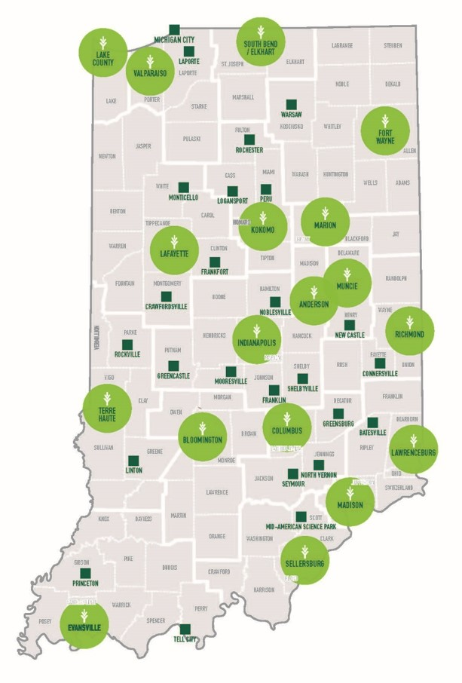
Ivy Tech Community College
We have more than 40 locations, and teach classes in more than 75 communities. We have grown to become the largest public postsecondary institution in Indiana: and the largest singly-accredited statewide community college system in the entire country.
Notes:
Largest singly-accredited statewide community college system in the country
We offer programs from our:
School of Business, Logistics, & Supply Chain
School of Public Affairs & Social Services
School of Information Technology
School of Arts, Sciences & Education
School of Health Sciences
School of Nursing
School of Advanced Manufacturing, Engineering & Applied Science
Ivy Tech offers more than 100 transfer programs with in-state and out-of-state schools

Slide 4
Ivy Tech VALLO Objective
Increase and expedite attainment of state occupational licenses by veterans and transitioning services members using our 3 core strategies
Improving access to efficient online, competency-based credentials and degree pathways;
Preparing veterans and TSMs for success through thorough prior learning assessments and offering accelerated bridge programs and pathways to licensures;
Increase reciprocity of license requirements and credentials with our surrounding states.

Slide 5
Project Strategy
Used the final report, Veterans’ Licensing and Certification Demonstration: A Summary of State Experiences, Preliminary Findings, and Cost Estimates, published in September 2015 as our primary guide.
Assemble a Team
Select Occupations
Understand Civilian Employment Requirements
Understand Military Occupational Specialties
Produce Gap analysis to Identify the Appropriate Strategy
Market to Veterans
Develop Assessment Plan
Notes:
We used the final report as a guide
Along the way we made a few adjustments. We added a step specifically to pathway development after the gap analysis

Slide 6
1. Assemble a Team
Final Report Recommendations | Ivy Tech VALLO Partners
Governor’s Office | Governor’s Cabinet
Workforce and Economic Development | Indiana Department of Workforce Development
Postsecondary Education | Ivy Tech Community College Indiana Commission for Higher Education
State Veterans’ Affairs Agency | Indiana Department of Veterans Affairs
State Licensing Boards | Indiana Professional Licensing Agency
State Approving Agency | Indiana Department of Veterans Affairs SAA
Notes:
On the left is the final reports recommended team members.
Other key partners of ours are the Council for state governments and the 2018 VALLO recipient , Kentucky Science and Technology Corporation (KSTC), Multi-state collaborative on military credit

Slide 7
2. Select Occupations
High-demand, high-wage
Licensed by the State
Military equivalency
Respiratory Care
Medical Imaging
Surgical Technician
Pharmacy Technician
Athletic Trainer
EMT
CDL
Police Officer
Aviation Maintenance
Plumber/HVAC
Notes:
The next
We created a spread sheet that displayed civilian occupation, licensing agency, military equivalent (broken down by branch), relevant Ivy Tech programs, projected annual job openings, median salary, total military separation, and total military separations to Indiana.

Slide 8
3. Understand Civilian Employment Requirements
Identify licensure requirements
Map civilian pathways
Identify existing accelerated pathways

Slide 9
4. Understand Military Occupational Specialties
Identify all relevant MOS
Obtain relevant Programs of Instruction (POI)
Review awarded credits
Review American Council on Education (ACE) credit recommendations

Slide 10
5. Produce Gap Analysis
Compare military skills and credentials to civilian requirements for state licensure
Scan for existing national analyses
Engage licensing boards and educational institutions
Determine whether military training and experience for the occupation in question is fully or partially equivalent
Partial-equivalency requires an educational institution to either (1) modify curriculum or course content policies; or (2) develop approve, and deliver accelerated courses for veterans

Slide 11
Pathway Development (Occupational Specific Planning)
Occupational specific teams
Faculty
Military experts
Licensing board
Faculty/curriculum committees review POI

Slide 12
6. Market to Veterans
Identify communication touch points with veterans for outreach
Establish mechanisms to share information among agencies
Targeted outreach to National Guard and Reserve members

Slide 13
7. Develop Assessment Plan
Engage educational partners to monitor and report enrollment, completion, and subsequent employment
Establish agreements to track veterans’ use of exam waivers and pass rates

Slide 14
Challenges
Lack of centrally location information
Demand for bridge program pathways
Lack of information about veteran population

Slide 15
Best Practices
Cross-state communication and collaboration
Stakeholder engagement
Veterans
Faculty
State agencies
Federal agencies
Veteran agencies

