Slide 3
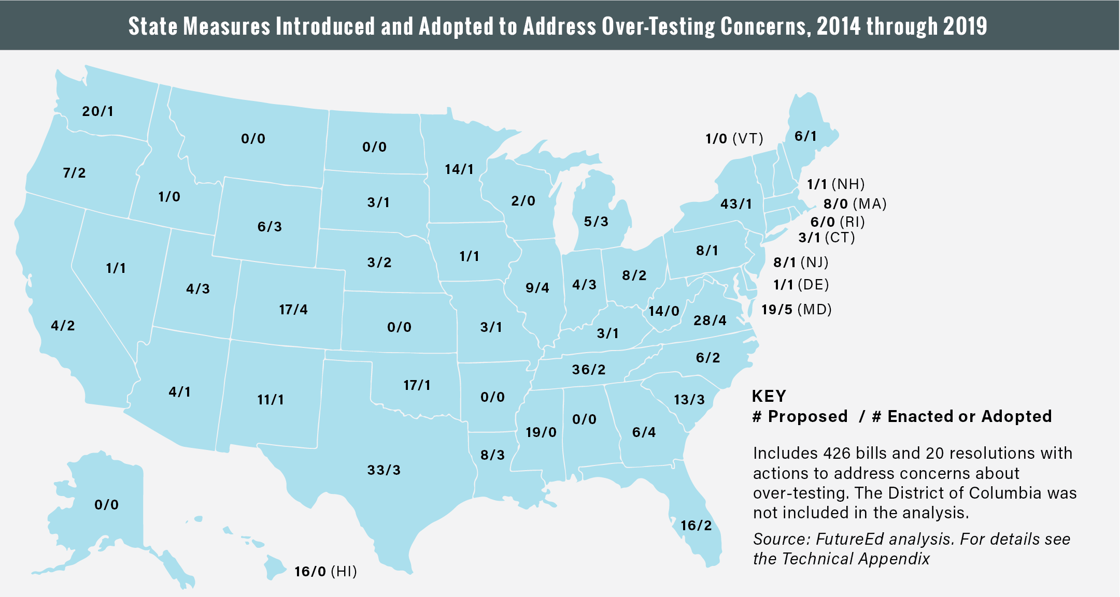

Slide 4
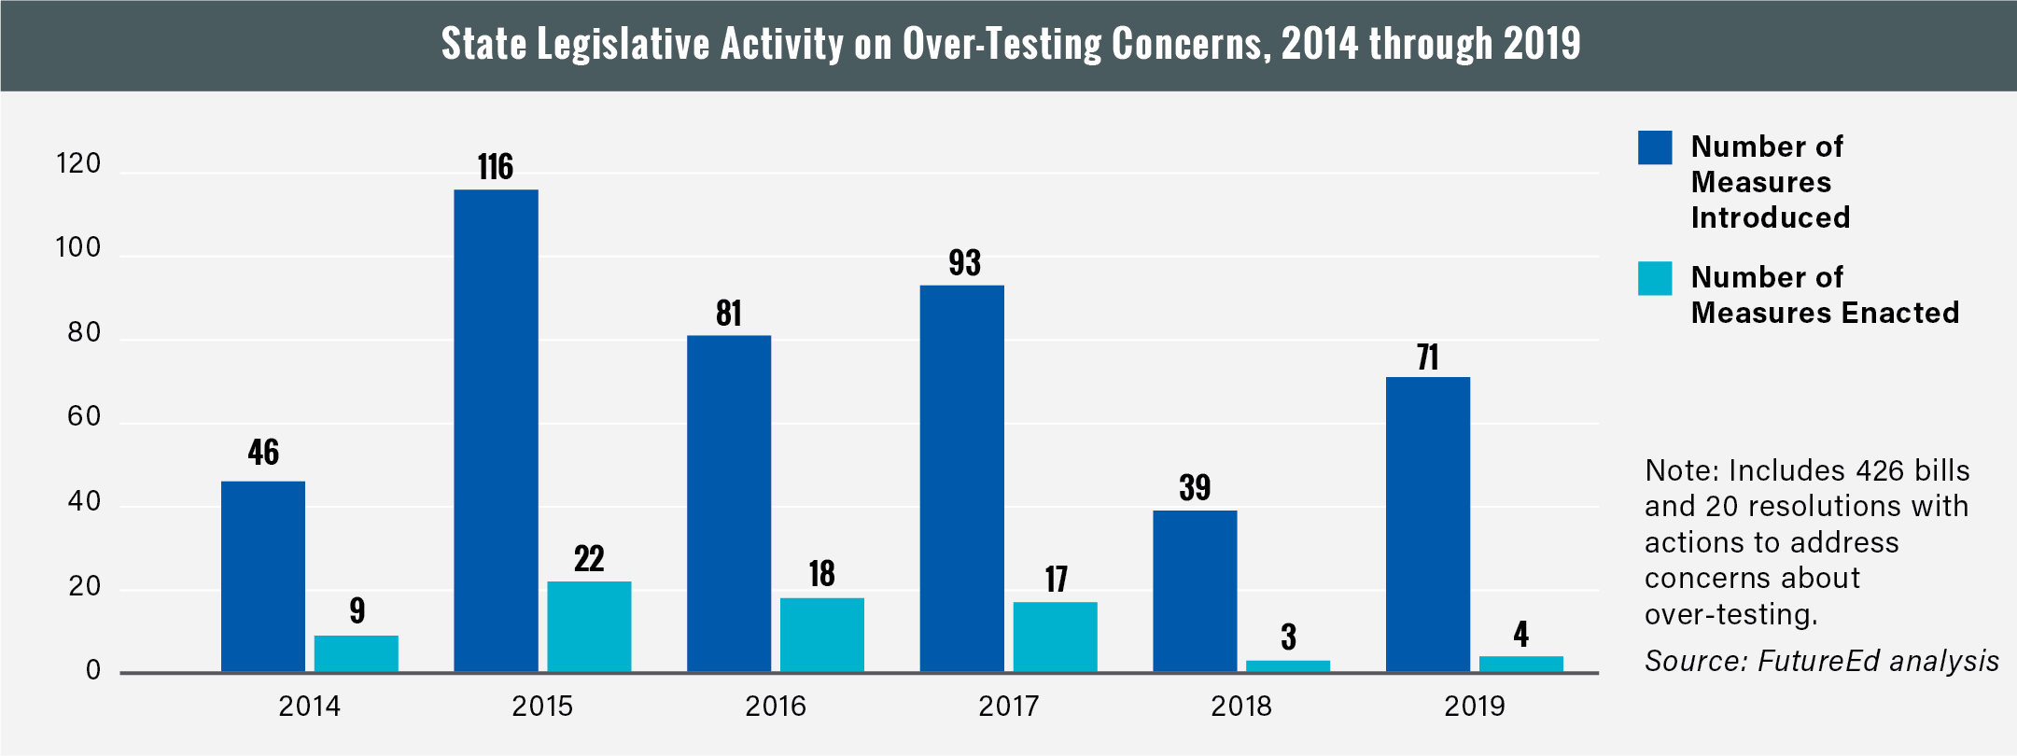

Slide 5
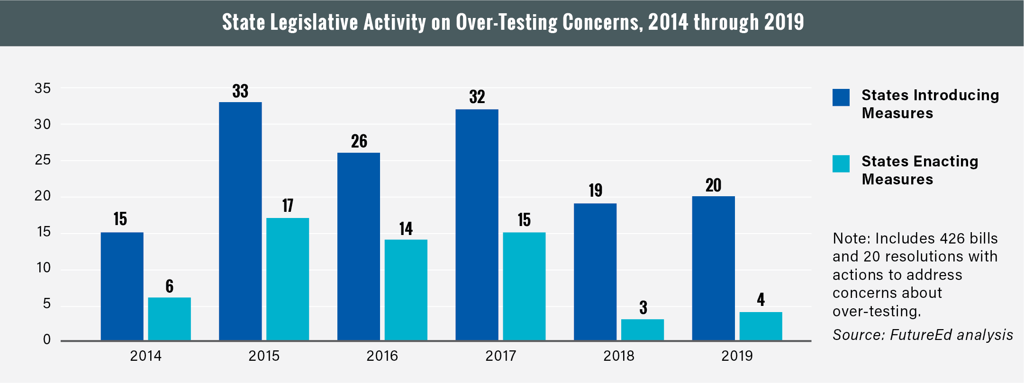

Slide 6
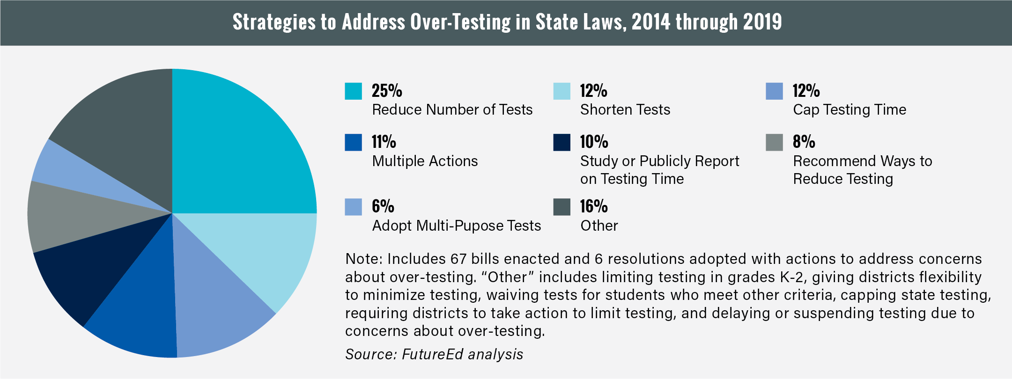

Slide 7
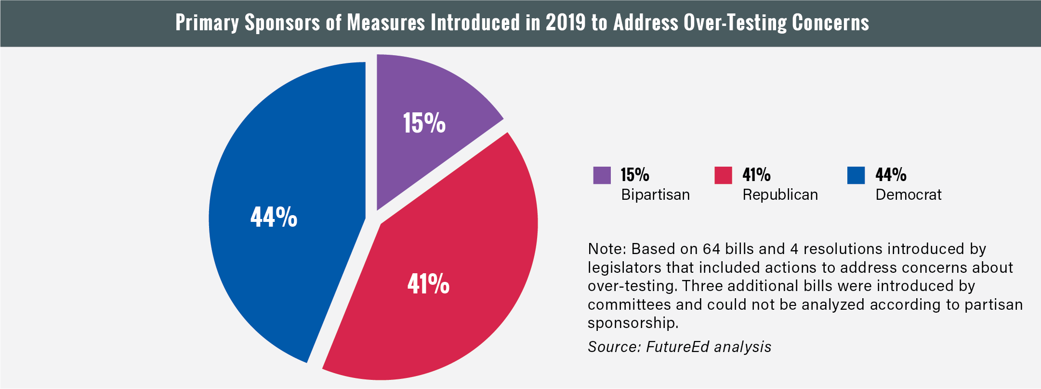

Slide 8
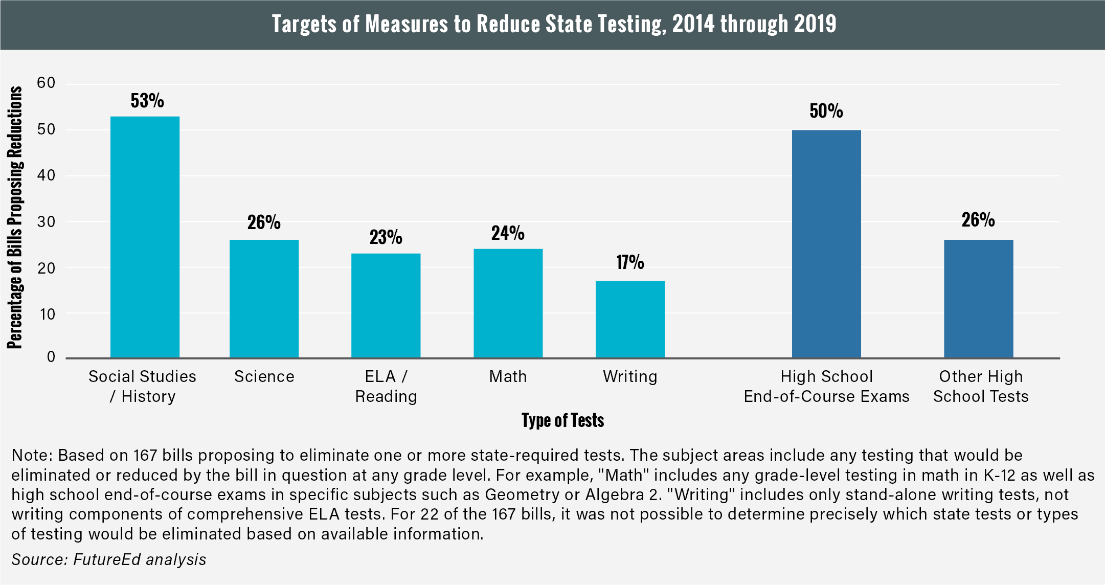

Slide 9
Thank you!

Slide 10
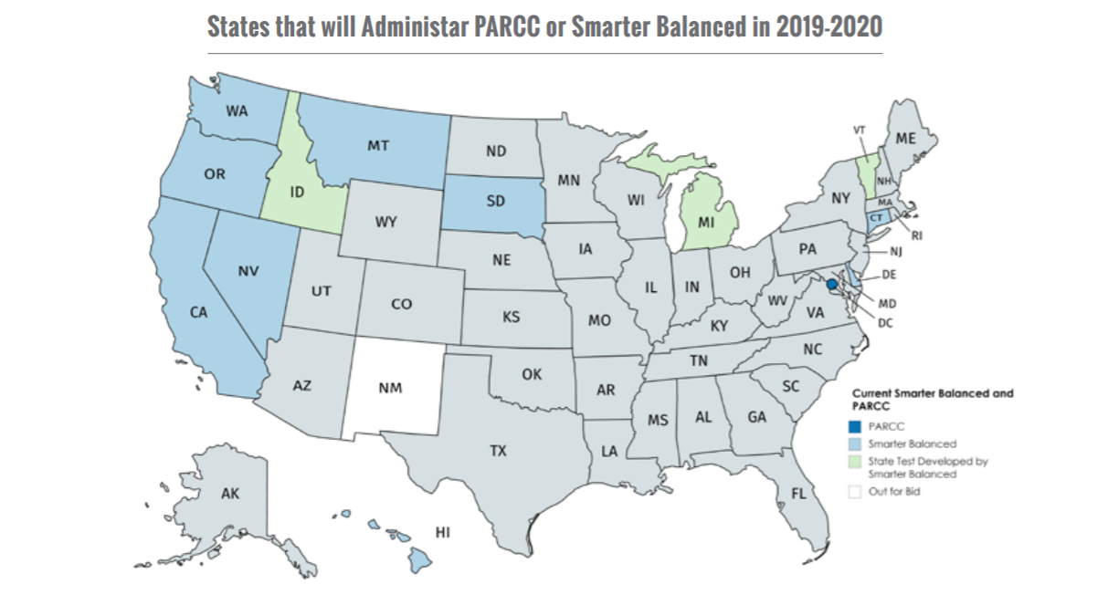
The New Testing Landscape: State Assessments Under ESSA

Slide 11
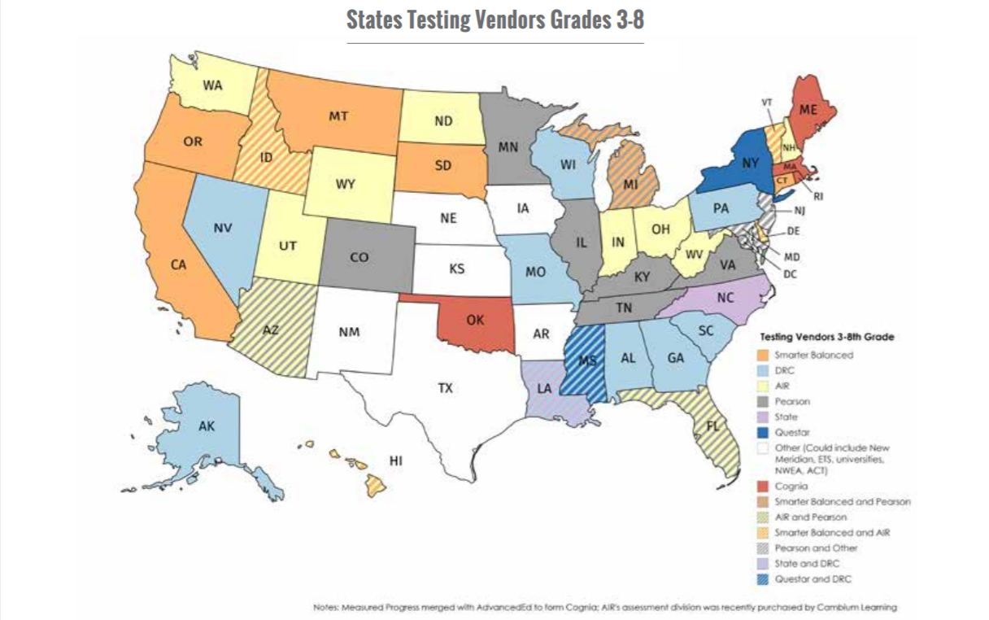
The New Testing Landscape: State Assessments Under ESSA

Slide 12
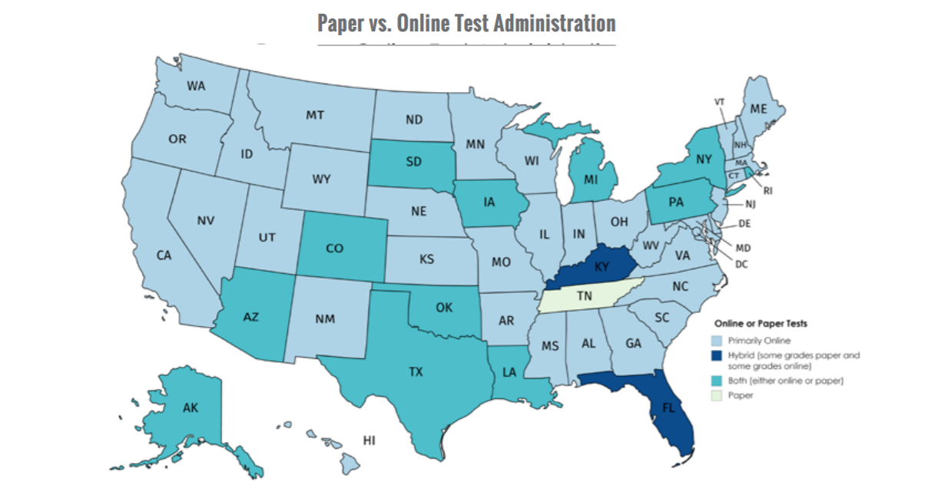
The New Testing Landscape: State Assessments Under ESSA

Slide 13
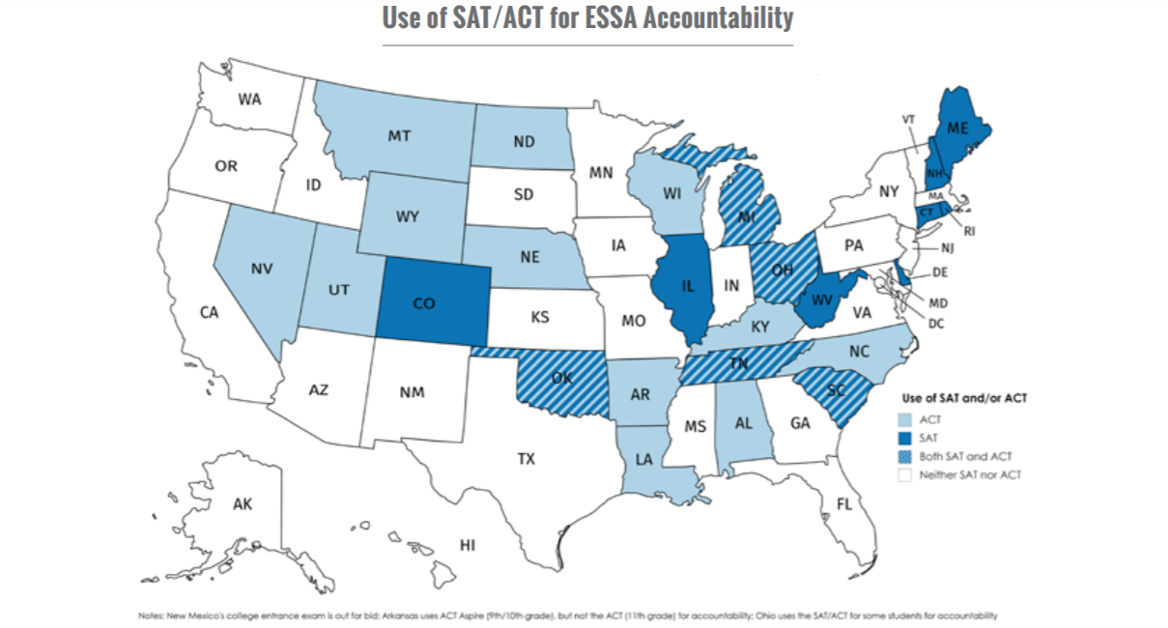
The New Testing Landscape: State Assessments Under ESSA

