Slide 2

2211 Nights at the Museum
April 23, 2025
Mike Firsick
Three Rivers CC

Slide 3

2211 Nights at the Museum

Slide 4





2211 Nights at the Museum
Connecticut’s Aviation History

Slide 5
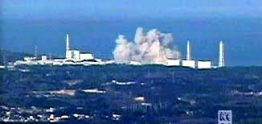
2211 Nights at the Museum
March 2011

Slide 6
2211 Nights at the Museum
Connecticut does not landfill waste
Alarm at waste recycler in Mass
Radium Dial Gauges set off alarm
Point of Origin- New England Air Museum

Slide 7
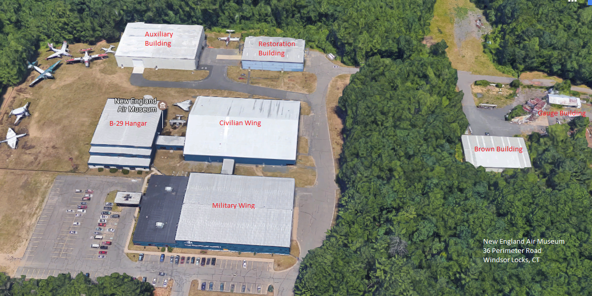
2211 Nights at the Museum

Slide 8

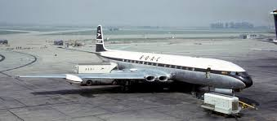
2211 Nights at the Museum

Slide 9
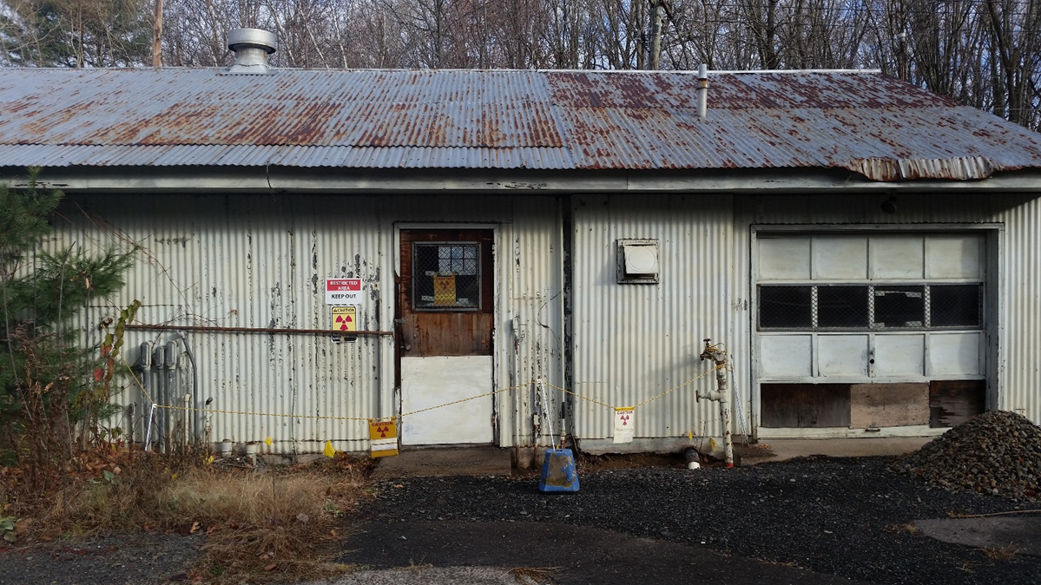
2211 Nights at the Museum
Oh…so you have more…

Slide 10
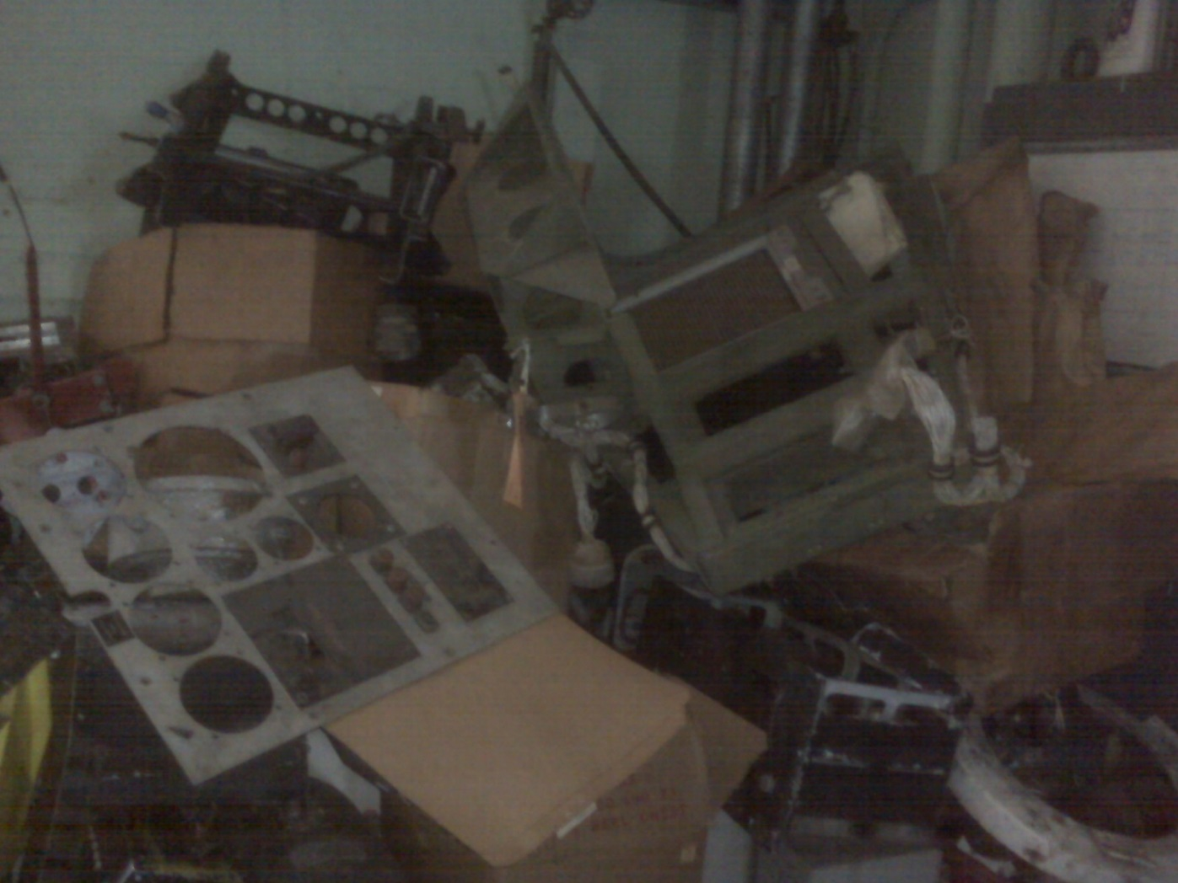
2211 Nights at the Museum

Slide 11
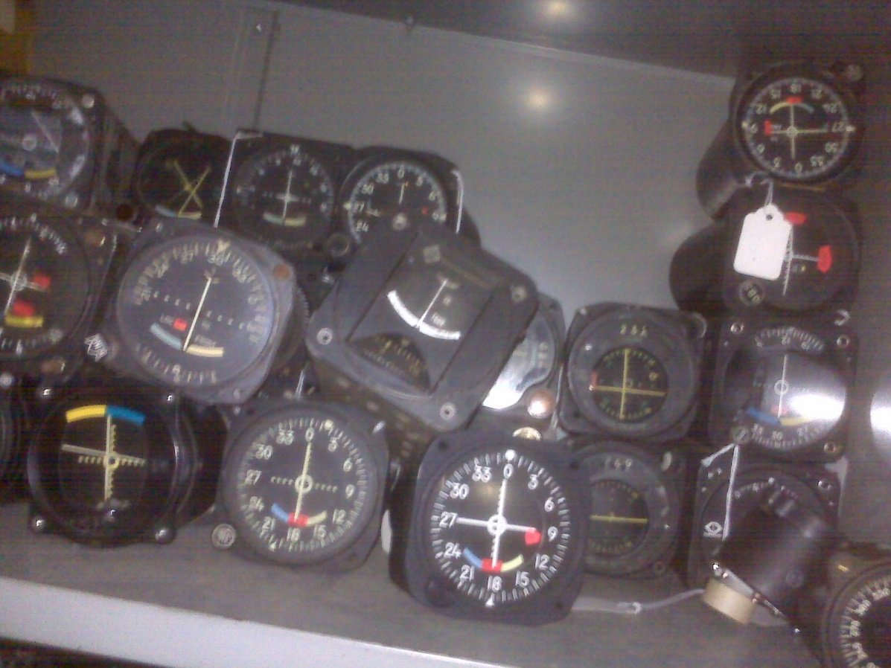
2211 Nights at the Museum

Slide 12
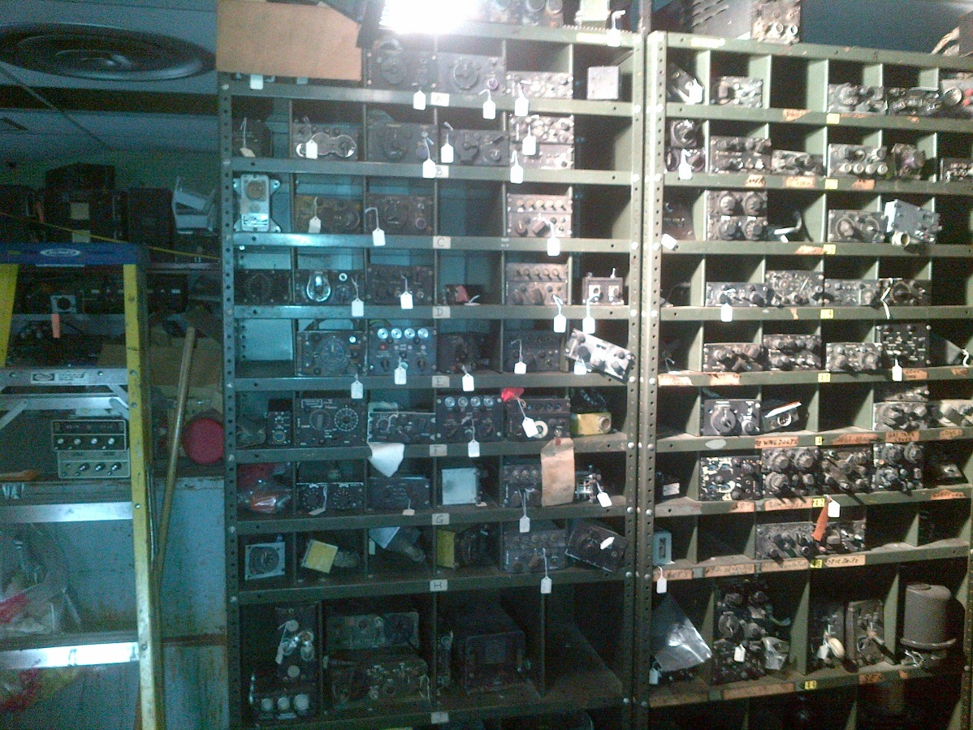
2211 Nights at the Museum

Slide 13
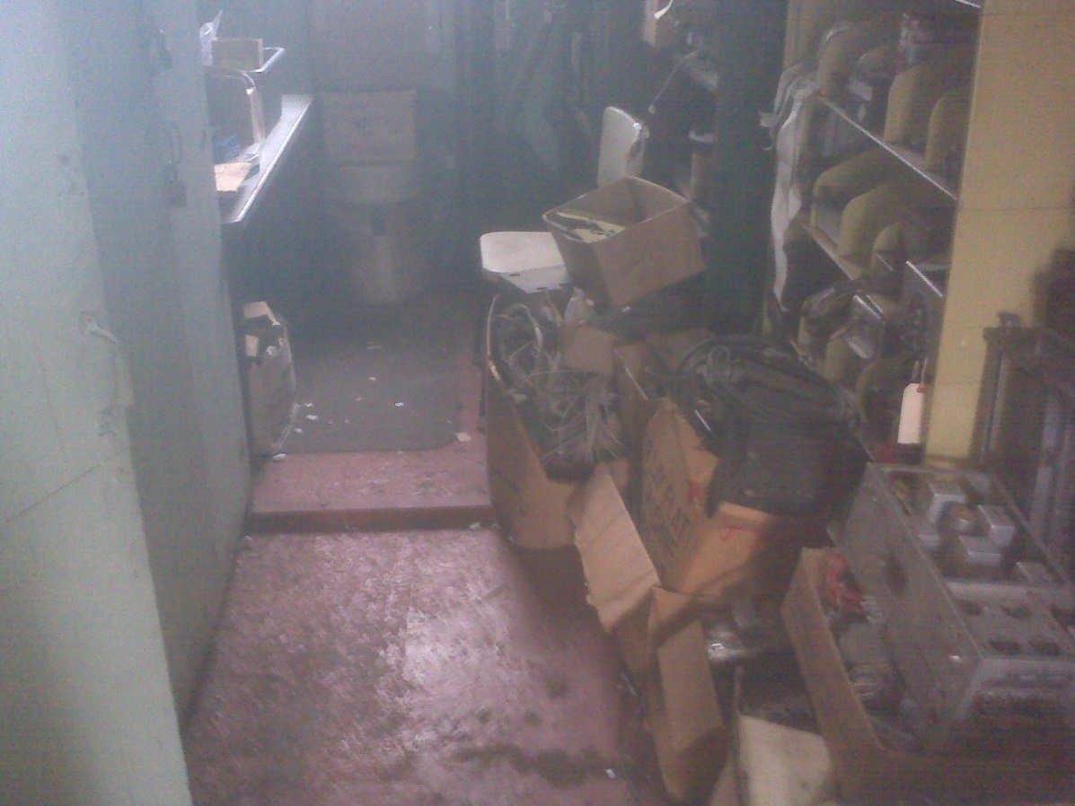
2211 Nights at the Museum

Slide 14
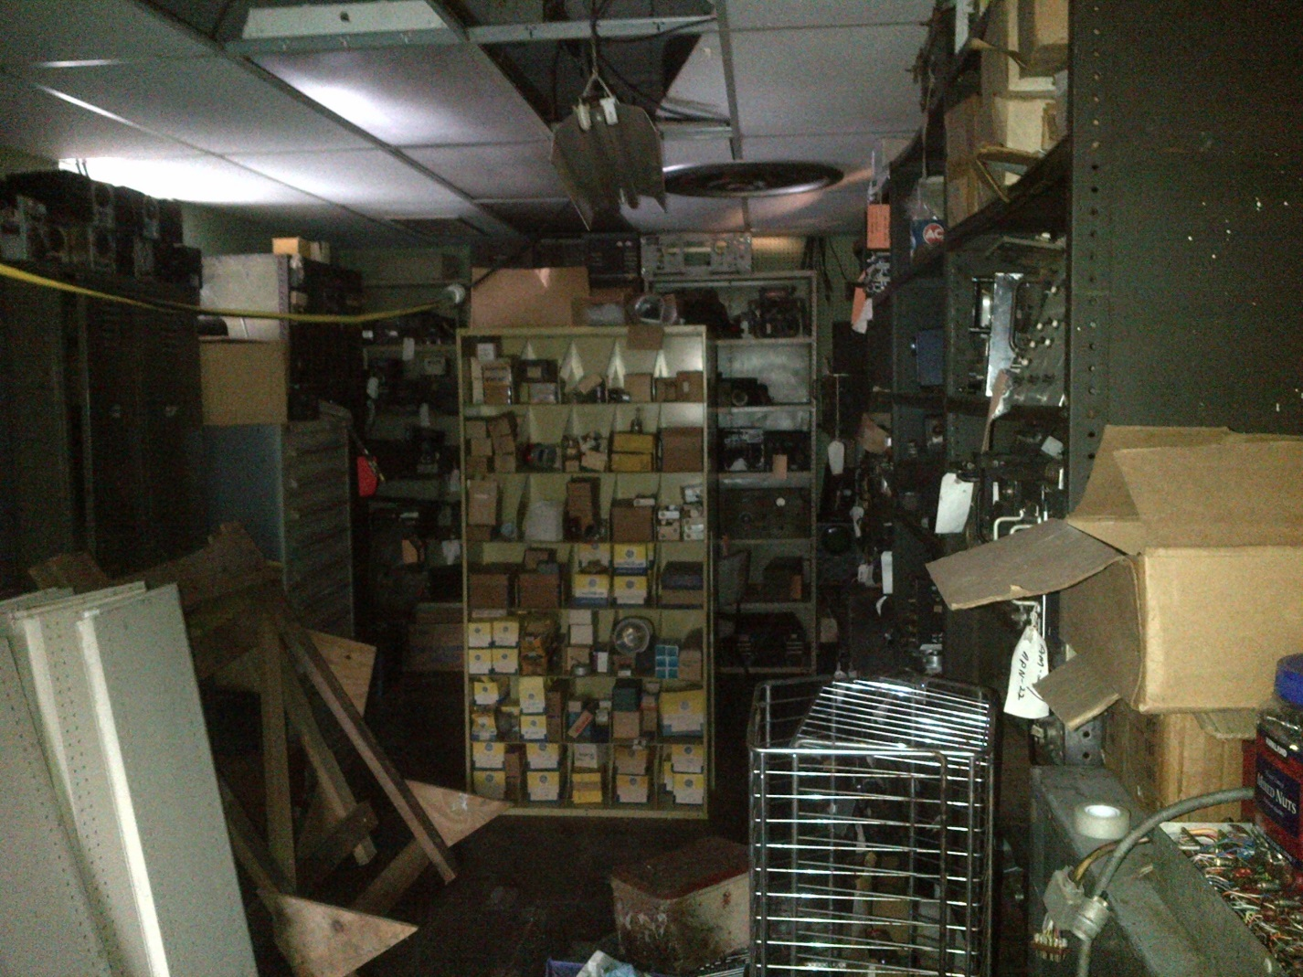
2211 Nights at the Museum

Slide 15
2211 Nights at the Museum
5 mR/hr general area
40-1000 dpm alpha general area
Where’s the key?

Slide 16
2211 Nights at the Museum
EPA Region One Contacted
Meeting with EPA Region One, CT DEEP and Museum Management

Slide 17
2211 Nights at the Museum
EPA Agrees action must be taken but….
Preform Assessment
Demolish and Bury
Give NEAM the Bill

Slide 18
2211 Nights at the Museum
Great Idea!!
Gauge Building on State Property (CT DOT)
$20K from CT DOT
$20K from State Tourism Board

Slide 19
2211 Nights at the Museum
Presentation on Work at NEAM at New England Radiological Health Annual Meeting

Slide 20

2211 Nights at the Museum

Slide 21
2211 Nights at the Museum
NEAM put on our NRC License
Museum Given an NOV

Slide 22
•Energy Policy Act of 2005 amended the AEA to add discrete sources of Ra-226 to the definition of by-product material. •There by giving NRC regulatory authority over Radium. •NRC became aware of Radium contaminated sites in Connecticut in 2013
Energy Policy Act of 2005 Amended the AEA to add Ra-226 to the Definition of By-Product Material
Gives US NRC Regulatory Authority Over Radium
NRC Became Aware of other Radium Issues
•Energy Policy Act of 2005 amended the AEA to add discrete sources of Ra-226 to the definition of by-product material.
•There by giving NRC regulatory authority over Radium.
•NRC became aware of Radium contaminated sites in Connecticut in 2013

Slide 23
2211 Nights at the Museum
New Mission
Remediate
Get the Museum under 100 “Uninstalled Devices”
Regulated Under 10 CFR 31.12

Slide 24
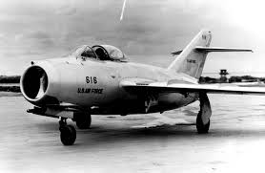
2211 Nights at the Museum
Hey What’s That?
12000 Square Foot
Restoration Bld.
Large Enough to
Restore B-29
Complete with Machine Shop

Slide 25

2211 Nights at the Museum

Slide 26

2211 Nights at the Museum

Slide 27
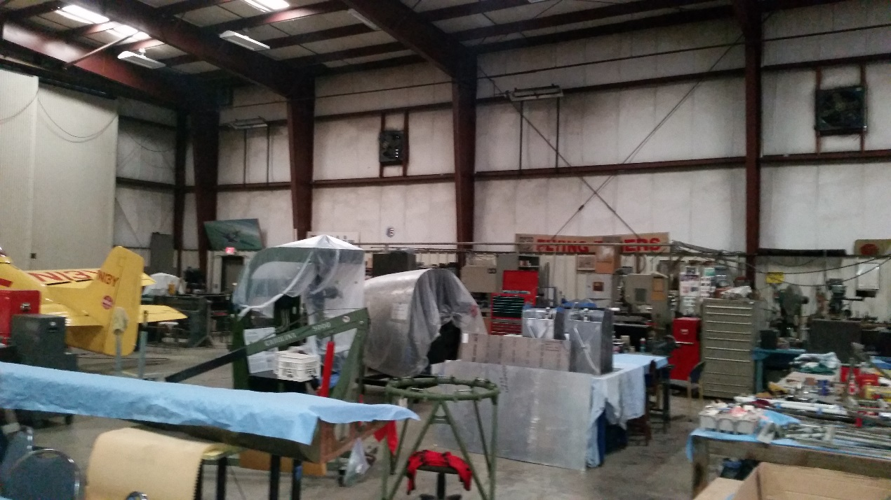
2211 Nights at the Museum

Slide 28
2211 Nights at the Museum
What Else Ya Got?
Santa is Going to Need Anti-C’s and a Respirator

Slide 29
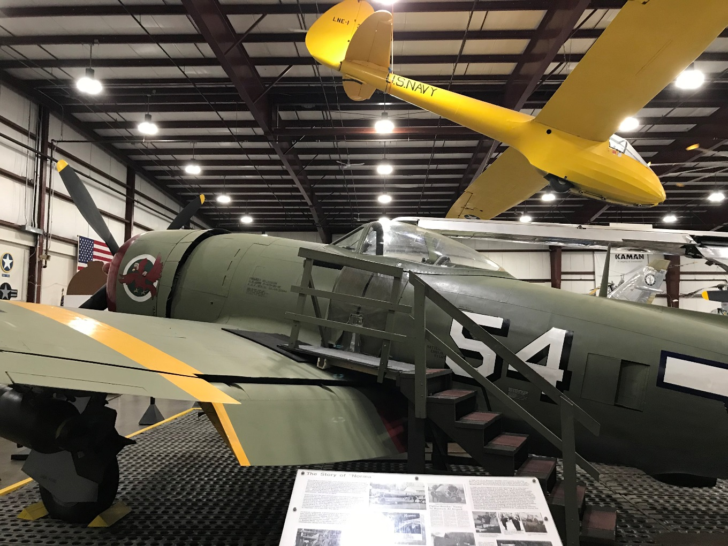
2211 Nights at the Museum

Slide 30
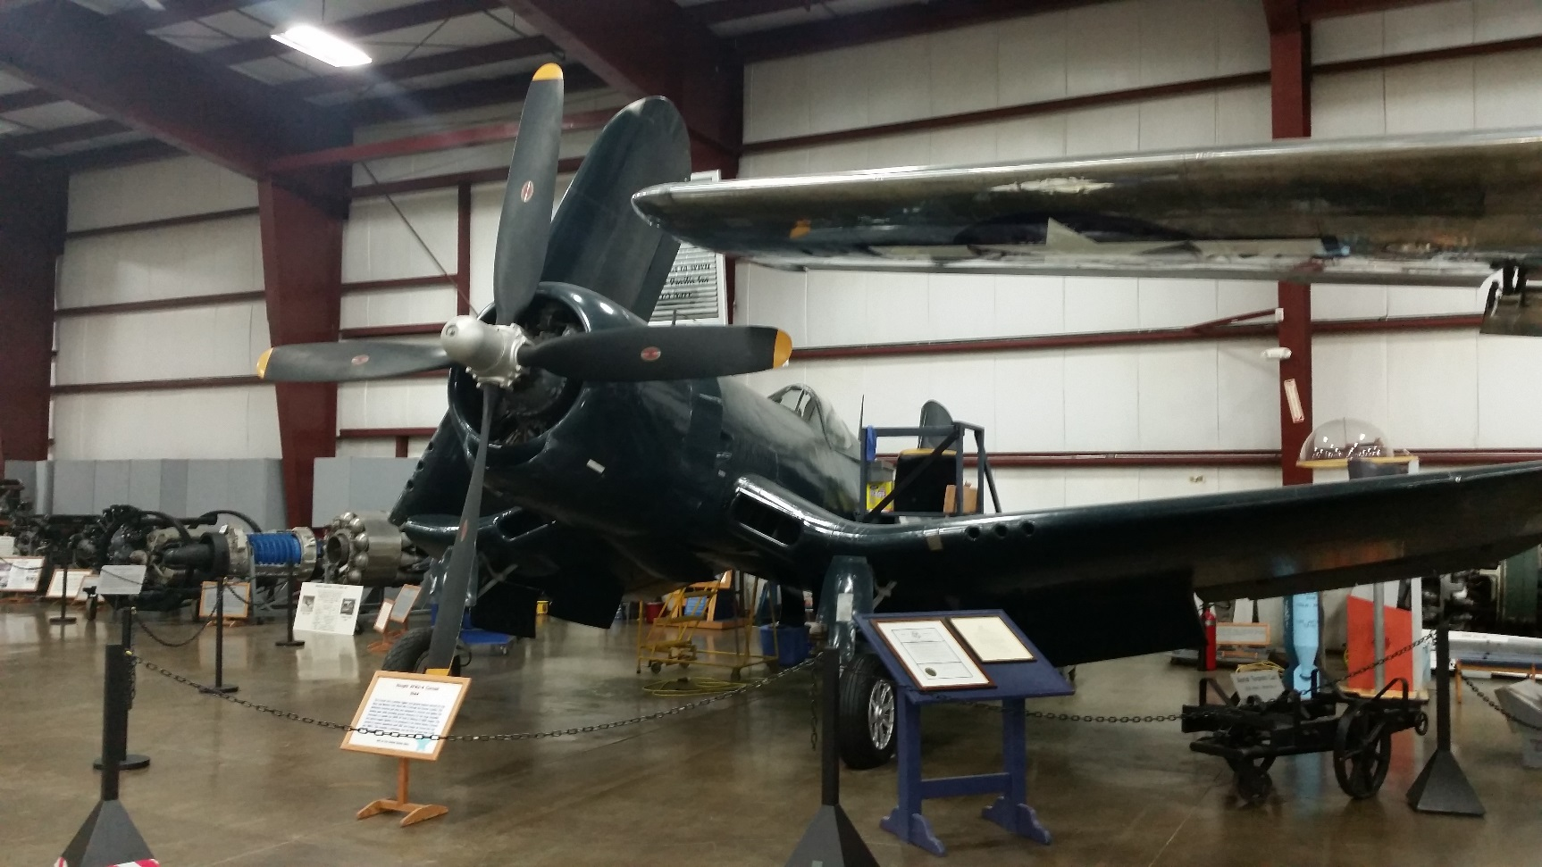
2211 Nights at the Museum

Slide 31
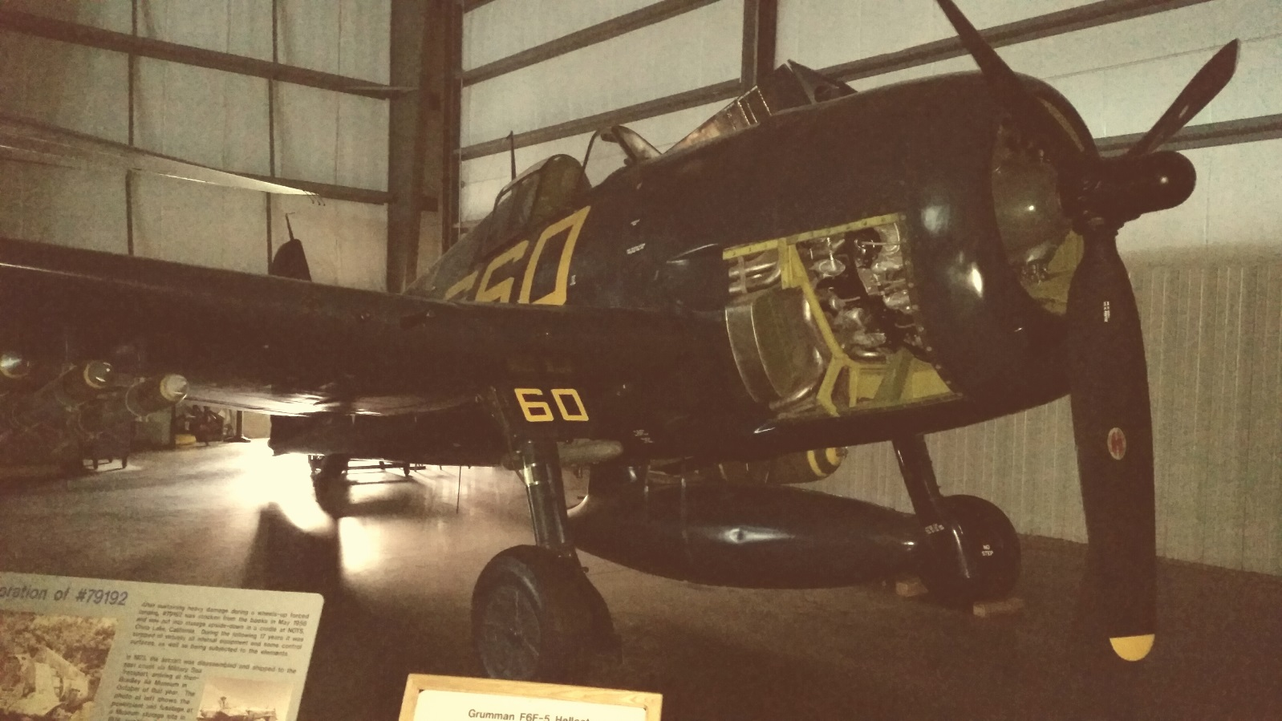
2211 Nights at the Museum

Slide 32
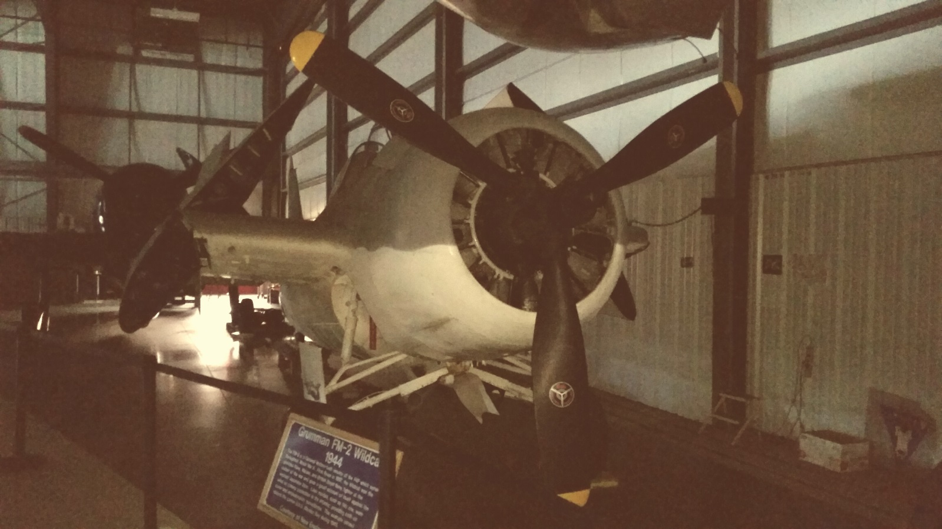
2211 Nights at the Museum

Slide 33
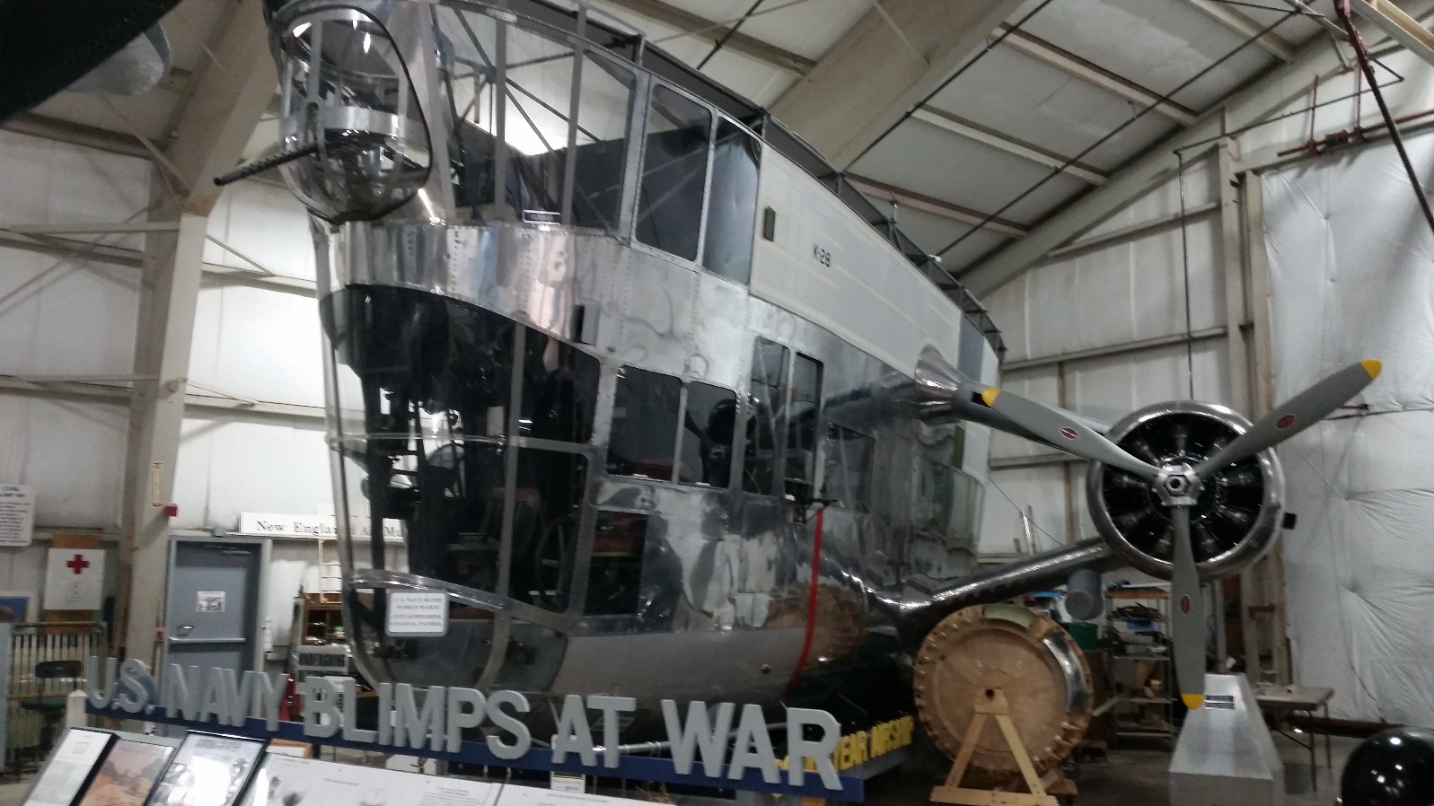
2211 Nights at the Museum

Slide 34
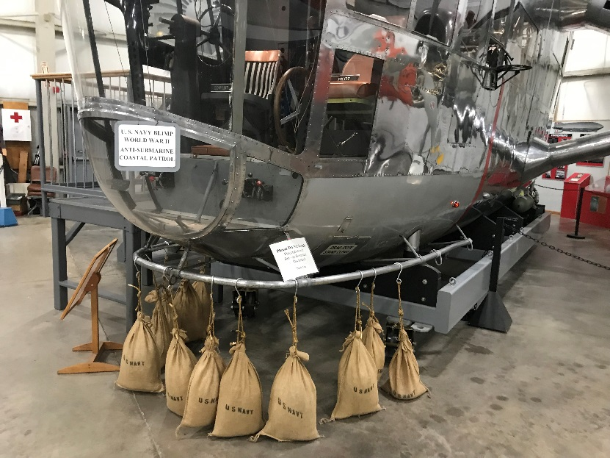
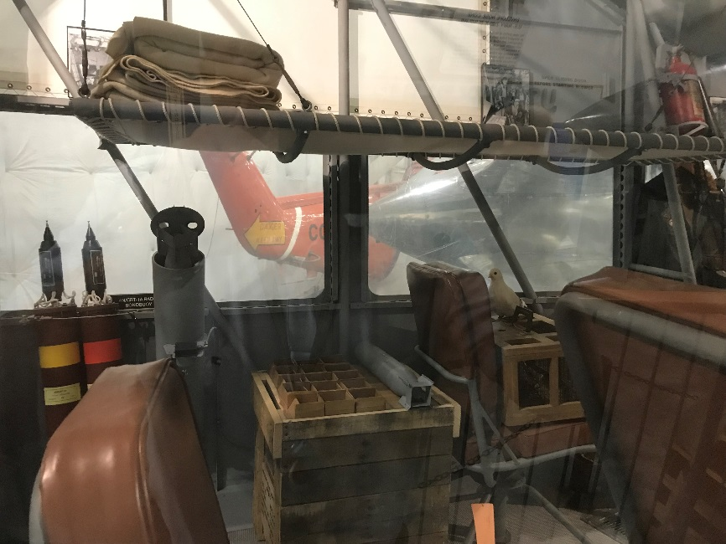
2211 Nights at the Museum

Slide 35
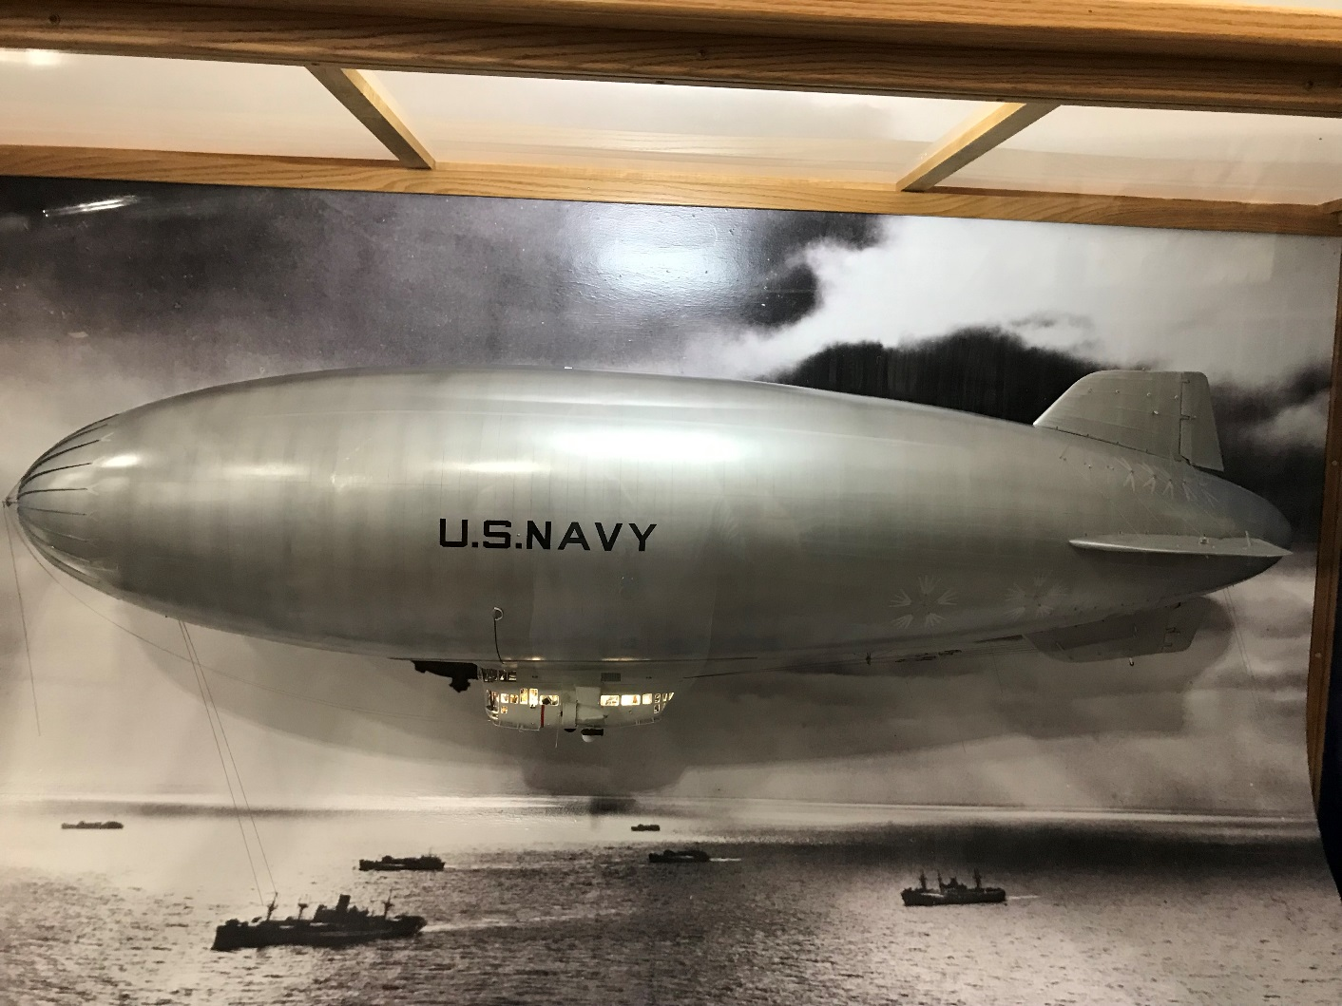
2211 Nights at the Museum

Slide 36
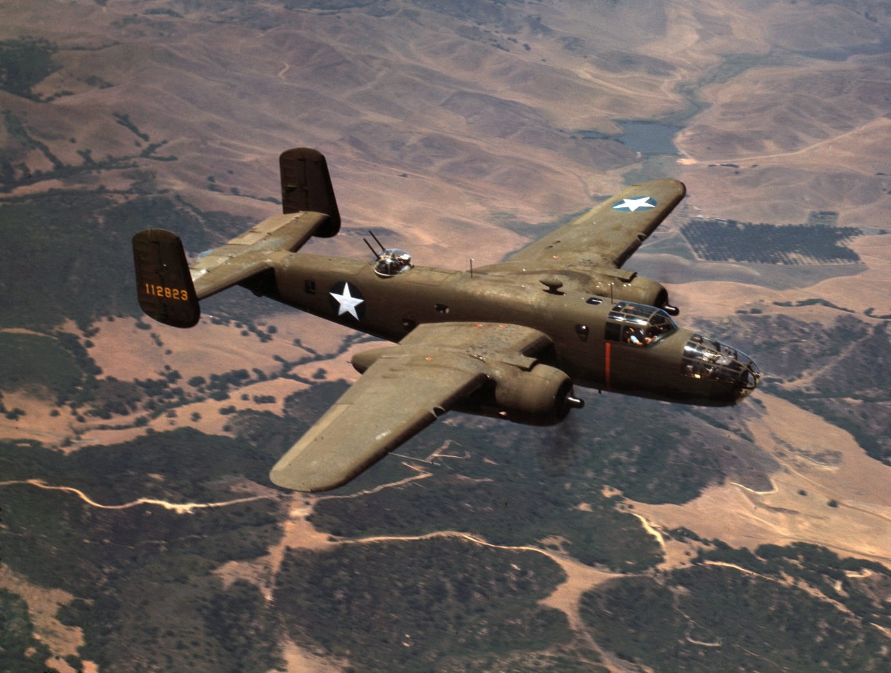
2211 Nights at the Museum

Slide 37
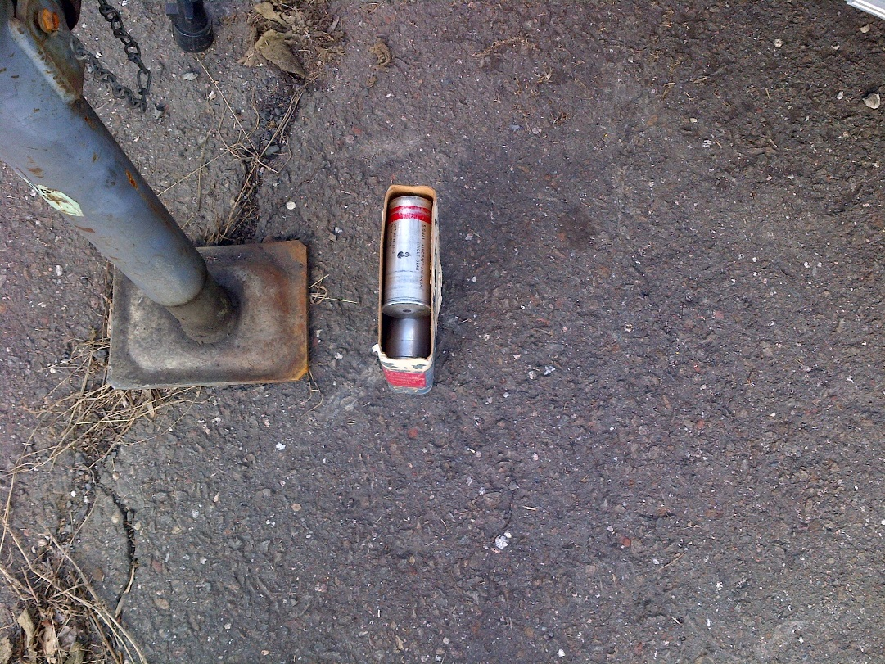
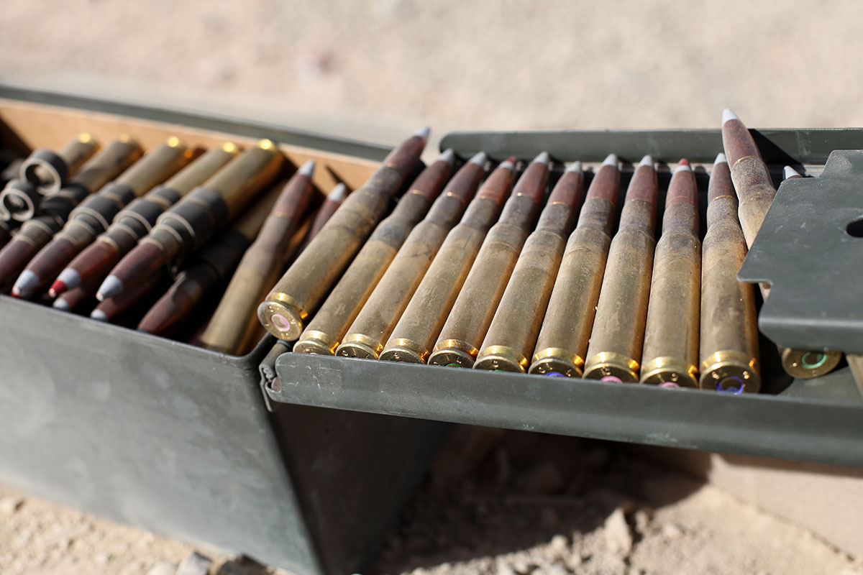
2211 Nights at the Museum

Slide 38
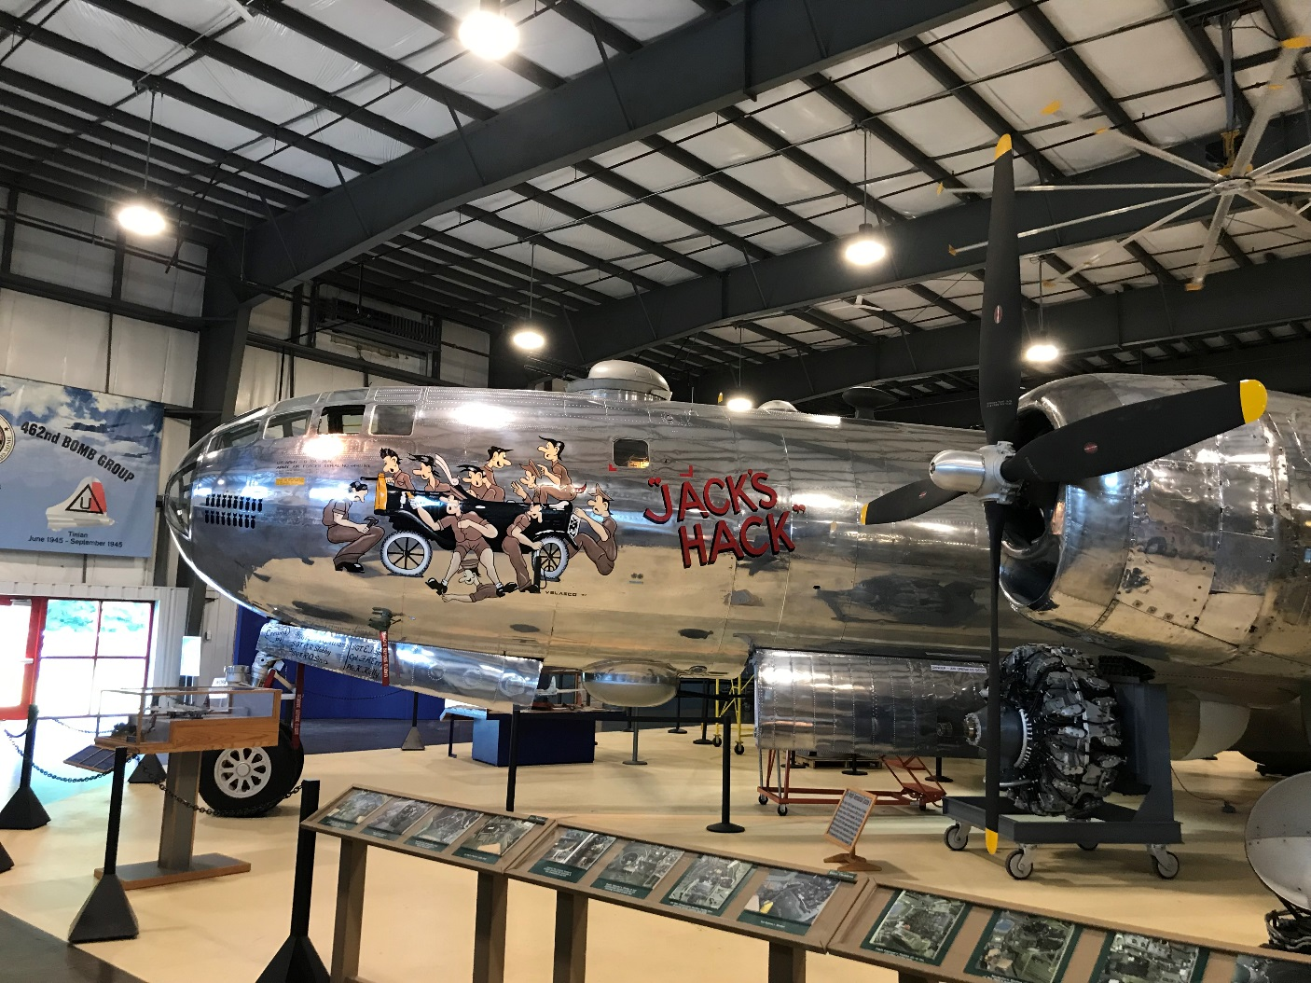
2211 Nights at the Museum

Slide 39
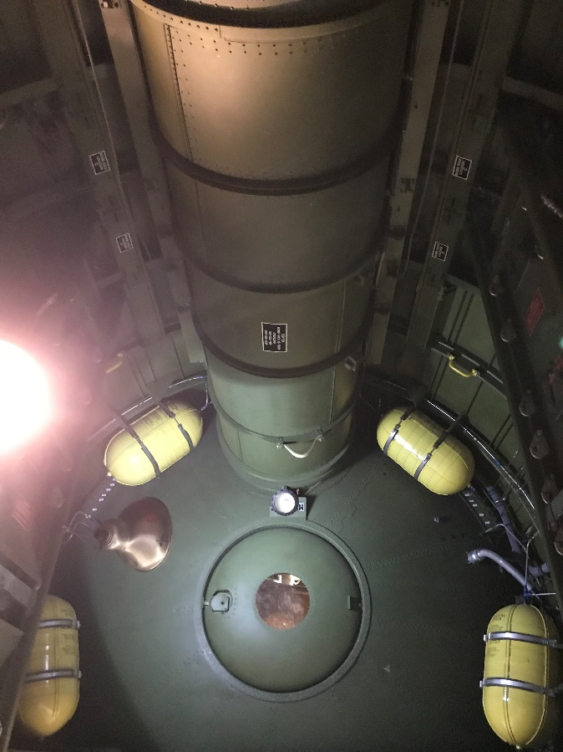
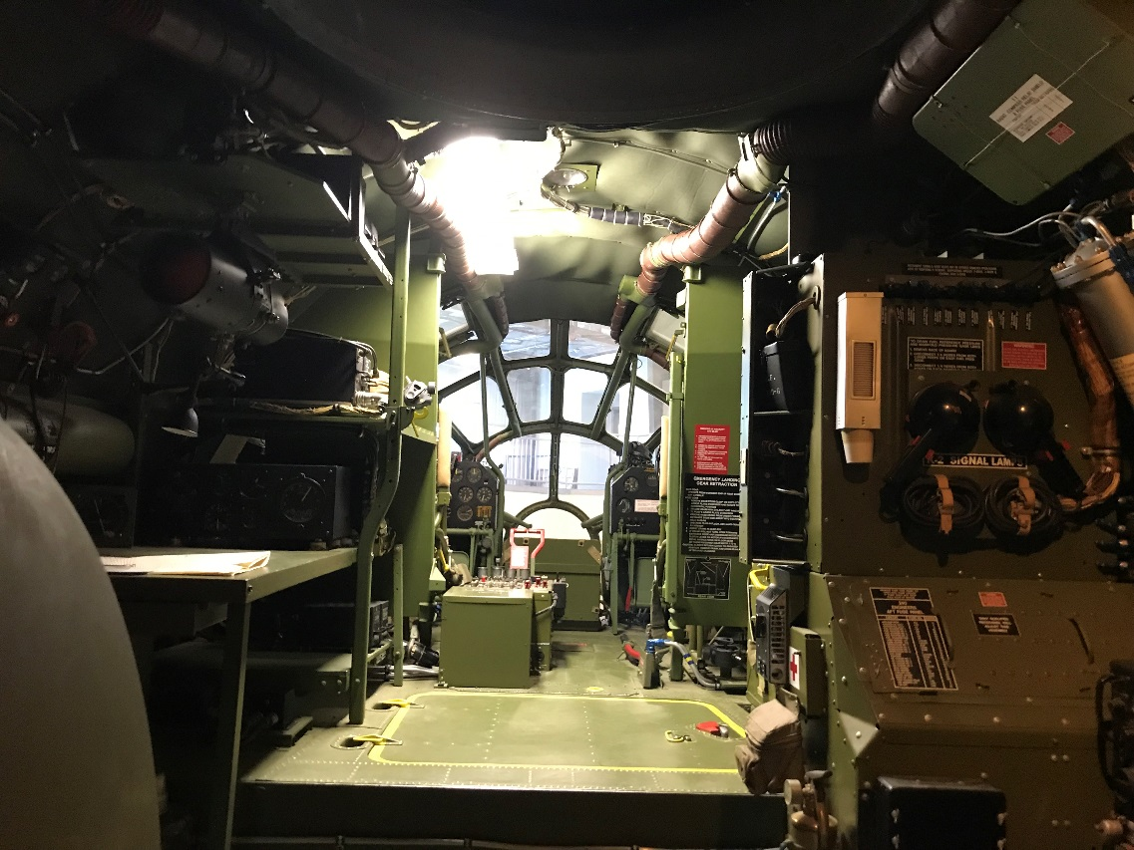
2211 Nights at the Museum

Slide 40
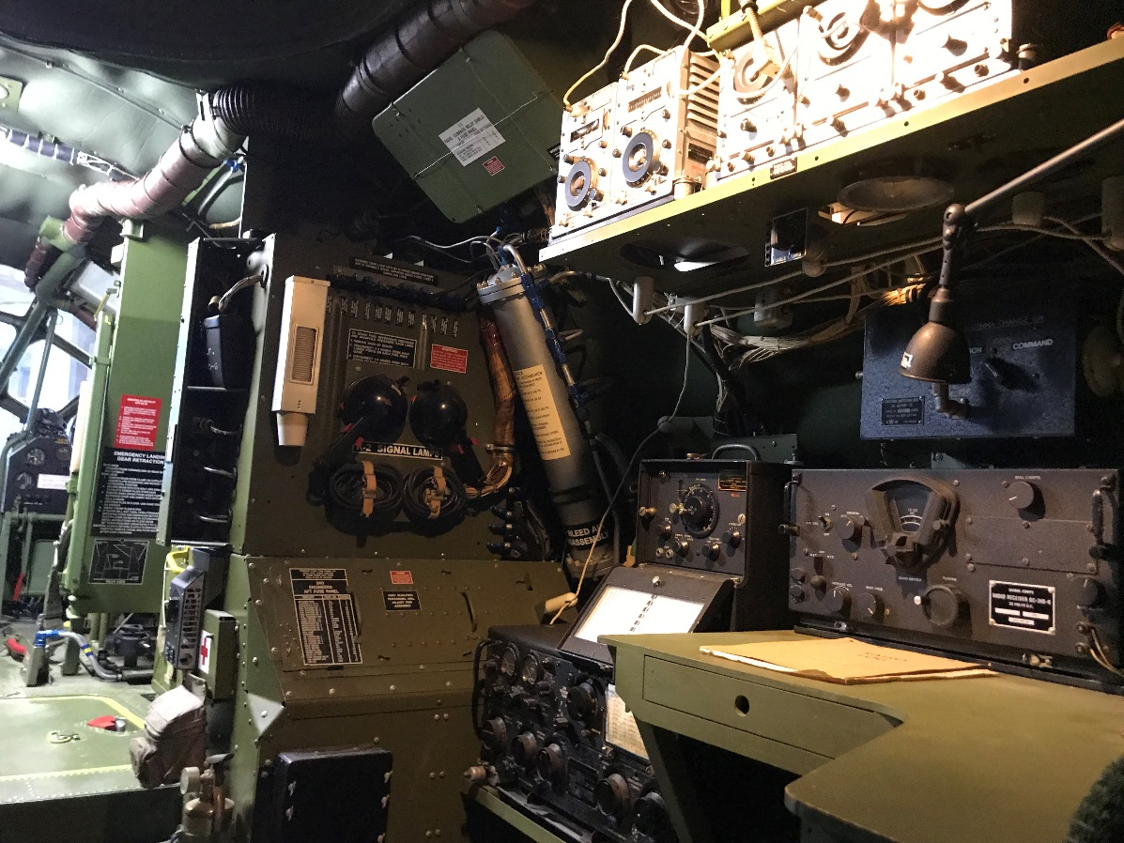
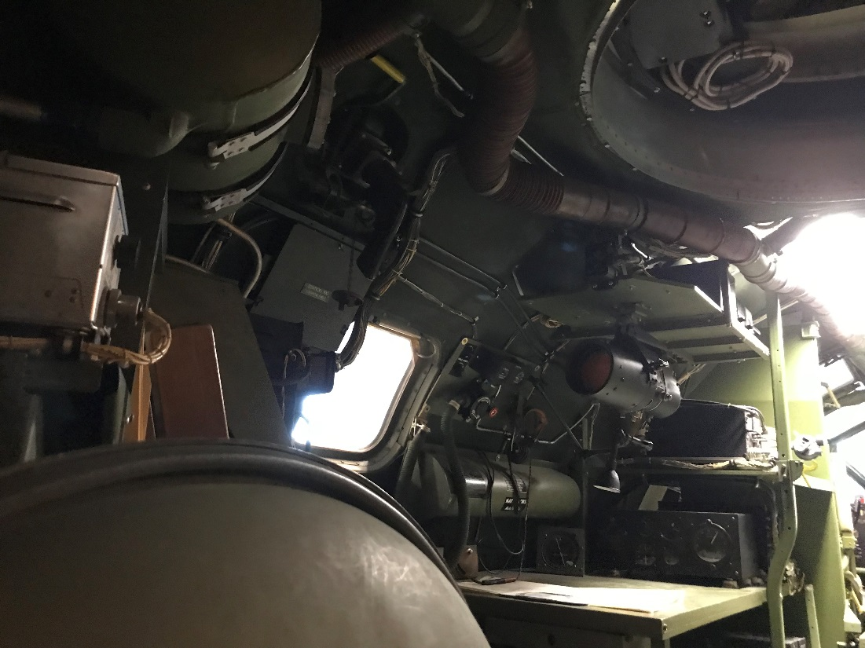
2211 Nights at the Museum

Slide 41
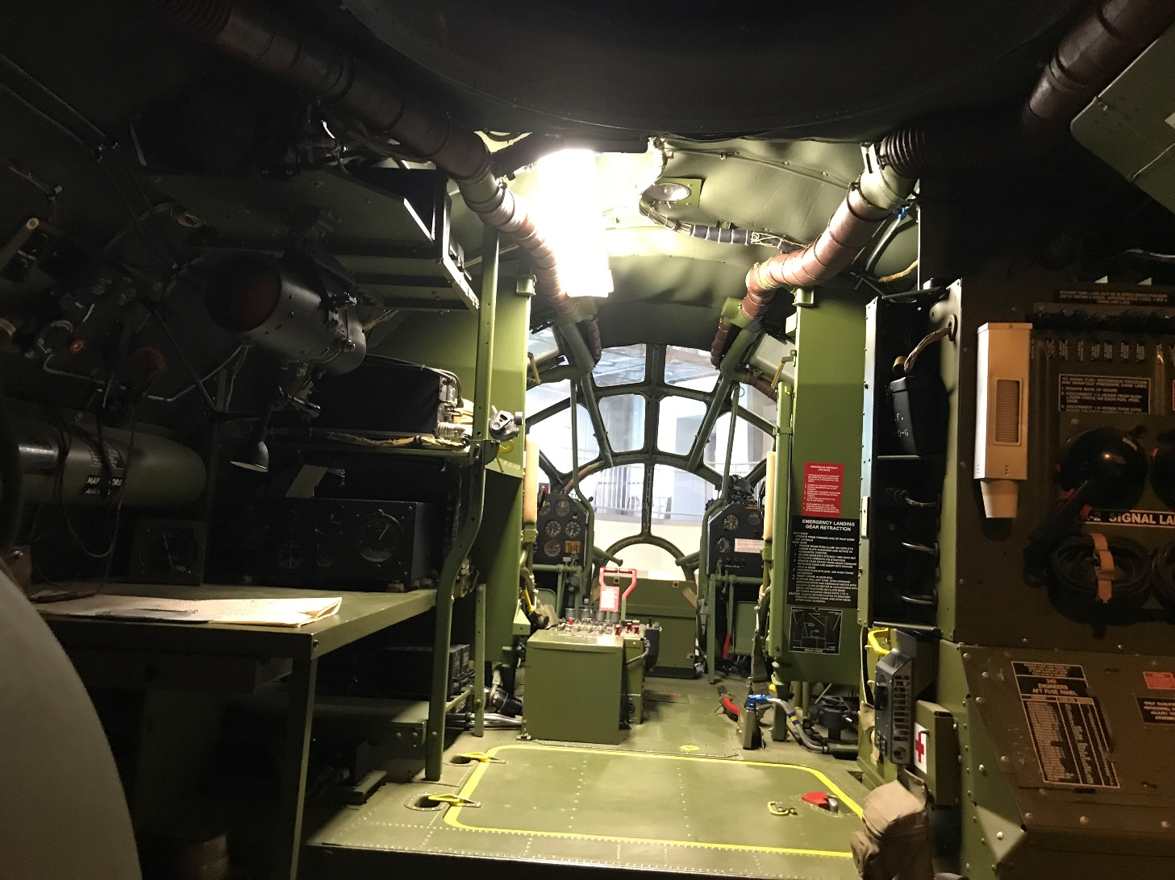
2211 Nights at the Museum

Slide 42
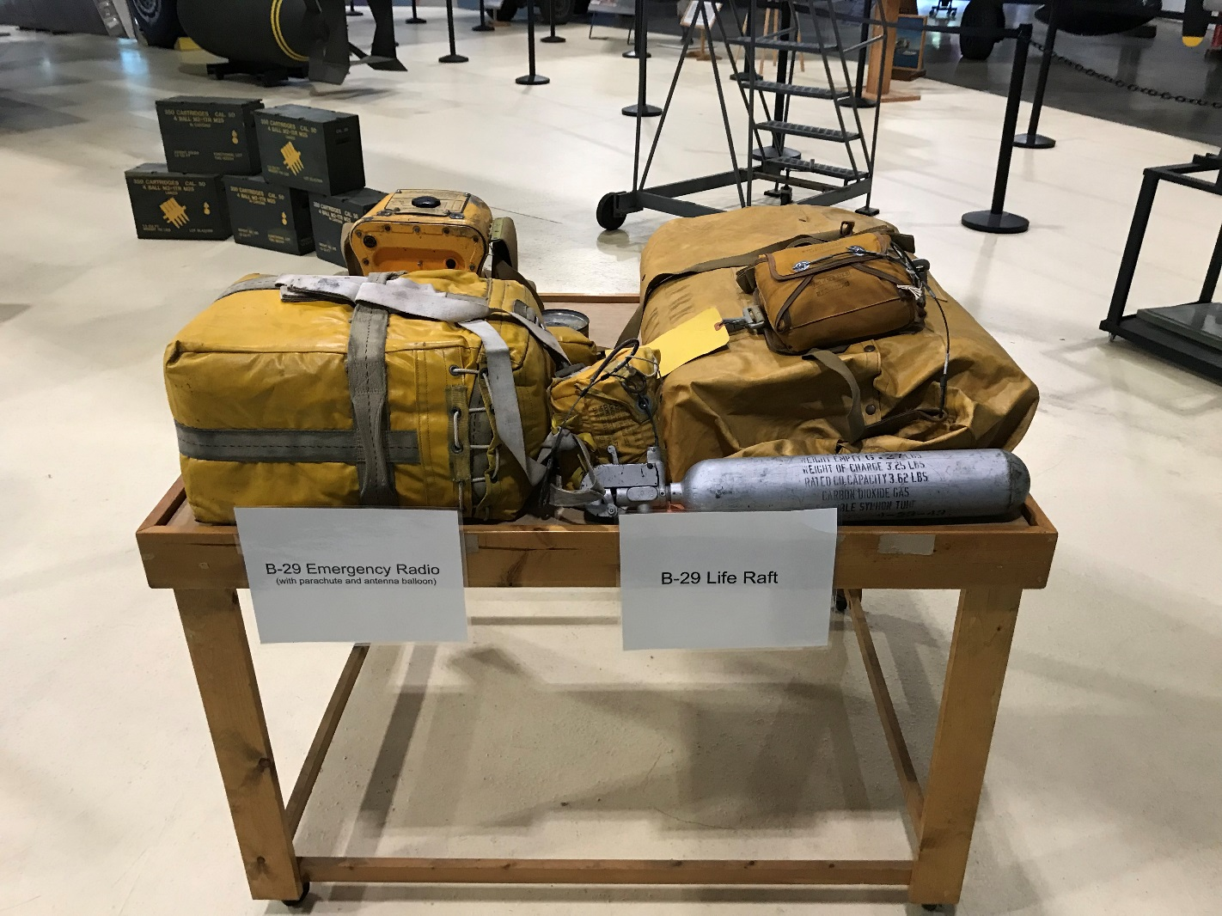
2211 Nights at the Museum

Slide 43
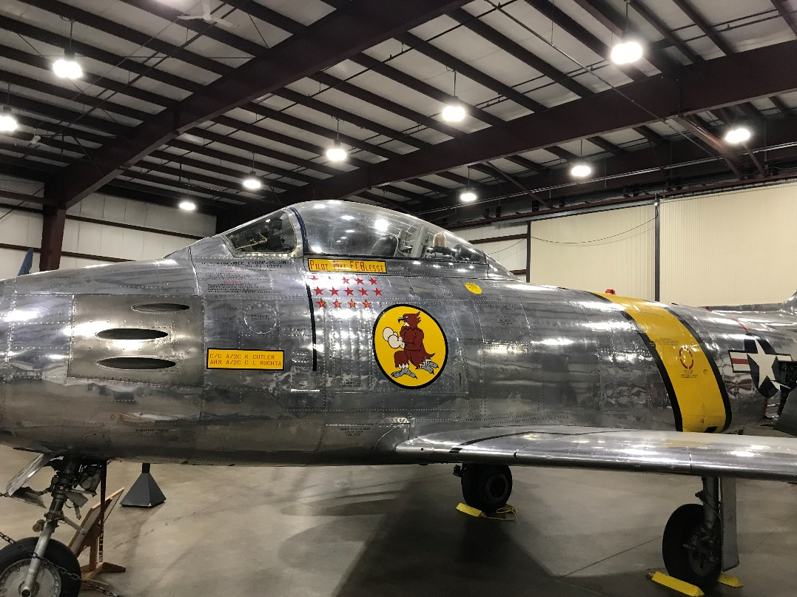
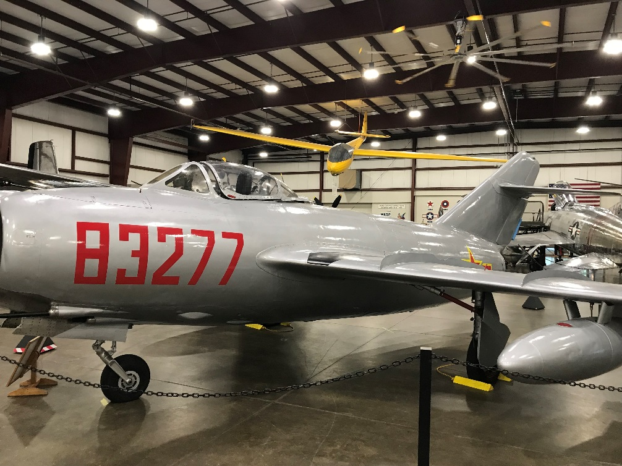
2211 Nights at the Museum

Slide 44
2211 Nights at the Museum
What goes? What Stays?
Who Can Receive Radioactive Material?
What Other Air Museum has an US NRC License?

Slide 45
2211 Nights at the Museum
Four 55 Gallon Drums of Gauges Sent to Smithsonian
79 Gauges
Five Complete Panel with Gauges
Predominately German and Japanese

Slide 46
2211 Nights at the Museum
Some of the German Devices (Luftwaffe) actually had Tri-Foil on back and Achtung Strahlung!
Box of Japanese Gauges Underneath “US Navy Captured Enemy Equipment” Wrapped in Stars & Stripes dated August 6, 1945

Slide 47
2211 Nights at the Museum
Fifty Seven 55 Gallon Drums of Waste Shipped off.
Half Just Gauges
Three Soil
DAW

Slide 48
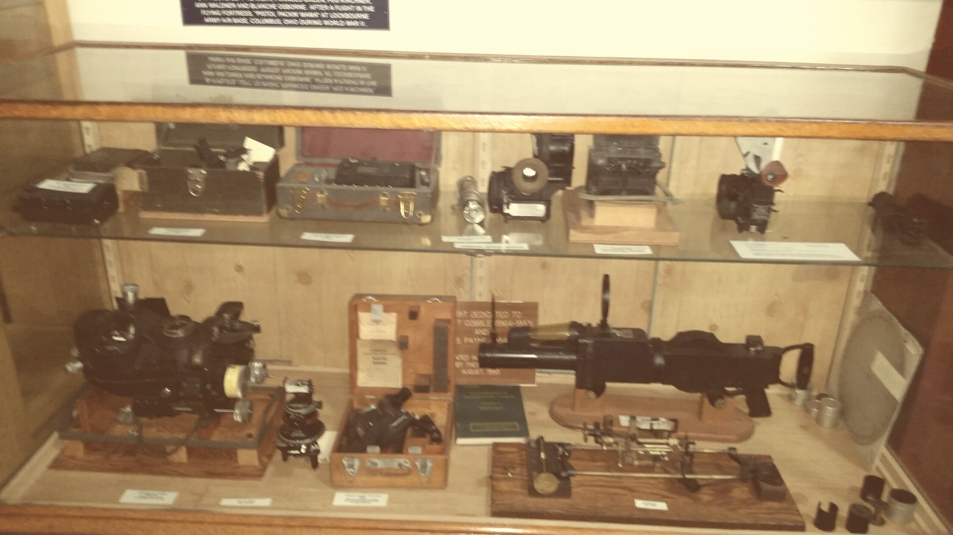
2211 Nights at the Museum
90 “Uninstalled” Gauges Left

Slide 49
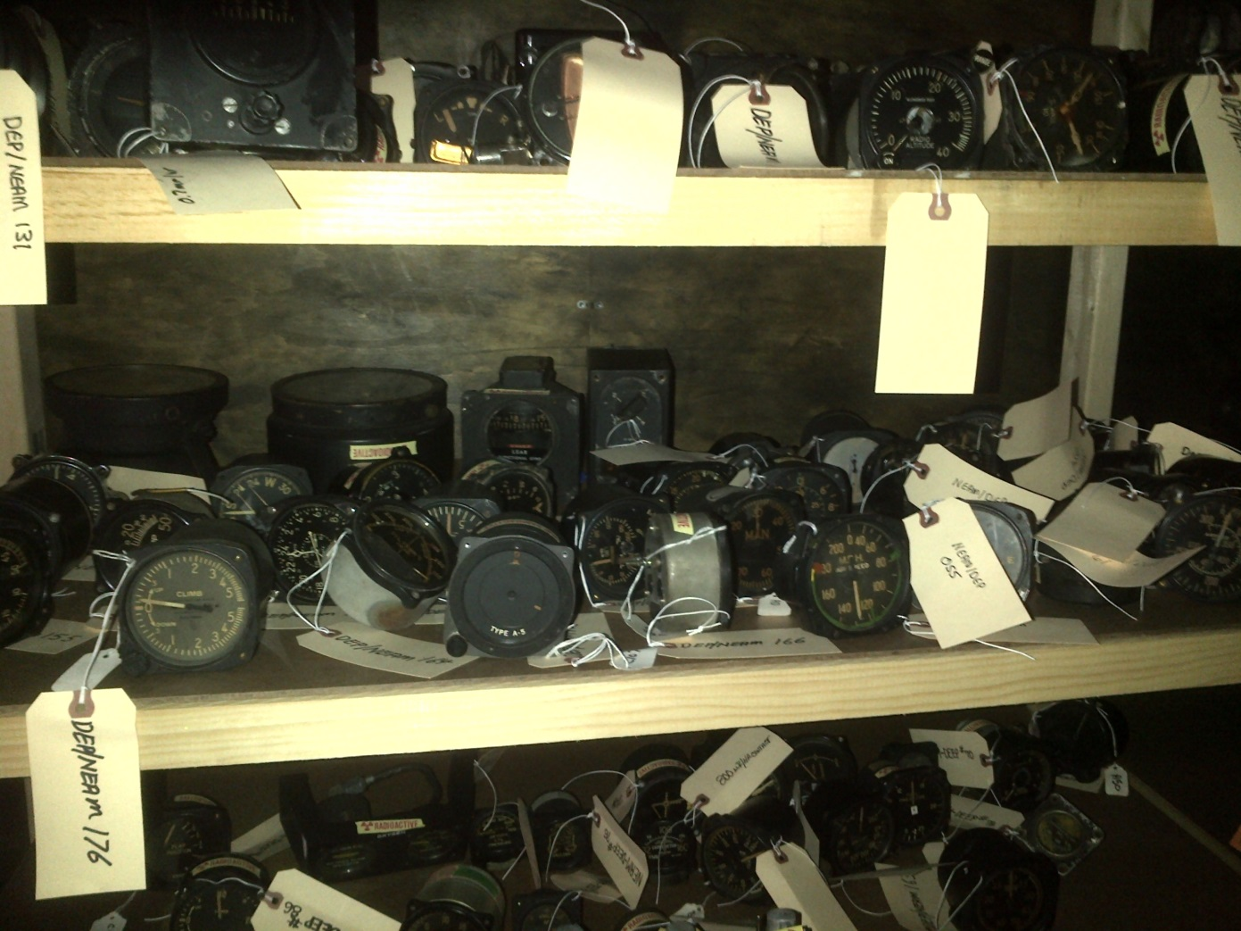
2211 Nights at the Museum

Slide 50
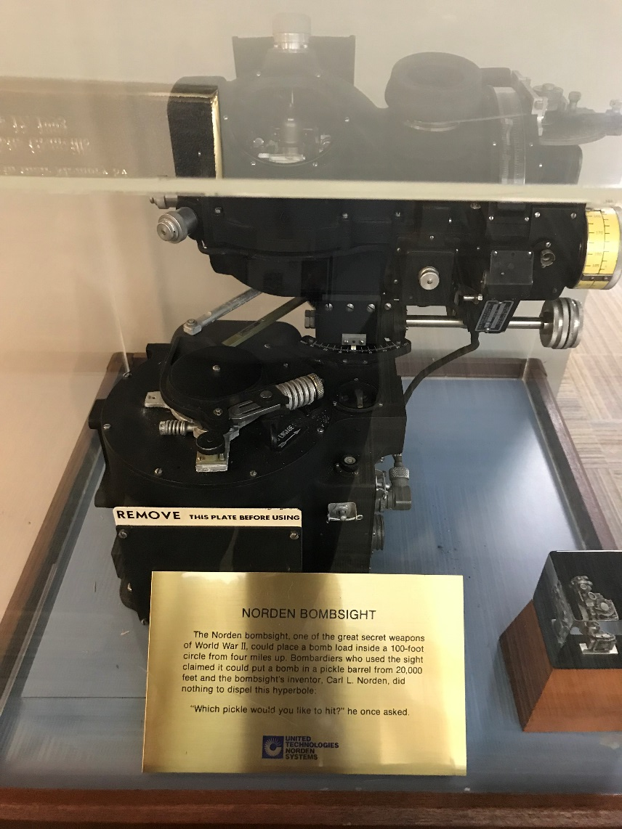
2211 Nights at the Museum

Slide 51
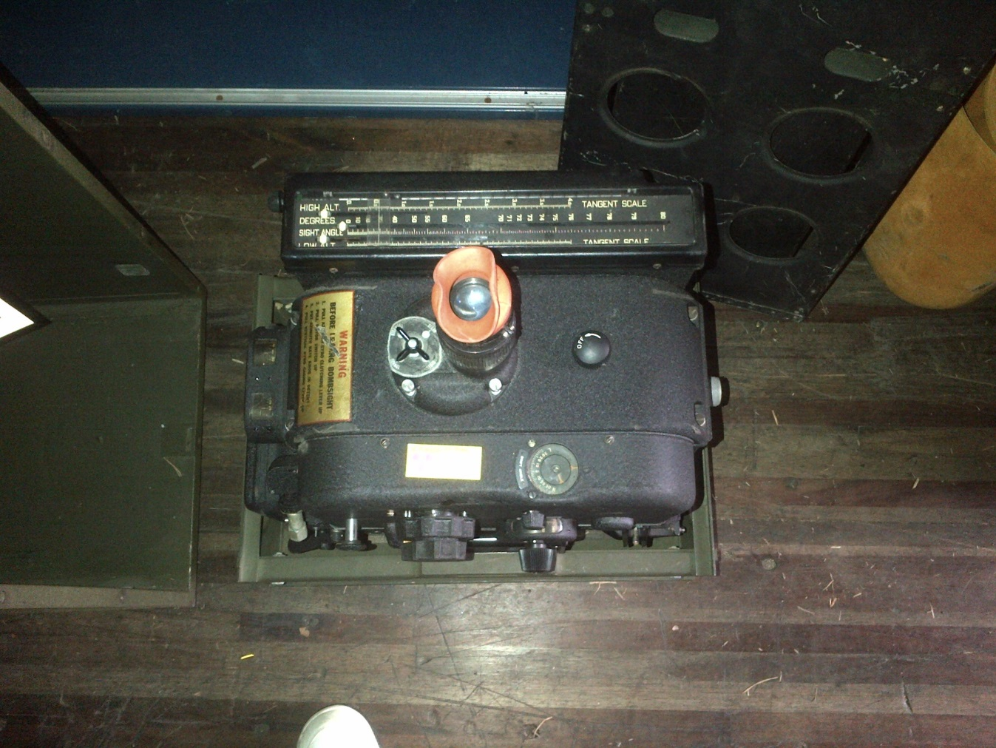
2211 Nights at the Museum

Slide 52
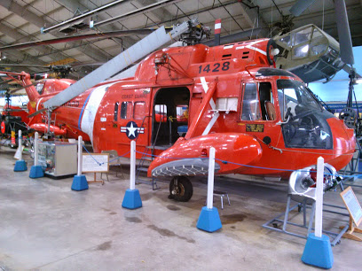
2211 Nights at the Museum

Slide 53
2211 Nights at the Museum
The Inflight Blade Inspection System (IBIS) Issue
Three 100 micro Curies Sr-90 Sources (in Engaged Position)
Started Nation Wide Search
Found Six Nation Wide Which were not Properly “Demilled”
USCG Given NOV

Slide 54
2211 Nights at the Museum
NEAM Remediated in Compliance with: NUREG 1757 “Consolidated NMSS Decommissioning Guidance
NUREG 1575 Multi-Agency Radiation Survey and Site Investigation Manual-MARSSIM

Slide 55
2211 Nights at the Museum
Gauge Building-1344 Square Feet
Class One Building
100% Scan of Floors and Up To Six Feet on Walls

Slide 56
2211 Nights at the Museum
Brown Building (AKA-Snake Building)
Class Two
10,206 Square Feet
Auxiliary Plane Storage Building
22,264 Square Feet
Class Three

Slide 57
2211 Nights at the Museum
Military Wing of Main Museum
28,565 Square Feet
Class Two
Had Two Contaminated Aircraft
P-47
Corsair

Slide 58
2211 Nights at the Museum
58th Memorial Bomb Wing Building
15,625 Square Feet
Class Two
Grumman Wildcat

Slide 59
2211 Nights at the Museum
All Aircraft Outside Surveyed
Two Had Gauges Removed

Slide 60
2211 Nights at the Museum
Final Status Survey Results:
All Static Measurements Less than 2,150 dpm/100cm2 alpha
No removable activity exceeded 20 dpm/100 cm2 alpha
No Soil Samples Greater than 4 picocuries/gram Ra-226

Slide 61
2211 Nights at the Museum
US NRC Dose Code DandD Version 2.1.0 for Building Structures and Surfaces- Occupancy Was Used
DandD Dose Code Residential for Soil Contamination
Only 18 Square Feet of Soil Remediation
Agriculture, Drinking Water and Irrigation Turned Off

Slide 62
2211 Nights at the Museum
Today Approximately 90 Gauges Remain Uninstalled
Leak Checks are Taken Quarterly
NEAM Volunteers take them DEEP Counts Them
Under General License

Slide 63
Questions?
Mike Firsick
Office Director
CT DEEP Radiation Division

