Slide 1
3 Yankee Companies & National SNF Status Update
NEHLRWT Taskforce Meeting, Providence Rhode Island
October 23, 2024
Kathleen Capstick, Director Public & Government Affairs
Maine Yankee Atomic Power Company

Slide 2
Overview of the 3 Yankee Companies
MY, CY, and YR are independent, single-asset, fully decommissioned nuclear power plant sites that have been stand-alone ISFSIs for nearly two decades.
The NRC License at MY was reduced to just the ISFSI area in 2004; CY & YR were reduced to just the ISFSI areas in 2007.
All three sites were successfully restored under federal and state environmental regulations.
When DOE meets its obligation to remove the SNF/GTCC waste, the ISFSIs will be decommissioned, the NRC licenses terminated, the sites made available for other purposes, and the companies will go out of business.
Until then it is the 3 Yankees’ responsibility as the NRC licensees to safely store and secure the SNF/GTCC waste in accordance with all applicable regulations.
The 3 Yankee Companies have been in litigation with the DOE since 1998 to recover costs for the 3 companies' utility owners and their electric ratepayers resulting from the federal government's ongoing failure to remove the SNF/GTCC waste.

Slide 3
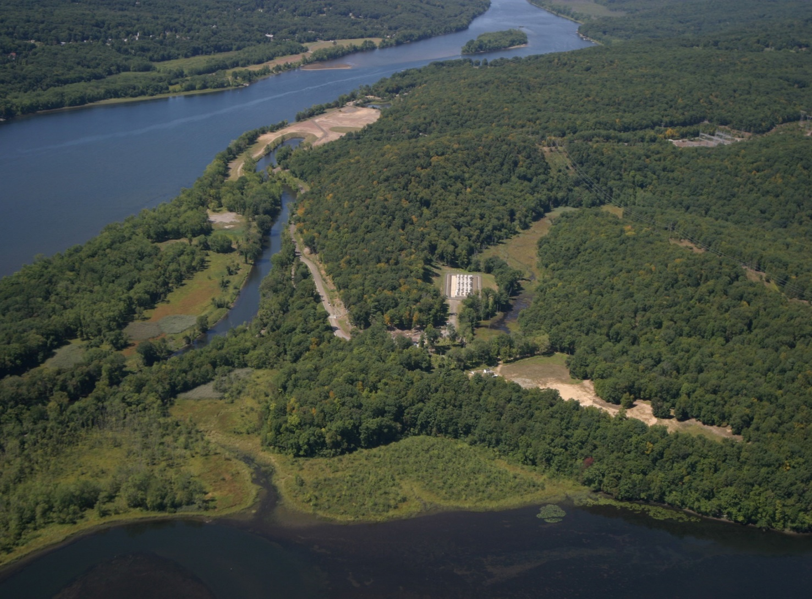
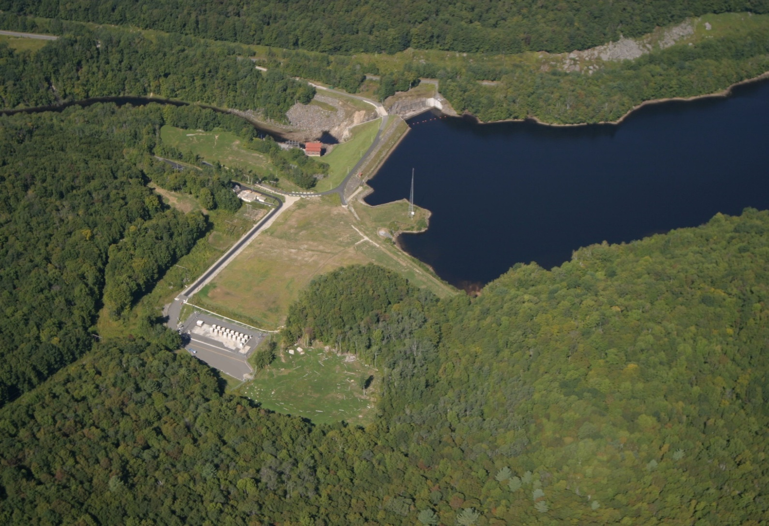
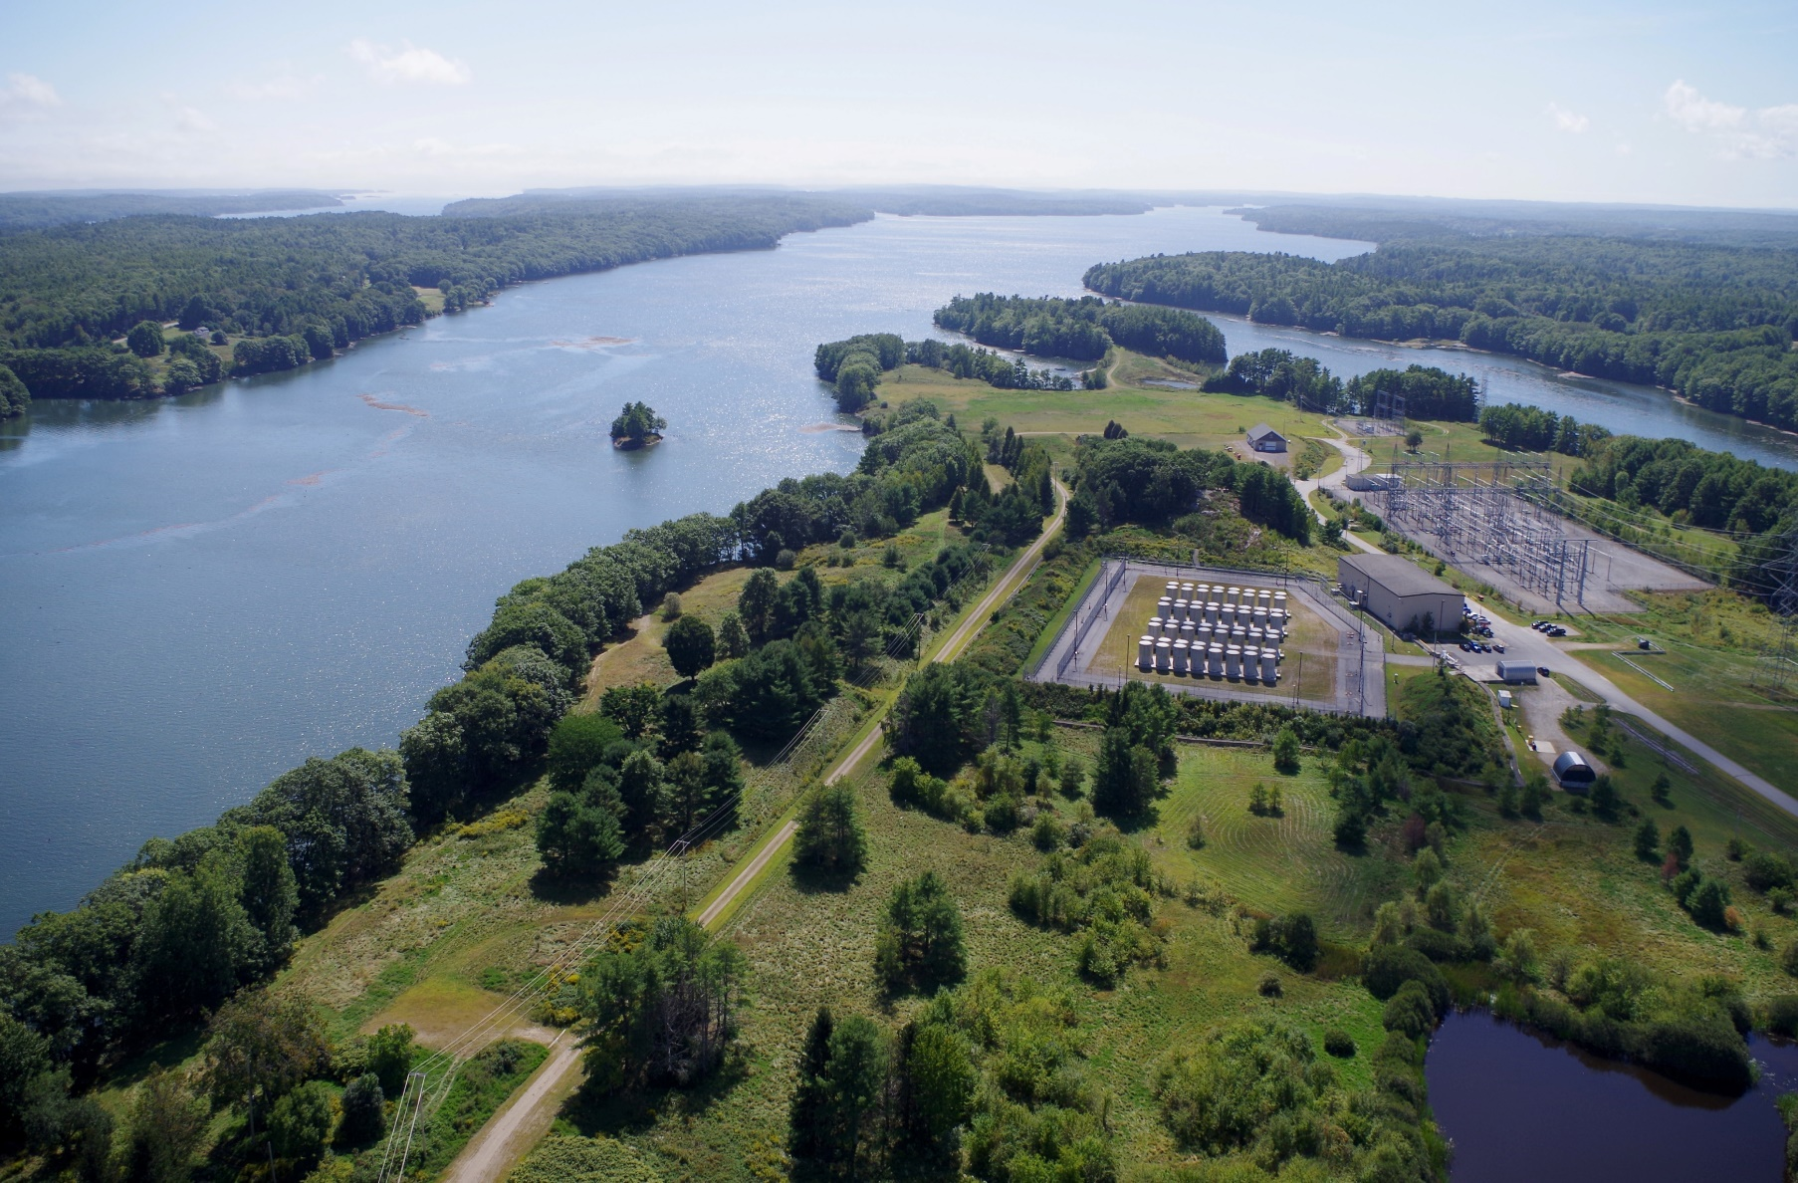
Connecticut Yankee
Yankee Rowe
Maine Yankee
Notes:
Pictures of the sites and will emphasize that the plants are decommissioned and the sites environmentally restored – but until DOE performs, the single asset 3 Yankees are forced to stay in business at an average annual cost to each site around $10 M

Slide 4
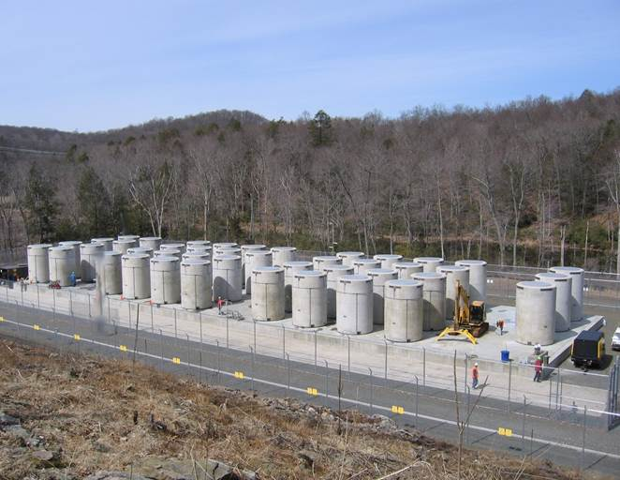
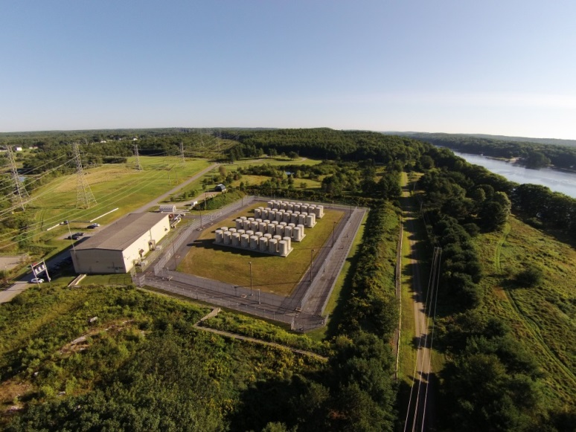
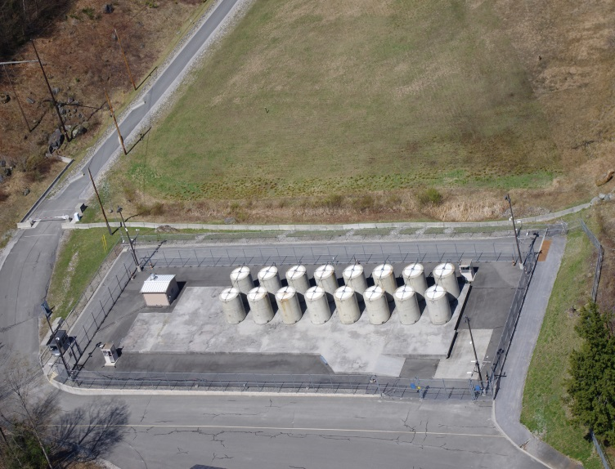
The 3 Yankee Company ISFSIs
Connecticut Yankee
Maine Yankee
15 Spent Fuel Dry Casks
1 GTCC Dry Cask
NAC canister system
40 Spent Fuel Dry Casks
3 GTCC Dry Casks
NAC canister system
Yankee Rowe
60 Spent Fuel Dry Casks
4 GTCC Dry Casks
NAC canister system
Notes:
Pictures of the ISFSIs – size of hockey rinks

Slide 5
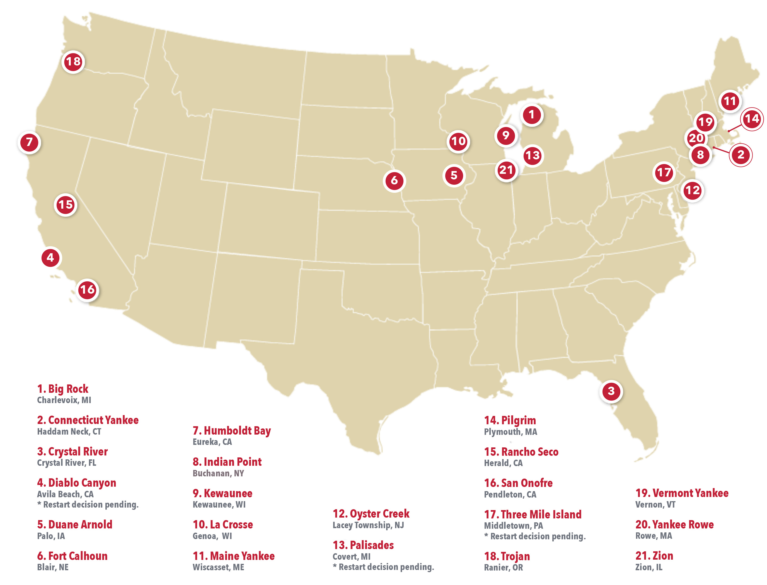
Permanently & Announced Shutdown Nuclear Plant Sites
10/1/2024
Notes:
There are currently 21 permanently & announced shutdown sites in the U.S.

Slide 6
Congress: Continuing Resolution & Appropriations
Continuing Resolution: House and Senate lawmakers passed a Continuing Resolution on September 25th to avert a government shutdown that was signed President Biden. The bill, (H.R. 9747) will maintain fiscal year 2024 funding levels through December 20th. Both the House and Senate have yet to pass all 12 FY 2025 appropriations bills, resolve their differences on spending and policy questions, and resubmit them to each branch for a final vote before they can become law.
House Energy & Water Development FY 2025 Appropriations bill: The bill was approved by the full Committee on July 9th. The funding tables indicate that they held Used Fuel Disposition R&D stable at $47 million, but again cut the Integrated Waste Management System program, this time by $30 million from last year’s level and $28 million from the Administration’s request for additional funding. This is similar to the position taken by the House last year that was overturned by the Senate and in the bicameral negotiations at the end of the FY ’24 process.
The Committee recommendation included $12,040,000 for Nuclear Waste Disposal for Nuclear Waste Fund (NWF) oversight activities essentially for continued DOE spent fuel contract administration and a holding pattern at Yucca Mountain. It again also contained a prohibition of the use of any federal funds in support of private CISF efforts not specifically authorized unless state, tribal and local governments formalize consent with an exception for currently licensed facilities storing commercial SNF as of the date of enactment. The Department was also directed to provide to the Committee not later than 90 days after enactment of the Act a briefing on anticipated future-year requirements for NWF oversight activities.

Slide 7
Congress: Appropriations continued
Senate Energy & Water Development FY 2025 bill: On August 1st the full Senate Appropriations Committee unanimously approved the FY 2025 Senate Energy and Water Appropriations Bill (S.4927). The Committee Report accompanying the bill text clarifies that the Committee fully funded the Administration’s request of $53 million for the Integrated Waste Management account. It also specifically directed the DOE to move forward under its existing authority to identify a site for a Federal CIS facility with priority for storage given to spent nuclear fuel located on sites without an operating nuclear reactor.
The DOE was further directed to use a consent-based approach - and it specifically reminded DOE that the Nuclear Waste Policy Act provides for a wide variety of activities that may take place prior to the limitations in that act. Which includes providing Congress with recommendations for a mechanism to ensure any SNF/HLRW stored at a consolidated storage facility pursuant to the section shall move to deep geologic disposal capacity.

Slide 8
Congress: Appropriations continued
Senate Interior & Environment Appropriations FY 2025 bill: The bill provides $250,000 to develop a generic, technology-neutral standard for a second nuclear waste disposal repository. The goal is for the Environmental Protection Agency to use modern and international practices in creating new plans to dispose of all the nation’s U.S. nuclear waste (commercial, naval, new nuclear...). The EPA had requested $635,000 to fund is work but the proposed $250,000 will assist getting the process moving. The DPC and NWSC joined other national organizations in July on a letter requesting Congress to provide EPA with funds to update the agency’s generic disposal standards with the view being that work on a permanent repository might help the effort to find a willing host for a CISF.
The bill passed the Senate on July 24th and included funding to develop a generic, technology-neutral standard for a second nuclear waste disposal repository. The goal is for the Environmental Protection Agency to use modern and international practices in creating - new plans to dispose of all the nation’s SNF and HLW (commercial, naval, WWII legacy, and new nuclear). The EPA had requested $635,000 to fund this work— but the bill’s proposed $250,000 - would assist getting the process initiated. In July the DPC and NWSC joined a number of other national organizations on a joint letter requesting Congress provide EPA with funds to update the agency’s generic disposal standards - the view being that work on a permanent second repository might help the effort to find a willing host for a federal CISF.

Slide 9
Congress: Funding legislation and related activity continued
On June 20th, a letter from multiple organizations was sent to the Chair’s and Ranking Members of both the House and Senate Appropriations Subcommittee on Interior, Environment, and Related Agencies regarding the FY25 E&WD Appropriations. This letter requested that the Subcommittees provide additional funding to enable the EPA Office of Radiation and Indoor Air to start developing new generic repository standards and disposal plans for all the nation’s waste forms. Maine Yankee is a member of two of the signatories of this letter, the Nuclear Waste Strategy Coalition (NWSC) and the Decommissioning Plant Coalition (DPC)
In efforts to modernize the nuclear regulatory framework, facilitate export of U.S. nuclear technology, and spur the deployment of advanced reactors, the Senate and House passed the ADVANCE Act and the Atomic Energy Advancement Act, respectively. The legislative packages were conferenced and merged into the ADVANCE Act of 2024 as part of S.870, the Fire Grants and Safety Act. One of the key provisions of the bill requires the DOE to biennially report on the U.S. spent nuclear fuel and high-level radioactive waste inventory.

Slide 10
Congress: Authorizing Legislation
Advancing Research in Nuclear Fuel Recycling Act of 2024: U.S. Sens. Ted Cruz (R-TX) and Martin Heinrich (D-N.M.) introduced a bill that would require the Department of Energy and the National Academies of Sciences, Engineering, and Medicine to create an independent committee of experts to study new technologies and opportunities for recycling the country’s inventory of spent nuclear fuel. Introduced on September 24th, the “Advancing Research in Nuclear Fuel Recycling Act of 2024’’ calls for a DOE-commissioned study evaluating the costs, benefits, and risks—including proliferation—of recycling U.S. spent nuclear fuel into usable fuels for commercial and advanced reactors, as well as for other nonreactor applications, including medical, space, industrial, and advanced battery applications.
The Nuclear Waste Administration Act: On September 25th Congressmen Mike Levin (D-CA) and August Pfluger (R-TX) introduced “The Nuclear Waste Administration Act” that would establish a new single-purpose, independent federal agency to manage the nation’s nuclear waste. The bill would transfer the responsibilities for siting, constructing, and operating nuclear waste storage facilities and repositories from the Department of Energy (DOE) to the new Nuclear Waste Administration. The bill mirrors legislation introduced a decade ago by a bipartisan group of Senators, which was largely inspired by recommendations made by an Obama-era Blue Ribbon Commission report that studied how to best deal with existing and future nuclear waste. Senate Energy and Natural Resources Chair Joe Manchin (I-WV) most recently reintroduced the bill in 2022. All of the prior versions of the Nuclear Waste Administration Act died in Committee even if they received a hearing.

Slide 11
3 Yankees’ Perspective on DOE’s Consent-Based Siting Initiative
DOE’s consent-based siting process and funding opportunity to establish federal interim storage facilities are important steps towards achieving an interim spent fuel storage solution and ultimately a national geologic repository for all the nation’s waste.
DOE’s effort also serves to raise the profile of the spent nuclear fuel storage issue and the need to re-establish an integrated national nuclear waste management program that includes interim storage with priority removal for SNF/GTCC waste stored at shutdown sites, transportation planning and funding for states and tribes, and a permanent disposal repository.
Congressional action is critical and needed to immediately reestablish a national integrated nuclear waste management program (addressing storage, transportation, and permanent disposal) with access to the $47.7 billion balance in the nuclear waste fund that was paid into by the nation’s electric ratepayers.
At the very least - the Congress must begin to provide sustained annual access to the interest on the NWF that continues to accumulate at a rate of approximately $1.7 billion a year - no new fee collection is necessary.
The indefinite storage of the SNF/GTCC waste was never consented to by our local communities, states, or companies.

Slide 12
3Yankees & DPC -- Consent-Based Siting Engagement
On October 16-17, the Energy Communities Alliance (ECA), one of the 12 consortia working on DOE’s consent-based siting efforts, held it’s fall quarterly consortia meeting up in Wiscasset Maine.
On Oct. 16th MY hosted a site tour for the ECA members, DOE’s Paul Murray, and state and local officials. Following the tour, the ECA, MY Community Advisory Panel (CAP), and Decommissioning Plant Coalition (DPC) held a discussion about the important role of the community in Maine Yankee’s decommissioning and SNF storage efforts
On the Oct 17th the ECA consortia members continued their discussions on CBS and the efforts being made by the three local communities that the ECA awarded 12-month grants to develop public engagement processes for nuclear waste management.

Slide 13
Private Consolidated Interim Storage Facility Status
Texas and New Mexico Private CIS Facility Litigation Status
The NRC and ISP June 12th filed petitions requesting the Supreme Court review and overturn 5th Circuit Texas facility decisions – and the NRC and HOLTEC June 25th petitions requesting the Supreme Court to review and overturn of the 5th Circuit New Mexico facility decisions – remain pending before the Supreme Court. NEI filed an amicus brief in support of NRC on July 12th and the State of Texas and Fasken Land and Minerals, LTD filed briefs in opposition on August 21st. On August 27th the DC Court denied the petitioners request to review the NRC license approval.
The US Supreme Court dockets in both cases (NRC and ISP) included petitions for a high-court conference by the Justices on September 30th.The US Supreme Court dockets in both cases (NRC and ISP) were included with petitions for a high-court conference by the Justices on September 30th. The Court then agreed to review the 5th Circuit decision. A decision by the Court is expected by the middle of next year.

Slide 14
Thank you!
kcapstick@3yankees.com
https://maineyankee.com/about/links/

