Slide 1
Three Mile Island Site Transportation Infrastructure Evaluation
Miriam Juckett
Pacific Northwest National Laboratory
Northeast High-Level Radioactive Waste
Transportation Task Force Fall Meeting
Portland, ME
October 25-26, 2023

Slide 2
Disclaimer
This is a technical presentation that does not take into account contractual limitations or obligations under the Standard Contract for Disposal of Spent Nuclear Fuel and/or High-Level Radioactive Waste (Standard Contract) (10 CFR Part 961).
To the extent discussions or recommendations in this presentation conflict with the provisions of the Standard Contract, the Standard Contract governs the obligations of the parties, and this presentation in no manner supersedes, overrides, or amends the Standard Contract.
This presentation reflects technical work which could support future decision making by the U.S. Department of Energy (DOE or Department). No inferences should be drawn from this presentation regarding future actions by DOE, which are limited both by the terms of the Standard Contract and Congressional appropriations for the Department to fulfill its obligations under the Nuclear Waste Policy Act including licensing and construction of a spent nuclear fuel repository.

Slide 3
Locations of Commercial SNF
Locations of Commercial SNF
Midwestern Sites Evaluated
Big Rock Point
Kewaunee
La Crosse
Zion
Fort Calhoun
Morris
(Operating)
Dresden
(Operating)
Palisades
Duane Arnold
Eastern Sites Evaluated
Maine Yankee
Vermont Yankee
Yankee Rowe
Pilgrim
Connecticut Yankee
Oyster Creek
Indian Point
Three Mile Island
Western Sites Evaluated
Trojan
Humboldt Bay
Rancho Seco
San Onofre
Operating Commercial Reactor
Non-DOE Research Reactors
Shutdown Commercial Reactor
Commercial HLW
DOE Sites with SNF/HLW
“New Build” Reactor (Under Construction)
Naval Reactor Fuel (Idaho National Laboratory)
Southern Site Evaluated
Crystal River
Commercial SNF Pool Storage (Away-From-Reactor)
Commercial SNF Dry Storage
SNF – Spent Nuclear Fuel
Updated October 2022
Note: Symbols do not reflect precise locations
Commercial SNF R&D Facility
3

Slide 4
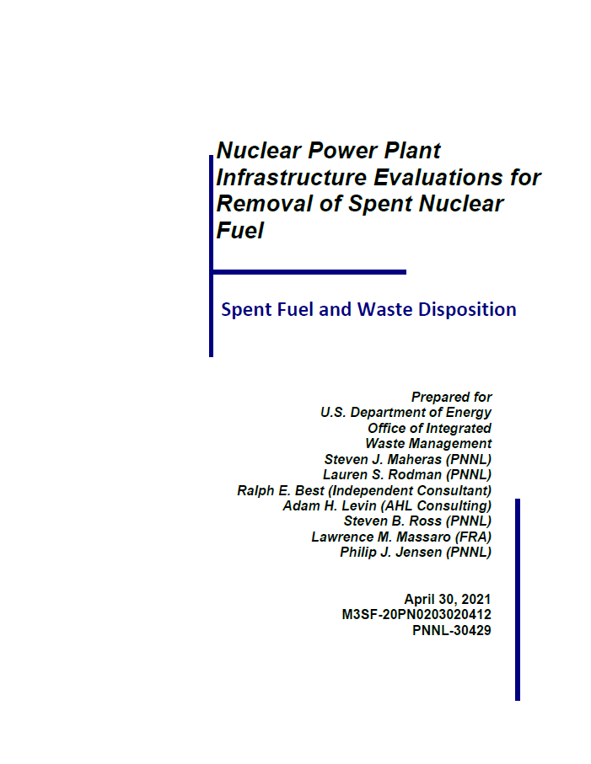
Nuclear Power Plant Site Evaluations
The purpose of nuclear power plant (NPP) site evaluations is to:
Confirm, gather, and identify gaps in information related to the inventory of spent nuclear fuel (SNF) and greater-than-Class C (GTCC) waste at the NPP sites
Document conditions at the NPP sites at time of evaluation
Evaluate site transportation experience and near-site transportation infrastructure at the NPP sites
Identify gaps in information needed to ship SNF and GTCC waste from the NPP sites
Based on the available information, identify options for transporting SNF and GTCC waste from the NPP sites

Slide 5
NPP Site Evaluation Process
Extensive NPP site research
Planning with NPP Site
List of questions submitted to NPP site about two months before site evaluation
Coordinate regarding security access requirements and logistics
Planning with nearby railroads
Federal Railroad Administration (FRA) leads this activity
Identify potential transload locations
Planning with Federal, Tribal, State, and State Regional Group partners
US Army Corps of Engineers and US Coast Guard if barging transport mode possible
State Regional Groups will often assist in external engagement meetings
Variety of State agencies will typically participate in a site evaluation
Planning with community engagement or advisory panels and local representatives
Logistics planning
These activities will typically take 6 months

Slide 6
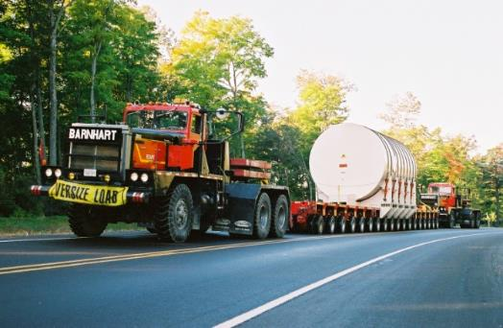
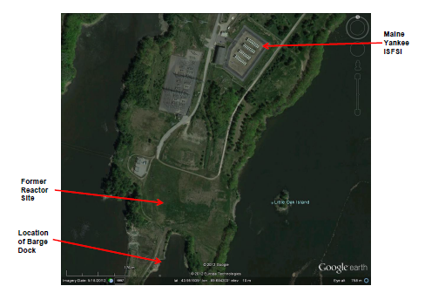
Sources of Information
Documents and Databases
Technical reports, nuclear industry trade publications, newspapers, web
Energy Information Administration (EIA) GC-859 Nuclear Fuel Data Survey Database
Geographic Information System (GIS) databases
Facility Interface Data Sheets (FIDS), Services Planning Documents (SPDs), Facility Interface Capability Assessment reports (FICAs), and Near-Site Transportation Infrastructure reports (NSTIs)
Independent Spent Fuel Storage Installation (ISFSI) Site Managers
Confirmed information obtained from other sources
Clarified current conditions at the sites
Provided photos and other detailed information
Heavy Equipment Lifting, Rigging, and Transporting Companies
Google Earth
Understand layout of sites
Used to provide detailed maps of sites and ISFSIs
Portray transload locations, and rail and heavy haul routes
Big Rock Point Reactor Pressure Vessel Heavy Haul
Photo courtesy of Barnhart Crane & Rigging
Maine Yankee Site

Slide 7
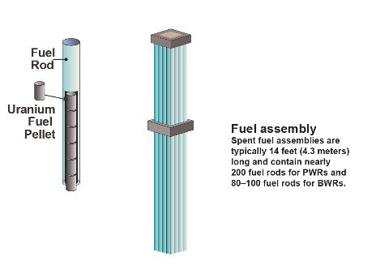
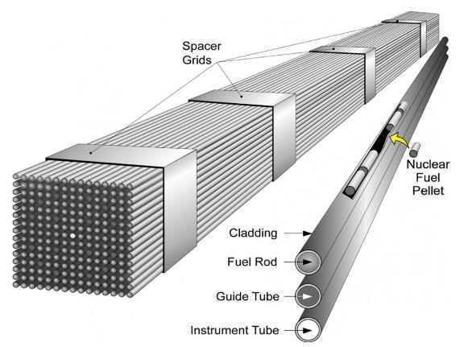
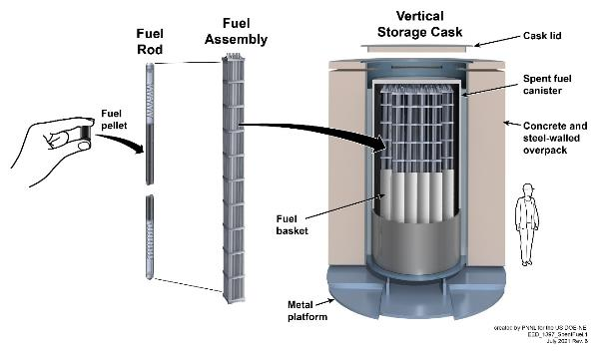
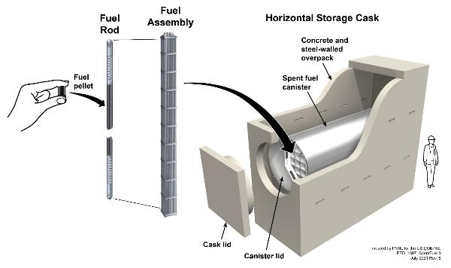
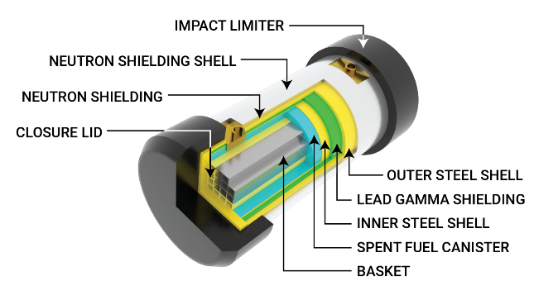
NPP Site Inventories
NPP SNF site inventories based on the GC‑859 Nuclear Fuel Data Survey
Database contains the characteristics of the fuel assemblies discharged from each reactor
Most recent data through December 31, 2017
Number of SNF assemblies, assembly ID and type, metric tons heavy metal (MTHM), discharge date, burnup, enrichment of SNF assemblies
Type and number of SNF storage systems (vendor and model) used at each site’s ISFSI
Canisters containing SNF
Canisters containing GTCC waste
Loading maps, logs, etc.
Storage features/conditions
Number of damaged fuel assemblies
Number of high burnup fuel assemblies
Canned/Not canned

Slide 8
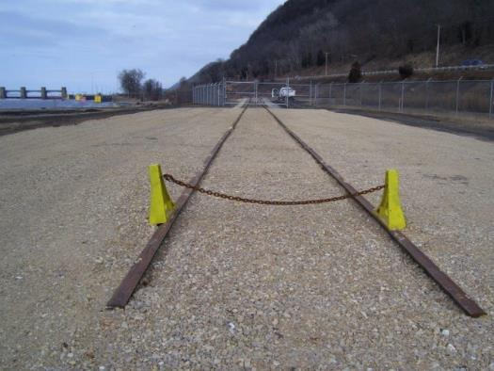
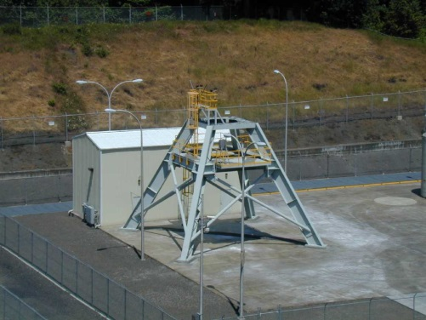
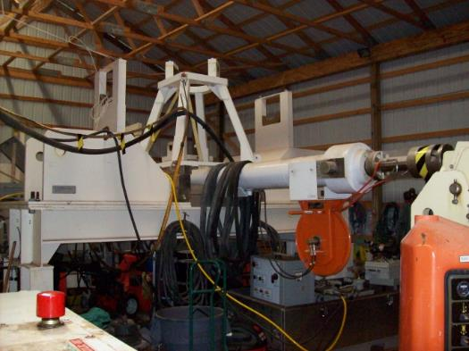
Site Conditions
Photo courtesy
of La Crosse
On-Site Transportation Features
On-Site Rail
On-Site Roads for Heavy-Haul Trucks
Barge Access
On-Site Equipment to Support Transportation Operations
Transfer Casks
Cranes and Rigging
On-Site Staging Areas for Transport Vehicles, Equipment and Operations Support
Trojan Transfer Station
Onsite Rail Spur at La Crosse
Photo courtesy of Trojan
Photo courtesy
of Big Rock Point
Big Rock Point Horizontal Transfer System

Slide 9
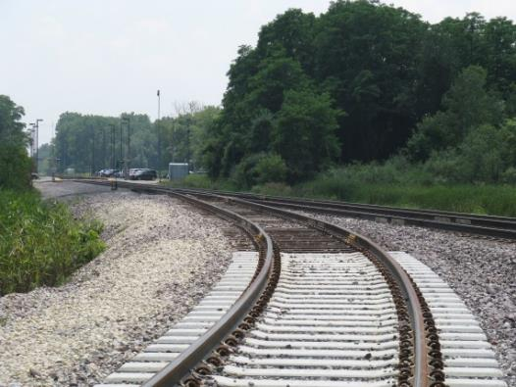
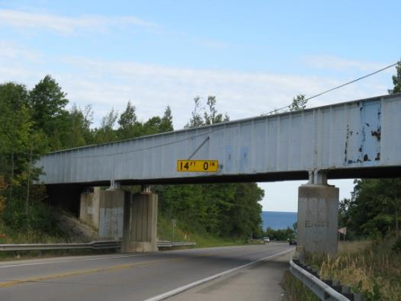
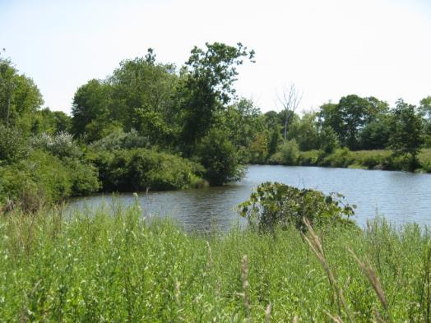
Near-Site Transportation Infrastructure and Experience
Evaluate transportation mode options for the NPP sites
National, Regional, or Short-Line Rail Access
Condition and capacity of near-site commercial rail infrastructure
Potential transload locations
Site experience with rail shipments
Local Roads and Highways
Distance to potential transload locations (rail spurs or sidings)
Characteristics and condition of roads and associated infrastructure that would be used by heavy haul vehicles
Site experience with heavy haul shipments
Barge Access
Characteristics of onsite or nearby docks/slips/sidings/shorelines
Site experience with barge shipments
Junction of Onsite Rail Spur and
Union Pacific Railroad at Zion
Low Overhead Bridge
Near Big Rock Point
Current Condition of Connecticut Yankee Barge Slip

Slide 10
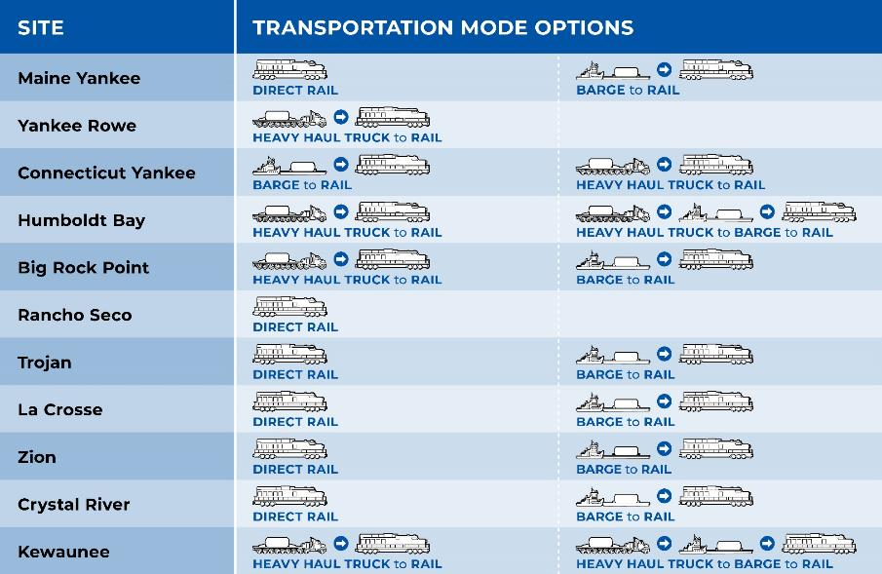
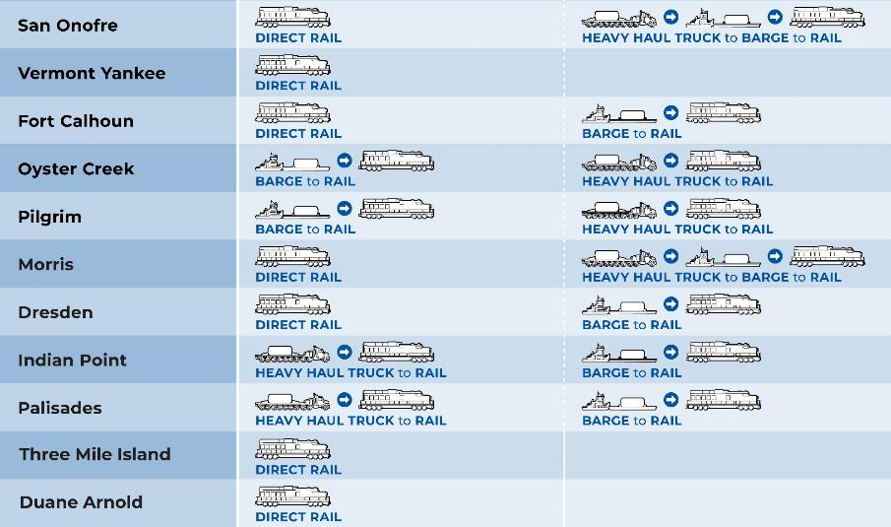
Transportation Mode Options
Notes:
UPDATE GRAPHIC

Slide 11
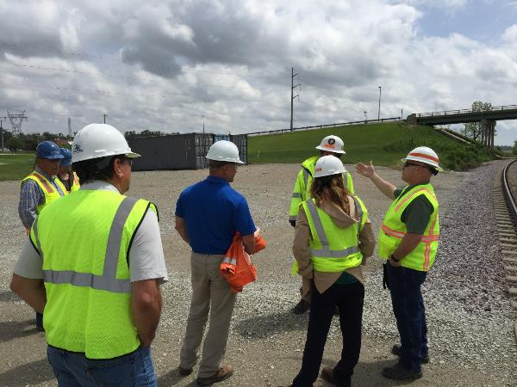
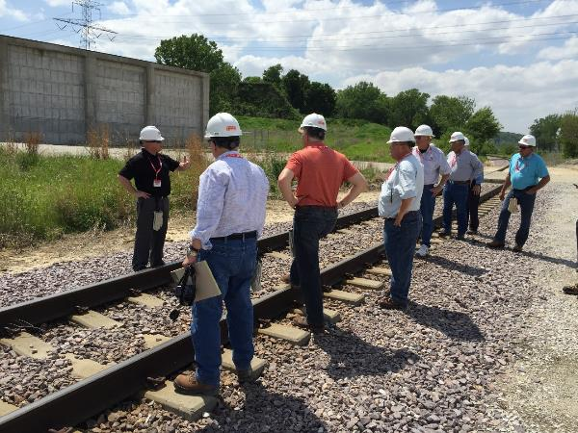
Key Parts of NPP Site Evaluations Are Site Visits
Twenty-two in-person NPP site evaluations conducted from August 2012 through September 2023
Site visits typically take place over three days
First day – NPP site
Second day – near-site transportation infrastructure
Rail infrastructure
Potential heavy haul truck routes
Potential rail and barge transload locations
Third day – often spent meeting with community engagement or advisory panels and local officials

Slide 12
Three Mile Island Site Visit

Slide 13
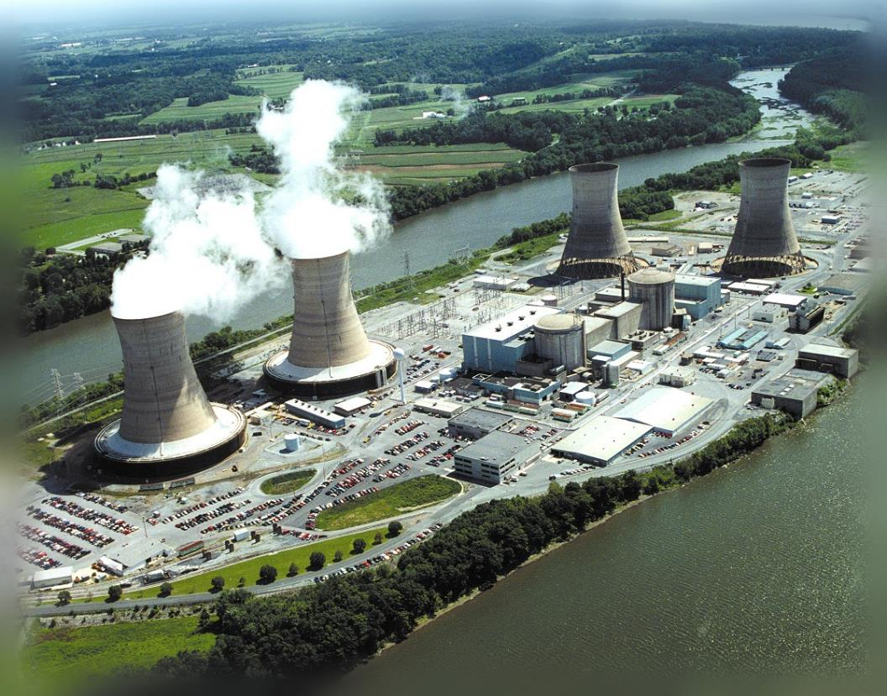
Aerial View of Three Mile Island (TMI) Site
Located in the Londonderry Township of Dauphin County, Pennsylvania
Approximately 16 kilometers (10 miles) southeast of Harrisburg, PA and 4.8 kilometers (3 miles) south of Middletown, PA
Photo of operating plant courtesy of

Slide 14
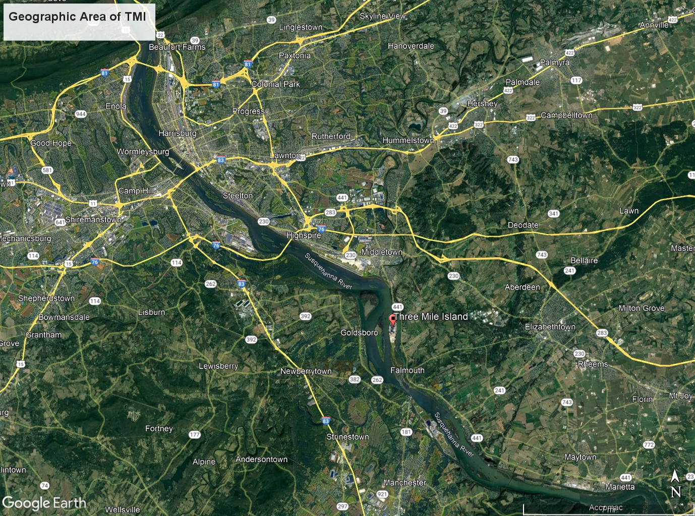

Slide 15
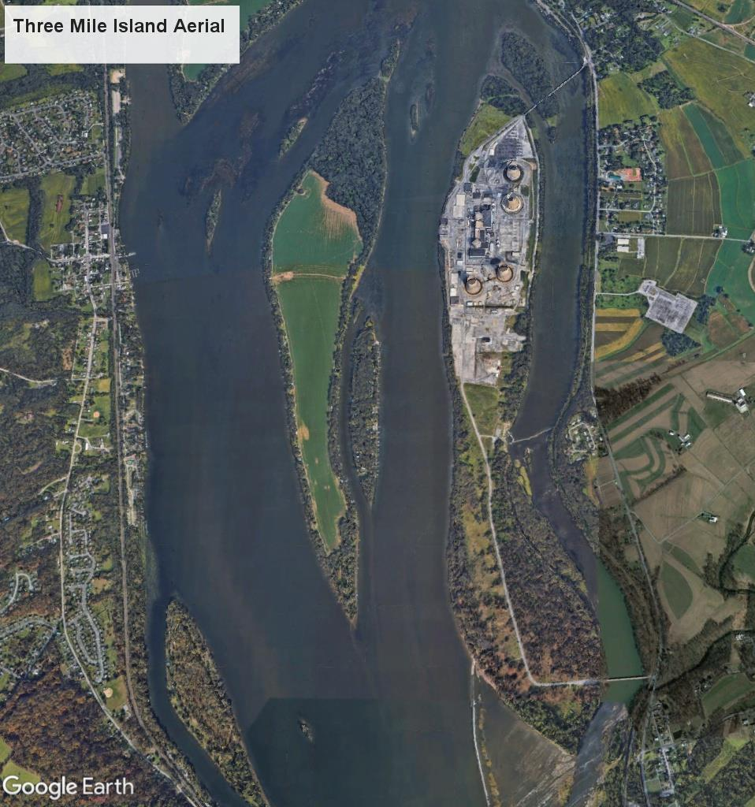
The plant takes its name from the oblong island in the Susquehanna River on which it is located.

Slide 16
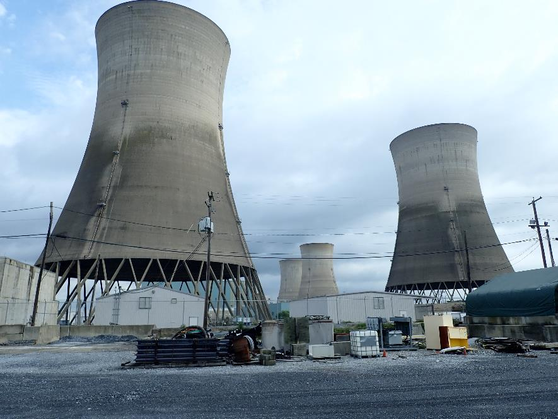
Three Mile Island Nuclear Station: Operations
Historic significance due to the partial meltdown of TMI Unit 2 on March 28, 1979 – the most significant nuclear accident in U.S. history.
TMI Unit 1
Issued operating license in 1974
Babcock and Wilcox Pressurized Water Reactor
Continued operations until permanently shut down on September 20, 2019
Owned by Constellation Energy Company
TMI Unit 2
Issued operating license on February 8, 1978, commercial operations December 1978
Babcock and Wilcox Pressurized Water Reactor
Operated for only a few months before accident; never operated again
Owned by TMI-2Solutions, an EnergySolutions subsidiary
Four TMI Cooling Towers - Looking North

Slide 17
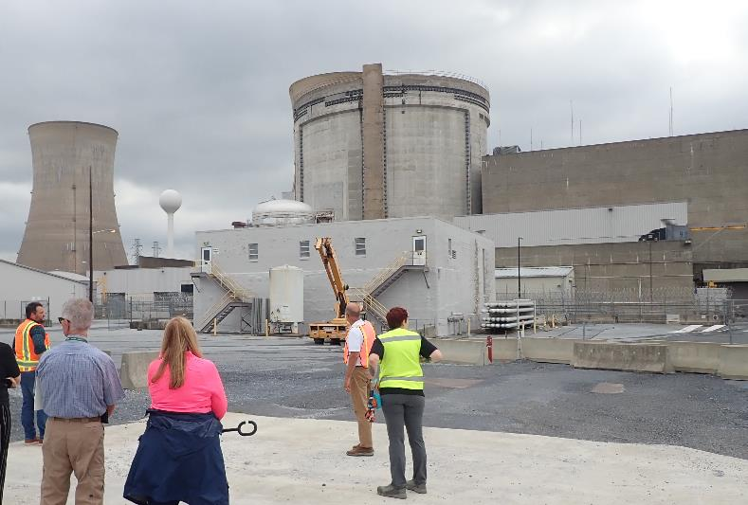
Three Mile Island Nuclear Station: Decommissioning
TMI Unit 1
Original License Expiration: April 19, 2014
Renewed License Expiration: April 19, 2034
Permanent shutdown determination: April 2017
All spent nuclear fuel (SNF) permanently removed from reactor: September 26, 2019
All SNF placed in ISFSI: July 27, 2022
SAFSTOR decommissioning status
TMI-1 cooling tower (left) Reactor Building (center)

Slide 18
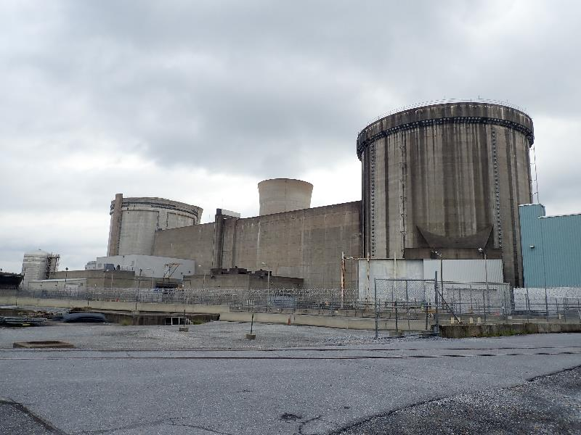
Three Mile Island Nuclear Station: Decommissioning
TMI Unit 2
Damaged fuel and contaminated reactor vessel components removed from the site; placed into storage on the Idaho National Laboratory site.
Removal actions completed by January 1990
Very small amount of residual debris outside the reactor vessel remains to be removed
Began SAFSTOR license status in 1993; recently transitioned to active decommissioning.
Evaluation focused on TMI Unit 1 (SNF on site)
Units collocated, so transportation infrastructure information considered for both Units
TMI-1 (left) and TMI-2 (right) Reactor Buildings

Slide 19
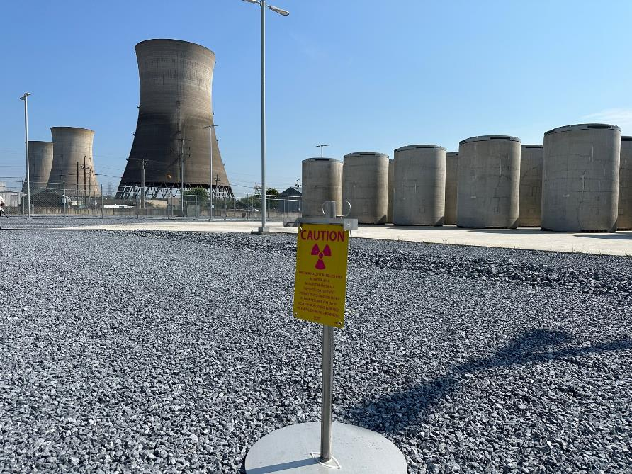
Three Mile Island Nuclear Station: TMI-1 ISFSI
ISFSI construction March 2020 – July 2021
ISFSI loading campaign Oct 2021 – July 2022
46 NAC MAGNASTOR SNF storage systems
1665 SNF assemblies
1 NAC MAGNASTOR Greater Than Class C Waste (GTCC) canister
4 additional decommissioning GTCC canisters expected
MAGNASTOR Components
Transportable Storage Container (TSC): Stainless steel cylindrical shell with welded lid; fuel basket structure
Vertical concrete cask: holds and protects sealed TSC during ISFSI storage, provides radiation shielding, structural protection, and heat dissipation
Canisters can be shipped in MAGNATRAN transportation cask
TMI Cooling Towers and ISFSI
*Independent Spent Fuel Storage Installation = ISFSI

Slide 20
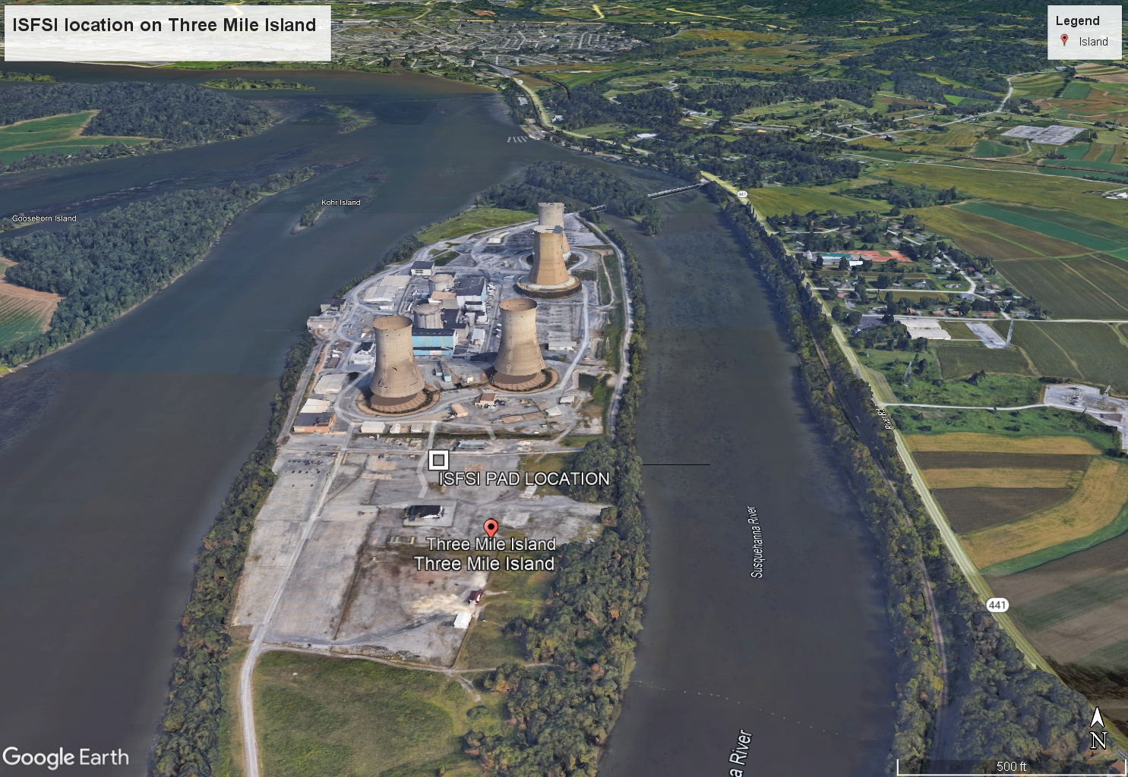

Slide 21
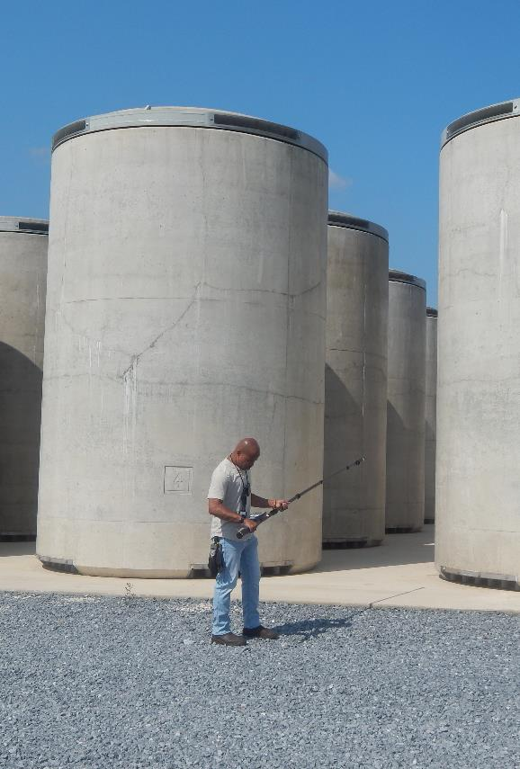
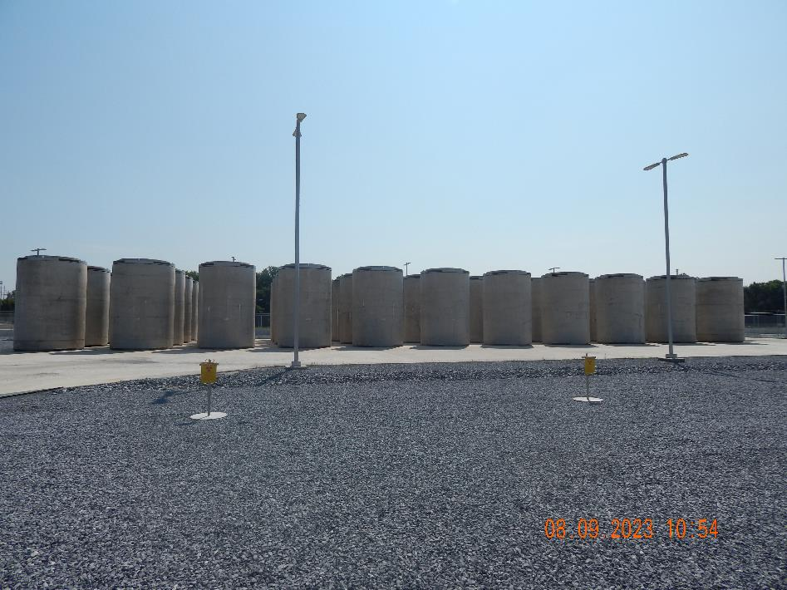
TMI-1 ISFSI
Long View of ISFSI Pad
Cask Scale

Slide 22
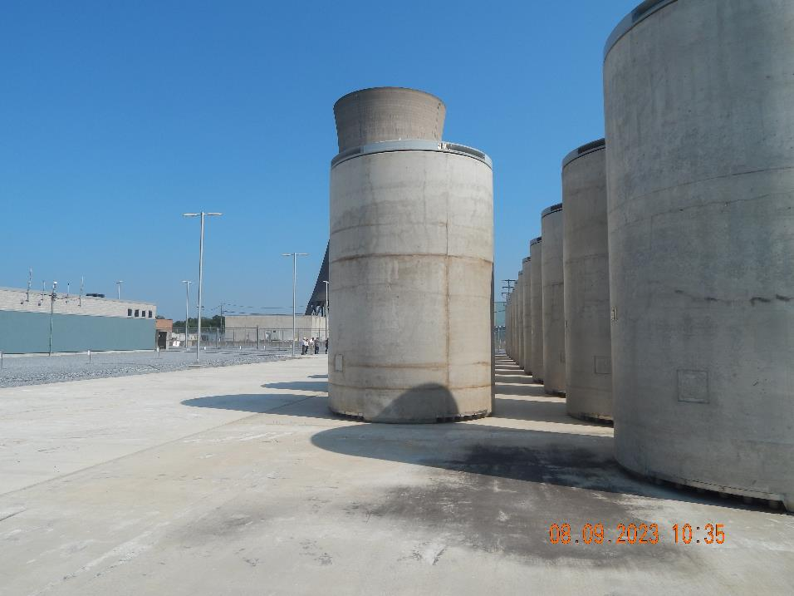
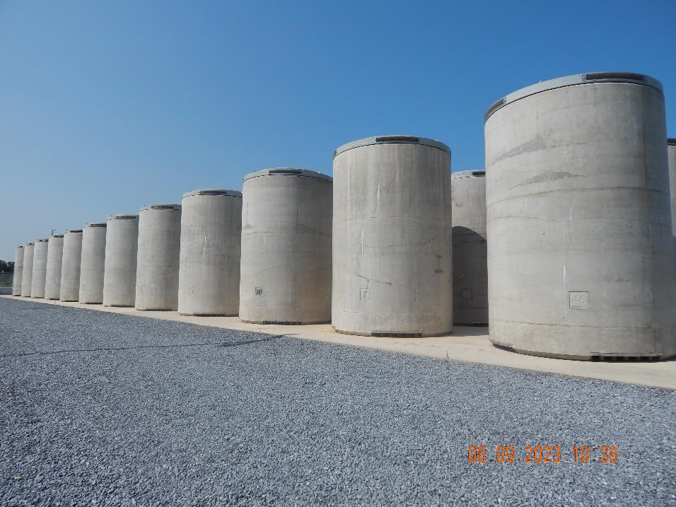
TMI-1 ISFSI
Layout of ISFSI with Cooling Tower
Corner View of ISFSI Pad

Slide 23
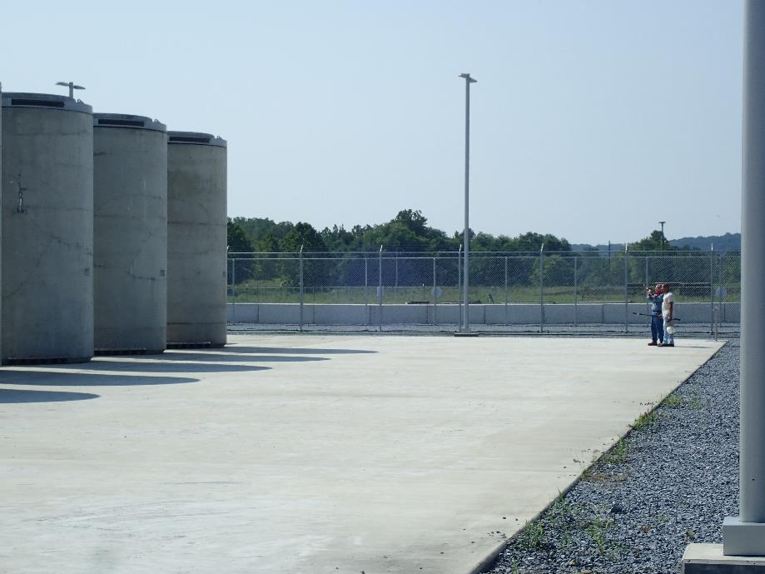
Three Mile Island Nuclear Station: TMI-2 GTCC
Most fuel and debris already removed from site
Decommissioning estimated to produce additional 14-15 GTCC canisters
Plan to continue to use MAGNASTOR system
TMI-1 ISFSI pad expansion area; room for up to 27 casks
Looking South – Pad Expansion Space

Slide 24
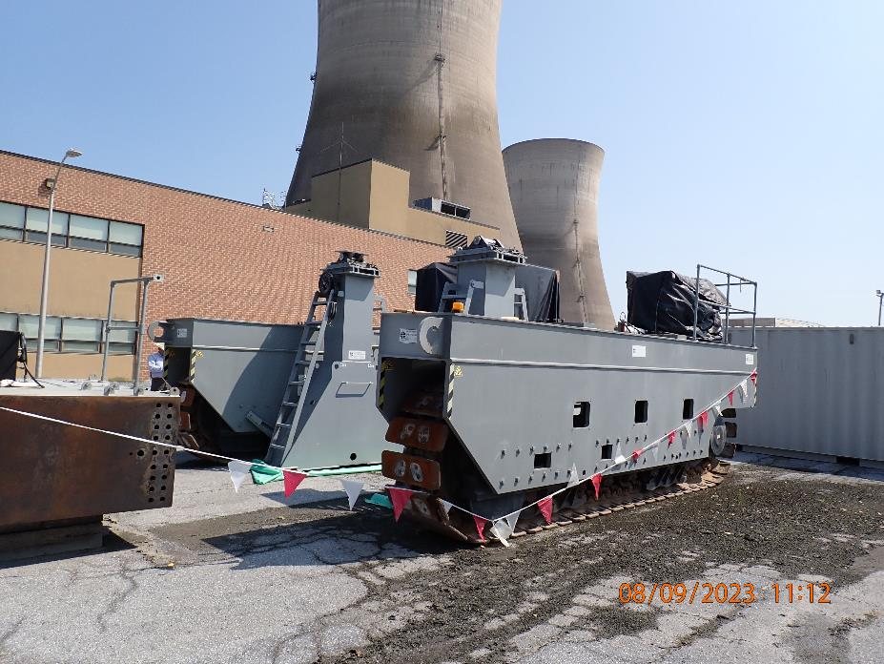
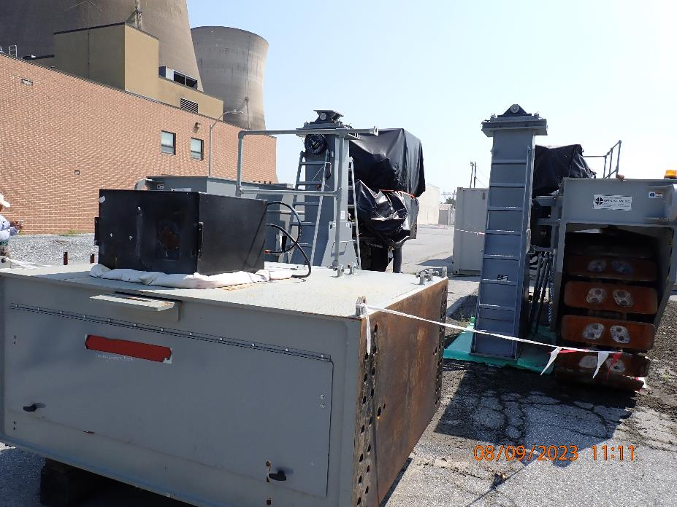
Vertical Cask Transporter
Disassembled Vertical Cask Transporter

Slide 25
Site Rail Access

Slide 26
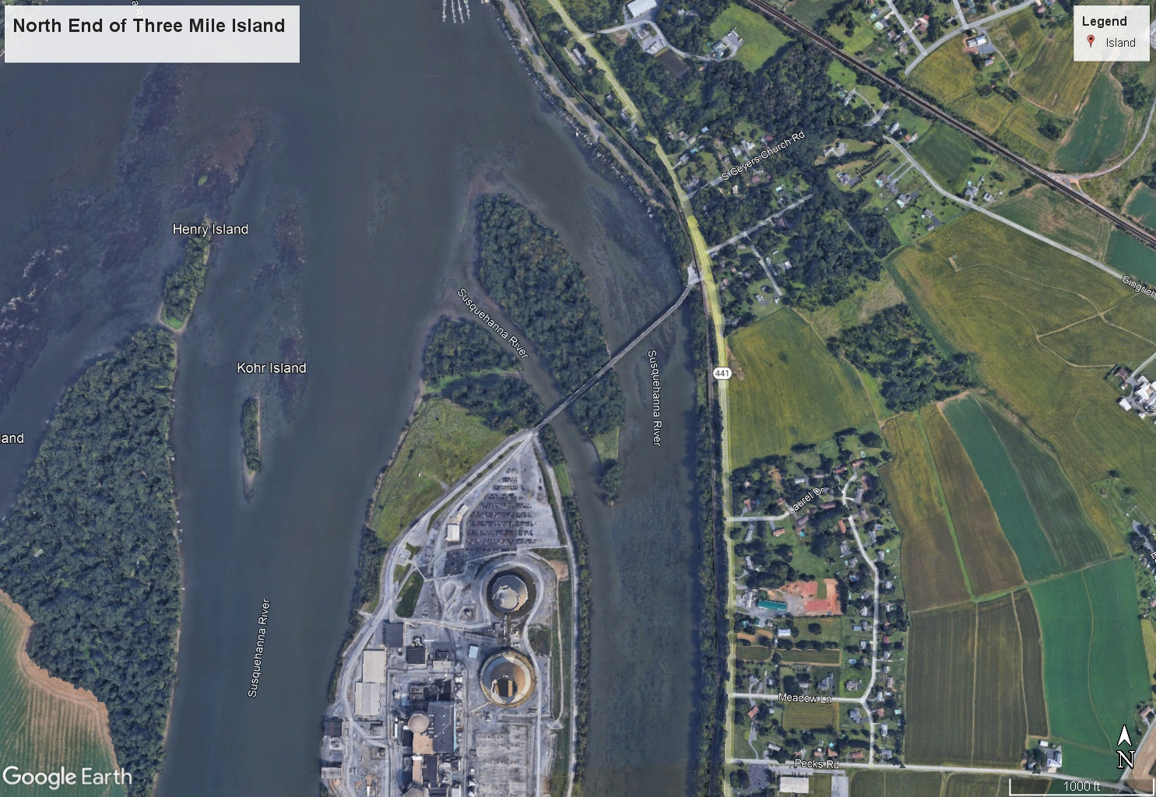

Slide 27
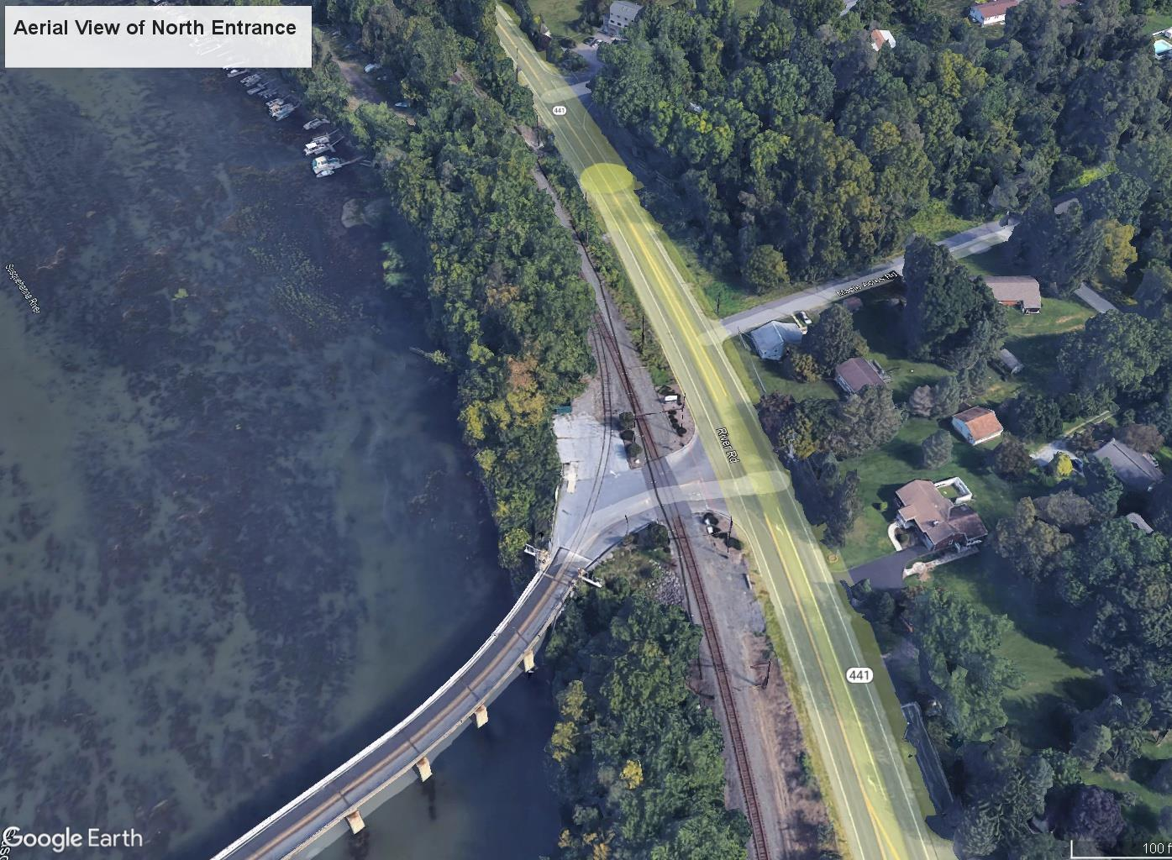

Slide 28
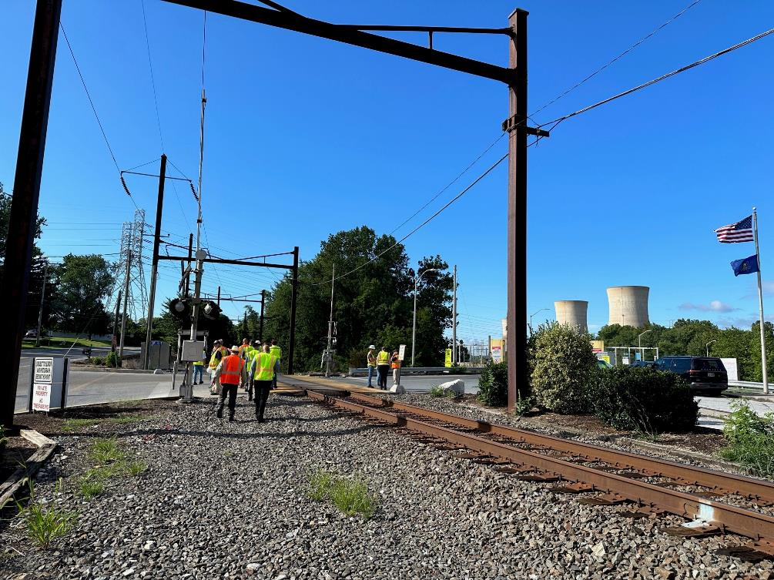
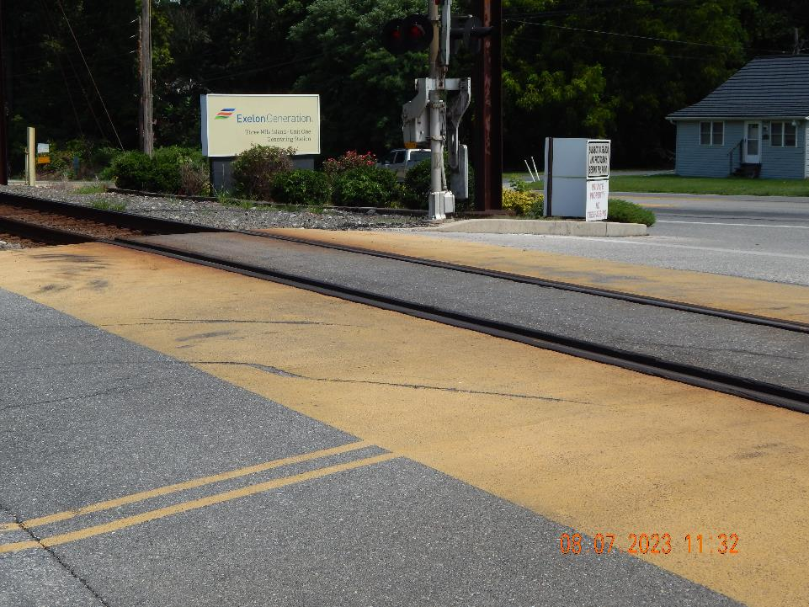
Rail Line Area at North Entrance
Rail Line at North Bridge Entrance

Slide 29
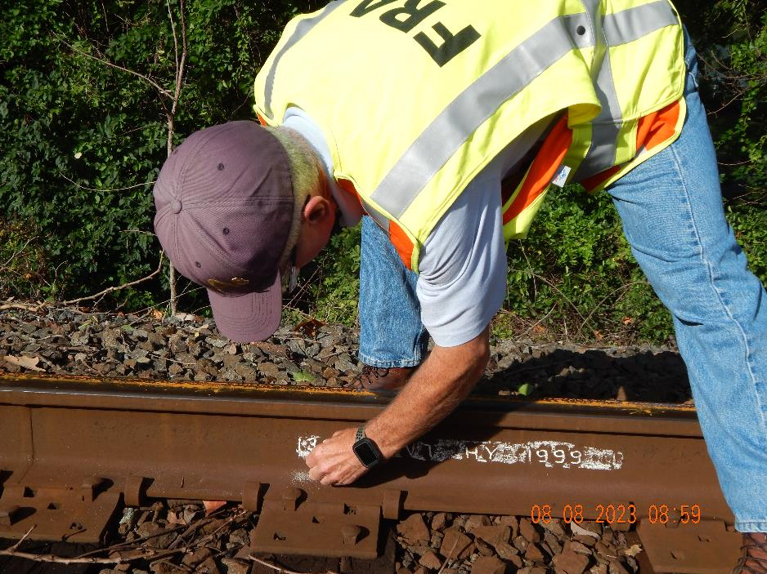
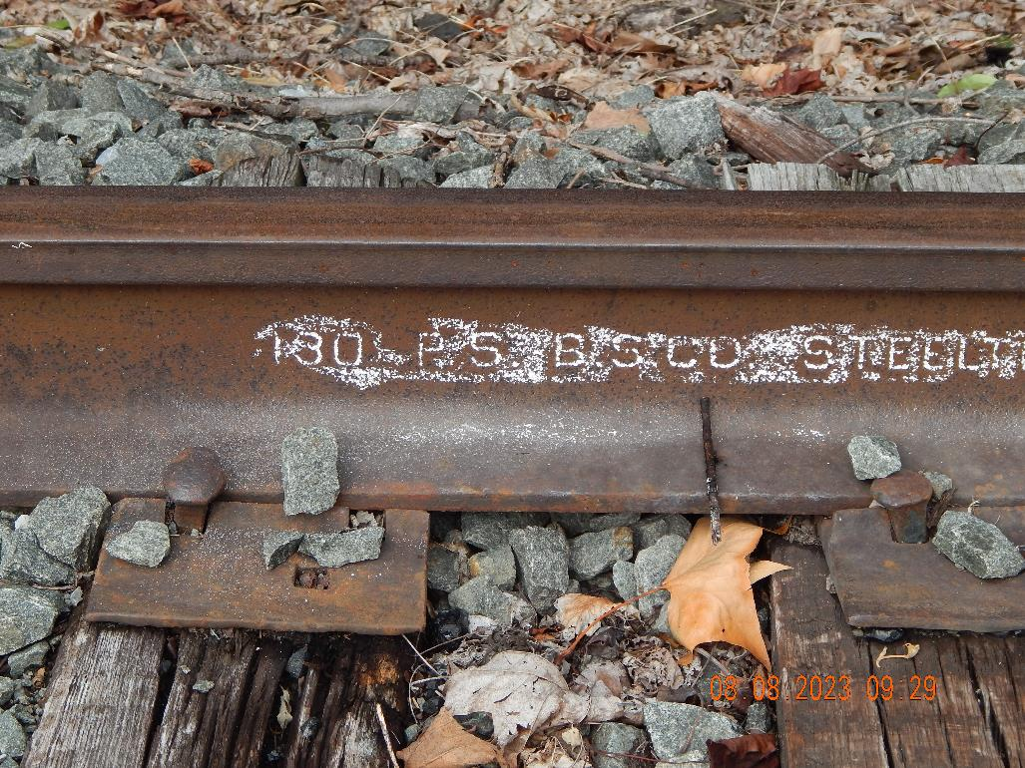
Rail Line Area at North Entrance
Chalked Rails with Weight

Slide 30
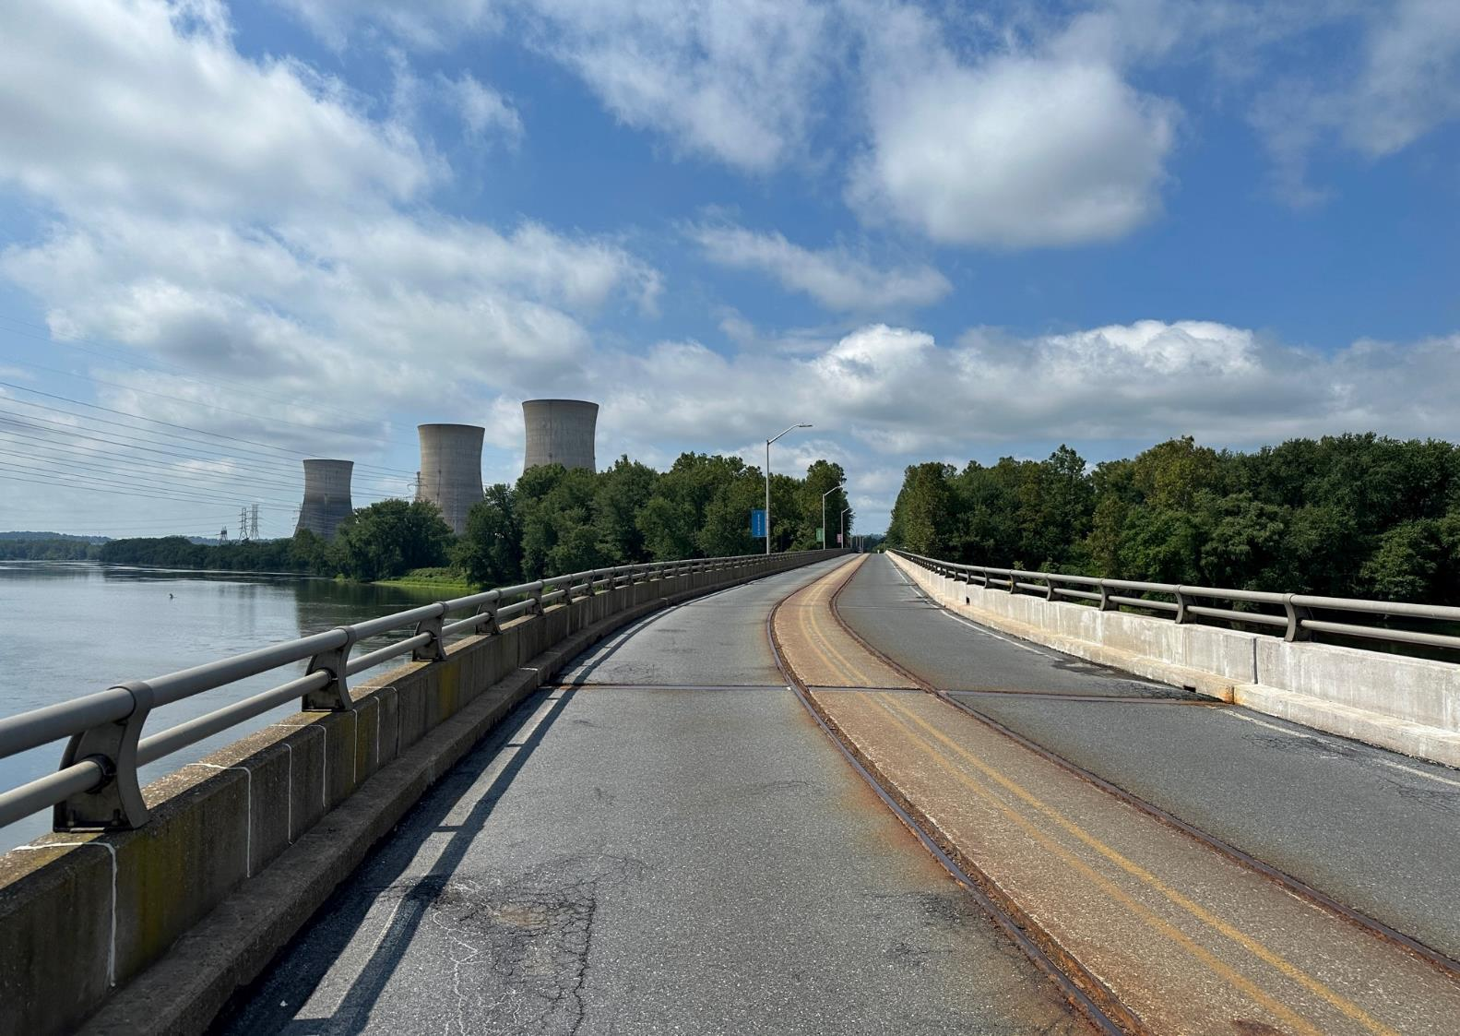
TMI North Bridge
Built in 1960s to support rail and vehicle traffic
Steel superstructure with concrete composite deck and asphalt surface
Rail lines installed to support construction of both Unit 1 and 2 remain but have not been utilized since a 2014 transformer delivery
Rated currently for 40-ton weight limit; higher loads require evaluation
Repairs and upgrades planned for decommissioning

Slide 31
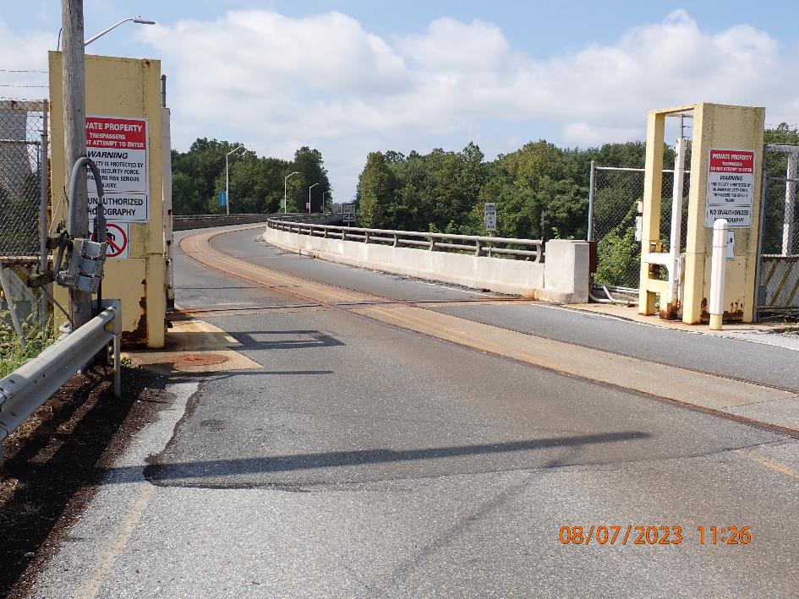
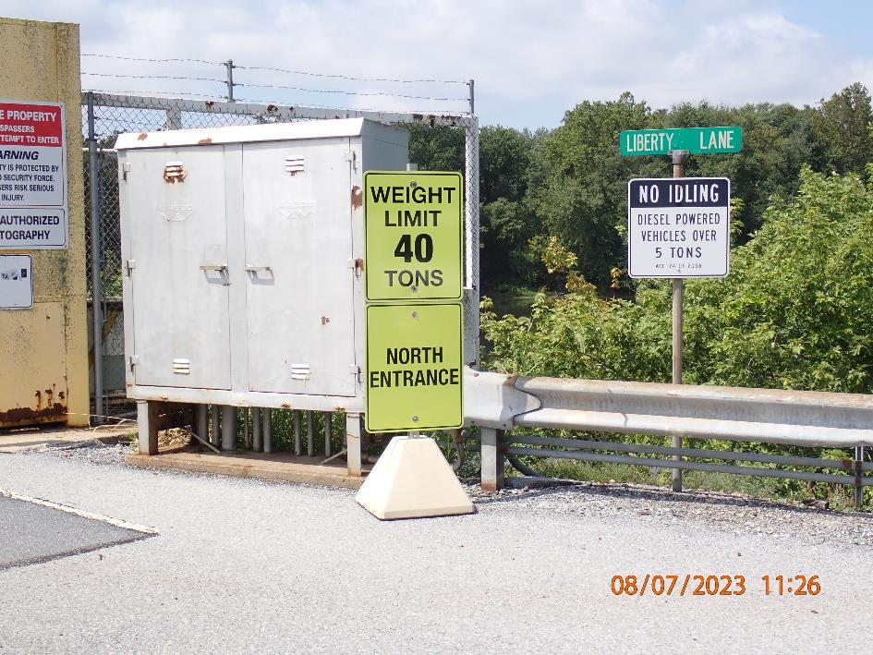
TMI North Bridge
Site Entrance at North Bridge
Sign Postings at North Bridge

Slide 32
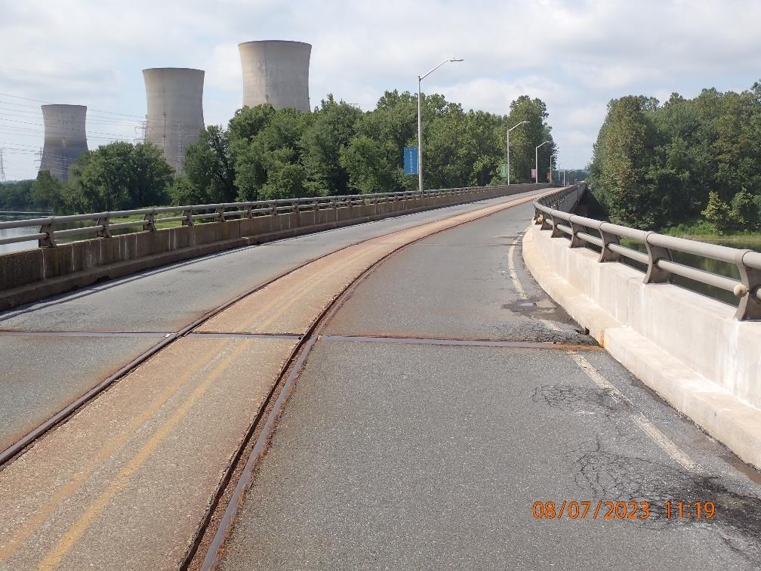
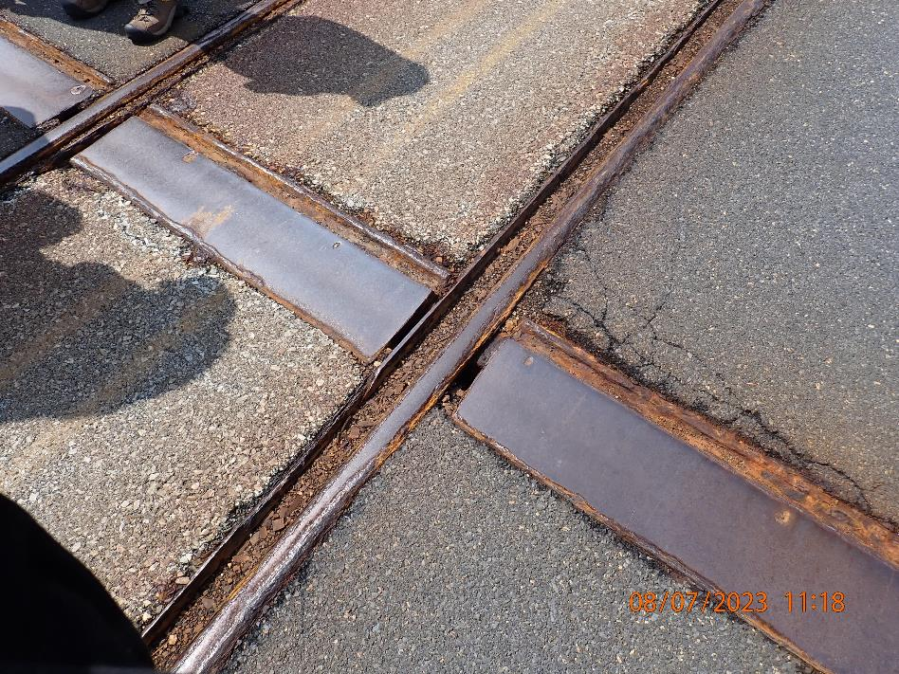
TMI North Bridge
Heading West onto TMI Site
Rail Condition on Bridge

Slide 33
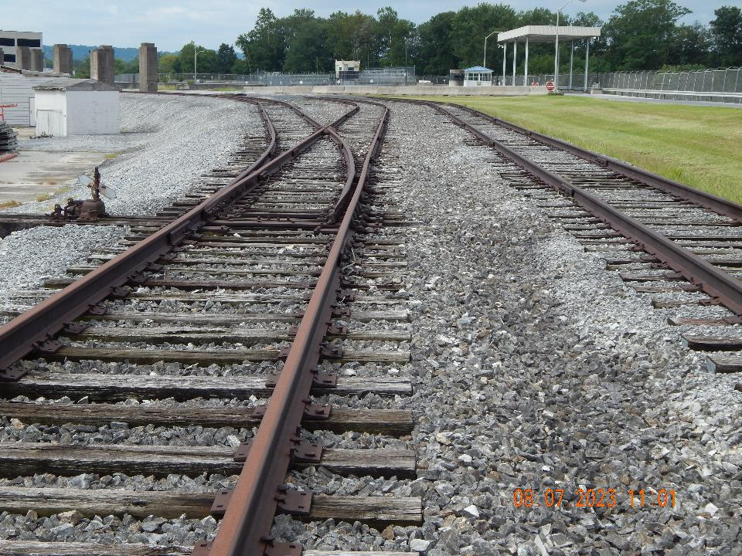
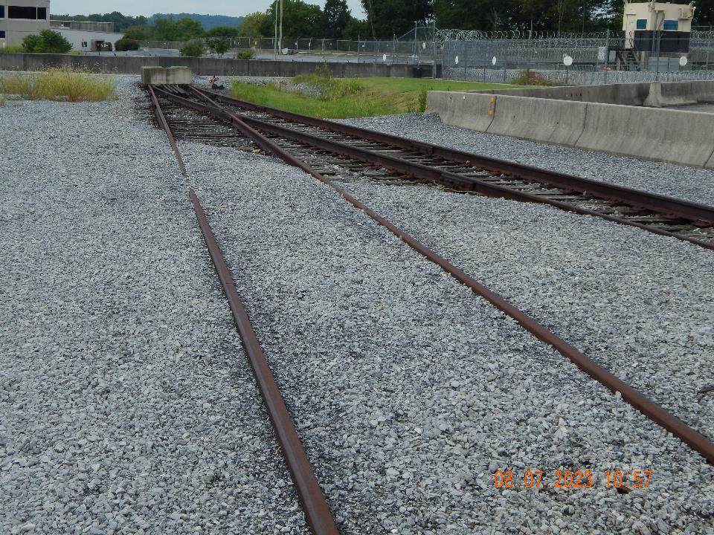
Onsite Rail
Heading West onto TMI Site
Rail Condition at Entrance

Slide 34
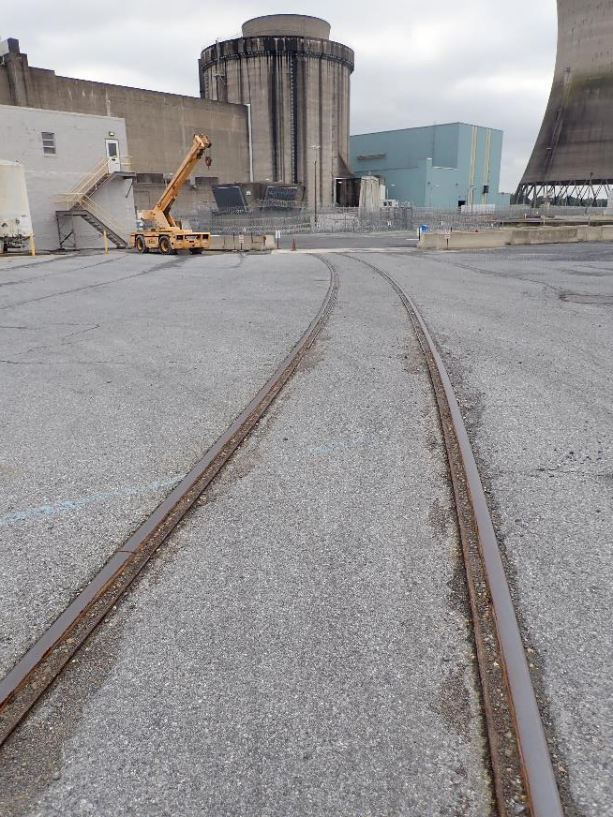
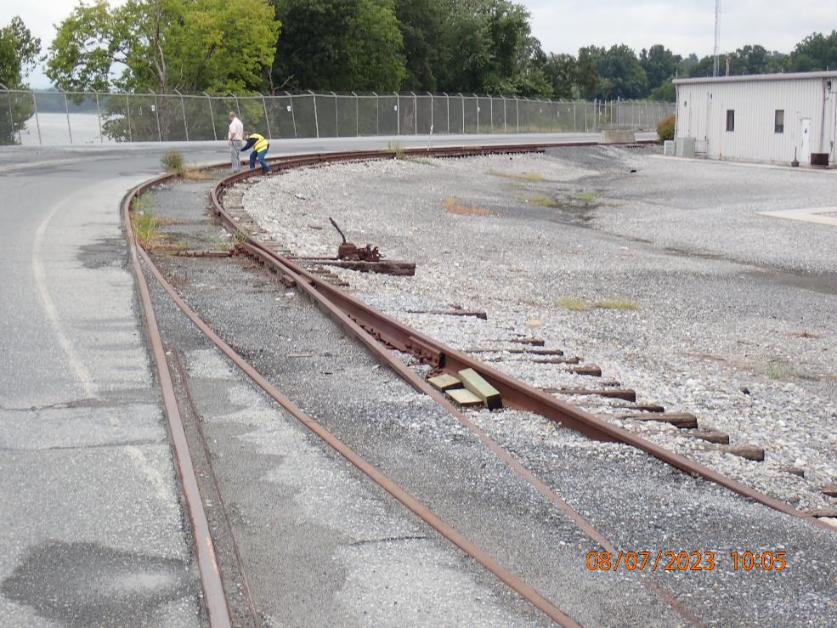
Onsite Rail
Rail Past North Bridge Entrance
Rail Near Reactor Buildings

Slide 35
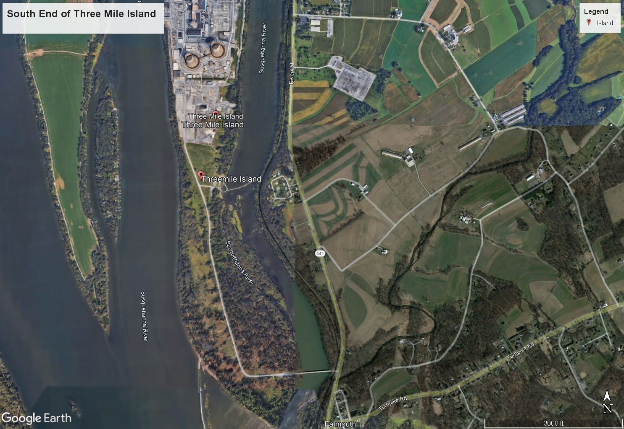

Slide 36
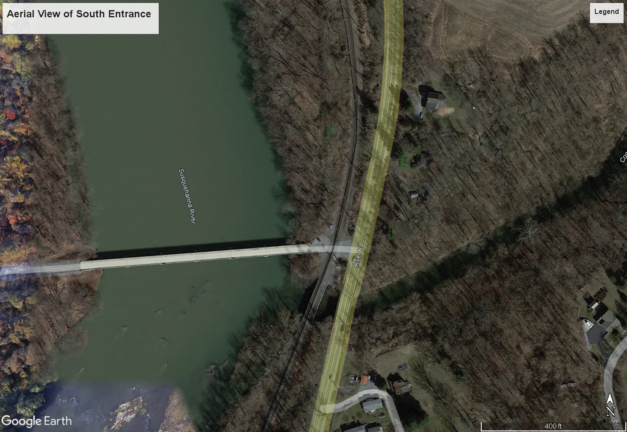

Slide 37
TMI South Entrance
South Bridge Entrance
Road Past South Bridge on Site Traveling North

Slide 38
Rail Near TMI South Entrance
Norfolk Southern Rail Near South Bridge
Rail Bridge Near South Entrance

Slide 39
Rail Near TMI South Entrance
Norfolk Southern Rail Near South Bridge

Slide 40
Rail Yard Near TMI – Potential Interchange Point
Rail Yard at 3652 Industrial Road – Bridge Views

Slide 41
Rockville Bridge – Rail Near TMI
Rockville Bridge Railroad Tracks (Norfolk Southern)

Slide 42
Visited Several Potential Transload Locations
West of DuraBond Protective Coatings (2716 South Front Street, Steelton, PA)
Cleveland Cliffs Steel (215 S. Front Street, Steelton, PA)
Steelton Regional Water Treatment Plant (282 Christian St., Steelton, PA
Cleveland Cliffs Scrap Yard (near Christian St.)
Consolidated Scrap (1616 N. Cameron St. Harrisburg, PA)

Slide 43
Planned Infrastructure Upgrade
Courtesy of
Cyan – Existing Rail Lines
Blue – New Rail Spur
Red – Excluded from Rail Scope

Slide 44
External Engagement
Extensive team participation
Federal: DOE and National Laboratories, FRA, FBI, NRC
State: PA Bureau of Radiation Protection, PA DOT, PA Emergency Management (PEMA) CSG-ERC
Tribal: TRMTC
Industry: Constellation, TMI-2 Solutions, Norfolk Southern
Meeting with TMI-2 Community Advisory Panel and local officials

Slide 45
Site Summary
Transportable canisters
Abundant staging areas
Vertical cask transporter remains onsite
Direct rail access
No barge access
Heavy haul truck unlikely
Rail and bridge infrastructure improvements planned

Slide 46
Status – Nuclear Power Plant Site Evaluations
All 22 decommissioned sites visited to date
Most recent site evaluations were of Morris (17) and Dresden (18) in May 2022, Indian Point (19) in July 2022, Palisades (20) in October 2022, and Three Mile Island in August 2023 (21).
Duane Arnold was final decommissioned site DOE visited (22): Sept. 2023

Slide 47
Status – Nuclear Power Plant Site Evaluations
April 2021 update of the NPP site evaluation report posted on DOE-NE website (https://www.energy.gov/ne/articles/nuclear-power-plant-infrastructure-evaluations-removal-spent-nuclear-fuel)
Includes 16 site evaluations through Oyster Creek (15) and Pilgrim (16)
Updated report 2023 to include up to Palisades
Additional reports to come; may include volumes
Continue to collect data on conditions at previously visited sites
DOE intends to continue conducting site evaluations of additional NPP sites and to eventually conduct evaluations for all NPP sites

Slide 48
Questions?

