Slide 1
Spent Nuclear Fuel Package Performance Demonstration: RFI Information Session
Gerard Jackson
U.S. Department of Energy
Miriam Juckett
Pacific Northwest National Laboratory
October 23, 2024

Slide 3
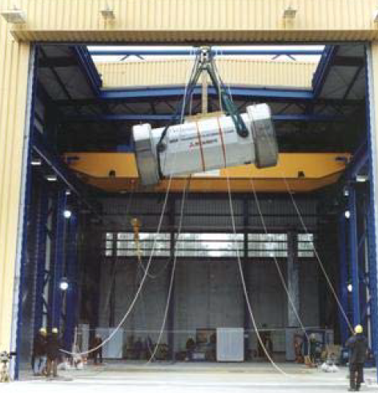
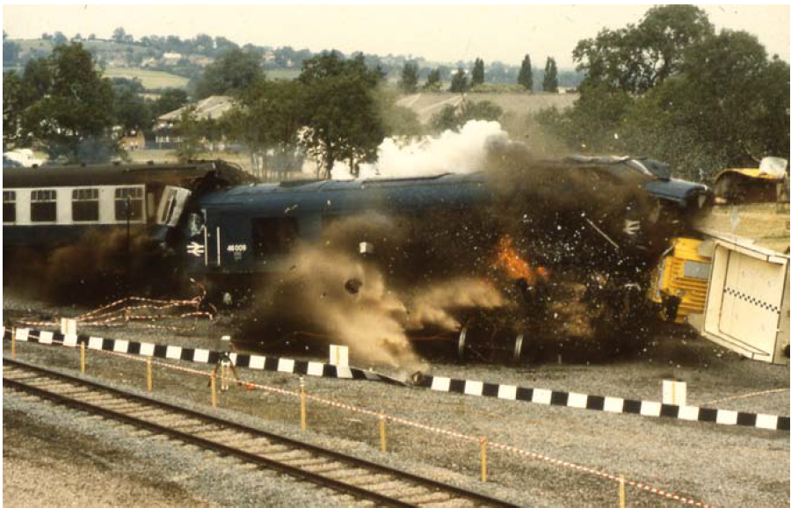
DOE Package performance demonstration (ppd)
What is a PPD?
Physical demonstrations on a rail-sized spent nuclear fuel (SNF) transportation cask
Previously referred to as a package performance study
CEGB public demonstration test. Image from, “Going the Distance? The Safe Transport of Spent Nuclear Fuel and High-Level Radioactive Waste in the United States,” The National Academies Press, Washington, D.C. (2006).
Image from Bernhard Droste, “Experiences and Perspectives of Package Testing Under Hypothetical Accident Conditions,” PATRAM 2007, Miami, Florida. (Conducted at PATRAM 2004).

Slide 4
DOE Package performance demonstration (PPD)
Why is DOE planning a PPD?
Build trust and confidence in the safety of SNF transportation casks and SNF transportation
Gather technical data to further support computer models
Record high-resolution video to use in DOE communication products and public outreach
Explore additional opportunities to strengthen relationships

Slide 5
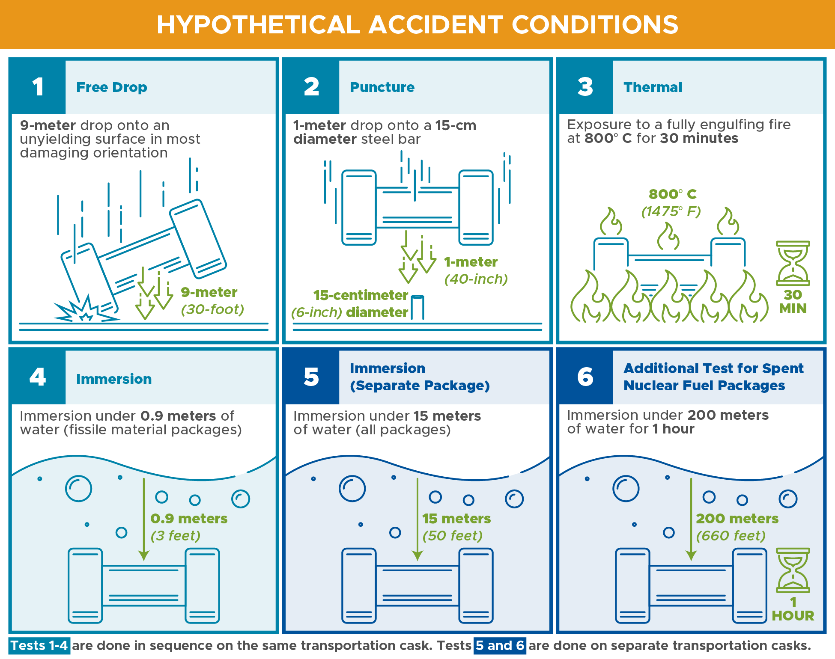
Doe ppd: Preliminary plans
Considering demonstrations based on tests described in U.S. Nuclear Regulatory Commission’s (NRC’s) 10 CFR Part 71

Slide 6
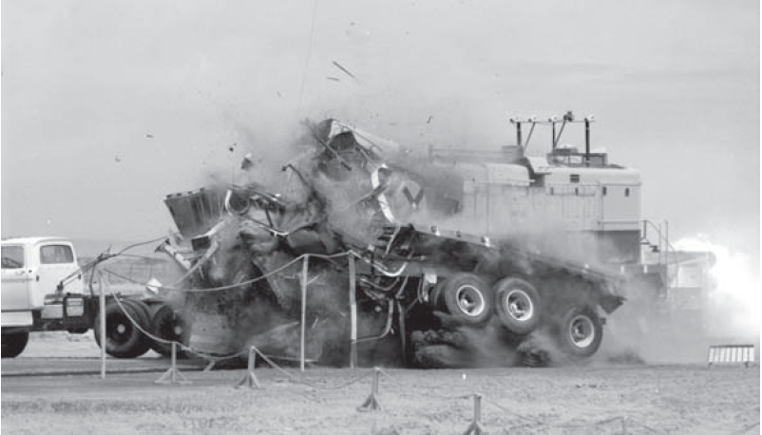
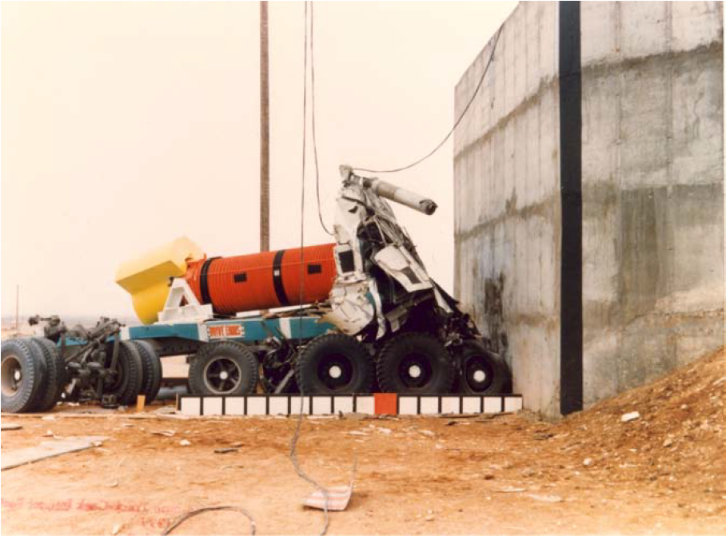
Doe ppd: Preliminary plans
Considering other demonstrations; for example:
Train collision with transportation package in a “realistic” type of scenario
Immersion demonstration in a body of water/waterbody retrieval demonstration
Locomotive impacting a tractor-trailer system
Truck tractor-trailer with SNF shipping cask
Images from National Academy of Sciences, Going the Distance? The Safe Transport of Spent Nuclear Fuel and High-Level Radioactive Waste in the United States, 2006.

Slide 7
Doe ppd: preliminary plans
DOE is seeking your input on:
Potential demonstrations to be performed
Potential transportation casks
Potential testing facilities/sites
Potential analytical tools, instrumentation, data collection, and videography
Completion of a PPD depends on continued availability of funding

Slide 8
External engagement expected outcomes
Short Term:
Input into which demonstrations to perform and other parameters, where possible
Input into how results are used and distributed
Identify potential success paths and pitfalls
Long Term:
“Shareable” confidence
Facilitated communication during future transportation campaigns
Improved knowledge base

Slide 9
Rfi content
Request for Information(RFI)/Sources Sought Notice (SSN) Contains:
Introduction/Background
Information Sought
Input and feedback from interested parties
Market research/info from potential vendors
Preliminary Parameters and Considerations
Response Instructions
Collaboration and Teaming
Categorized Questions
Attachment

Slide 10
Preliminary Parameters and Considerations
Contained in Section II “Background” of RFI
DOE-NE intends to use a cask that is likely to be relevant to future SNF transportation operations scenarios to Federal storage and/or disposal facilities
(a) a high-capacity design and with a loaded weight between 136,000 kg (300,000 lb) to 193,000 kg (425,000 lb)
(b) a design that involves a canister overpack transportation configuration
(c) anticipated to be used frequently or regularly for transport
DOE-NE does not intend to consider scenarios that would simulate specific terrorism or sabotage scenarios such that security-related information would be integral to the demonstration
DOE-NE does not intend to use casks loaded with SNF in a PPD. Casks may be loaded with simulated fuel content to replicate real loaded conditions

Slide 11
Preliminary Parameters and Considerations
DOE-NE does not intend to conduct demonstrations that apply forces to a SNF cask beyond those prescribed in 10 CFR Part 71 regulations (i.e., no extra-regulatory or beyond design basis testing)
DOE-NE intends to consider conducting potential full-scale demonstrations based on the tests described in 10 CFR Part 71 as well as scenario demonstrations, and these various demonstrations may be conducted at a single facility/site or multiple facilities/sites, depending on the demonstration(s) selected
DOE-NE intends to ensure that instrumentation and high-resolution videography are incorporated into a demonstration plan
DOE-NE intends to conduct a PPD in as open and transparent a manner as possible, which may include (but is not limited to) measures such as inviting observers to the demonstrations, publicly sharing information about how demonstrations were designed and conducted, publishing reports about demonstrations and results, inviting or contracting independent verification, potentially sharing live video of PPD demonstrations via digital platforms, etc.

Slide 12
RFI QUESTION CATEGORIES
Category A. Stakeholder Input and Feedback
Category D. Instrumentation, Data Collection, and/or High-Resolution Videography Services
Category B. Cask Vendors
Category E. Miscellaneous Questions for Potential Vendors and Service Providers
Category C. Testing Facilities, Sites, and Services to Conduct Demonstrations

Slide 13
Response instructions
Address as many of the topics as possible
Respondents are not required to address all topics or questions.
Limit responses to the topics and questions that are relevant to your area of expertise, interest, and/or industry.
Responses can include multiple categories.
Label (number) responses according to Section VII question being answered
Example template available in Section IX of RFI
Mark proprietary or confidential information accordingly
DOE will not be publishing responses, but plans to publish summary report
Send submissions and questions to DOE-PPD@id.doe.gov

Slide 14
Collaboration and teaming
If you wish to be included on the publicly available list, indicate contact information (company or organization name, mailing address, and point of contact name, title, telephone number, and email address). Also indicate which area(s) of interest (Category B, C, D, or E of this RFI/SSN) best suits your organization’s capabilities.
DOE will publish a table in information portal updated periodically

Slide 15
Rfi process
RFI Published (~90 Day Response Window)
Informational webinars/Q&A sessions
CURIE information resource portal
Responses Received
Teaming list posted in resource portal
Responses sorted by topic
Responses Reviewed
Publicly available general summary report
Options and recommendations developed
Performance Work Statements developed
Request for Proposals published
Demonstration Protocols Determined

Slide 16
phased engagement approach
Phase 1: Preliminary Outreach (Pre-RFI)
Initial engagement
Phase 2: RFI and Comment Period
RFI published, gather responses, review feedback
Increase breadth of outreach
Webinars, listening sessions
Informs request for proposal (RFP)
Phase 3: RFP through PPD Implementation
RFP issued, responses received, DOE decisions on demonstrations
Broadest outreach
Educational/ informational webinars, updates
Informs PPD and post-PPD communications
Develop preliminary technical considerations
Develop information portal
Advises RFI development
Mid-2023 – Summer 2024
Summer 2024 – Spring 2025
Spring 2025 – 2028* (target)

Slide 17
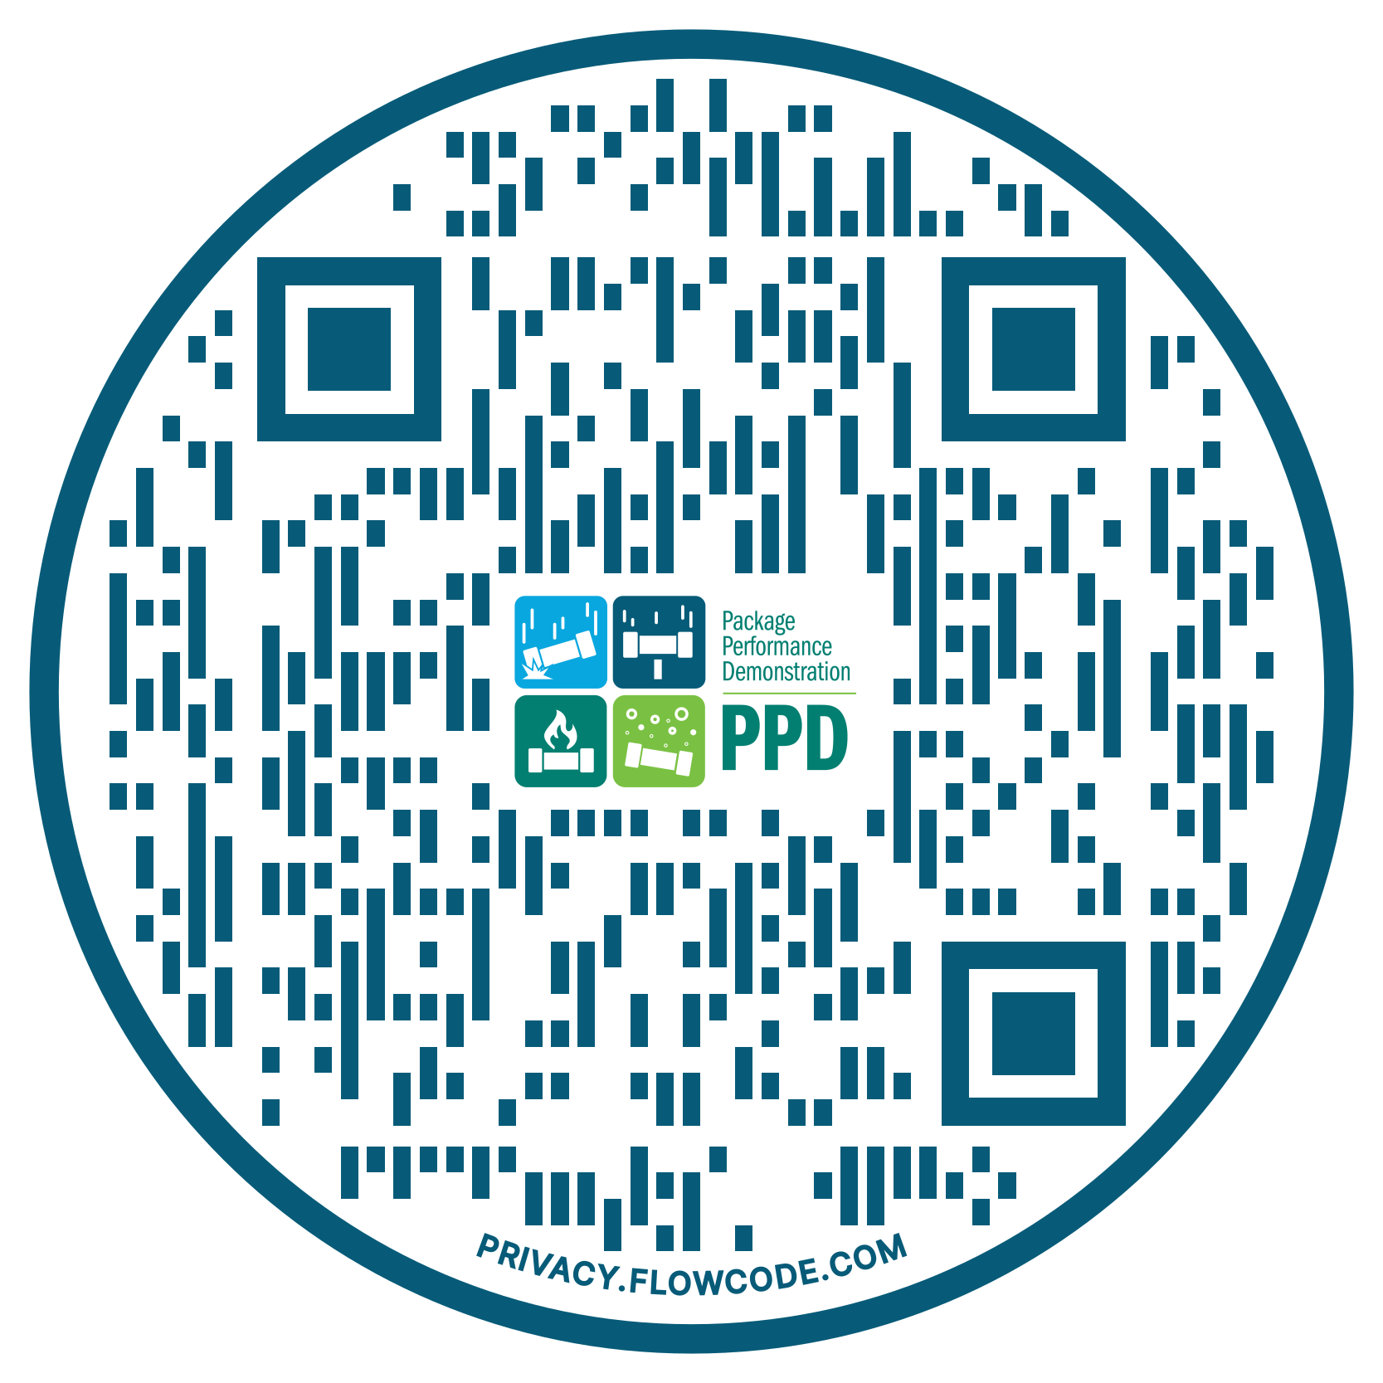
stay up to date on ppd
Subscribe to our email list for updates
Tune in to future DOE webinars and conference events
Learn more on our PPD information portal: https://curie.pnnl.gov/DOE-PPD
Respond to the RFI by October 31, 2024

Slide 18
Q&A

Slide 19
Thank you!
More info: https://curie.pnnl.gov/DOE-PPD
Submit questions to: DOE-PPD@id.doe.gov
Gerard.Jackson@nuclear.energy.gov Miriam.Juckett@pnnl.gov

