Slide 1
Office of Packaging & Transportation Overview for the
Northeast High-Level Radioactive Waste Transportation Task Force
Ellen Edge
TEPP and NTSF Lead, Office of Packaging & Transportation
October 23, 2024

Slide 2
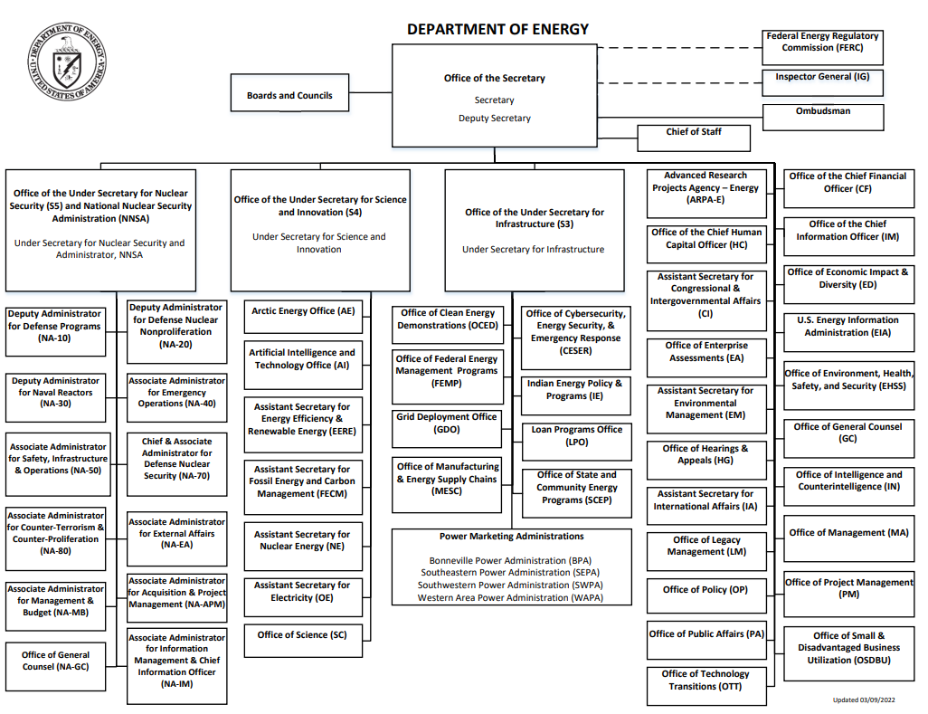

Slide 3
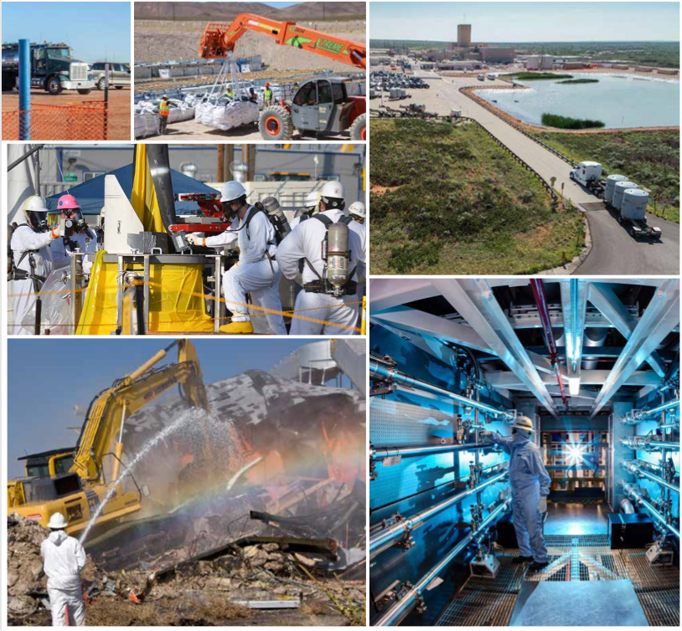
Environmental Management’s Mission
To complete the safe cleanup of the environmental legacy brought about from decades of nuclear weapons development and government-sponsored nuclear energy research. EM's priority is to ensure the safety and health of the public and EM's workforce while continuing to protect the environment.
Notes:
Photo Captions:
Moving waste that has been retried from burial grounds and placed in new drums for transport to above ground storage until it is disposed of at a compliant landfill or WIPP.
Tank waste at ORP
Hanford Plutonium Finishing Plant – a worker holds a plutonium button, which the size of a hockey puck during Cold War operations
K- area at the Savannah River Site where plutonium is now stored
A chemical separation facility at Hanford
Hanford U plant – historical photo

Slide 4
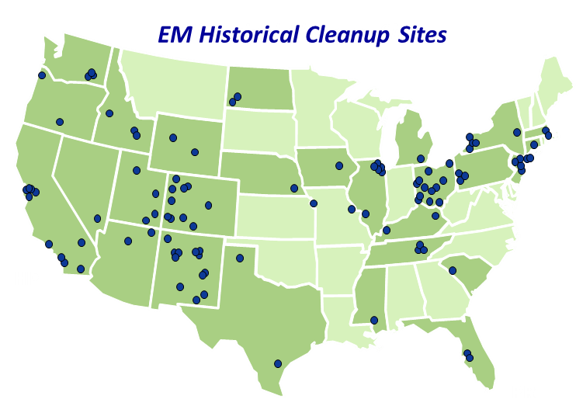
107 Original EM Cleanup Sites
End State Contracting Model
End State Contracting Model
EM Efforts under the Justice40 Initiative
Notes:
This is what are site map looked like when EM was established in 1989.

Slide 5
A Proven Record of Cleanup Results
15 Remaining Cleanup Sites
Washington
Hanford
Richland Operations Office
Office of River Protection
Idaho
Idaho National Laboratory
Idaho Cleanup Project
New York
EMCBC – New York Project Office
California
Lawrence Livermore
National Laboratory
Utah
Moab Site
Kentucky
Paducah
Portsmouth/Paducah
Project Office
New York
West Valley
Demonstration Project
End State Contracting Model
End State Contracting Model
EM Efforts under the Justice40 Initiative
Ohio
Portsmouth
Portsmouth/Paducah Project Office
Nevada
Nevada National
Security Site
EM Nevada
New Mexico
Sandia National Laboratory
South Carolina
Savannah River Site
Savannah River Operations Office
California
Energy Technology
Engineering Center
Tennessee
Oak Ridge Reservation
Oak Ridge Office of Environmental Management
New Mexico
Los Alamos National
Laboratory
EM Los Alamos Field Office
New Mexico
Waste Isolation Pilot Plant
Carlsbad Field Office
Since 1989, DOE has completed its cleanup mission at 92 of the 107 major nuclear weapons and nuclear research sites.
Notes:
This is our current site map with our remaining 15 sites.

Slide 6
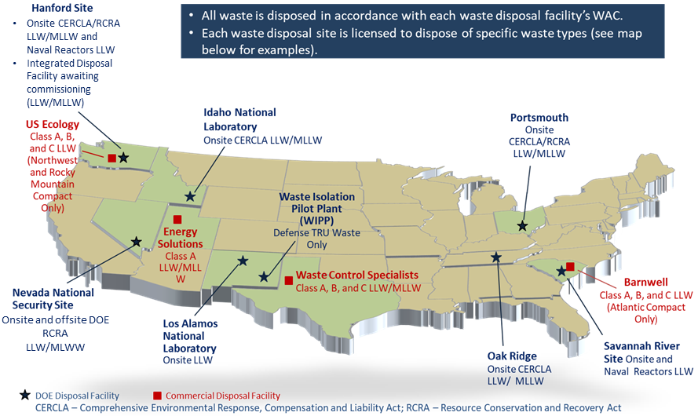
Operating DOE & Commercial Disposal Facilities

Slide 7
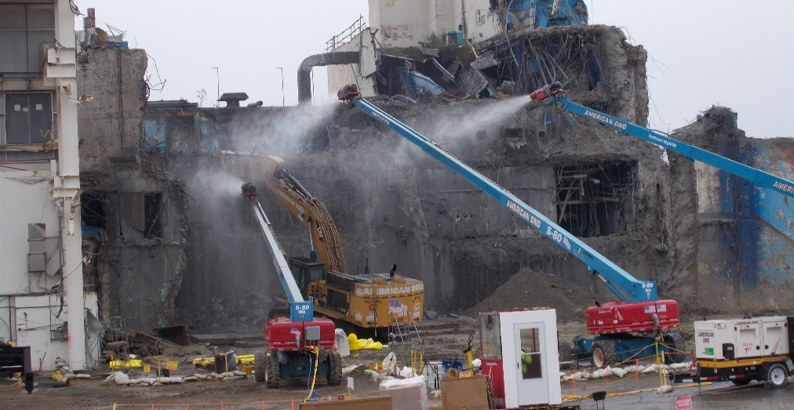
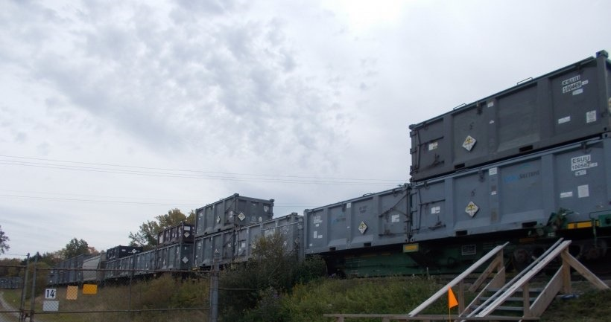
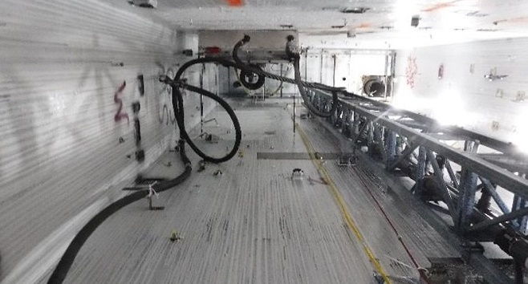
West Valley,
New York
West Valley Demonstration Project
Progress
Safely solidified 600,000 gallons of high-level liquid radioactive waste into 278 steel canisters, removed from the former reprocessing plant, loaded into 56 vertical storage casks, and stored onsite awaiting a final disposition path
Removed 69 buildings and shipped 2.8 million cubic feet of low-level waste off-site for disposal
Started the controlled demolition of the Main Plant Processing Building in September 2022
Notes:
Photo Caption
RIGHT: Workers take down a portion of a 5-foot-thick concrete wall of the Chemical Process Cell on the west side of the Main Plant Process Building at the West Valley Demonstration Project.
MIDDLE:
LEFT: A floor-to-ceiling view of the Product Purification Cell-South within the Main Plant Process Building at the West Valley Demonstration Project.
Regulatory Structure
EMCBC-NY complies with all federal and state regulations, including New York State Department of Environmental Conservation (NYSDEC). DOE submits annual reports to NYSDEC on progress to disposition suspect TRU waste, the last remaining piece of DOE completed field work and site restoration at the F-Yard located at the former research facility, SPRU. DOE has responsibilities for decommissioning the WVDP in accordance with criteria prescribed by the U.S. Nuclear Regulatory Commission, pursuant to the WVDP Act of 1980 (PL 96-368)
Progress
Safely solidified 600,000 gallons of high-level liquid radioactive waste into 278 steel canisters, removed them from the former reprocessing plant, loaded them into 56 vertical storage casks, and stored onsite awaiting a permanent repository
Removed 69 facilities no longer needed for current or future cleanup and shipped 2.8 million cubic feet of low-level waste off-site for disposal
Started the controlled demolition of the Main Plant Processing Building in September 2022
Upcoming Work
Complete the controlled demolition of the Main Plant Process Building and ship all the waste
Install polyethylene weather protective cover over the Main Plant concrete slab

Slide 8
West Valley,
New York
West Valley Demonstration Project
Upcoming Work:
Complete the controlled demolition of the Main Plant Process Building
Install polyethylene weather protective cover over the Main Plant concrete slab for added environmental protection
Notes:
Photo Caption
RIGHT: Workers take down a portion of a 5-foot-thick concrete wall of the Chemical Process Cell on the west side of the Main Plant Process Building at the West Valley Demonstration Project.
MIDDLE:
LEFT: A floor-to-ceiling view of the Product Purification Cell-South within the Main Plant Process Building at the West Valley Demonstration Project.
Regulatory Structure
EMCBC-NY complies with all federal and state regulations, including New York State Department of Environmental Conservation (NYSDEC). DOE submits annual reports to NYSDEC on progress to disposition suspect TRU waste, the last remaining piece of DOE completed field work and site restoration at the F-Yard located at the former research facility, SPRU. DOE has responsibilities for decommissioning the WVDP in accordance with criteria prescribed by the U.S. Nuclear Regulatory Commission, pursuant to the WVDP Act of 1980 (PL 96-368)
Progress
Safely solidified 600,000 gallons of high-level liquid radioactive waste into 278 steel canisters, removed them from the former reprocessing plant, loaded them into 56 vertical storage casks, and stored onsite awaiting a permanent repository
Removed 69 facilities no longer needed for current or future cleanup and shipped 2.8 million cubic feet of low-level waste off-site for disposal
Started the controlled demolition of the Main Plant Processing Building in September 2022
Upcoming Work
Complete the controlled demolition of the Main Plant Process Building and ship all the waste
Install polyethylene weather protective cover over the Main Plant concrete slab

Slide 9
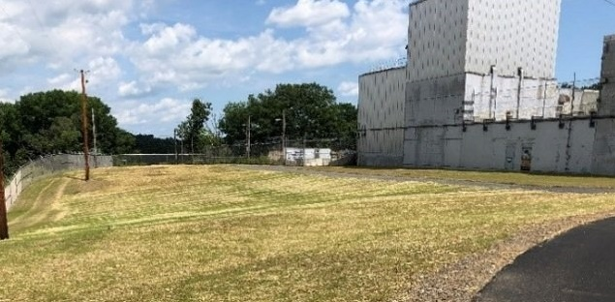
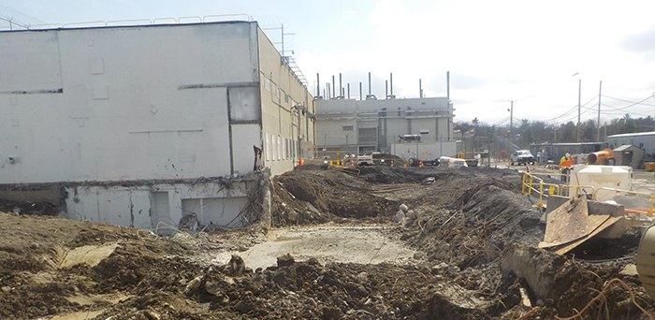
EMCBC-NY (formerly SPRU)
EMCBC-NY,
New York
Progress
Twenty-four containers of suspect transuranic (TRU) waste from the Separations Process Research Unit (SPRU) project are being evaluated for commercial characterization and processing.
Renamed the SPRU field office as the Environmental Management Consolidated Business Center (EMCBC) New York (NY) Project Support Office
8A Contractors are conducting decontamination and decommissioning work for Naval Reactors at Knolls Atomic Power Laboratory and Kesselring sites.
Notes:
Photo Caption:
LEFT: TRU Waste Storage at EMCBC-NY
MIDDLE: A view of the restored site of the former Building H2 at the former Separations Process Research Unit.
RIGHT: EM recently completed deactivation, decontamination, demolition, and site restoration at the Separations Process Research Unit (SPRU) nuclear facilities at the Knolls Atomic Power Laboratory.
Regulatory Structure
EMCBC-NY complies with all federal and state regulations, including New York State Department of Environmental Conservation (NYSDEC). DOE submits annual reports to NYSDEC on progress to disposition suspect TRU waste, the last remaining piece of DOE completed field work and site restoration at the F-Yard located at the former research facility, SPRU.
Progress
Twenty-four containers of suspect TRU waste from the SPRU project are being evaluated for commercial characterization and processing.
In 2022, DOE renamed the Separations Process Research Unit (SPRU) field office in Niskayuna New York as the Environmental Management Consolidated Business Center (EMCBC) New York (NY) Project Support Office, in order to reflect the office’s updated function as a DOE EMCBC support office. EMCBC-NY supports remediation of nuclear defense sites in New York.
8A Contractors are conducting D&D work for Naval Reactors at KAPL and Kesselring sites.
Upcoming Work
Future budget requests and carryover support continued storage and disposition of remaining suspect TRU waste.
Site to begin commercial processing of suspect TRU waste in FY2023/2024.
DOE-EM and Naval Reactors signed MOA for EM to conduct D&D and environmental remediation at Naval Nuclear Laboratory Sites.

Slide 10
EMCBC-NY (formerly SPRU)
EMCBC-NY,
New York
Upcoming Work
Future budget requests and carryover support continued storage and disposition of remaining suspect TRU waste
Site to begin commercial processing of suspect TRU waste in FY2023/2024.
EM and Naval Reactors signed memorandum of agreement for EM to conduct D&D and environmental remediation at Naval Nuclear Laboratory Sites.
Notes:
Photo Caption:
LEFT: TRU Waste Storage at EMCBC-NY
MIDDLE: A view of the restored site of the former Building H2 at the former Separations Process Research Unit.
RIGHT: EM recently completed deactivation, decontamination, demolition, and site restoration at the Separations Process Research Unit (SPRU) nuclear facilities at the Knolls Atomic Power Laboratory.
Regulatory Structure
EMCBC-NY complies with all federal and state regulations, including New York State Department of Environmental Conservation (NYSDEC). DOE submits annual reports to NYSDEC on progress to disposition suspect TRU waste, the last remaining piece of DOE completed field work and site restoration at the F-Yard located at the former research facility, SPRU.
Progress
Twenty-four containers of suspect TRU waste from the SPRU project are being evaluated for commercial characterization and processing.
In 2022, DOE renamed the Separations Process Research Unit (SPRU) field office in Niskayuna New York as the Environmental Management Consolidated Business Center (EMCBC) New York (NY) Project Support Office, in order to reflect the office’s updated function as a DOE EMCBC support office. EMCBC-NY supports remediation of nuclear defense sites in New York.
8A Contractors are conducting D&D work for Naval Reactors at KAPL and Kesselring sites.
Upcoming Work
Future budget requests and carryover support continued storage and disposition of remaining suspect TRU waste.
Site to begin commercial processing of suspect TRU waste in FY2023/2024.
DOE-EM and Naval Reactors signed MOA for EM to conduct D&D and environmental remediation at Naval Nuclear Laboratory Sites.

Slide 11
Office of Packaging and Transportation

Slide 12
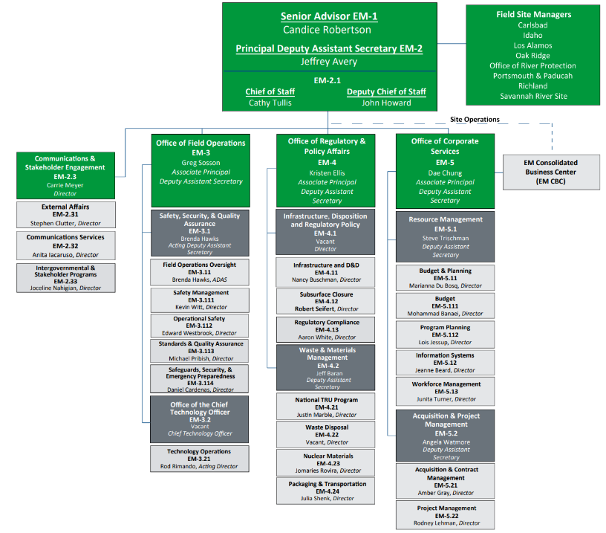
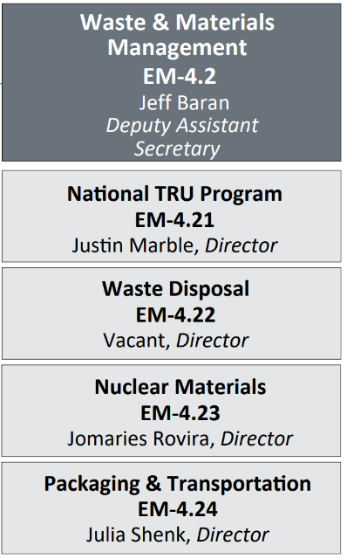


Slide 13
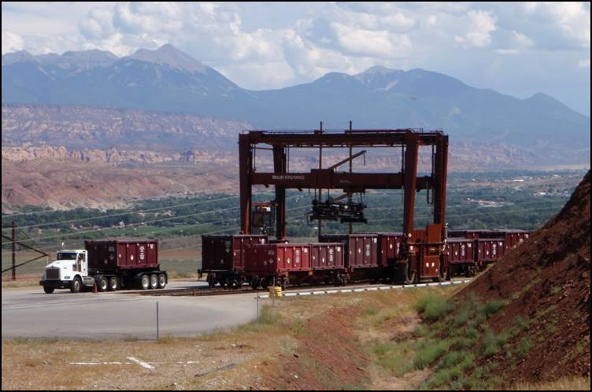
OPT Mission
The Office of Packaging and Transportation (OPT) protects people and the environment by ensuring safe, compliant and efficient packaging and transportation of materials. We achieve this mission by conducting packaging and transportation assessments and oversight; assisting field sites; and developing and managing policies, guidance and tools in accordance with DOE requirements and government regulations.

Slide 14
FY24 DOE Offsite HAZMAT Shipments by Program*
EM 1,623
NE 25
SC 1,045
NNSA 1,962
PMA 0**
Total 4,655
*Data Pulled before FY24 completion, in September, 2024

Slide 15
FY24 EM Offsite HAZMAT Shipments
Waste 474
Non-Waste 1,158
Total 1,632**
**One shipment may contain both waste and non-waste
*Data Pulled before FY24 completion, in September, 2024

Slide 16
FY24 EM Offsite HAZMAT Waste Materials* Shipped
LLW 155
MLLW 18
TRU 186
Other 180
Total Waste 539**
Materials
**One shipment may contain multiple materials
*Data Pulled before FY24 completion, in September, 2024
Notes:
Other Breakdown:
HRCQ: 65
RCRA: 103
SNF: 0
SNM: 6
HLW: 0
TSCA: 6
NonReg 0
* One ‘Other’ may contain multiple materials

Slide 17
OPT Key Programs & Responsibilities
  Compliance and safety
  Motor Carrier Evaluation Program (MCEP); 30+ carriers
  Transportation Compliance Assurance Program (TCAP) for DOE sites
Packaging Certification Program (PCP)
  Supported by specialized teams at DOE National Laboratories
  Type B package Certificates of Compliance and revisions
  Accredited, graduate-level courses in packaging and transportation
  RFID technology and transportation security innovations
Partner engagement and training
  Transportation Emergency Preparedness Program (TEPP)
  National Transportation Stakeholders Forum (NTSF)

Slide 18
OPT Key Programs & Responsibilities
Transportation planning and management tools
  ATLAS – transportation management
  RadAnalysis (formerly RADCALC) – shipping calculations
  TRAGIS – transportation routing
  Field support
  Program support for site transportation managers
  Transportation Management Council; Packaging Management Council
  Policy and regulatory support
  DOE Orders 460.1 and 460.2
  Primary interface with other federal agencies on transportation matters

Slide 19
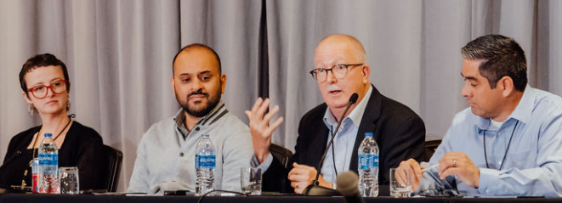
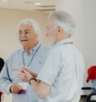
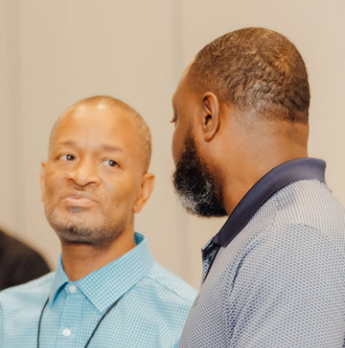
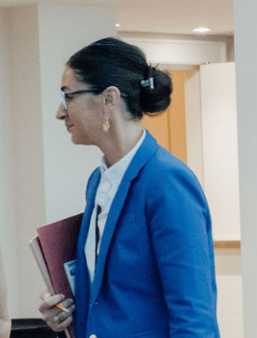

National Transportation Stakeholders Forum (NTSF)
  DOE’s primary mechanism to communicate with States and Tribes about shipments of radioactive material
  EM solicits State and Tribal input for shipment planning and execution
  Chaired by EM-OPT

Slide 20
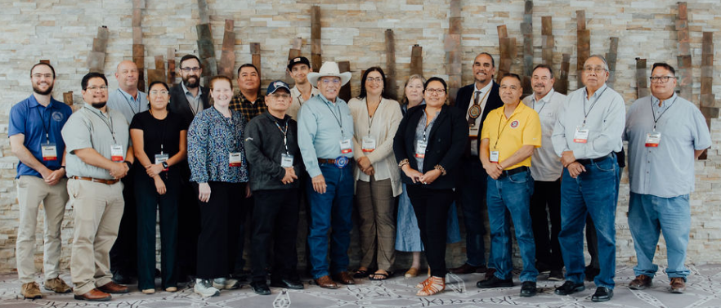
National Transportation Stakeholders Forum (NTSF)
  OPT provides funding for NTSF with additional funding and participation from the Office of Nuclear Energy (NE)
  Cooperative agreements with four State Regional Groups (SRGs) and the Tribal Radioactive Materials Transportation Committee (TRMTC)
  Annual meetings are hosted in rotation among the SRGs and TRMTC.
  Public website: https://www.ntsf.info/
TRMTC hosted the 2024 Annual Meeting in Denver, CO.
Notes:
2024 annual meeting was hosted by TRMTC in Denver, CO
2025 annual meeting will be hosted by WIEB in

Slide 21
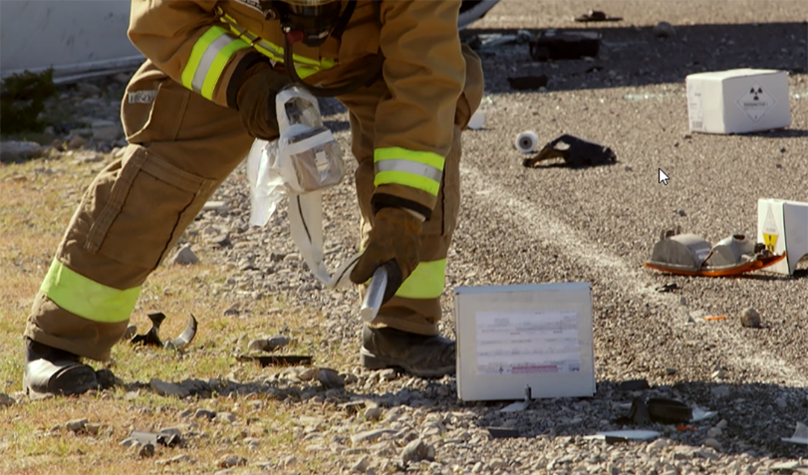
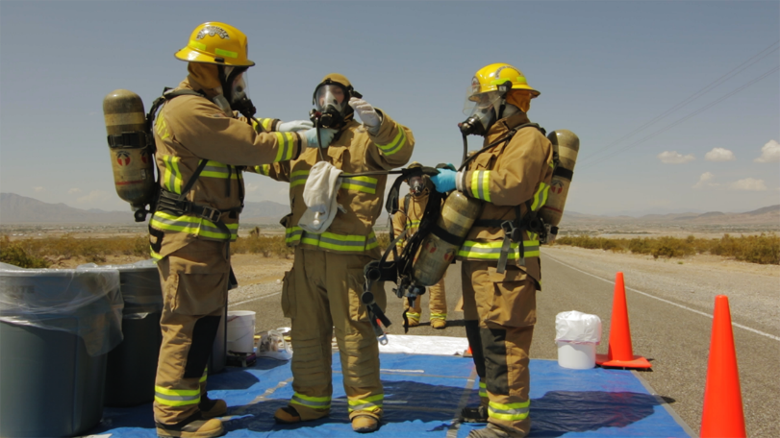
Transportation Emergency Preparedness Program (TEPP)
  Provides tools for planning, training and exercises, and technical assistance to State and Tribal authorities to prepare for transportation incidents involving DOE radioactive material shipments
  First responder training provided at no cost to jurisdictions along DOE shipping routes
  FY24 training conducted in 20 states
    2140 students, 136 courses

Slide 22
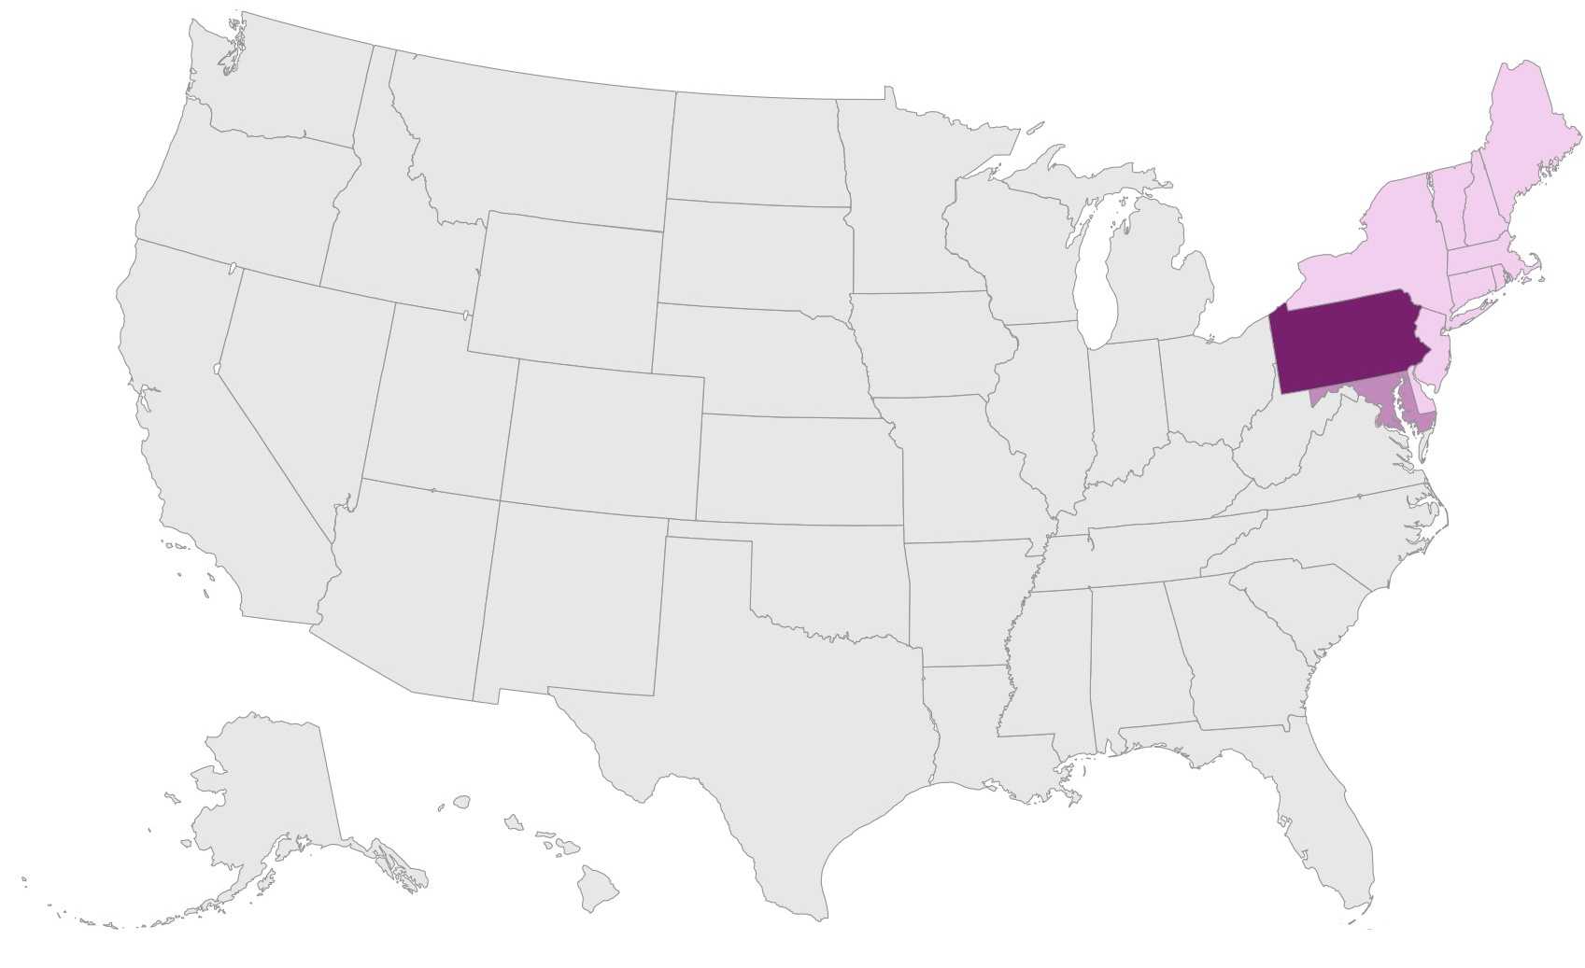
TEPP Training in the Northeast
Connecticut | 0
Delaware | 0
Maine | 0
Maryland | 98
Massachusetts | 0
New Hampshire | 0
New Jersey | 0
New York | 0
Pennsylvania | 248
Rhode Island | 0
Vermont | 0

Slide 23

Contacts
Julia Shenk
Director/NTSF Chair
301-903-1388
julia.shenk@em.doe.gov
Ellen Edge
TEPP manager/NTSF lead
301-903-8327
ellen.edge@em.doe.gov
AskPAT@hq.doe.gov

Slide 24
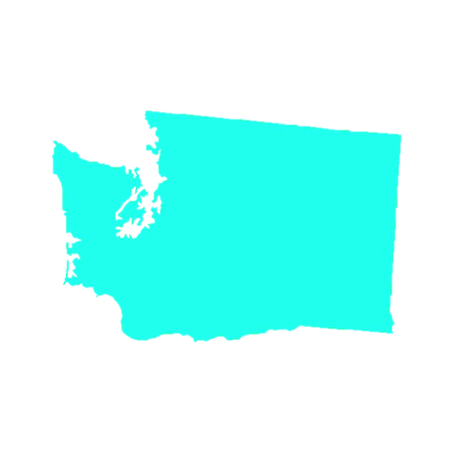
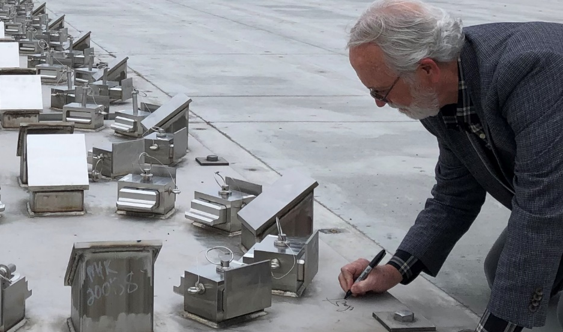
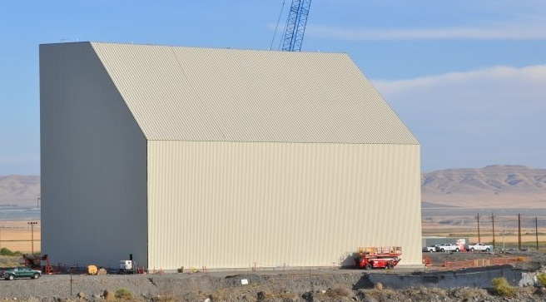
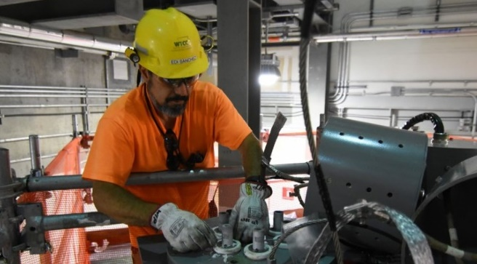
Hanford
Hanford, Washington
Progress
Tank-Side Cesium Removal System (TSCR) operations.
Protective enclosure, or “cocoon,” around K East Reactor.
Construction of new water treatment plant.
24
Notes:
Photo Captions:
LEFT: Workers with EM contractor Central Plateau Cleanup Company recently completed construction of a protective enclosure, or cocoon, over the former K East Reactor building. The cocoon is designed to protect the reactor building while the radioactivity in the deactivated reactor core decays over the next several decades, making it safer to complete disposition of the reactor in the future
MIDDLE: A Hanford electrician assembles temporary heaters that started up the first Melter at the Waste Treatment and Immobilization Plant.
RIGHT: U.S. Representative Dan Newhouse signs his name on the base of the TSCR Ion Exchange Column Storage Pad.
Regulatory Structure
Hanford complies with all state and federal regulations. The Hanford Federal Facility Agreement and Consent Order, also known as the Tri-Party Agreement, provides the legal framework for Hanford cleanup.
Progress
Began first large-scale industrial treatment of waste from large underground storage tanks with start of Tank-Side Cesium Removal (TSCR) System operations. TSCR supports the treatment and disposal of the 56 million gallons of chemical and radioactive waste stored in the Hanford Site’s 177 underground tanks.
Completed construction of protective enclosure, or “cocoon,” around K East Reactor. The K West Reactor is next and final reactor at the site to be cocooned.
Began construction of new water treatment plant in overall effort to optimize infrastructure required to support site cleanup objectives in future.
Upcoming Work
Progress Direct-Feed Low-Activity Waste (DFLAW) commissioning activities for the Waste Treatment Plant (WTP) Low-Activity Waste (LAW) Facility by heating up and commissioning the facility’s two large melters.
Complete Liquid Effluent Retention Facility (LERF) and Effluent Treatment Facility (ETF) upgrades to support DFLAW hot commissioning — 2023
Complete the characterization, dewatering, and grouting of the K West Basin

Slide 25
Hanford
Hanford, Washington
Upcoming Work
Direct-Feed Low-Activity Waste commissioning activities for the Waste Treatment Plant Low-Activity Waste Facility
Upgrades at the Liquid Effluent Retention Facility and Effluent Treatment Facility
Complete characterization, dewatering, and grouting of the K West Basin
25
Notes:
Photo Captions:
LEFT: Workers with EM contractor Central Plateau Cleanup Company recently completed construction of a protective enclosure, or cocoon, over the former K East Reactor building. The cocoon is designed to protect the reactor building while the radioactivity in the deactivated reactor core decays over the next several decades, making it safer to complete disposition of the reactor in the future
MIDDLE: A Hanford electrician assembles temporary heaters that started up the first Melter at the Waste Treatment and Immobilization Plant.
RIGHT: U.S. Representative Dan Newhouse signs his name on the base of the TSCR Ion Exchange Column Storage Pad.
Regulatory Structure
Hanford complies with all state and federal regulations. The Hanford Federal Facility Agreement and Consent Order, also known as the Tri-Party Agreement, provides the legal framework for Hanford cleanup.
Progress
Began first large-scale industrial treatment of waste from large underground storage tanks with start of Tank-Side Cesium Removal (TSCR) System operations. TSCR supports the treatment and disposal of the 56 million gallons of chemical and radioactive waste stored in the Hanford Site’s 177 underground tanks.
Completed construction of protective enclosure, or “cocoon,” around K East Reactor. The K West Reactor is next and final reactor at the site to be cocooned.
Began construction of new water treatment plant in overall effort to optimize infrastructure required to support site cleanup objectives in future.
Upcoming Work
Progress Direct-Feed Low-Activity Waste (DFLAW) commissioning activities for the Waste Treatment Plant (WTP) Low-Activity Waste (LAW) Facility by heating up and commissioning the facility’s two large melters.
Complete Liquid Effluent Retention Facility (LERF) and Effluent Treatment Facility (ETF) upgrades to support DFLAW hot commissioning — 2023
Complete the characterization, dewatering, and grouting of the K West Basin

Slide 26
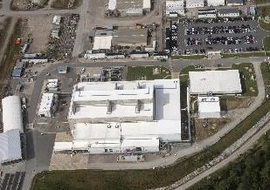
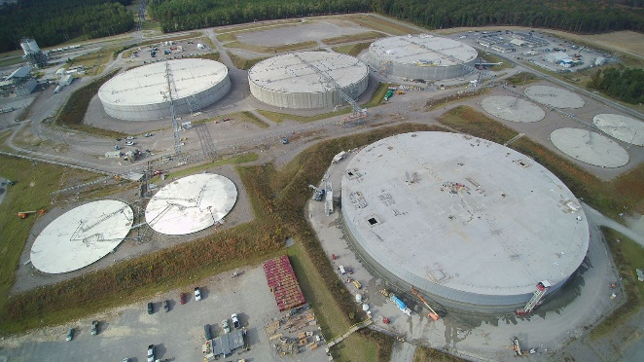
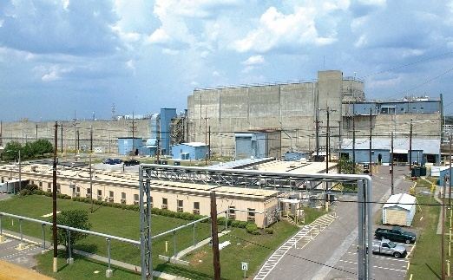
Savannah River Site
Aiken, SC
Progress
Processed approximately 7 million gallons of waste at the Salt Waste Processing Facility (SWPF) in just over 3 years of operation.
Completed construction of Saltstone Disposal Unit (SDU) 8.
Notes:
Photo Captions:
LEFT: Salt Waste Processing Facility (SWPF)
MIDDLE: Saltstone Disposal Units (SDU)
RIGHT: H Canyon
Regulatory Structure
SRS complies with all federal and state regulations, including those of the U.S. Environmental Protection Agency, the South Carolina Division Health and Environmental Control, the Nuclear Regulatory Commission, and the U.S. Department of Transportation.
Progress
Processed approximately 7 million gallons of waste at the Salt Waste Processing Facility (SWPF) in just over 3 years of operation.
Completed construction of Saltstone Disposal Unit (SDU) 8.
Began acceptance of highly enriched uranium-235 from L-Basin as part of the Accelerated Basin De-Inventory campaign.
Transition primary authority for the Savannah River Site from EM to NNSA.

Slide 27
Savannah River Site
Aiken, SC
Progress
Began acceptance of highly enriched uranium-235 from L-Basin as part of the Accelerated Basin De-Inventory campaign.
Transition primary authority for the Savannah River Site from EM to National Nuclear Security Administration.
Notes:
Photo Captions:
LEFT: Salt Waste Processing Facility (SWPF)
MIDDLE: Saltstone Disposal Units (SDU)
RIGHT: H Canyon
Regulatory Structure
SRS complies with all federal and state regulations, including those of the U.S. Environmental Protection Agency, the South Carolina Division Health and Environmental Control, the Nuclear Regulatory Commission, and the U.S. Department of Transportation.
Progress
Processed approximately 7 million gallons of waste at the Salt Waste Processing Facility (SWPF) in just over 3 years of operation.
Completed construction of Saltstone Disposal Unit (SDU) 8.
Began acceptance of highly enriched uranium-235 from L-Basin as part of the Accelerated Basin De-Inventory campaign.
Transition primary authority for the Savannah River Site from EM to NNSA.

Slide 28
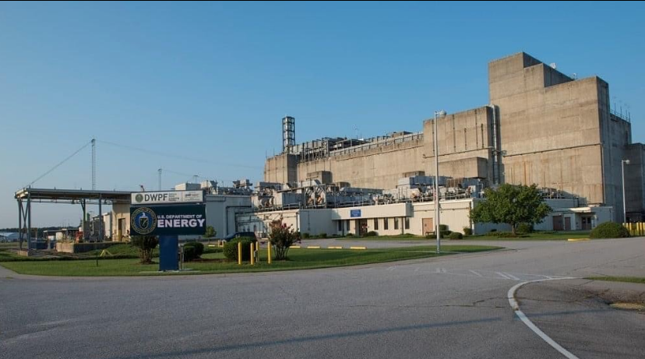
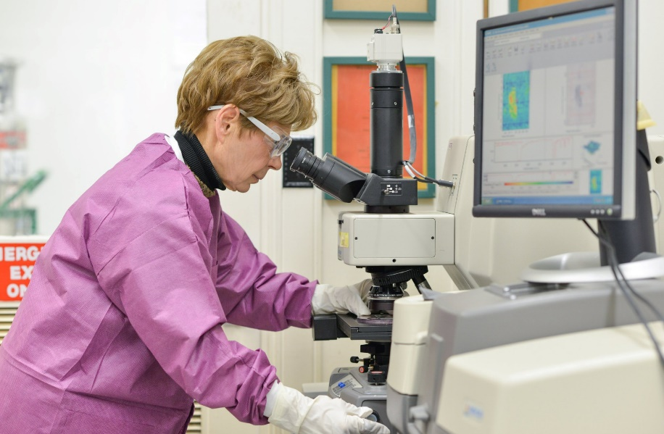
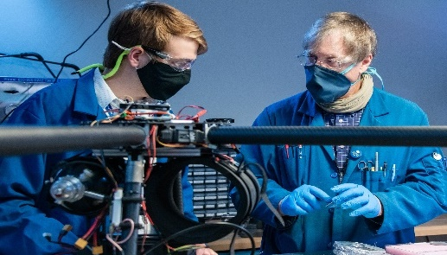
Savannah River National Laboratory
Progress
Crews placed the last piece of structural steel on the 60,000-square feet Advanced Manufacturing Collaborative being constructed on the University of South Carolina-Aiken campus. The 60,000-square-foot facility will provide a new laboratory, office, and conference space suitable for advanced manufacturing research and development.
Notes:
Photo Captions:
LEFT: SRNL researchers led extensive materials compatibility testing coupled and innovative equipment design to establish SRS’s Defense Waste Processing Facility, the only radioactive waste vitrification facility in the nation.
MIDDLE: SRNL Researcher Christine Langton
RIGHT: SRNL Drone Lab
Regulatory Structure
The Savannah River National Laboratory (SRNL) is the applied research and development laboratory at the SRS Site.
Progress
Crews placed the last piece of structural steel on the 60,000-square feet Advanced Manufacturing Collaborative being constructed on the University of South Carolina-Aiken campus. The 60,000-square-foot facility will provide a new laboratory, office, and conference space suitable for advanced manufacturing research and development.
SRNL completed the installation of the Advanced Long Tern Environmental Monitoring System (ALTEMIS) sensor network in the F-Area Seepage Basin for long-term monitoring and data collection, a system designed to move from reactive to proactive monitoring at SRS.

Slide 29
Savannah River National Laboratory
Progress
SRNL completed the installation of the Advanced Long Tern Environmental Monitoring System (ALTEMIS) sensor network in the F-Area Seepage Basin for long-term monitoring and data collection, a system designed to move from reactive to proactive monitoring at Savannah River Site.
Notes:
Photo Captions:
LEFT: SRNL researchers led extensive materials compatibility testing coupled and innovative equipment design to establish SRS’s Defense Waste Processing Facility, the only radioactive waste vitrification facility in the nation.
MIDDLE: SRNL Researcher Christine Langton
RIGHT: SRNL Drone Lab
Regulatory Structure
The Savannah River National Laboratory (SRNL) is the applied research and development laboratory at the SRS Site.
Progress
Crews placed the last piece of structural steel on the 60,000-square feet Advanced Manufacturing Collaborative being constructed on the University of South Carolina-Aiken campus. The 60,000-square-foot facility will provide a new laboratory, office, and conference space suitable for advanced manufacturing research and development.
SRNL completed the installation of the Advanced Long Tern Environmental Monitoring System (ALTEMIS) sensor network in the F-Area Seepage Basin for long-term monitoring and data collection, a system designed to move from reactive to proactive monitoring at SRS.

Slide 30
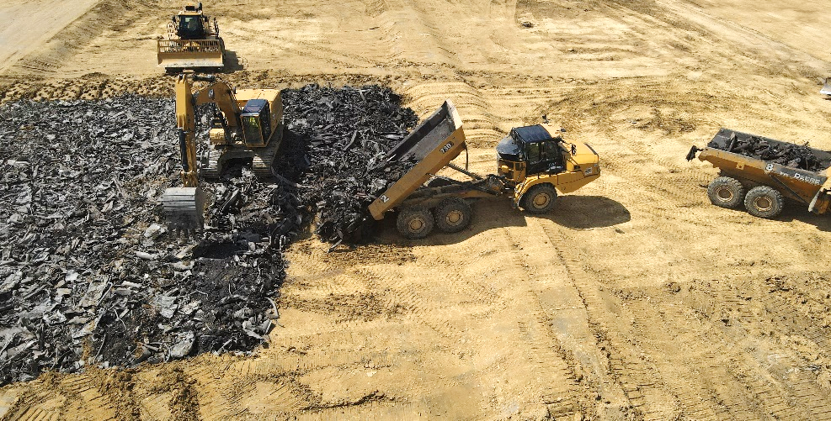
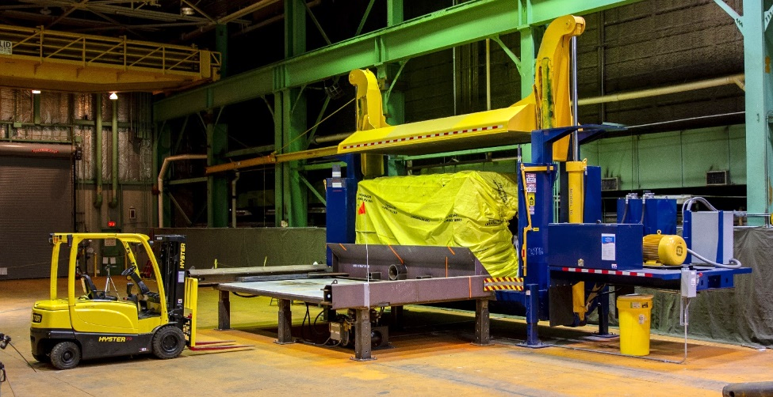
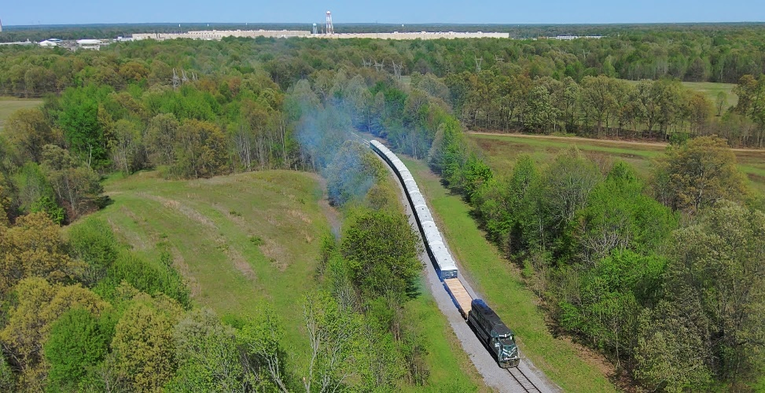
Portsmouth/Paducah Project Office (PPPO)
Progress
Portsmouth - completed waste placement of 163K cubic yards from the demolition of X-326 Process Building in the On-site Waste Disposal Facility (22 months ahead of schedule and $30M under budget)
Paducah - removed an additional 1M pounds of hazardous R-114 Refrigerant from the site; began converter segmentation and bundle crushing for the C-333 process building deactivation
Portsmouth,
OH
Lexington, KY
Paducah,
KY
Notes:
Photo Captions:
LEFT: In Portsmouth, final waste placement of X-326 process building debris in the Onsite Waste Disposal Facility was completed in 2023.
MIDDLE: The Paducah site has begun bundle crushing activities to support the C-333 process building deactivation.
RIGHT: The first major shipment of depleted uranium oxide for disposal departed EM’s Paducah Site in Kentucky recently and arrived safely a few days later at its destination in Texas.
Regulatory Structure
Portsmouth is governed by RCRA and Paducah by RCRA, Comprehensive Environmental Response, Compensation, and Liability Act (CERCLA), and a Federal Facility Agreement.
Progress
Portsmouth - completed waste placement of 163K cubic yards from the demolition of X-326 Process Building in the On-site Waste Disposal Facility (22 months ahead of schedule and $30M under budget)
Paducah - removed an additional 1M pounds of hazardous R-114 Refrigerant from the site; began converter segmentation and bundle crushing for the
C-333 process building deactivation
Paducah and Portsmouth - began the first offsite shipment of depleted uranium hexafluoride (DUF6) from both sites’ DUF6 conversion plants via multi-car rail shipments for disposal at a licensed facility
Upcoming Work
Portsmouth and Paducah - work toward advancing deactivation and demolition projects at both sites to transfer land back to the community for future reuse

Slide 31
Portsmouth/Paducah Project Office (PPPO)
Progress
Paducah and Portsmouth - began the first offsite shipment of depleted uranium hexafluoride (DUF6) from both sites’ DUF6 conversion plants via multi-car rail shipments for disposal at a licensed facility
Upcoming Work
Portsmouth and Paducah - work toward advancing deactivation and demolition projects at both sites to transfer land back to the community for future reuse
Portsmouth,
OH
Lexington, KY
Paducah,
KY
Notes:
Photo Captions:
LEFT: In Portsmouth, final waste placement of X-326 process building debris in the Onsite Waste Disposal Facility was completed in 2023.
MIDDLE: The Paducah site has begun bundle crushing activities to support the C-333 process building deactivation.
RIGHT: The first major shipment of depleted uranium oxide for disposal departed EM’s Paducah Site in Kentucky recently and arrived safely a few days later at its destination in Texas.
Regulatory Structure
Portsmouth is governed by RCRA and Paducah by RCRA, Comprehensive Environmental Response, Compensation, and Liability Act (CERCLA), and a Federal Facility Agreement.
Progress
Portsmouth - completed waste placement of 163K cubic yards from the demolition of X-326 Process Building in the On-site Waste Disposal Facility (22 months ahead of schedule and $30M under budget)
Paducah - removed an additional 1M pounds of hazardous R-114 Refrigerant from the site; began converter segmentation and bundle crushing for the
C-333 process building deactivation
Paducah and Portsmouth - began the first offsite shipment of depleted uranium hexafluoride (DUF6) from both sites’ DUF6 conversion plants via multi-car rail shipments for disposal at a licensed facility
Upcoming Work
Portsmouth and Paducah - work toward advancing deactivation and demolition projects at both sites to transfer land back to the community for future reuse

Slide 32
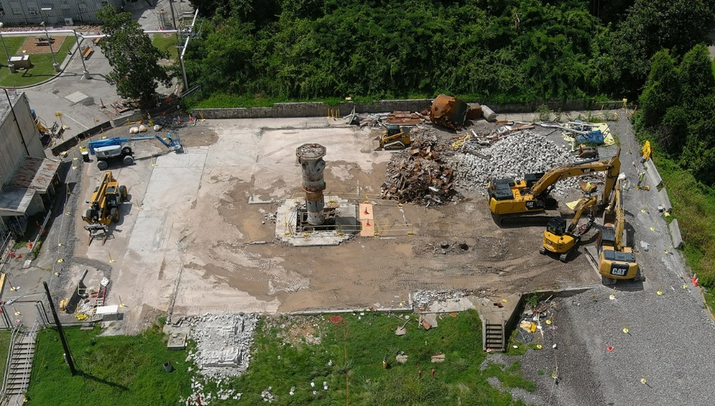
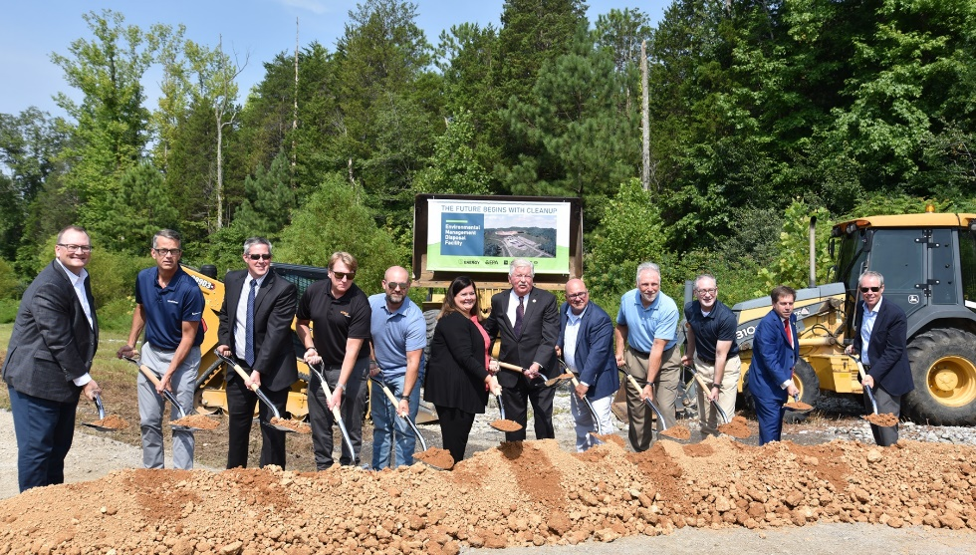
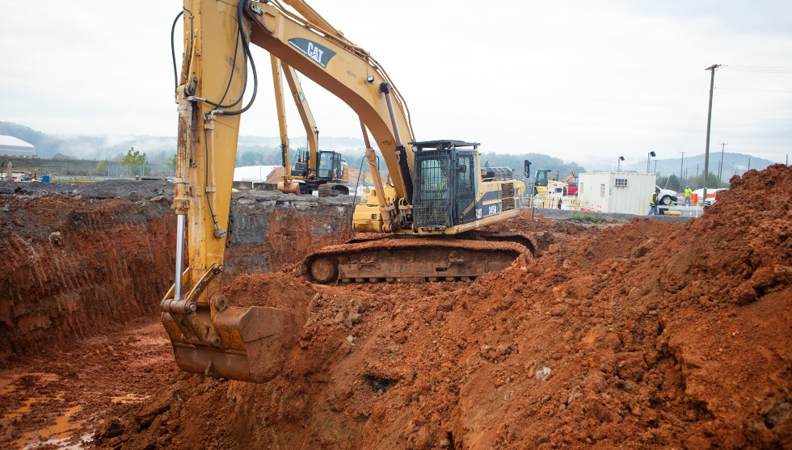
Oak Ridge
Oak Ridge, Tennessee
Progress
Finished demolition on two former reactor facilities in the heart of ORNL.
Processing and disposing of the high dose inventory of U-233 stored at ORNL.
Initiated early site preparations for the Environmental Management Disposal Facility.
Notes:
Photo Captions
LEFT: Low Intensity Test Reactor demolition.
MIDDLE: Leaders shovel the first scoops of dirt for the new EMDF project.
RIGHT: OREM has completed 40% of all federal facility remedial actions in the U.S. EPA’s Region 4 since 2018. These tasks are eliminating risks to the environment. Workers are pictured conducting soil remediation projects at the East Tennessee Technology Park. That work is scheduled for completion in 2024.
Regulatory Structure
Cleanup under CERCLA and a Federal Facility Agreement
Progress
Finished demolition on two former reactor facilities in the heart of ORNL.
Processing and disposing of the high dose inventory of U-233 stored at ORNL.
Initiated early site preparations for the Environmental Management Disposal Facility
Upcoming Work
Begin demolition on Alpha-2, a former Manhattan Project enrichment facility, at Y-12.
Finish soil remediation at the East Tennessee Technology Park.

Slide 33
Oak Ridge
Oak Ridge, Tennessee
Upcoming Work
Begin demolition on Alpha-2, a former Manhattan Project enrichment facility, at Y-12.
Finish soil remediation at the East Tennessee Technology Park.
Notes:
Photo Captions
LEFT: Low Intensity Test Reactor demolition.
MIDDLE: Leaders shovel the first scoops of dirt for the new EMDF project.
RIGHT: OREM has completed 40% of all federal facility remedial actions in the U.S. EPA’s Region 4 since 2018. These tasks are eliminating risks to the environment. Workers are pictured conducting soil remediation projects at the East Tennessee Technology Park. That work is scheduled for completion in 2024.
Regulatory Structure
Cleanup under CERCLA and a Federal Facility Agreement
Progress
Finished demolition on two former reactor facilities in the heart of ORNL.
Processing and disposing of the high dose inventory of U-233 stored at ORNL.
Initiated early site preparations for the Environmental Management Disposal Facility
Upcoming Work
Begin demolition on Alpha-2, a former Manhattan Project enrichment facility, at Y-12.
Finish soil remediation at the East Tennessee Technology Park.

Slide 34
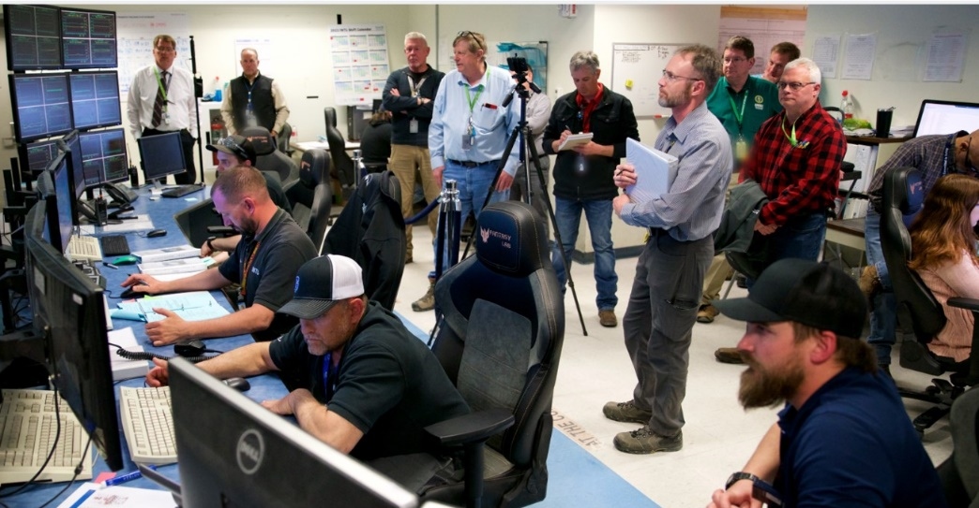
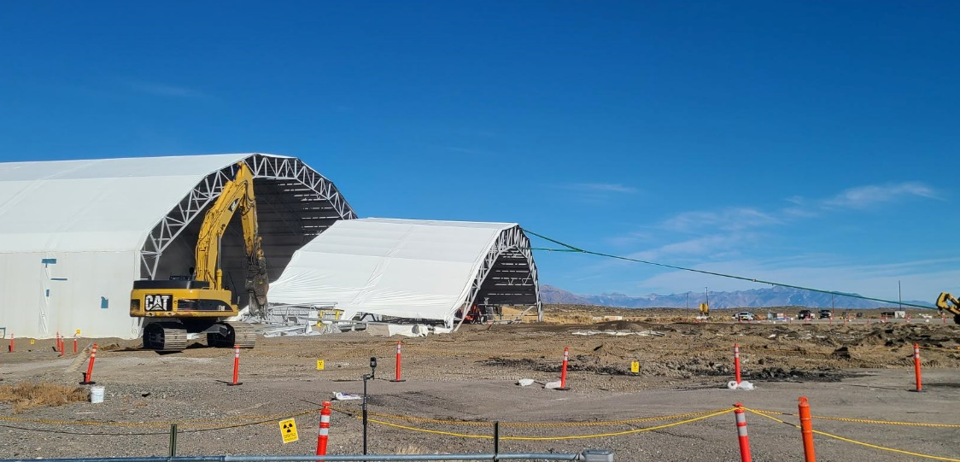
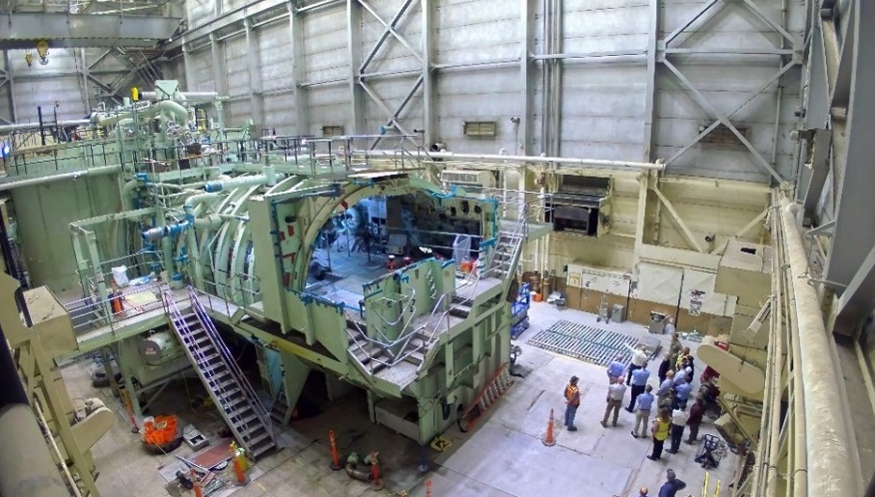
Idaho Cleanup Project
Idaho Falls,
Idaho
Progress
Started radiological operations at the Integrated Waste Treatment Unit processing over 68K Gallons of Sodium Bearing Waste
Decontamination and demolition (D&D) four Accelerated Retrieval Project (ARP) structures in preparation for the construction of the Subsurface Disposal Area (SDA) cap
Completed 48% of D&D of the S1W facility and commenced D&D activities at A1W
Completed transfer for all SNF from wet to dry storage
Notes:
Photo Captions: new photos?!
RIGHT: The Integrated Waste Treatment Unit begins processing radioactive, liquid waste on April 11, 2023.
MIDDLE: Final demolition of the Accelerated Retrieval Project II facility at the Subsurface Disposal Area.
LEFT: Decontamination and demolition of the S1W Naval Reactor prototype facility showing the removal of the upper engine room hull and equipment dismantlement.
Regulatory Structure
Cleanup governed by RCRA, CERCLA, and a 1995 Idaho Settlement Agreement/2019 Supplemental Agreement. ICP complies with all federal and state regulations, including those of the Idaho Department of Environmental Quality, the Nuclear Regulatory Commission, and the Environmental Protection Agency.
Progress
RWMC:
Completed D&D on 4 ARP structures in the past 2 years, 2 other structures underwent D&D in previous years
Completed a 17-year effort that retrieved more than 10,300 cubic meters of targeted buried waste from 5.69 acres within the Subsurface Disposal Area
Completed a 15-year effort to retrieve and package 65,000 cubic meters of legacy TRU waste at the Advanced Mixed Waste Treatment Project
Continuing shipment of packaged TRU waste to WIPP to meet settlement agreement requirements
INTEC:
Processed over 68K of 300K gallons of Sodium Bearing Waste
Completed transfer all SNF from wet to dry storage
Navy: Completed 48% of D%D of the S1W facility; Commenced D&D activities at A1W
Contract Management: Awarded 7 Task Orders under the End State Contract Model
Upcoming Work:
RWMC
Decontamination and Demolition of buried waste exhumation facilities at the Radioactive Waste Management Complex
Construction of evapotranspiration cap over the SDA
Finish shipping waste to WIPP
INTEC
Complete ICDF expansion construction to support planned D&D efforts
Finish processing sodium bearing waste and close the tank farm (4 remaining tanks)
Begin packaging SNF into road ready containers – planning underway for packaging demonstration and use of Navy facilities
Progress critical decisions for Calcine Disposition Project and Spent Fuel Staging Facility
Navy
Finish D&D efforts at prototype facilities

Slide 35
Idaho Cleanup Project
Idaho Falls,
Idaho
Upcoming Work:
Complete D&D of three remaining ARP structures and begin
  construction of SDA Cap
Finish construction of the Idaho CERCLA Disposal Facility expansion
Complete processing of sodium-bearing waste and close Idaho Nuclear Technical and Engineering Center tank farm facilities
Begin packaging spent nuclear fuel into road ready containers
Complete D&D of the S1W, S1W and S5G prototype reactors
Notes:
Photo Captions: new photos?!
RIGHT: The Integrated Waste Treatment Unit begins processing radioactive, liquid waste on April 11, 2023.
MIDDLE: Final demolition of the Accelerated Retrieval Project II facility at the Subsurface Disposal Area.
LEFT: Decontamination and demolition of the S1W Naval Reactor prototype facility showing the removal of the upper engine room hull and equipment dismantlement.
Regulatory Structure
Cleanup governed by RCRA, CERCLA, and a 1995 Idaho Settlement Agreement/2019 Supplemental Agreement. ICP complies with all federal and state regulations, including those of the Idaho Department of Environmental Quality, the Nuclear Regulatory Commission, and the Environmental Protection Agency.
Progress
RWMC:
Completed D&D on 4 ARP structures in the past 2 years, 2 other structures underwent D&D in previous years
Completed a 17-year effort that retrieved more than 10,300 cubic meters of targeted buried waste from 5.69 acres within the Subsurface Disposal Area
Completed a 15-year effort to retrieve and package 65,000 cubic meters of legacy TRU waste at the Advanced Mixed Waste Treatment Project
Continuing shipment of packaged TRU waste to WIPP to meet settlement agreement requirements
INTEC:
Processed over 68K of 300K gallons of Sodium Bearing Waste
Completed transfer all SNF from wet to dry storage
Navy: Completed 48% of D%D of the S1W facility; Commenced D&D activities at A1W
Contract Management: Awarded 7 Task Orders under the End State Contract Model
Upcoming Work:
RWMC
Decontamination and Demolition of buried waste exhumation facilities at the Radioactive Waste Management Complex
Construction of evapotranspiration cap over the SDA
Finish shipping waste to WIPP
INTEC
Complete ICDF expansion construction to support planned D&D efforts
Finish processing sodium bearing waste and close the tank farm (4 remaining tanks)
Begin packaging SNF into road ready containers – planning underway for packaging demonstration and use of Navy facilities
Progress critical decisions for Calcine Disposition Project and Spent Fuel Staging Facility
Navy
Finish D&D efforts at prototype facilities
CERCLA: Comprehensive Environmental Response, Compensation, and Liability Act of 1980

Slide 36
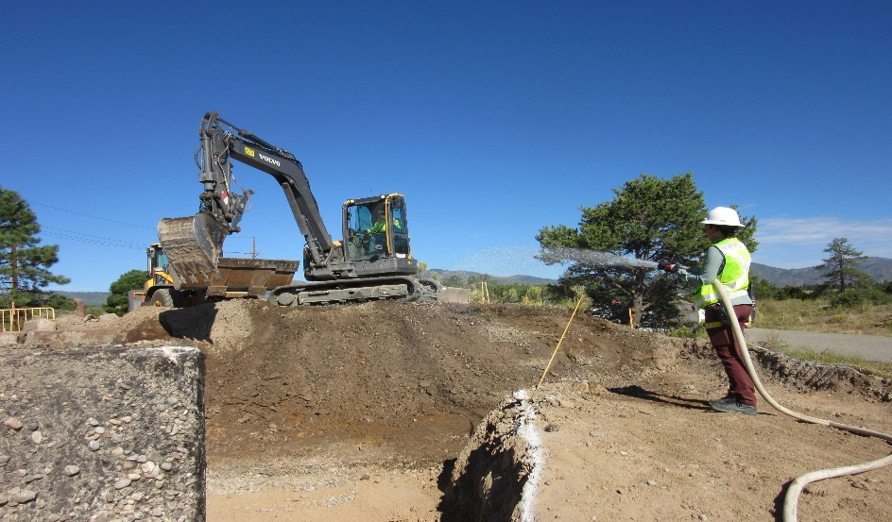
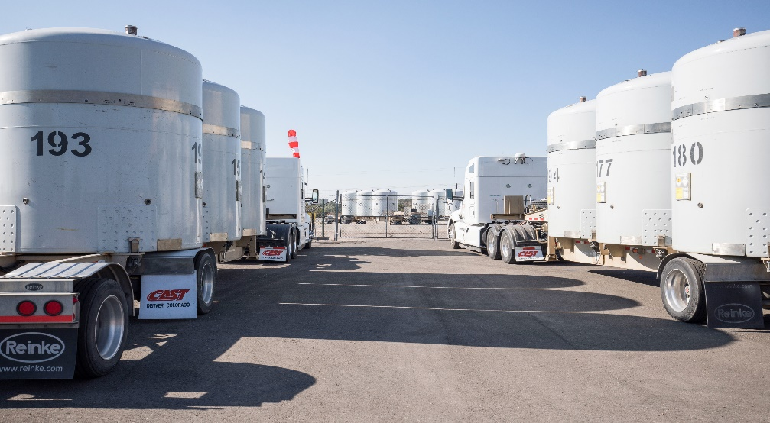
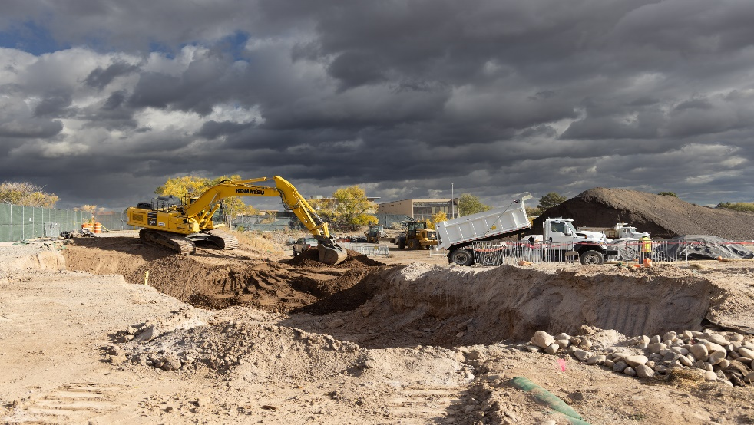
Los Alamos
Los Alamos
Los Alamos,
New Mexico
Progress
Exceeded EM goal for transuranic waste shipments to Waste Isolation Pilot Plant for the last 3 years
Finished investigation and soil remediation for 2 legacy cleanup campaigns
Completed field work for Middle DP Road Site – a key cleanup project for Los Alamos County economic development
Implemented EM Los Alamos Field Office Strategic Vision initiative to obtain input from pueblos, stakeholders and the public for remaining legacy cleanup projects
Notes:
Photo Caption:
LEFT: Environmental crew members conduct excavation to clean up contamination in Lower Water Canyon near one of Los Alamos National Laboratory’s Cold War-era underground explosives firing chambers.
MIDDLE: Transuranic waste shipments at Los Alamos National Laboratory are staged for transportation to the Waste Isolation Pilot Plant (WIPP) for permanent disposal. EM and National Nuclear Security Administration contractor Triad commingle shipments to maximize efficiency and reduce the number of trucks on the roads to WIPP.
RIGHT: Cleanup of the Middle DP Road Site in Los Alamos included removal of more than 5,917 cubic yards of waste and debris for disposal.
Regulatory Structure
Cleanup is governed by Resource Conservation and Recovery Act and a 2016 Compliance Order on Consent with New Mexico Environment Department
Progress
Exceeded EM goal for transuranic waste shipments to WIPP for the last 3 years
Finished investigation and soil remediation for 2 legacy cleanup campaigns
Completed field work for Middle DP Road Site – a key cleanup project for Los Alamos County economic development
Implemented EM-LA Strategic Vision initiative to obtain input from pueblos, stakeholders and the public for remaining legacy cleanup projects
Upcoming Work
Complete below-ground retrieval and size-reduction of 158 corrugated metal pipes of cemented TRU waste
Perform site characterization and soil remediation at 5 Aggregate Areas within watersheds or canyons at LANL

Slide 37
Los Alamos
Los Alamos
Los Alamos,
New Mexico
Upcoming Work
Complete below-ground retrieval and size-reduction of 158 corrugated metal pipes of cemented transuranic waste
Perform site characterization and soil remediation at 5 Aggregate Areas within watersheds or canyons at Los Alamos National Laboratory
Notes:
Photo Caption:
LEFT: Environmental crew members conduct excavation to clean up contamination in Lower Water Canyon near one of Los Alamos National Laboratory’s Cold War-era underground explosives firing chambers.
MIDDLE: Transuranic waste shipments at Los Alamos National Laboratory are staged for transportation to the Waste Isolation Pilot Plant (WIPP) for permanent disposal. EM and National Nuclear Security Administration contractor Triad commingle shipments to maximize efficiency and reduce the number of trucks on the roads to WIPP.
RIGHT: Cleanup of the Middle DP Road Site in Los Alamos included removal of more than 5,917 cubic yards of waste and debris for disposal.
Regulatory Structure
Cleanup is governed by Resource Conservation and Recovery Act and a 2016 Compliance Order on Consent with New Mexico Environment Department
Progress
Exceeded EM goal for transuranic waste shipments to WIPP for the last 3 years
Finished investigation and soil remediation for 2 legacy cleanup campaigns
Completed field work for Middle DP Road Site – a key cleanup project for Los Alamos County economic development
Implemented EM-LA Strategic Vision initiative to obtain input from pueblos, stakeholders and the public for remaining legacy cleanup projects
Upcoming Work
Complete below-ground retrieval and size-reduction of 158 corrugated metal pipes of cemented TRU waste
Perform site characterization and soil remediation at 5 Aggregate Areas within watersheds or canyons at LANL

Slide 38
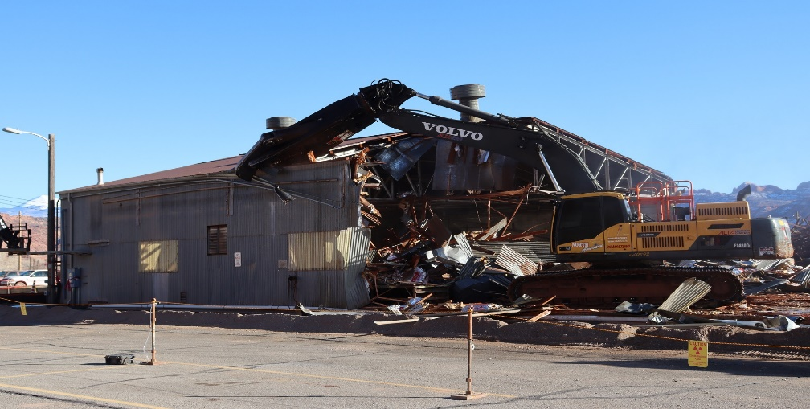
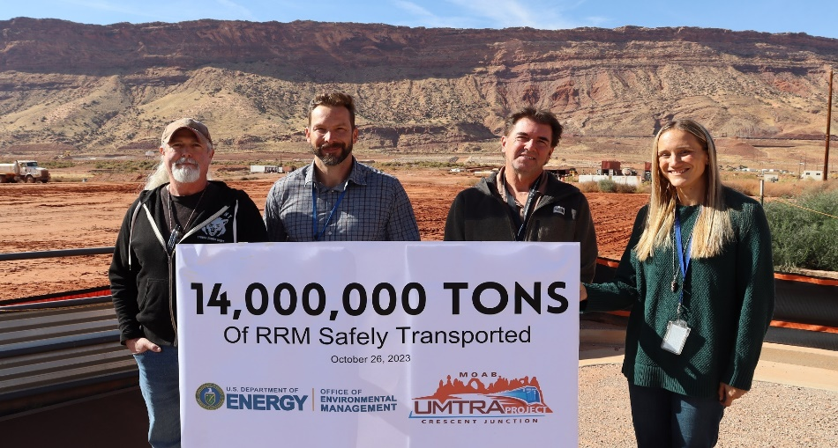
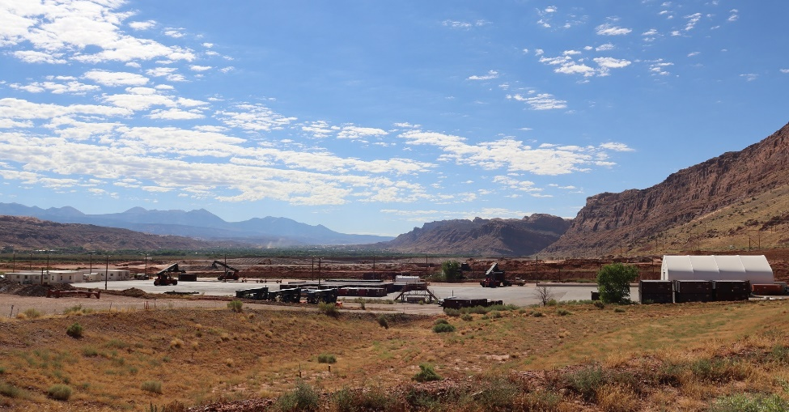
Moab Uranium Mill Tailings Remedial Action Project
Progress
Disposed of over 14 million tons of contaminated soil and debris out of the approximated 16-million-ton tailings pile
Removed a cumulative total of more than 980,000 pounds of ammonia and 5,600 pounds of uranium from groundwater
Final expansion phase of the Crescent Junction disposal cell was completed
Completed demo and removal of the Atlas Building
Remediated and removed 14 autoclaves
Moab,
Utah
Notes:
Photo Caption:
LEFT:
MIDDLE:
RIGHT:
Regulatory Structure
Cleanup includes mill tailings, groundwater, buildings, and debris, and is governed by Uranium Mill Tailings Radiation Control Act (UMTRCA)
Progress
Disposed of over 14 million tons of contaminated soil and debris out of the approximated 16-million-ton tailings pile
Removed a cumulative total of more than 980,000 pounds of ammonia and 5,600 pounds of uranium from groundwater
Final expansion phase of the Crescent Junction disposal cell was completed
Completed demo and removal of the Atlas Building
Remediated and removed 14 autoclaves
Upcoming Work
GCAP Field Study Investigations with National Labs
Approval of ET Cover Design
Move an additional 1 million tons of tailings

Slide 39
Moab Uranium Mill Tailings Remedial Action Project
Upcoming Work
Groundwater Compliance Action Plan field study investigations with National Labs
Approval of Evapotranspiration (ET) Cover Design
Move an additional 1 million tons of tailings
Moab,
Utah
Notes:
Photo Caption:
LEFT:
MIDDLE:
RIGHT:
Regulatory Structure
Cleanup includes mill tailings, groundwater, buildings, and debris, and is governed by Uranium Mill Tailings Radiation Control Act (UMTRCA)
Progress
Disposed of over 14 million tons of contaminated soil and debris out of the approximated 16-million-ton tailings pile
Removed a cumulative total of more than 980,000 pounds of ammonia and 5,600 pounds of uranium from groundwater
Final expansion phase of the Crescent Junction disposal cell was completed
Completed demo and removal of the Atlas Building
Remediated and removed 14 autoclaves
Upcoming Work
GCAP Field Study Investigations with National Labs
Approval of ET Cover Design
Move an additional 1 million tons of tailings
An ET cover is a type of “store-andrelease” cover that controls percolation by allowing natural vegetation to grow on the cover surface to remove excess moisture from the cover layers via transpiration: 1) Takes advantage of sustainable natural ecological systems and processes and 2) Utilizes the uptake capacity of native vegetation

Slide 40
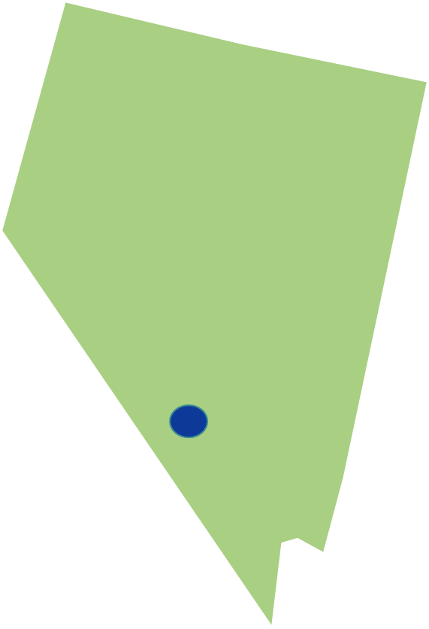
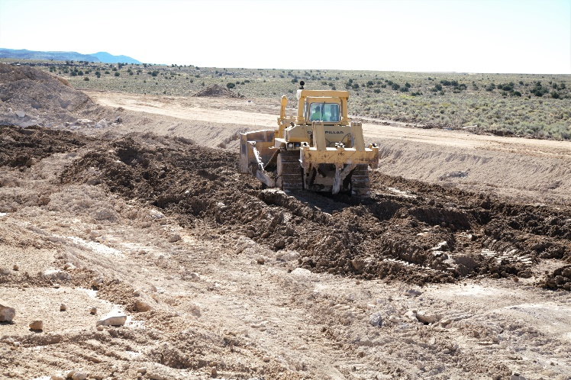
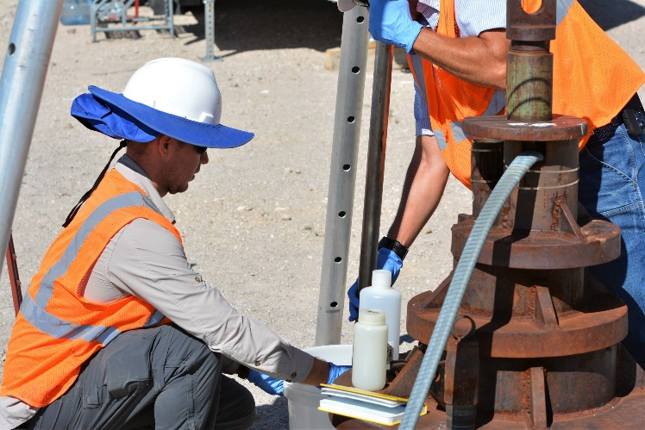
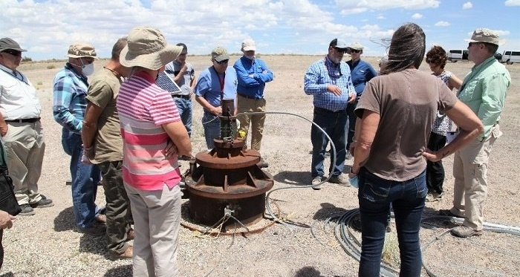
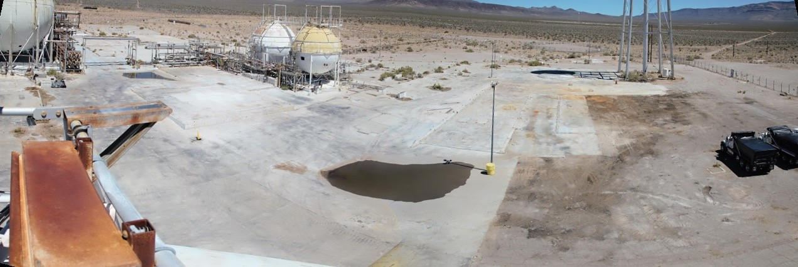
Nevada National Security Site
Progress:
Environmental restoration at approximately 900 former underground test locations, approximately 100 surface or near-surface soil contamination locations, and more than 1,000 industrial-type sites.
Obtained regulatory approval of the corrective action plan for the Pahute Mesa groundwater region – the last active groundwater corrective action area at the NNSS.
Safely disposed of approximately 600,000 cubic feet of low-level waste (LLW), mixed low-level waste (MLLW), and classified waste transported to the NNSS.
Nevada National Security Site
Nye County, Nevada
Notes:
Photo Caption:
LEFT:
MIDDLE:
RIGHT:
Regulatory Structure:
EM Nevada Program is responsible for completing cleanup actions at historic nuclear testing locations. Activities are primarily regulated by the Federal Facility Agreement and Consent Order (FFACO), an agreement between the State of Nevada and the Department of Energy governing environmental corrective actions at sites.
Progress:
Environmental restoration at approximately 900 former underground test locations, approximately 100 surface or near-surface soil contamination locations, and more than 1,000 industrial type sites.
Obtained regulatory approval on the data for the Pahute Mesa groundwater region – the last active groundwater corrective action area at the NNSS.
Safely disposed more than 635,000 cubic feet of LLW, MLLW, and classified waste transported to the NNSS. This disposal capability supports DOE cleanup and other activities at federal sites across the U.S.
Upcoming Work:
Completing the model evaluation phase for Pahute Mesa groundwater region, including the drilling of groundwater wells.
Conduct demolition and closure of the Engine Maintenance, Assembly, and Disassembly (EMAD) and the Test Cell C (TCC) complexes
The EM Nevada program expects to complete its current scope of cleanup activities safely, securely, and successfully at the NNSS by 2035.

Slide 41
Nevada National Security Site
Upcoming Work:
Complete the evaluation phase for Pahute Mesa groundwater region.
Conduct demolition and closure of the Engine Maintenance, Assembly, and Disassembly (EMAD) and the Test Cell C (TCC) complexes.
Nevada National Security Site
Nye County, Nevada
Notes:
Photo Caption:
LEFT:
MIDDLE:
RIGHT:
Regulatory Structure:
EM Nevada Program is responsible for completing cleanup actions at historic nuclear testing locations. Activities are primarily regulated by the Federal Facility Agreement and Consent Order (FFACO), an agreement between the State of Nevada and the Department of Energy governing environmental corrective actions at sites.
Progress:
Environmental restoration at approximately 900 former underground test locations, approximately 100 surface or near-surface soil contamination locations, and more than 1,000 industrial type sites.
Obtained regulatory approval on the data for the Pahute Mesa groundwater region – the last active groundwater corrective action area at the NNSS.
Safely disposed more than 635,000 cubic feet of LLW, MLLW, and classified waste transported to the NNSS. This disposal capability supports DOE cleanup and other activities at federal sites across the U.S.
Upcoming Work:
Completing the model evaluation phase for Pahute Mesa groundwater region, including the drilling of groundwater wells.
Conduct demolition and closure of the Engine Maintenance, Assembly, and Disassembly (EMAD) and the Test Cell C (TCC) complexes
The EM Nevada program expects to complete its current scope of cleanup activities safely, securely, and successfully at the NNSS by 2035.

Slide 42



Energy Technology Engineering Center (ETEC)
Progress
Completed remediation and demolition of the last 18 DOE-owned buildings
Collected 105,000+ endangered Braunton’s Milk-vetch seeds with U.S. Fish and Wildlife for preservation and future revegetation.
Continued ongoing groundwater interim measures, reducing volatile organic compound impacted groundwater concentrations by 10,000 ppb in 2017 to < 500 ppb in 2023.
Energy Technology
Engineering Center
Ventura County,
California
Notes:
Photo Caption:
LEFT: Braunton’s milk-vetch, an endangered short-lived perennial plant in the pea family, a plant with a natural habitat on DOE’s ETEC site.
MIDDLE: Jeff Avery tours the ETEC site with the EM team. EM has been performing continuous environmental monitoring using air monitoring stations around the perimeter of the ETEC site. The cleanup program has also been conducting ongoing groundwater monitoring.
RIGHT: Water is applied for dust suppression following the demolition of the Sodium Pump Test Facility at ETEC.
Regulatory Structure
ETEC complies with all federal and state regulations, including those of the California Department of Toxic Substance Control, California State Water Resources Board, California State Air Resources Board, the Regional Water Quality Control Board, Ventura County Air Pollution Control District, and Ventura County Environmental Health.
Progress
Continued active cleanup after more than a decade
Issued the 2020 Record of Decision for Groundwater Remediation, Area IV, Santa Susana Field Laboratory, completed remediation and demolition of the last 18 DOE-owned buildings, collected 105,000+ endangered Braunton’s Milk-vetch seeds with U.S. Fish and Wildlife for preservation and future revegetation, and continued ongoing groundwater interim measures, reducing VOC-impacted groundwater concentrations by 10,000 ppb in 2017 to < 500 ppb.
Upcoming Work
Automate groundwater pumping in 2024 to continue groundwater remediation.
Commence the Groundwater Corrective Measures Study.
Full implementation of the Record of Decision for Groundwater Remediation.
Working with the state of California on finalizing the cleanup of Area IV and the Northern Buffer Zone, including next steps for cleanup of soils.

Slide 43
Energy Technology Engineering Center (ETEC)
Upcoming Work
Automate groundwater pumping in 2024 to continue interim measures.
Finalize the Groundwater Corrective Measures Study and, following state regulatory approval, commence implementation of the 2020 Record of Decision for Groundwater Remediation.
Finalize the cleanup of Area IV and the Northern Buffer Zone with the state of California, including next steps for cleanup of soils.
Energy Technology
Engineering Center
Ventura County,
California
Notes:
Photo Caption:
LEFT: Braunton’s milk-vetch, an endangered short-lived perennial plant in the pea family, a plant with a natural habitat on DOE’s ETEC site.
MIDDLE: Jeff Avery tours the ETEC site with the EM team. EM has been performing continuous environmental monitoring using air monitoring stations around the perimeter of the ETEC site. The cleanup program has also been conducting ongoing groundwater monitoring.
RIGHT: Water is applied for dust suppression following the demolition of the Sodium Pump Test Facility at ETEC.
Regulatory Structure
ETEC complies with all federal and state regulations, including those of the California Department of Toxic Substance Control, California State Water Resources Board, California State Air Resources Board, the Regional Water Quality Control Board, Ventura County Air Pollution Control District, and Ventura County Environmental Health.
Progress
Continued active cleanup after more than a decade
Issued the 2020 Record of Decision for Groundwater Remediation, Area IV, Santa Susana Field Laboratory, completed remediation and demolition of the last 18 DOE-owned buildings, collected 105,000+ endangered Braunton’s Milk-vetch seeds with U.S. Fish and Wildlife for preservation and future revegetation, and continued ongoing groundwater interim measures, reducing VOC-impacted groundwater concentrations by 10,000 ppb in 2017 to < 500 ppb.
Upcoming Work
Automate groundwater pumping in 2024 to continue groundwater remediation.
Commence the Groundwater Corrective Measures Study.
Full implementation of the Record of Decision for Groundwater Remediation.
Working with the state of California on finalizing the cleanup of Area IV and the Northern Buffer Zone, including next steps for cleanup of soils.

Slide 44



Lawrence Livermore National Laboratory
Progress
Continued the Building 280 Pool-Type Reactor Demolition Project activities.
Continued Building 251 Demolition to Slab project activities, an EM 2023 priority.
Continued the Legacy Slab 377 Slab and Soil removal project.
Commenced the Legacy Slab 412 Slab and Soil removal project.
Completed the Legacy Slab 175 Slab and Soil predemolition activities.
Lawrence Livermore
National Laboratory
Notes:
Photo Caption:
LEFT: An aerial view of Lawrence Livermore National Laboratory.
MIDDLE: The first transuranic waste shipment from Lawrence Livermore in a decade departs the laboratory
RIGHT: After views of the demolition of Building 175 at Lawrence Livermore.
Regulatory Structure
LLNL complies with all federal and state regulations, including those of the Environmental Protection Agency, National Nuclear Security Administration, California State Water Resources Board, California State Air Resources Board, and the California Department of Toxic Substance Control.
Progress
Completed the Building 280 Reactor Removal Project.
Completed the Building 175 Demolition to Slab Project, removing a high-risk excess facility.
Completed characterization and began mobilization of demolition of Building 251, a high-risk excess facility, and an EM 2022 priority.
Completed demolition of the ancillary office building T2552 in preparation for commencing demolition of Building 251.
Upcoming Work
Commence the Building 280 demolition project.
Commence the Building 175 slab and soil removal project.
Commence the Building 251 demolition to slab project.
Continue the LS 377 slab and soil removal project.
Commence the LS 412 slab and soil removal project

Slide 45
Lawrence Livermore National Laboratory
Upcoming Work
Commence the Building 175 slab and soil removal project.
Commence the Legacy Slab 175 Slab and Soil removal project.
Commence Building 212 hazard removal activities
Lawrence Livermore
National Laboratory
Notes:
Photo Caption:
LEFT: An aerial view of Lawrence Livermore National Laboratory.
MIDDLE: The first transuranic waste shipment from Lawrence Livermore in a decade departs the laboratory
RIGHT: After views of the demolition of Building 175 at Lawrence Livermore.
Regulatory Structure
LLNL complies with all federal and state regulations, including those of the Environmental Protection Agency, National Nuclear Security Administration, California State Water Resources Board, California State Air Resources Board, and the California Department of Toxic Substance Control.
Progress
Completed the Building 280 Reactor Removal Project.
Completed the Building 175 Demolition to Slab Project, removing a high-risk excess facility.
Completed characterization and began mobilization of demolition of Building 251, a high-risk excess facility, and an EM 2022 priority.
Completed demolition of the ancillary office building T2552 in preparation for commencing demolition of Building 251.
Upcoming Work
Commence the Building 280 demolition project.
Commence the Building 175 slab and soil removal project.
Commence the Building 251 demolition to slab project.
Continue the LS 377 slab and soil removal project.
Commence the LS 412 slab and soil removal project

Slide 46



Lawrence Berkeley National Laboratory
Progress
Commenced the Old Town Demolition (OTD) Phase VI Project which removes the Building 4 and 14 slabs, underground structures and associated contaminated soil to provide for a buildable site for future mission use.
Continued Excess Facility Demolition planning activities for Bayview Buildings 56 and 64.
Lawrence Berkeley
National Laboratory
Notes:
Photo Captions:
RIGHT: A view of Bayview Parcel 1 South at Lawrence Berkeley National Laboratory in June 2019 before EM crews began demolition of the site.
MIDDLE: A view of Bayview Parcel 1 South at Lawrence Berkeley National Laboratory in July 2021 following EM’s completion of cleanup at the site.
BOTTOM: Energy Secretary Jennifer Granholm, far right, meets with U.S. Rep. Barbara Lee of California and DOE Joint Genome Institute Director Nigel Mouncey during a visit to the Lawrence Berkeley National Laboratory.
Regulatory Structure
LBNL complies with all federal and state regulations, including those of the Environmental Protection Agency, California State Water Resources Board, California State Air Resources Board, and the California Department of Toxic Substance Control.
Progress
Commenced the Old Town Demolition (OTD) Phase VI Project which removes the Building 4 and 14 slabs, underground structures and associated contaminated soil to provide for a buildable site for future mission use. Completion of this effort will complete the Old Town Demolition Projects which started in FY 2012.
Commenced Excess Facility Demolition planning activities for Bayview Buildings 56 and 64.
Upcoming Work
Complete the OTD Phase VI demolition project (removal of the Building 4 and 14 slabs and associated contaminated soil) in FY2023.
Continue Excess Facility Demolition planning activities for Bayview Buildings 56 and 64. This includes removal of Building 56 and associated contaminated soil, and demolition and removal of Building 64 and associated contaminated soil.

Slide 47
Lawrence Berkeley National Laboratory
Upcoming Work
Continue Excess Facility Demolition planning activities for Bayview Buildings 56 and 64.
Commence planning activities for Building 71 complex work, including removal of Building 71A, removal of 8 office trailers, and develop a demolition scope for Building 71.
Lawrence Berkeley
National Laboratory
Notes:
Photo Captions:
RIGHT: A view of Bayview Parcel 1 South at Lawrence Berkeley National Laboratory in June 2019 before EM crews began demolition of the site.
MIDDLE: A view of Bayview Parcel 1 South at Lawrence Berkeley National Laboratory in July 2021 following EM’s completion of cleanup at the site.
BOTTOM: Energy Secretary Jennifer Granholm, far right, meets with U.S. Rep. Barbara Lee of California and DOE Joint Genome Institute Director Nigel Mouncey during a visit to the Lawrence Berkeley National Laboratory.
Regulatory Structure
LBNL complies with all federal and state regulations, including those of the Environmental Protection Agency, California State Water Resources Board, California State Air Resources Board, and the California Department of Toxic Substance Control.
Progress
Commenced the Old Town Demolition (OTD) Phase VI Project which removes the Building 4 and 14 slabs, underground structures and associated contaminated soil to provide for a buildable site for future mission use. Completion of this effort will complete the Old Town Demolition Projects which started in FY 2012.
Commenced Excess Facility Demolition planning activities for Bayview Buildings 56 and 64.
Upcoming Work
Complete the OTD Phase VI demolition project (removal of the Building 4 and 14 slabs and associated contaminated soil) in FY2023.
Continue Excess Facility Demolition planning activities for Bayview Buildings 56 and 64. This includes removal of Building 56 and associated contaminated soil, and demolition and removal of Building 64 and associated contaminated soil.

Slide 48

TEPP Training in the Midwest
Illinois | 0
Indiana | 45
Iowa | 0
Kansas | 0
Michigan | 0
Minnesota | 0
Nebraska | 0
North Dakota | 0
Ohio | 14
South Dakota | 0
Wisconsin | 0

Slide 49

TEPP Training in the South

Slide 50

TEPP Training in the West
Alaska | 0
Arizona | 29
California | 139
Colorado | 0
Hawaii | 0
Idaho | 144
Montana | 0
Nevada | 175
New Mexico | 2
Oregon | 0
Utah | 0
Washington | 0
Wyoming | 0

