Slide 1
Transportation Emergency Preparedness Program (TEPP) Update
The Council of State Governments (CSG)
Northeast High-Level Radioactive Waste
Transportation Task Force
Mid-Year Meeting – Portland, ME
Ellen Edge – DOE TEPP Program Manager
Mark Linsley – DOE TEPP Contractor
mark@trgroupinc.com or 814-404-9668

Slide 2
TEPP Mission
To ensure that federal, state, tribal, and local responders have access to the plans, training, and technical assistance necessary to safely, efficiently, and effectively respond to transportation accidents involving DOE-owned radioactive materials.

Slide 3
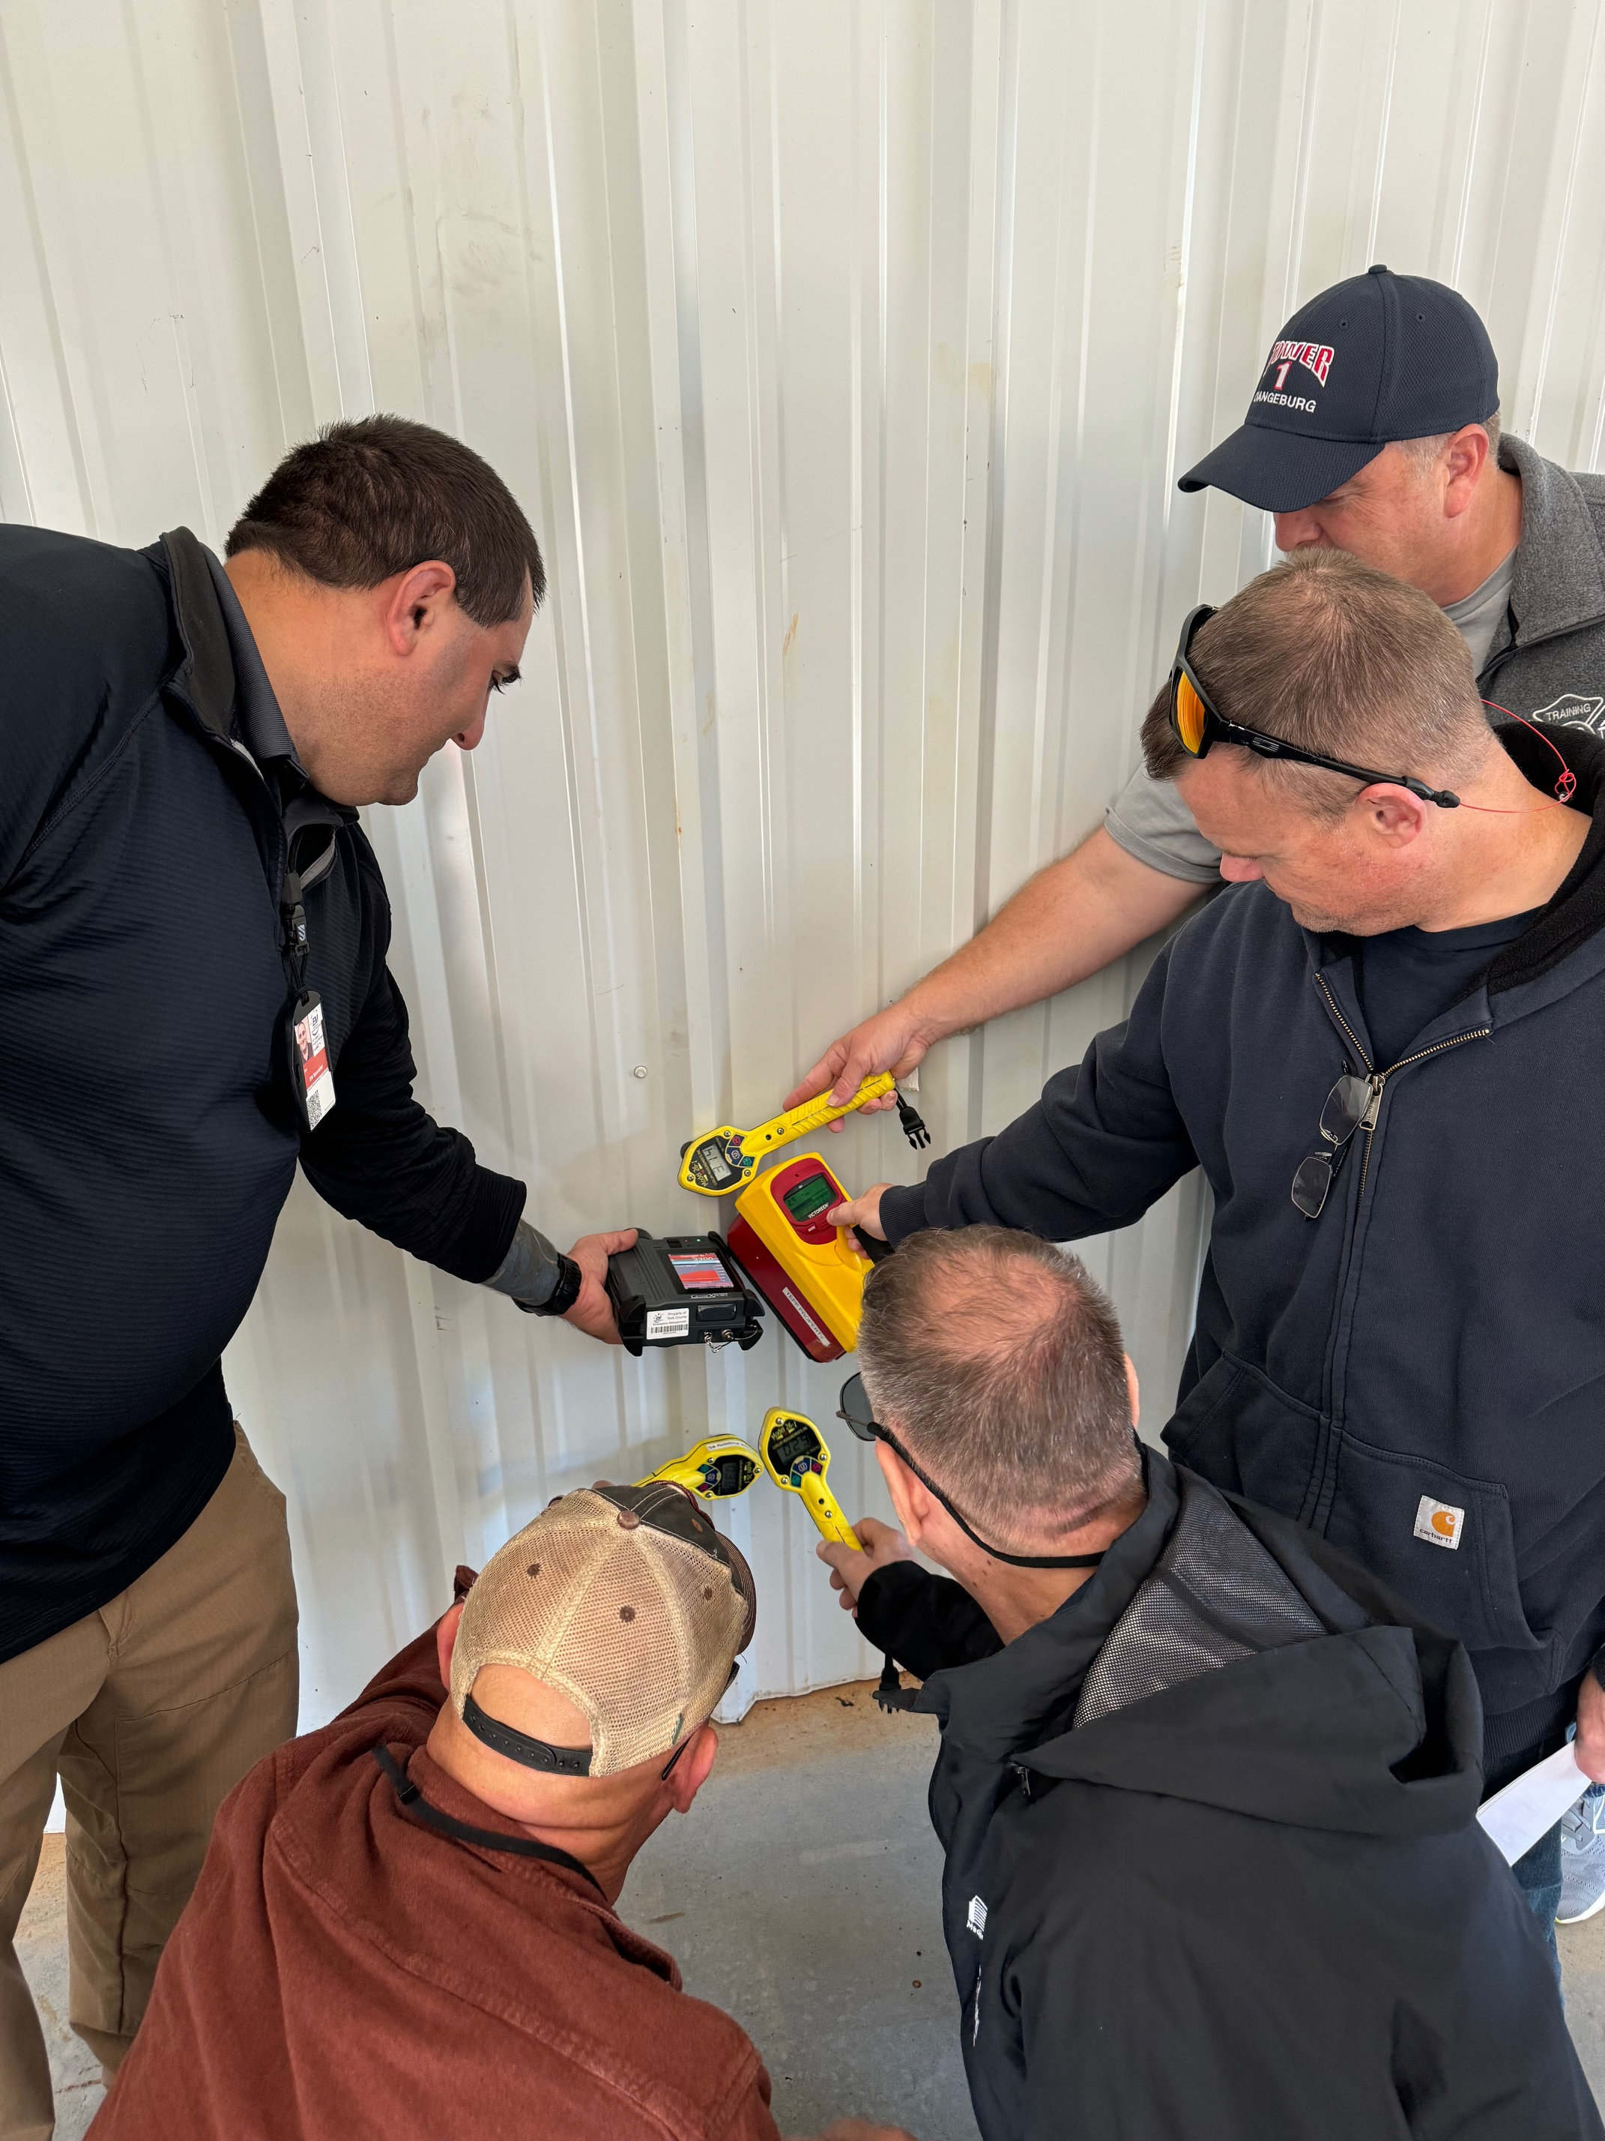
TEPP Mission
Suite of tools developed to aid response jurisdictions in their readiness activities
Training
Needs Assessment
Model Procedures
Exercises

Slide 4
TEPP Mission
Committed to maintaining TEPP training, exercises, and support to all stakeholders during this government funding delay, even through possible furloughs or layoffs.

Slide 5
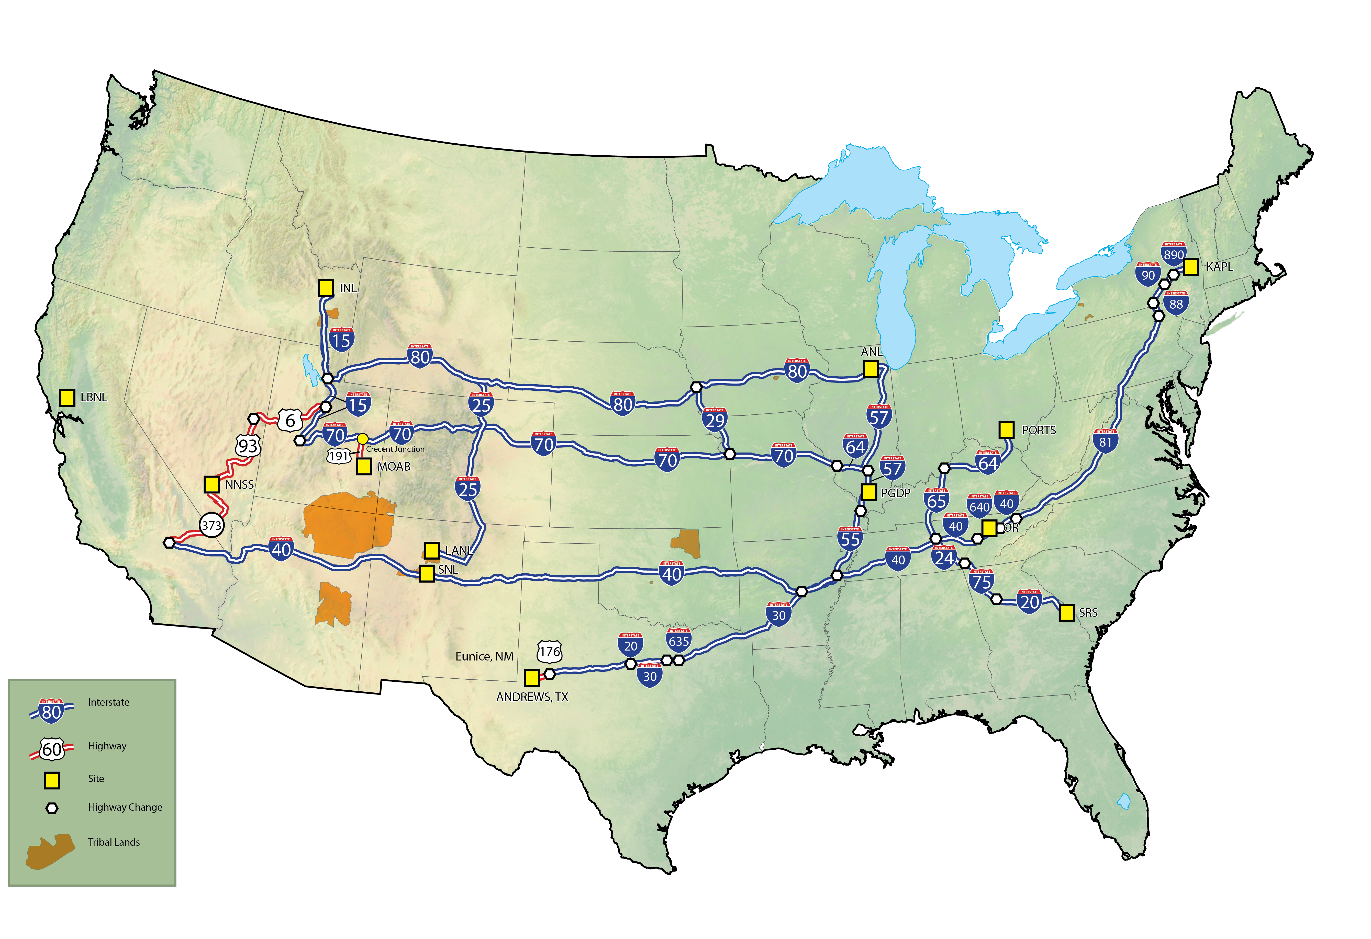
DOE Shipping Routes
Office of Environmental Management

Slide 6
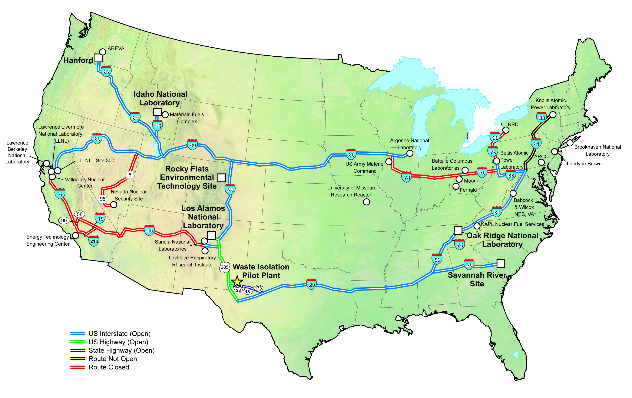
DOE Shipping Routes
Waste Isolation Pilot Plant

Slide 7
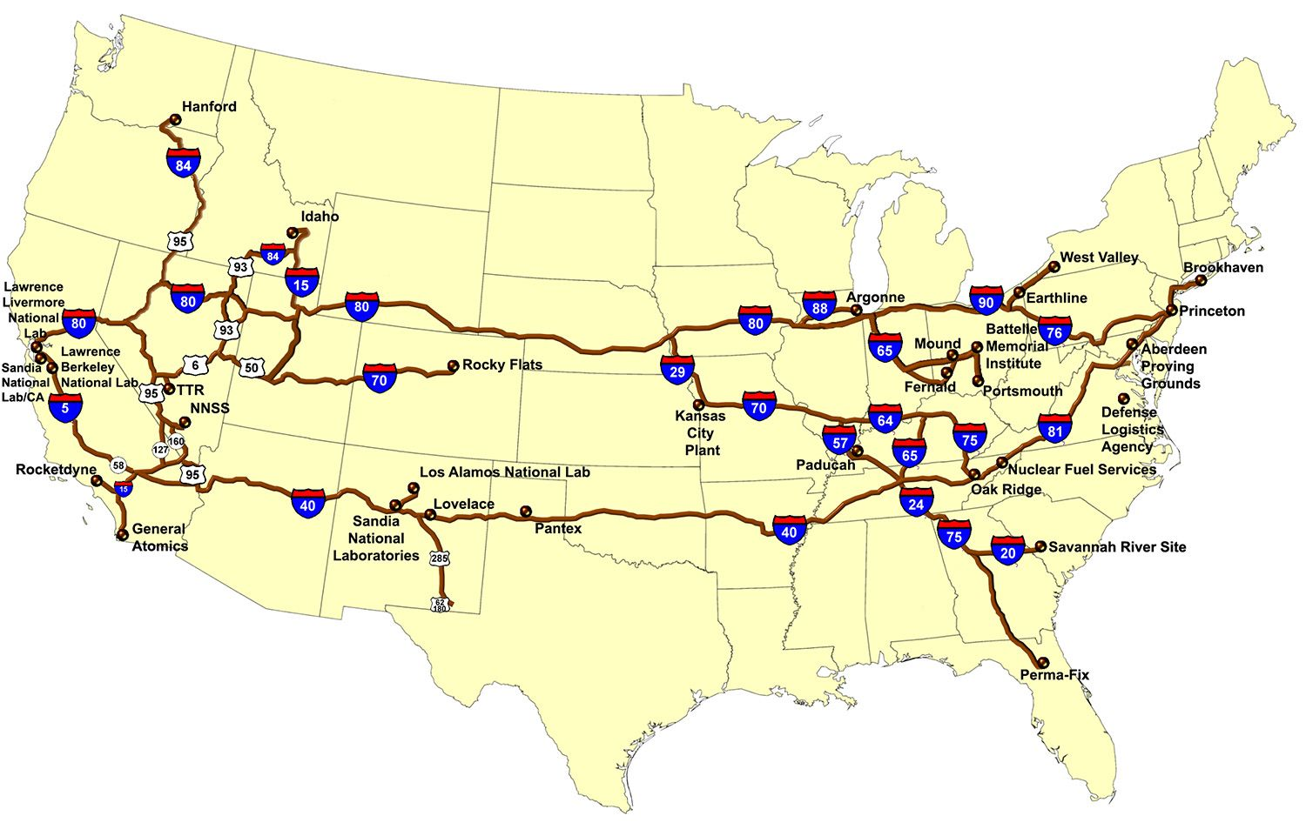
DOE Shipping Routes
National Nuclear Security Sites

Slide 8
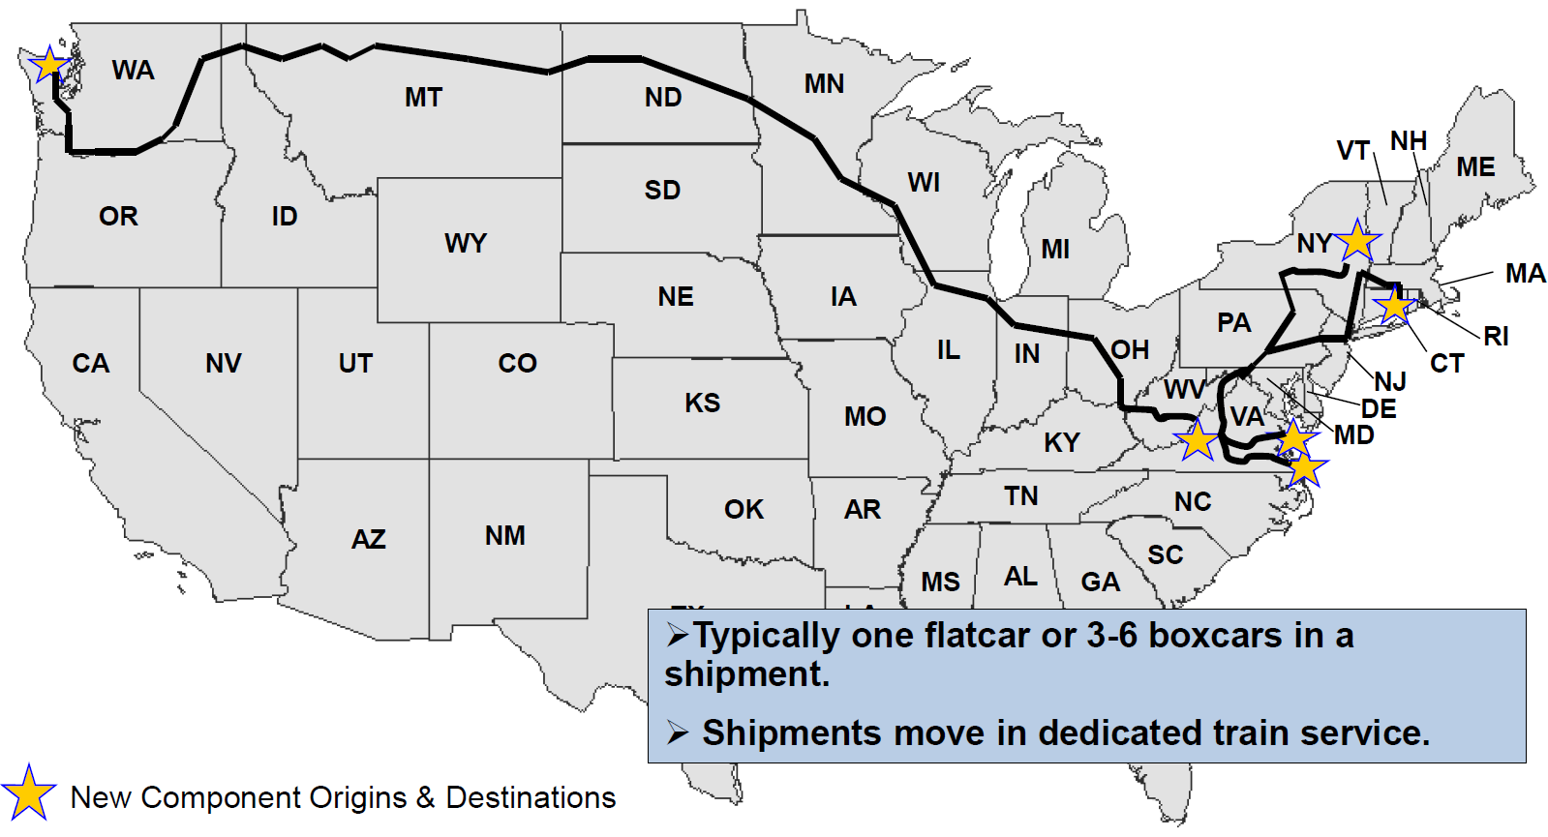
DOE Shipping Routes
Typical New Component Shipping Routes

Slide 9
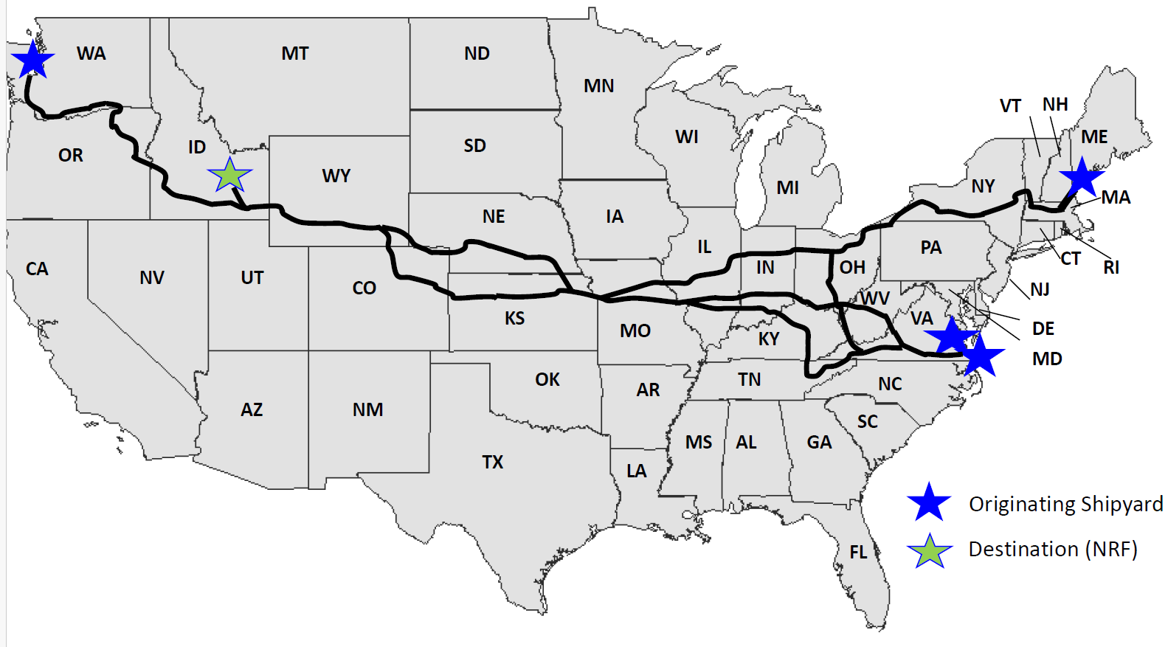
DOE Shipping Routes
Typical Naval Spent Fuel Shipping Routes

Slide 10
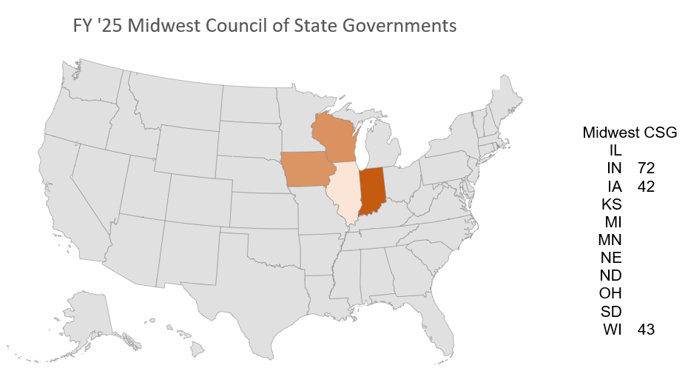
Regional CSG Highlights
Midwest
Resurgence in nuclear power commitment
Multiple isotope production companies
High burnup spent fuel shipment

Slide 11
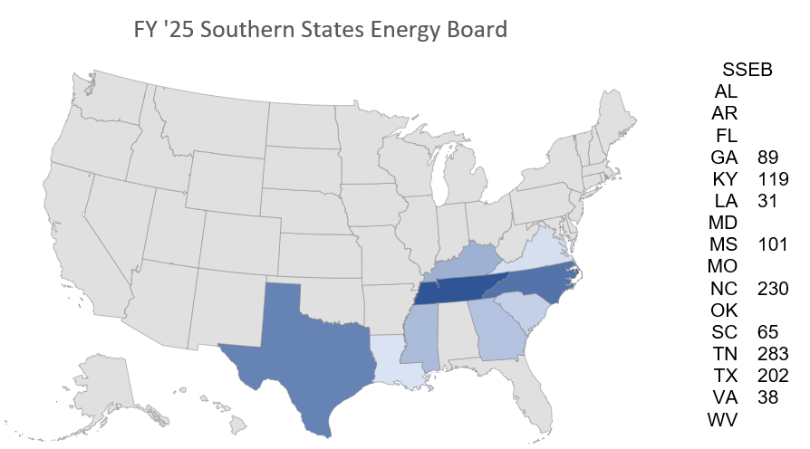
Regional CSG Highlights
SSEB
Full range of training to prep for Dirty Dirt TTX and FSX in TX partnering with WCS and WIPP
High burnup spent fuel shipment

Slide 12
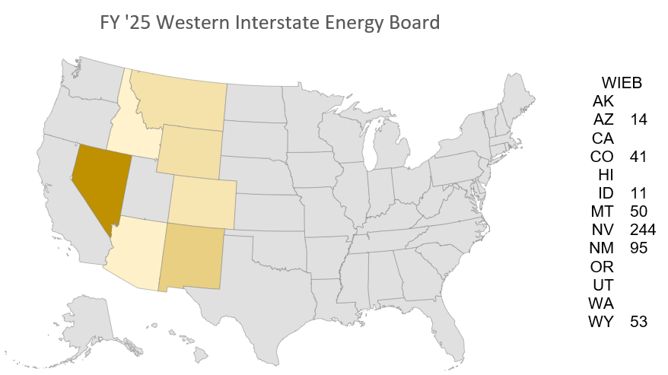
Regional CSG Highlights
WIEB
Focus on training in Nevada: Las Vegas, NNSS
TRU shipments from Hanford
Other WIPP routes?

Slide 13
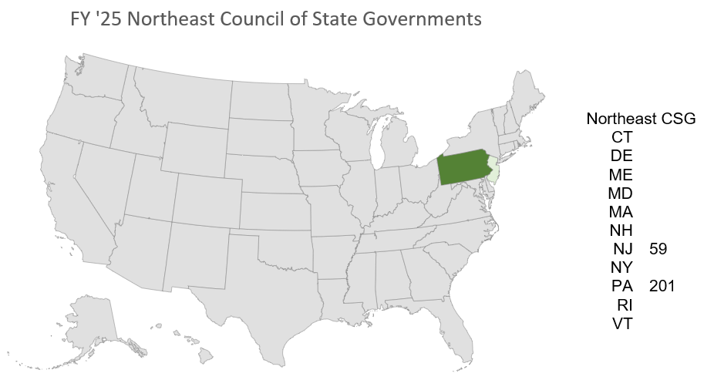
Regional CSG Highlights
NE
Planning Guide for Shipments of Radioactive Material

Slide 14
CY 2025 Training to Date
Courses | NE Classes-Students | Midwest Classes-Students | WIEB Classes-Students | SSEB Classes-Students
Full MERRTT | 5 – 90 | 6 – 81 | 15 – 285 | 20 – 384
C-MERRTT | 3 – 56 | 2 – 41 | 13 - 160 | 24 – 281
P-MERRTT |  | 7 | 6 | 1
T-MERRTT | 2 – 39 |  | 1 – 13 | 9 – 113
Hospital |  |  | 2 – 58
Specialist |  |  | 1 – 32
Coroner | 1 – 15
Totals | 11 – 200 | 8 – 129 | 32 – 554 | 53 – 779

Slide 15
Upcoming Northeast Training
CMERRTT – Nazareth, PA, November 13
CMERRTT – Ft. Dietrick, MD, February 9 – 13
MERRTT – Dauphin, PA, February 27 – 28
TMERRTT – Ft. Dietrick, MD, March 9 – 13
CMERRT – Lebanon, PA, April 18
CMERRTT – Clarksboro, NJ, April 20
TMERRTT – Clarksboro, NJ, April 21

Slide 16
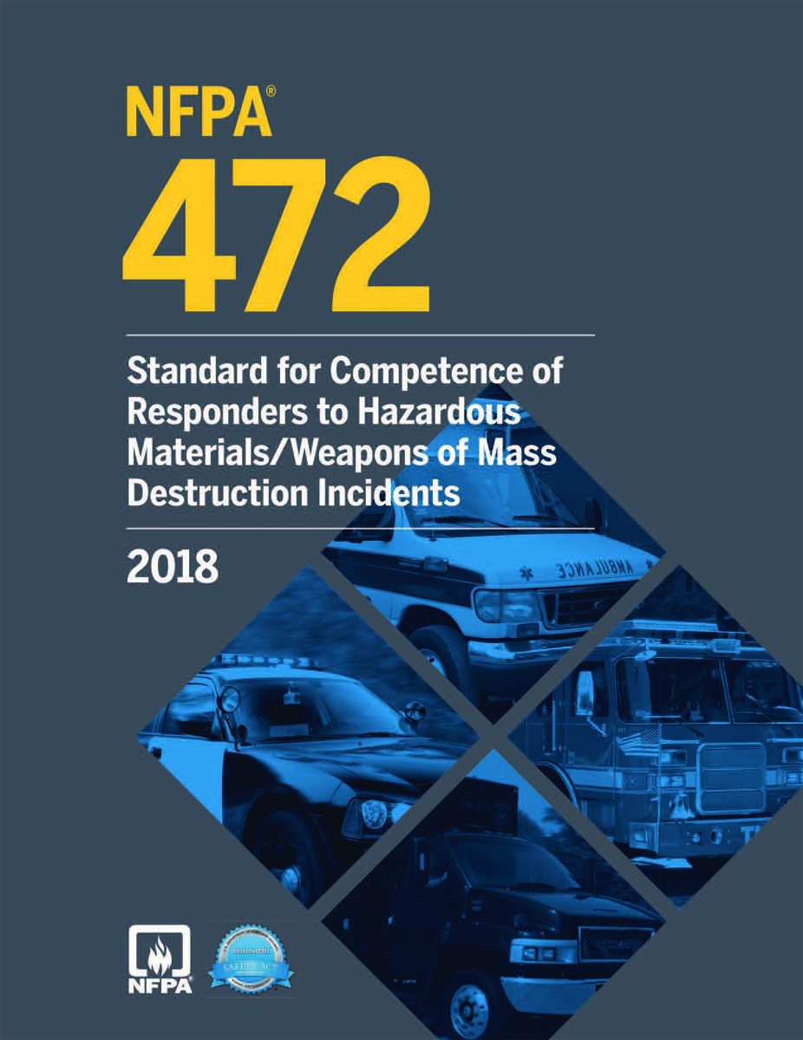
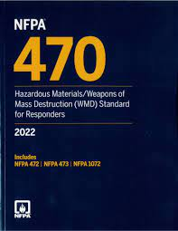
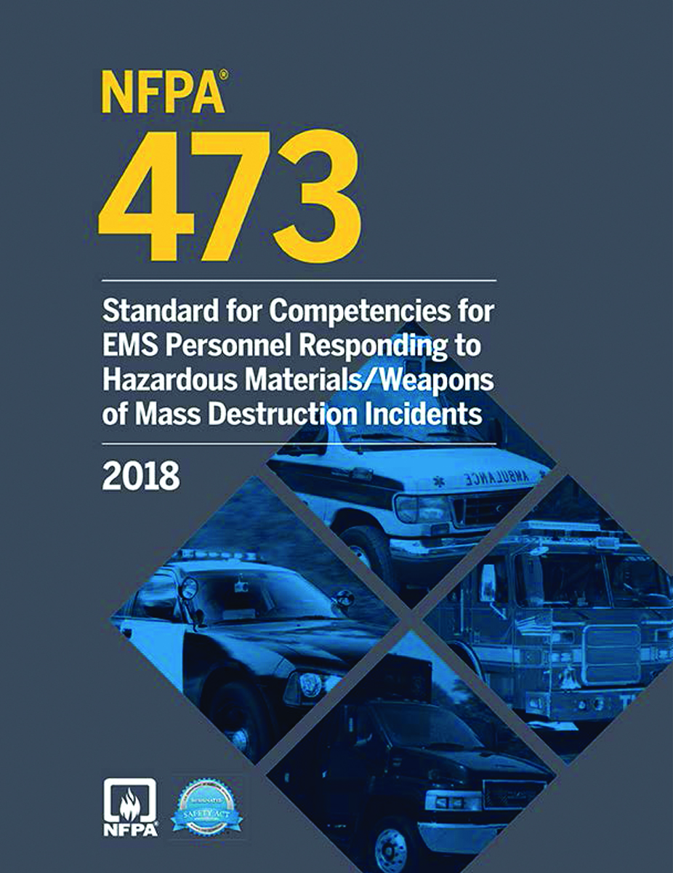
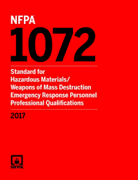
TEPP Improvement Project Updates
NFPA 470
Hazardous Materials/Weapons of Mass Destruction (WMD) Standard for Responders

Slide 17
TEPP Improvement Project Updates
NFPA 472 – Annex D
Competencies for Operations Level Responders Assigned Radiological Agent–Specific Tasks

Slide 18
TEPP Improvement Project Updates
Awareness Person
Operations Responder
Operations Responders – Mission Specific
Technician
Technician Specialty
Specialist Employee
BLS Responder
ALS Responder
ALS – Mission-Specific

Slide 19
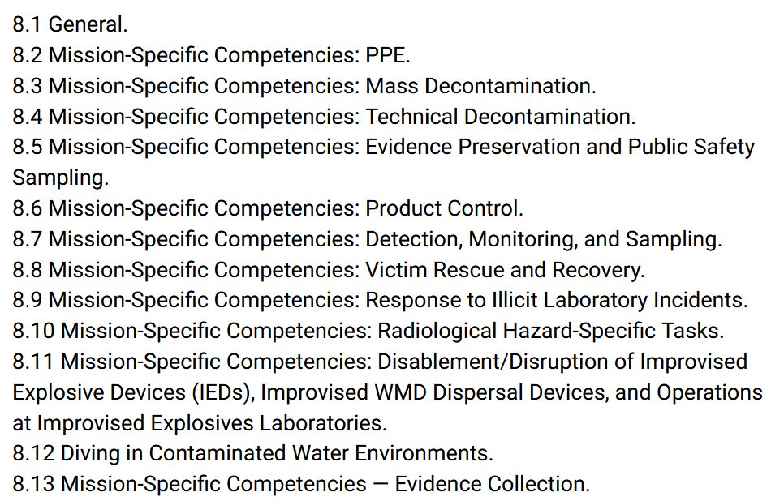
TEPP Improvement Project Updates
Ops Level Assigned Mission-Specific Responsibilities
XXXXXXXXXXXXXXXXXXXXXXXXXXXXXXXXXXXXXXXXXXXXXXXXXXXX

Slide 20
TEPP Improvement Project Updates
Hospital Emergency Department Management of Radiation Accidents Course
8-hour course designed to introduce hospital medical care providers to ionizing radiation, the biological effects of ionizing radiation, facility preparation, rad instrumentation, patient decontamination, and patient care and treatment
Revised program being piloted in Redding, CA, Nov. 4

Slide 21
TEPP Improvement Project Updates
Medical Examiner/Coroner: Handling of a Body/Human Remains that are Potentially Radiologically Contaminated
Piloted August 6 in Reading, PA: Attendees included
Berks, Lehigh, and Schuylkill County Coroner’s Offices (PA)
Glouster, Camden, Salem Medical Examiner’s Office (NJ)
Berks County HazMat Team
Reading Hospital Department of Pathology
8-hours ConEd through PA State Coroners’ Association

Slide 22
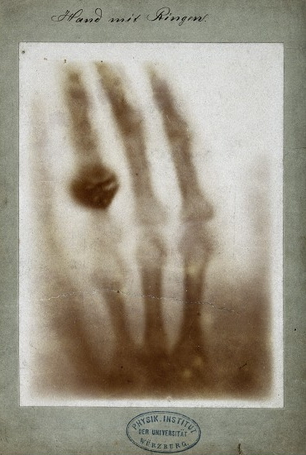
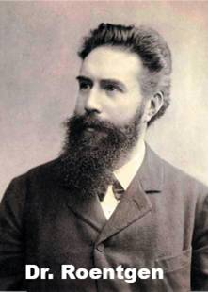
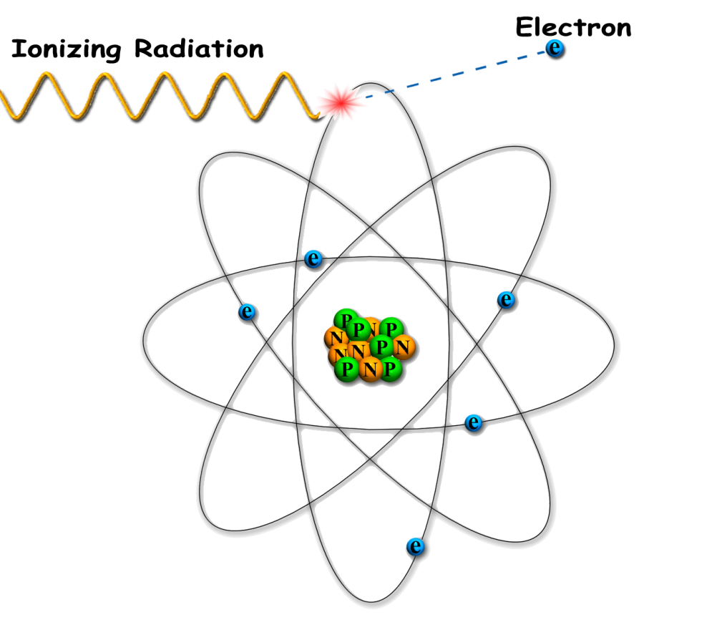
TEPP Improvement Project Updates
8 modules with hands-on practical exercises
Radiological Basics

Slide 23
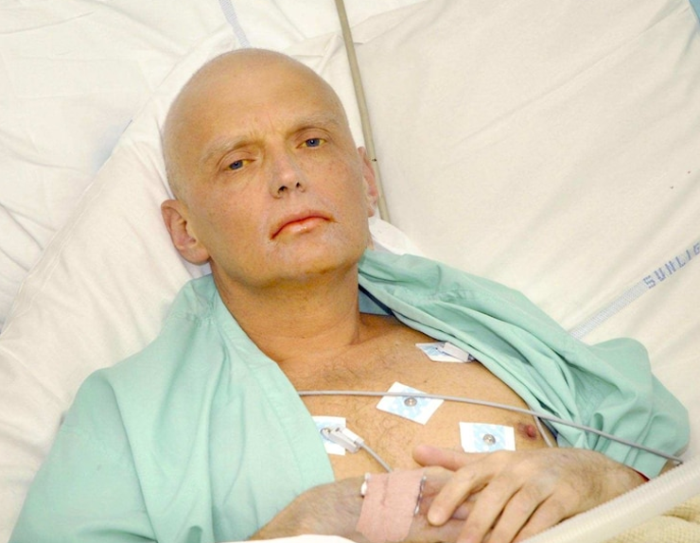
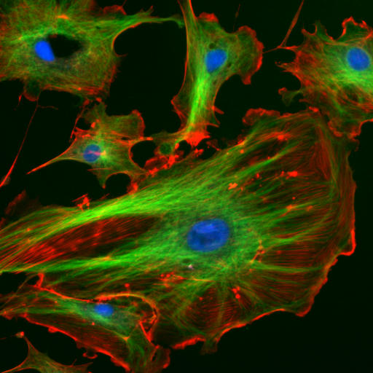
TEPP Improvement Project Updates
8 modules with hands-on practical exercises
Radiological Basics
Biological Effects

Slide 24
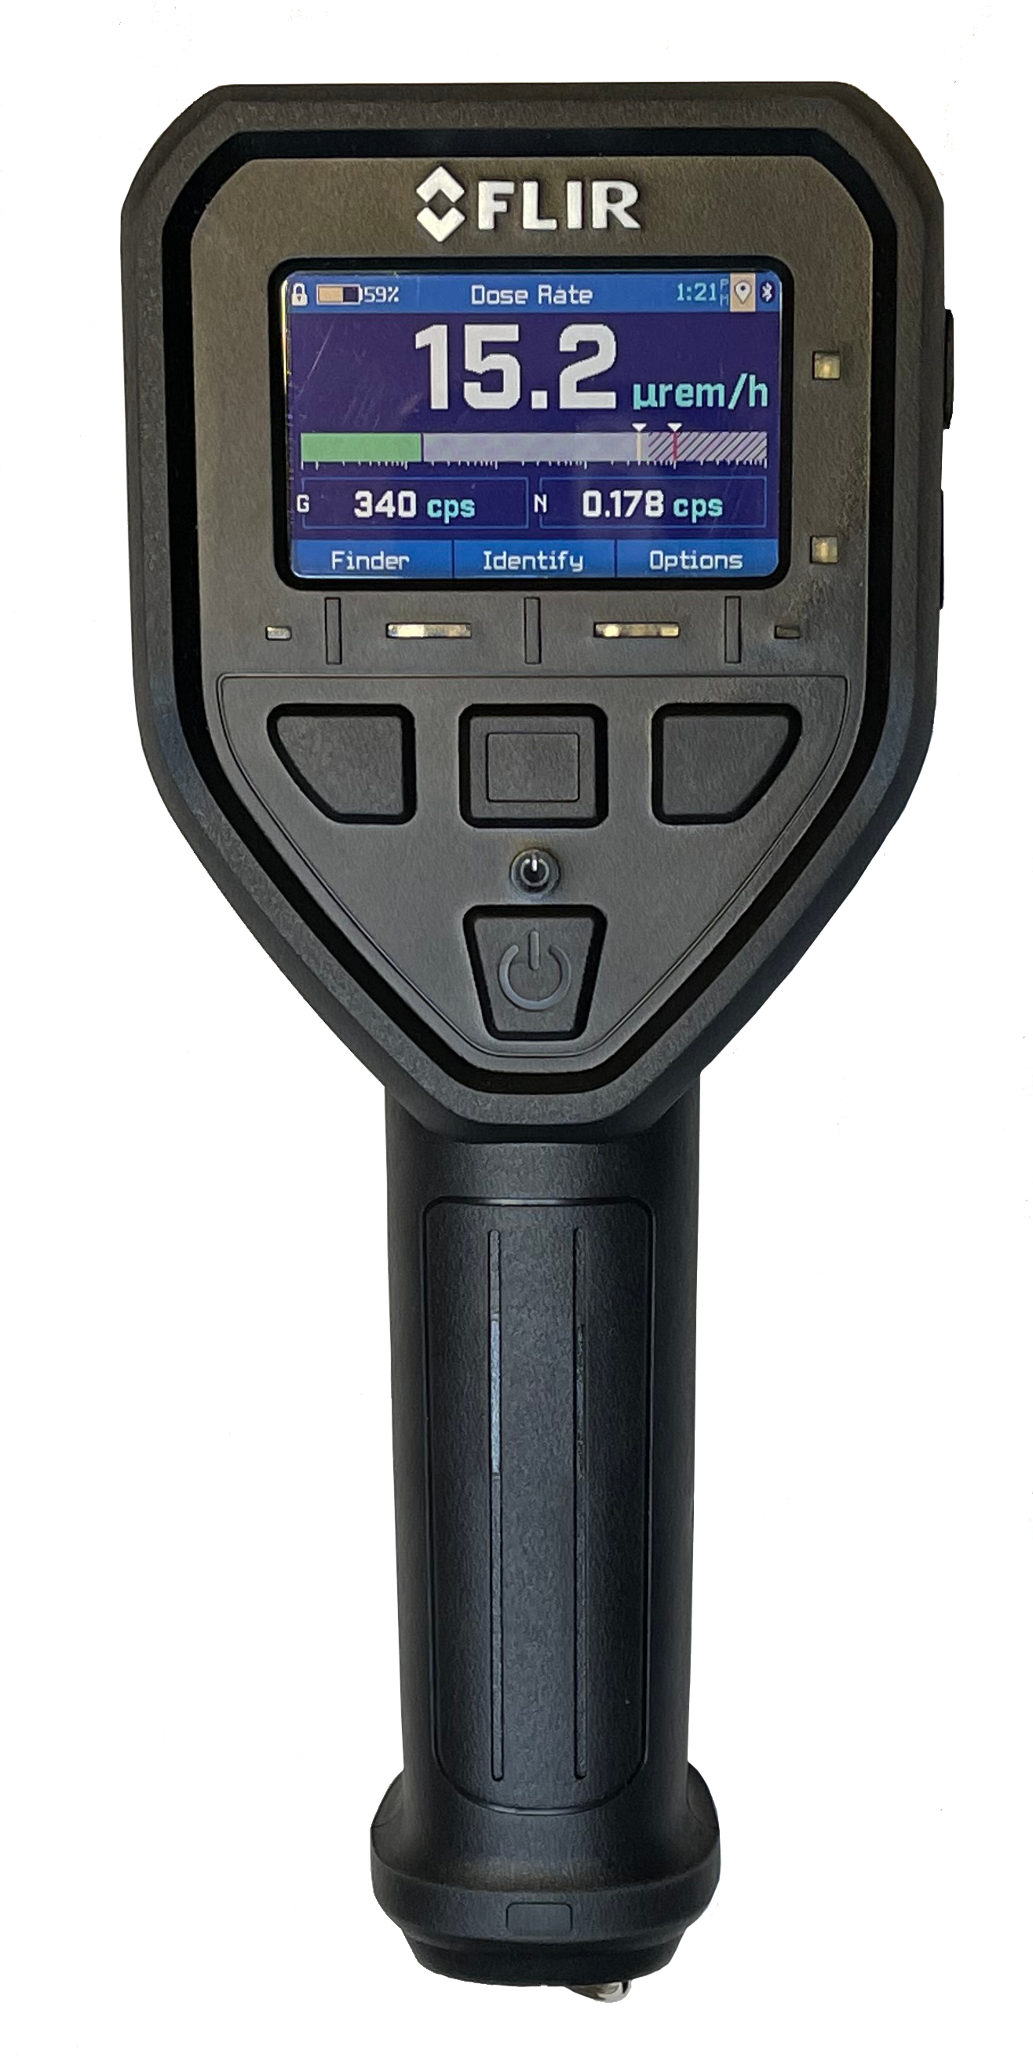
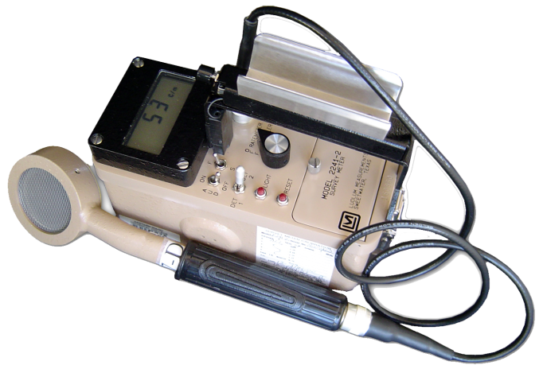
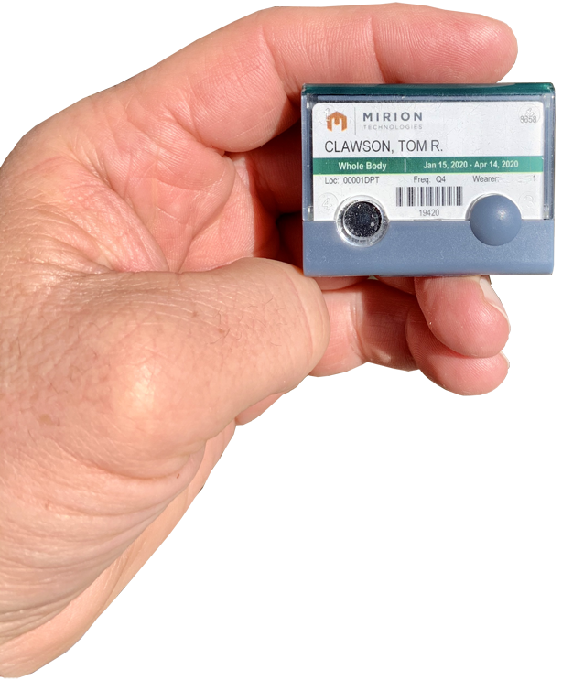
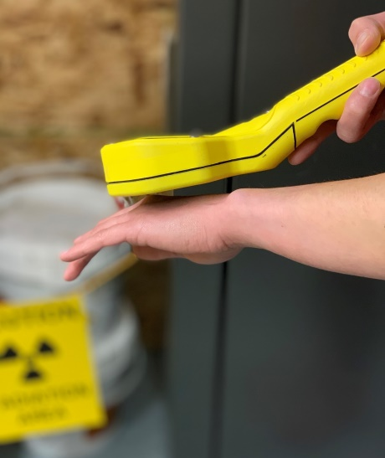
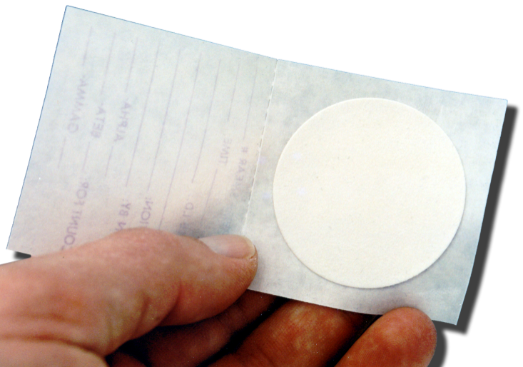
TEPP Improvement Project Updates
8 modules with hands-on practical exercises
Radiological Basics
Biological Effects
Radiological Survey Instruments
and Dosimetry Devices

Slide 25
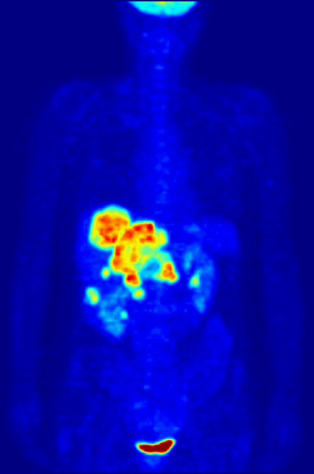

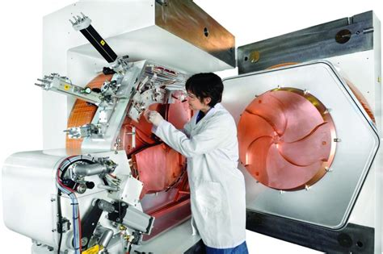
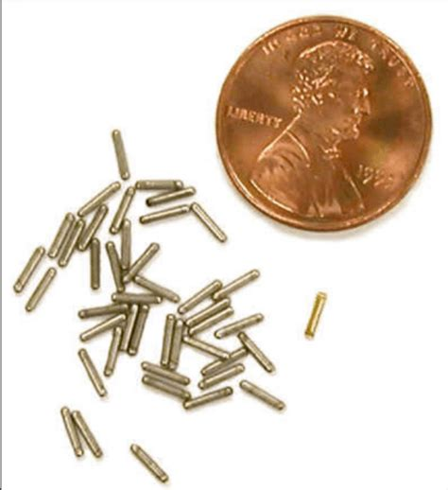
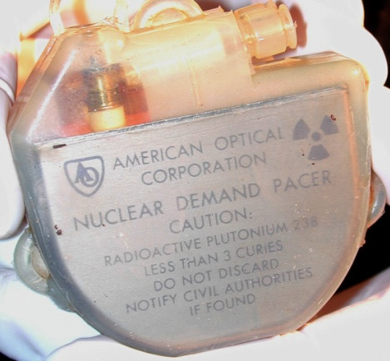
TEPP Improvement Project Updates
8 modules with hands-on practical exercises
Radiological Basics
Biological Effects
Radiological Survey Instruments
and Dosimetry Devices
Uses and Regulations

Slide 26
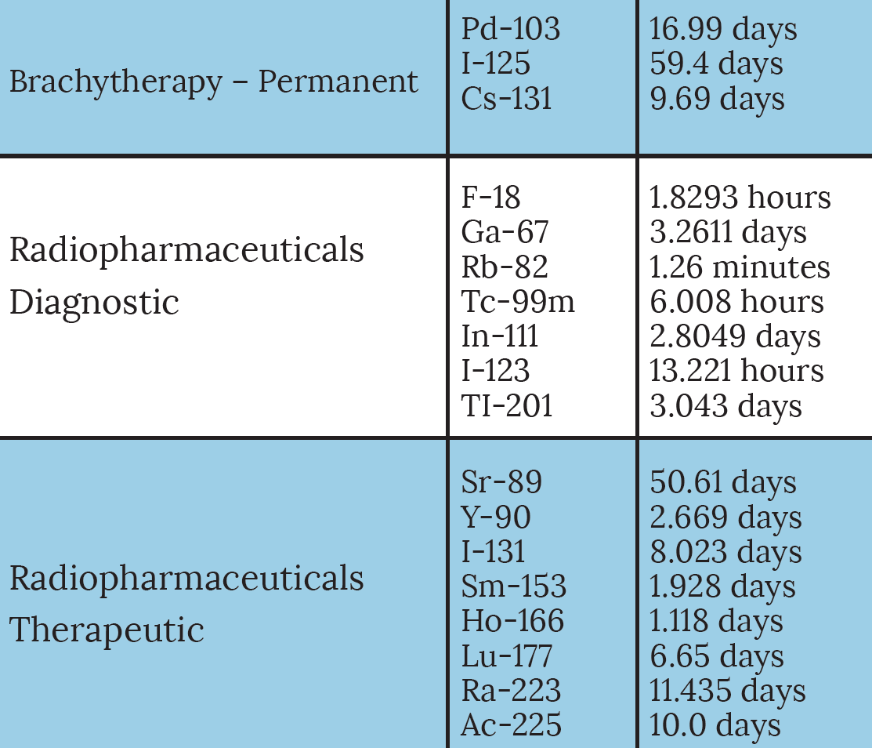
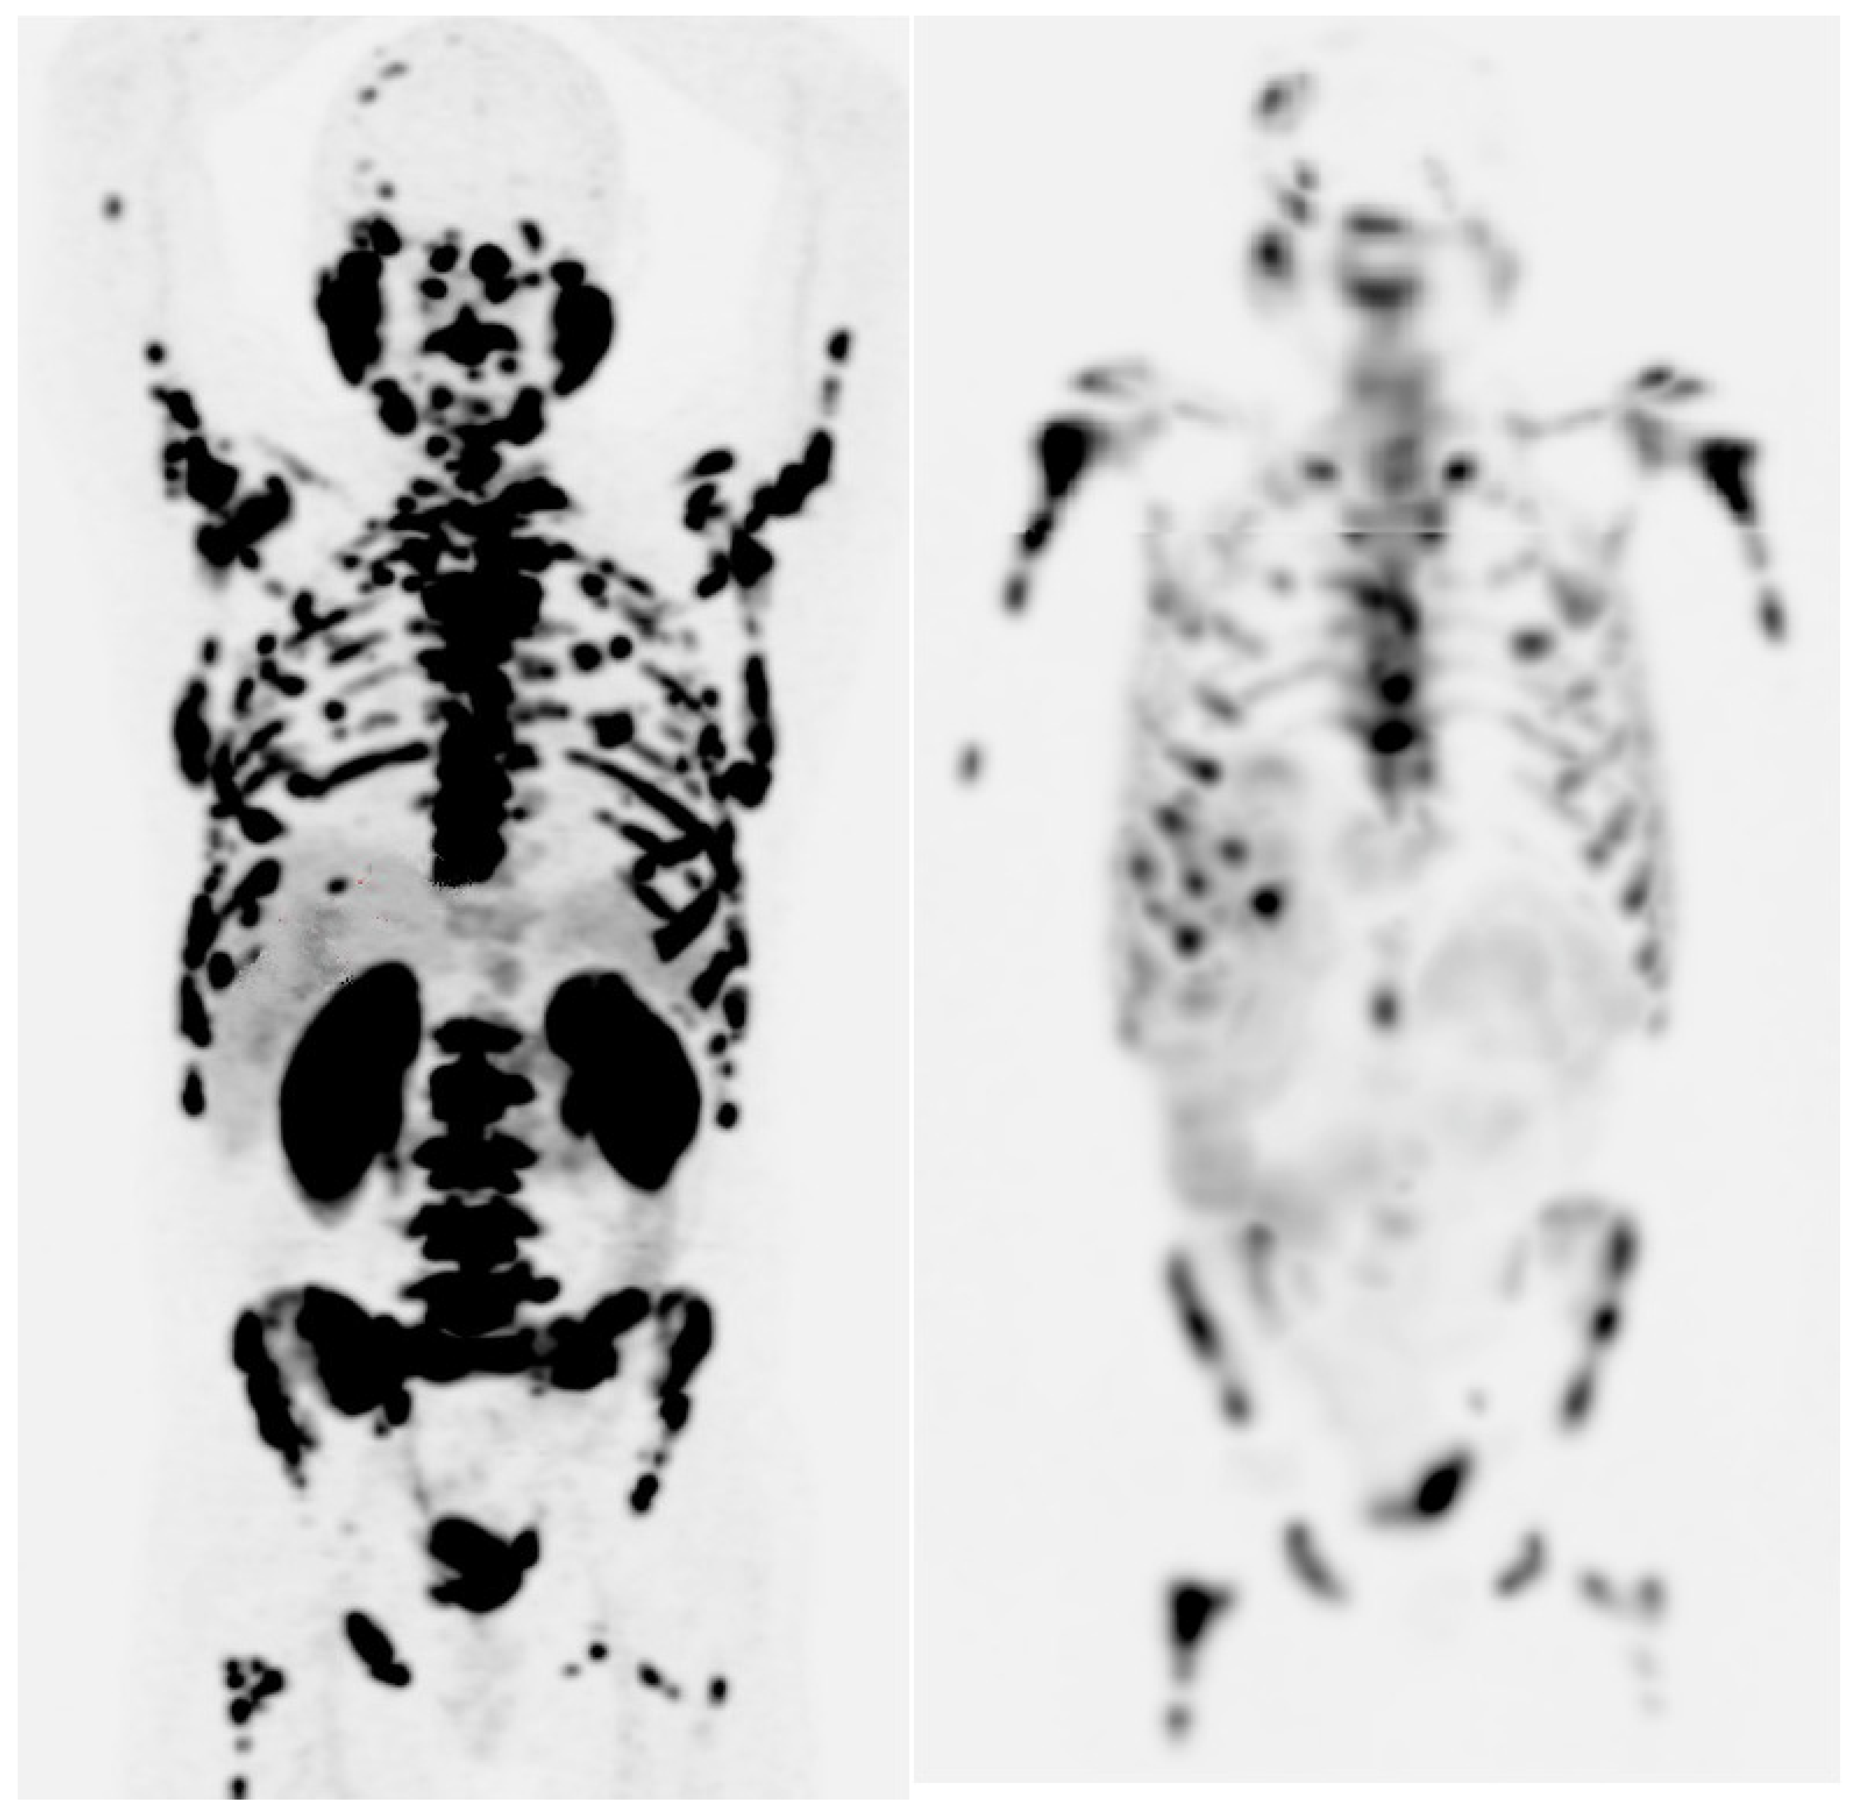
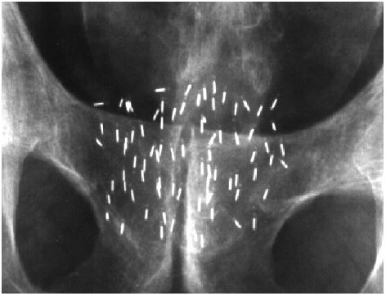
TEPP Improvement Project Updates
8 modules with hands-on practical exercises
Radiological Basics
Biological Effects
Radiological Survey Instruments
and Dosimetry Devices
Uses and Regulations
Usual Circumstance

Slide 27
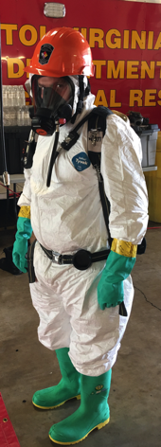

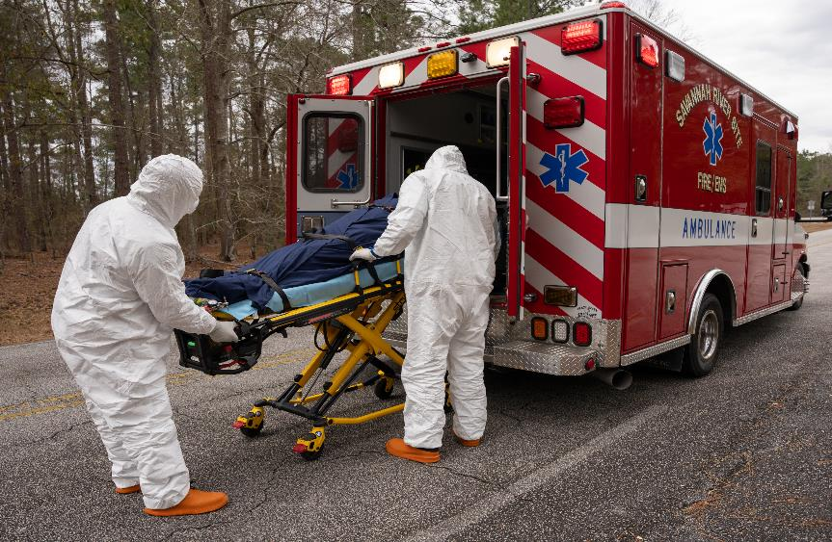
TEPP Improvement Project Updates
8 modules with hands-on practical exercises
Radiological Basics
Biological Effects
Radiological Survey Instruments
and Dosimetry Devices
Uses and Regulations
Usual Circumstance
Incident Scene Considerations

Slide 28
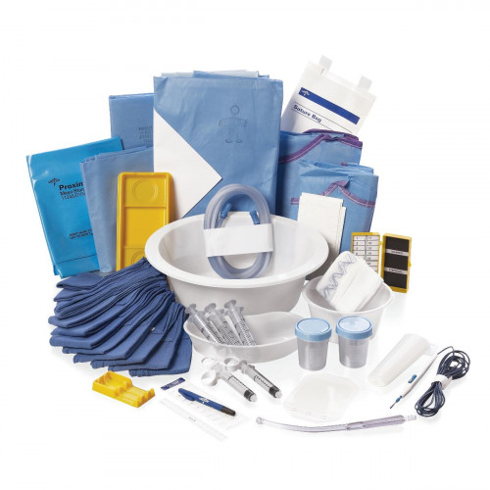
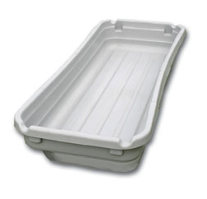
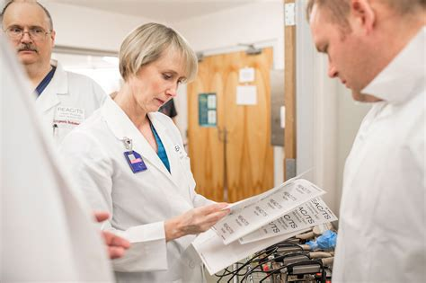
TEPP Improvement Project Updates
8 modules with hands-on practical exercises
Radiological Basics
Biological Effects
Radiological Survey Instruments
and Dosimetry Devices
Uses and Regulations
Usual Circumstance
Incident Scene Considerations
Managing Radiological Hazards

Slide 29
TEPP Improvement Project Updates
8 modules with hands-on practical exercises
Radiological Basics
Biological Effects
Radiological Survey Instruments
and Dosimetry Devices
Uses and Regulations
Usual Circumstance
Incident Scene Considerations
Managing Radiological Hazards
Disposition of Remains

Slide 30
Other Available TEPP Training
MERRTT Overview
Understanding Radiological Threats in Your Community
Advanced Radiation Instrumentation
TMERRTT
Radiation Specialist

Slide 31
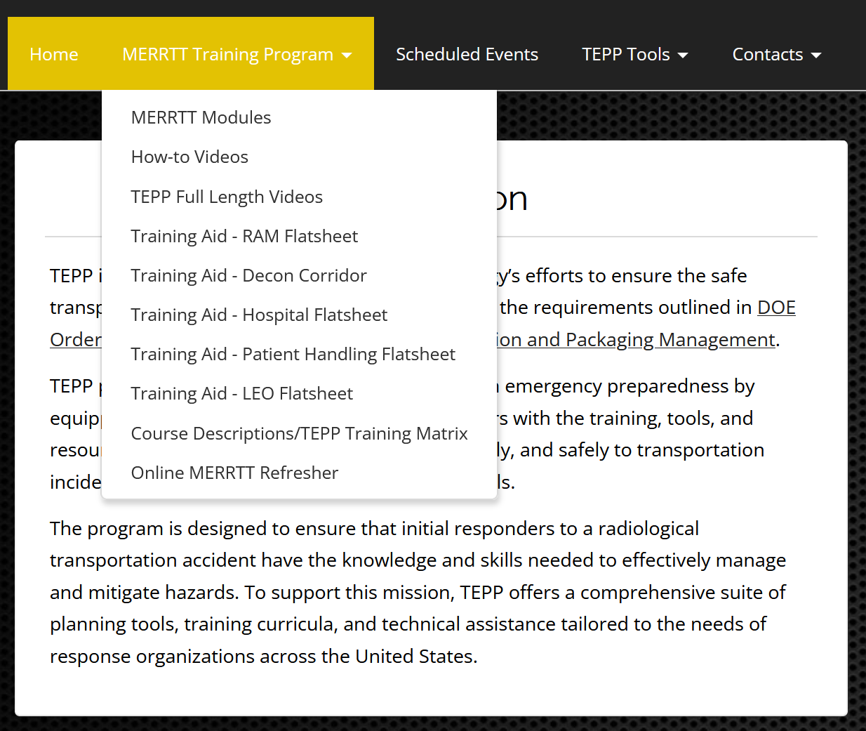
Website Resources
National Training and Exercise Schedule
MERRTT Refresher
State 24-Hour Points of Contact
Needs Assessment
Model Procedures
Exercise Planning Resources
TEPP Central Operations Contact
www.em.doe.gov/otem
www.teppinfo.com

Slide 32
Questions
?

